Slide 1
Java Swing, Events and MVC
Optional Readings:
Eckel’s Thinking in Java: Chap 14
(http://mindview.net/Books/TIJ/DownloadSites)

Slide 2
Java Foundation Classes
JFC:
  Abstract Window Toolkit (AWT)
    original user interface toolkit
    don’t go there!
  Swing
    package javax.swing.*, introduced in Java 1.2

Slide 3
Swing
Portable API:
  The appearance and behavior (look-and-feel) of the user interface components are implemented in Java …
  might work slightly differently from any host platform
  pluggable look-and-feels
  e.g., Motif, windows,…

Slide 4
Containment Hierarchy
Top-level container:
  place for other Swing components to paint themselves
  e.g., JFrame, JDialog, Japplet
Intermediate container:
  simplify positioning of atomic components
  e.g., JPanel, JSplitPane, JTabbedPane

Slide 5
Containment Hierarchy
Atomic components:
  self-sufficient components that present information to and get input from the user
  e.g., JButton, JLabel, JComboBox, JTextField, JTable

Slide 6
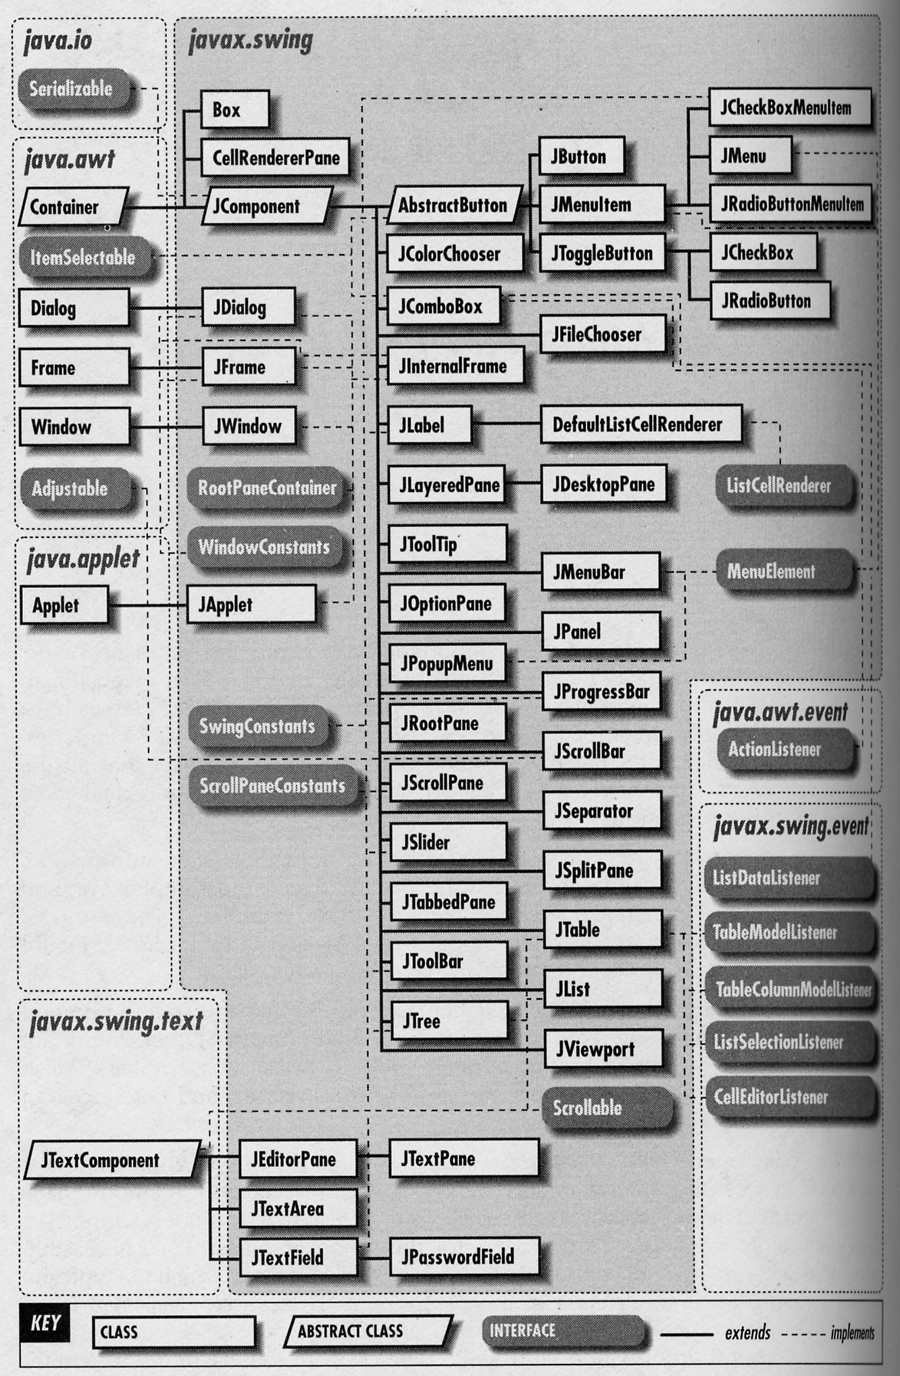
Swing
Components
and containers:
  superclasses
  and interfaces
  extends
  and implements
© O’Reilly 1999

Slide 7
Containers
Notes:
  Container objects group components, arranging them for display with a layout manager.

Slide 8
Top-Level Containers
JFrame example:
  contains a single component JRootPane, which has a JMenuBar (optional) and a content pane
    theFrame.setJMenuBar( theMenuBar )
    theFrame.setContentPane( thePanel )
  add non-menu components to this content pane
    theFrame.getContentPane().add( aButton )

Slide 9
Events
Two approaches to event handling
  read-evaluation loop (client-written loop)
  notification-based (callbacks)
Swing uses the 2nd approach

Slide 10
Events
Swing:
  objects communicate by “firing” and “handling” events (event objects)
  (conventional method call)
  events are sent from a single source object to one or more registered listener objects

Slide 11
Events
Swing:
  different event sources produce different kinds of events
  e.g., a JButton object, when clicked, generates an ActionEvent object, which is handled by an ActionListener (an object whose class implements this interface)

Slide 12
Events

Slide 13
Events
Handling:
  create a component
    e.g., a JButton
  add it to the GUI
    e.g., to a JPanel
  register a listener to be notified when the component generates an event
    e.g., interface ActionListener
  define the callback method
    e.g., actionPerformed()

Slide 14
Event Handling
class MyListener implements ActionListener {
…
public void actionPerformed( ActionEvent event ) {
// react to event
…
}
}
…
// instantiate event listener
ActionListener listener = new MyListener();
…
// instantiate event source
JButton button = new JButton( “Hello” );
…
// register event listener with event source
button.addActionListener( listener );

Slide 15
UML Sequence Diagram

Slide 16
Event Handling
Options for implementing listeners:
  listener class
  anonymous inner classes
  named inner classes

Slide 17
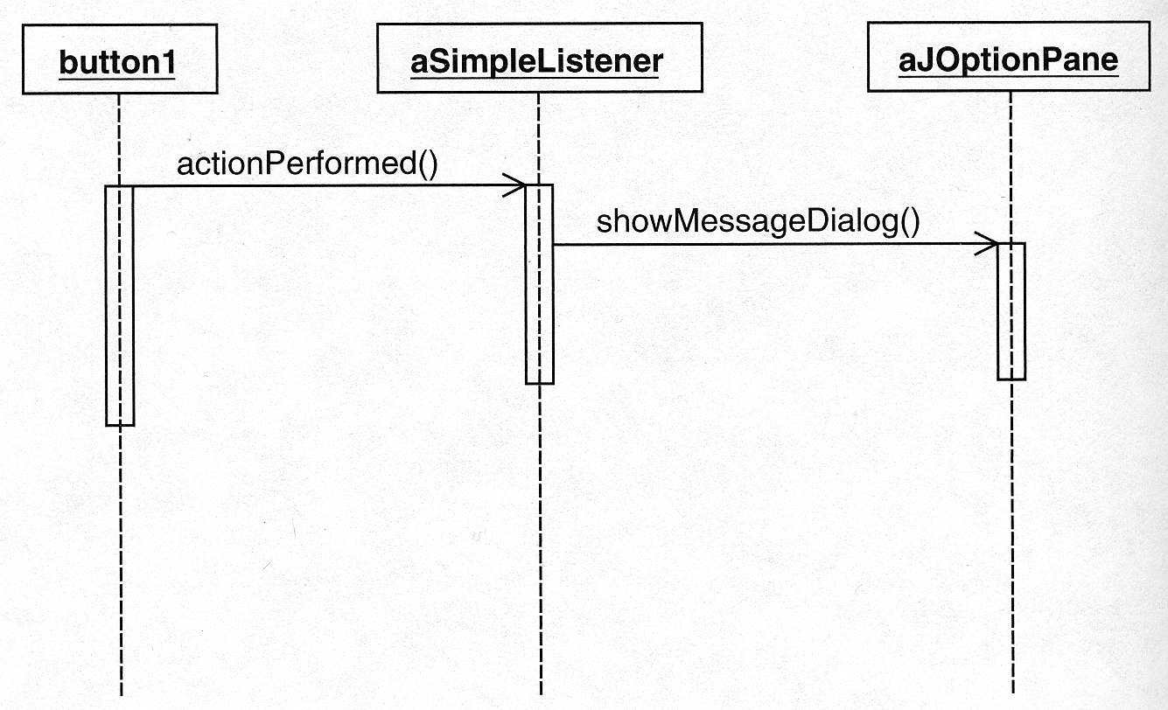
Event Handling
Listener class:

Slide 18
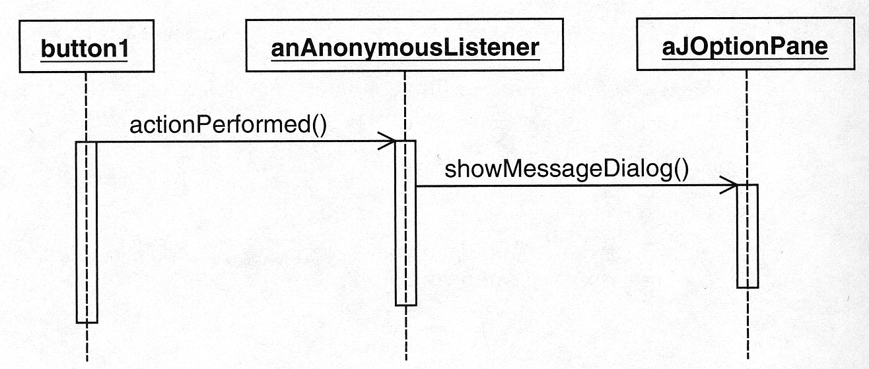
Event Handling
Anonymous inner listener class:

Slide 19
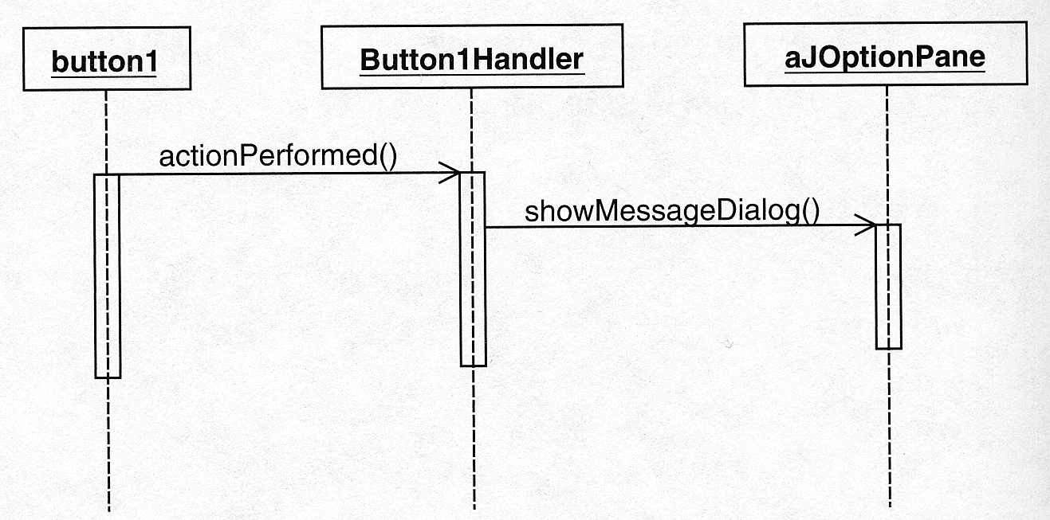
Event Handling
Named inner listener class:

Slide 20
Event Handling
Note:
  A class could potentially be both an event source and event listener.
  Good or bad idea? …

Slide 21
Event Handling
public class MyButton extends JButton implements ActionListener {
…
public MyButton() {
…
addActionListener( this );
}
…
public void actionPerformed( ActionEvent event ) {
…
}
}
JButton button = new MyButton() …

Slide 22
Model/View/Controller

Slide 23
Dependencies

Slide 24
Dependencies
Problems:
  need to maintain consistency in the views (or observers)
  need to update multiple views of the common data model (or subject)
  need clear, separate responsibilities for presentation (look), interaction (feel), computation, persistence

Slide 25
Model/View/Controller
MVC roles:
  model
    complete, self-contained representation of object managed by the application
    e.g., spreadsheet document
    provides a number of services to manipulate the data
    e.g., recalculate, save
    computation and persistence issues
  …

Slide 26
Model/View/Controller
MVC roles:
  view
    tracks what is needed for a particular perspective of the data
    e.g., bar chart view
    presentation issues
  controller
    gets input from the user, and uses appropriate information from the view to modify the model
    e.g., get slider value, trigger chart modify
    interaction issues

Slide 27
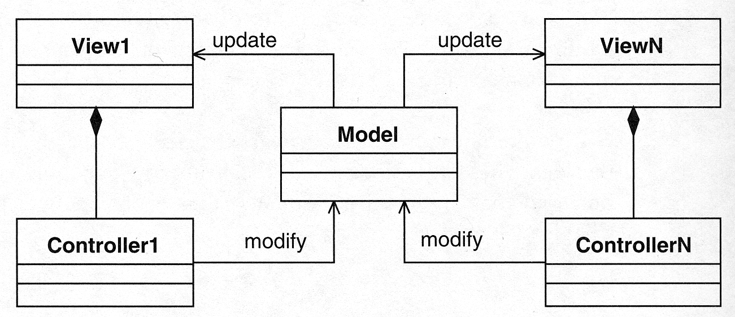
Model/View/Controller

Slide 28
Model/View/Controller
Separation:
  you can modify or create views without affecting the underlying model
  the model should not need to know about all the kinds of views and interaction styles available for it
  separate threads?

Slide 29
Model/View/Controller
Smalltalk:
  originated the MVC concept
  integral support in interactive applications with MVC classes

Slide 30
Ruby on Rails
Getting a lot of attention in the web-application world
See http://en.wikipedia.org/wiki/Ruby_on_Rails
Based on model-view-controller (MVC) architecture
Integrates with DMBS like MySQL, Postgres, etc
Uses Ruby for dynamic webpage create (used like PHP or Javascript)

Slide 31
What’s Nice about Ruby on Rails
Based on conventions and standards to support code-generation
  You call something by its usual name and its generated for you
  A form of “metaprogramming”
  "Don't Repeat Yourself" (DRY)
    Define a Ruby class, and it defines DBMS table
  “Bridge-code” handled for you
  Result: you write code at a “high-level”
Origin
  Extracted from a real commercial application

Slide 32
Model/View/Controller
http://java.sun.com/products/jfc/tsc/articles/architecture/
In Swing:
  in practice, views and controllers are implemented with Swing components and listeners
  both views and controllers will be dependent on Swing APIs

Slide 33
Model/View/Controller
In Swing:
  still, try to separate the model and its services so that it is Swing-free
  model is like a “virtual machine” or “kernel” specific to the application

Slide 34
Model/View/Controller
Java and Swing:
  concept is still valid to help structure interactive applications
  e.g., use a framework that supports MVC
  Swing internally uses a variant of MVC for its pluggable look-and-feel capability …

Slide 35
Pluggable Look-and-Feel
Swing:
  the look-and-feel is implemented in Java, but could mimic Windows, Motif, Classic, Aqua, etc.
  UIManager.setLookAndFeel(
  “com.sun.java.swing.plaf.windows.WindowsLookAndFeel”
  );
  UIManager.setLookAndFeel(
  “javax.swing.plaf.metal.MetalLookAndFeel”
  );

Slide 36
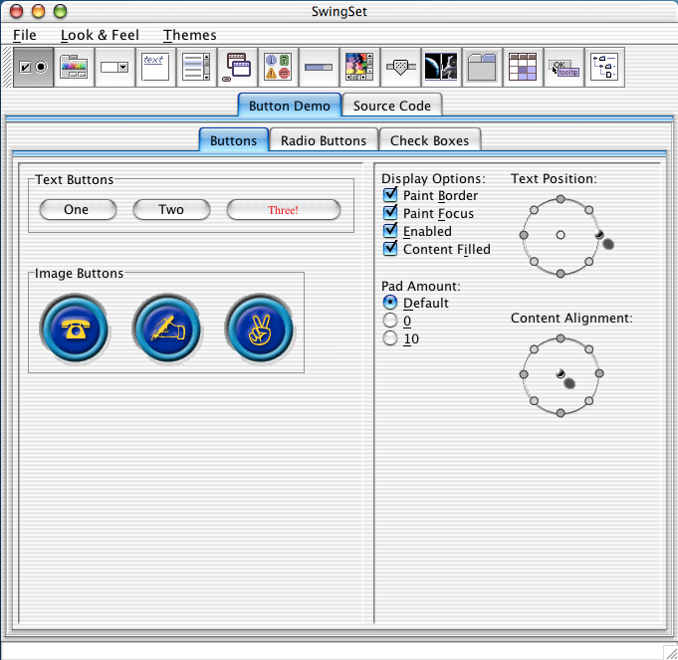
Pluggable Look-and-Feel
SwingSet:
  http://www.oracle.com/technetwork/java/javase/demos-nojavascript-137100.html

Slide 37
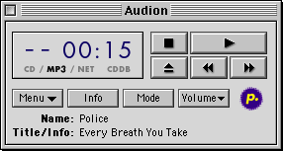
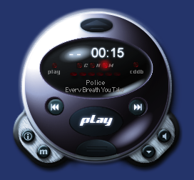
Pluggable Look-and-Feel
Idea:
  similar to skins, themes, schemes, etc., but must include “feel” as well as “look”

Slide 38
Pluggable Look-and-Feel
Swing internals:
  each component uses a user interface delegate object (responsible for view and controller roles)

Slide 39
Pluggable Look-and-Feel
Swing internals:
  each component specifies a model interface that an associated model class must implement

Slide 40
End
Credits for some slides to CMPUT 301, Department of Computing Science, University of Alberta

