Slide 1
CS4780: Information Retrieval Course Policy
Hongning Wang
CS@UVa
http://www.cs.virginia.edu/~hw5x/Course/IR2021-Spring/_site/

Slide 2
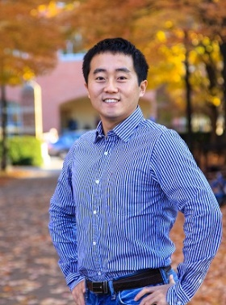
Instructor
Hongning Wang
Graduated from University of Illinois at Urbana-Champaign in 2014

Slide 3
Instructor
Hongning Wang
Research area
Information retrieval
Data mining
Machine learning
Industry experience
Yahoo Labs
Microsoft Research
Snap
Google Research

Slide 4
Goal of this course
Discuss fundamental problems in information retrieval
Building blocks of search engine systems
Wide coverage of important IR techniques
Personalized recommendation
Online advertising
Get hands-on experience by developing practical systems/components
Prepare students for doing cutting-edge research in information retrieval and related fields
Open the door to the amazing job opportunities in IT industry

Slide 5
Outcomes
Letters from former students
Dear professor,
Thank you so much for teaching me Information Retrieval where I have benefitted the most this semester. I have got an internship position in Walmart Labs search team all because of the knowledge I leant from your class. Although you are strict on the grade, but after all I think it’s fair and still encourage me to learn better on IR.
Hi Professor Wang,
My name is XXX Zhang, and I just graduated from UVA in May.
I will start working full-time at Google starting next Monday and I just got my team assignment today. I will be working at Google‘s search ranking team. I still remembered the Information Retrieval class I took with you. That still remain one of my favorite CS classes at UVA! I'm sending this email just to let you know that you have a former student working on search engines.
Hi Professor Wang,
I took your Info Retrieval class in Spring 2018 (almost exactly 3 years ago now...!) and I have saved the amazing powerpoints that you made to explain basic search architecture to us. Before I took the class, I hoped it was going to be a fun challenge and some of my other friends were taking it too. After taking the class I realized how lucky we all were to have you teaching us! So many things I learned in your class made me comfortable with the big words being thrown around and I had a second moment of feeling lucky that I decided to take your class back then.

Slide 6
Character of this course
Discussion oriented
This is how great ideas are created!
You are encouraged to express your thoughts, confusions, and suggestions
Focusing on why, rather than how

Slide 7
Prerequisites
Programming skills – Important!
Basic data structures: CS 2150 or equivalent
Java is required for machine problems
Most open source packages are written in Java
Any language you choose for the rest of this course
Math background
Probability
Discrete/continuous distributions, expectation, moments
Linear algebra
Vector, matrix, dot product
Optimization
Gradient-based methods

Slide 8
Pop-up quiz
Let a=(1,2,3) and b=(2,3,-2), the inner product between a and b is
0 (b) 1 (c) 2 (d) 3
Let A = $(\begin{matrix}1 & 2 \\ 2 & 1\end{matrix})$, what is A⁻¹,
(a) $(\begin{matrix}−1 & −2 \\ −2 & −1\end{matrix})$ (b) $(\begin{matrix}−\frac{1}{3} & \frac{2}{3} \\ \frac{2}{3} & −\frac{1}{3}\end{matrix})$ (c) $(\begin{matrix}1 & 0 \\ 0 & 1\end{matrix})$ (d) $(\begin{matrix}2 & 1 \\ 1 & 2\end{matrix})$

Slide 9
Pop-up quiz
What is the expectation of random variables drawn from Gaussian distribution N(0, 1),
0 (b) 0.5 (c) 1 (d) 2
Complexity of merge sort,
(a) $O(n)$ (b) $O(n^{2})$ (c) $O(\log{n})$ (d) $O(n\log{n})$

Slide 10
Pop-up quiz
Let a=(1,2,3) and b=(2,3,-2), the inner product between a and b is
0 (b) 1 (c) 2 (d) 3
Let A = $(\begin{matrix}1 & 2 \\ 2 & 1\end{matrix})$, what is A⁻¹,
(a) $(\begin{matrix}−1 & −2 \\ −2 & −1\end{matrix})$ (b) $(\begin{matrix}−\frac{1}{3} & \frac{2}{3} \\ \frac{2}{3} & −\frac{1}{3}\end{matrix})$ (c) $(\begin{matrix}1 & 0 \\ 0 & 1\end{matrix})$ (d) $(\begin{matrix}2 & 1 \\ 1 & 2\end{matrix})$
(c)
(b)

Slide 11
Pop-up quiz
What is the expectation of random variables drawn from Gaussian distribution N(0, 1),
0 (b) 0.5 (c) 1 (d) 2
Time complexity of merge sort,
(a) $O(n)$ (b) $O(n^{2})$ (c) $O(\log{n})$ (d) $O(n\log{n})$
(a)
(c)
(d)

Slide 12
Structure of this course
Six major topics will be covered by lectures
E.g., Search engine architecture, retrieval models, search evaluation, relevance feedback, and link analysis
Latest development will be covered by paper reading assignments and presentations
E.g., mobile search, recommendation, personalization, online learning, you name it!

Slide 13
Grading policy
No curving will be applied!
Reading assignments (10%)
Peer evaluation, after each chapter
Homework (35%)
Machine problems (~3)
Paper presentation (20%)
In class, performed in groups
Course project (35%)
In the exam week
fairness will be guaranteed by the instructor

Slide 14
Reading assignments
Read the instructor selected papers after each chapter
Open-ended essay questions
Peer evaluation on course forum

Slide 15
Paper presentation
Choose to present the most recent works in the area of information retrieval
Peer evaluation
Choose from the instructor’s selected papers, which are beyond our course content, so as to increase our topic coverage

Slide 16
Course project
Topics
Implement algorithms in assigned research papers
Self-selected topics with permission from the instructor
Team work
3-4 students per group
Evaluation
Two-page proposal (25%)
15-minutes in-class presentation (40%)
Written report (35%)

Slide 17
In-class quiz
After each chapter, the instructor will prepare a quiz to cover the most important concept in that chapter
Its sole purpose is to help you review the learnt materials, and it is not part of our grading

Slide 18
Late policy
Homework
Submit via Collab (no extension)
Late penalty: 15%, two weeks after the due date; 30%, afterwards
Course project
Final report is due right after presentation (no extension)

Slide 19
Classroom participation
HIGHLY APPRECIATED!
Helps me quickly remember your names
Reminds me what is still confusing
You can drive the lecture/discussion in this class!

Slide 20
Contact information
Lecture
Instructor: Hongning Wang
Time: Tu/Th 2:00pm to 3:15pm
All via zoom, and recordings will be uploaded to collab right after
Office hours
Time: Tu/Th 3:30pm to 4:30pm
All via zoom, make appointments beforehand
Additional office hour can be requested by email

Slide 21
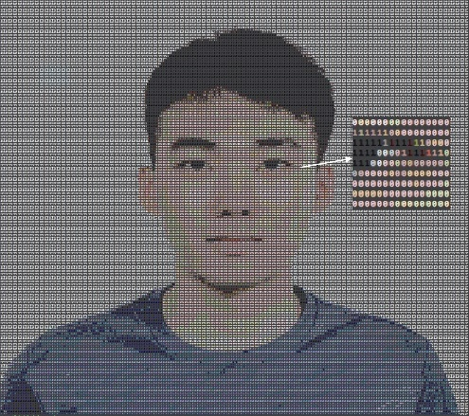
Contact information
TA
Nan Wang (nw6a@virginia.edu)
Office hour
Time: Monday/Wednesday 10:30am to 11:30am
All via zoom, make appointments beforehand
Additional office hour can be request by email

Slide 22
Questions?
Thank you!

