Slide 1
Web Crawling and Basic Text Analysis
Hongning Wang
CS@UVa

Slide 2
Abstraction of search engine architecture
Indexed corpus
Crawler
Ranking procedure
Feedback
Evaluation
Doc Analyzer
(Query)
Query Rep
User
Doc Representation
Ranker
Indexer
results
Index

Slide 3
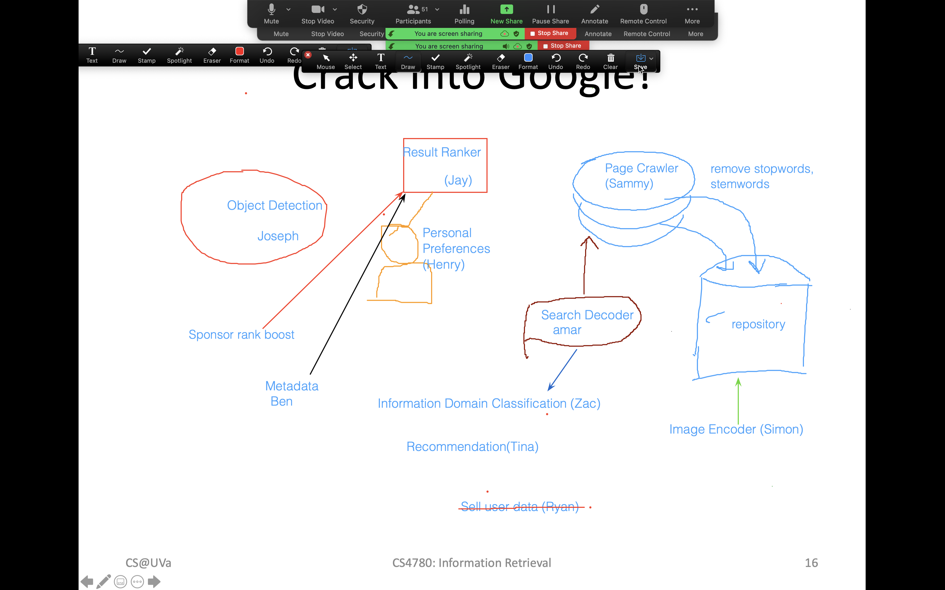

Slide 4
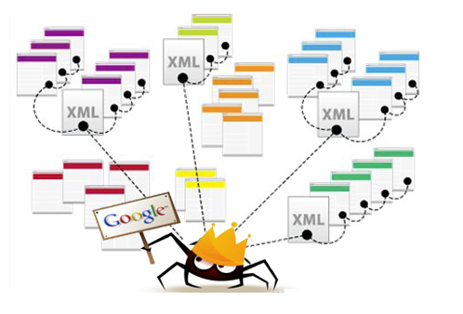
Web crawler
  An automatic program that systematically browses the web for the purpose of Web content indexing and updating
    Synonyms: spider, robot, bot

Slide 5
How does it work
In pseudo code
Def Crawler(entry_point) {
  URL_list = [entry_point]
  while (len(URL_list)>0) {
  URL = URL_list.pop();
  if (isVisited(URL) or !isLegal(URL) or !checkRobotsTxt(URL))
  continue;
  HTML = URL.open();
  for (anchor in HTML.listOfAnchors()) {
  URL_list .append(anchor);
  }
  setVisited(URL);
  insertToIndex(HTML);
  }
}
Which page to visit next?
Is it visited already? Or shall we visit it again?
Is the access granted?

Slide 6
Visiting strategy
Breadth first
  Uniformly explore from the entry page
  Memorize all nodes on the previous level
  As shown in pseudo code
Depth first
  Explore the web by branch
  Biased crawling given the web is not a tree structure
Focused crawling
  Prioritize the new links by predefined strategies

Slide 7
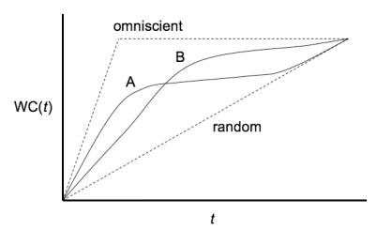

Focused crawling
Prioritize the visiting sequence of the web
  The size of Web is too large for a crawler (even Google) to completely cover
  Not all documents are equally important
  Emphasize more on the high-quality documents
    Maximize weighted coverage
In 1999, no search engine indexed more than 16% of the Web
In 2005, large-scale search engines index no more than 40-70% of the indexable Web
Importance of page p
Weighted coverage till time t
Pages crawled till time t

Slide 8
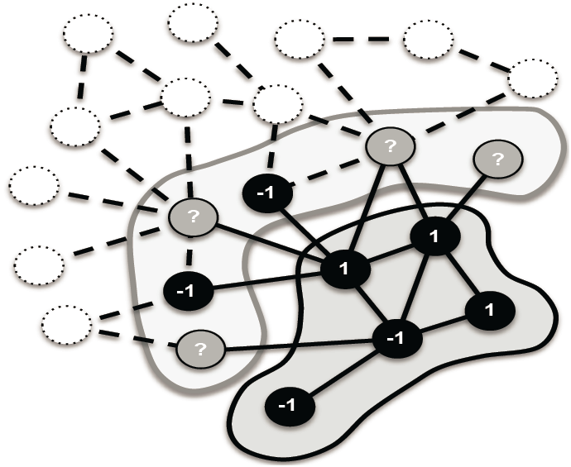
Focused crawling
Prioritize by in-degree ^{[Cho et al. WWW’98]}
  The page with the highest number of incoming hyperlinks from previously crawled pages is crawled next
Prioritize by PageRank [Abiteboul et al. WWW’07, Cho and Uri VLDB’07]
  Breadth-first in early stage, then compute/approximate PageRank periodically
  More consistent with search relevance ^{[Fetterly et al. SIGIR’09]}

Slide 9
Focused crawling
Prioritize by topical relevance
  In vertical search, only crawl relevant pages ^{[De et al. WWW’94]}
    E.g., restaurant search engine should only crawl restaurant pages
  Estimate the similarity to current page by anchor text or text near anchor ^{[Hersovici et al. WWW’98]}
  User given taxonomy or topical classifier ^{[Chakrabarti et al. WWW’98]}

Slide 10
Avoid duplicate visit
Given web is a graph rather than a tree, avoid loop in crawling is important
How to check
  trie or hash table
What to check
  URL: must be normalized, not necessarily can avoid all duplication
    http://dl.acm.org/event.cfm?id=RE160&CFID=516168213&CFTOKEN=99036335
    http://dl.acm.org/event.cfm?id=RE160
  Page: minor change might cause misfire
    Timestamp, data center ID change in HTML

Slide 11
Welcome back
We will start our discussion at 2pm
sli.do event code: 49954
Reading assignment 1 is due this Friday, 11:59pm
You can update your paper presentation choice by submitting the information again; and we will take the latest one recorded in the system as your final choice

Slide 12
Recap: how does it work
In pseudo code
Def Crawler(entry_point) {
  URL_list = [entry_point]
  while (len(URL_list)>0) {
  URL = URL_list.pop();
  if (isVisited(URL) or !isLegal(URL) or !checkRobotsTxt(URL))
  continue;
  HTML = URL.open();
  for (anchor in HTML.listOfAnchors()) {
  URL_list .append(anchor);
  }
  setVisited(URL);
  insertToIndex(HTML);
  }
}
Which page to visit next?
Is it visited already? Or shall we visit it again?
Is the access granted?

Slide 13
Recap: visiting strategy
Breadth first
  Uniformly explore from the entry page
  Memorize all nodes on the previous level
  As shown in pseudo code
Depth first
  Explore the web by branch
  Biased crawling given the web is not a tree structure
Focused crawling
  Prioritize the new links by predefined strategies

Slide 14
Politeness policy
    Crawlers can retrieve data much quicker and in greater depth than human searchers
Costs of using Web crawlers
  Network resources
  Server overload
Robots exclusion protocol
  Examples: CNN, UVa

Slide 15
Robot exclusion protocol examples
Exclude specific directories:
User-agent: *
Disallow: /tmp/
Disallow: /cgi-bin/
Disallow: /users/paranoid/
Exclude a specific robot:
User-agent: GoogleBot
Disallow: /
Allow a specific robot:
User-agent: GoogleBot
Disallow:
User-agent: *
Disallow: /

Slide 16
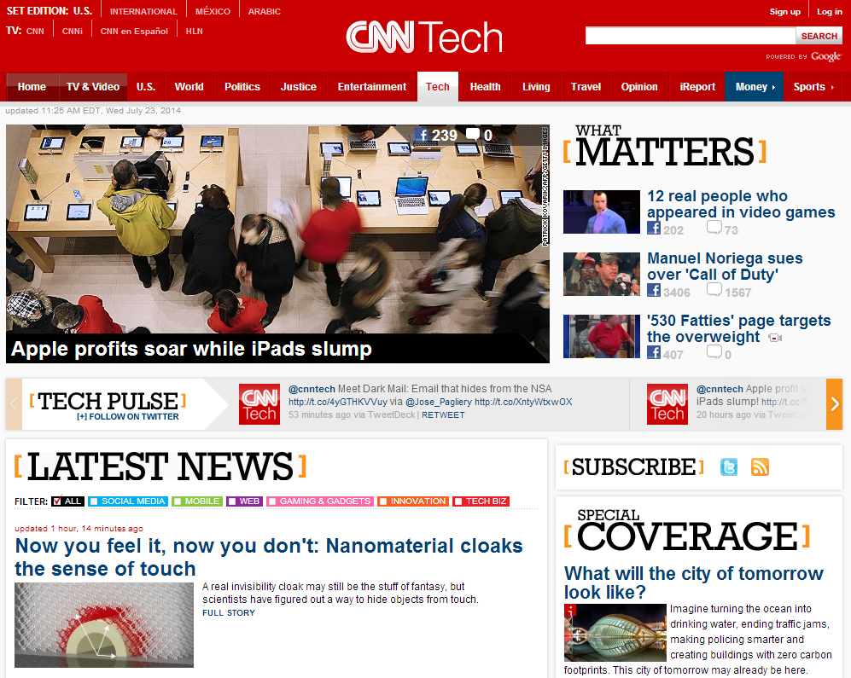
Analyze crawled web pages
What you care from the crawled web pages

Slide 17
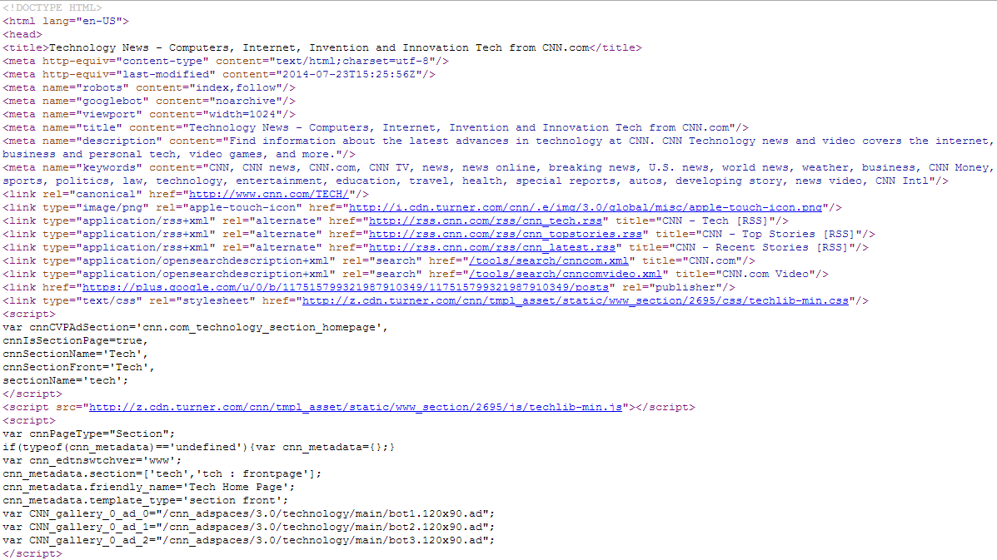
Analyze crawled web pages
What machine gets from the crawled web pages

Slide 18
Basic text analysis techniques
Need to analyze and index the crawled web pages
  Extract informative content from HTML
  Build machine accessible data representation

Slide 19
HTML parsing
Generally difficult due to the free style of HTML
Solutions
  Shallow parsing
    Remove all HTML tags
    Only keep text between <title></title> and <p></p>
  Automatic wrapper generation ^{[Crescenzi et al. VLDB’01]}
    Wrapper: regular expression for HTML tags’ combination
    Inductive reasoning from examples
  Visual parsing ^{[Yang and Zhang DAR’01]}
    Frequent pattern mining of visually similar HTML blocks

Slide 20
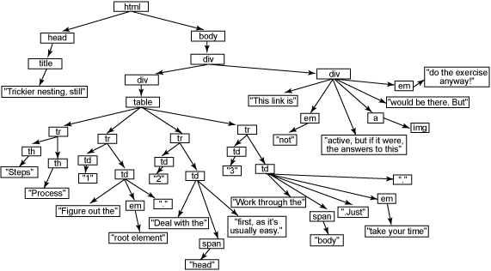
HTML parsing
jsoup
  Java-based HTML parser
    Scrape and parse HTML from a URL, file, or string to DOM tree
    Find and extract data, using DOM traversal or CSS selectors
      children(), parent(), siblingElements()
      getElementsByClass(), getElementsByAttributeValue()
  Python version: Beautiful Soup

Slide 21
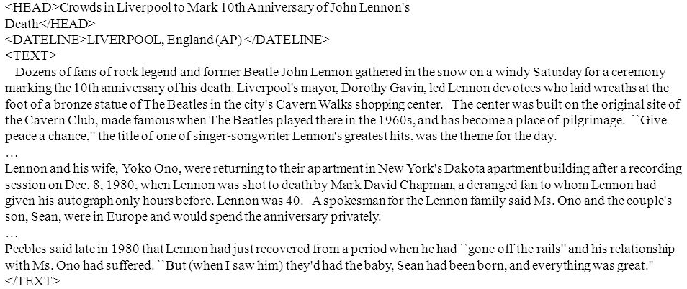
How to represent a document
Represent by a string?
  No semantic meaning
Represent by a list of sentences?
  Sentence is just like a short document (recursive definition)
Represent by a list of words?
  Tokenize it first
  Bag-of-Words representation!

Slide 22
Tokenization
Break a stream of text into meaningful units
  Tokens: words, phrases, symbols
  Definition depends on language, corpus, or even context
Input: It’s not straight-forward to perform so-called “tokenization.”
Output(1): 'It’s', 'not', 'straight-forward', 'to', 'perform', 'so-called', '“tokenization.”'
Output(2): 'It', '’', 's', 'not', 'straight', '-', 'forward, 'to', 'perform', 'so', '-', 'called', ‘“', 'tokenization', '.', '”‘

Slide 23
Tokenization
Solutions
  Regular expression
    [\w]+: so-called -> ‘so’, ‘called’
    [\S]+: It’s -> ‘It’s’ instead of ‘It’, ‘’s’
  Statistical methods
    Explore rich features to decide where is the boundary of a word
      Apache OpenNLP (http://opennlp.apache.org/)
      Stanford NLP Parser (http://nlp.stanford.edu/software/lex-parser.shtml)
    Online Demo
      Stanford (https://corenlp.run/)
      UIUC (http://cogcomp.cs.illinois.edu/curator/demo/index.html)

Slide 24
Full text indexing
Bag-of-Words representation
  Doc1: Information retrieval is helpful for everyone.
  Doc2: Helpful information is retrieved for you.
 | information | retrieval | retrieved | is | helpful | for | you | everyone
Doc1 | 1 | 1 | 0 | 1 | 1 | 1 | 0 | 1
Doc2 | 1 | 0 | 1 | 1 | 1 | 1 | 1 | 0
Word-document adjacency matrix

Slide 25
Full text indexing
Bag-of-Words representation
  Assumption: word is independent from each other
  Pros: simple
  Cons: grammar and order are missing
  (Used to be) The most frequently used document representation
    Image, speech, gene sequence

Slide 26
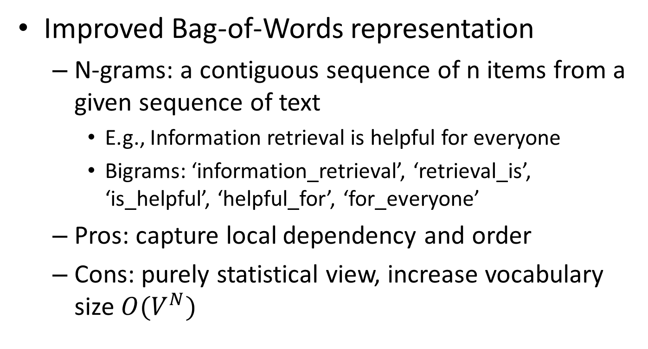
Full text indexing
Improved Bag-of-Words representation
  N-grams: a contiguous sequence of n items from a given sequence of text
    E.g., Information retrieval is helpful for everyone
    Bigrams: ‘information_retrieval’, ‘retrieval_is’, ‘is_helpful’, ‘helpful_for’, ‘for_everyone’
  Pros: capture local dependency and order
  Cons: purely statistical view, increase vocabulary size $O(V^{N})$

Slide 27
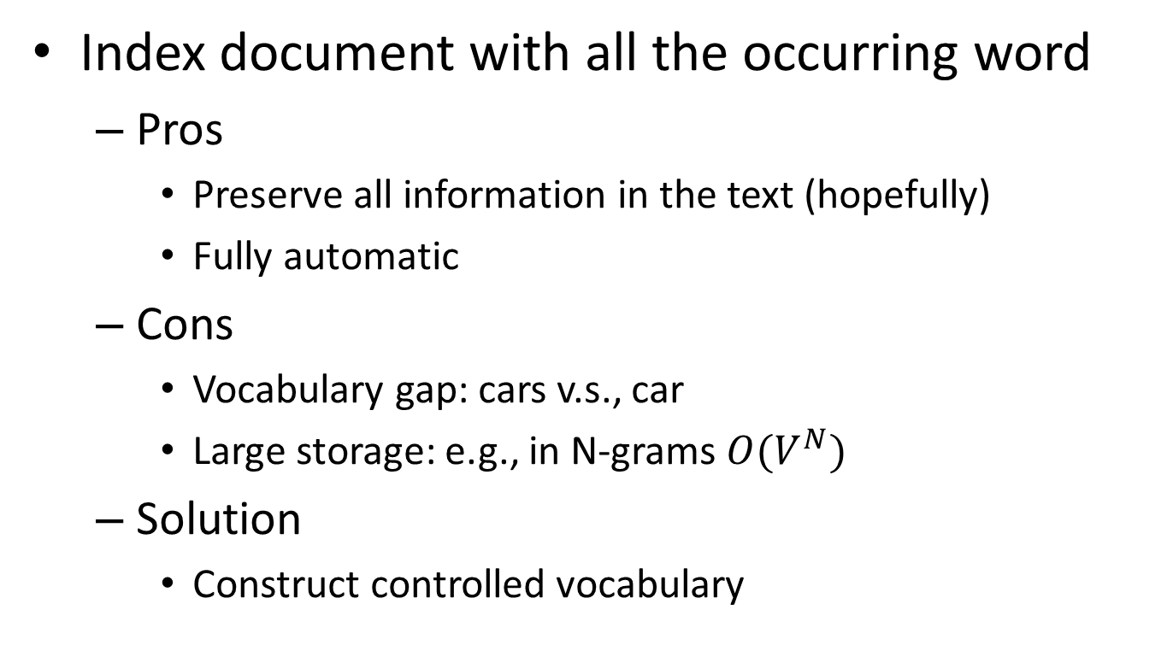
Full text indexing
Index document with all the occurring word
  Pros
    Preserve all information in the text (hopefully)
    Fully automatic
  Cons
    Vocabulary gap: cars v.s., car
    Large storage: e.g., in N-grams $O(V^{N})$
  Solution
    Construct controlled vocabulary

Slide 28
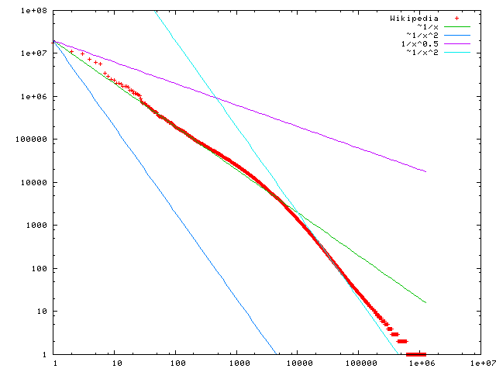

Statistical property of language
Zipf’s law
  Frequency of any word is inversely proportional to its rank in the frequency table
  Formally
    $f\left(k;s,N\right)=\frac{1/k^{s}}{\sum_{n=1}^{N}{1/n^{s}}}$
    where $k$ is rank of the word; $N$ is the vocabulary size; $s$ is a language-specific parameter
discrete version of power law
Word frequency
In the Brown Corpus of American English text, the word "the" is the most frequently occurring word, and by itself accounts for nearly 7% of all word occurrences; the second-place word "of" accounts for slightly over 3.5% of words.
Word rank by frequency
A plot of word frequency in Wikipedia (Nov 27, 2006)

Slide 29
Welcome back
We will start our discussion at 2pm
sli.do event code: 49954
Reading assignment 1 is due this Friday, 11:59pm

Slide 30
Recap: Zipf’s Law
Word frequency
Word rank by frequency
A plot of word frequency in Wikipedia (Nov 27, 2006)

Slide 31
Zipf’s law tells us
Head words may take large portion of occurrence, but they are semantically meaningless
  E.g., the, a, an, we, do, to
Tail words take major portion of vocabulary, but they rarely occur in documents
  E.g., dextrosinistral
The rest is most representative
  To be included in the controlled vocabulary

Slide 32
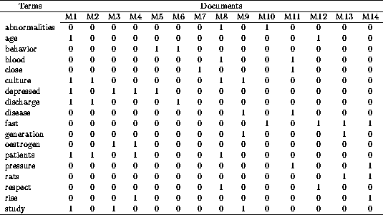
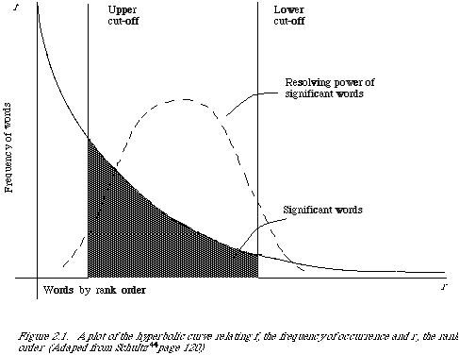
Automatic text indexing
Remove non-informative words
Remove 1s
Remove 0s
Remove rare words

Slide 33
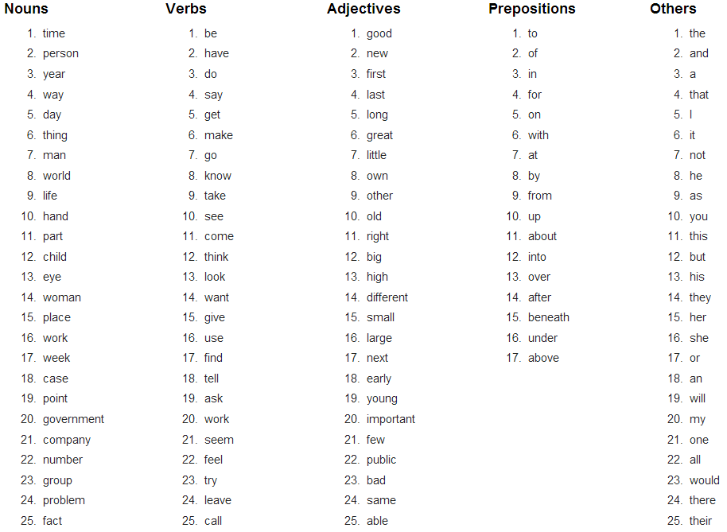
Stopwords
Useless words for query/document analysis
  Not all words are informative
  Remove such words to reduce vocabulary size
  No universal definition
  Risk: break the original meaning and structure of text
    E.g., this is not a good option -> option
    to be or not to be -> null
The OEC: Facts about the language

Slide 34
Normalization
Convert different forms of a word to normalized form in the vocabulary
  U.S.A -> USA, St. Louis -> Saint Louis
Solution
  Rule-based
    Delete periods and hyphens
    All in lower case
  Dictionary-based
    Construct equivalent class
      Car -> “automobile, vehicle”
      Mobile phone -> “cellphone”

Slide 35
Stemming
Reduce inflected or derived words to their root form
  Plurals, adverbs, inflected word forms
    E.g., ladies -> ladi, referring -> refer, forgotten -> forget
  Bridge the vocabulary gap
  Risk: lose precise meaning of the word
    E.g., lay -> lie (a false statement? or be in a horizontal position?)
  Solutions (for English)
    Porter stemmer: pattern of vowel-consonant sequence
    Krovetz stemmer: morphological rules

Slide 36
Abstraction of search engine architecture
Indexed corpus
Visiting strategy
Avoid duplicated visit
Re-visit policy
Crawler
HTML parsing
Tokenization
Stemming/normalization
Stopword/controlled vocabulary filter
Doc Analyzer
Doc Representation
BagOfWord representation!

Slide 37
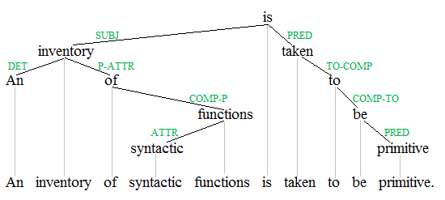
Automatic text indexing
In modern search engine
  No stemming or stopword removal, since computation and storage are no longer the major concerns
  More advanced NLP techniques are applied
    Named entity recognition
      E.g., people, location and organization
    Dependency parsing
    Word/Document embeddings
Query: “to be or not to be”

Slide 38
What you should know
Basic techniques for crawling
Zipf’s law
Procedures for automatic text indexing
Bag-of-Words document representation

Slide 39
Today’s reading
Introduction to Information Retrieval
  Chapter 20: Web crawling and indexes
    Section 20.1, Overview
    Section 20.2, Crawling
  Chapter 2: The term vocabulary and postings lists
    Section 2.2, Determining the vocabulary of terms
  Chapter 5: Index compression
    Section 5.1, Statistical properties of terms in information retrieval

Slide 40
Reference I
Cho, Junghoo, Hector Garcia-Molina, and Lawrence Page. "Efficient crawling through URL ordering." Computer Networks and ISDN Systems 30.1 (1998): 161-172.
Abiteboul, Serge, Mihai Preda, and Gregory Cobena. "Adaptive on-line page importance computation." Proceedings of the 12th international conference on World Wide Web. ACM, 2003.
Cho, Junghoo, and Uri Schonfeld. "RankMass crawler: a crawler with high personalized pagerank coverage guarantee." Proceedings of the 33rd international conference on Very large data bases. VLDB Endowment, 2007.
Fetterly, Dennis, Nick Craswell, and Vishwa Vinay. "The impact of crawl policy on web search effectiveness." Proceedings of the 32nd international ACM SIGIR conference on Research and development in information retrieval. ACM, 2009.
De Bra, Paul ME, and R. D. J. Post. "Information retrieval in the World-Wide Web: making client-based searching feasible." Computer Networks and ISDN Systems 27.2 (1994): 183-192.
Hersovici, Michael, et al. "The shark-search algorithm. An application: tailored Web site mapping." Computer Networks and ISDN Systems 30.1 (1998): 317-326.

Slide 41
Reference II
Chakrabarti, Soumen, Byron Dom, Prabhakar Raghavan, Sridhar Rajagopalan, David Gibson, and Jon Kleinberg. "Automatic resource compilation by analyzing hyperlink structure and associated text." Computer Networks and ISDN Systems 30, no. 1 (1998): 65-74.
Crescenzi, Valter, Giansalvatore Mecca, and Paolo Merialdo. "Roadrunner: Towards automatic data extraction from large web sites." VLDB. Vol. 1. 2001.
Yang, Yudong, and HongJiang Zhang. "HTML page analysis based on visual cues." Document Analysis and Recognition, 2001. Proceedings. Sixth International Conference on. IEEE, 2001.

