Slide 1
Implicit User Feedback
Hongning Wang
CS@UVa

Slide 2


What we have learned so far
Indexed corpus
Crawler
Ranking procedure
Research attention
Feedback
Evaluation
Doc Analyzer
(Query)
User
Query Rep
Doc Rep (Index)
Ranker
Indexer
results
Index

Slide 3
Explicit relevance feedback
Results:
d₁ 3.5
d₂ 2.4
…
d_{k} 0.5
...
Query
Retrieval
Engine
User
judgment
Updated
query
Document
collection
Judgments:
d₁ +
d₂ -
d₃ ₊
…
d_{k} -
...
Feedback

Slide 4
Welcome back
We will start our discussion at 2pm
sli.do event code: 776440
Please provide your preferred date for project presentation
For everyone, please focus on your course project, please!

Slide 5
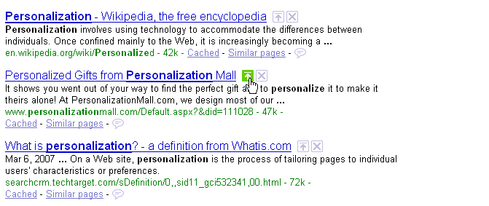
Relevance feedback in real systems
Google used to provide such functions
  Vulnerable to spammers
Relevant
Nonrelevant

Slide 6
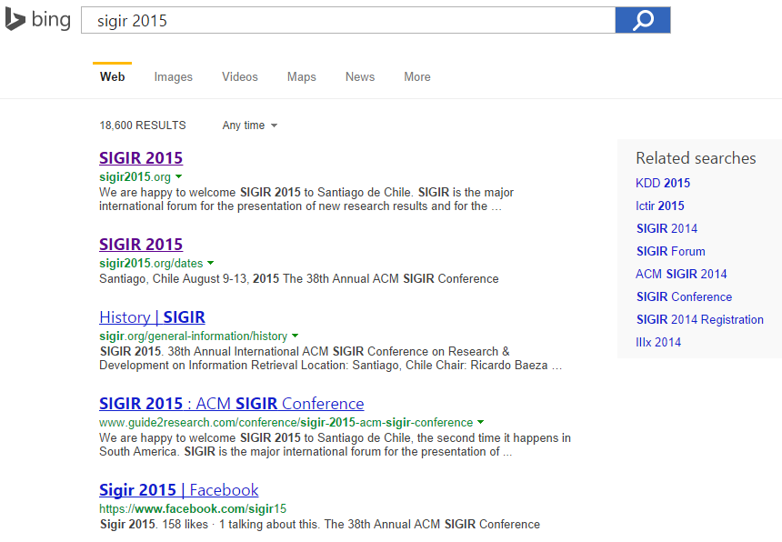
How about using clicks
Clicked document as relevant, non-clicked as non-relevant
  Cheap, largely available

Slide 7
Is click reliable?
Why do we click on the returned document?
  Title/snippet looks attractive
    We haven’t read the full text content of the document
  It was ranked higher
    Belief bias towards ranking
  We know it is the answer!

Slide 8

Is click reliable?
Why do not we click on the returned document?
  Title/snippet has already provided the answer
    Instant answers, knowledge graph
  Extra effort of scrolling down the result page
    The expected loss is larger than skipping the document
  We did not see it….
Can we trust click as relevance feedback?

Slide 9
Accurately Interpreting Clickthrough Data as Implicit Feedback ^{[Joachims SIGIR’05]}
Eye tracking, click and manual relevance judgment to answer
  Do users scan the results from top to bottom?
  How many abstracts do they read before clicking?
  How does their behavior change, if search results are artificially manipulated?

Slide 10
Which links do users view and click?
Positional bias
Fixations: a spatially stable gaze lasting for approximately 200-300ms, indicating visual attention
First 5 results are visible without scrolling

Slide 11
Do users scan links from top to bottom?
Need scroll down to view these results
View the top two results within the second or third fixation

Slide 12
Which links do users evaluate before clicking?
The lower the click in the ranking, the more abstracts are viewed before the click

Slide 13
Does relevance influence user decisions?
Controlled relevance quality
  Reverse the ranking from search engine
Users’ reactions
  Scan significantly more abstracts than before
  Less likely to click on the first result
  Average clicked rank position drops from 2.66 to 4.03
  Average clicks per query drops from 0.8 to 0.64

Slide 14

Are clicks absolute relevance judgments?
Position bias
  Focus on position one and two, equally likely to be viewed

Slide 15
Are clicks relative relevance judgments?
Clicks as pairwise preference statements
  Given a ranked list and user clicks
    Click > Skip Above
    Last Click > Skip Above
    Click > Earlier Click
    Last Click > Skip Previous
    Click > Skip Next
(2)
(1)
(3)

Slide 16
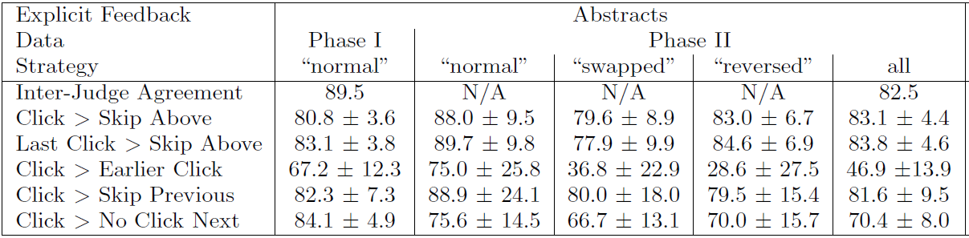
Clicks as pairwise preference statements
Accuracy against manual relevance judgment

Slide 17
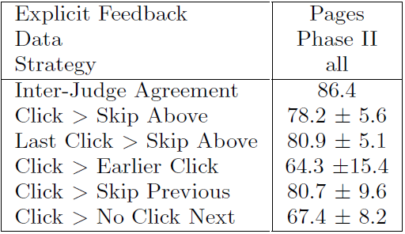
How accurately do clicks correspond to explicit judgment of a document?
Accuracy against manual relevance judgment

Slide 18
What do we get from this user study?
Clicks are influenced by the relevance of results
  Biased by the trust over rank positions
Clicks as relative preference statement is more accurate
  Several heuristics to generate the preference pairs

Slide 19
How to utilize such preference pairs?
Pairwise learning to rank algorithms
  We have covered it in learning to rank discussions

Slide 20
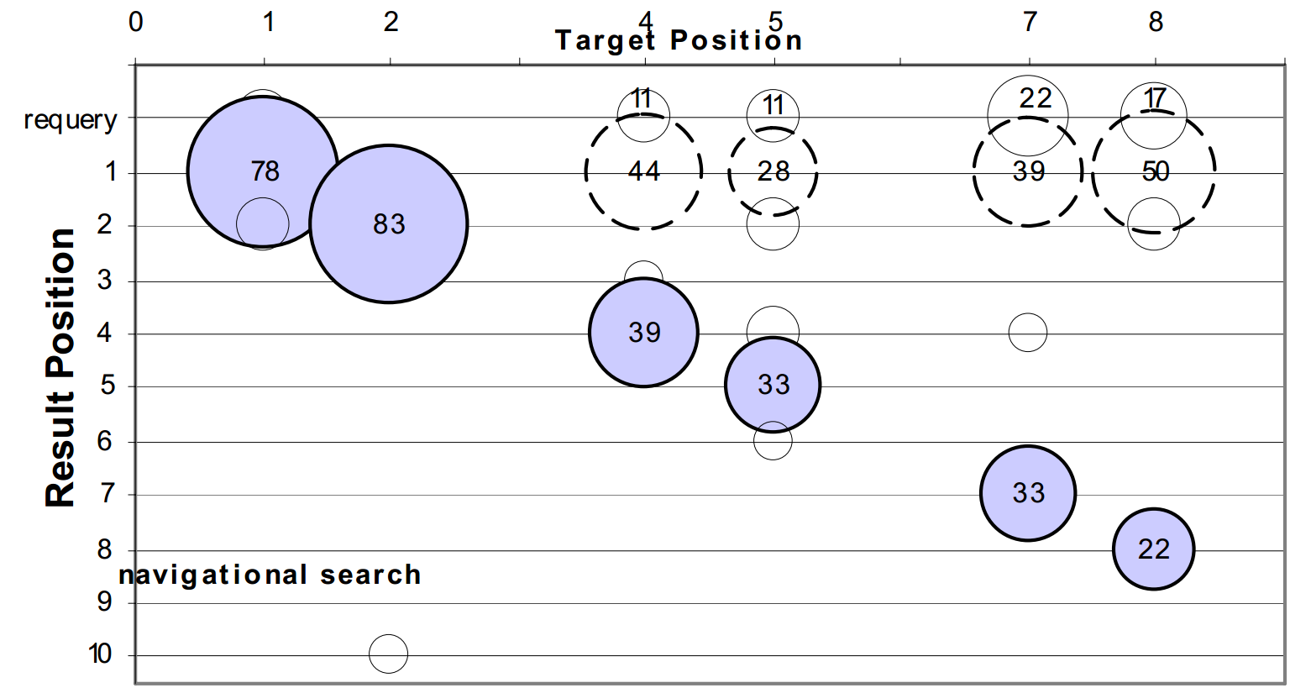
An eye tracking study of the effect of target rank on web search ^{[Guan CHI’07]}
Break down of users’ click accuracy
  Navigational search
First result

Slide 21
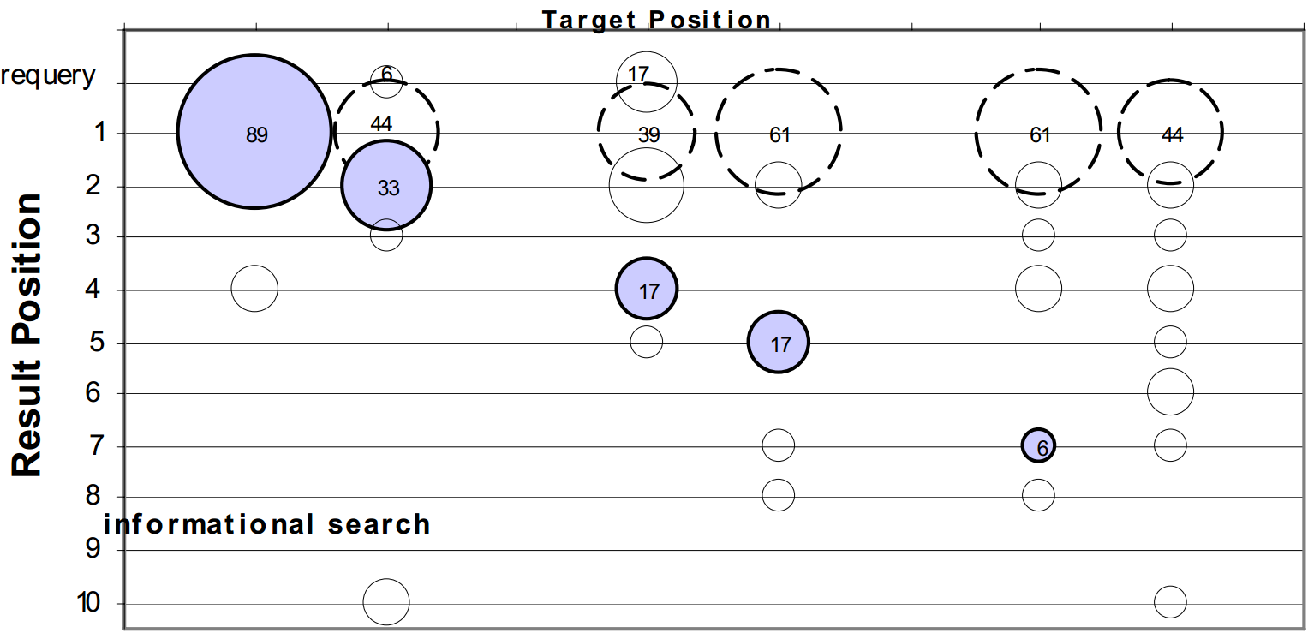
An eye tracking study of the effect of target rank on web search ^{[Guan CHI’07]}
Break down of users’ click accuracy
  Informational search
First result

Slide 22
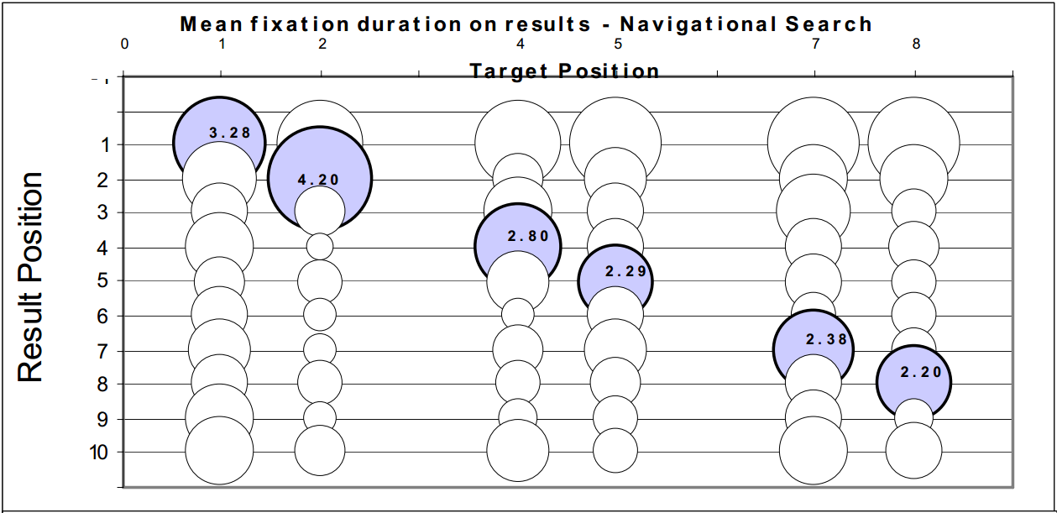
Users failed to recognize the target because they did not read it!
Navigational search

Slide 23
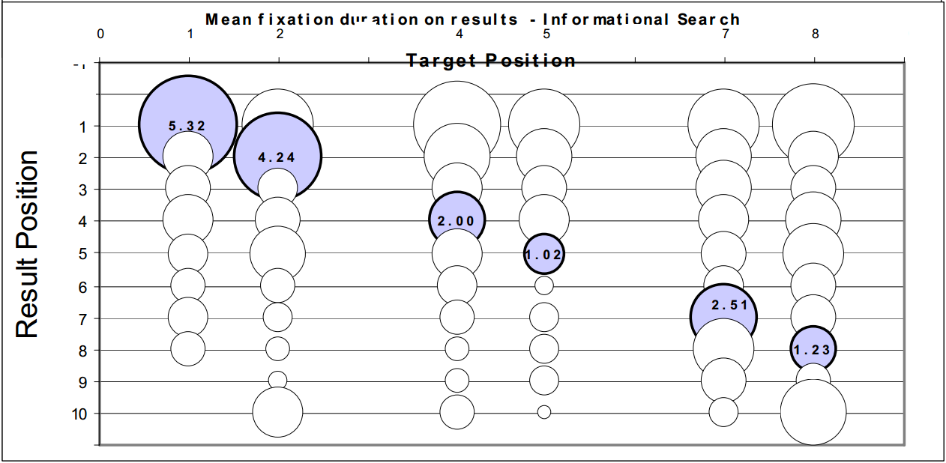
Users did not click because they did not read the results!
Informational search

Slide 24
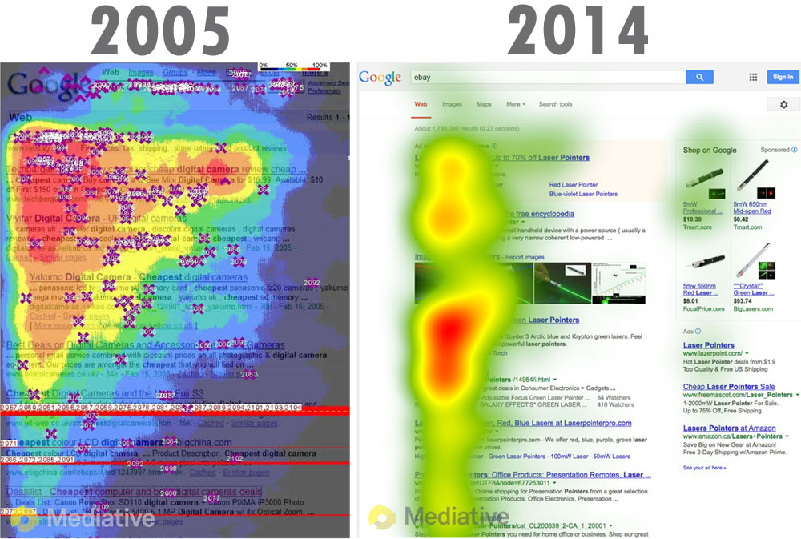
Where do we pay attention to?

Slide 25
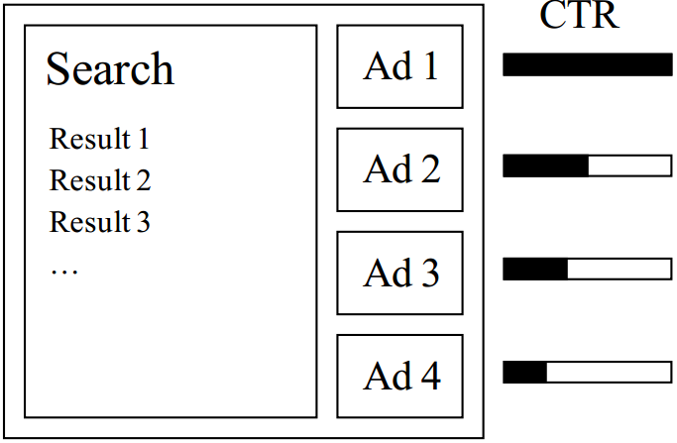
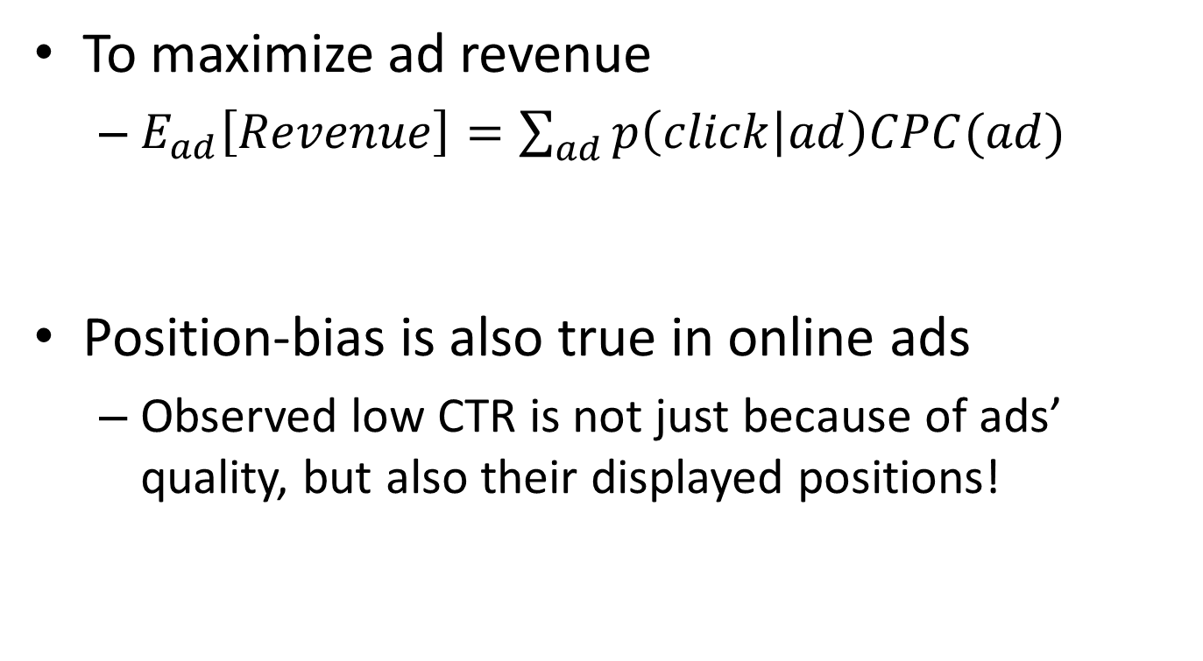
Predicting clicks: estimating the click-through rate for new ads ^{[Richardson WWW’07]}
To maximize ad revenue
  $E_{ad}\left[Revenue\right]=\sum_{ad}{p\left(click | ad\right)CPC(ad)}$
Position-bias is also true in online ads
  Observed low CTR is not just because of ads’ quality, but also their displayed positions!
Cost per click: basic business model in search engines
Estimated click-through rate

Slide 26

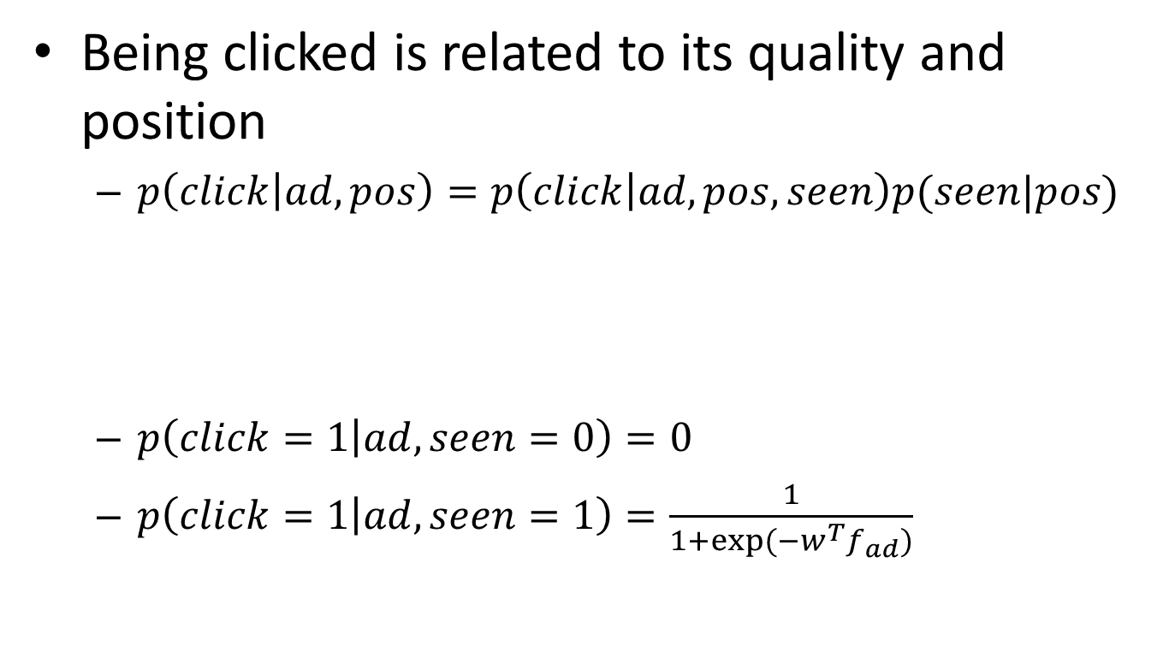
Combat position-bias by explicitly modeling it
Being clicked is related to its quality and position
  $p\left(click | ad,pos\right)=p\left(click | ad,pos,seen\right)p(seen|pos)$
  $p\left(click=1 | ad,seen=0\right)=0$
  $p\left(click=1 | ad,seen=1\right)=\frac{1}{1+exp⁡(−w^{T}f_{ad})}$
$$=p\left(click | ad,seen\right)p(seen|pos)$$
Calibrated CTR for ads ranking
Discounting factor
Logistic regression by features of the ad

Slide 27
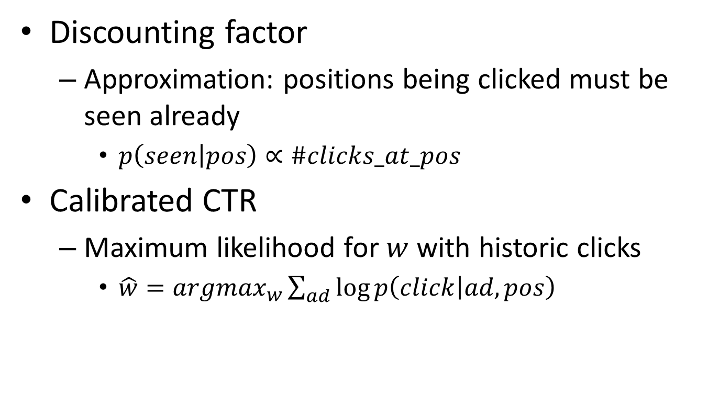
Parameter estimation
Discounting factor
  Approximation: positions being clicked must be seen already
    $p\left(seen | pos\right)∝\#clicks_at_pos$
Calibrated CTR
  Maximum likelihood for $w$ with historic clicks
    $\hat{w}=argmax_{w}\sum_{ad}{\log{p\left(click | ad,pos\right)}}$

Slide 28
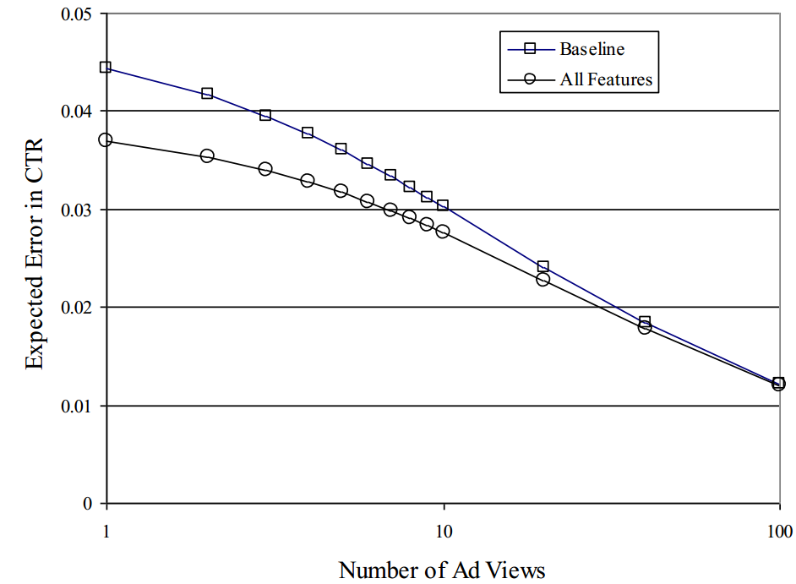
Calibrated CTR is more accurate for new ads
Simple counting of CTR
Unfortunately, their evaluation criterion is still based on biased clicks in testing set

Slide 29
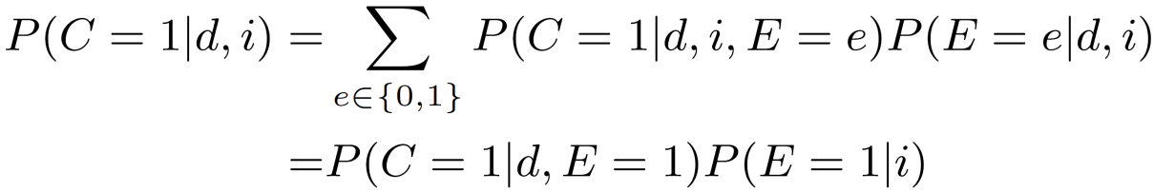
Click models
Decompose relevance-driven skips from position-driven skips
  Examine: user reads the displayed result
  Click: user clicks on the displayed result
  Atomic unit: (query, doc)
Prob.
(q,d₁)
(q,d₂)
Relevance quality
Pos.
Click probability
Examine probability
(q,d₃)
(q,d₄)
Notes:
A user clicks on a returned document if and only if that document has been examined by the user and it is relevant to the given query.

Slide 30
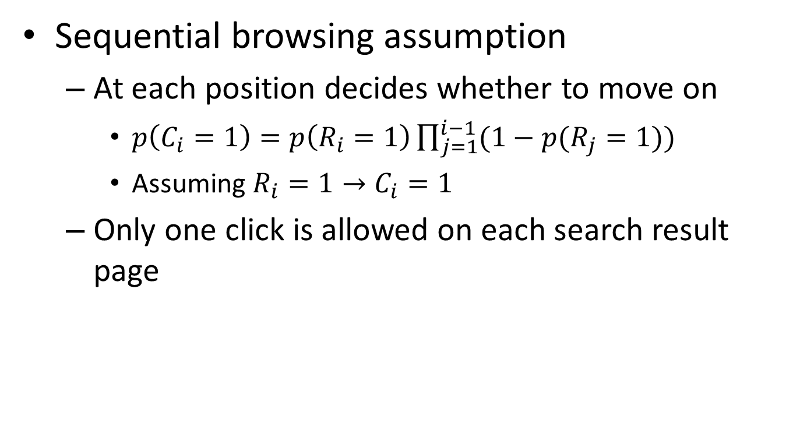
Cascade Model ^{[Craswell et al. WSDM’08]}
Sequential browsing assumption
  At each position decides whether to move on
    $p\left(C_{i}=1\right)=p\left(R_{i}=1\right)\prod_{j=1}^{i−1}{(1−p(R_{j}=1))}$
    Assuming $R_{i}=1→C_{i}=1$
  Only one click is allowed on each search result page
    Kind of “Click > Skip Above”?

Slide 31
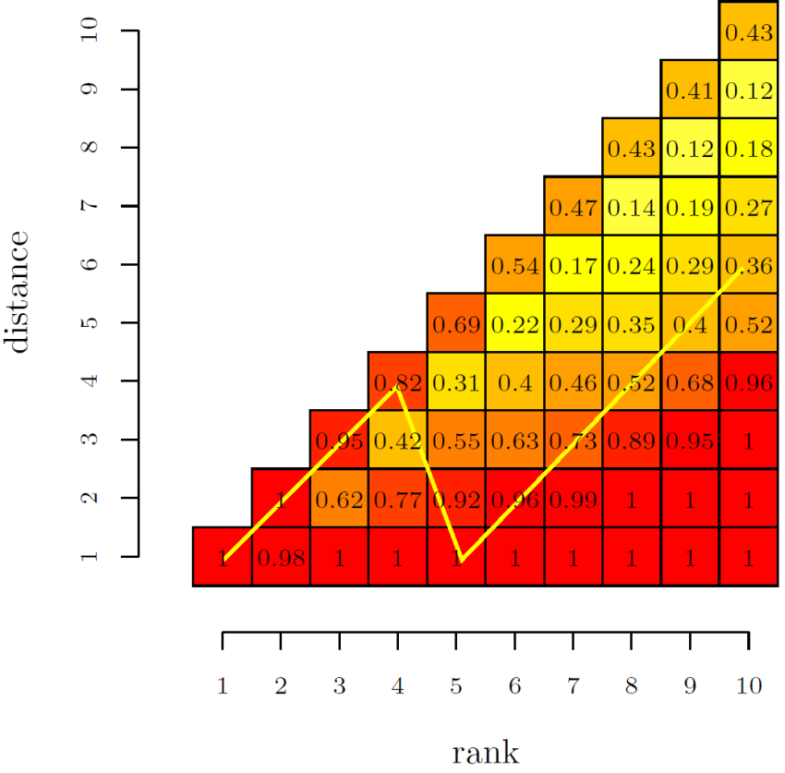
User Browsing Model ^{[Dupret et al. SIGIR’08]}
Examination depends on distance to the last click
Attractiveness, determined by query and URL
Examination, determined by position and distance to last click
EM for parameter estimation
From absolute discount to relative discount
    Kind of “Click > Skip Next”
    + “Click > Skip Above”?

Slide 32
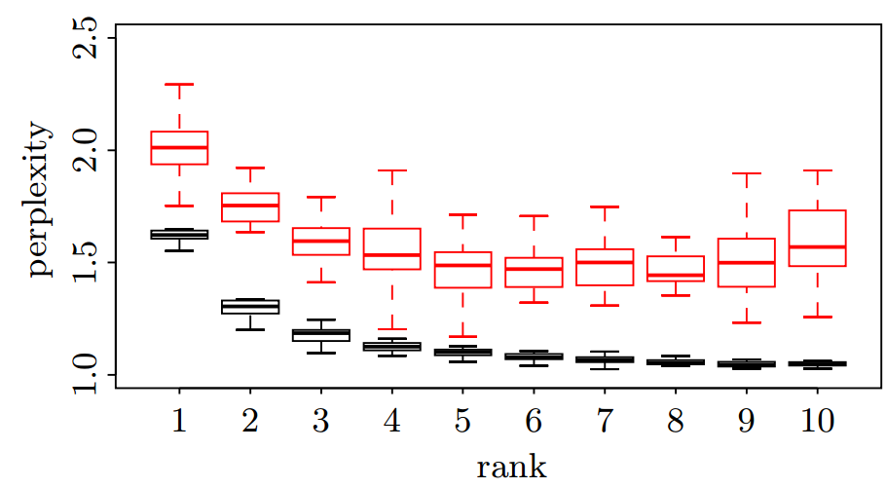
More accurate prediction of clicks
Perplexity – randomness of prediction
Cascade model
Browsing model

Slide 33
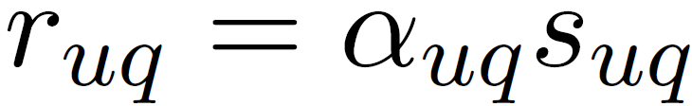




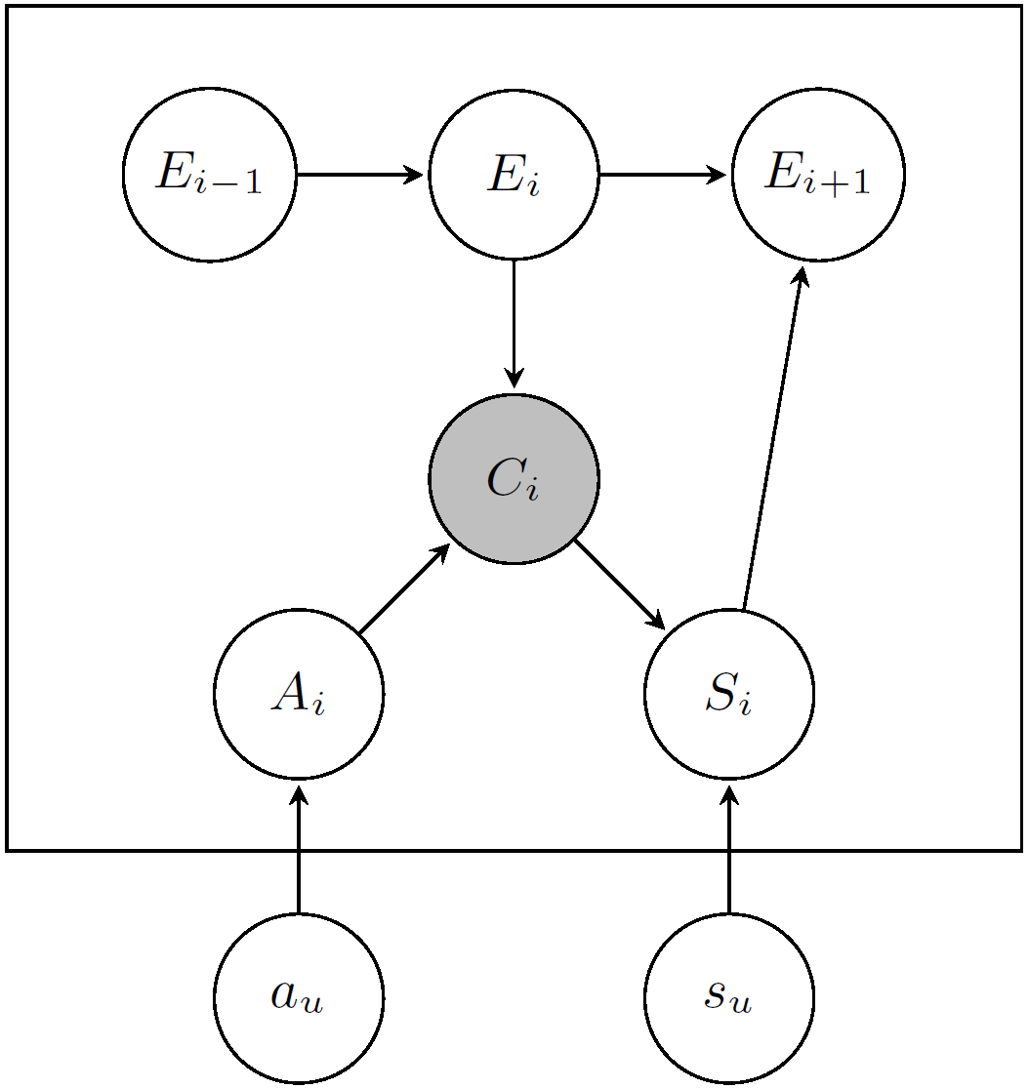
Dynamic Bayesian Model ^{[Chapelle et al. WWW’09]}
A cascade model
  Relevance quality:
User’s satisfaction
Examination chain
Perceived relevance
Intrinsic relevance
Notes:
Cascade model assumes the user will examine the returned documents from top to bottom and make click decisions over each examined position sequentially.
Imposing stronger dependency assumption over the user’s click behaviors
Perceived relevance controls click and intrinsic relevance controls user’s satisfaction.

Slide 34
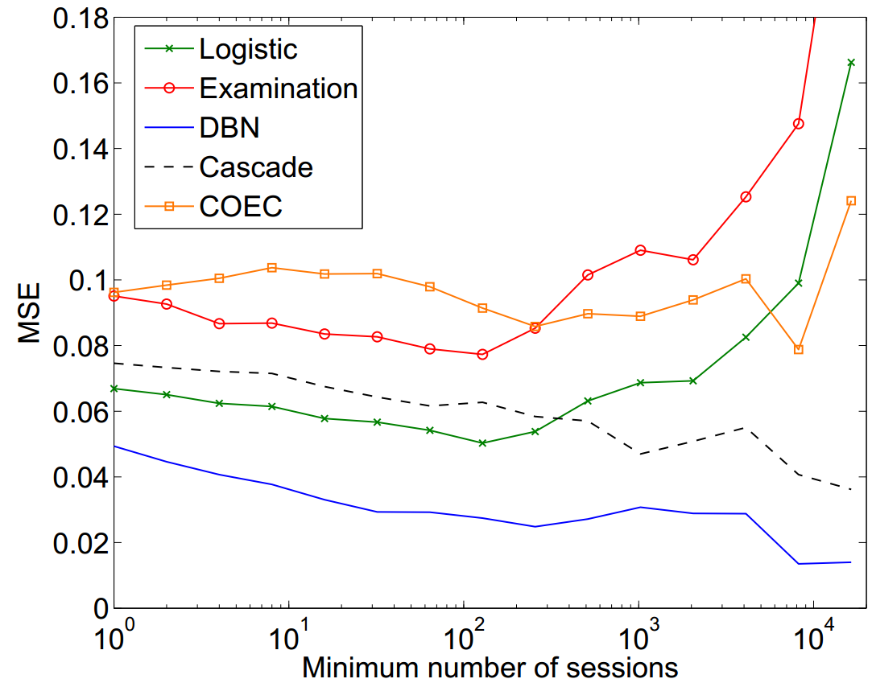
Accuracy in predicting CTR

Slide 35
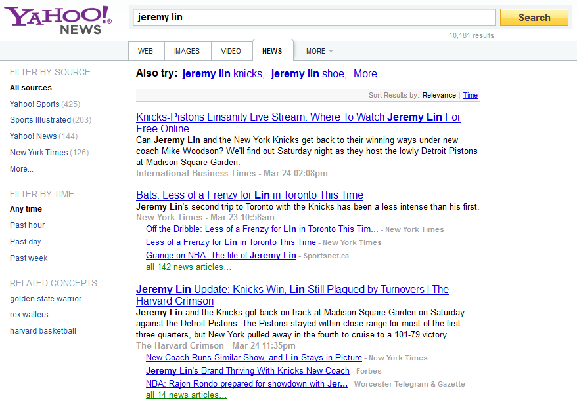

Revisit User Click Behaviors
Match my query?
Redundant doc?
Shall I move on?

Slide 36
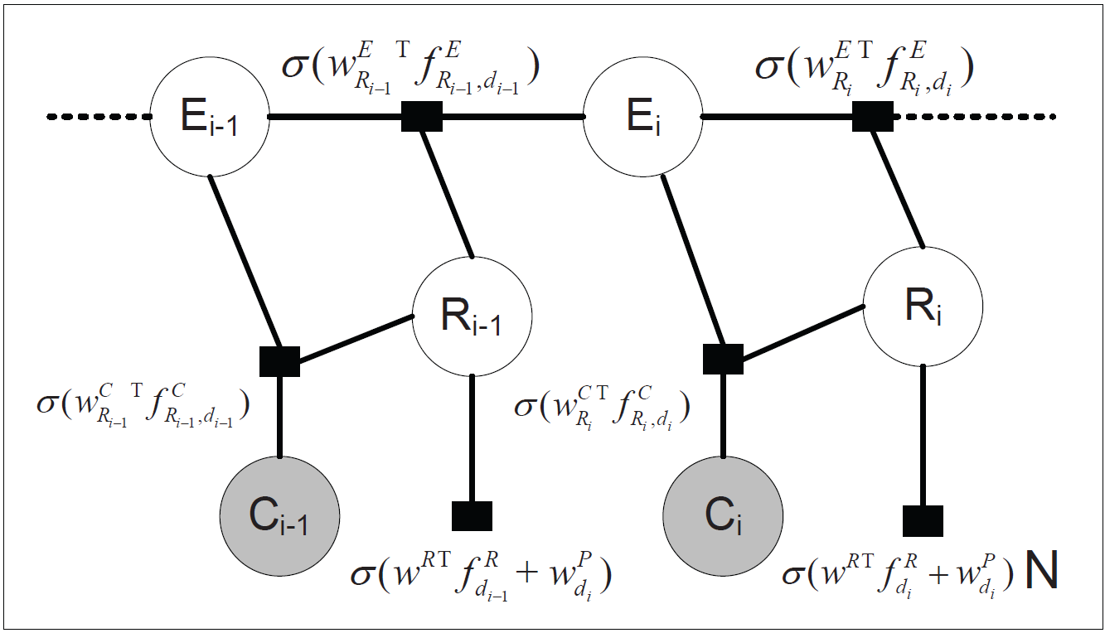
Content-Aware Click Modeling ^{[Wang et al. WWW’12]}
Encode dependency within user browsing behaviors via descriptive features
Chance to further examine the result documents: e.g., position, # clicks, distance to last click
Chance to click on an examined and relevant document: e.g., clicked/skipped content similarity
Relevance quality of a document: e.g., ranking features

Slide 37
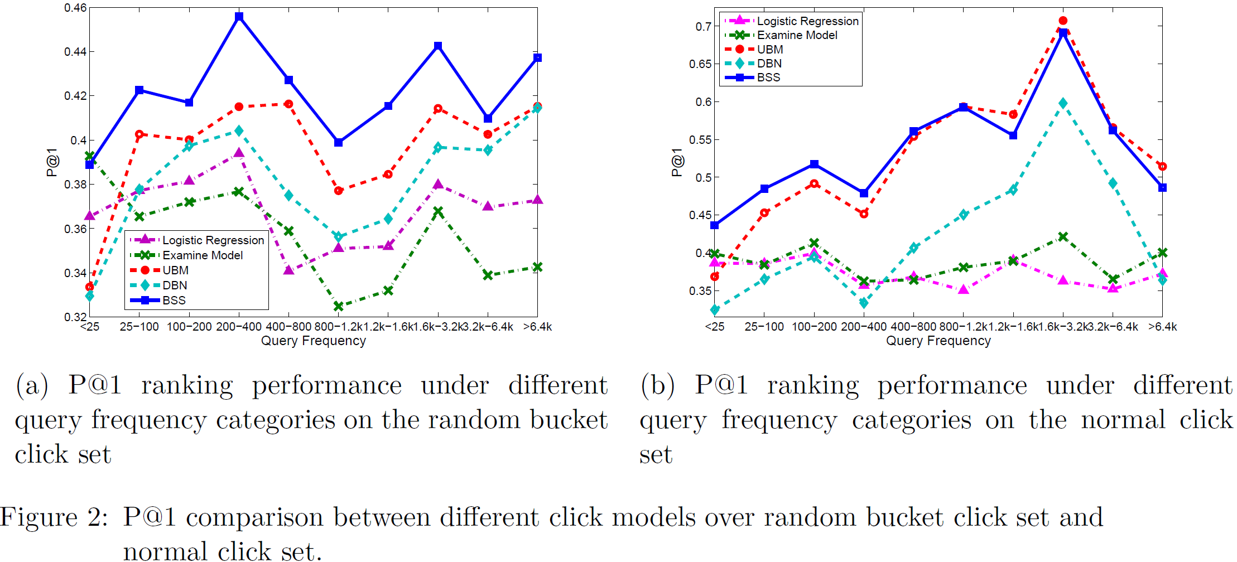
Quality of relevance modeling
Estimated relevance for ranking

Slide 38
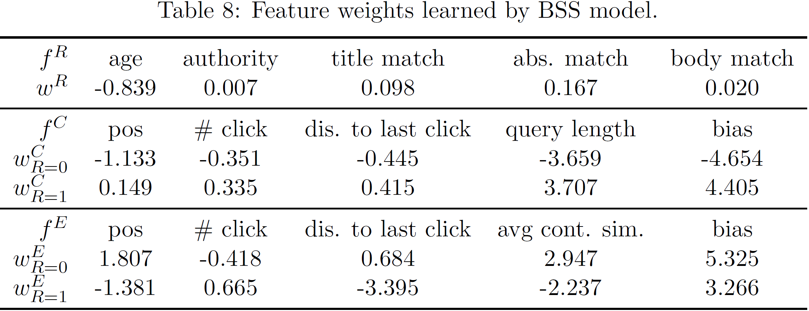
Understanding user behaviors
Analyzing factors affecting user clicks

Slide 39
What you should know
Clicks as implicit relevance feedback
Positional bias
Heuristics for generating pairwise preferences
Assumptions and modeling approaches for click models

