Slide 1
Introduction to Information Retrieval
Hongning Wang
CS@UVa

Slide 2
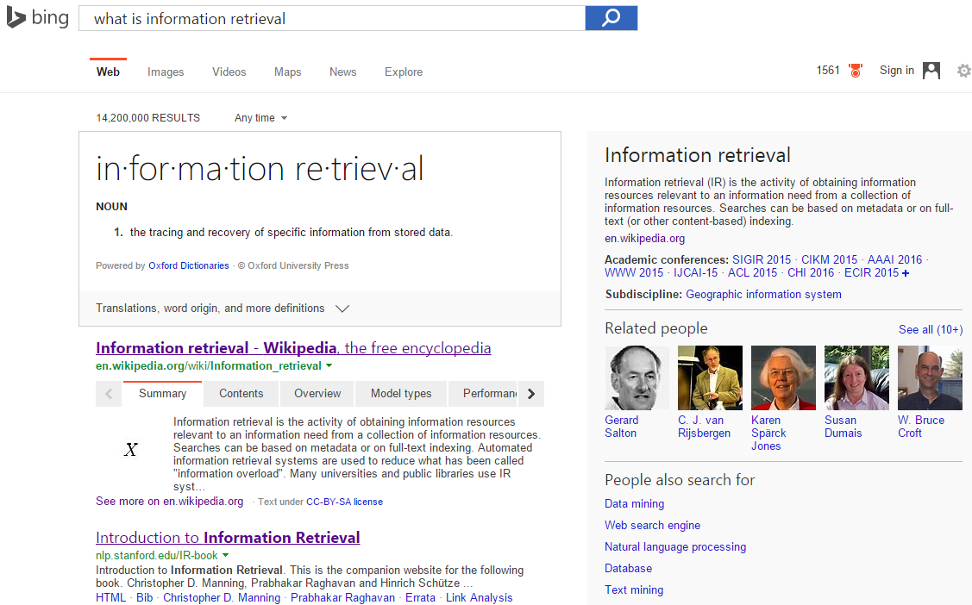
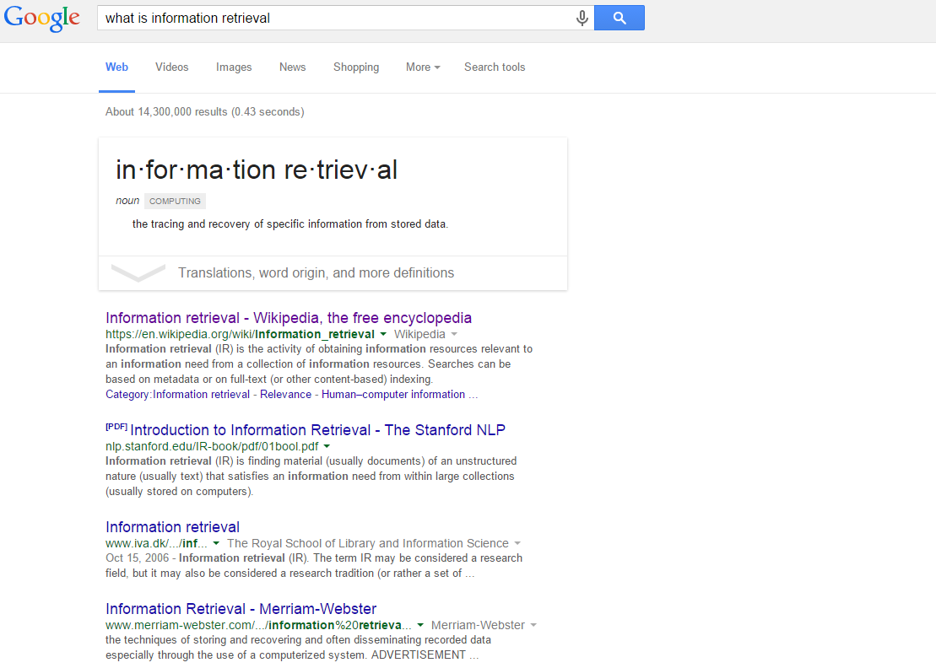
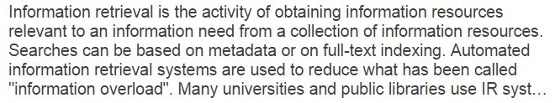
What is information retrieval?

Slide 3
What is information retrieval?
Apple’s vision 35 years ago
  Knowledge Navigator

Slide 4


Why information retrieval
Information overload
  “It refers to the difficulty a person can have understanding an issue and making decisions that can be caused by the presence of too much information.” - wiki

Slide 5
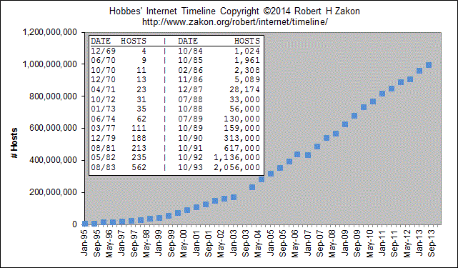
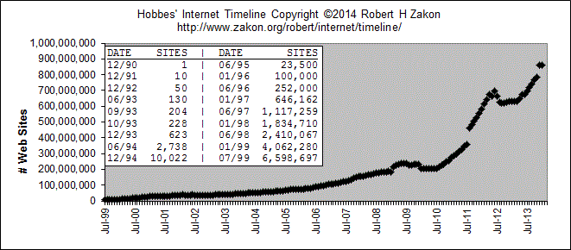
Why information retrieval
Information overload
Figure 2: Growth of WWW
Figure 1: Growth of Internet

Slide 6
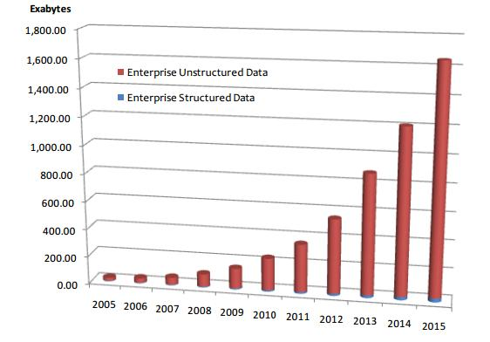
Why information retrieval
Handling unstructured data
  Structured data: database system is a good choice
  Unstructured data is more dominant
    Text in Web documents or emails, image, audio, video…
    “85 percent of all business information exists as unstructured data” - Merrill Lynch
    Unknown semantic meaning
Table 1: People in CS Department
ID | Name | Job
1 | Jack | Professor
3 | David | Stuff
5 | Tony | IT support
select Name from People where Job = ‘Stuff’;
Total Enterprise Data Growth 2005-2015, IDC 2012

Slide 7

Why information retrieval
An essential tool to deal with information overload
You are here!

Slide 8
History of information retrieval
Idea popularized in the pioneer article “As We May Think” by Vannevar Bush, 1945
  “Wholly new forms of encyclopedias will appear, ready-made with a mesh of associative trails running through them, ready to be dropped into the memex and there amplified.”
  “A memex is a device in which an individual stores all his books, records, and communications, and which is mechanized so that it may be consulted with exceeding speed and flexibility.”
-> WWW
-> Search engine

Slide 9
Major research milestones
Early days (late 1950s to 1960s): foundation of the field
  Luhn’s work on automatic indexing
  Cleverdon’s Cranfield evaluation methodology and index experiments
  Salton’s early work on SMART system and experiments
1970s-1980s: a large number of retrieval models
  Vector space model
  Probabilistic models
1990s: further development of retrieval models and new tasks
  Language models
  TREC evaluation
  Web search
2000s-present: more applications, especially Web search and interactions with other fields
  Learning to rank
  Scalability (e.g., MapReduce)
  Real-time search

Slide 10
History of information retrieval
Catalyst
  Academia: Text Retrieval Conference (TREC) in 1992
    “Its purpose was to support research within the information retrieval community by providing the infrastructure necessary for large-scale evaluation of text retrieval methodologies.”
    “… about one-third of the improvement in web search engines from 1999 to 2009 is attributable to TREC. Those enhancements likely saved up to 3 billion hours of time using web search engines.”
    Till today, it is still a major test-bed for academic research in IR

Slide 11
History of information retrieval
Catalyst
  Industry: web search engines
    WWW unleashed explosion of published information and drove the innovation of IR techniques
    First web search engine: “Oscar Nierstrasz at the University of Geneva wrote a series of Perl scripts that periodically mirrored these pages and rewrote them into a standard format.” Sept 2, 1993
    Lycos (started at CMU) was launched and became a major commercial endeavor in 1994
    Booming of search engine industry: Magellan, Excite, Infoseek, Inktomi, Northern Light, AltaVista, Yahoo!, Google, and Bing

Slide 12
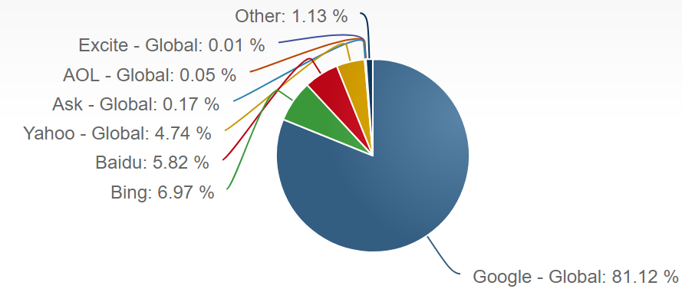
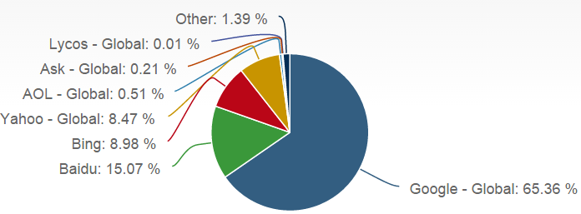
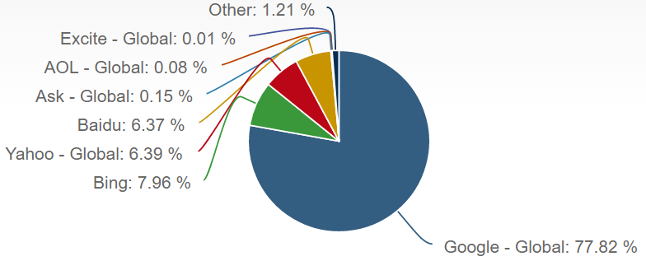
Major players in this game
Global search engine market - desktop
  By http://marketshare.hitslink.com/search-engine-market-share.aspx
2015 Fall
Fall 2017
2016 Fall

Slide 13
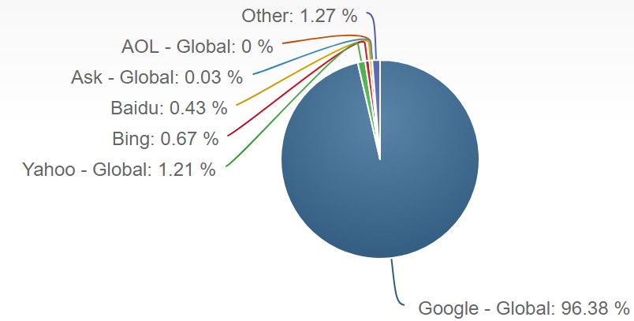
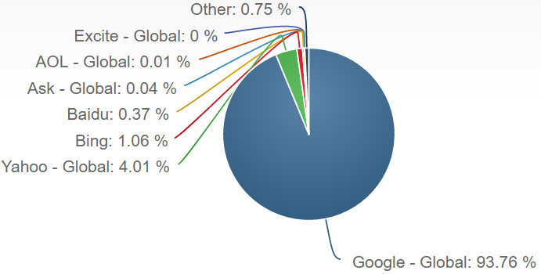
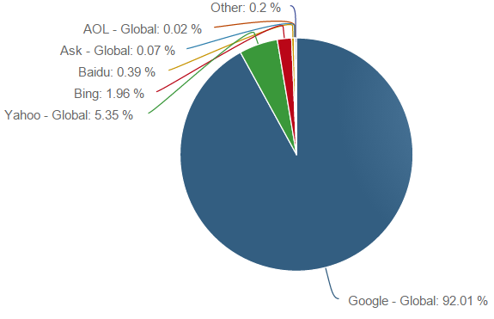
Major players in this game
Global search engine market - mobile
  By http://marketshare.hitslink.com/search-engine-market-share.aspx
2016 Fall
2015 Fall
Fall 2017

Slide 14
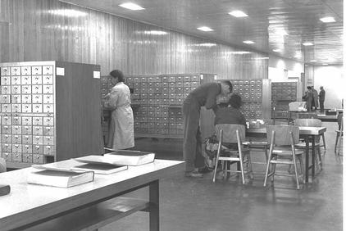

How to perform information retrieval
Information retrieval when we did not have a computer

Slide 15
Welcome back
We will start our discussion at 2pm
sli.do event code: 32233
TA’s office hour has been finalized at Mon/Wed, 1pm-2pm, via zoom, by appointment

Slide 16
Recap: why information retrieval
Handling unstructured data
  Structured data: database system is a good choice
  Unstructured data is more dominant
    Text in Web documents or emails, image, audio, video…
    “85 percent of all business information exists as unstructured data” - Merrill Lynch
    Unknown semantic meaning

Slide 17
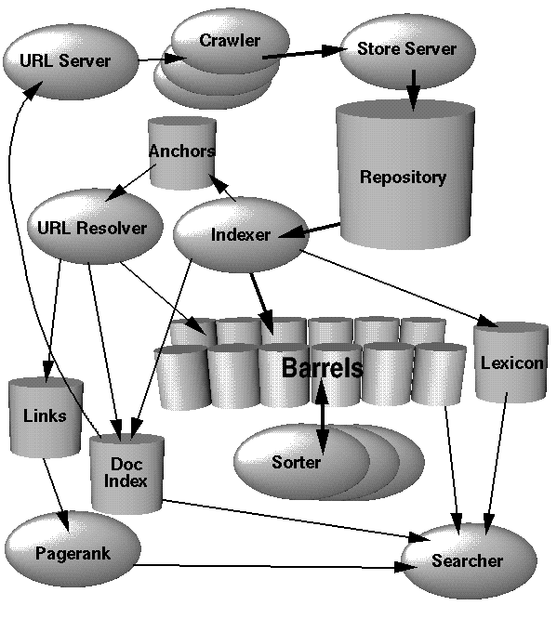
How to perform information retrieval
Crawler and indexer
Query parser
Ranking model
Document analyzer

Slide 18
Crack into Google!

Slide 19
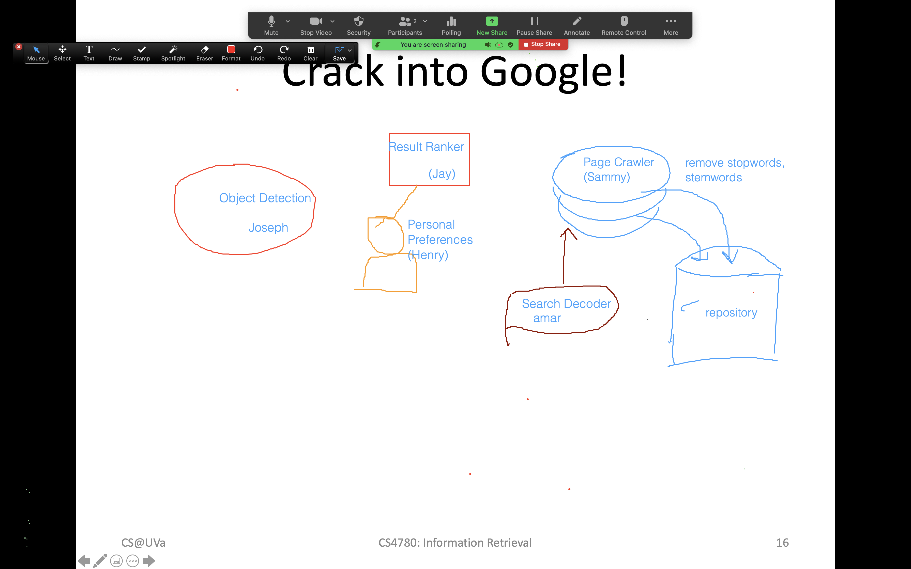

Slide 20
How to perform information retrieval
PARSING & INDEXING
Doc
Rep
Query
Rep
query
User
Repository
Ranking
SEARCH
results
APPLICATIONS
LEARNING
Evaluation
judgments
FEEDBACK
We will cover:
1) Search engine architecture; 2)Retrieval models;
3) Retrieval evaluation; 4) Relevance feedback;
5) Link analysis; 6) Search applications.

Slide 21
Core concepts in IR
Query representation
  Lexical gap: say v.s. said
  Semantic gap: ranking model v.s. retrieval method
Document representation
  Special data structure for efficient access
  Lexical gap and semantic gap
Retrieval model
  Algorithms that find the most relevant documents for the given information need

Slide 22
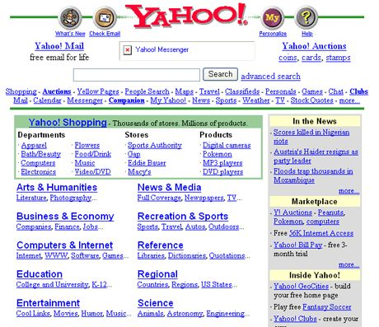
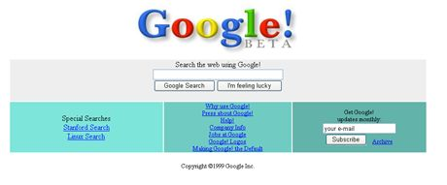
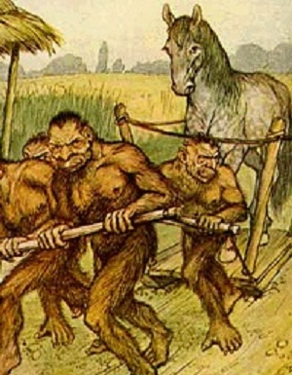
A glance of modern search engine
Yet Another Hierarchical Officious/Obstreperous/ Odiferous/Organized Oracle
In old times
Yahoo race of fictional beings from Gulliver's Travels

Slide 23
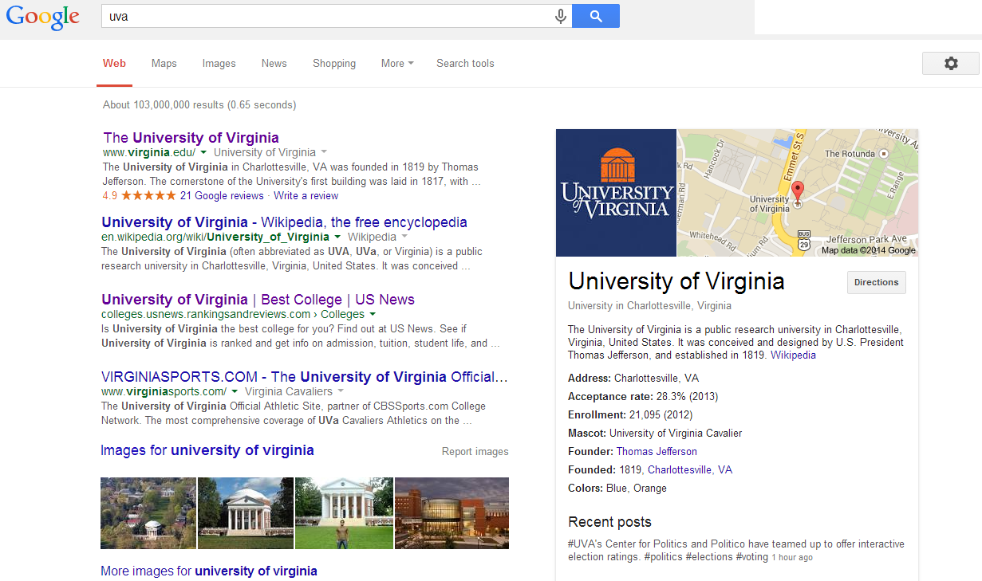

A glance of modern search engine
Demand of understanding
Modern time
Demand of efficiency
Demand of convenience
Demand of accuracy
Demand of diversity

Slide 24

IR is not just about web search
Web search is just one important area of information retrieval, but not all
Information retrieval also includes
  Recommendation

Slide 25

IR is not just about web search

Slide 26
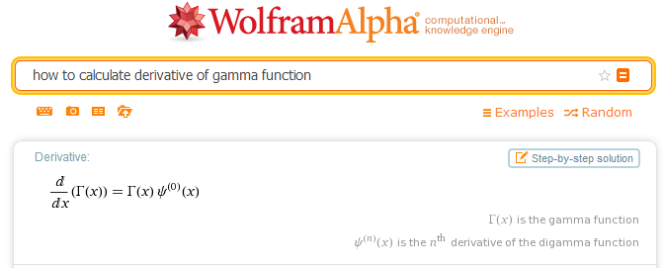
IR is not just about web search
Web search is just one important area of information retrieval, but not all
Information retrieval also includes
  Question answering

Slide 27
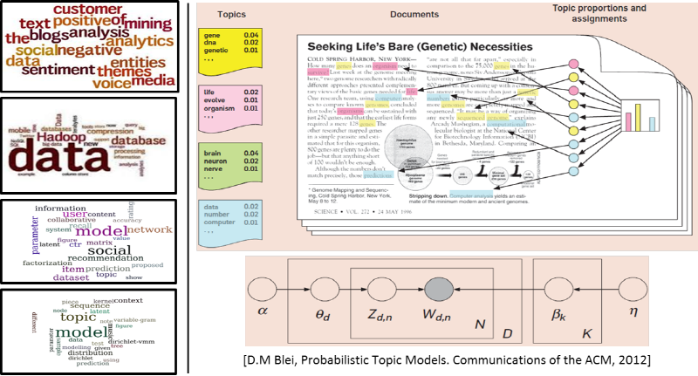
IR is not just about web search
Web search is just one important area of information retrieval, but not all
Information retrieval also includes
  Text mining

Slide 28


IR is not just about web search
Web search is just one important area of information retrieval, but not all
Information retrieval also includes
  Online advertising

Slide 29
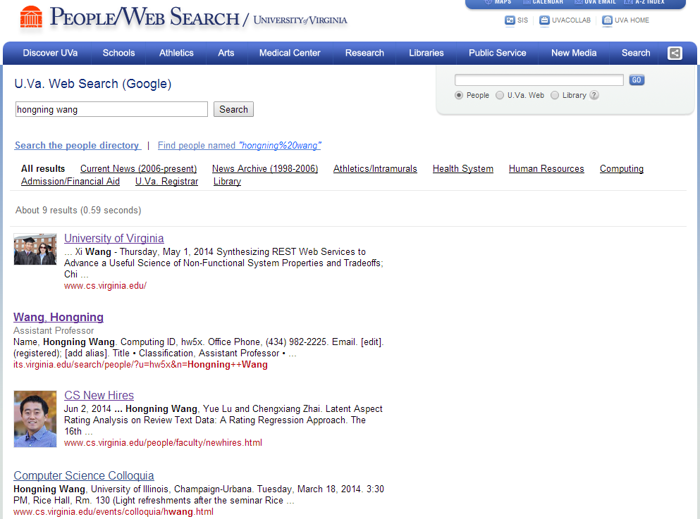
IR is not just about web search
Web search is just one important area of information retrieval, but not all
Information retrieval also includes
  Enterprise search: web search + desktop search

Slide 30
Related Areas
Applications
Mathematics
Web Applications,
Bioinformatics…
Machine Learning
Pattern Recognition
Library & Info
Science
Information
Retrieval
Natural
Language
Processing
Statistics
Optimization
Databases
Data Mining
Software engineering
Computer systems
Algorithms
Systems

Slide 31
IR v.s. DBs
Information Retrieval:
  Unstructured data
  Semantics of objects are subjective
  Simple keyword queries
  Relevance-drive retrieval
  Effectiveness is primary issue, though efficiency is also important
Database Systems:
  Structured data
  Semantics of each object are well defined
  Structured query languages (e.g., SQL)
  Exact retrieval
  Emphasis on efficiency

Slide 32
IR and DBs are getting closer
IR => DBs
  Approximate search is available in DBs
  Eg. in mySQL
DBs => IR
  Use information extraction to convert unstructured data to structured data, e.g., knowledge base
  Semi-structured representation: XML data; queries with structured information
mysql> SELECT * FROM articles
-> WHERE MATCH (title,body)
AGAINST ('database');

Slide 33
IR v.s. NLP
Information retrieval
  Computational approaches
  Statistical (shallow) understanding of language
  Handle large scale problems
Natural language processing
  Cognitive, symbolic and computational approaches
  Semantic (deep) understanding of language
  (often times) small scale problems

Slide 34
IR and NLP are getting closer
IR => NLP
  Larger data collections
  Scalable/robust NLP techniques, e.g., translation models
NLP => IR
  Deep analysis of text documents and queries
  Information extraction for structured IR tasks
  Natural language based QA systems

Slide 35
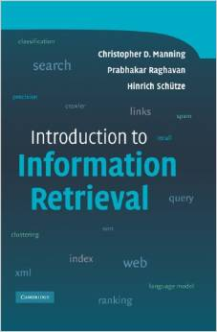
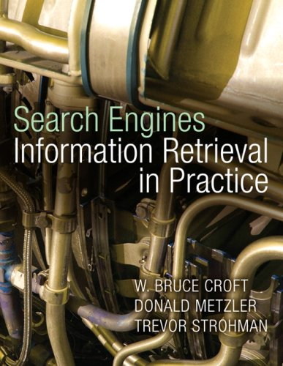
Text books
Introduction to Information Retrieval. Christopher D. Manning, Prabhakar Raghavan, and Hinrich Schuetze, Cambridge University Press, 2007.
Search Engines: Information Retrieval in Practice. Bruce Croft, Donald Metzler, and Trevor Strohman, Pearson Education, 2009.

Slide 36
What to read?
Applications
Mathematics
Web Applications,
Bioinformatics…
Machine Learning
Pattern Recognition
Library & Info
Science
ICML, NIPS, UAI
Information Retrieval
Statistics
Optimization
NLP
SIGIR, WWW, WSDM, CIKM
Databases
ACL, EMNLP, COLING
SIGMOD, VLDB, ICDE
Data Mining
Software engineering
Computer systems
KDD, ICDM, SDM
Algorithms
Systems
Find more on course website for resource

Slide 37
IR in future
Mobile search
  Desktop search + location? Not exactly!!
Interactive retrieval
  Machine collaborates with human for information access
Personal assistant
  Proactive information retrieval
  Knowledge navigator
And many more
  You name it!

Slide 38
What you should know
IR originates from library science for handling unstructured data
IR has many important application areas, e.g., web search, recommendation, and question answering
IR is a highly interdisciplinary area with DBs, NLP, ML, HCI

Slide 39
Today’s reading
Bush, Vannevar. "As we may think." The atlantic monthly 176, no.1 (1945): 101-108.
Introduction to Information Retrieval
  Chapter 1: Boolean Retrieval

