Slide 1
Inverted Index
Hongning Wang
CS@UVa

Slide 2
Abstraction of search engine architecture
Indexed corpus
Crawler
Ranking procedure
Feedback
Evaluation
Doc Analyzer
(Query)
Query Rep
User
Doc Representation
Ranker
Indexer
results
Index

Slide 3
What we have now
Documents have been
  Crawled from Web
  Tokenized/normalized
  Represented as Bag-of-Words
Let’s do search!
  Query: “information retrieval”
 | information | retrieval | retrieved | is | helpful | for | you | everyone
Doc1 | 1 | 1 | 0 | 1 | 1 | 1 | 0 | 1
Doc2 | 1 | 0 | 1 | 1 | 1 | 1 | 1 | 0

Slide 4
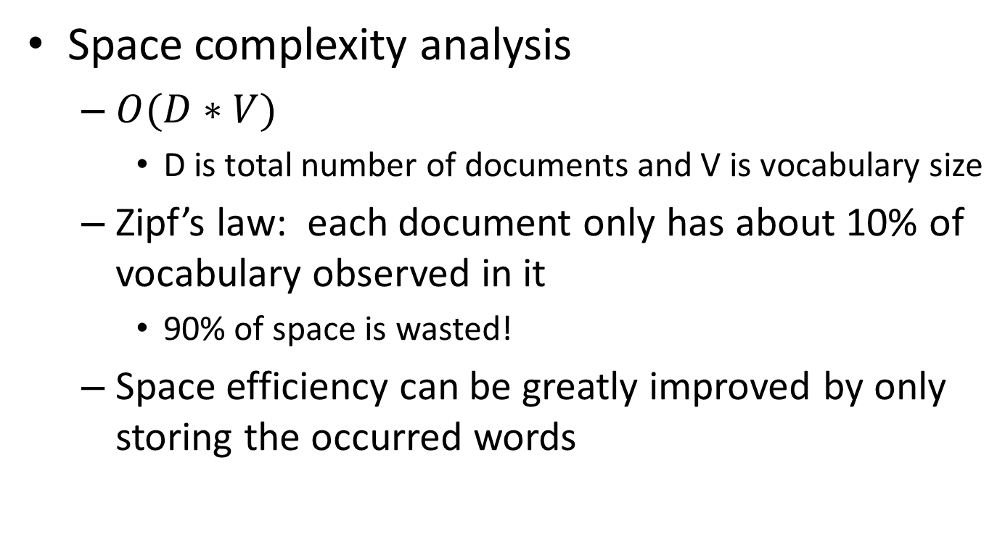
Complexity analysis
Space complexity analysis
  $O(D∗V)$
    D is total number of documents and V is vocabulary size
  Zipf’s law: each document only has about 10% of vocabulary observed in it
    90% of space is wasted!
  Space efficiency can be greatly improved by only storing the occurred words
Solution: linked list for each document

Slide 5
Welcome back
We will start our discussion at 2pm
sli.do event code: 67175
Paper presentation sign up is due this Friday, 11:59pm
Project proposal is due next Friday, 11:59pm

Slide 6
Recap: document retrieval via BoW
Documents have been
  Crawled from Web
  Tokenized/normalized
  Represented as Bag-of-Words
Let’s do search!
  Query: “information retrieval”
 | information | retrieval | retrieved | is | helpful | for | you | everyone
Doc1 | 1 | 1 | 0 | 1 | 1 | 1 | 0 | 1
Doc2 | 1 | 0 | 1 | 1 | 1 | 1 | 1 | 0

Slide 7
Recap: complexity analysis
Space complexity analysis
  $O(D∗V)$
    D is total number of documents and V is vocabulary size
  Zipf’s law: each document only has about 10% of vocabulary observed in it
    90% of space is wasted!
  Space efficiency can be greatly improved by only storing the occurred words
Solution: linked list for each document

Slide 8

Complexity analysis
Time complexity analysis
  $O(\left|q\right|∗D∗|D|)$
    $\left|q\right|$ is the length of query, $|D|$ is the length of a document
doclist = []
for (wi in q) {
for (d in D) {
for (wj in d) {
if (wi == wj) {
doclist += [d];
break;
}
}
}
}
return doclist;
Bottleneck, since most of them won’t match!

Slide 9
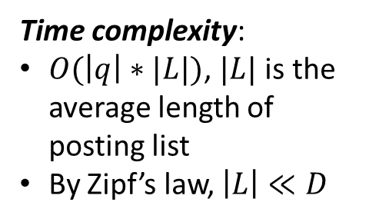
Solution: inverted index
Build a look-up table for each word in vocabulary
  From word to documents!
Dictionary
Postings
information
retrieval
retrieved
is
helpful
for
you
everyone
Doc1
Doc2
Time complexity:
$O(\left|q\right|∗|L|)$, $|L|$ is the average length of posting list
By Zipf’s law, $\left|L\right|≪D$
Doc1
Query:
information
retrieval
Doc2
Doc1
Doc2
Doc1
Doc2
Doc1
Doc2
Doc2
Doc1

Slide 10
Structures for inverted index
Dictionary: modest size
  Needs fast random access
  Stay in memory
    Hash table, B-tree, trie, …
Postings: huge
  Stay on disk
  Sequential access is expected
  Contain docID, term freq, term position, …
  Compression is needed
“Key data structure underlying modern IR”
  - Christopher D. Manning

Slide 11
Sorting-based inverted index construction
<Tuple>: <termID, docID, count>
Sort by docId
Sort by termId
All info about term 1
doc1
<1,1,3>
<2,1,2>
<3,1,1>
...
<1,2,2>
<3,2,3>
<4,2,5>
…
<1,300,3>
<3,300,1>
...
<1,1,3>
<1,2,2>
<2,1,2>
<2,4,3>
...
<1,5,3>
<1,6,2>
…
<1,299,3>
<1,300,1>
...
<1,1,3>
<1,2,2>
<1,5,2>
<1,6,3>
...
<1,300,3>
<2,1,2>
…
<5000,299,1>
<5000,300,1>
...
Term Lexicon:
1 the
2 cold
3 days
4 a
...
doc2
...
DocID
Lexicon:
1 doc1
2 doc2
3 doc3
...
doc300
Parse & Count
“Local” sort
Merge sort

Slide 12
Sorting-based inverted index
Challenges
  Document size exceeds memory limit
Key steps
  Local sort: sort by termID
    For later global merge sort
  Global merge sort
    Preserve docID order: for later posting list join
Can index large corpus with a single machine!
Also suitable for MapReduce!

Slide 13
A close look at inverted index
Approximate search:
e.g., misspelled queries, wildcard queries
Proximity search:
e.g., phrase queries
Dictionary
Postings
information
retrieval
retrieved
is
helpful
for
you
everyone
Doc1
Doc2
Doc1
Dynamic index update
Doc2
Doc1
Doc2
Doc1
Doc2
Doc1
Doc2
Index compression
Doc2
Doc1

Slide 14
Dynamic index update
Periodically rebuild the index
  Acceptable if change is small over time and penalty of missing new documents is negligible
Auxiliary index
  Keep index for new documents in memory
  Merge to index when size exceeds threshold
    Increase I/O operation
    Solution: multiple auxiliary indices on disk, logarithmically merging

Slide 15
Index compression
Benefits
  Save storage space
  Increase cache efficiency
  Improve disk-memory transfer rate
Target
  Postings file

Slide 16

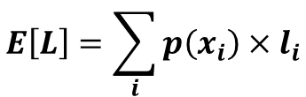


Basics in coding theory
Expected code length
$$E\left[L\right]=\sum_{i}{p\left(x_{i}\right)×l_{i}}$$
Event | P(X) | Code
a | 0.25 | 00
b | 0.25 | 01
c | 0.25 | 10
d | 0.25 | 11
Event | P(X) | Code
a | 0.75 | 00
b | 0.10 | 01
c | 0.10 | 10
d | 0.05 | 11
Event | P(X) | Code
a | 0.75 | 0
b | 0.10 | 10
c | 0.10 | 111
d | 0.05 | 110
$$E\left[L\right]=2$$
$$E\left[L\right]=1.4$$
$$E\left[L\right]=2$$

Slide 17
Welcome back
We will start our discussion at 2pm
sli.do event code: 67175
Paper presentation sign up is due this Friday (tomorrow), 11:59pm
Project proposal is due next Friday, 11:59pm

Slide 18
Recap: a close look at inverted index
Approximate search:
e.g., misspelled queries, wildcard queries
Proximity search:
e.g., phrase queries
Dictionary
Postings
information
retrieval
retrieved
is
helpful
for
you
everyone
Doc1
Doc2
Doc1
Dynamic index update
Doc2
Doc1
Doc2
Doc1
Doc2
Doc1
Doc2
Index compression
Doc2
Doc1

Slide 19
Index compression
Observation of posting files
  Instead of storing docID in posting, we store gap between docIDs, since they are ordered
  Zipf’s law again:
    The more frequent a word is, the smaller the gaps are
    The less frequent a word is, the shorter the posting list is
  Heavily biased distribution gives us great opportunity of compression!
Information theory: entropy measures compression difficulty.

Slide 20
Index compression
Solution
  Fewer bits to encode small (high frequency) integers
  Variable-length coding
    Unary: x≥1 is coded as x-1 bits of 1 followed by 0, e.g., 3=> 110; 5=>11110
    γ-code: x=> unary code for 1+⎣log x⎦ followed by uniform code for x-2 ^{⎣log x⎦} in ⎣log x⎦ bits, e.g., 3=>101, 5=>11001
    δ-code: same as γ-code ,but replace the unary prefix with γ-code. E.g., 3=>1001, 5=>10101

Slide 21
Index compression
Example
Table 1: Index and dictionary compression for Reuters-RCV1. (Manning et al. Introduction to Information Retrieval)
Data structure | Size (MB)
Text collection | 960.0
dictionary | 11.2
Postings, uncompressed | 400.0
Postings γ-coded | 101.0
Compression rate: (101+11.2)/960 = 11.7%

Slide 22
Search within in inverted index
Query processing
  Parse query syntax
    E.g., Barack AND Obama, orange OR apple
  Perform the same processing procedures as on documents to the input query
    Tokenization->normalization->stemming->stopwords removal

Slide 23
Search within inverted index
Procedures
  Lookup query terms in the dictionary
  Retrieve the posting lists
  Operation
    AND: intersect the posting lists
    OR: union the posting list
    NOT: diff the posting list

Slide 24

Search within inverted index
Example: AND operation
scan the postings
Term1
2
4
8
16
32
64
128
Term2
1
2
3
5
8
13
21
34
Time complexity: $O(\left|L_{1}\right|+|L_{2}|)$
Trick for speed-up: when performing multi-way join, starts from lowest frequency term to highest frequency ones

Slide 25
Phrase query
“computer science”
  “He uses his computer to study science problems” is not a match!
  We need the phase to be exactly matched in documents
  N-grams generally does not work for this
    Large dictionary size, how to break a long phrase into N-grams?
  We need term positions in documents
    We can store them in the inverted index

Slide 26
Phrase query
Generalized postings matching
  Equality condition check with requirement of position pattern between two query terms
    e.g., T2.pos-T1.pos = 1 (T1 must be immediately before T2 in any matched document)
  Proximity query: |T2.pos-T1.pos| ≤ k
scan the postings
Term1
2
4
8
16
32
64
128
Term2
1
2
3
5
8
13
21
34

Slide 27
More and more things are put into index
Document structure
  Title, abstract, body, bullets, anchor
Entity annotation
  Being part of a person’s name, location’s name

Slide 28
Spelling correction
Tolerate the misspelled queries
  “barck obama” -> “barack obama”
Principles
  Of various alternative correct spellings of a misspelled query, choose the nearest one
  Of various alternative correct spellings of a misspelled query, choose the most common one

Slide 29
Spelling correction
Proximity between query terms
  Edit distance
    Minimum number of edit operations required to transform one string to another
    Insert, delete, replace
    Tricks for speed-up
      Fix prefix length (error does not happen on the first letter)
      Build character-level inverted index, e.g., for length 3 characters
      Consider the layout of a keyboard
        E.g., ‘u’ is more likely to be typed as ‘y’ instead of ‘z’

Slide 30
Spelling correction
Proximity between query terms
  Query context
    “flew form IAD” -> “flew from IAD”
  Solution
    Enumerate alternatives for all the query terms
    Heuristics must be applied to reduce the search space

Slide 31
Spelling correction
Proximity between query terms
  Phonetic similarity
    “herman” -> “Hermann”
  Solution
    Phonetic hashing – similar-sounding terms hash to the same value

Slide 32
What you should know
Inverted index for modern information retrieval
  Sorting-based index construction
  Index compression
Search in inverted index
  Phrase query
  Query spelling correction

Slide 33
Today’s reading
Introduction to Information Retrieval
  Chapter 2: The term vocabulary and postings lists
    Section 2.3, Faster postings list intersection via skip pointers
    Section 2.4, Positional postings and phrase queries
  Chapter 4: Index construction
  Chapter 5: Index compression
    Section 5.2, Dictionary compression
    Section 5.3, Postings file compression

