Slide 1
Modern Retrieval Evaluations
Hongning Wang
CS@UVa

Slide 2
What we have known about IR evaluations
Three key elements for IR evaluation
  A document collection
  A test suite of information needs
  A set of relevance judgments
Evaluation of unranked retrieval sets
  Precision/Recall
Evaluation of ranked retrieval sets
  P@k, MAP, MRR, NDCG
Statistic significance
  Avoid randomness in evaluation

Slide 3
Rethink retrieval evaluation
Goal of any IR system
  Satisfying users’ information need
Core quality measure criterion
  “how well a system meets the information needs of its users.” – wiki
Are traditional IR evaluations qualified for this purpose?
  What is missing?

Slide 4
Do user preferences and evaluation measures line up? ^{[Sanderson et al. SIGIR’10]}
Research question
  Does effectiveness measured on a test collection predict user preferences for one IR system over another?
  If such predictive power exists, does the strength of prediction vary across different search tasks and topic types?
  If present, does the predictive power vary when different effectiveness measures are employed?
  When choosing one system over another, what are the reasons given by users for their choice?

Slide 5
Experiment settings
User population
  Crowd sourcing
    Mechanical Turk
    296 ordinary users
Test collection
  TREC’09 Web track
    50 million documents from ClueWeb09
  30 topics
    Each included several sub-topics
    Binary relevance judgment against the sub-topics

Slide 6
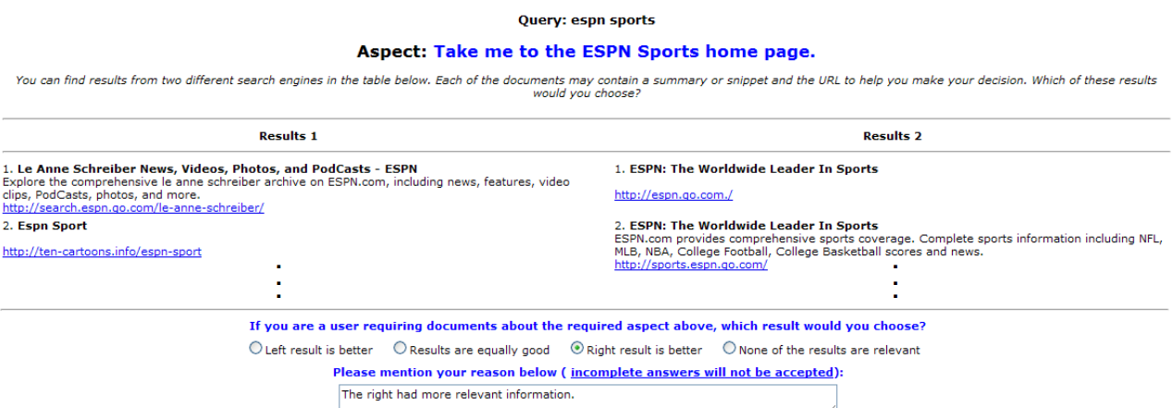
Experiment settings
IR systems
  19 runs of submissions to the TREC evaluation
Users need to make side-by-side comparison to give their preferences over the ranking results

Slide 7
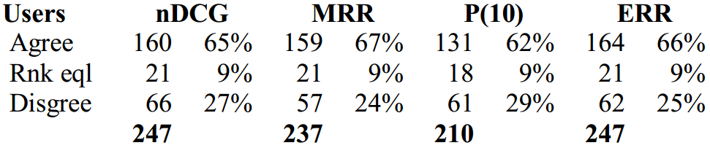
Experimental results
User preferences v.s., retrieval metrics
  Metrics generally match users’ preferences, no significant differences between metrics

Slide 8
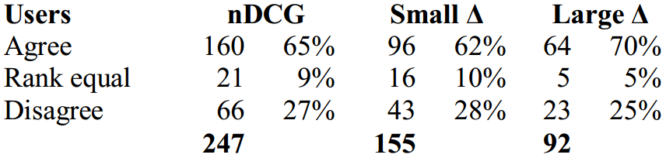
Experimental results
Zoom into nDCG
  Separate the comparison into groups of small differences and large differences
  Users tend to agree more when the difference between the ranking results is large
Compare to mean difference

Slide 9
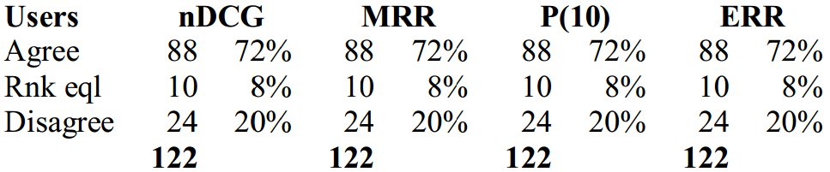
Experimental results
What if when one system did not retrieve anything relevant
  All metrics tell the same and mostly align with the users

Slide 10
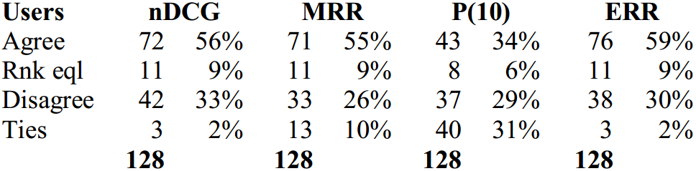
Experimental results
What if when both systems retrieved something relevant at top positions
  P@10 cannot distinguish the difference between systems

Slide 11
Conclusions of this study
IR evaluation metrics measured on a test collection predicted user preferences for one IR system over another
The correlation is strong when the performance difference is large
Effectiveness of different metrics vary

Slide 12
How does clickthrough data reflect retrieval quality ^{[Radlinski CIKM’08]}
User behavior oriented retrieval evaluation
  Low cost
  Large scale
  Natural usage context and utility
Common practice in modern search engine systems
  A/B test

Slide 13
A/B test
Two-sample hypothesis testing
  Two versions (A and B) are compared, which are identical except for one variation that might affect a user's behavior
    E.g., indexing with or without stemming
  Randomized experiment
    Separate the population into equal size groups
      10% random users for system A and 10% random users for system B
    Null hypothesis: no difference between system A and B
      Z-test, t-test

Slide 14
Behavior-based metrics
Abandonment Rate
  Fraction of queries for which no results were clicked on
Reformulation Rate
  Fraction of queries that were followed by another query during the same session
Queries per Session
  Mean number of queries issued by a user during a session

Slide 15
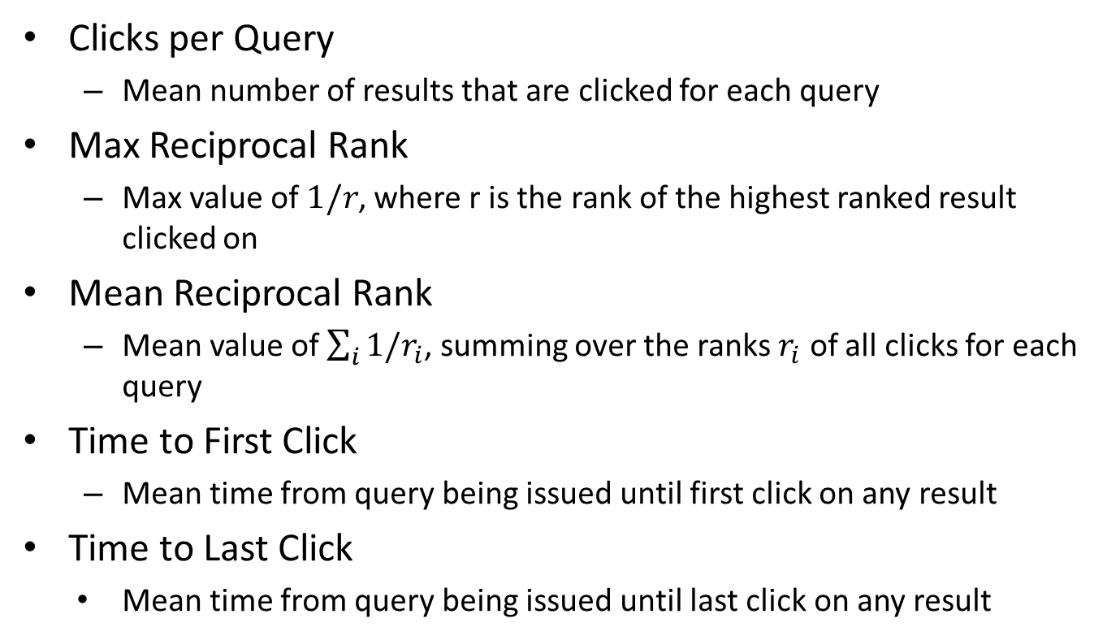
Behavior-based metrics
Clicks per Query
  Mean number of results that are clicked for each query
Max Reciprocal Rank
  Max value of $1/r$, where r is the rank of the highest ranked result clicked on
Mean Reciprocal Rank
  Mean value of $\sum_{i}{1/r_{i}}$, summing over the ranks $r_{i}$ of all clicks for each query
Time to First Click
  Mean time from query being issued until first click on any result
Time to Last Click
    Mean time from query being issued until last click on any result

Slide 16
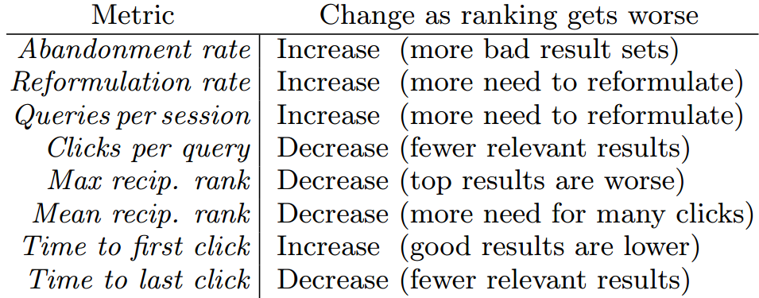
Behavior-based metrics
When search results become worse:

Slide 17
Experiment setup
Philosophy
  Given systems with known relative ranking performance
  Test which metric can recognize such difference
Reverse thinking of hypothesis testing
In hypothesis testing, we choose system by test statistics
In this study, we choose test statistics by systems

Slide 18
Constructing comparison systems
Orig > Flat > Rand
  Orig: original ranking algorithm from arXiv.org
  Flat: remove structure features (known to be important) in original ranking algorithm
  Rand: random shuffle of Flat’s results
Orig > Swap2 > Swap4
  Swap2: randomly selects two documents from top 5 and swaps them with two random documents from rank 6 through 10 (the same for next page)
  Swap4: similar to Swap2, but select four documents for swap

Slide 19
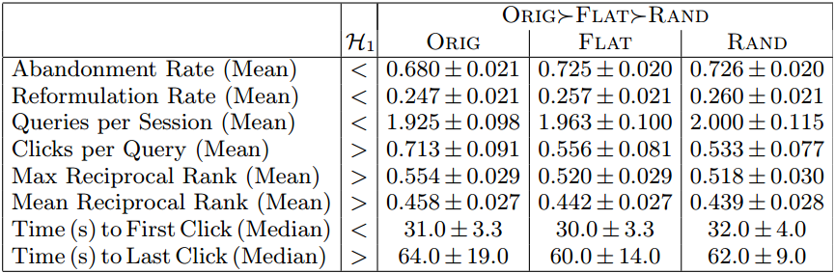
Result for A/B test
1/6 users of arXiv.org are routed to each of the testing systems in one month period

Slide 20
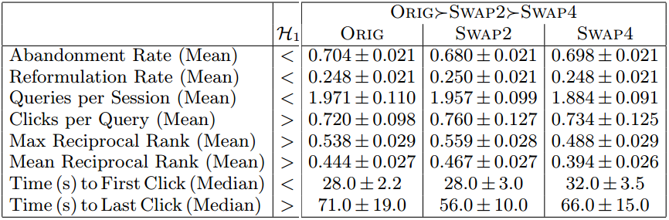
Result for A/B test
1/6 users of arXiv.org are routed to each of the testing systems in one month period

Slide 21
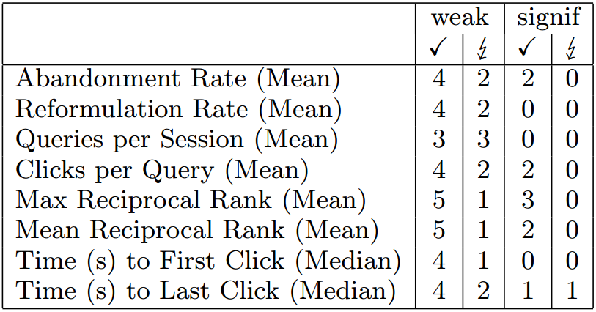
Result for A/B test
Few of such comparisons are significant

Slide 22
Interleave test
Design principle from sensory analysis
  Instead of asking for absolute ratings, ask for relative comparison between alternatives
    E.g., is A better than B?
  Randomized experiment
    Interleave results from both A and B
    Giving interleaved results to the same population and ask for their preference
    Hypothesis test over preference votes

Slide 23
Coke v.s. Pepsi
Market research
  Do customers prefer coke over pepsi, or they do not have any preference
  Option 1: A/B Testing
    Randomly find two groups of customers and give coke to one group and pepsi to another, and ask them if they like the given beverage
  Option 2: Interleaved test
    Randomly find a group of users and give them both coke and pepsi, and ask them which one they prefer

Slide 24
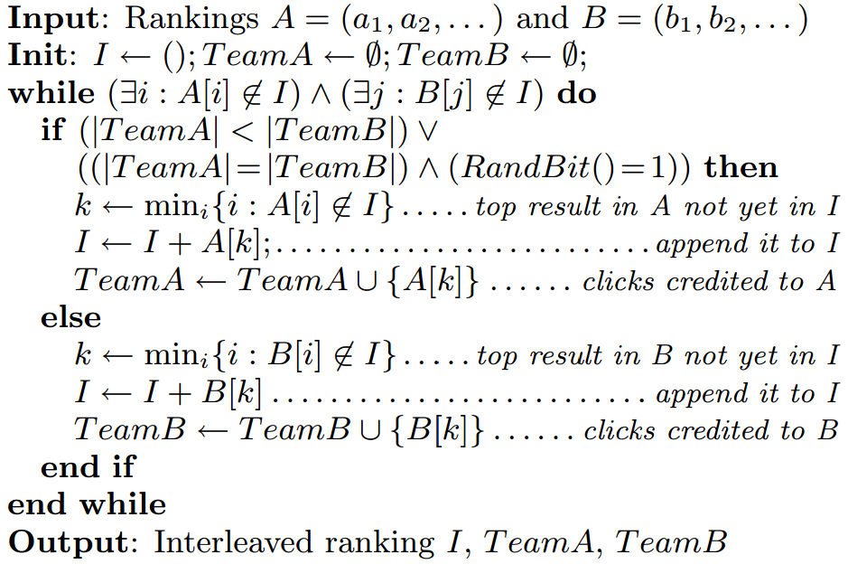
Interleave for IR evaluation
Team-draft interleaving

Slide 25
Interleave for IR evaluation
Team-draft interleaving
Ranking A:
2
3
1
4
5
7
8
6
Ranking B:
1
2
5
3
6
8
7
4
1
1
RND =
0
Interleaved ranking
1
2
3
5
4
6

Slide 26
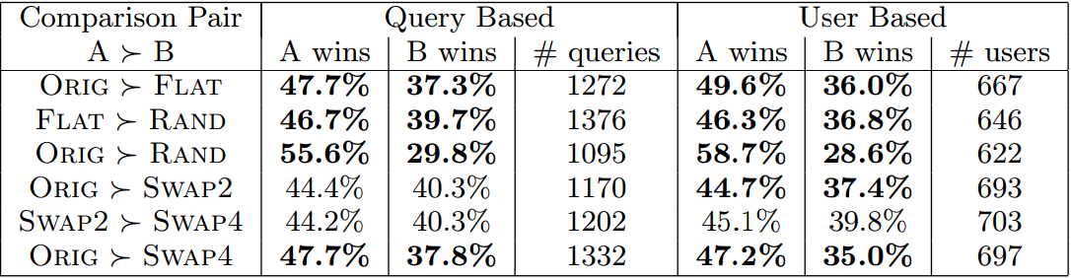
Result for interleaved test
1/6 users of arXiv.org are routed to each of the testing systems in a one month period
  Test which group receives more clicks

Slide 27
Conclusion
Interleaved test is more accurate and sensitive
  9 out of 12 experiments follow our expectation
Only click count is utilized in this interleaved test
  More aspects can be evaluated
    E.g., dwell-time, reciprocal rank, if leads to download, is last click, is first click
Interleave more than two systems for comparison

Slide 28
Welcome back
We will start our discussion at 2pm
sli.do event code: 654588
MP2 will be official from tonight
Please start thinking about our literature survey task for graduate students

Slide 29
Recap: do user preferences and evaluation measures line up? ^{[Sanderson et al. SIGIR’10]}
IR evaluation metrics measured on a test collection predicted user preferences for one IR system over another
The correlation is strong when the performance difference is large
Effectiveness of different metrics vary

Slide 30
Recap: how does clickthrough data reflect retrieval quality ^{[Radlinski CIKM’08]}
Interleaved test is more accurate and sensitive
  9 out of 12 experiments follow our expectation
Only click count is utilized in this interleaved test
  More aspects can be evaluated
    E.g., dwell-time, reciprocal rank, if leads to download, is last click, is first click
Interleave more than two systems for comparison

Slide 31
Comparing the sensitivity of information retrieval metrics [Radlinski & Craswell, SIGIR’10]
How sensitive are those IR evaluation metrics?
  How many queries do we need to get a confident comparison result?
  How quickly can it recognize the difference between different IR systems?

Slide 32
Experiment setup
IR systems with known search effectiveness
Large set of annotated corpus
  12k queries
  Each retrieved document is labeled into 5-grade level
Large collection of real users’ clicks from a major commercial search engine
Approach
  Gradually increase evaluation query size to investigate the conclusion of metrics

Slide 33
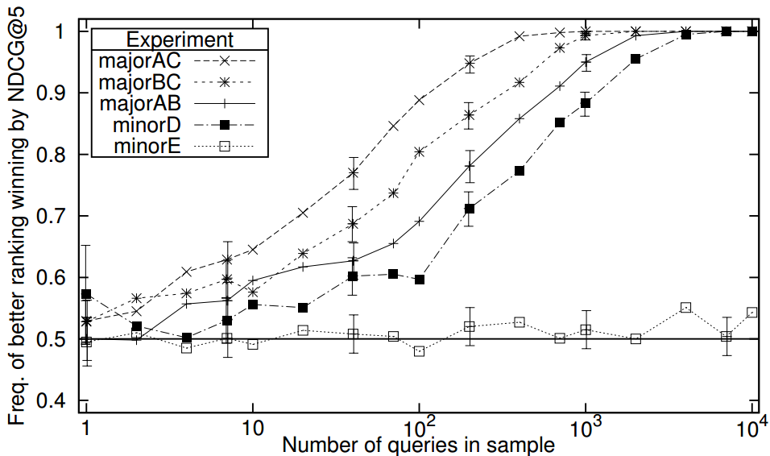
Sensitivity of NDCG@5
System effectiveness: A>B>C

Slide 34
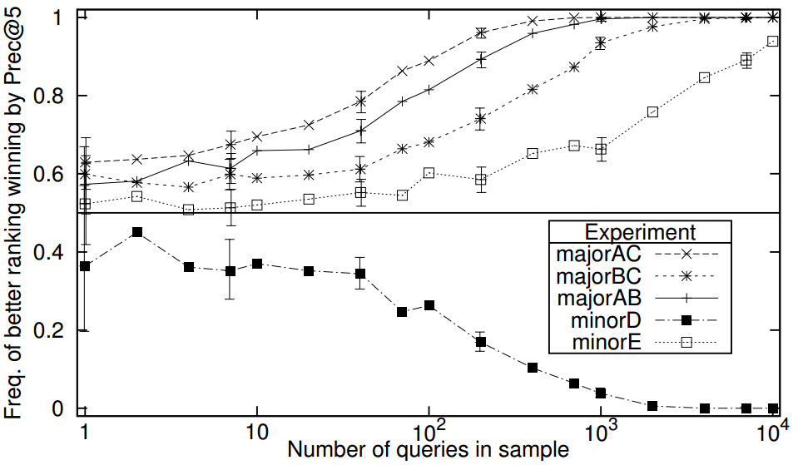
Sensitivity of P@5
System effectiveness: A>B>C

Slide 35
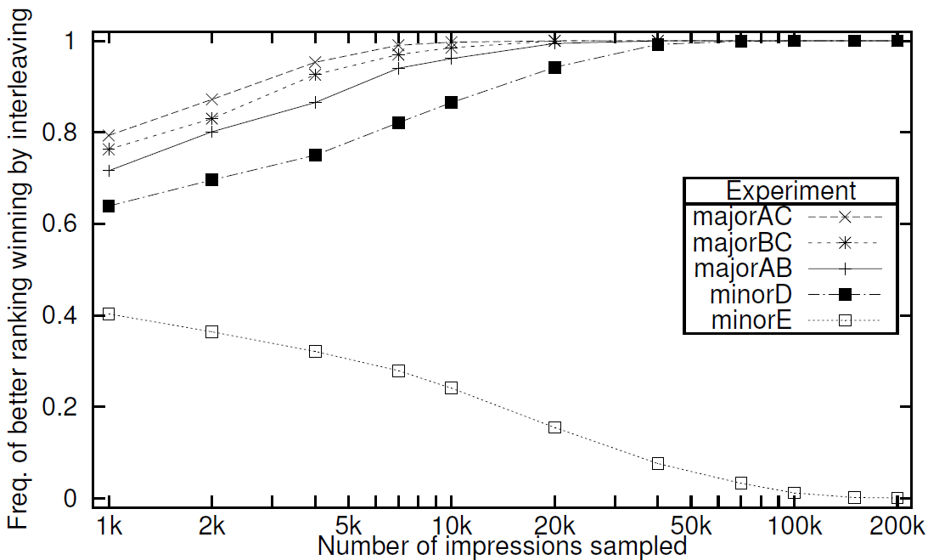
Sensitivity of interleaving

Slide 36
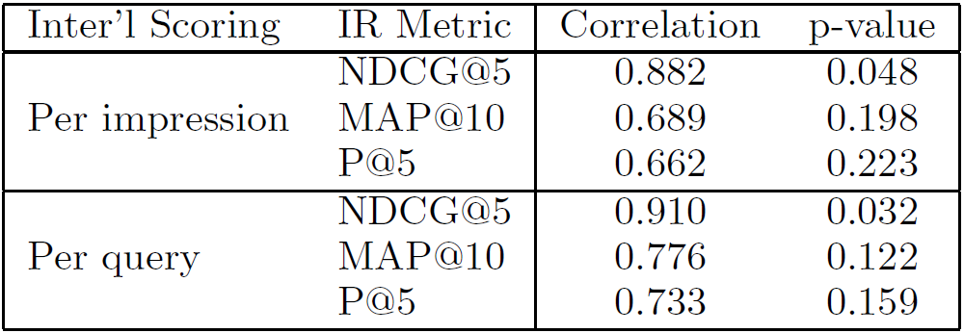
Correlation between IR metrics and interleaving

Slide 37
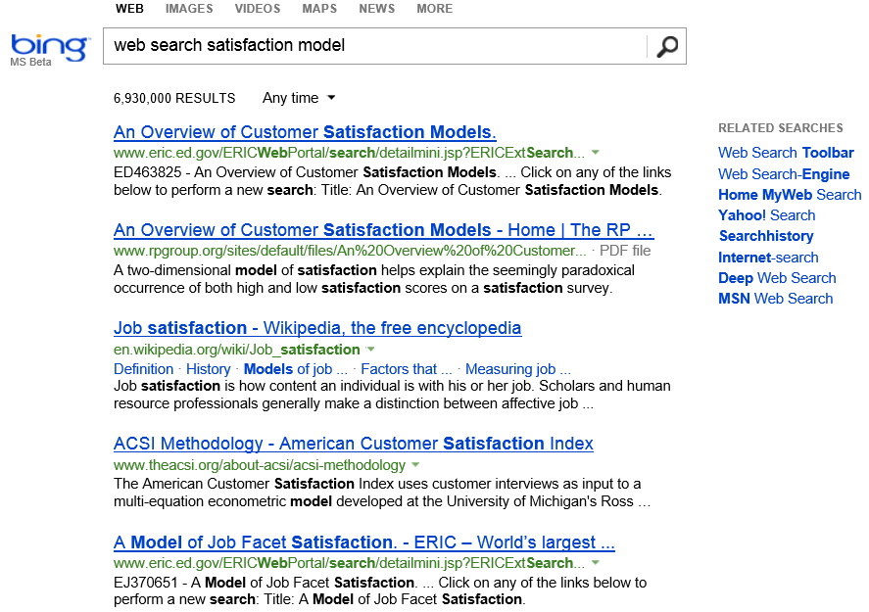
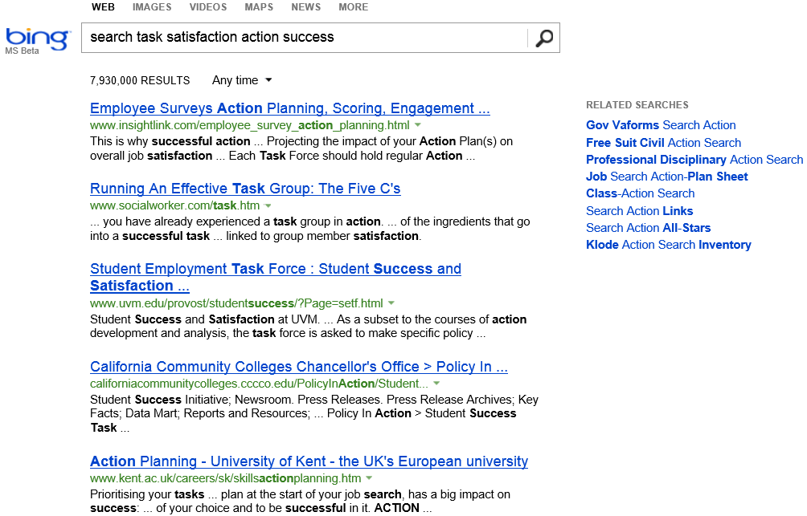
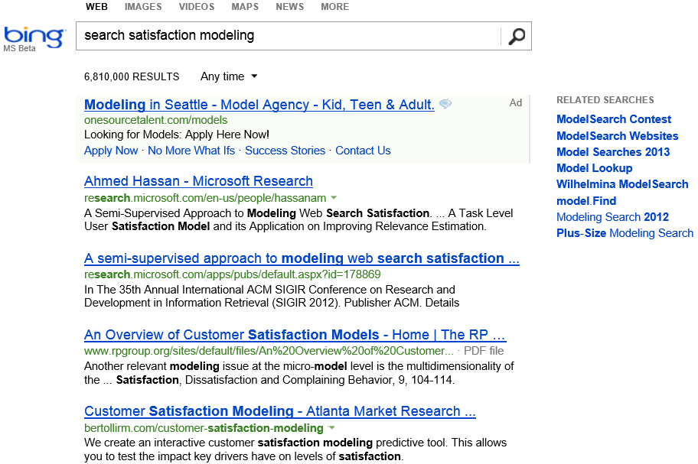





How to assess search result quality?
Query-level relevance evaluation
  Metrics: MAP, NDCG, MRR, CTR
Task-level satisfaction evaluation
  Users’ satisfaction of the whole search task
Goal: find existing work for “action-level search satisfaction prediction”
Notes:
Accurately assessing users' satisfaction of a search engine's output is of particular importance in retrieval system development. Classical IR studies focus on query-based evaluations, where the focus is to evaluate the relevance quality of the returned documents for a given query.
However, such query-centric evaluation can hardly capture the holistic utility of a search engine in supporting the users to perform a complex search task, e.g., survey a research topic, where a series of queries have to be issued to fulfill the same information need.
Measuring search engine performance via behavioral indicators of search satisfaction has recently received considerable attention. In comparison with traditional relevance-based evaluations, such methods enable evaluation using real user populations, in naturalistic settings, and across a diverse set of information needs.

Slide 38
Example of search task
Information need: find out what metal can float on water
Search Actions | Engine | Time
Q: metals float on water | Google | 10s
SR: wiki.answers.com |  | 2s
BR: blog.sciseek.com |  | 3s
Q: which metals float on water | Google | 31s
Q: metals floating on water | Google | 16s
SR: www.blurtit.com |  | 5s
Q: metals floating on water | Bing | 53s
Q: lithium sodium potassium float on water | Google | 38s
SR: www.docbrown.info |  | 15s
quick back
query reformulation
search engine switch

Slide 39
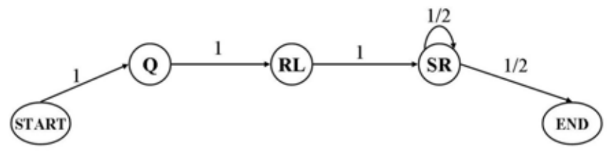
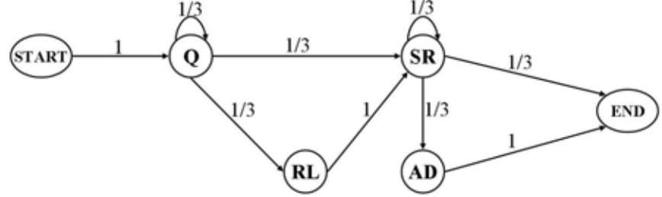
Beyond DCG: User Behavior as a Predictor of a Successful Search ^{[Ahmed et al. WSDM’10]}
Modeling users’ sequential search behaviors with Markov models
  A model for successful search patterns
  A model for unsuccessful search patterns
ML for parameter estimation on annotated data set

Slide 40
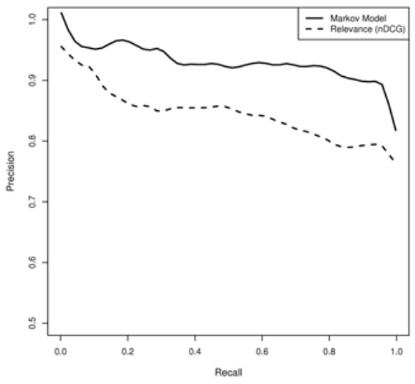

Predict user satisfaction
Choose the model that better explains users’ search behavior
  $P\left(S=1 | B\right)=\frac{P\left(B | S=1\right)p\left(S=1\right)}{P\left(B | S=1\right)p\left(S=1\right)+P\left(B | S=0\right)p\left(S=0\right)}$
Likelihood: how well the model explains users’ behavior
Prior: difficulty of this task, or users’ expertise of search
Prediction performance for search task satisfaction

Slide 41
What you should know
IR evaluation metrics generally align with users’ result preferences
A/B test v.s. interleaved test
Sensitivity of evaluation metrics
Direct evaluation of search satisfaction

