Slide 1
Learning to Rank from heuristics to theoretic approaches
Hongning Wang

Slide 2
Congratulations
Job Offer from Bing Core Ranking team
Design the ranking module for Bing.com

Slide 3
How should I rank documents?
Answer: Rank by relevance!

Slide 4
Relevance ?!

Slide 5
The Notion of Relevance
Relevance constraints
[Fang et al. 04]
Relevance
Div. from Randomness
(Amati & Rijsbergen 02)
Δ(Rep(q), Rep(d))
Similarity
P(r=1|q,d) r ∈{0,1}
Probability of Relevance
P(d →q) or P(q →d)
Probabilistic inference
Regression
Model (Fuhr 89)
Generative
Model
Different
inference system
Different
rep & similarity
Learn. To Rank
(Joachims 02,
Berges et al. 05)
Doc
generation
Query
generation
…
Prob. concept
space model
(Wong & Yao, 95)
Inference
network
model
(Turtle & Croft, 91)
Vector space
model
(Salton et al., 75)
Prob. distr.
model
(Wong & Yao, 89)
Classical
prob. Model
(Robertson &
Sparck Jones, 76)
LM
approach
(Ponte & Croft, 98)
(Lafferty & Zhai, 01a)

Slide 6
Relevance Estimation
Query matching
Language model
BM25
Vector space cosine similarity
Document importance
PageRank
HITS

Slide 7
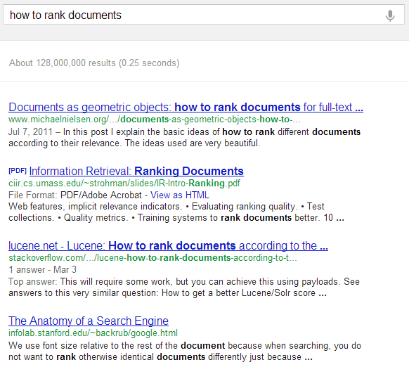
Did I do a good job of ranking documents?
PageRank
BM25

Slide 8
Did I do a good job of ranking documents?
IR evaluation metrics
Precision@K
MAP
NDCG

Slide 9
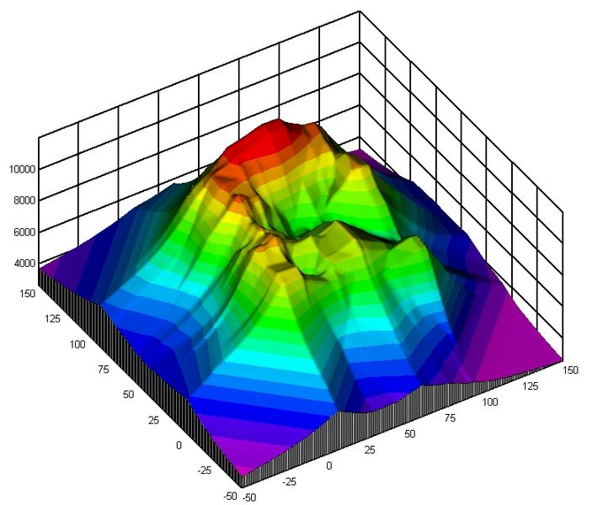
Take advantage of different relevance estimator?
Ensemble the cues
Linear?
Non-linear?
Decision tree-like
$$a_{1}×BM25+α_{2}×LM+α_{3}×PageRank+α_{4}×HITS$$
$${\{α}_{1}=0.4, α_{2}=0.2,α_{3}=0.1,α_{4}=0.1\}→\{MAP=0.20, NDCG=0.6\}$$
${\{α}_{1}=0.2, α_{2}=0.2,α_{3}=0.3,α_{4}=0.1\}→\{MAP=0.12, NDCG=0.5$ }
BM25>0.5
$${\{α}_{1}=0.1, α_{2}=0.1,α_{3}=0.5,α_{4}=0.2\}→\{MAP=0.18, NDCG=0.7\}$$
True
False
LM > 0.1
PageRank > 0.3
True
False
True
False
r= 1.0
r= 0.7
r= 0.4
r= 0.1

Slide 10
What if we have thousands of features?
Is there any way I can do better?
Optimize the metrics automatically!
Where to find those tree structures?
How to determine those $α$s?

Slide 11
Rethink the task
Given: (query, document) pairs represented by a set of relevance estimators, a.k.a., features
Needed: a way of combining the estimators
$f\left(q,{\left\{d\right\}}_{i=1}^{D}\right)→$ordered ${\left\{d\right\}}_{i=1}^{D}$
Criterion: optimize IR metrics
P@k, MAP, NDCG, etc.
DocID | BM25 | LM | PageRank | Label
0001 | 1.6 | 1.1 | 0.9 | 0
0002 | 2.7 | 1.9 | 0.2 | 1
Key!

Slide 12
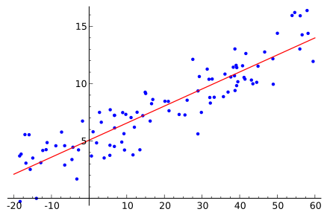
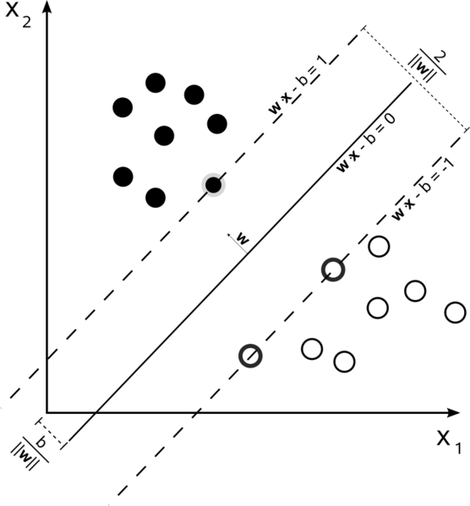
Machine Learning
M
Input: $\{\left(X_{1},Y_{1}\right),\left(X_{2},Y_{2}\right),…,(X_{n},Y_{n})\}$, where $X_{i}∈R^{N},Y_{i}∈R^{M}$
Objective function : $O(Y^{′}, Y)$
Output: $f\left(X\right)→Y$, such that $f={argmax}_{f^{′}⊂F}O(f^{′}(X),Y)$
NOTE: We will only talk about supervised learning.
Classification
Regression
$$O\left(Y^{′},Y\right)=δ(Y^{′}=Y)$$
$$O\left(Y^{′},Y\right)=−||Y^{′}−Y||$$
http://en.wikipedia.org/wiki/Statistical_classification
http://en.wikipedia.org/wiki/Regression_analysis

Slide 13
Learning to Rank
General solution in optimization framework
Input: $\left\{\left({(q_{i},d}_{1}),y_{1}\right),\left({(q_{i},d}_{2}),y_{2}\right),…,\left({(q_{i},d}_{n}),y_{n}\right)\right\}$, where $d_{n}∈R^{N},y_{i}∈\{0,…,L\}$
Objective: O = {P@k, MAP, NDCG}
Output: $f\left(q,d\right)→Y$, s.t., $f={argmax}_{f^{′}⊂F}O(f^{′}(q,d),Y)$
DocID | BM25 | LM | PageRank | Label
0001 | 1.6 | 1.1 | 0.9 | 0
0002 | 2.7 | 1.9 | 0.2 | 1

Slide 14
Challenge: how to optimize?
Evaluation metric recap
Average Precision
DCG
Order is essential!
$f→$ order $→$metric
Not continuous with respect to f(X)!

Slide 15
Approximate the objective function!
Pointwise
Fit the relevance labels individually
Pairwise
Fit the relative orders
Listwise
Fit the whole order

Slide 16
Pointwise Learning to Rank
Ideally perfect relevance prediction leads to perfect ranking
$f→$ score $→$order $→$metric
Reducing ranking problem to
Regression
$O\left(f\left(Q,D\right),Y\right)=−\sum_{i}{\left||f\left(q_{i},d_{i}\right)−y_{i}\right|| }$
Subset Ranking using Regression, D.Cossock and T.Zhang, COLT 2006
(multi-)Classification
$O\left(f\left(Q,D\right),Y\right)=\sum_{i}{δ(f\left(q_{i},d_{i}\right)=y_{i}) }$
Ranking with Large Margin Principles, A. Shashua and A. Levin, NIPS 2002

Slide 17
Subset Ranking using Regression D.Cossock and T.Zhang, COLT 2006
Fit relevance labels via regression
Emphasize more on relevant documents
Weights on each document
Most positive document
http://en.wikipedia.org/wiki/Regression_analysis

Slide 18
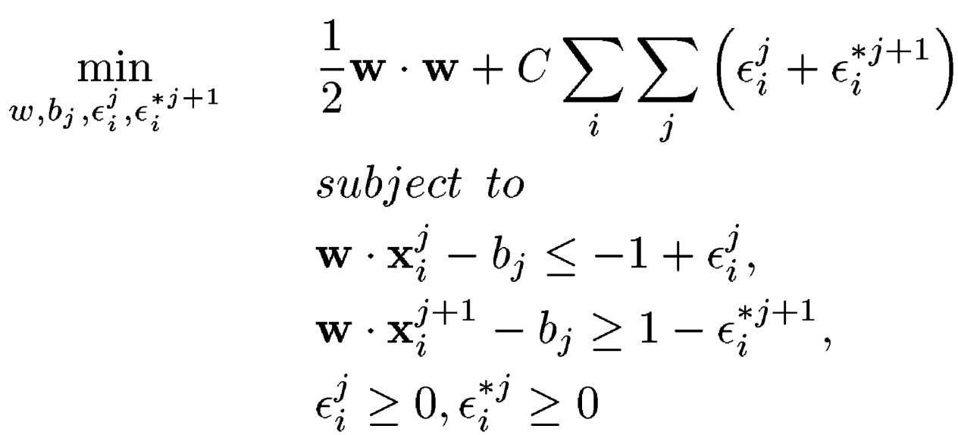
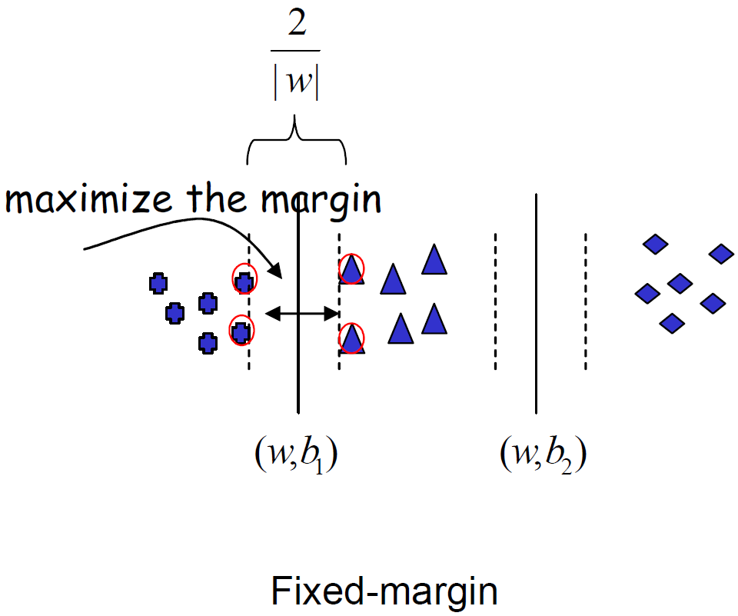
Ranking with Large Margin Principles A. Shashua and A. Levin, NIPS 2002
Goal: correctly place the documents in the corresponding category and maximize the margin
Y=1
Reduce the violations
Y=0
Y=2
$$αs$$

Slide 19
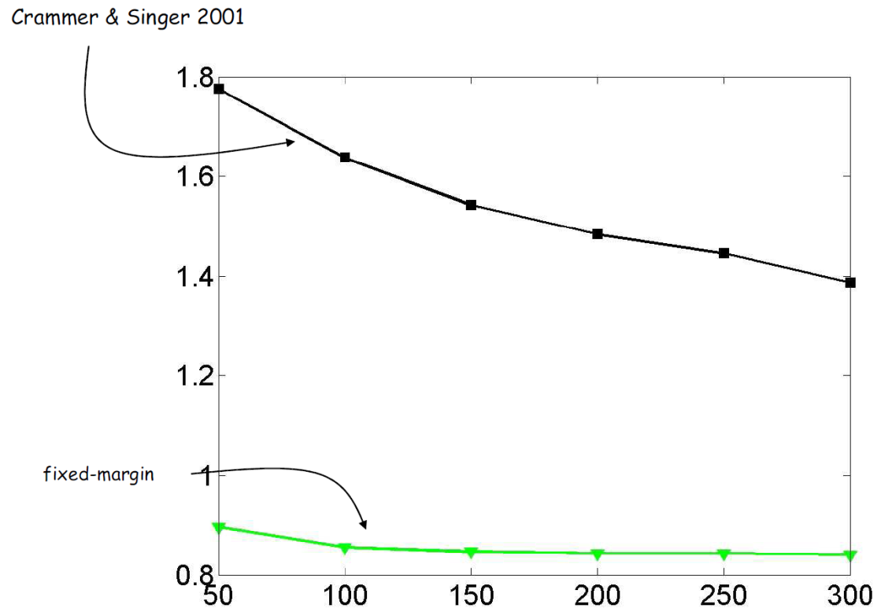
Ranking with Large Margin Principles A. Shashua and A. Levin, NIPS 2002
Ranking lost is consistently decreasing with more training data

Slide 20
What did we learn
Machine learning helps!
Derive something optimizable
More efficient and guided

Slide 21
Deficiencies
Cannot directly optimize IR metrics
(0 $→$ 1, 2 $→$ 0) worse than (0 $→$-2, 2 $→$4)
Position of documents are ignored
Penalty on documents at higher positions should be larger
Favor the queries with more documents
2
1
$$d_{1}^{′′}$$
$$d_{2}^{}$$
0
-1
$$d_{1}^{}$$
-2
$$d_{1}^{′}$$

Slide 22
Pairwise Learning to Rank
Ideally perfect partial order leads to perfect ranking
$f→$ partial order $→$order $→$metric
Ordinal regression
$O\left(f\left(Q,D\right),Y\right)=\sum_{i≠j}{δ(y_{i}>y_{j})δ(f\left(q_{i},d_{i}\right)<f(q_{i},d_{i})) }$
Relative ordering between different documents is significant
E.g., (0 $→$-2, 2 $→$4) is better than (0 $→$ 1, 2 $→$ 0)
Large body of research
2
1
$$d_{1}^{′′}$$
0
$$d_{2}^{}$$
-1
$$d_{1}^{}$$
-2
$$d_{1}^{′}$$

Slide 23
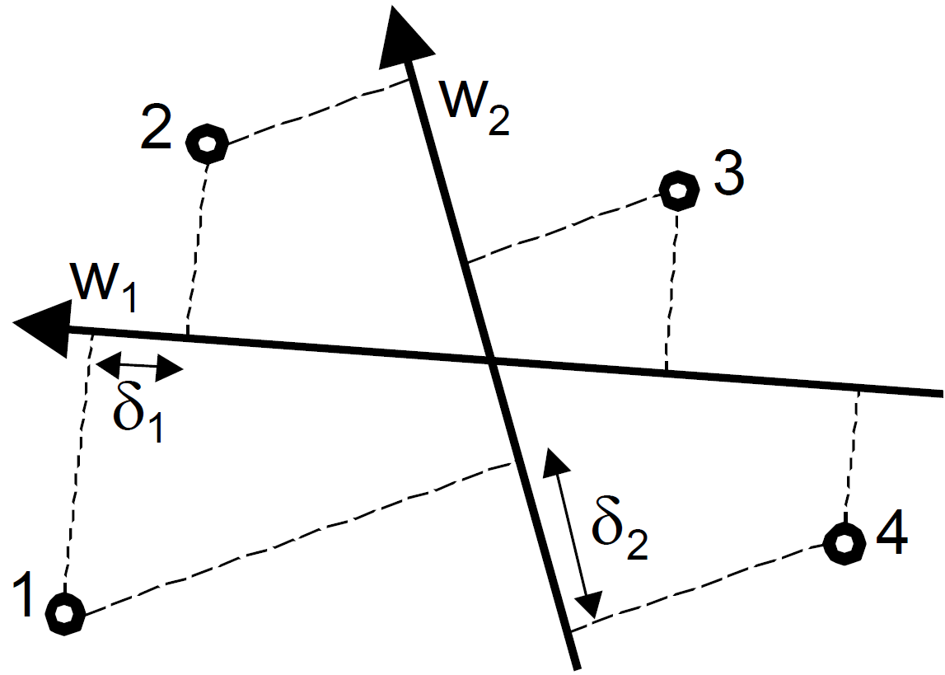
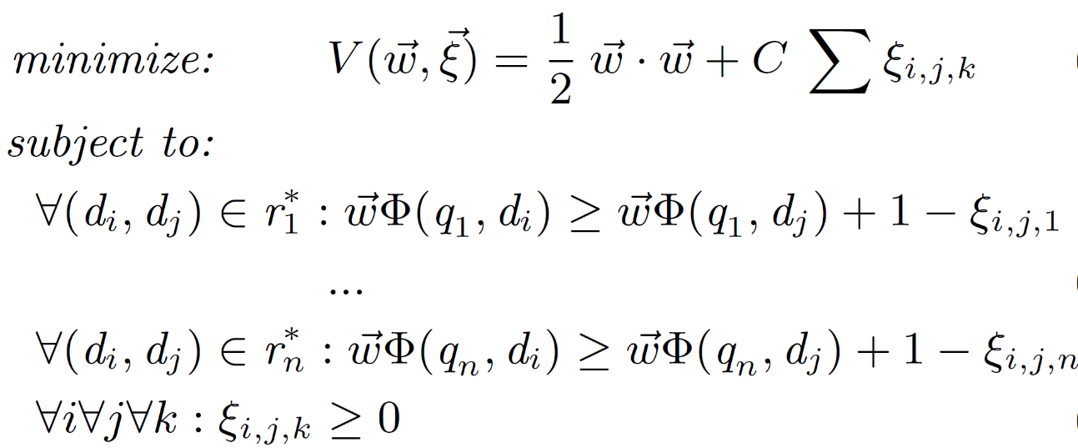
Optimizing Search Engines using Clickthrough Data Thorsten Joachims, KDD’02
Minimizing the number of mis-ordered pairs
linear combination of features
$y_{1}>y_{2}, y_{2}>y_{3} ,y_{1}>y_{4}$
$$y_{1}>y_{2}$$
$$f\left(q,d\right)=w^{T}X_{q,d}$$
1
0
RankSVM
Keep the relative orders

Slide 24
Optimizing Search Engines using Clickthrough Data Thorsten Joachims, KDD’02
How to use it?
$f→$ s$core→$order
$y_{1}>y_{2}>y_{3} >y_{4}$

Slide 25
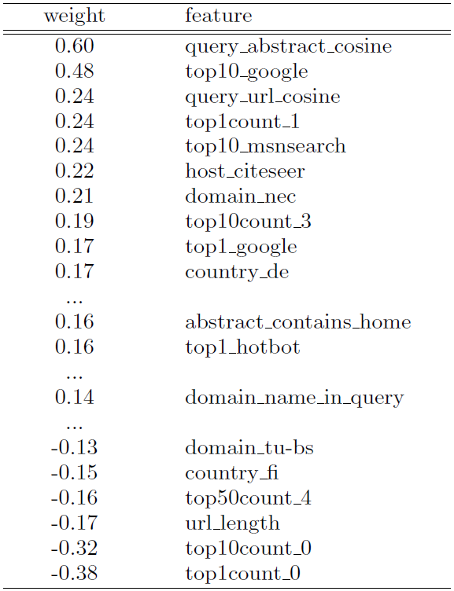
Optimizing Search Engines using Clickthrough Data Thorsten Joachims, KDD’02
What did it learn from the data?
Linear correlations
Positively correlated features
Negatively correlated features

Slide 26
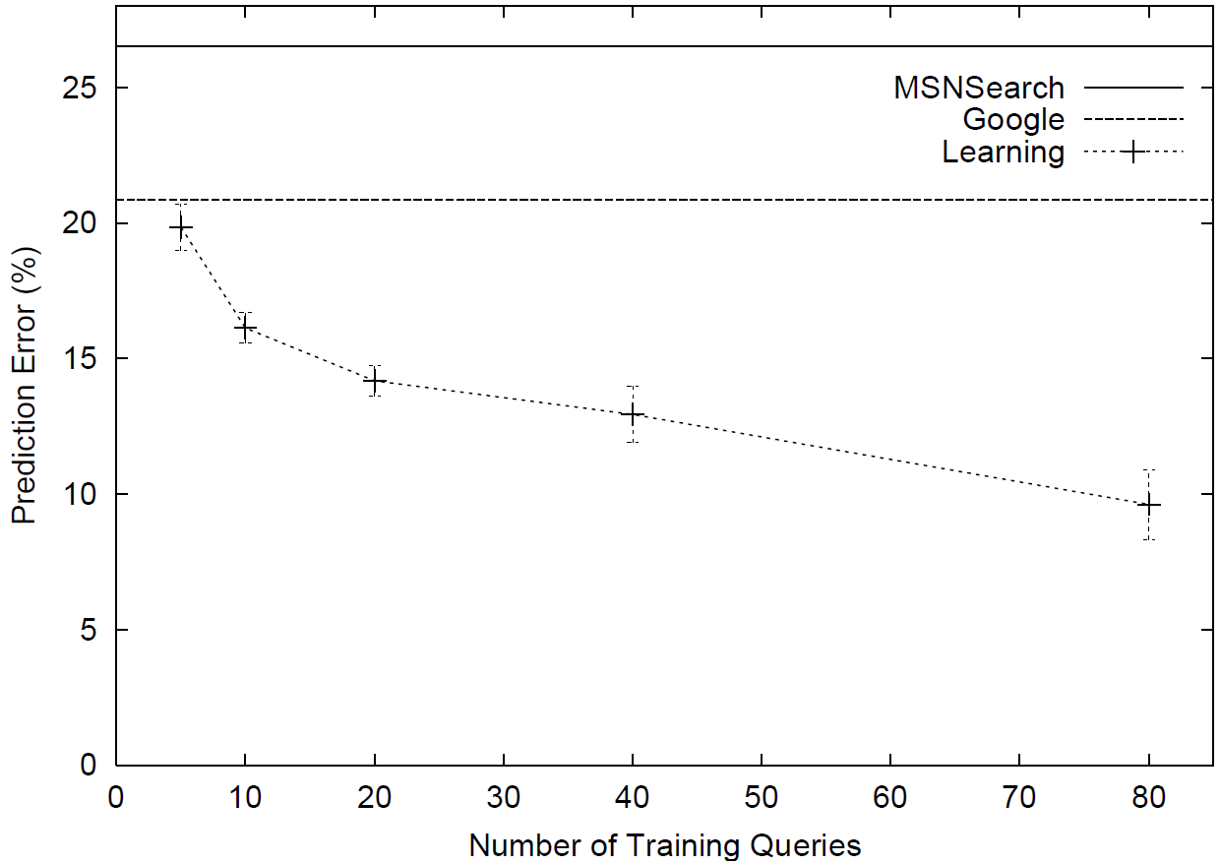
Optimizing Search Engines using Clickthrough Data Thorsten Joachims, KDD’02
How good is it?
Test on real system

Slide 27
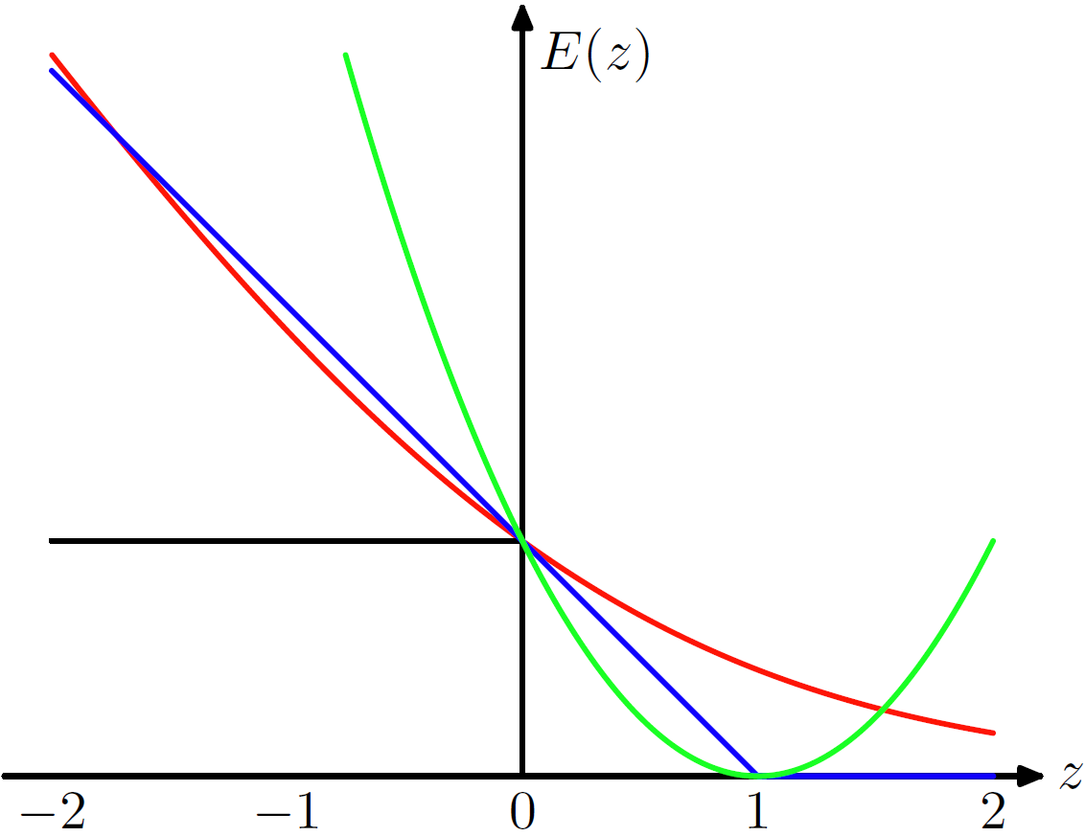
An Efﬁcient Boosting Algorithm for Combining Preferences Y. Freund, R. Iyer, et al. JMLR 2003
Smooth the loss on mis-ordered pairs
$\sum_{y_{i}>y_{j}}{Pr\left(d_{i}, d_{j}\right)\exp{[f\left(q,d_{j}\right)−f\left(q,d_{i}\right)]}}$
square loss
hinge loss (RankSVM)
0/1 loss
exponential loss
from Pattern Recognition and Machine Learning, P337

Slide 28
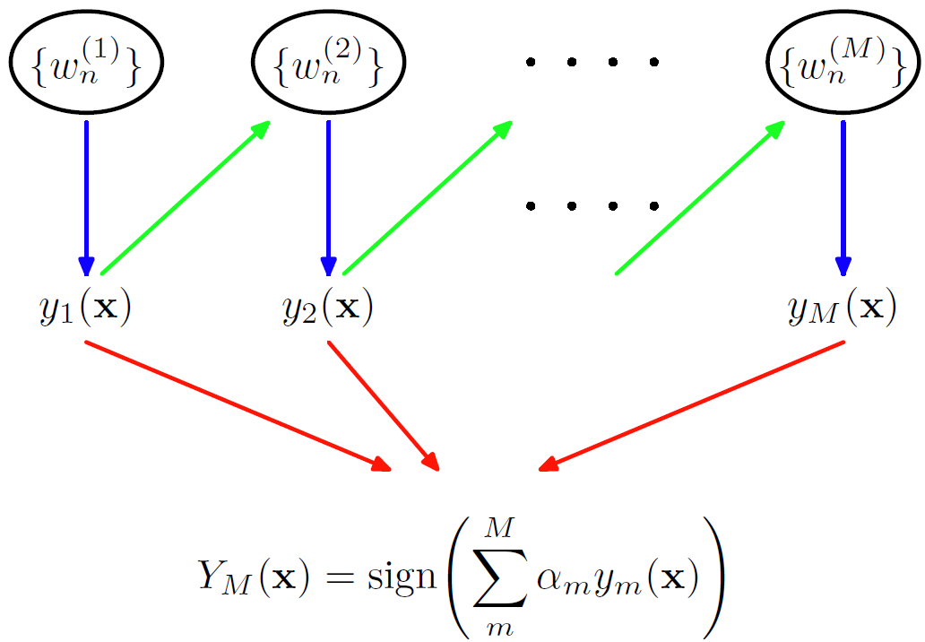
An Efﬁcient Boosting Algorithm for Combining Preferences Y. Freund, R. Iyer, et al. JMLR 2003
RankBoost: optimize via boosting
Vote by a committee
BM25
PageRank
Cosine
Updating $Pr⁡(d_{i},d_{j})$
Credibility of each committee member (ranking feature)
from Pattern Recognition and Machine Learning, P658

Slide 29
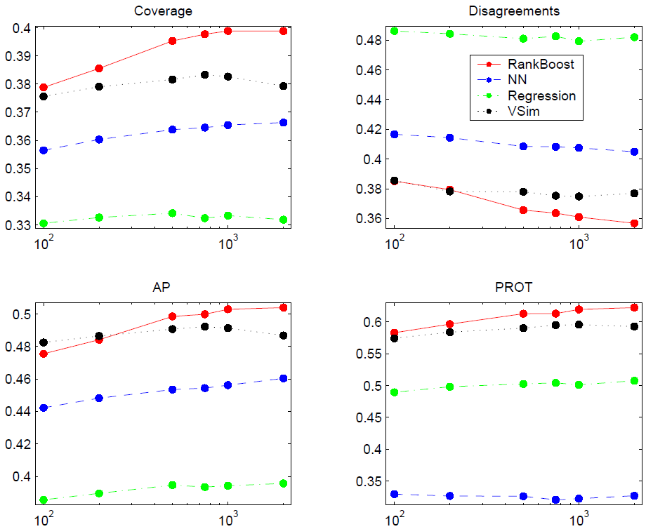
An Efﬁcient Boosting Algorithm for Combining Preferences Y. Freund, R. Iyer, et al. JMLR 2003
How good is it?

Slide 30
A Regression Framework for Learning Ranking Functions Using Relative Relevance Judgments Zheng et al. SIRIG’07
Non-linear ensemble of features
Object: $\sum_{y_{i}>y_{j}}{{\left(\max\left\{0,f\left(q,d_{j}\right)−f\left(q,d_{i}\right)\right\}\right)}^{2}}$
Gradient descent boosting tree
Boosting tree
Using regression tree to minimize the residuals
$r^{t}(q,d,y)=O^{t}(q,d,y)−f^{\left(t−1\right)}(q,d,y)$
BM25>0.5
True
False
LM > 0.1
PageRank > 0.3
True
False
True
False
r= 1.0
r= 0.7
r= 0.4
r= 0.1

Slide 31
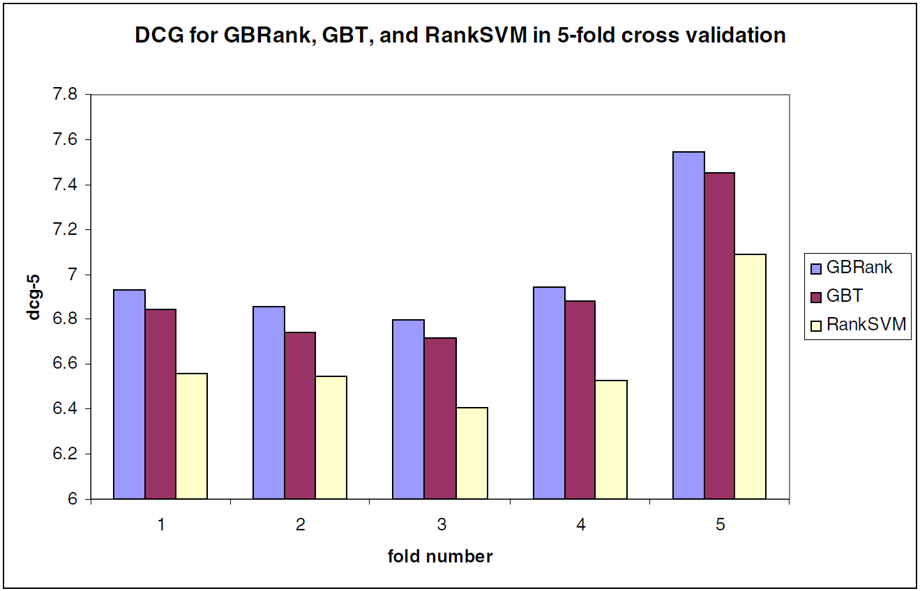
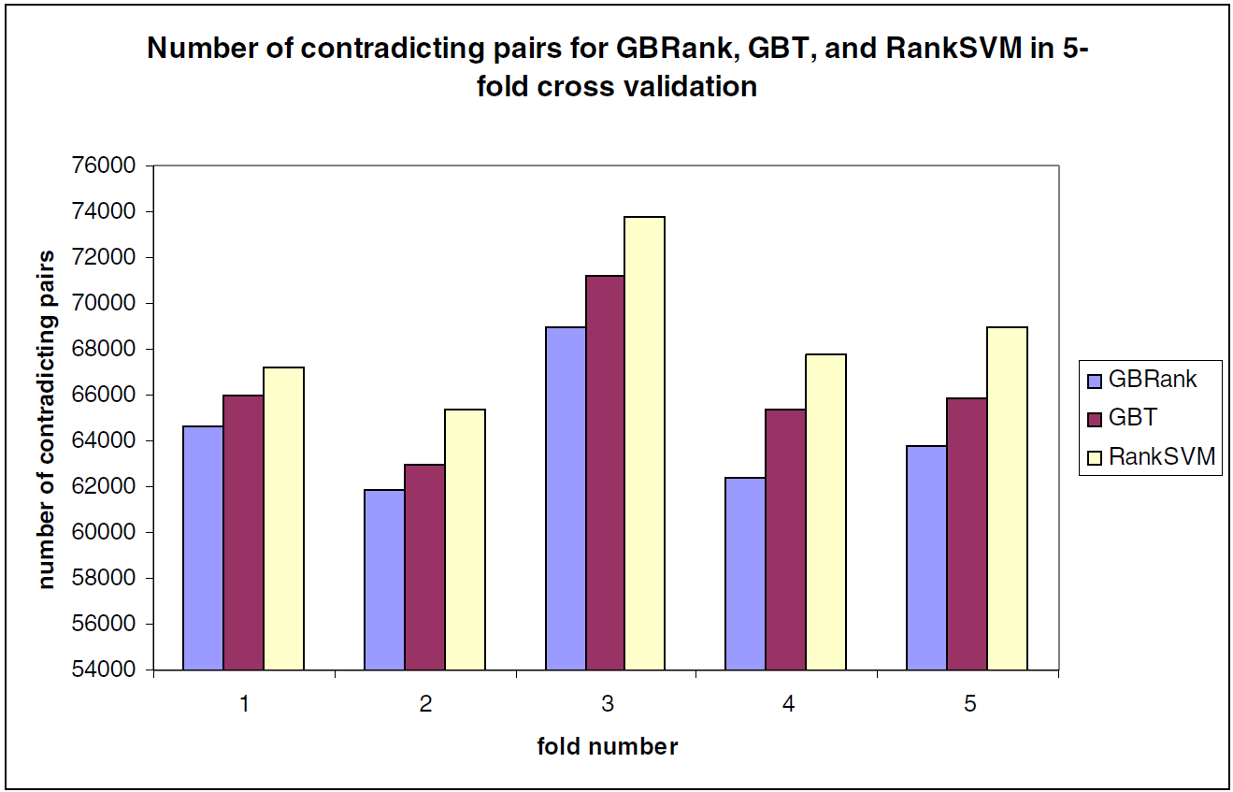
A Regression Framework for Learning Ranking Functions Using Relative Relevance Judgments Zheng et al. SIRIG’07
Non-linear v.s. linear
Comparing with RankSVM

Slide 32
Where do we get the relative orders
Human annotations
Small scale, expensive to acquire
Clickthroughs
Large amount, easy to acquire

Slide 33
What did we learn
Predicting relative order
Getting closer to the nature of ranking
Promising performance in practice
Pairwise preferences from click-throughs

Slide 34
Listwise Learning to Rank
Can we directly optimize the ranking?
$f→$ order $→$metric
Tackle the challenge
Optimization without gradient

Slide 35
From RankNet to LambdaRank to LambdaMART: An Overview Christopher J.C. Burges, 2010
Minimizing mis-ordered pair => maximizing IR metrics?
Mis-ordered pairs: 6
Mis-ordered pairs: 4
AP: $\frac{5}{8}$
AP: $\frac{5}{12}$
DCG: $1.333$
DCG: $0.931$
Position is crucial!

Slide 36
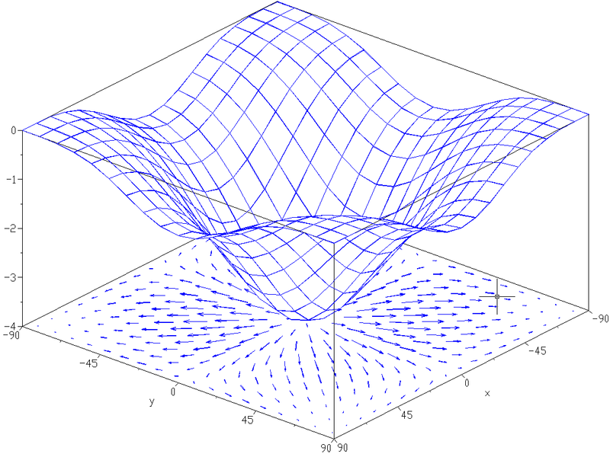
From RankNet to LambdaRank to LambdaMART: An Overview Christopher J.C. Burges, 2010
Weight the mis-ordered pairs?
Some pairs are more important to be placed in the right order
Inject into object function
$\sum_{y_{i}>y_{j}}{Ω\left(d_{i}, d_{j}\right)\exp\left(−wΔΦ \left(q_{n},d_{i}, d_{j}\right)\right)}$
Inject into gradient
$λ_{ij}=\frac{∂O_{appro}}{∂w}ΔO$
Depend on the ranking of document i, j in the whole list
Change in original object, e.g., NDCG, if we switch the documents i and j, leaving the other documents unchanged
Gradient with respect to approximated objective, i.e., exponential loss on mis-ordered pairs

Slide 37
From RankNet to LambdaRank to LambdaMART: An Overview Christopher J.C. Burges, 2010
Lambda functions
Gradient?
Yes, it meets the sufficient and necessary condition of being partial derivative
Lead to optimal solution of original problem?
Empirically

Slide 38
From RankNet to LambdaRank to LambdaMART: An Overview Christopher J.C. Burges, 2010
Evolution
 | RankNet | LambdaRank | LambdaMART
Objective | Cross entropy over the pairs | Unknown | Unknown
Gradient ($λ$ function) | Gradient of cross entropy | Gradient of cross entropy times pairwise change in target metric | Gradient of cross entropy times pairwise change in target metric
Optimization method | neural network | stochastic gradient descent | Multiple Additive Regression Trees (MART)
As we discussed in RankBoost
Optimize solely by gradient
Non-linear combination

Slide 39
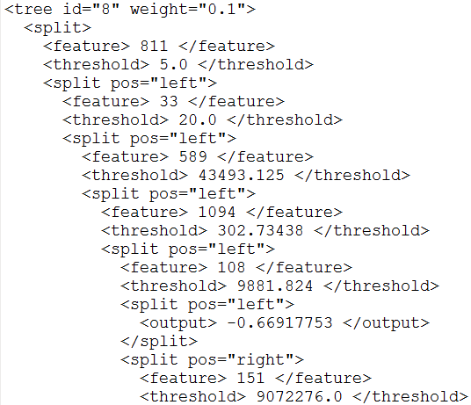
From RankNet to LambdaRank to LambdaMART: An Overview Christopher J.C. Burges, 2010
A Lambda tree
splitting
Combination of features

Slide 40
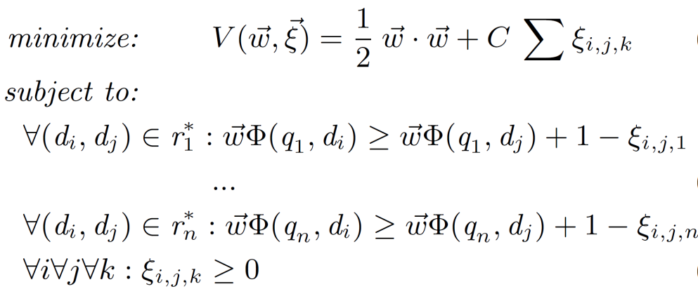
A Support Vector Machine for Optimizing Average Precision Yisong Yue, et al., SIGIR’07
RankSVM
SVM-MAP
Minimizing the pairwise loss
Minimizing the structural loss
MAP difference
Loss defined on the number of mis-ordered document pairs
Loss defined on the quality of the whole list of ordered documents

Slide 41
A Support Vector Machine for Optimizing Average Precision Yisong Yue, et al., SIGIR’07
Max margin principle
Push the ground-truth far away from any mistake one might make
Finding the most likely violated constraints

Slide 42
A Support Vector Machine for Optimizing Average Precision Yisong Yue, et al., SIGIR’07
Finding the most violated constraints
MAP is invariant to permutation of (ir)relevant documents
Maximize MAP over a series of swaps between relevant and irrelevant documents
Start from the reverse order of ideal ranking
Right-hand side of constraints
Greedy solution

Slide 43
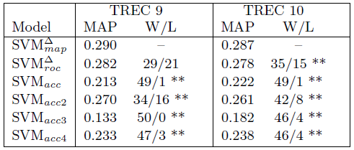
A Support Vector Machine for Optimizing Average Precision Yisong Yue, et al., SIGIR’07
Experiment results

Slide 44
Other listwise solutions
Soften the metrics to make them differentiable
Michael Taylor et al., SoftRank: optimizing non-smooth rank metrics, WSDM'08
Minimize a loss function defined on permutations
Zhe Cao et al., Learning to rank: from pairwise approach to listwise approach, ICML'07

Slide 45
What did we learn
Ranking a list of documents as a whole
Positions are vital for the ranking algorithms
Directly optimizing the target metric
Limitation
The search space is huge!

Slide 46
Summary
Learning to rank
An automated combination of ranking features for optimizing IR evaluation metrics
Approaches
Pointwise
Fit the relevance labels individually
Pairwise
Fit the relative orders
Listwise
Fit the whole order

Slide 47
Experimental Comparisons
My experiments
1.2k queries, 45.5K documents with 1890 features
800 queries for training, 400 queries for testing
 | MAP | P@1 | ERR | MRR | NDCG@5
ListNET | 0.2863 | 0.2074 | 0.1661 | 0.3714 | 0.2949
LambdaMART | 0.4644 | 0.4630 | 0.2654 | 0.6105 | 0.5236
RankNET | 0.3005 | 0.2222 | 0.1873 | 0.3816 | 0.3386
RankBoost | 0.4548 | 0.4370 | 0.2463 | 0.5829 | 0.4866
RankSVM | 0.3507 | 0.2370 | 0.1895 | 0.4154 | 0.3585
AdaRank | 0.4321 | 0.4111 | 0.2307 | 0.5482 | 0.4421
pLogistic | 0.4519 | 0.3926 | 0.2489 | 0.5535 | 0.4945
Logistic | 0.4348 | 0.3778 | 0.2410 | 0.5526 | 0.4762

Slide 48
Connection with Traditional IR
People have foreseen this topic long time ago
Recall: probabilistic ranking principle

Slide 49
Conditional models for P(R=1|Q,D)
Basic idea: relevance depends on how well a query matches a document
P(R=1|Q,D)=g(Rep(Q,D)|θ)
Rep(Q,D): feature representation of query-doc pair
E.g., #matched terms, highest IDF of a matched term, docLen
Using training data (with known relevance judgments) to estimate parameter θ
Apply the model to rank new documents
Special case: logistic regression
a functional form

Slide 50
Analysis of the Approaches
What are they really optimizing?
Relation with IR metrics
gap

Slide 51
Broader Notion of Relevance
Language Model
Documents
Click/View
Query
BM25
Cosine
Linkage structure
Query relation
Language Model
Documents
Visual Structure
Social network
Query
BM25
Cosine
Query relation
Linkage structure
Language Model
Documents
likes
Query
BM25
Cosine

Slide 52
Future
Tighter bounds
Faster solution
Larger scale
Wider application scenario

Slide 53
Resources
Books
Liu, Tie-Yan. Learning to rank for information retrieval. Vol. 13. Springer, 2011.
Li, Hang. "Learning to rank for information retrieval and natural language processing." Synthesis Lectures on Human Language Technologies 4.1 (2011): 1-113.
Helpful pages
http://en.wikipedia.org/wiki/Learning_to_rank
Packages
RankingSVM: http://svmlight.joachims.org/
RankLib: http://people.cs.umass.edu/~vdang/ranklib.html
Data sets
LETOR http://research.microsoft.com/en-us/um/beijing/projects/letor//
Yahoo! Learning to rank challenge http://learningtorankchallenge.yahoo.com/

Slide 54
References
Liu, Tie-Yan. "Learning to rank for information retrieval." Foundations and Trends in Information Retrieval 3.3 (2009): 225-331.
Cossock, David, and Tong Zhang. "Subset ranking using regression." Learning theory (2006): 605-619.
Shashua, Amnon, and Anat Levin. "Ranking with large margin principle: Two approaches." Advances in neural information processing systems 15 (2003): 937-944.
Joachims, Thorsten. "Optimizing search engines using clickthrough data." Proceedings of the eighth ACM SIGKDD. ACM, 2002.
Freund, Yoav, et al. "An efficient boosting algorithm for combining preferences." The Journal of Machine Learning Research 4 (2003): 933-969.
Zheng, Zhaohui, et al. "A regression framework for learning ranking functions using relative relevance judgments." Proceedings of the 30th annual international ACM SIGIR. ACM, 2007.

Slide 55
References
Joachims, Thorsten, et al. "Accurately interpreting clickthrough data as implicit feedback." Proceedings of the 28th annual international ACM SIGIR. ACM, 2005.
Burges, C. "From ranknet to lambdarank to lambdamart: An overview." Learning 11 (2010): 23-581.
Xu, Jun, and Hang Li. "AdaRank: a boosting algorithm for information retrieval." Proceedings of the 30th annual international ACM SIGIR. ACM, 2007.
Yue, Yisong, et al. "A support vector method for optimizing average precision." Proceedings of the 30th annual international ACM SIGIR. ACM, 2007.
Taylor, Michael, et al. "Softrank: optimizing non-smooth rank metrics." Proceedings of the international conference WSDM. ACM, 2008.
Cao, Zhe, et al. "Learning to rank: from pairwise approach to listwise approach." Proceedings of the 24th ICML. ACM, 2007.

Slide 56
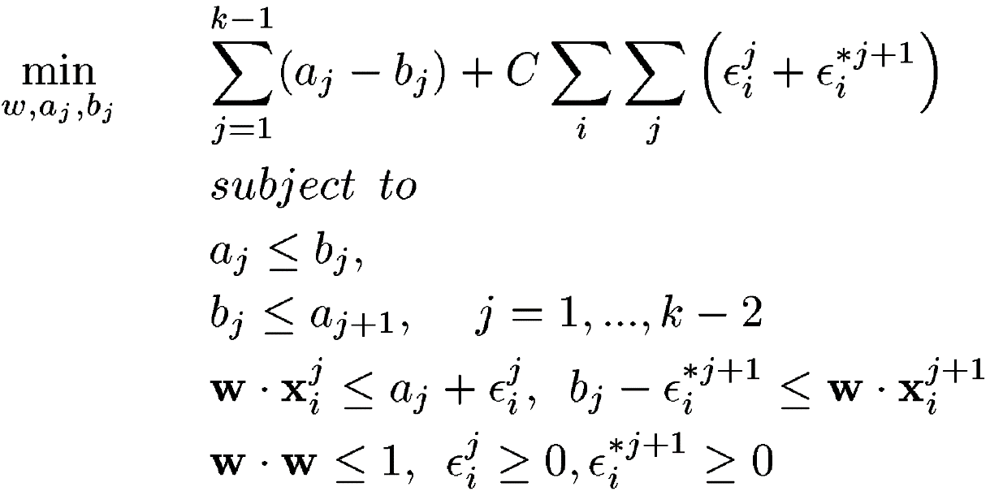
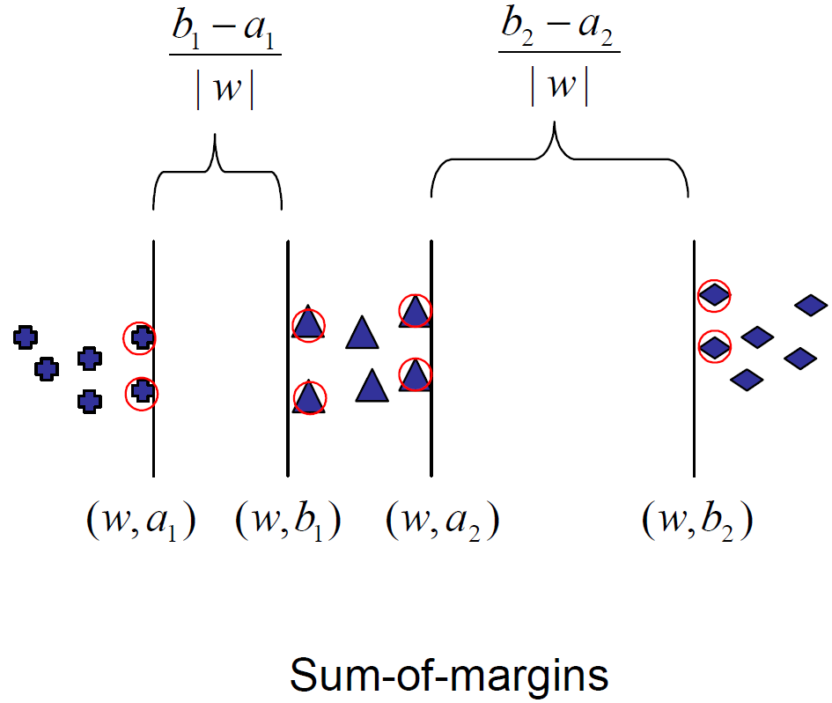
Ranking with Large Margin Principles A. Shashua and A. Levin, NIPS 2002
Maximizing the sum of margins
Y=0
Y=1
Y=2
$$αs$$

Slide 57
AdaRank: a boosting algorithm for information retrieval Jun Xu & Hang Li, SIGIR’07
Loss defined by IR metrics
$\sum_{q∈Q}{Pr\left(q\right)exp[−O(q)]}$
Optimizing by boosting
Target metrics: MAP, NDCG, MRR
BM25
PageRank
Cosine
Updating $Pr⁡(q)$
Credibility of each committee member (ranking feature)
from Pattern Recognition and Machine Learning, P658

Slide 58
Pointwise Approaches
Regression based
Classification based
Discount coefficients in DCG
Regression loss
Discount coefficients in DCG
Classification loss

Slide 59
From

Slide 60
Discount coefficients in DCG
From

Slide 61
Listwise Approaches
No general analysis
Method dependent
Directness and consistency

