Slide 1
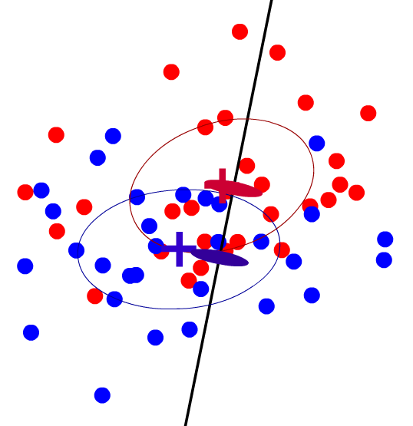
Automated Black-Box Detection of Side‑Channel Vulnerabilities in Web Applications
Peter Chapman
David Evans
University of Virginia
http://www.cs.virginia.edu/sca/
CCS '11
October 19, 2011

Slide 2






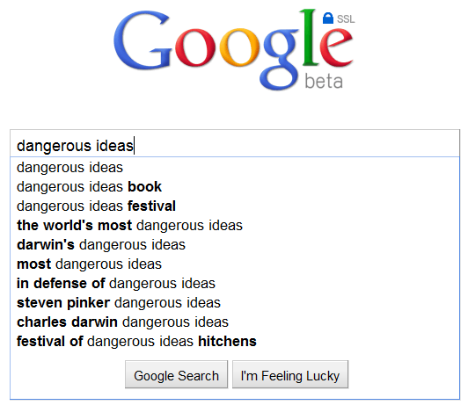

Side-Channel Leaks in Web Apps
HTTPS over WPA2
Client
d
Google
Client
dan
Google
748
762
674
679
da
dang
755
775
681
672
Chen⁺, Oakland 2010

Slide 3






Modern Web Apps
Dynamic and Responsive Browsing Experience
On-Demand Content
Traffic
Latency
Responsiveness
Traffic is now closely associated with the demanded content.

Slide 4
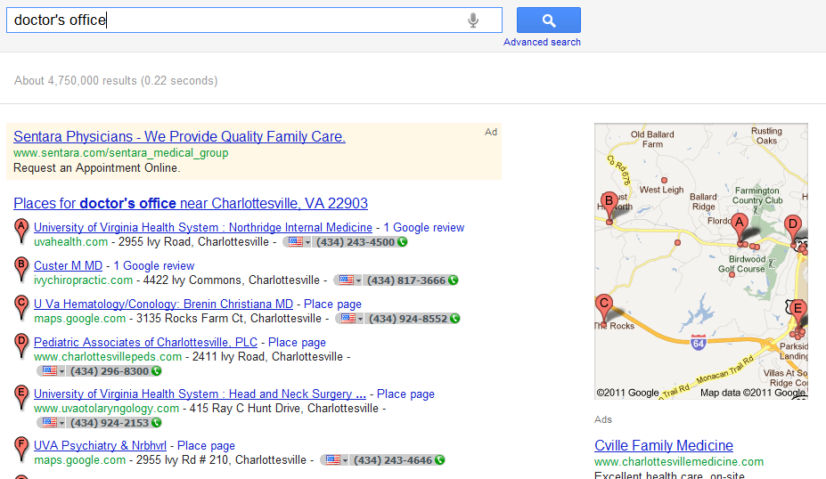
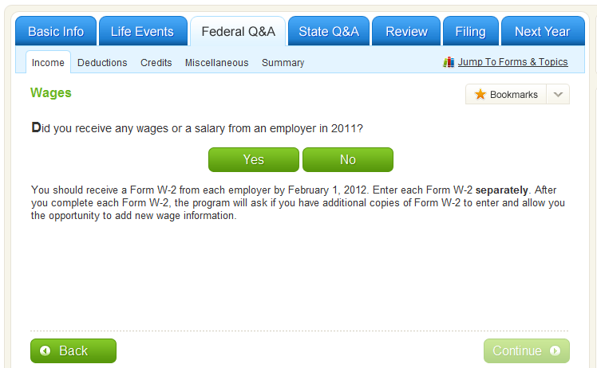
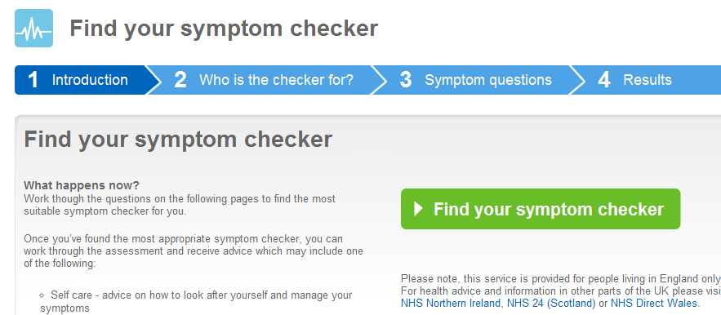
Motivation: Detect Vulnerabilities

Slide 5
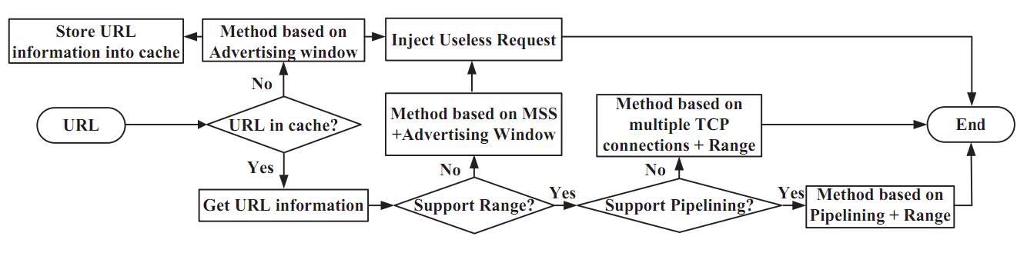
Motivation: Evaluate Defenses
Randomized or Uniform Communication Attributes
Packet Sizes
Transfer Control Flow
Inter-Packet Timings
Requests and Responses
HTTPOS [Luo+, NDSS 2011]

Slide 6
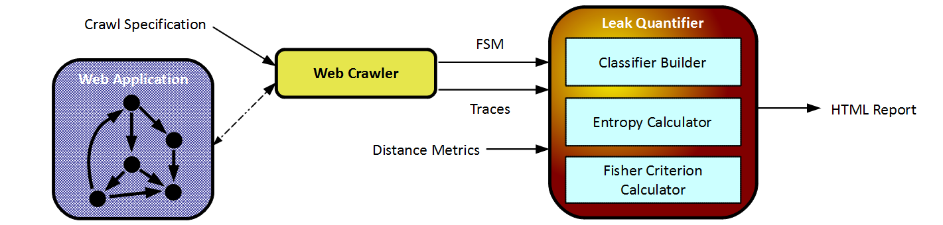
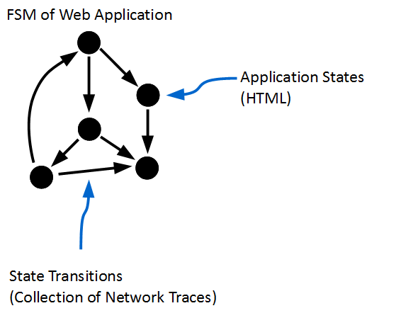
Approach
Attacker Builds a Classifier to Identify State Transitions

Slide 7



A Black-Box Approach
Similar to Real Attack
Scenario
Applicable to Most Web Applications
Full Browser Analysis

Slide 8
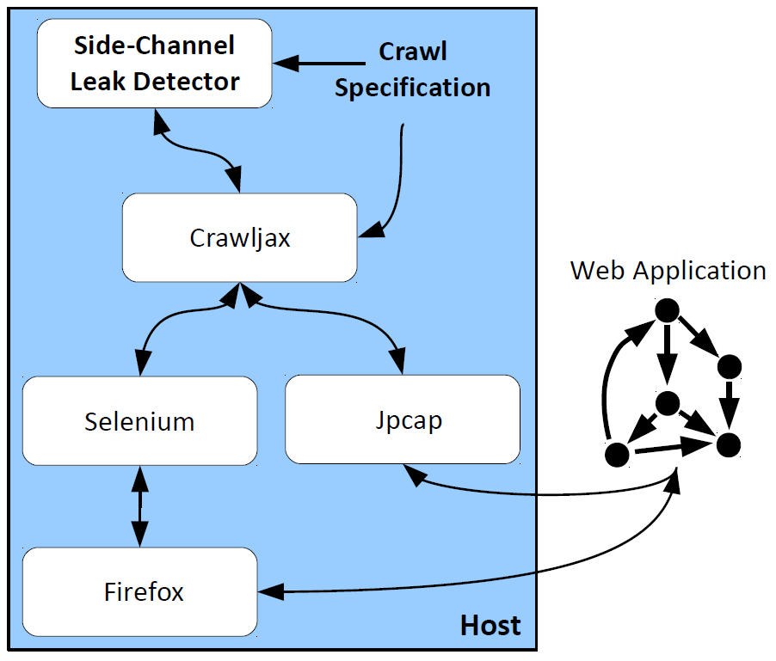
Black-Box Web Application Crawling

Slide 9
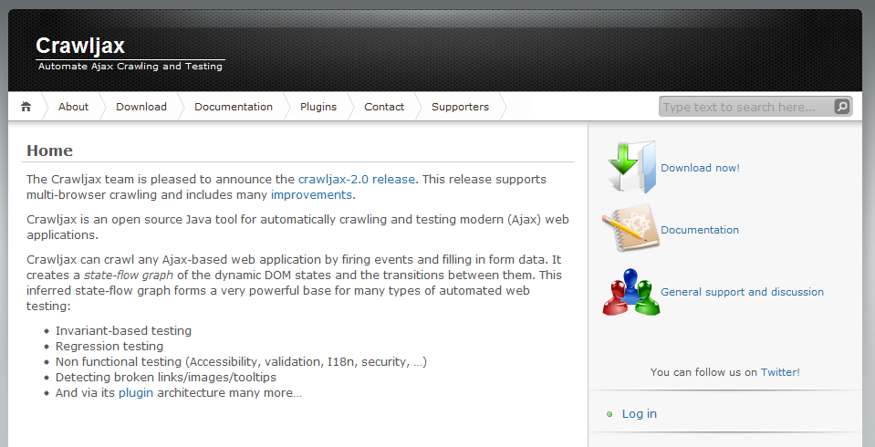
Crawljax
Web crawling back-end drives Firefox
instance via Selenium
Designed to build Finite-State Machines of AJAX Applications
http://crawljax.com/

Slide 10
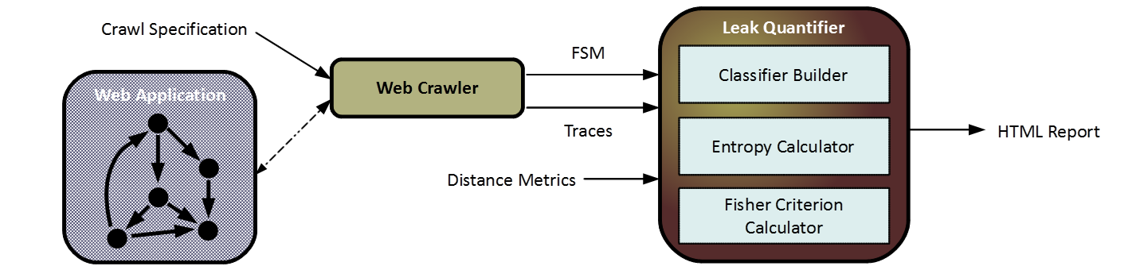
Approach

Slide 11


Threat Models and Assumptions
Both: Victim begins at root of application
No disruptive traffic
Distinguish incoming and outgoing
WiFi
ISP
Access to TCP header

Slide 12
Nearest-Centroid Classifier
Given an unknown network trace, we want to determine to which state transition it belongs
Classify unknown trace as one with the closest centroid

Slide 13
Distance Metrics
Metrics to determine similarity between two traces
192.168.1 -> 72.14.204 62 bytes
72.14.204 -> 192.168.1 62 bytes
192.168.1 -> 72.14.204 482 bytes
72.14.204 -> 192.168.1 693 bytes
192.168.1 -> 72.14.204 62 bytes
72.14.204 -> 192.168.1 62 bytes
192.168.1 -> 72.14.204 281 bytes
72.14.204 -> 192.168.1 1860 bytes
192.168.1 -> 72.14.204 294 bytes
72.14.204 -> 192.168.1 296 bytes
192.168.1 -> 72.14.204 453 bytes
72.14.204 -> 192.168.1 2828 bytes
Size-Weighted-Edit-Distance
Convert to string, weighted edit
distance based on size
Edit-Distance
Summed difference of bytes
transferred between each party
Total-Source-Destination
Unweighted edit
distance
192.168.1 -> 72.14.204 62 bytes
72.14.204 -> 192.168.1 62 bytes
192.168.1 -> 72.14.204 482 bytes
72.14.204 -> 192.168.1 693 bytes
192.168.1 -> 72.14.204 62 bytes
72.14.204 -> 192.168.1 62 bytes
192.168.1 -> 72.14.204 281 bytes
72.14.204 -> 192.168.1 1860 bytes
192.168.1 -> 72.14.204 294 bytes
72.14.204 -> 192.168.1 296 bytes
192.168.1 -> 72.14.204 453 bytes
72.14.204 -> 192.168.1 2828 bytes
A 62 bytes
B 62 bytes
A 482 bytes
B 693 bytes
A 62 bytes
B 62 bytes
A 281 bytes
B 1860 bytes
A 294 bytes
B 296 bytes
A 453 bytes
B 2828 bytes

Slide 14
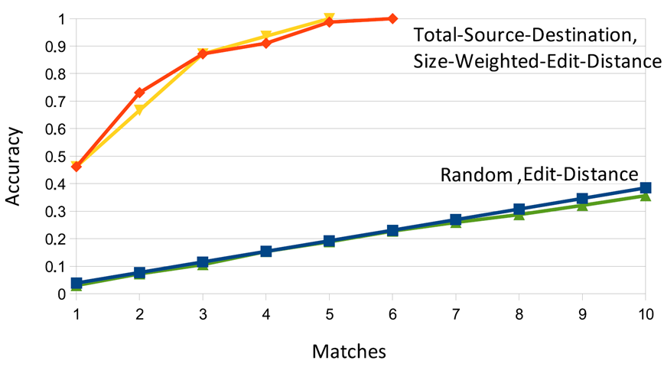
Classifier Performance – Google Search
First character typed, ISP threat model

Slide 15
Quantifying Leaks
Leak quantification should be independent of a specific classifier implementation

Slide 16
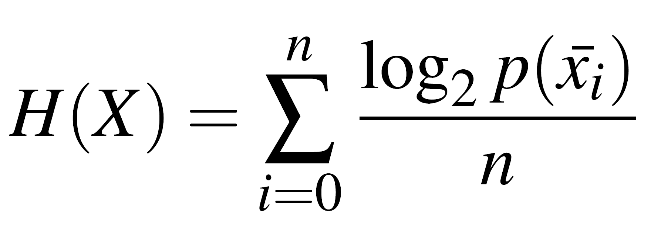
Entropy Measurements
Entropy measurements are a function of the average size of an attacker's uncertainty set given a network trace
Problems
The same network trace can be the result of multiple classifications
Every possible network trace is unknown
Size of uncertainty set
Centroid for class
Use the centroids
Number of classes
Traditional Entropy Measurement

Slide 17
Determining Indistinguishability
At what point are two classes indistinguishable (same uncertainty sets)?

Slide 18
Determining Indistinguishability
Same issue with individual points.
In practice the area can be very large due to high variance in network conditions
Compare points to centroids?

Slide 19
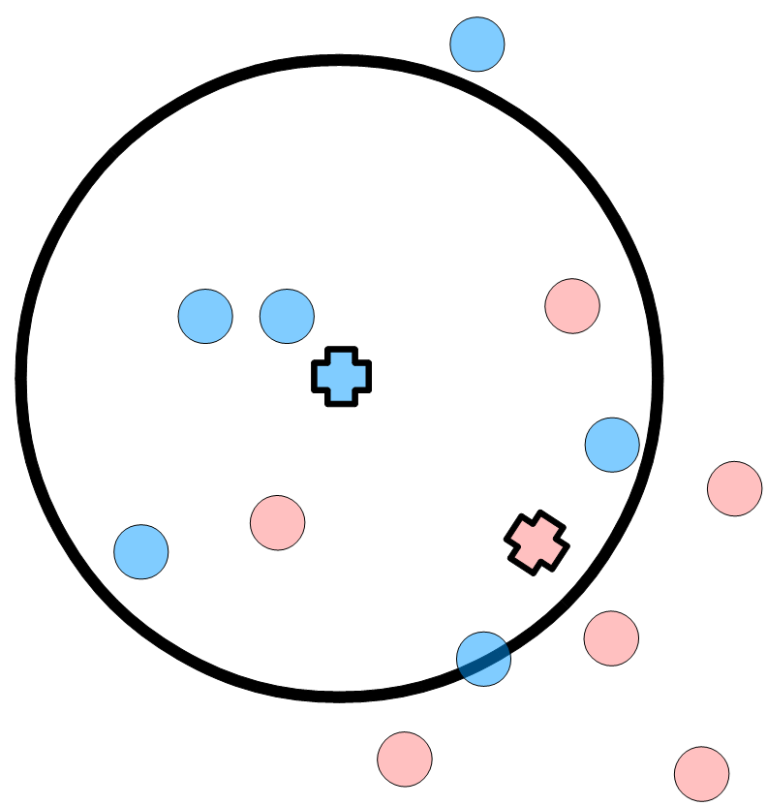
Entropy Distinguishability Threshold
Threshold of 75%

Slide 20
Google Search Entropy Calculations
Threshold
 | 100% | 75% | 50%
Desired | 4.70 | 4.70 | 4.70
Total-Source-Destination | 2.95 | 2.40 | 0.44
Size-Weighted-Edit-Distance | 1.13 | 0.56 | 0.44
Edit-Distance | 4.70 | 4.70 | 4.70
(measured in bits of entropy)
We'd rather not use something with an arbitrary parameter

Slide 21
Fisher Criterion

Slide 22
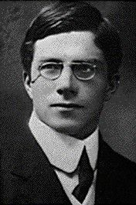
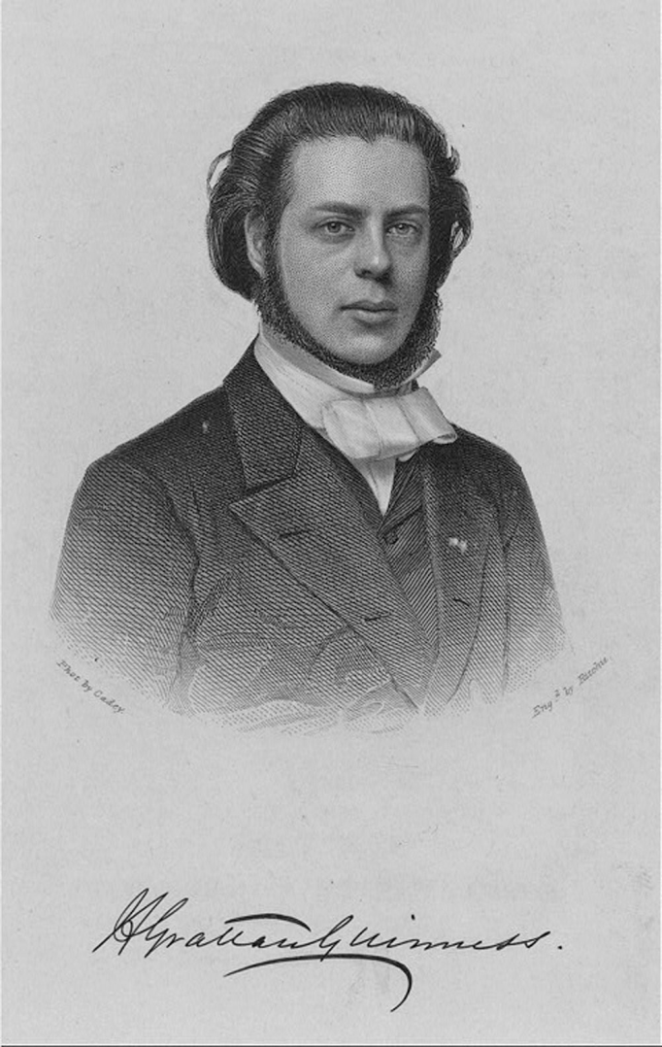
Fisher Criterion
Marred Arthur Guinness' daughter, secret wedding (she was 17) in 1917
Ronald Fisher (1890-1962)
Developed many statistical tools as a part of his prominent role in the eugenics community
Arthur Guinness (1835-1910)

Slide 23
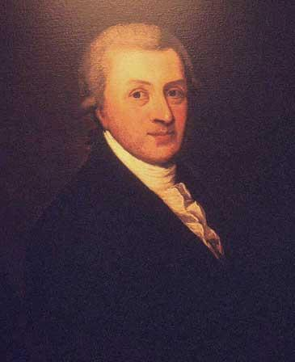

Fisher Criterion
Like all good stories, this one starts with a Guinness.
Arthur Guinness (1725-1803)
“Guinness is Good for You”

Slide 24

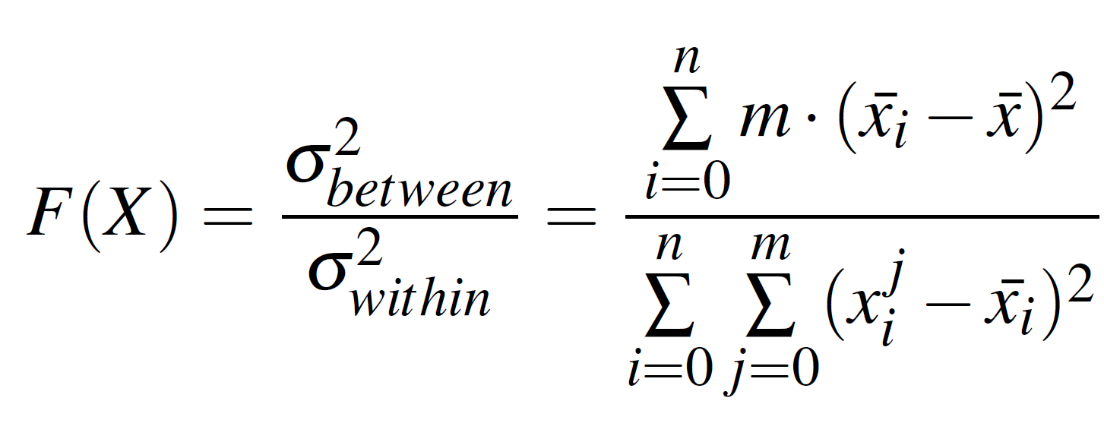
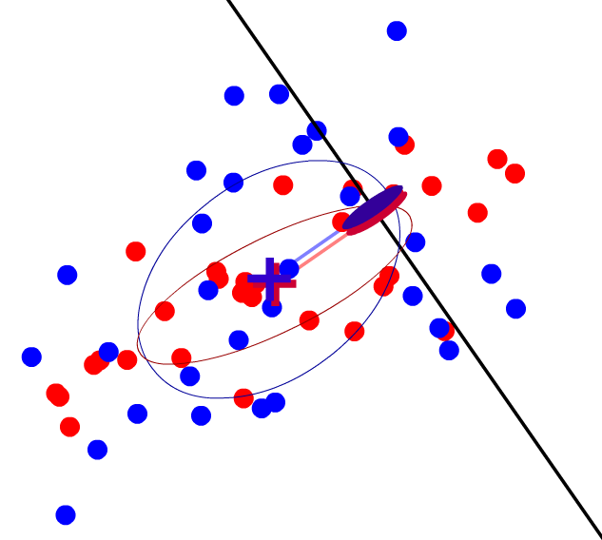
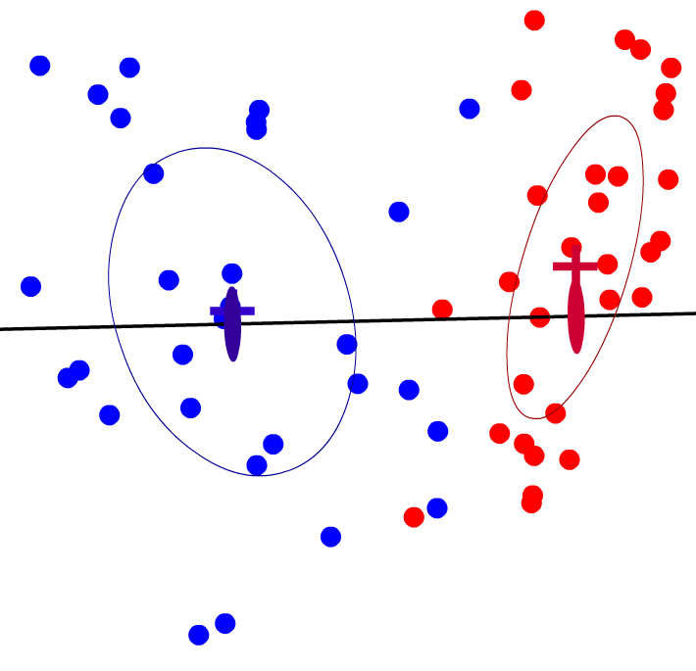



Fisher Criterion
$$F\left(X\right)=0$$
$$F\left(X\right)=1$$
$$F\left(X\right)=11$$

Slide 25
Google Search Fisher Calculations
Fisher Criterion Calculations
Total-Source-Destination | 4.13
Size-Weighted-Edit-Distance | 41.7
Edit-Distance | 0.00
Entropy Calculations
 | 100% | 75% | 50%
Desired | 4.70 | 4.70 | 4.70
Total-Source-Destination | 2.95 | 2.40 | 0.44
Size-Weighted-Edit-Distance | 1.13 | 0.56 | 0.44
Edit-Distance | 4.70 | 4.70 | 4.70

Slide 26
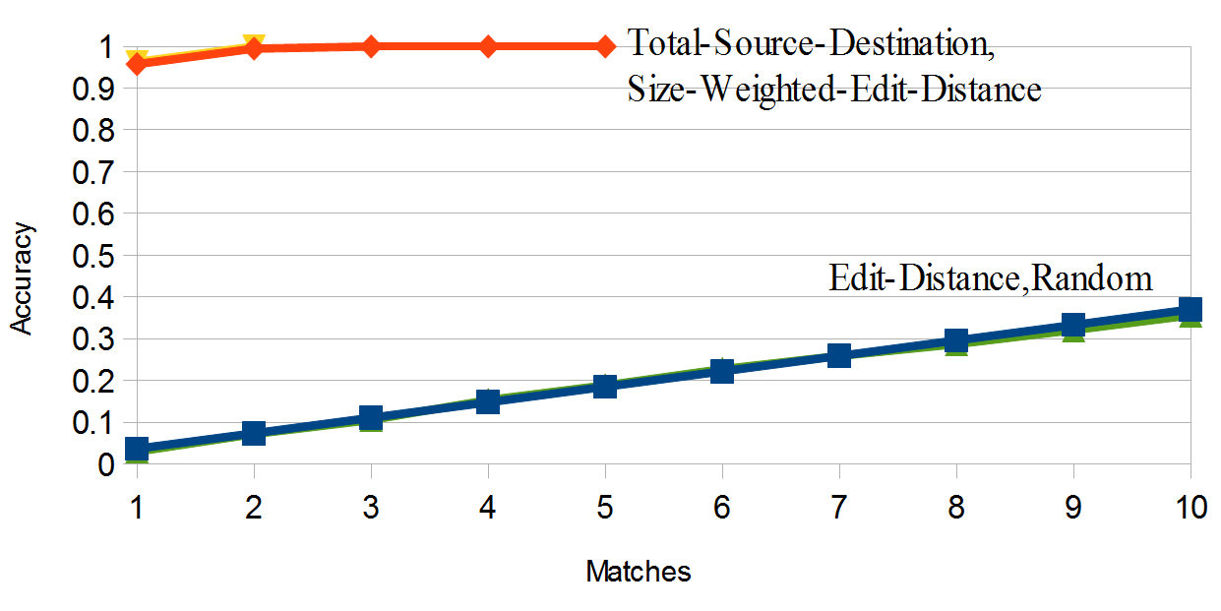
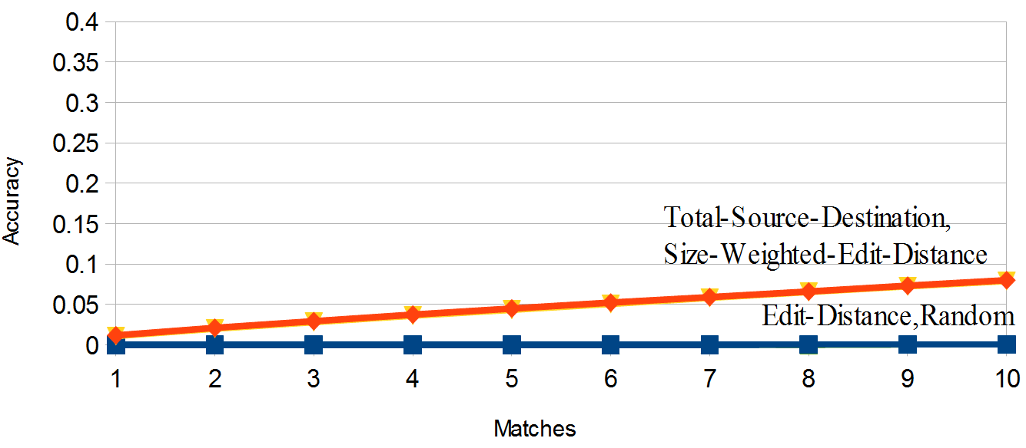
Other Applications
Bing Search Suggestions
Yahoo Search Suggestions

Slide 27
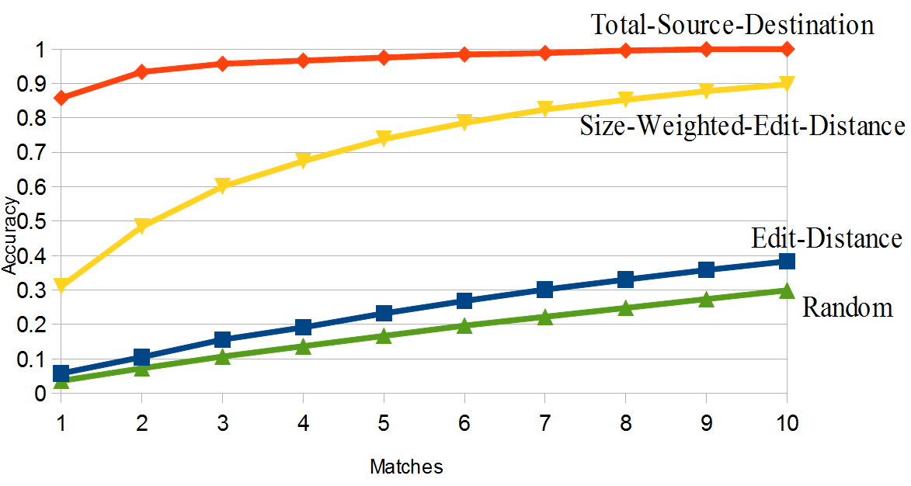
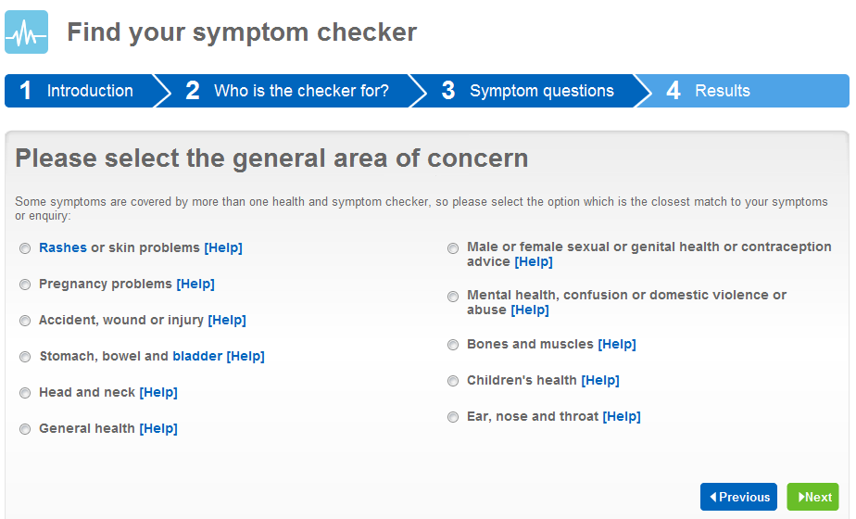
Other Applications
NHS Symptom Checker
See paper for Google Health Find-A-Doctor
Seems like a lot on this slide, perhaps divide into two (one on the search sites, one others). Could make second slide just NHS (and just a note for Google Health is in the paper) to show a bit more including web site screenshot.

Slide 28
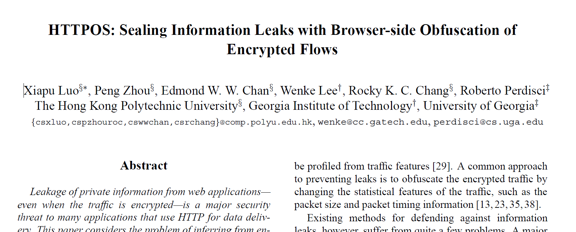
Evaluating Defenses
With black-box approach, evaluating defenses is easy!
NDSS 2011

Slide 29
HTTPOS Search Suggestions
Before HTTPOS
(matches)
 | 1 | 10
Random | 2.9% | 35.6%
Total-Source-Destination | 46.1% | 100%
Size-Weighted-Edit-Distance | 46.1% | 100%
Edit-Distance | 3.8% | 39.5%
(matches)
 | 1 | 10
Random | 2.9% | 35.6%
Total-Source-Destination | 3.4% | 38.0%
Size-Weighted-Edit-Distance | 3.8% | 38.0%
Edit-Distance | 3.4% | 35.5%
After HTTPOS

Slide 30
HTTPOS Search Suggestions
Before HTTPOS
After HTTPOS
Fisher Criterion Calculations
Total-Source-Destination | 4.13
Size-Weighted-Edit-Distance | 41.7
Edit-Distance | 0.00
Fisher Criterion Calculations
Total-Source-Destination | 0.28
Size-Weighted-Edit-Distance | 0.43
Edit-Distance | 0.14
HTTPOS works well with search suggestions

Slide 31
HTTPOS Google Instant
Before HTTPOS
(matches)
 | 1 | 10
Random | 2.9% | 35.6%
Total-Source-Destination | 47.5% | 88.3%
Size-Weighted-Edit-Distance | 7.3% | 52.6%
Edit-Distance | 7.7% | 56.0%
(matches)
 | 1 | 10
Random | 2.9% | 35.6%
Total-Source-Destination | 43.7% | 87.6%
Size-Weighted-Edit-Distance | 8.2% | 51.4%
Edit-Distance | 8.7% | 55.0%
After HTTPOS

Slide 32
HTTPOS Google Instant
Before HTTPOS
After HTTPOS
Fisher Criterion Calculations
Total-Source-Destination | 1.13
Size-Weighted-Edit-Distance | 0.34
Edit-Distance | 0.22
Fisher Criterion Calculations
Total-Source-Destination | 0.60
Size-Weighted-Edit-Distance | 0.55
Edit-Distance | 0.47

Slide 33
Summary
Built system to record network traffic of web apps
Developed Fisher Criterion as an alternative measurement for information leaks in this domain
Evaluated real web apps and a proposed defense system
With a tutorial
Code available now: http://www.cs.virginia.edu/sca

