Slide 1
Meta Talk: How to Give a Talk so Good People Will Ask You To Give Talks About Talks About Nothing
JMRL In-Service Day
11 . 11 . 11
David Evans
www.cs.virginia.edu/evans

Slide 2
Who Gives Talks?

Slide 3
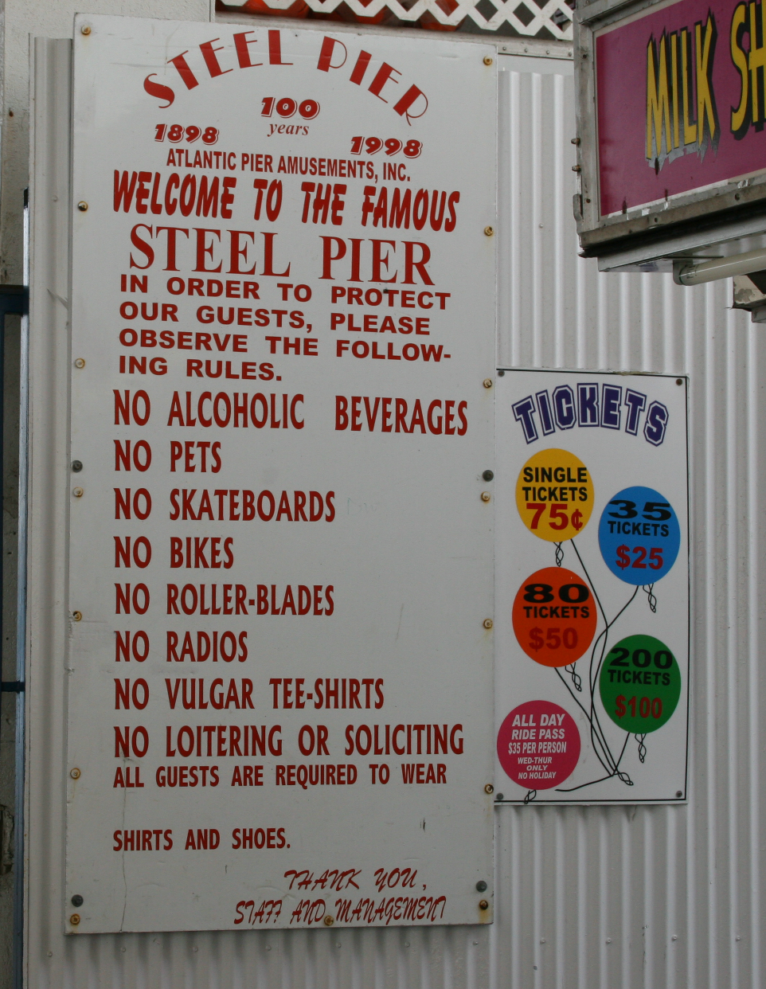
Rule #1
Never give a talk about giving talks!
It might be a good rule simply to avoid any prestigious task. If it didn't suck, they wouldn't have had to make it prestigious. Paul Graham,
How to Do What You Love

Slide 4
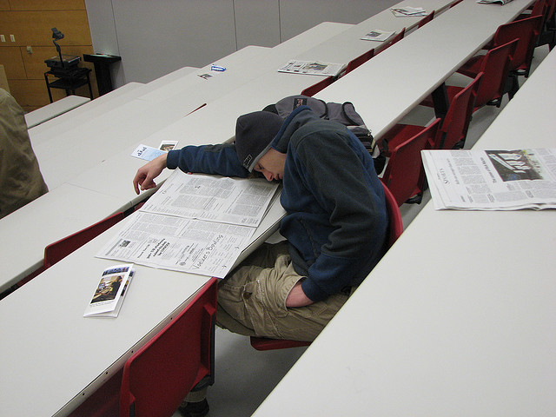
Rule #2
Never give a talk after 2pm!*
* Especially not on Friday!
flickrcc: rofltosh

Slide 5
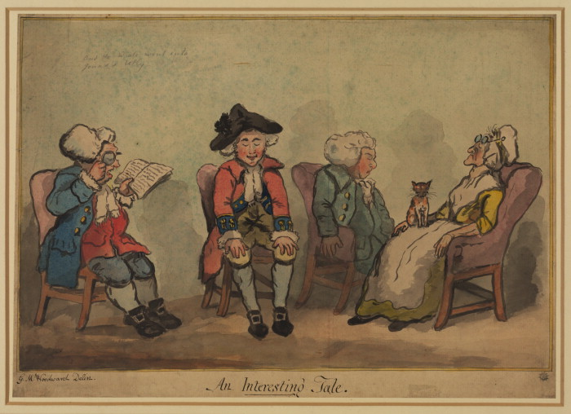
Rule #3
Never read your talk!
George Woodward, Man reading to a sleeping audience, 18th century

Slide 6
Rule #4
Finish on time
(Even better to leave time for questions!)
flickrcc: Lynda Giddens

Slide 7
Story The Rabbit, the Fox, and the Wolf (author unknown)
Notes:
The Rabbit, the Fox, and the Wolf
Taken from http://ux6.cso.uiuc.edu/~k-lee7/humor/rabbit&fox.htm, original author unknown. One sunny day a rabbit came out of her hole in the ground to enjoy the fine weather. The day was so nice that she became careless and a fox snuck up behind her and caught her.
"I am going to eat you for lunch!" said the fox.
"Wait!" replied the rabbit, "You should at least wait a few days."
"Oh yeah? Why should I wait?"
"Well, I am just finishing my thesis on 'The Superiority of Rabbits over Foxes and Wolves'."
"Are you crazy? I should eat you right now! Everybody knows that a fox will always win over a rabbit."
"Not really, not according to my research. If you like, you can come into my hole and read it for yourself. If you are not convinced, you can go ahead and have me for lunch."
"You really are crazy!" But since the fox was curious and had nothing to lose, he went with the rabbit. The fox never came out.
A few days later the rabbit was again taking a break from writing and sure enough, a wolf came out of the bushes and was ready to set upon her.
"Wait!" yelled the rabbit, "you can't eat me right now."
"And why might that be, my furry appetizer?"
"I am almost finished writing my thesis on 'The Superiority of Rabbits over Foxes and Wolves'."
The wolf laughed so hard that it almost lost its grip on the rabbit.
"Maybe I shouldn't eat you. You really are sick...in the head. You might have something contagious."
"Come and read it for yourself. You can eat me afterward if you disagree with my conclusions."
So the wolf went down into the rabbit's hole...and never came out.
The rabbit finished her thesis and was out celebrating in the local lettuce patch. Another rabbit came along and asked, "What's up? You seem very happy."
"Yup, I just finished my thesis."
"Congratulations. What's it about?"
"'The Superiority of Rabbits over Foxes and Wolves'."
"Are you sure? That doesn't sound right."
"Oh yes. Come and read it for yourself."
So together they went down into the rabbit's hole. As they entered, the friend saw the typical graduate student abode, albeit a rather messy one after writing a thesis.
The computer with the controversial work was in one corner. To the right there was a pile of fox bones, to the left a pile of wolf bones. And in the middle was a large, well-fed lion.
The moral of the story:
The title of your thesis doesn't matter. The subject doesn't matter. The research doesn't matter. All that matters is who your advisor is.

Slide 8
All Talks Should Tell a Story
Stories
Beginning, middle, and end
Everything is motivated by earlier events
Build and resolve tension
List Talks
Could be in any order
Points are disconnected
Tension is whether it will ever end
PowerPoint is designed for making List Talks!
Fight the Power (or use something else).

Slide 9
The Beginning
Introduce characters
If your characters are not cute and furry, give your audience a reason to care about them
Your characters may be abstract ideas
Put them in a predicament
Motivate a problem: interesting and important
Suspense: use judiciously in talks
Give clear idea of the big message at the beginning
If your audience is bored by the beginning of your talk,
they will be doing other things before you get to the rest.

Slide 10
The Middle
Build up to resolution of the problem
Short talk (20 minutes): one nugget idea (∼10 minutes)
Long talk (45 minutes): 2-3 small nuggets (∼5 minutes each), 1 big one (∼15 minutes)
Longer talk = 45 minutes + more question time
The goal is to get one interesting idea across,
not to explain everything shallowly

Slide 11
What is the Goal of your Talk?
“Get to the end without passing out”
Sell something
Always: yourself, your institution
An idea, an approach, a direction

Slide 12
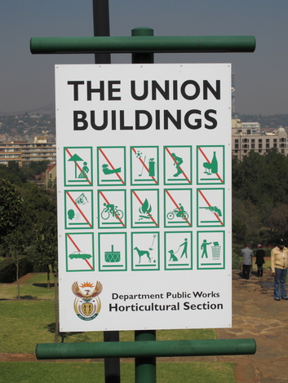
Some Concrete Dos and Don’ts

Slide 13
Dos and Don’ts
Don’t Apologize
“I didn’t have time to prepare a good talk...”
“I don’t have time to explain this well...”
Don’t Be Arrogant
dismissing questions, belittling previous work, wasting your audience’s time, giving talks about talks
Do Be Nervous
If you aren’t nervous, you don’t care about your audience or aren’t taking any risks
Do Be Confident (with cause)
Be well prepared
Set up early: before the audience arrives

Slide 14
Dos and Don’ts
Don’t Have Useless Outlines
Don’t Be Distracting
fancy backgrounds, useless animations, laser pointer, physical/verbal mannerisms
Don’t Be Boring: if you are bored, you are boring
Don’t spend two minutes on every slide: one 8-minute slide, some 2-minute slides, some 15-second slides
Do Structure Your Talk
Make sections clear and how parts connect
Do Use a Remote Presenter
Do have peaks and valleys
Build and release tension
Vary Pacing
Do Use Anaphora
Outline
Introduction
Motivation
Approach
Results
Conclusion

Slide 15
Slide Tips
Fonts: simple, sans serif font
But please don’t use Comic Sans!
Color text to convey meaning, not to distract
Lighted room:
White background, black text
Dark room (but only if you have no choice):
Dark background (black, dark blue, dark green)
Light text (white, yellow, grey)
Show your creativity with your ideas, not your font/color choices

Slide 16
Animate Judiciously

Slide 17
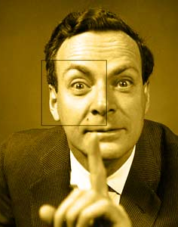
The real entertainment gimmick is the excitement, drama and mystery of the subject matter. People love to learn something, they are “entertained” enormously by being allowed to understand a little bit of something they never understood before... The faith in the value of the subject matter must be sincere and show through clearly. All gimmicks, etc. should be subservient to this.
Richard Feynman Letter to Mr. Ralph Brown, Advisory Board in Connection with Programs on Science (in Perfectly Reasonable Deviations from the Beaten Track)

Slide 18
The End
Resolve the Predicament (or explain what is still open)
Summarize why the problem and solution are important and interesting
Good stories have a moral not just an end!
Something to takeway: idea + handout
It is dangerous (except in meta-talks) to have a slide titled “The End” that is not your last slide!

Slide 19
Why You Should Give Good Talks
You care about your audience
More fun than giving a bad talk
All talks are “job talks”
Typical talks are quickly forgotten
Great talks are remembered for years
Horrible talks are remembered forever

Slide 20
How to Learn to Give Good Talks
Observe Bad Talks
Think how to present the same material better
Observe Good Talks
Think how to present the same material better
“Steal” things that work, but adapt to your style*
Practice, Practice, Practice
In your head, with imaginary audiences, with friendly audiences, with critical audiences
* I mostly try to steal from Patrick Henry Winston, John Guttag,
Avi Rubin, Steve Jobs, Neil DeGrasse Tyson, Bill Maher, etc.

Slide 21
Moral of the Story
Respect your Audience!

Slide 22
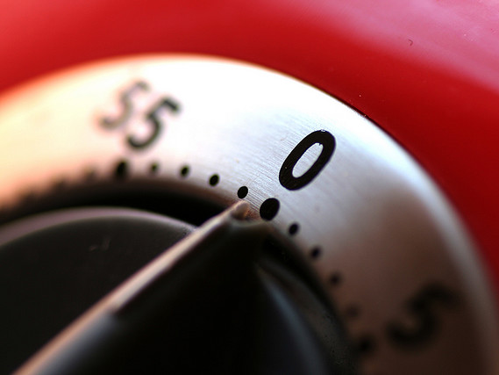
Remember Rule #4:
Finish on Time?

Slide 23
Thank you!
http://www.cs.virginia.edu/evans/
Always end with a slide that makes it clear you are done and shows how to contact you (gratuitous picture optional)

