Slide 1

Secure Computation in the
Real(ish) World
Carnegie Mellon
20 April 2011
David Evans
University of Virginia
http://www.cs.virginia.edu/evans
http://www.MightBeEvil.com

Slide 2


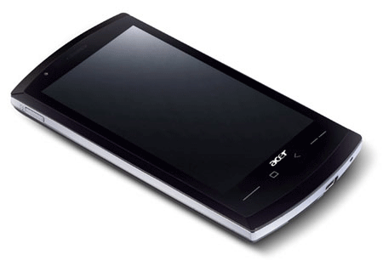

“Genetic Dating”
Bob
Alice
Genome Compatibility Protocol
Your offspring will have good immune systems!
Your offspring will have good immune systems!
WARNING!
Don’t Reproduce
WARNING!
Don’t Reproduce

Slide 3


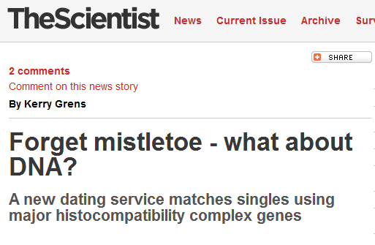


Slide 4
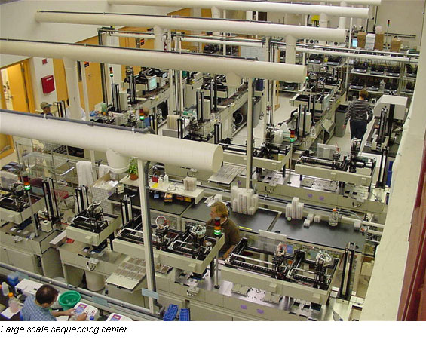
Genome Sequencing
1990: Human Genome Project starts, estimate $3B to sequence one genome ($0.50/base)
2000: Human Genome Project declared complete, cost ~$300M
Whitehead Institute, MIT

Slide 5
Cost to sequence human genome
Moore’s Law prediction
(halve every 18 months)
Data from National Human Genome Research Institute: http://www.genome.gov/sequencingcosts

Slide 6
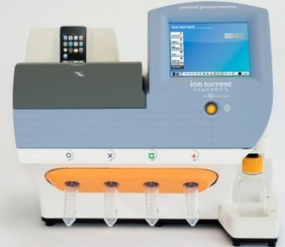
Cost to sequence human genome
Moore’s Law prediction
(halve every 18 months)
Ion torrent Personal Genome Machine
Data from National Human Genome Research Institute: http://www.genome.gov/sequencingcosts

Slide 7
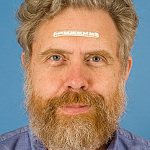
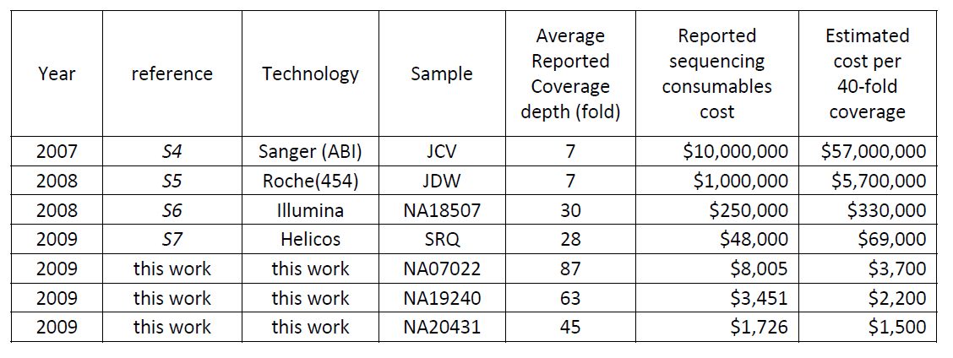
Human Genome Sequencing Using Unchained Base Reads on Self-Assembling DNA Nanoarrays. Radoje Drmanac, Andrew B. Sparks, Matthew J. Callow, Aaron L. Halpern, Norman L. Burns, Bahram G. Kermani, Paolo Carnevali, Igor Nazarenko, Geoffrey B. Nilsen, George Yeung, Fredrik Dahl, Andres Fernandez, Bryan Staker, Krishna P. Pant, Jonathan Baccash, Adam P. Borcherding, Anushka Brownley, Ryan Cedeno, Linsu Chen, Dan Chernikoff, Alex Cheung, Razvan Chirita, Benjamin Curson, Jessica C. Ebert, Coleen R. Hacker, Robert Hartlage, Brian Hauser, Steve Huang, Yuan Jiang, Vitali Karpinchyk, Mark Koenig, Calvin Kong, Tom Landers, Catherine Le, Jia Liu, Celeste E. McBride, Matt Morenzoni, Robert E. Morey, Karl Mutch, Helena Perazich, Kimberly Perry, Brock A. Peters, Joe Peterson, Charit L. Pethiyagoda, Kaliprasad Pothuraju, Claudia Richter, Abraham M. Rosenbaum, Shaunak Roy, Jay Shafto, Uladzislau Sharanhovich, Karen W. Shannon, Conrad G. Sheppy, Michel Sun, Joseph V. Thakuria, Anne Tran, Dylan Vu, Alexander Wait Zaranek, Xiaodi Wu, Snezana Drmanac, Arnold R. Oliphant, William C. Banyai, Bruce Martin, Dennis G. Ballinger, George M. Church, Clifford A. Reid. Science, January 2010.
George Church (Personal Genome Project)

Slide 8
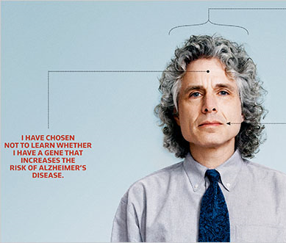
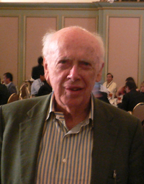
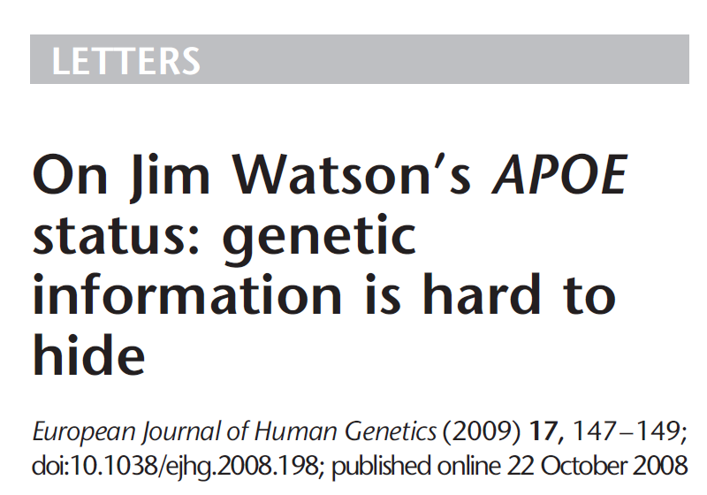
Steven Pinker (PGP-10)

Slide 9




Dystopia
Personalized Medicine

Slide 10
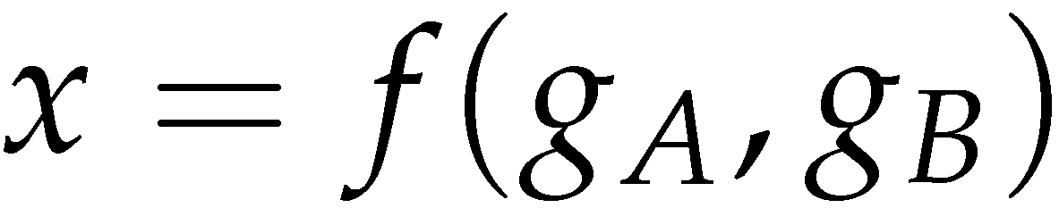
Secure Two-Party Computation
Bob’s Genome: ACTG…
Markers (~1000): [0,1, …, 0]
Alice’s Genome: ACTG…
Markers (~1000): [0, 0, …, 1]
Bob
Alice
Can Alice and Bob compute a function of their private data, without exposing anything about their data besides the result?

Slide 11
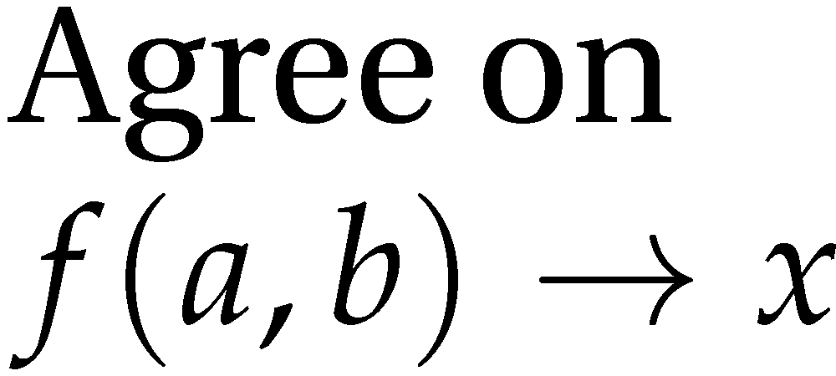


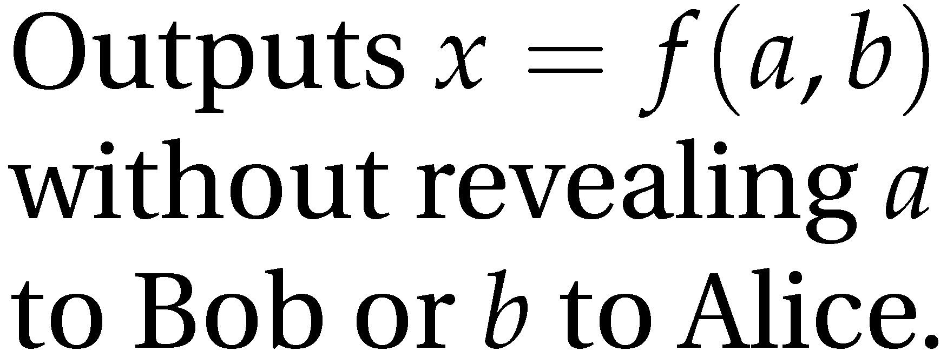
Secure Function Evaluation
Alice (circuit generator)
Bob (circuit evaluator)
Garbled Circuit Protocol
Andrew Yao, 1982/1986

Slide 12
Yao’s Garbled Circuits
Inputs |  | Output
a | b | x
0 | 0 | 0
0 | 1 | 0
1 | 0 | 0
1 | 1 | 1
a
b
AND
x

Slide 13
Computing with Meaningless Values?
Inputs |  | Output
a | b | x
a₀ | b₀ | x₀
a₀ | b₁ | x₀
a₁ | b₀ | x₀
a₁ | b₁ | x₁
a₀ or a₁
b₀ or b₁
a_{i}, b_{i}, x_{i} are random values, chosen by the circuit generator but meaningless to the circuit evaluator.
AND
x₀ or x₁

Slide 14
Computing with Garbled Tables
Inputs |  | Output
a | b | x
a₀ | b₀ | Enc_{a0,b0}(x₀)
a₀ | b₁ | Enc_{a0,b1}(x₀)
a₁ | b₀ | Enc_{a1,b0}(x₀)
a₁ | b₁ | Enc_{a1,b1}(x₁)
Bob can only decrypt one of these!
a₀ or a₁
b₀ or b₁
Garbled And Gate
Enc_{a0, b1}(x₀)
Enc_{a1,b1}(x₁)
Enc_{a1,b0}(x₀)
Enc_{a0,b0}(x₀)
a_{i}, b_{i}, x_{i} are random values, chosen by the circuit generator but meaningless to the circuit evaluator.
AND
x₀ or x₁

Slide 15

Garbled Circuit Protocol
Alice (circuit generator)
Bob (circuit evaluator)
And Gate
Enc_{a0, b1}(x₀)
Enc_{a1,b1}(x₁)
Enc_{a1,b0}(x₀)
Enc_{a0,b0}(x₀)
Sends a_{i} to Bob based on her input value
How does the Bob learn his own input wires?

Slide 16




Primitive: Oblivious Transfer
Alice
Bob
Oblivious Transfer Protocol
Oblivious: Alice doesn’t learn which secret Bob obtains
Transfer: Bob learns one of Alice’s secrets
Rabin, 1981; Even, Goldreich, and Lempel, 1985; many subsequent papers

Slide 17
Chaining Garbled Circuits
And Gate 1
Enc_{a10, b11}(x1₀)
Enc_{a11,b11}(x1₁)
Enc_{a11,b10}(x1₀)
Enc_{a10,b10}(x1₀)
a0
b0
a1
b1
AND
AND
x0
x1
Or Gate 2
Enc_{x00, x11}(x2₁)
Enc_{x01,x11}(x2₁)
Enc_{x01,x10}(x2₁)
Enc_{x00,x10}(x2₀)
OR
x₂
…
We can do any computation privately this way!

Slide 18
Threat Model
Semi-Honest (Honest But Curious) Adversary
Adversary follows the protocol as specified (!)
Curious adversary tries to learn more from protocol execution transcript
Garbled Circuits security proofs depend on this very weak model
Amount of information that could leak is probably small
General techniques for converting protocols secure in semi-honest model to resist malicious adversary.
Possibility to use software attestation to validate executing code?

Slide 19
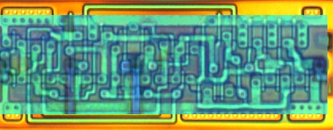
Building Computing Systems
Enc_{x00, x11}(x2₁)
Enc_{x01,x11}(x2₁)
Enc_{x01,x10}(x2₁)
Enc_{x00,x10}(x2₀)
Digital Electronic Circuits | Garbled Circuits
Operate on known data | Operate on encrypted wire labels
One-bit logical operation requires moving a few electrons a few nanometers (hundreds of Billions per second) | One-bit logical operation requires performing (up to) 4 encryption operations (~100,000 gates per second)
Reuse is great! | Reuse is not allowed!
All basic operations have similar cost | Some logical operations “free” (XOR, NOT)

Slide 20
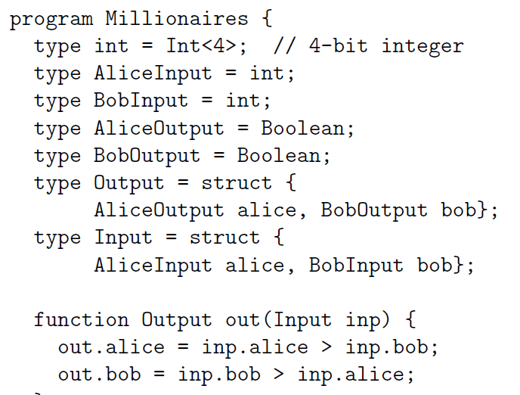
Fairplay
Bob
Alice
SFDL Compiler
SFDL Compiler
Circuit
(SHDL)
SFDL Program
Garbled Tables Generator
Dahlia Malkhi, Noam Nisan, Benny Pinkas and Yaron Sella [USENIX Sec 2004]
Garbled Tables Evaluator

Slide 21
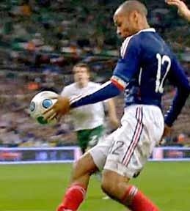
(Un)Fairplay?
An alternative approach to our protocols would have been to apply Yao’s generic secure two-party protocol to the recognition algorithm. This would have required expressing the algorithm as a circuit which computes and compares many Hamming distances, and then sending and computing that circuit. … We therefore believe that the performance of our protocols is significantly better than that of applying generic protocols.
Margarita Osadchy, Benny Pinkas, Ayman Jarrous, Boaz Moskovich.
SCiFI – A System for Secure Face Identification. Oakland 2010.
Protocol 1 (generic SMC) is very fast. Protocol 1 is ideal for small strings because the entire computation is performed in one round, but the circuit size is extremely large for longer strings. Our prototype circuit compiler can compile circuits for problems of size (200, 200) but uses almost 2 GB of memory to do so. Significantly larger circuits would be constrained by available memory for constructing their garbled versions.
Somesh Jha, Louis Kruger, Vitaly Shmatikov.
Towards Practical Privacy for Genomic Computation. Oakland 2008.

Slide 22
Faster Garbled Circuits
Circuit-Level Application
Circuit Structure
Circuit Structure
GC Framework (Generator)
GC Framework
(Evaluator)
Enc_{x00, x11}(x2₁)
Enc_{x01,x11}(x2₁)
Enc_{x01,x10}(x2₁)
Enc_{x20, x21}(x3₀)
Enc_{x21,x21}(x3₀)
Enc_{x21,x20}(x3₁)
x2₁
Enc_{x20, x31}(x4₁)
Enc_{x21,x31}(x4₁)
Enc_{x21,x30}(x4₀)
x3₁
Enc_{x40, x31}(x5₁)
Enc_{x41,x31}(x5₀)
Enc_{x41,x30}(x5₀)
Enc_{x40, x51}(x6₁)
Enc_{x41,x51}(x6₀)
Enc_{x41,x50}(x6₀)
x4₁
Enc_{x30, x61}(x7₁)
Enc_{x31,x61}(x7₀)
Enc_{x31,x60}(x7₁)
x5₁
x6₀
x7₁
Gates can be evaluated as they are generated: pipelining
Gates can be evaluated in any topological sort order: parallelizing
Garbled evaluation can be combined with normal execution

Slide 23

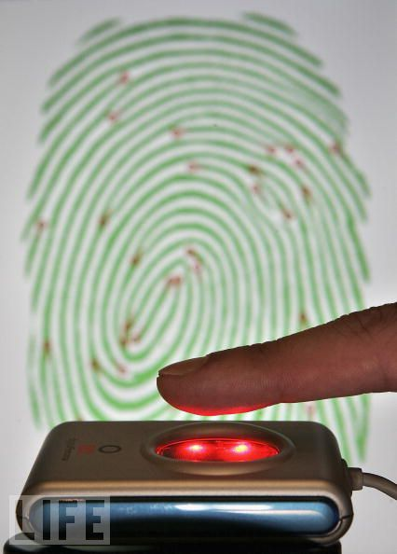


Applications
Private Personal Genomics
Privacy-Preserving Biometric Matching
Private AES Encryption
Private Set Intersection

Slide 24

Heterozygous Recessive Risk
Alice
 | A | a
A | AA | Aa
a | aA | aa
carrier
Bob
cystic fibrosis
Alice’s Heterozygous Recessive genes: { 5283423, 1425236, 839523, … }
Bob’s Heterozygous Recessive genes: { 5823527, 839523, 169325, … }
Goal: find the intersection of A and B

Slide 25
Bit Vector Intersection
Alice’s Recessive genes:
{ 5283423, 1425236, 839523, … }
Bob’s Recessive genes:
{ 5823527, 839523, 169325, … }
[ PAH, PKU, CF, … ]
[ 0, 0, 1, 0, 0, 0, 1, 0, 1, 1, 0]
[ 0, 0, 1, 0, 0, 0, 0, 0, 1, 0, 0]
. . .
AND
AND
AND
. . .
Bitwise AND

Slide 26
Scaling
What if there are millions of possible diseases?
Length of bit vector:
number of possible values
(2^{L} where L is number of bits for each value)
Other private set intersection problems:
Do Alice and Bob have any friends in common?
Data mining problems: combine medical records across hospitals
Two companies want to do joint marketing to common customers

Slide 27
Pairwise Comparison
randomly permute A
randomly permute B
for i in range(0, n-1):
for j in range(0, n-1):
if A[i] = B[j] output A[i]
data-oblivious algorithm
A[1]
A[2]
A[0]
A[3]
n² comparisons
B[0]
B[3]
B[1]
B[2]

Slide 28
Short-Circuit Pairwise Comparison
for i in range(0, n-1):
mask[i] = false
for i in range(0, n-1):
for j in range(0, n-1):
if not mask[i] and A[i] = B[j]:
reveal A[i] to both
mask[i] = true
break

Slide 29
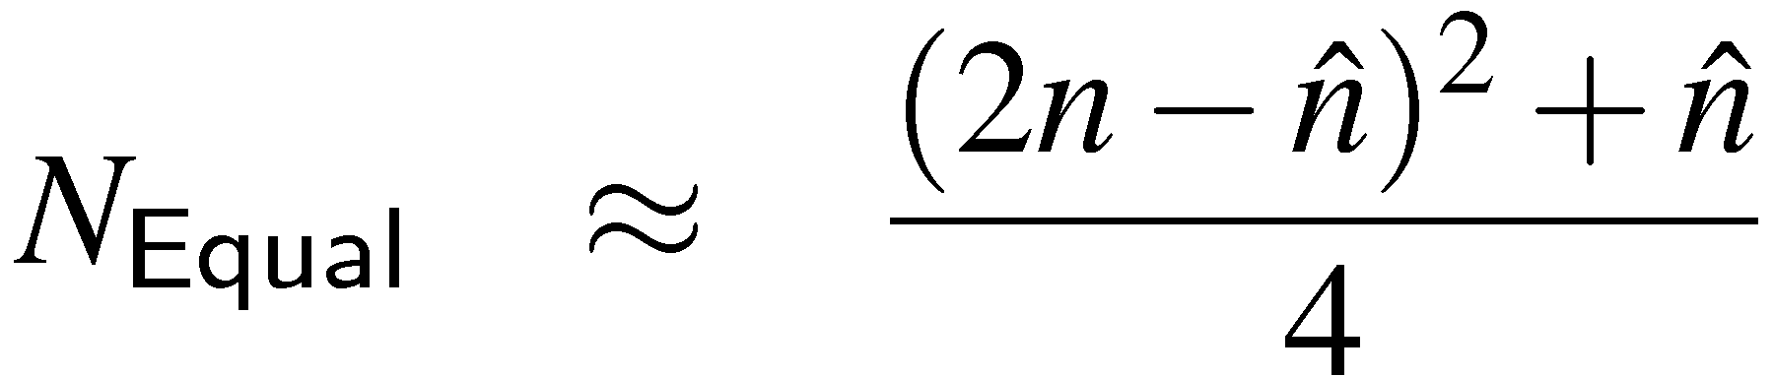
Short-Circuit Analysis
Number of Garbled Equal Circuits
(n = 100)
½ of elements joint: save 43% of effort
Fraction of Input Set in Intersection

Slide 30
Scaling
Other private set intersection problems:
Do Alice and Bob have any friends in common?
Data mining problems: combine medical records across hospitals
Two companies want to do joint marketing to common customers

Slide 31
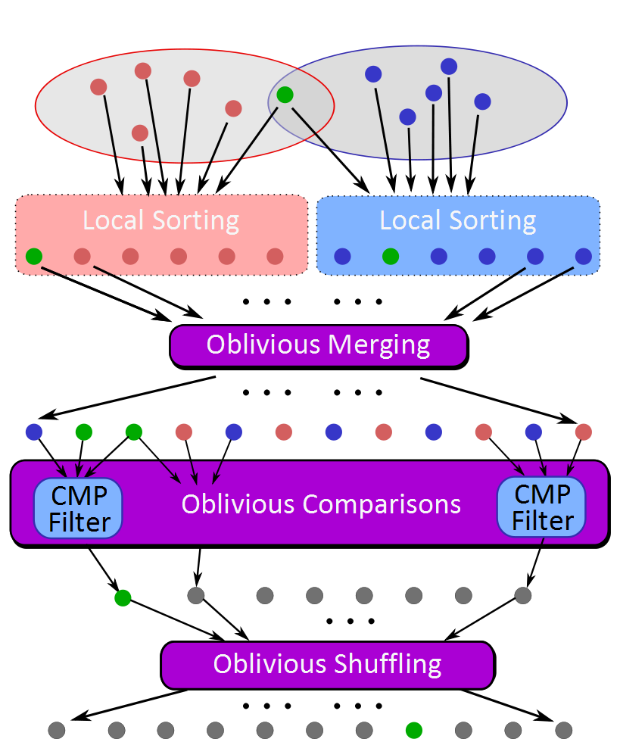
Sort-Compare-Shuffle
Sort: Take advantage of total order of elements
Compare adjacent elements
Shuffle to hide positions

Slide 32
Sort-Compare-Shuffle
Sort: Take advantage of total order of elements
Compare adjacent elements
Shuffle to hide positions

Slide 33
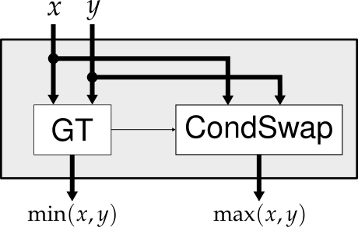
Bitonic Sorting
1
1
1
1
1
4
2
2
2
4
9
3
3
3
3
2
4
4
7
4
5
5
5
4
4
4
4
4
5
5
3
9
9
7
7
2
7
7
9
9

Slide 34
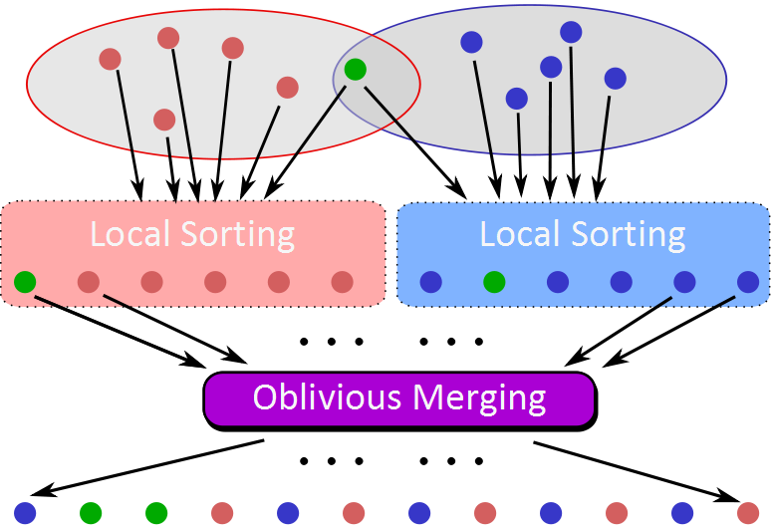
CMP
Filter
CMP
Filter
CMP
Filter
…

Slide 35
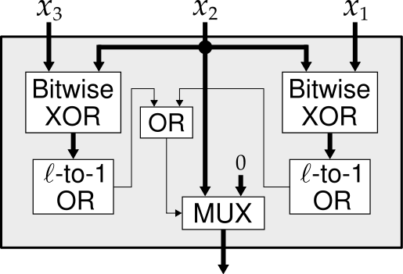
CMP3
Filter
CMP3
Filter
CMP3
Filter

Slide 36
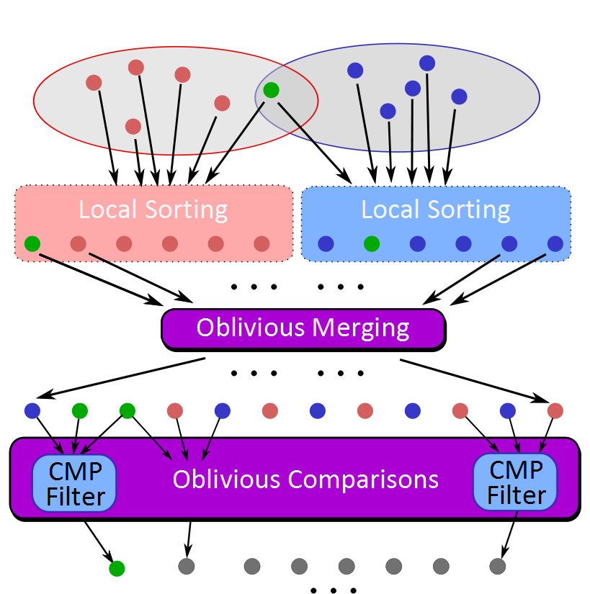
Can’t reveal results yet! Position leaks information.

Slide 37
Oblivious Shuffling
Homomorphic Encryption Shuffling Protocol
Add random mask, permute, exchange and reveal
Expensive
Sort
Simple…but expensive
Random Permutation

Slide 38
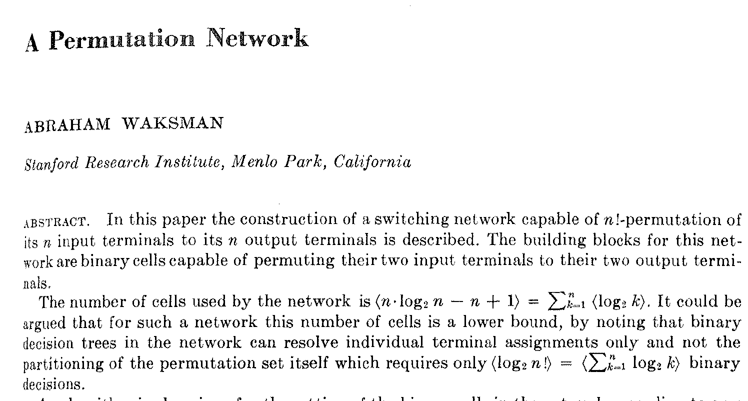
Journal of the ACM, January 1968

Slide 39
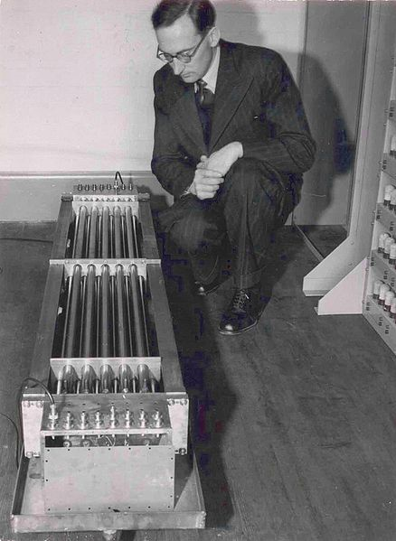
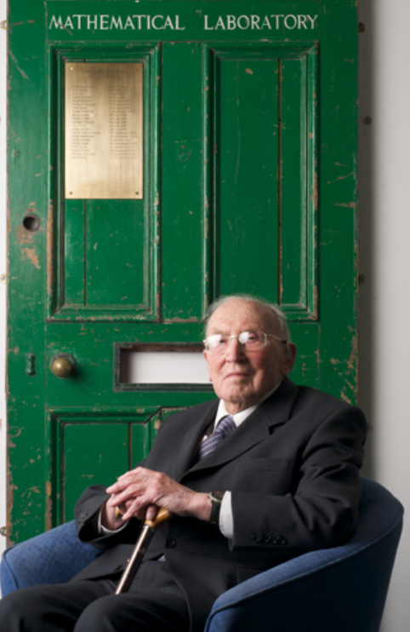
I do not imagine that many of the Turing lecturers who will follow me will be people who were acquainted with Alan Turing. … Although a mathematician, Turing took quite an interest in the engineering side of computer design… Turing’s contribution to this discussion was to advocate the use of gin, which he said contained alcohol and water in just the right proportions …
Sir Maurice Wilkes (1913-29 Nov 2010), Computers Then and Now
(1967 Turing Award Lecture)
flickr: rolandeva

Slide 40
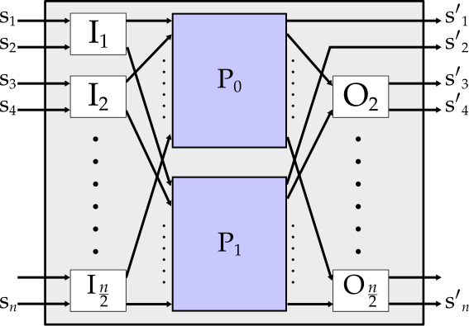

Waksman Network
Same circuit can generate any permutation:
select a random permutation, and pick swaps

Slide 41
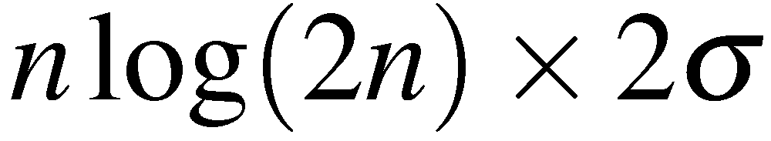
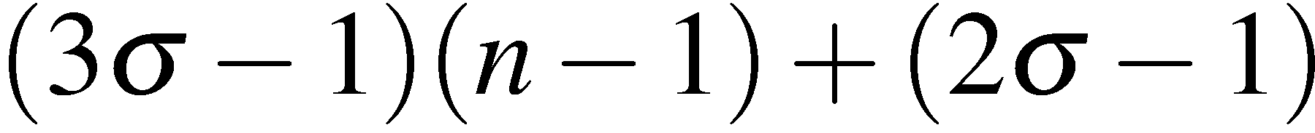
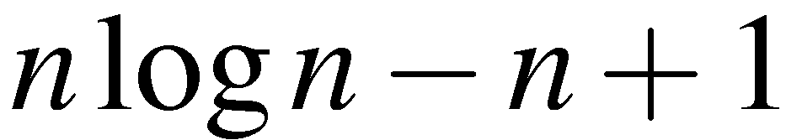
Private Set Intersection Protocol
Gates to generate and evaluate
Free

Slide 42
Private Set Intersection Results
32-bit values
Seconds
Set Size (each set)

Slide 43
Some Other Results
Problem | Best Previous Result | Our Result | Speedup
Hamming Distance (Face Recognition, Genetic Dating) – two 900-bit vectors | 213s [SCiFI, 2010] | 0.051s | 4176
Levenshtein Distance (genome, text comparison) – two 200-character inputs | 534s [Jha+, 2008] | 18.4s | 29
Smith-Waterman (genome alignment) – two 60-nucleotide sequences | [Not Implementable] | 447s | -
AES Encryption | 3.3s [Henecka, 2010] | 0.2s | 16.5
Fingerprint Matching (1024-entry database, 640x8bit vectors) | ~83s [Barni, 2010] | 18s | 4.6
USENIX Security 2011
NDSS 2011
Scalable: 1 Billion gates evaluated at ~100,000 gates/second on laptop

Slide 44

Demo!
Private Set Intersection on
Android Devices
http://MightBeEvil.com/mobile/
Peter Chapman and Yan Huang

Slide 45
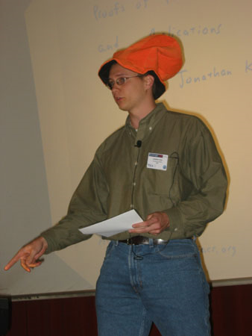
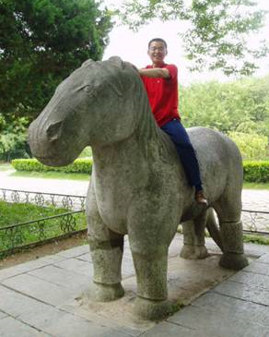



Jonathan Katz
(University of Maryland)
Peter Chapman
(UVa BACS 2012)
Yan Huang
(UVa Computer Science PhD Student)
Aaron Mackey
(UVa Public Health Genomics)
Lior Makla
(UMd / Intel)
Funding: NSF, MURI (AFOSR)
Android toys: Google

Slide 46
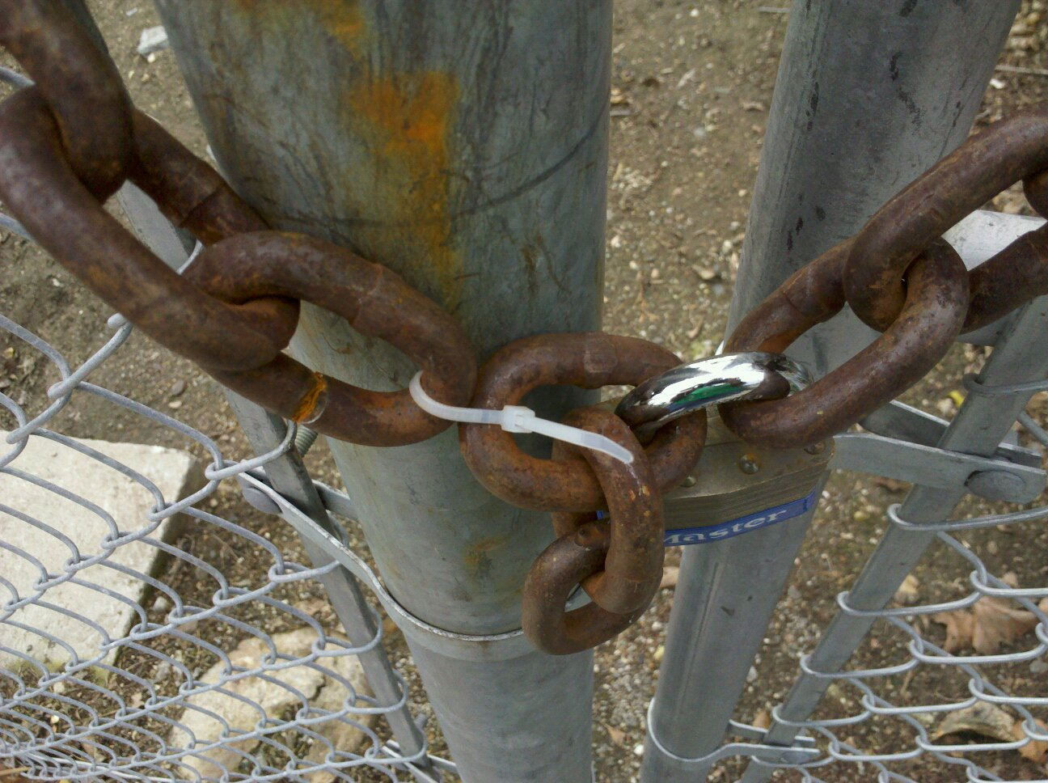
Much of the early engineering development of digital computers was done in universities. A few years ago, the view was commonly expressed that universities had played their part in computer design, and that the matter could now safely be left to industry. I do not think that it is necessary that work on computer design should go on in all universities, but I am glad that some have remained active in the field. Apart from the obvious functions of universities in spreading knowledge, and keeping in the public domain material that might otherwise be hidden, universities can make a special contribution by reason of their freedom from commercial considerations, including freedom from the need to follow the fashion.
Sir Maurice Wilkes (June 1913-Nov 2010), 1967 Turing Award Lecture
David Evans
evans@cs.virginia.edu
http://www.cs.virginia.edu/evans

Slide 47
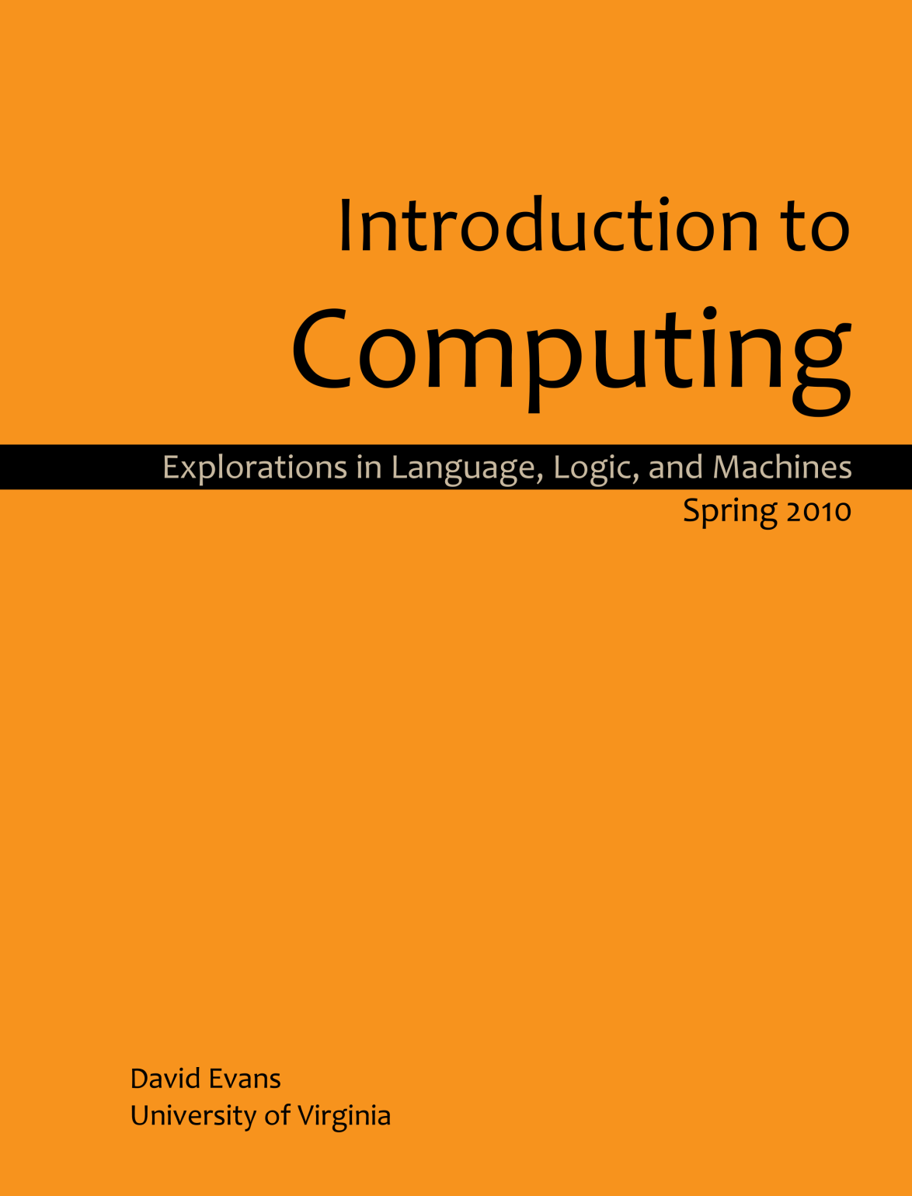
Shameless Plug
www.computingbook.org

