Slide 1
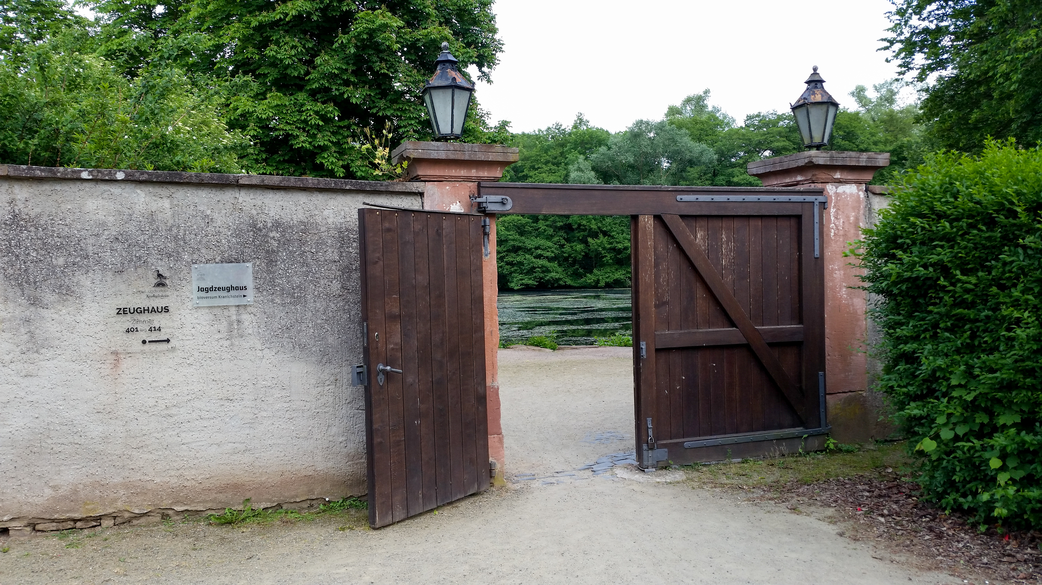
Multi-Party Computation for the Masses
CROSSING – Where Quantum Physics, Cryptography, System Security and Software Engineering meet
Darmstadt, 1 June 2015
David Evans
www.cs.virginia.edu/evans

Slide 2
(De)Motivating Application
Bob
Alice
Notes:
archaic courtship rituals
healthy and successful children

Slide 3
(De)Motivating Application
“Genetic Dating”
Genetic
Matchr
Genetic
Matchr
Bob
Alice
processing…
Start
[Don’t sue us.]
WARNING!
Reproduction not recommended
processing…
Your offspring would have good immune systems!
Start
[Don’t sue us.]
WARNING!
Reproduction not recommended
Your offspring would have good immune systems!
Genome Compatibility Protocol
Notes:
archaic courtship rituals
healthy and successful children

Slide 4
Cost to sequence genome
“Moore’s Law”
“Moore’s Law”

Slide 5
Cost to sequence genome
“Moore’s Law”
Tomorrow: Jean-Pierre Hubaux
“Whole Genome Sequencing: Revolutionary Medicine or Privacy Nightmare?”

Slide 6
Secure Two-Party Computation
Bob’s Genome
Alice’s Genome
Bob
Alice
r = f(a, b)
Can Alice and Bob compute a function on private data, without exposing anything about their data besides the result?

Slide 7
Secure Two-Party Computation
“private” and “correct”
Bob’s Genome
Alice’s Genome
Bob
Alice
r = f(a, b)
Can Alice and Bob compute a function on private data, without exposing anything about their data besides the result?

Slide 8
Yao’s Garbled Circuit Protocol
Andrew Yao, 1980s
Alice (circuit generator)
Bob (circuit evaluator)
Agree on function f
secret input a
secret input b
Garbled Circuit Protocol
r = f(a, b)
r = f(a, b)
Learns nothing else about b
Learns nothing else about a
Notes:
sounds like this should be impossible...but cryptography enables many seemingly impossible things!
apologize to people already familiar with this, but I want to do a short tutorial on how it works so everyone sees that it is possible and understand some important aspects.

Slide 9
Regular Logic
Inputs |  | Output x
a | b
0 | 0 | 0
0 | 1 | 0
1 | 0 | 0
1 | 1 | 1
a
b
AND
x
Notes:
to actually evaluate a gate, need to know the inputs

Slide 10
“Obfuscated” Logic
a_{i}, b_{i}, x_{i} are random values, chosen by generator but meaningless to evaluator.
a₀ or a₁
b₀ or b₁
Inputs |  | Output x
a | b
a₁ | b₀ | x₀
a₀ | b₁ | x₀
a₁ | b₁ | x₁
a₁ | b₀ | x₀
AND
x
Notes:
this doesn't work too well...in fact it doesn't work at all!

Slide 11
“Obfuscated” Logic
a_{i}, b_{i}, x_{i} are random values, chosen by generator but meaningless to evaluator.
a₀ or a₁
b₀ or b₁
Inputs |  | Output x
a | b
a₁ | b₀ | x₀
a₀ | b₁ | x₀
a₁ | b₁ | x₁
a₁ | b₀ | x₀
AND
x
Leaks information!

Slide 12
Garbled Logic
a₀ or a₁
b₀ or b₁
Inputs |  | Output x
a | b
a₁ | b₀ | E_{a1 ||} _{b0} (x₀)
a₀ | b₁ | E_{a0 ||} _{b1} (x₀)
a₁ | b₁ | E_{a1 ||} _{b1} (x₁)
a₀ | b₀ | E_{a0 ||} _{b0} (x₀)
AND
x

Slide 13
Garbled Logic
G
a₀ or a₁
b₀ or b₁
Inputs |  | Output x
a | b
a₁ | b₀ | E_{a1 ||} _{b0} (x₀)
a₀ | b₁ | E_{a0 ||} _{b1} (x₀)
a₁ | b₁ | E_{a1 ||} _{b1} (x₁)
a₀ | b₀ | E_{a0 ||} _{b0} (x₀)
AND
Garbled Table
x

Slide 14
Garbled Circuit Protocol
Alice (generator)
Bob (evaluator)
Picks random values for a_{{0, 1}}, b_{{0, 1}}, x_{{0, 1}}
E_{a1||b0} (x₀)
E_{a0||b1} (x₀)
E_{a1||b1} (x₁)
E_{a0||b0} (x₀)
Evaluates circuit, decrypting one row of each garbled gate
Sends a_{i}, based on her input
x_{r}
Sends hashes to decode outputs
r

Slide 15
Garbled Circuit Protocol
Alice (generator)
Bob (evaluator)
Picks random values for a_{{0, 1}}, b_{{0, 1}}, x_{{0, 1}}
E_{a1||b0} (x₀)
E_{a0||b1} (x₀)
E_{a1||b1} (x₁)
E_{a0||b0} (x₀)
How does the Bob learn his own input values?
Evaluates circuit, decrypting one row of each garbled gate
Sends a_{i}, based on her input
x_{r}
Sends hashes to decode outputs
r

Slide 16
Primitive: Oblivious Transfer
Rabin, 1981; Even, Goldreich, and Lempel, 1985; …
Alice (generator)
Bob (evaluator)
b₀ , b₁
selector i
Oblivious Transfer Protocol
Learns nothing else about i
b_{i}
Learns nothing about other value

Slide 17
E_{a0,1||b0,0}(x_{0,0})
E_{a0,0||b0,1}(x_{0,0})
E_{a0,1||b0,1}(x_{0,1})
E_{a0,0||b0,1}(x_{0,0})
E_{a1,1||b1,1}(x_{1,1})
E_{a1,0||b1,1}(x_{1,0})
E_{a1,1||b1,0}(x_{1,0})
E_{a1,0||b1,0}(x_{1,0})
a_{0,0} or a_{0,1}
b_{0,0} or b_{1,0}
b_{1,0} or b_{1,1}
a_{1,0} or a_{1,1}
G0
G1
E_{x0,0||x1,0}(x_{2,0})
E_{x0,1||x1,1}(x_{2,1})
E_{x0,1||x1,0}(x_{2,0})
E_{x0,0||x1,0}(x_{2,0})
x₀ or x₁
x_{1,0} or x_{1,1}
G2
…
Chain gates to securely compute
any discrete function!
x_{2,0} or x_{2,1}
Notes:
so, in theory, all our problems are solved! In practice, this is ridiculously expensive.

Slide 18
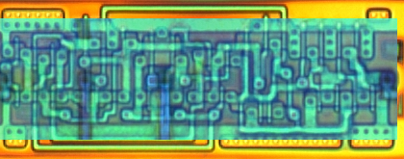
Building Computing Systems
E_{a1||b0} (x₀)
E_{a0||b1} (x₀)
E_{a1||b1} (x₁)
Digital Electronic Circuits | Garbled Circuits
Operate on known data | Operate on encrypted wire labels
One-bit logical operation requires moving some electrons a few nanometers | One-bit logical operation requires performing four encryption operations
Reuse is great! | Reuse is not allowed!

Slide 19
[Fairplay, USENIX Sec 2004]
MPC Cost (“Moore’s Law”)
>$1M
Cost to sequence genome
Estimated cost of 10k x 10k Smith-Waterman, 4T gates

Slide 20
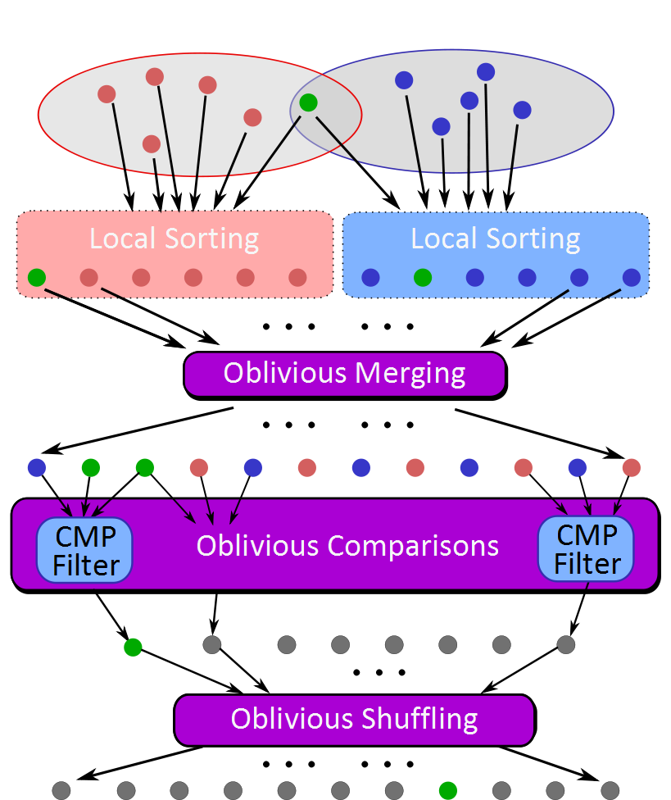
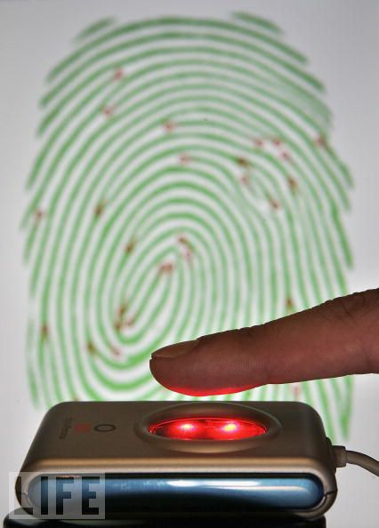
Scaling MPC
Private Biometrics
[NDSS 2011]
Personalized Medicine,
Medical Research
[USENIX Sec 2011]
for (i = 1; i <= n1; ++i) {
for(j = 1; j <= n2; ++j) {
Accum temp = acMin (dp[i][j-1], dp[i-1][j]);
obliv bool d = true;
obliv if (acLessEq(dp[i-1][j-1], temp)) {
acCopy(&temp, &dp[i-1][j-1]);
d = (s1[i-1] != s2[j-1]);
}
Circuit Construction
Obliv-C
Private Set Intersection
[NDSS 2012]
Machine Learning [S&P 2013]
Protocols
E_{a0,1||b0,0}(x_{0,0})
E_{a0,0||b0,1}(x_{0,0})
E_{a0,1||b0,1}(x_{0,1})
E_{a0,0,|b0,1}(x_{0,0})
Gate Execution

Slide 21
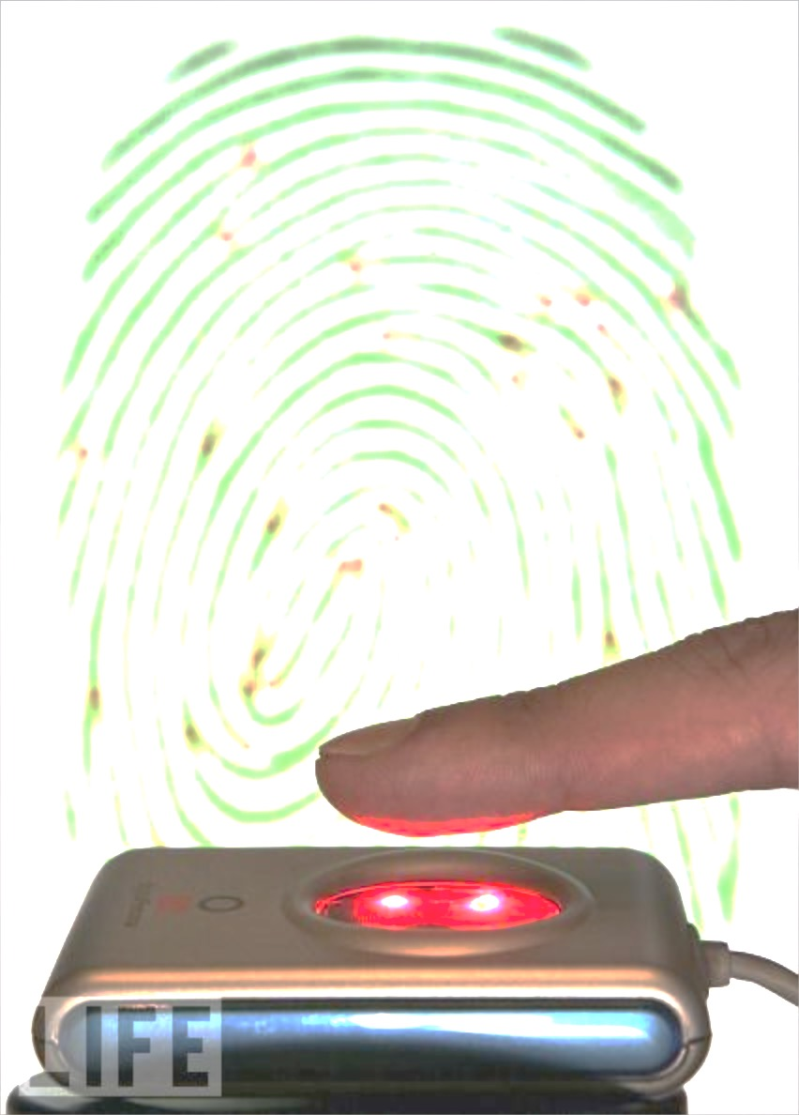
Scaling MPC
Private Biometrics
[NDSS 2011]
Personalized Medicine,
Medical Research
[USENIX Sec 2011]
for (i = 1; i <= n1; ++i) {
for(j = 1; j <= n2; ++j) {
Accum temp = acMin (dp[i][j-1], dp[i-1][j]);
obliv bool d = true;
obliv if (acLessEq(dp[i-1][j-1], temp)) {
acCopy(&temp, &dp[i-1][j-1]);
d = (s1[i-1] != s2[j-1]);
}
Circuit Construction
Obliv-C
Private Set Intersection
[NDSS 2012]
Machine Learning [S&P 2013]
Protocols
E_{a0,1||b0,0}(x_{0,0})
E_{a0,0||b0,1}(x_{0,0})
E_{a0,1||b0,1}(x_{0,1})
E_{a0,0,|b0,1}(x_{0,0})
Gate Execution

Slide 22
Talk Outline
Enc_{a0,1,b0,0}(x_{0,0})
Enc_{a0,0,b0,1}(x_{0,0})
Enc_{a0,1,b0,1}(x_{0,1})
Enc_{a0,0,b0,1}(x_{0,0})
Gate Execution
z₁
z₂
Protocols
This Afternoon
Farinaz Koushanfar
“TinyGarble: Synthesis of Highly Compact Circuits for Secure Computation”
Stefan Katzenbeisser
“Towards Practical Two-Party Computations”
Circuit Construction

Slide 23
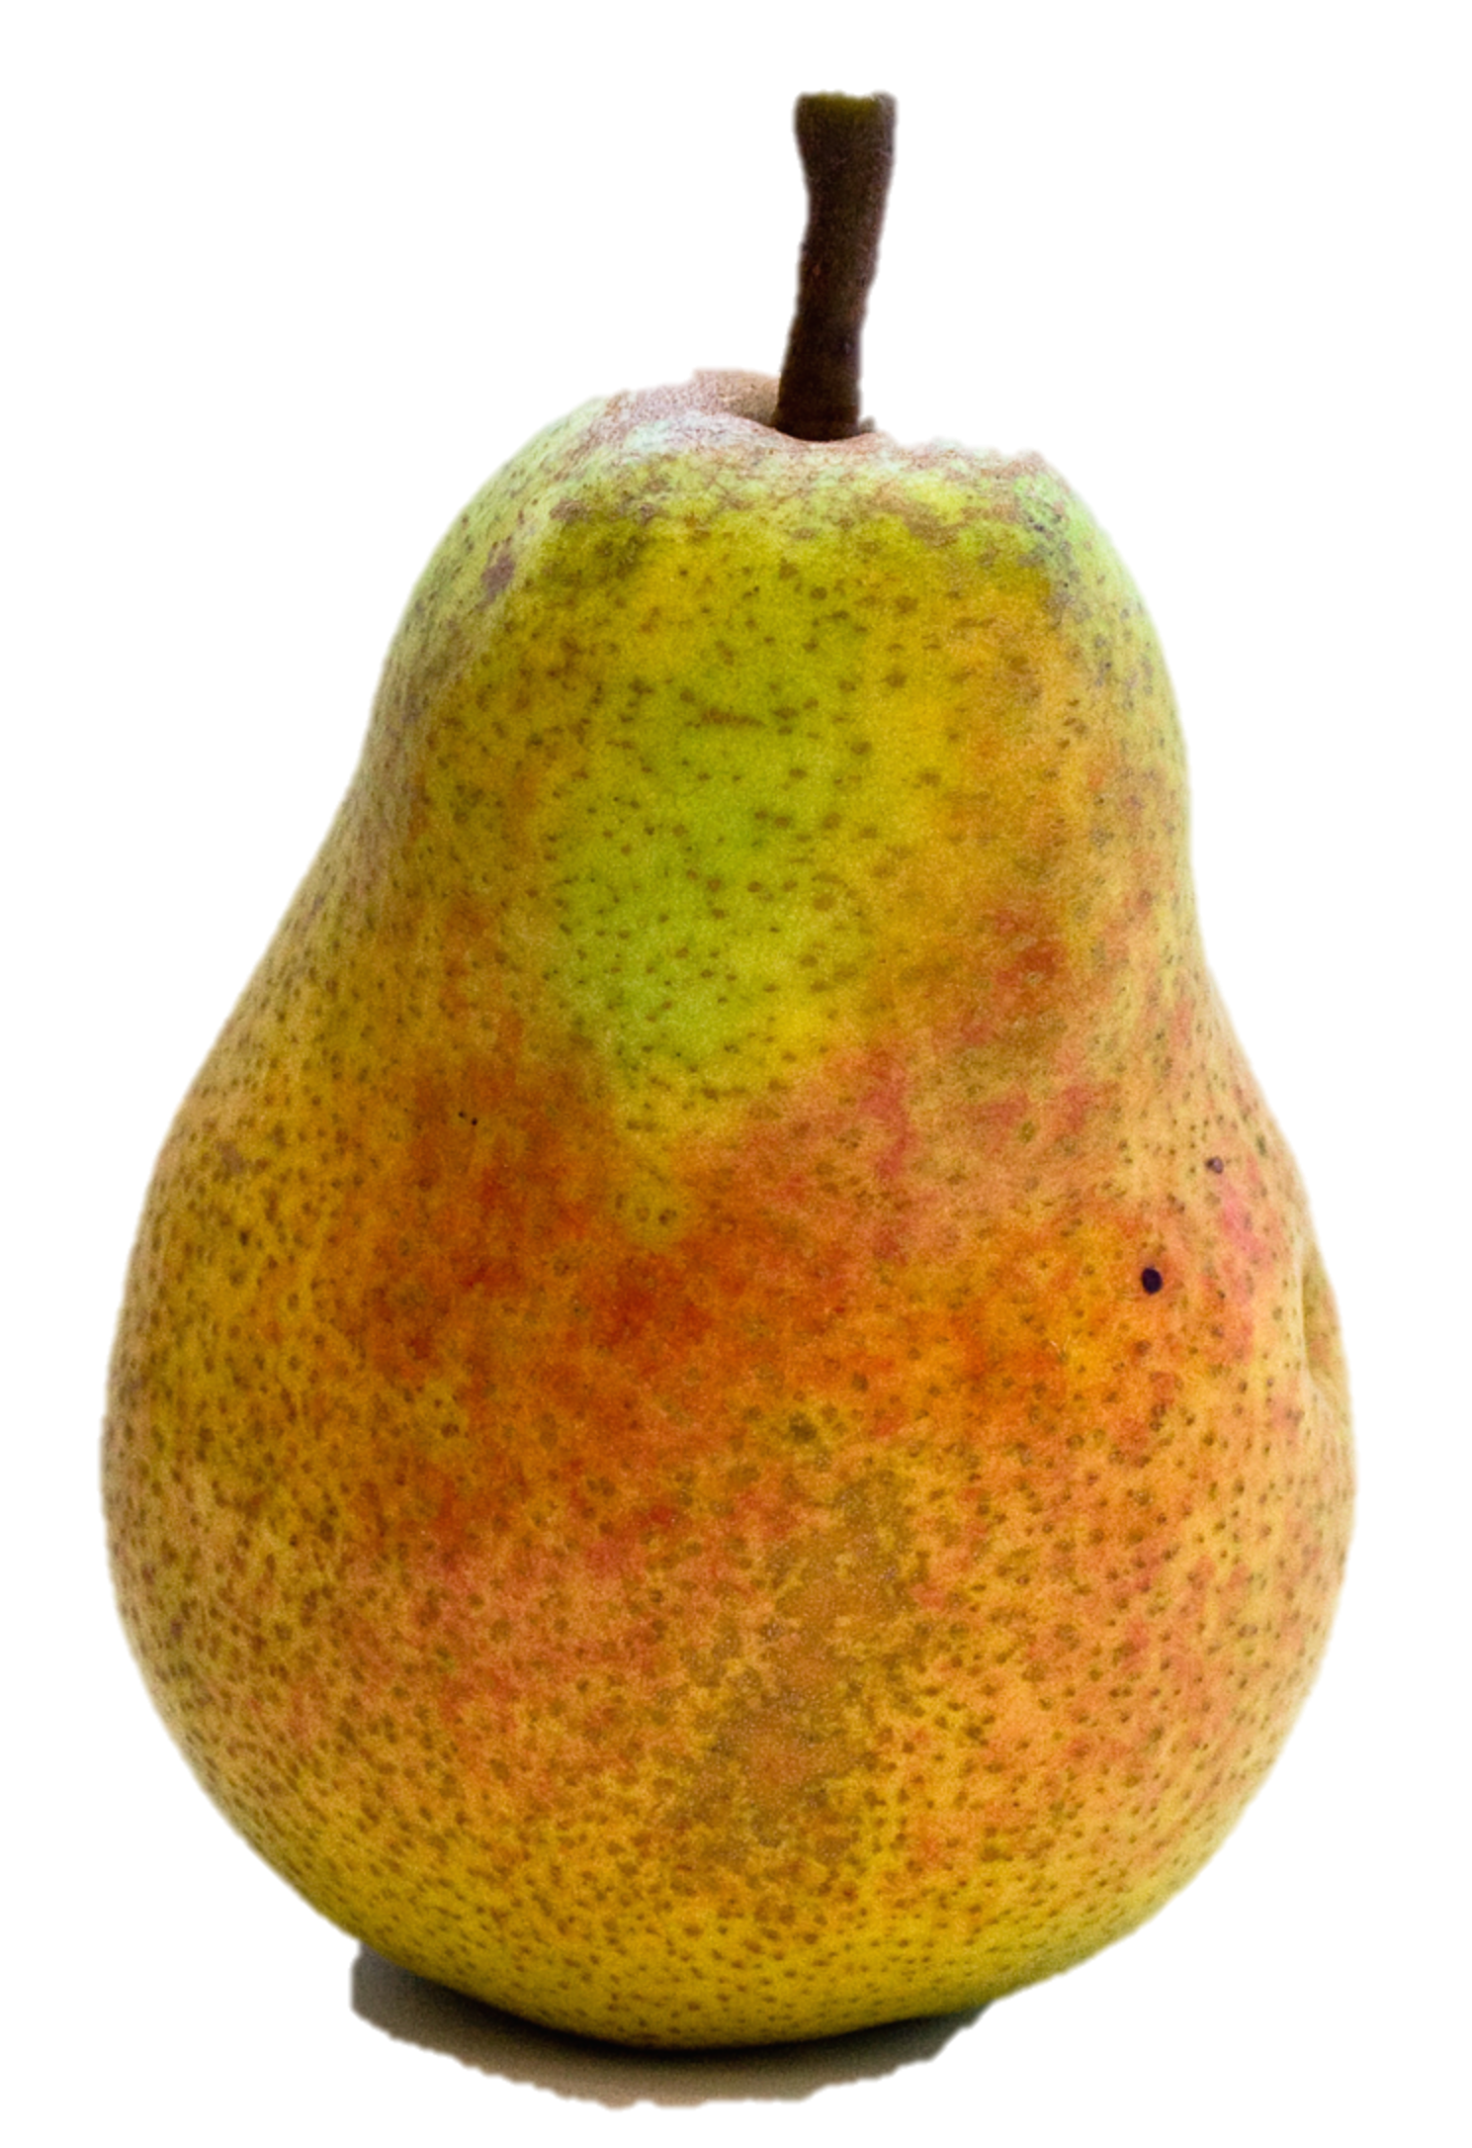
Two Halves Make a Whole Reducing Data Transfer in Garbled Circuits using Half Gates
+
=
Samee Zahur
(UVa PhD Student)
Samee Zahur, Mike Rosulek, and David Evans. In EuroCrypt 2015.

Slide 24
Background: Point-and-Permute
Enc_{a0,,b0,}(c₀)
Enc_{a0,,b1}(c₀)
Enc_{a0,,b0}(c₀)
Enc_{a1,b1}(c₁)
Encoding garble table entries:
Output wire label
Input wire labels
(with selection bits)
Beaver, Micali and Rogaway [STOC 1990]

Slide 25
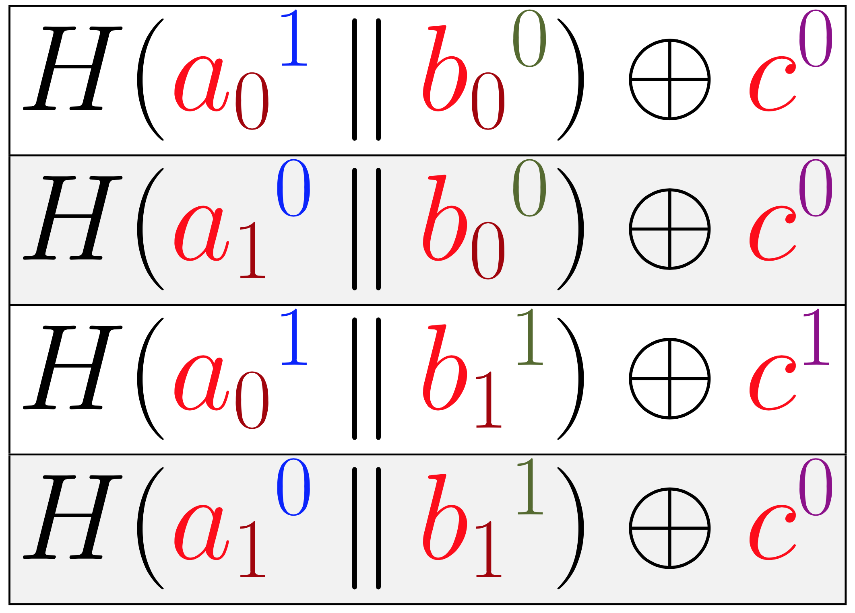
Background: Garbled Row Reduction
Naor, Pinkas and Sumner [1999]

Slide 26
Background: Garbled Row Reduction
Naor, Pinkas and Sumner [1999]

Slide 27
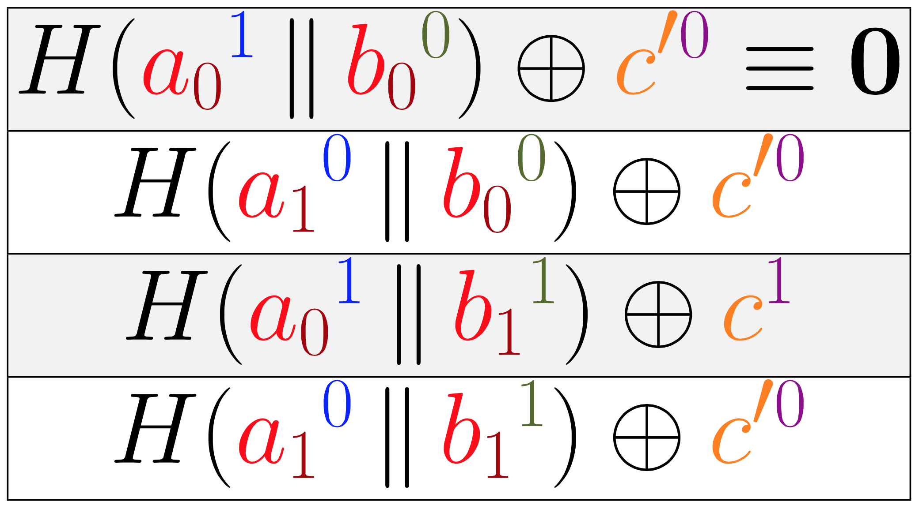
Background: Garbled Row Reduction
Naor, Pinkas and Sumner [1999]

Slide 28
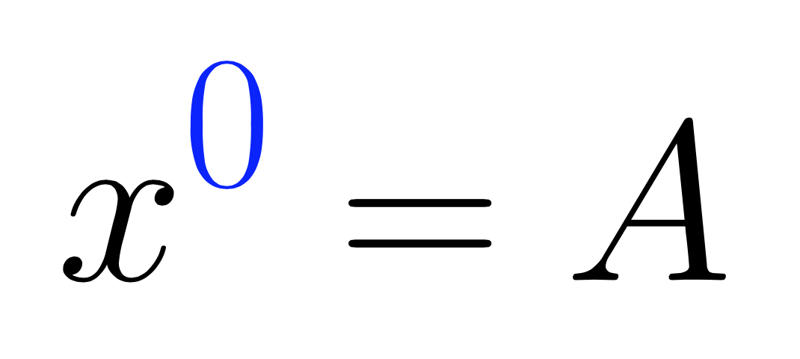
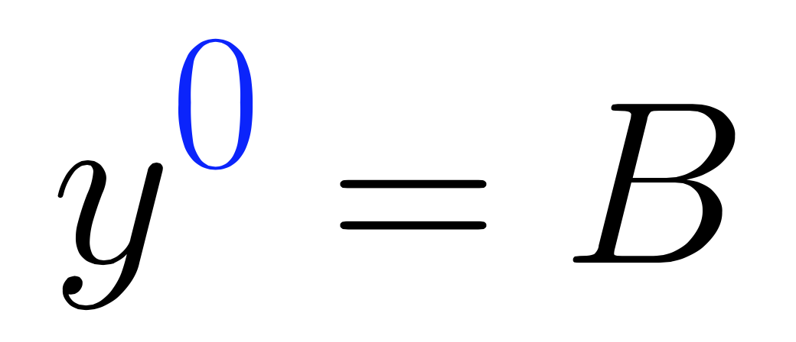
Background: Free-XOR
Global generator secret
Kolesnikov and Schneider [2008]

Slide 29
Background: Free-XOR
Global generator secret
Kolesnikov and Schneider [2008]

Slide 30
Background: Free-XOR
Global generator secret
XOR are free! No ciphertexts or encryption needed.
Kolesnikov and Schneider [2008]

Slide 31
Half Gates
Yan Huang, David Evans, and Jonathan Katz. Private Set Intersection: Are Garbled Circuits Better than Custom Protocols? [NDSS 2012]

Slide 32
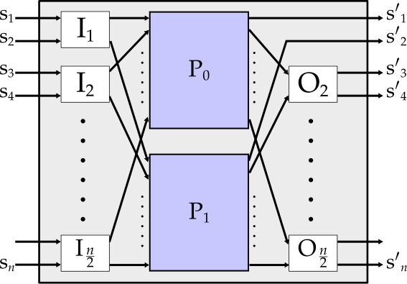
Yan Huang, David Evans, and Jonathan Katz. Private Set Intersection: Are Garbled Circuits Better than Custom Protocols? [NDSS 2012]

Slide 33
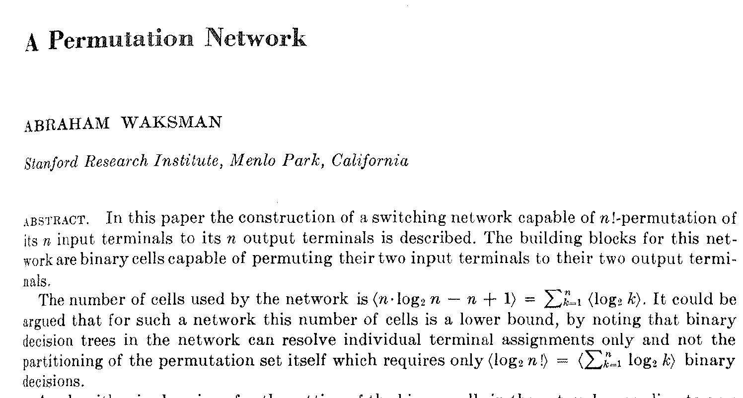
Journal of the ACM, January 1968
Yan Huang, David Evans, and Jonathan Katz. Private Set Intersection: Are Garbled Circuits Better than Custom Protocols? [NDSS 2012]
swap gates, configured (by generator) to do random permutation

Slide 34
Generator Half Gate
Known to generator (but secret to evaluator)

Slide 35
Generator Half Gate
Known to generator (but secret to evaluator)

Slide 36
Swapper: “Generator Half Gate”
Known to generator (but secret to evaluator)
With Garbled Row Reduction:

Slide 37
Evaluator Half-Gate
Known to evaluator (but secret to generator)

Slide 38
Evaluator Half-Gate
Known to evaluator (but secret to generator)
But, we need a gate where both inputs are secret…

Slide 39
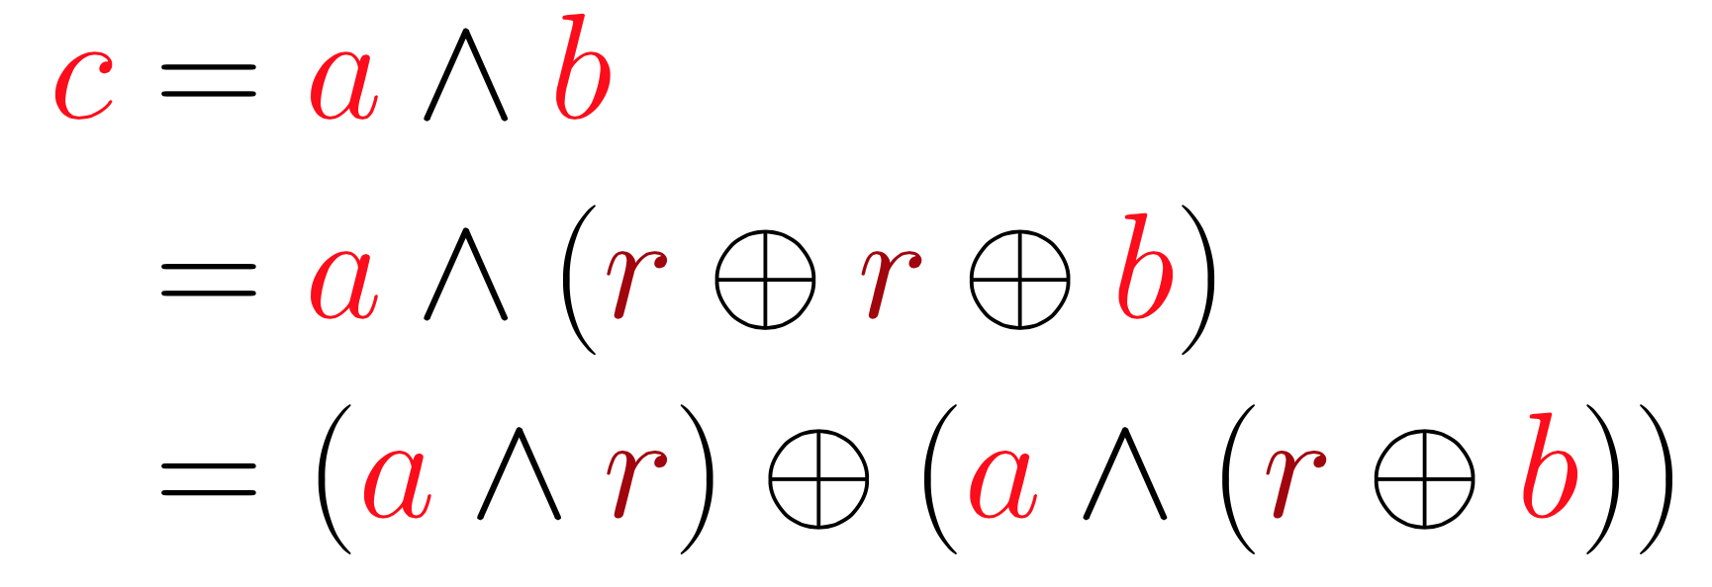
Half + Half = Full Secret Gate
random bit selected by generator
unknown
known
unknown
“leaked”

Slide 40
Half + Half = Full Secret Gate
random bit selected by generator
unknown
known
unknown
“leaked”

Slide 41
Half + Half = Full Secret Gate
random bit selected by generator
unknown
known
unknown
“leaked”

Slide 42
Half + Half = Full Secret Gate
random bit selected by generator
unknown
known
unknown
“leaked”
generator half gate
evaluator half gate

Slide 43
 | Standard Gates | Half Gates
Generator Encryptions (H) | 4 | 4
Evaluator Encryptions (H) | 1 | 2
Ciphertexts Transmitted | 3 | 2
XORs Free | ✓ | ✓
Bandwidth |  | ⬇33%
Execution Time (edit distance) |  | ⬇25%
Energy |  | ⬇21%

Slide 44
 | Standard Gates | Half Gates
Generator Encryptions (H) | 4 | 4
Evaluator Encryptions (H) | 1 | 2
Ciphertexts Transmitted | 3 | 2
XORs Free | ✓ | ✓
Bandwidth |  | ⬇33%
Execution Time (edit distance) |  | ⬇25%
Energy |  | ⬇21%

Slide 45
Is one ciphertext enough?

Slide 46
Is one ciphertext enough?
No, two is minimum at least assuming garbling schemes use only random oracle and linear operations.

Slide 47
Scaling MPC
Private Biometrics
[NDSS 2011]
Personalized Medicine,
Medical Research
[USENIX Sec 2011]
for (i = 1; i <= n1; ++i) {
for(j = 1; j <= n2; ++j) {
Accum temp = acMin (dp[i][j-1], dp[i-1][j]);
obliv bool d = true;
obliv if (acLessEq(dp[i-1][j-1], temp)) {
acCopy(&temp, &dp[i-1][j-1]);
d = (s1[i-1] != s2[j-1]);
}
Circuit Construction
obliv-C
Private Set Intersection
[NDSS 2012]
Machine Learning [S&P 2013]
Protocols
E_{a0,1||b0,0}(x_{0,0})
E_{a0,0||b0,1}(x_{0,0})
E_{a0,1||b0,1}(x_{0,1})
E_{a0,0,|b0,1}(x_{0,0})
Gate Execution

Slide 48
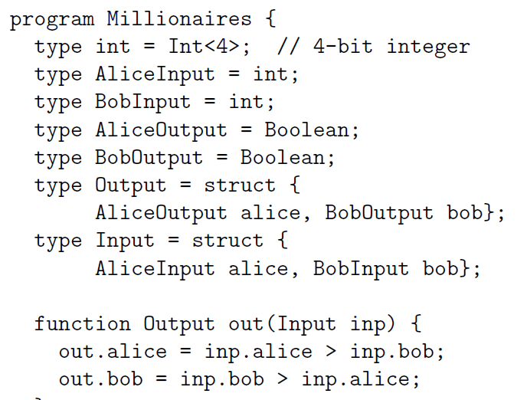
Fairplay
Bob
Alice
SFDL Compiler
SFDL Compiler
Circuit
(SHDL)
SFDL Program
Garbled Tables Generator
Garbled Tables Evaluator
Malkhi, Nisan, Pinkas and Sella [USENIX Sec 2004]

Slide 49
Pipelined Execution
Circuit-Level Application
Circuit Structure
Circuit Structure
GC Framework (Generator)
GC Framework
(Evaluator)
x1
x2
y1
y2
z1
z2
Yan Huang
(UVa PhD,
U Indiana)
Yan Huang, David Evans, Jonathan Katz, and Lior Malka. Faster Secure Two-Party Computation Using Garbled Circuits. USENIX Security 2011.
Notes:
Big scalability problem is size of circuits because of all the garbled tables - way to solve that is to avoid ever needing to store the whole circuit.

Slide 50
100s gates/second
Free-XOR
Pipelining, +
100k gates/second
Half Gates
(Estimates for 2PC, 4T gates)
~5M gates/second

Slide 51
Semi-Honest (“Honest but Curious”)
Alice
Bob
oblivious transfer
generator
generated circuits
Evaluates
output decoding/sharing
r
r
r = f(a, b)
Only provides privacy and correctness guarantees if circuit is generated honestly!

Slide 52
Standard Fix: “Cut-and-Choose”
Generator
(Alice)
Evaluator
(Bob)
(1) N instances of generated circuit
(2) Challenge: choose a random subset
(4) checks all revealed circuits
(3) Keys for selected circuits
(5) If okay,
evaluate rest and select majority output
Provides security against active attacker, but for reasonable security N > 300

Slide 53
Active Security
Symmetric
Cut-and-Choose
[HKE 2013]
Semi-Honest

Slide 54
Semi-Honest is Half-Way There
Privacy
Nothing is revealed other than the output
(Not) Correctness
The output of the protocol is f(a, b)
Generator
Evaluator
Malicious-resistant OT
As long as evaluator doesn’t send result (or complaint) back, privacy for evaluator is guaranteed.
Semi-Honest GC
Notes:
Observation

Slide 55
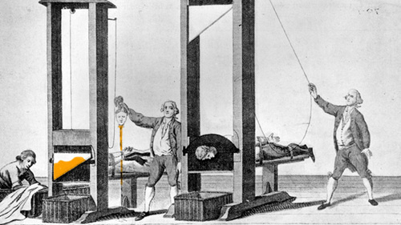
Dual Execution Protocols
Yan Huang, Jonathan Katz, David Evans.
[IEEE S&P (Oakland) 2012]
Mohassel and Franklin. [PKC 2006]

Slide 56
Dual Execution Protocol
Alice
Bob
generator
first round execution (semi-honest)
evaluator
z=f(x, y)
evaluator
second round execution (semi-honest)
generator
z'=f(x, y)
fully-secure, authenticated equality test
z, learned output
wire labels
z’, learned output
wire labels
Pass if z = z’ and correct wire labels

Slide 57
Security Properties
Correctness: guaranteed by authenticated, secure equality test
Privacy: Leaks one (extra) bit on average
adversarial circuit fails on ½ of inputs
Malicious generator can decrease likelihood of being caught, and increase information leaked when caught (but decreases average information leaked): at extreme, circuit fails on just one input.

Slide 58
Proving Security: Malicious
Ideal World
Show equivalence
Real World
A
y
B
A
B
x
Trusted Party in Ideal World
y
x
Secure Computation Protocol
Corrupted party behaves arbitrarily
Adversary receives:
f (x, y)
Standard Malicious Model: can’t prove this for Dual Execution

Slide 59
Proof of Security: One-Bit Leakage
Controlled by
malicious A
Ideal World
A
y
B
x
Trusted Party in Ideal World
g ∈ R → {0, 1}
g is an arbitrary Boolean function selected by adversary
Adversary receives:
f (x, y) and g(x, y)
Can prove equivalence to this for Dual Execution protocols

Slide 60
Intuition: 1-bit Leak
Broken Circuit for these Inputs
Cheating detected
Inputs where
f (?, y) = r
Victim’s Possible Inputs

Slide 61
Implementation
Alice
Bob
generator
first round execution (semi-honest)
evaluator
z=f(x, y)
Recall: work to generate is ∼2x work to evaluate!
evaluator
second round execution (semi-honest)
generator
z'=f(x, y)
fully-secure, authenticated equality test
z, learned output
wire labels
z’, learned output
wire labels
Pass if z = z’ and correct wire labels

Slide 62
Active Security
Semi-Honest
Dual Execution

Slide 63
Secure Computation for the Masses?
Remarkable progress in past 10 years
Costs reduced by 10¹²
Beginning to see commercial deployments
Scaling number of parties still very hard
Challenge of End-to-End Trust
Trusting Software
Understanding leaks from output
User-understandable information release policies

Slide 64
David Evans
evans@virginia.edu
www.cs.virginia.edu/evans
oblivc.org
mightBeEvil.org
Collaborators (this work):
Yan Huang, Jonathan Katz,
Mike Rosulek, Samee Zahur
Funding: NSF, AFOSR, Google

Slide 65
Not Used

Slide 66
