Slide 1
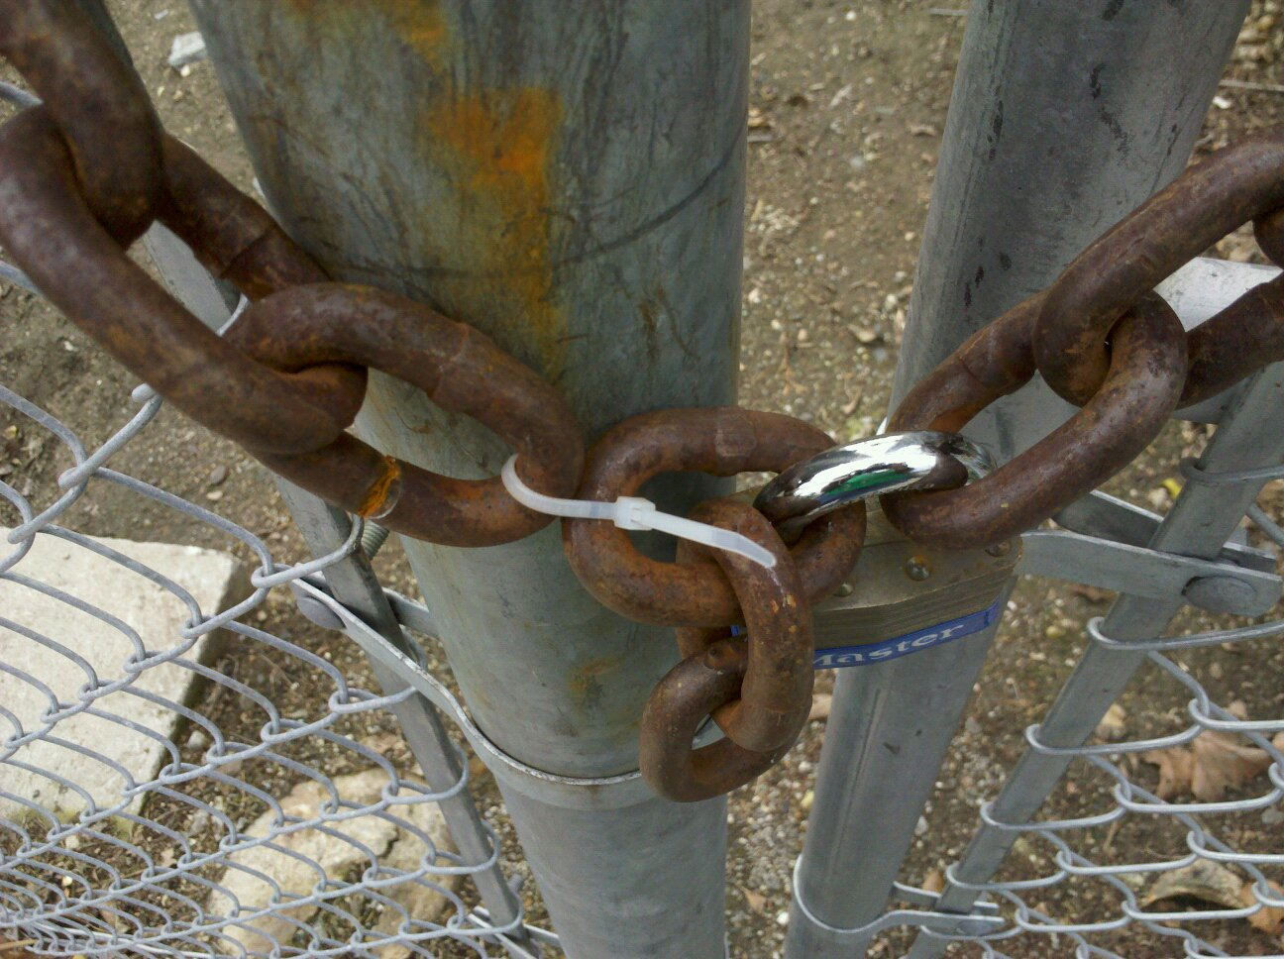
Research in
Security and Privacy
David Evans
www.cs.virginia.edu/evans
www.jeffersonswheel.org
cs6190 - 21 September 2011
Image: Roger Halbheer

Slide 2
My Life Story!

Slide 3
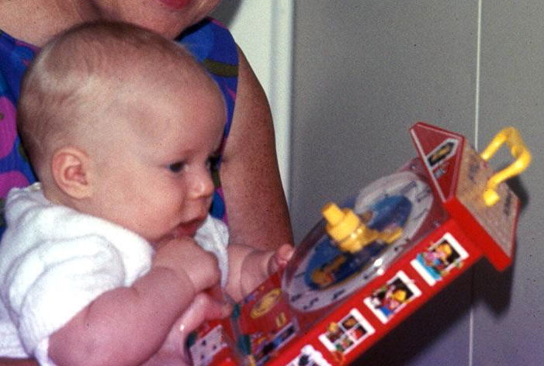
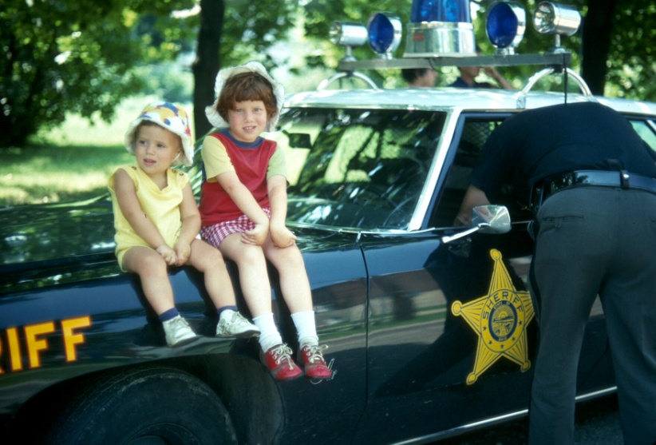
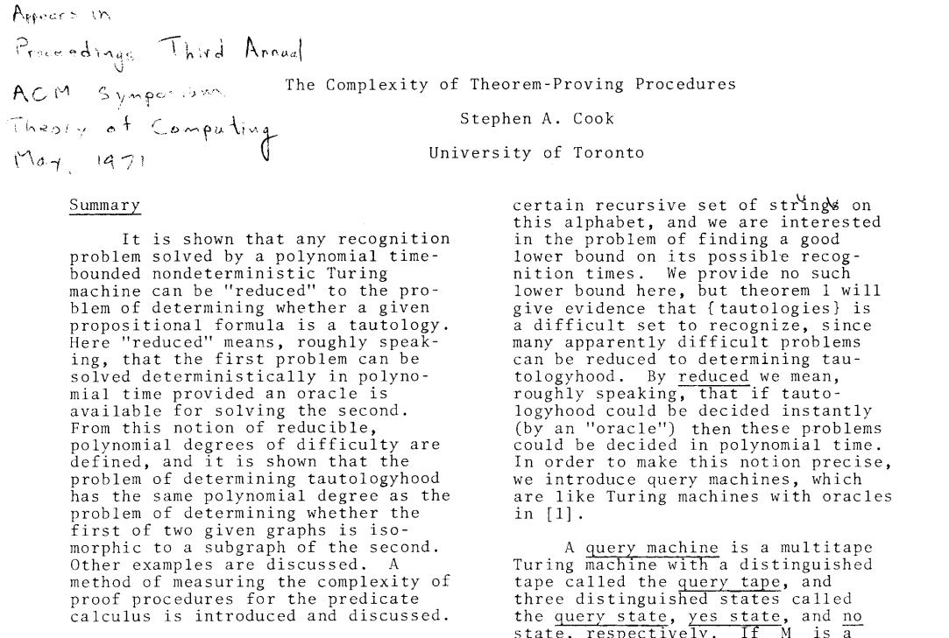
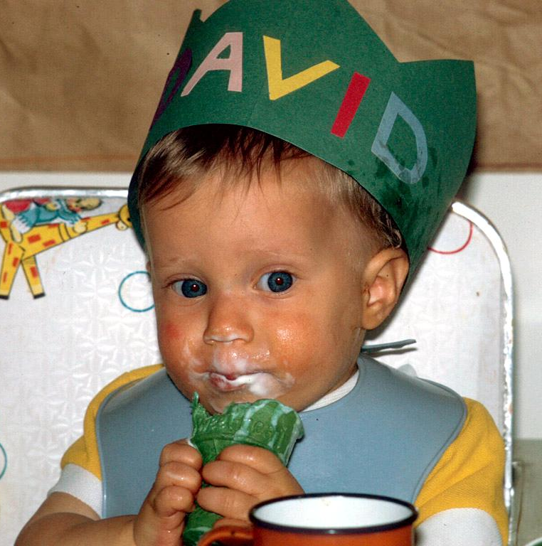
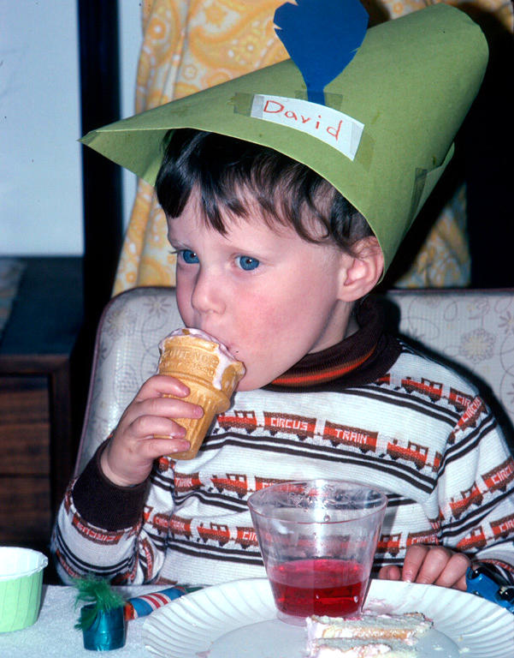
Later in May 1971
(Michigan)
May 3, 1971
(Shaker Heights, Ohio)

Slide 4
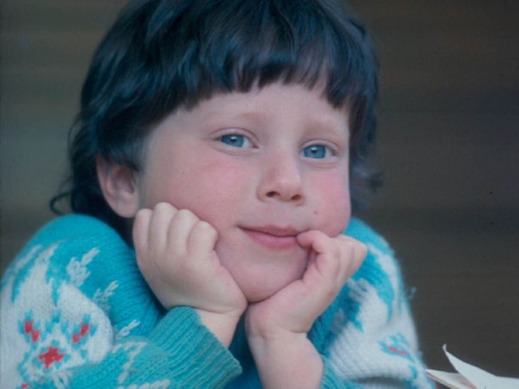
Finding a Research Area

Slide 5
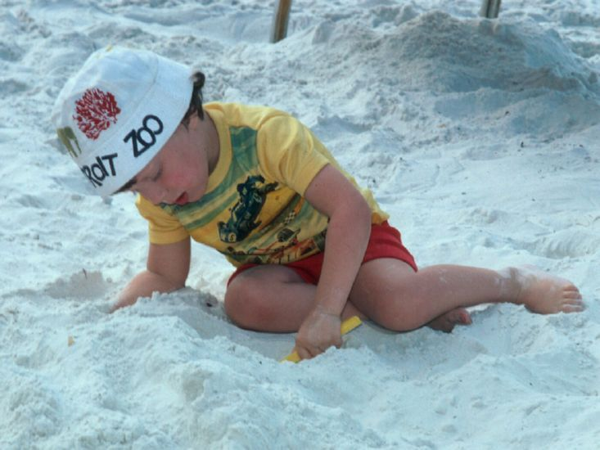
Semiconductor Design?

Slide 6
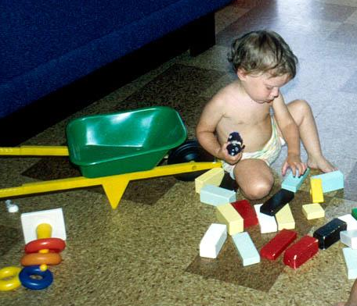
Architecture?

Slide 7
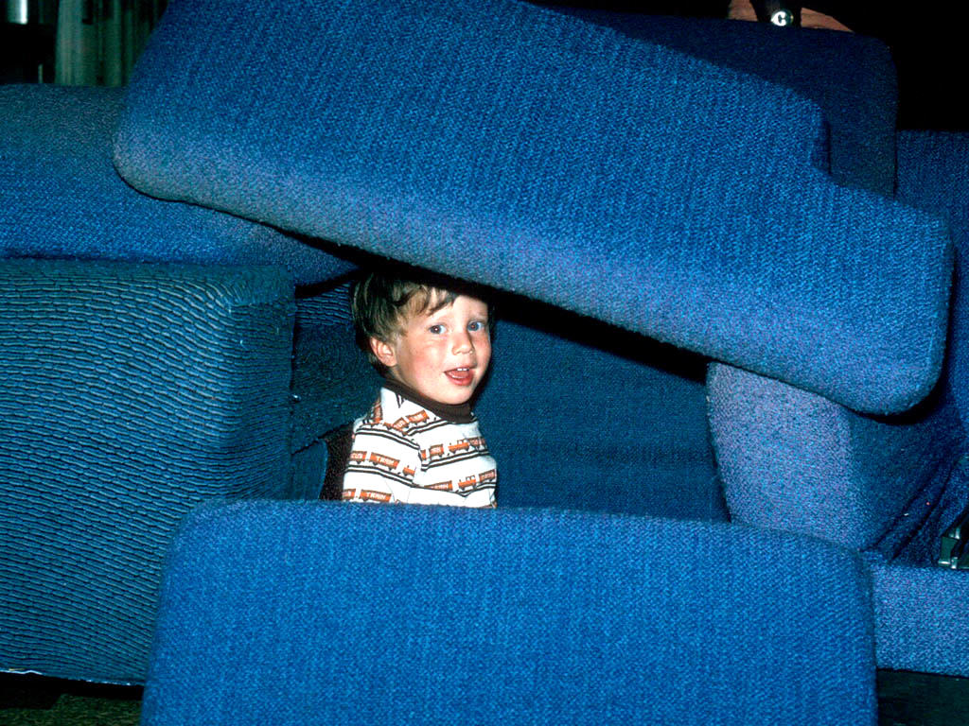
Softwear Engineering?

Slide 8
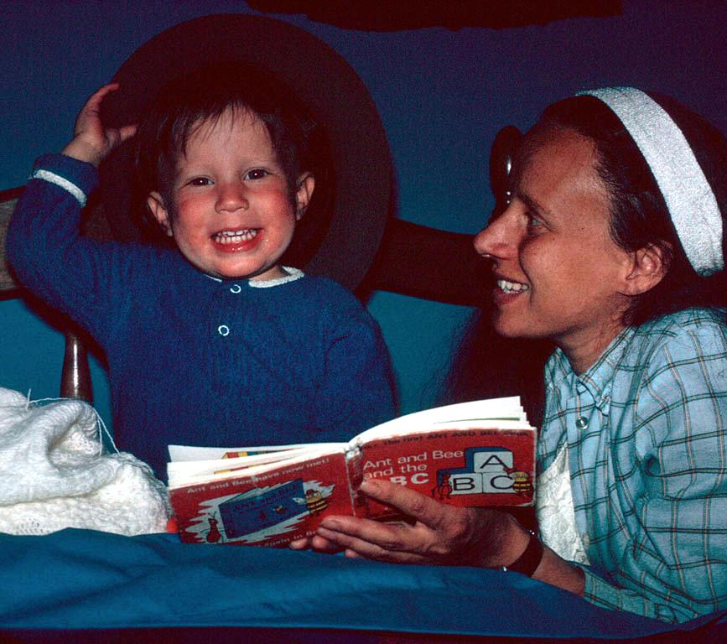
Programming Languages?

Slide 9
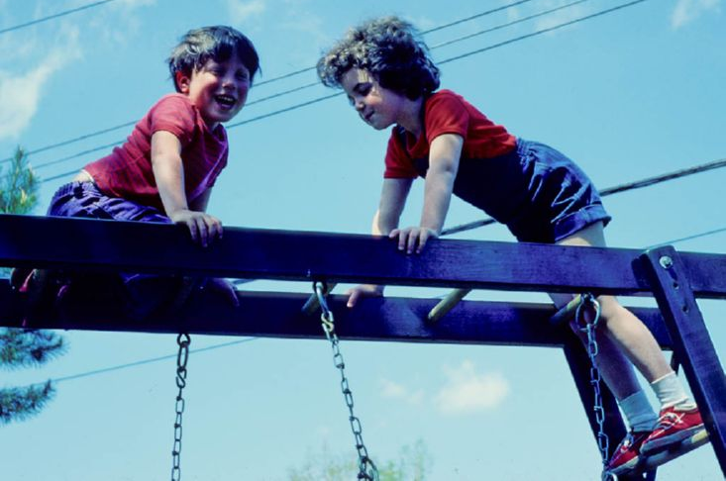
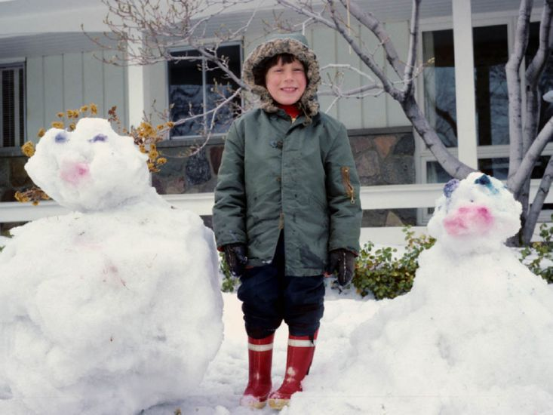
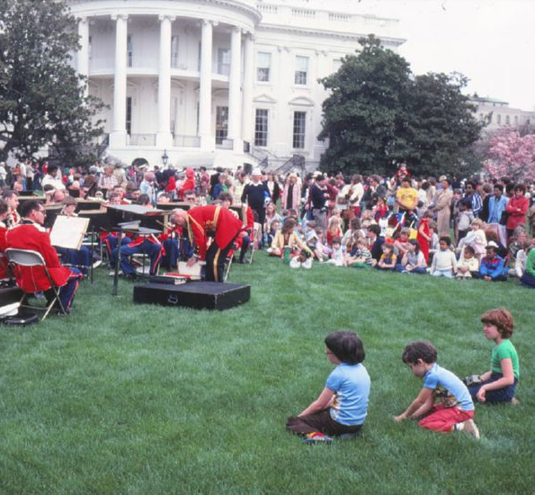
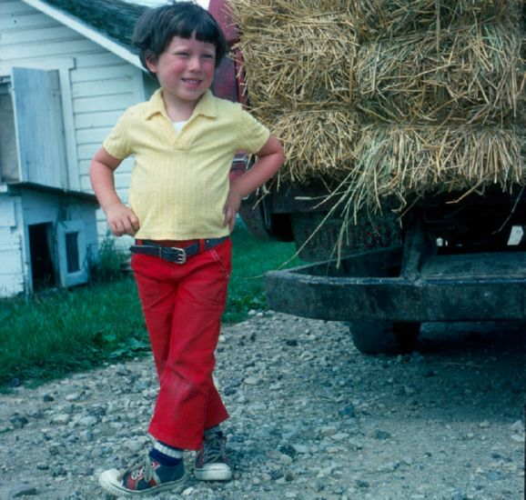
Networking?
Temperature-Aware Computing?
Sensor
Networks?
Information Retrieval?

Slide 10


Slide 11
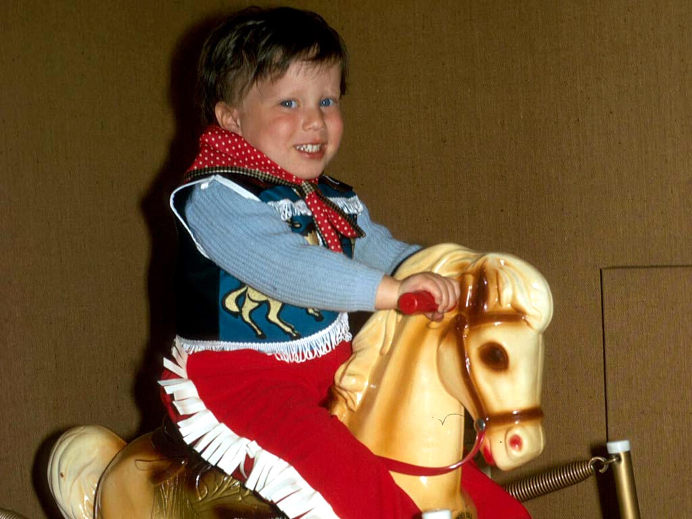
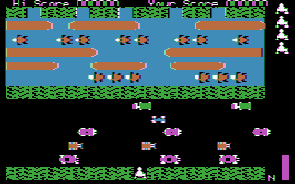
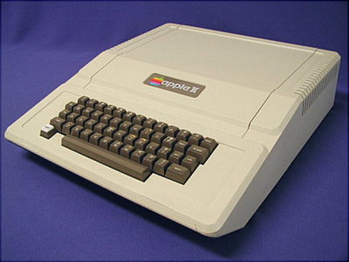
Eureka! Graphics!

Slide 12
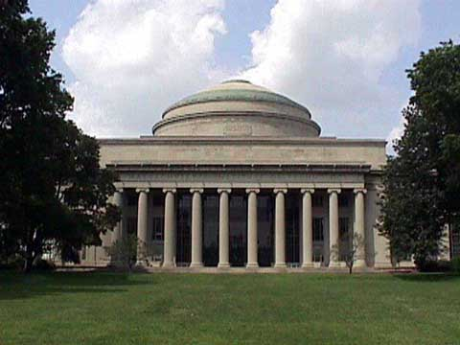
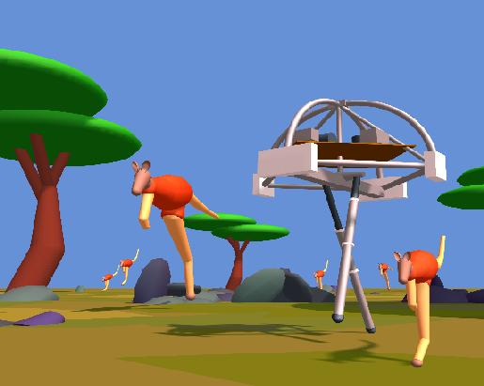
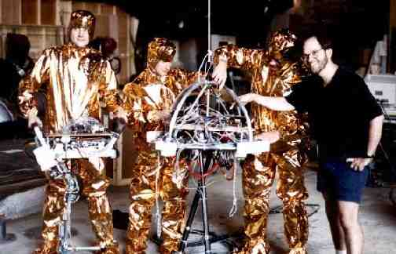
“On the Run”, 1991
MIT
1978
1989
1990
Marc Raibert

Slide 13
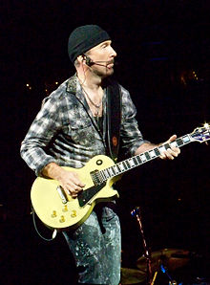
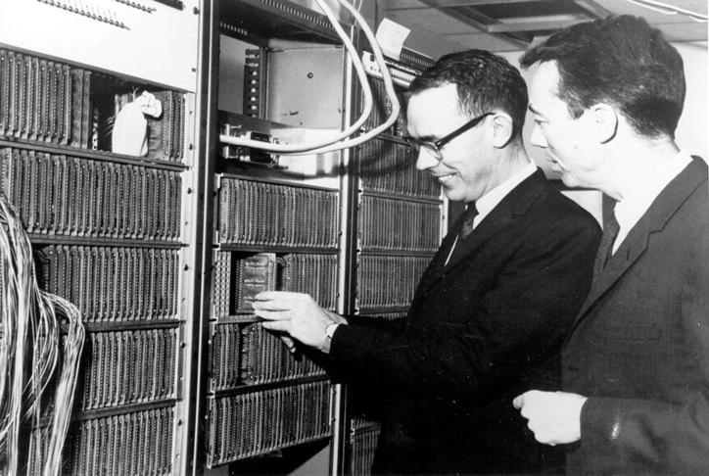

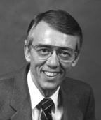
David (H.) Evans (aka, “The Edge”)
David (C.) Evans (and Ivan Sutherland)
Computer Graphics Pioneer

Slide 14
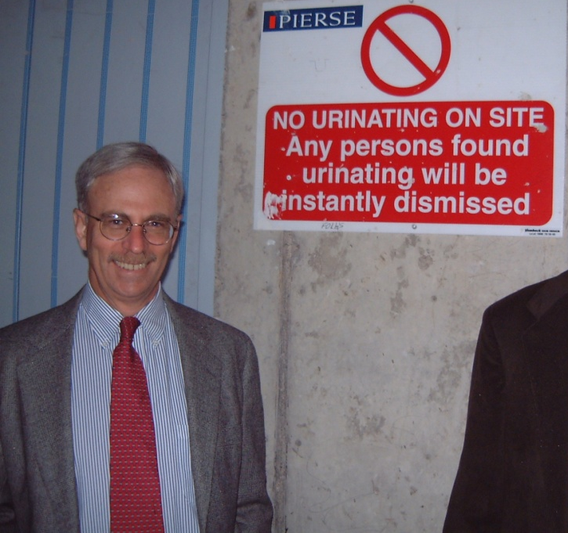
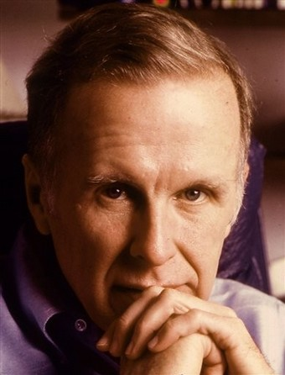


John Backus
(IBM Almaden)
Someone noticed I hadn’t passed quals yet
Idea for PhD topic
Finished PhD
Joined UVa
John Guttag (MIT)
1991
1994
1999
2000
Programming Languages
Software Engineering
splint.org
Security

Slide 15

2000
2011
Programming Languages
Software Engineering
Networking, Sensor Networks
Applied Cryptography
Operating Systems
Security

Slide 16

Computer Security
Study of computing systems in the presence of adversaries
about what happens when people don’t follow the rules

Slide 17
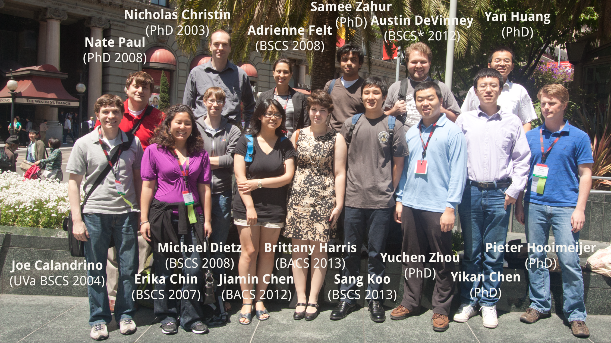
Security Research Group
In PL Group
At USENIX Security Symposium, San Francisco, August 2011

Slide 18
Main Active Projects
DHOSA: End-to-end Security for Web and Smartphone Applications
(MURI with UC Berkeley, Harvard, UIUC, Stonybrook)
Secure Computation (www.securecomputation.org)
(NSF with abhi shelat, UMd, Indiana)
Resilient Clouds
(DARPA with JHU, Purdue)
I am looking for 1-3 students for each of these, but will only talk about Secure Computation today.

Slide 19
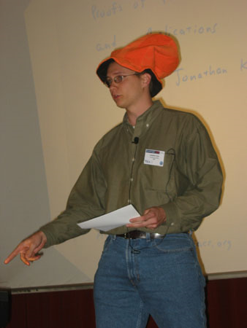
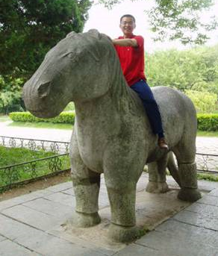
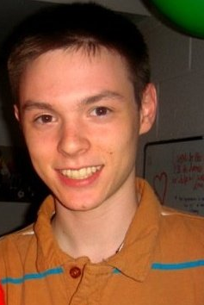

Secure Computation with Garbled Circuits
Jonathan Katz
(University of Maryland)
Peter Chapman
(UVa BACS 2012)
Aaron Mackey
(UVa Public Health Genomics)
Yan Huang
(UVa Computer Science PhD Student)

Slide 20
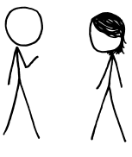
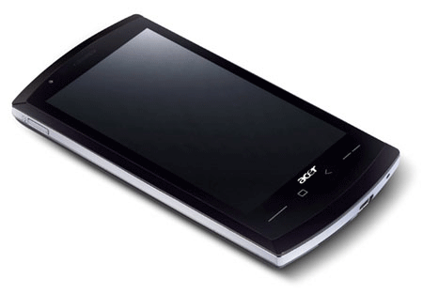

“Genetic Dating”
Bob
Alice
Genome Compatibility Protocol
Your offspring will have good immune systems!
Your offspring will have good immune systems!
WARNING!
Don’t Reproduce
WARNING!
Don’t Reproduce

Slide 21


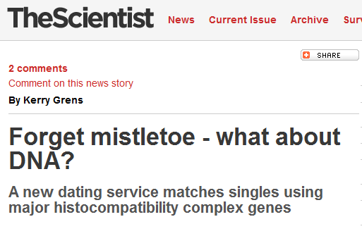
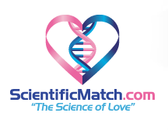

Slide 22
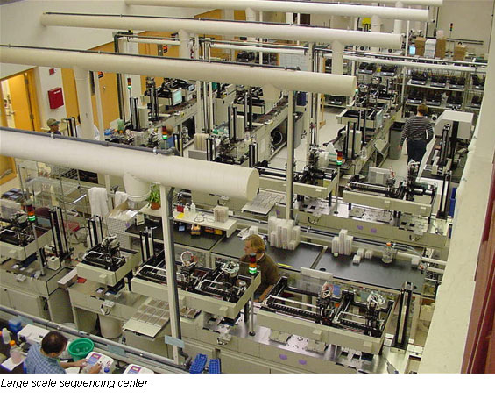
Genome Sequencing
1990: Human Genome Project starts, estimate $3B to sequence one genome ($0.50/base)
2000: Human Genome Project declared complete, cost ~$300M
Whitehead Institute, MIT

Slide 23
Cost to sequence human genome
Moore’s Law prediction
(halve every 18 months)
Data from National Human Genome Research Institute: http://www.genome.gov/sequencingcosts

Slide 24
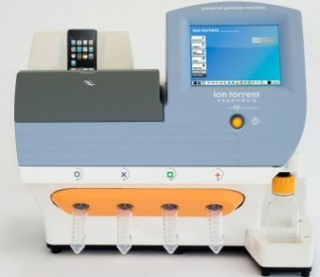
Cost to sequence human genome
Moore’s Law prediction
(halve every 18 months)
Ion torrent Personal Genome Machine
Data from National Human Genome Research Institute: http://www.genome.gov/sequencingcosts

Slide 25
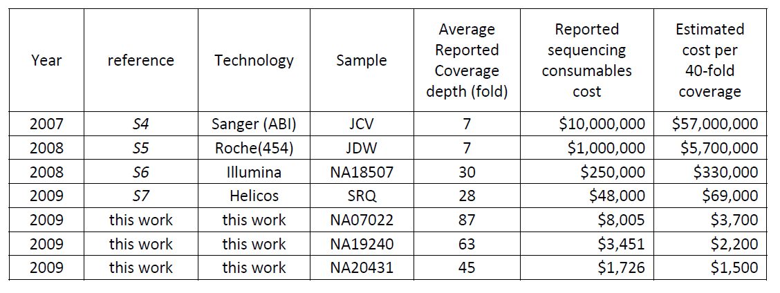
Human Genome Sequencing Using Unchained Base Reads on Self-Assembling DNA Nanoarrays. Radoje Drmanac, Andrew B. Sparks, Matthew J. Callow, Aaron L. Halpern, Norman L. Burns, Bahram G. Kermani, Paolo Carnevali, Igor Nazarenko, Geoffrey B. Nilsen, George Yeung, Fredrik Dahl, Andres Fernandez, Bryan Staker, Krishna P. Pant, Jonathan Baccash, Adam P. Borcherding, Anushka Brownley, Ryan Cedeno, Linsu Chen, Dan Chernikoff, Alex Cheung, Razvan Chirita, Benjamin Curson, Jessica C. Ebert, Coleen R. Hacker, Robert Hartlage, Brian Hauser, Steve Huang, Yuan Jiang, Vitali Karpinchyk, Mark Koenig, Calvin Kong, Tom Landers, Catherine Le, Jia Liu, Celeste E. McBride, Matt Morenzoni, Robert E. Morey, Karl Mutch, Helena Perazich, Kimberly Perry, Brock A. Peters, Joe Peterson, Charit L. Pethiyagoda, Kaliprasad Pothuraju, Claudia Richter, Abraham M. Rosenbaum, Shaunak Roy, Jay Shafto, Uladzislau Sharanhovich, Karen W. Shannon, Conrad G. Sheppy, Michel Sun, Joseph V. Thakuria, Anne Tran, Dylan Vu, Alexander Wait Zaranek, Xiaodi Wu, Snezana Drmanac, Arnold R. Oliphant, William C. Banyai, Bruce Martin, Dennis G. Ballinger, George M. Church, Clifford A. Reid. Science, January 2010.

Slide 26




Dystopia
Personalized Medicine

Slide 27
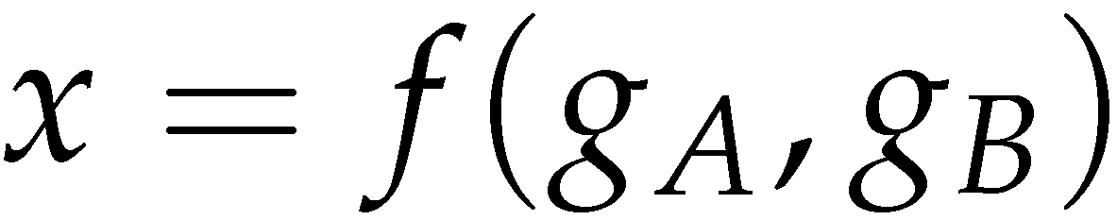
Secure Two-Party Computation
Bob’s Genome: ACTG…
Markers (~1000): [0,1, …, 0]
Alice’s Genome: ACTG…
Markers (~1000): [0, 0, …, 1]
Bob
Alice
Can Alice and Bob compute a function of their private data, without exposing anything about their data besides the result?

Slide 28
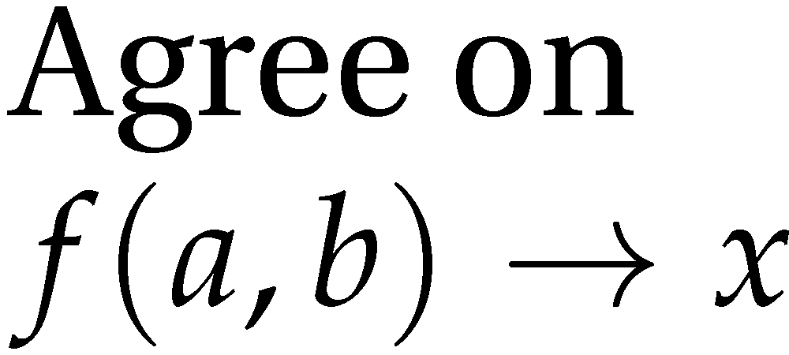


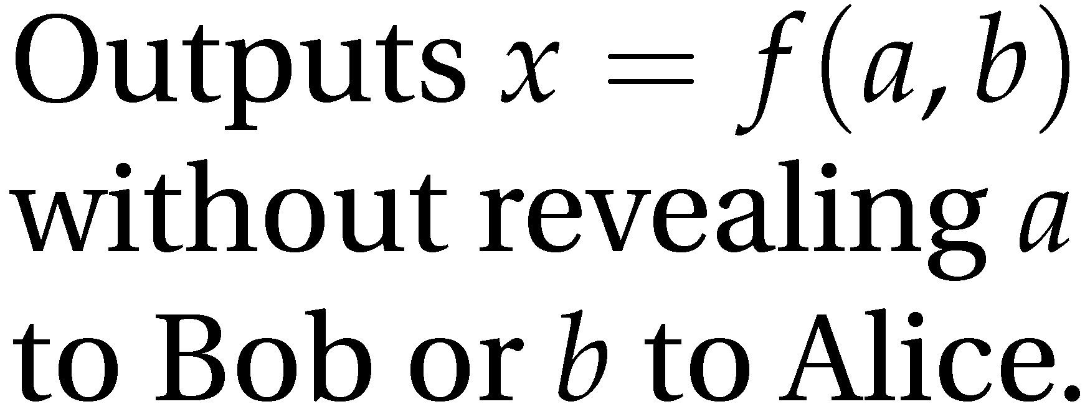
Secure Function Evaluation
Alice (circuit generator)
Bob (circuit evaluator)
Garbled Circuit Protocol
Andrew Yao, 1982/1986

Slide 29
Yao’s Garbled Circuits
Inputs |  | Output
a | b | x
0 | 0 | 0
0 | 1 | 0
1 | 0 | 0
1 | 1 | 1

Slide 30
Computing with Garbled Tables
Inputs |  | Output
a | b | x
a₀ | b₀ | Enc_{a0,b0}(x₀)
a₀ | b₁ | Enc_{a0,b1}(x₀)
a₁ | b₀ | Enc_{a1,b0}(x₀)
a₁ | b₁ | Enc_{a1,b1}(x₁)
Bob can only decrypt one of these!
a₀ or a₁
b₀ or b₁
Garbled And Gate
Enc_{a0, b1}(x₀)
Enc_{a1,b1}(x₁)
Enc_{a1,b0}(x₀)
Enc_{a0,b0}(x₀)
a_{i}, b_{i}, x_{i} are random values, chosen by the circuit generator but meaningless to the circuit evaluator.
AND
x₀ or x₁

Slide 31

Garbled Circuit Protocol
Alice (circuit generator)
Bob (circuit evaluator)
And Gate
Enc_{a0, b1}(x₀)
Enc_{a1,b1}(x₁)
Enc_{a1,b0}(x₀)
Enc_{a0,b0}(x₀)
Sends a_{i} to Bob based on her input value
How does the Bob learn his own input wires?

Slide 32




Primitive: Oblivious Transfer
Alice
Bob
Oblivious Transfer Protocol
Oblivious: Alice doesn’t learn which secret Bob obtains
Transfer: Bob learns one of Alice’s secrets
Rabin, 1981; Even, Goldreich, and Lempel, 1985; many subsequent papers

Slide 33
Chaining Garbled Circuits
And Gate 1
Enc_{a10, b11}(x1₀)
Enc_{a11,b11}(x1₁)
Enc_{a11,b10}(x1₀)
Enc_{a10,b10}(x1₀)
a0
b0
a1
b1
AND
AND
x0
x1
Or Gate 2
Enc_{x00, x11}(x2₁)
Enc_{x01,x11}(x2₁)
Enc_{x01,x10}(x2₁)
Enc_{x00,x10}(x2₀)
OR
x₂
…
We can do any computation privately this way!

Slide 34
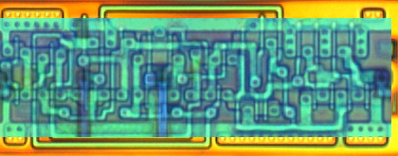
Building Computing Systems
Enc_{x00, x11}(x2₁)
Enc_{x01,x11}(x2₁)
Enc_{x01,x10}(x2₁)
Enc_{x00,x10}(x2₀)
Digital Electronic Circuits | Garbled Circuits
Operate on known data | Operate on encrypted wire labels
One-bit logical operation requires moving a few electrons a few nanometers (hundreds of Billions per second) | One-bit logical operation requires performing (up to) 4 encryption operations (~100,000 gates per second)
Reuse is great! | Reuse is not allowed!
All basic operations have similar cost | Some logical operations “free” (XOR, NOT)

Slide 35
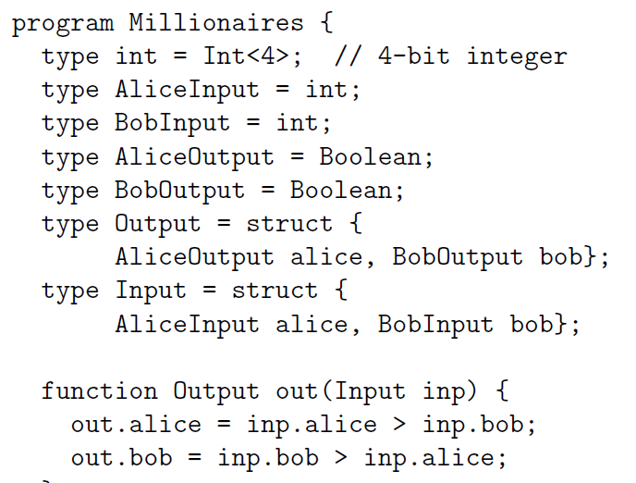
Fairplay
SFDL Compiler
SFDL Program
Circuit
(SHDL)
Alice
Bob
Garbled Tables Generator
Garbled Tables
Garbled Tables Evaluator
Dahlia Malkhi, Noam Nisan, Benny Pinkas and Yaron Sella [USENIX Security 2004]

Slide 36
Problems?
An alternative approach … would have been to apply Yao’s generic secure two-party protocol…. This would have required expressing the algorithm as a circuit … and then sending and computing that circuit.… [We] believe that the performance of our protocols is significantly better than that of applying generic protocols.
Margarita Osadchy, Benny Pinkas, Ayman Jarrous, Boaz Moskovich.
SCiFI – A System for Secure Face Identification. Oakland 2010.
[Generic SFE] is very fast … but the circuit size is extremely large…. Our prototype circuit compiler can compile circuits for problems of size (200, 200) but uses almost 2 GB of memory to do so…. larger circuits would be constrained by available memory for constructing their garbled versions.
Somesh Jha, Louis Kruger, Vitaly Shmatikov.
Towards Practical Privacy for Genomic Computation. Oakland 2008.

Slide 37
The Fallacy
SFDL Compiler
SFDL Program
Circuit
(SHDL)
Alice
Bob
Garbled Tables Generator
Garbled Tables
Garbled Tables
Garbled Tables Evaluator
The entire circuit is prepared and stored on both sides

Slide 38
Faster Garbled Circuits
Circuit-Level Application
Circuit Structure
Circuit Structure
GC Framework (Generator)
GC Framework
(Evaluator)
Enc_{x00, x11}(x2₁)
Enc_{x01,x11}(x2₁)
Enc_{x01,x10}(x2₁)
Enc_{x20, x21}(x3₀)
Enc_{x21,x21}(x3₀)
Enc_{x21,x20}(x3₁)
x2₁
Enc_{x20, x31}(x4₁)
Enc_{x21,x31}(x4₁)
Enc_{x21,x30}(x4₀)
x3₁
Enc_{x40, x31}(x5₁)
Enc_{x41,x31}(x5₀)
Enc_{x41,x30}(x5₀)
Enc_{x40, x51}(x6₁)
Enc_{x41,x51}(x6₀)
Enc_{x41,x50}(x6₀)
x4₁
Enc_{x30, x61}(x7₁)
Enc_{x31,x61}(x7₀)
Enc_{x31,x60}(x7₁)
x5₁
x6₀
x7₁
Gates can be evaluated as they are generated: pipelining
Notes:
Circuit structure is small and can be reused;
Each GT can be used only once.
Significance:
1) allow GC to easily scale to arbitrary problem size;
2) indirectly improves time efficiency;

Slide 39
Results
Scalability
Performance

Slide 40

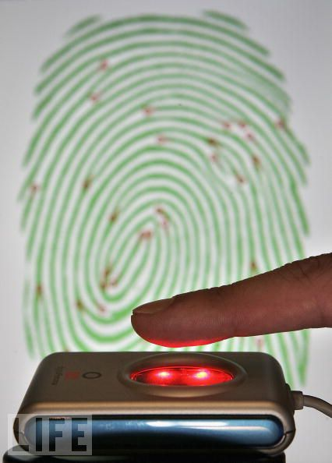


Applications
Private Personal Genomics
Privacy-Preserving Biometric Matching
Private AES Encryption
Private Set Intersection

Slide 41

Heterozygous Recessive Risk
Alice
 | A | a
A | AA | Aa
a | aA | aa
carrier
Bob
cystic fibrosis
Alice’s Heterozygous Recessive genes: { 5283423, 1425236, 839523, … }
Bob’s Heterozygous Recessive genes: { 5823527, 839523, 169325, … }
Goal: find the intersection of A and B

Slide 42
Bit Vector Intersection
Alice’s Recessive genes:
{ 5283423, 1425236, 839523, … }
Bob’s Recessive genes:
{ 5823527, 839523, 169325, … }
[ PAH, PKU, CF, … ]
[ 0, 0, 1, 0, 0, 0, 1, 0, 1, 1, 0]
[ 0, 0, 1, 0, 0, 0, 0, 0, 1, 0, 0]
. . .
AND
AND
AND
. . .
Bitwise AND

Slide 43
Scaling
What if there are millions of possible diseases?
Length of bit vector:
number of possible values
(2^{L} where L is number of bits for each value)
Other private set intersection problems:
Do Alice and Bob have any common address book contacts?
Data mining problems: combine medical records across hospitals
Two companies want to do joint marketing to common customers

Slide 44
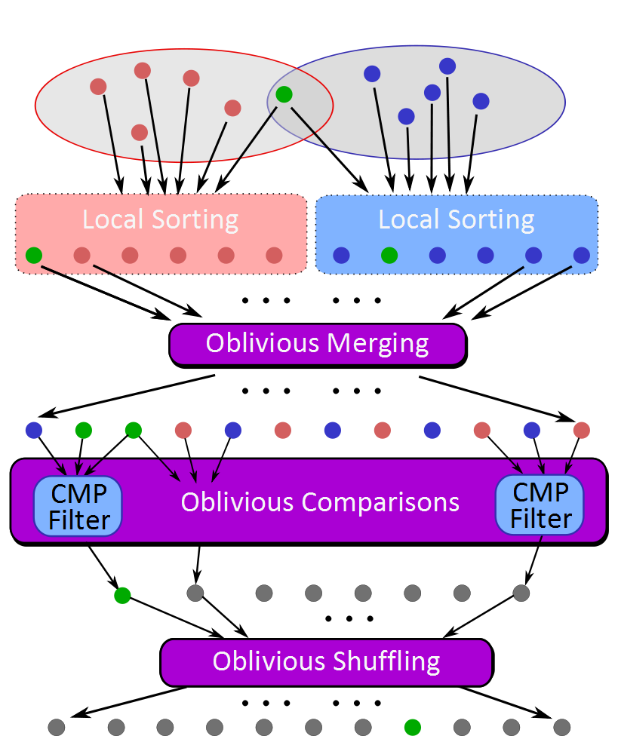
Sort-Compare-Shuffle
Sort: Take advantage of total order of elements
Compare adjacent elements
Shuffle to hide positions

Slide 45
Problem | Best Previous Result | Our Result | Speedup
Hamming Distance (Face Recognition, Genetic Dating) – two 900-bit vectors | 213s [SCiFI, 2010] | 0.051s | 4176
Levenshtein Distance (genome, text comparison) – two 200-character inputs | 534s [Jha+, 2008] | 18.4s | 29
Smith-Waterman (genome alignment) – two 60-nucleotide sequences | [Not Implementable] | 447s | -
AES Encryption | 3.3s [Henecka, 2010] | 0.2s | 16.5
Fingerprint Matching (1024-entry database, 640x8bit vectors) | ~83s [Barni, 2010] | 18s | 4.6
USENIX Security 2011
NDSS 2011
Scalable: 1 Billion gates evaluated at ~100,000 gates/second on laptop

Slide 46
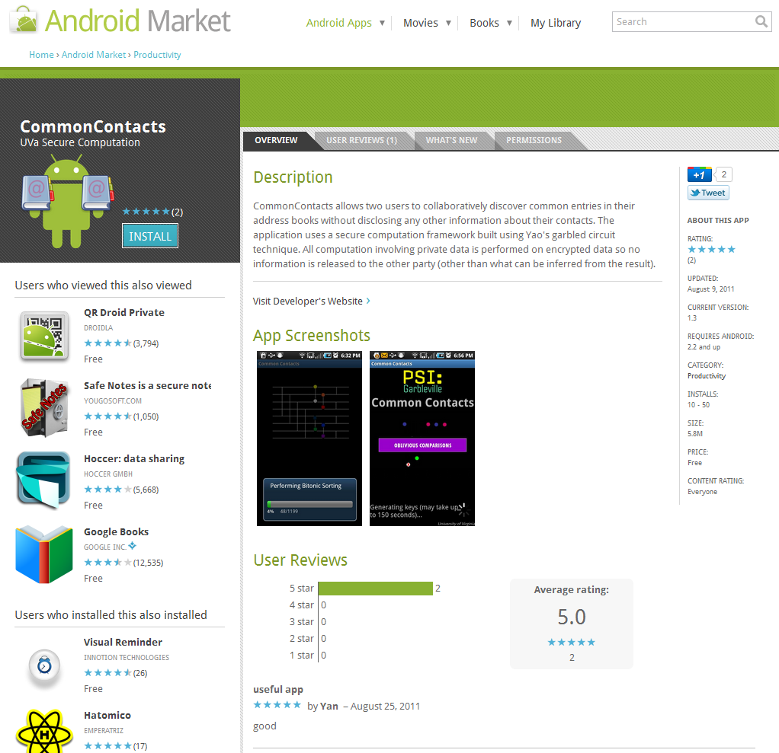

Slide 47
Current Projects
Genomics Applications (Aaron Mackey)
Taking advantage of third-party randomness (Peter Chapman, Yan Huang)
Using Partial Evaluation (PL) (Samee Zahur)
Auditing Leakage: when is it safe to reveal result? (Yikan Chen)
Stronger threat model (Yan Huang, students in abhi’s group)

Slide 48
What Next?
Visit our research group blog: http://www.jeffersonswheel.org
Project site for today: www.mightbeevil.com
Come to our research group meetings
  Mailing list: http://www.cs.virginia.edu/evans/srg
Read our recent publications: http://www.cs.virginia.edu/evans/pubs/
Arrange to meet with me or come by Rice 507

