Slide 1

David Evans
University of Virginia
www.cs.virginia.edu/evans
bitcoin-class.org
DC Area Crypto Day
All Hallows’ Eve²
Johns Hopkins University
Trick or Treat?
Bitcoin for Non-Believers, Cryptocurrencies for Cypherpunks

Slide 2
Plan
Tutorial Introduction to Bitcoin
Hype vs. Reality in Bitcoin Today
Scaling Bitcoin
Ombuds (Nick Skelsey)

Slide 3
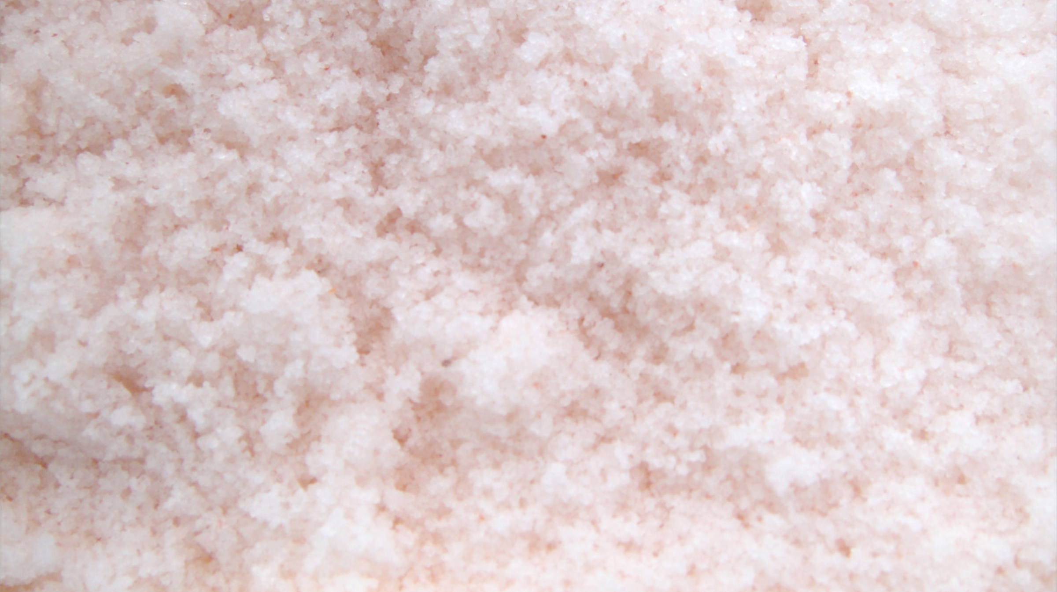
What is money?

Slide 4
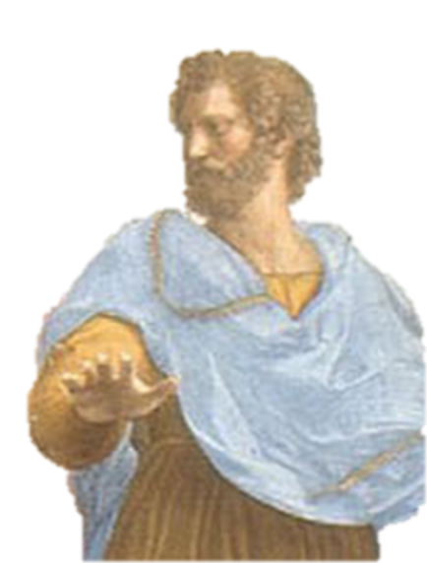
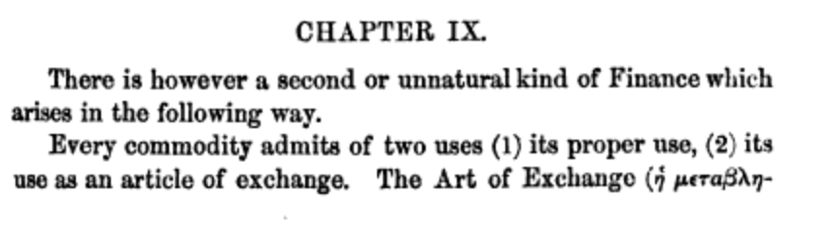
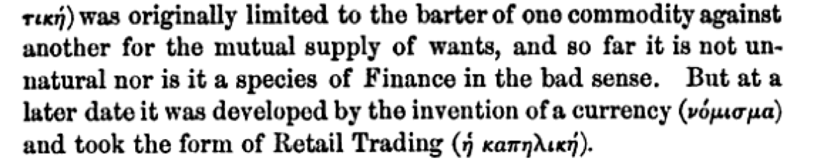
Aristotle’s Politics 350 BCE

Slide 5
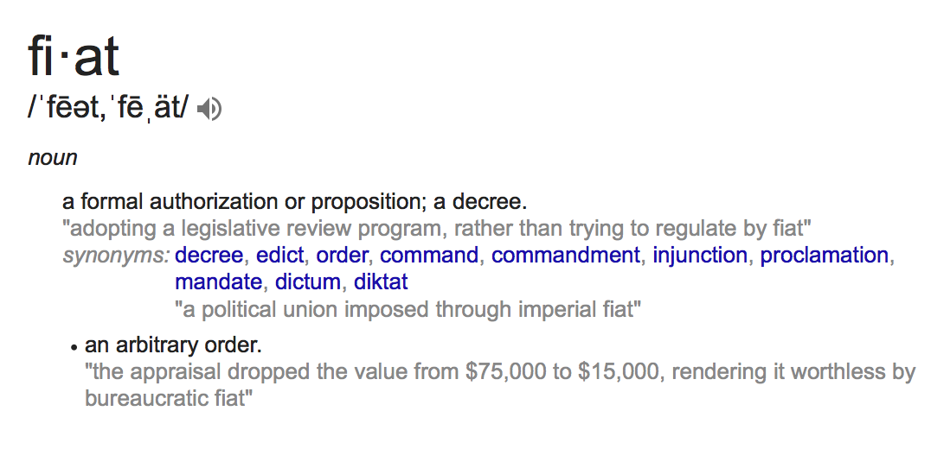
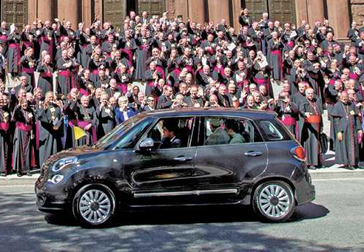
Fiat Currency

Slide 6
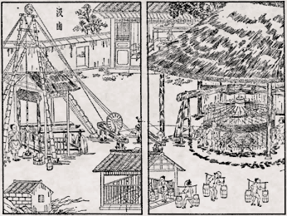
With a strong enough army, anything can be a fiat currency
Notes:
"BankStatementChequing" by Sergio Ortega. Licensed under CC BY-SA 3.0 via Commons - https://commons.wikimedia.org/wiki/File:BankStatementChequing.png#/media/File:BankStatementChequing.png

Slide 7
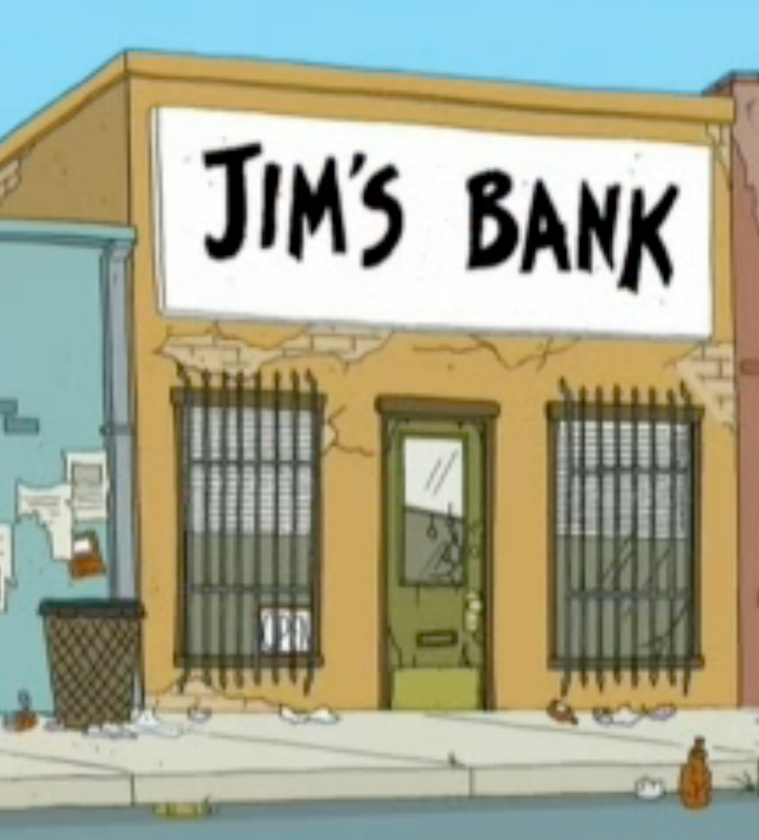
Centralized Digital Currency
Account No. | Owner’s Identify | Value
3022493 | Alice | 2033.23
3022494 | Bob | 85733.03
3022495 | Colleen | 24331.77
3022496 | Dave | 0.01
Trusted Bank

Slide 8
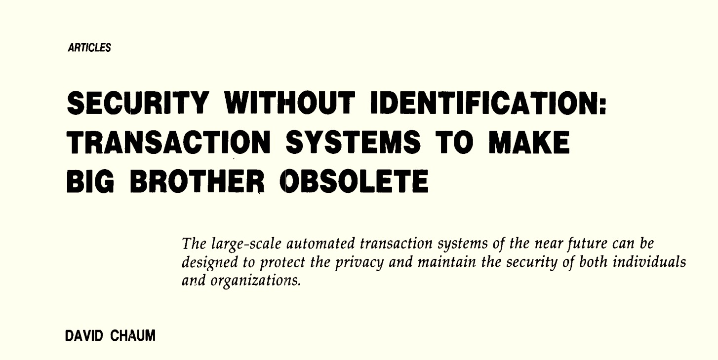
Communications of the ACM
October 1985

Slide 9
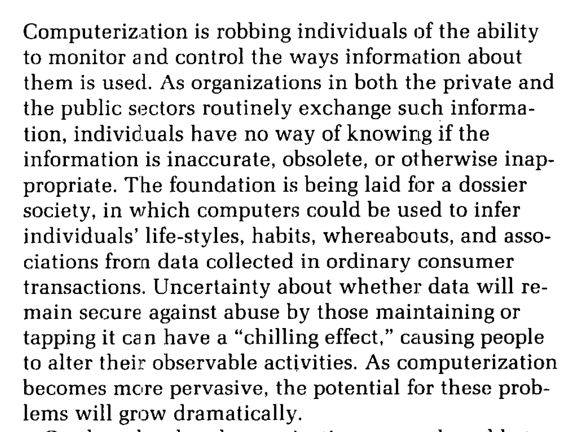
Communications of the ACM
October 1985

Slide 10
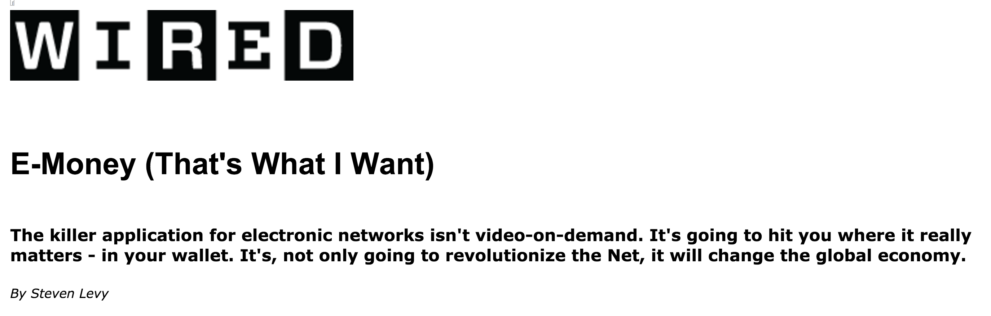
First Wave Cryptocurrency
David Chaum

Slide 11
First Wave Cryptocurrency
Bankrupt, 1998
David Chaum

Slide 12
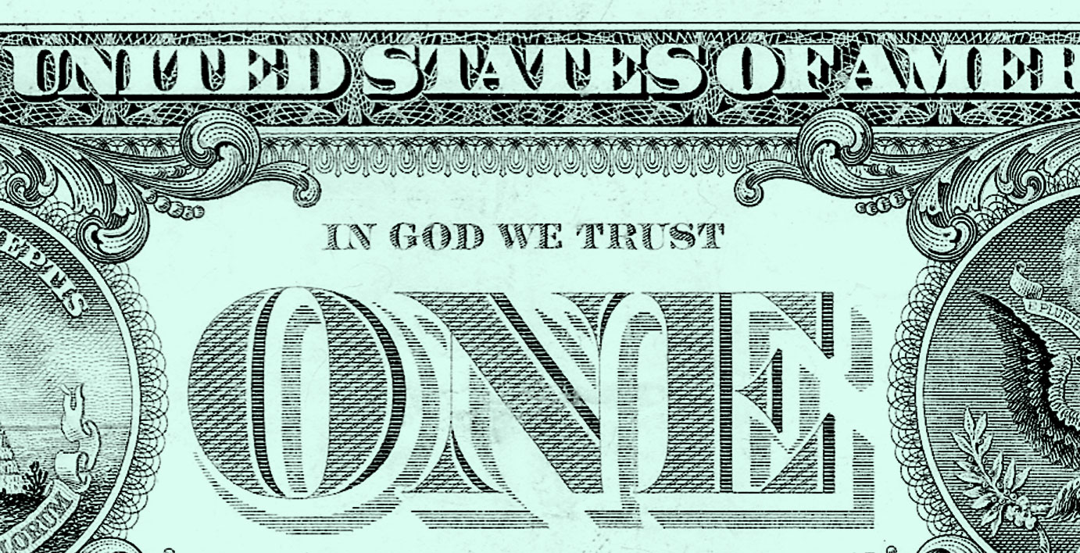
Decentralized Currency
Currency without trust

Slide 13


Double Spending Challenge
Bob wants to verify:
Alice owns X
Alice hasn’t transferred X
The coin will be valuable for Bob
M = transfer X to Bob
Sign_{KRA}[H(M)]

Slide 14
Double Spending Challenge
Node A
Node B
Node C
tx_{b}
Bob wants to verify:
Alice owns X
Alice hasn’t transferred X
The coin will be valuable for Bob
M = transfer X to Bob
Sign_{KRA}[H(M)]
tx_{b}

Slide 15
M = transfer X to Coleen
Sign_{KRA}[H(M)]
tx_{c}
Node A
Node B
Node C
tx_{b}
Bob wants to verify:
Alice owns X
Alice hasn’t transferred X
The coin will be valuable for Bob
M = transfer X to Bob
Sign_{KRA}[H(M)]
tx_{b}

Slide 16
M = transfer X to Coleen
Sign_{KRA}[H(M)]
tx_{c}
Node A
Node B
Node C
tx_{b}
Bob wants to verify:
Alice owns X
Alice hasn’t transferred X
The coin will be valuable for Bob
M = transfer X to Bob
Sign_{KRA}[H(M)]
tx_{b}

Slide 17
Node E
M = transfer X to Coleen
Sign_{KRA}[H(M)]
tx_{c}
Node A
Node B
Node C
Node D
tx_{b}
Bob wants to verify:
Alice owns X
Alice hasn’t transferred X
The coin will be valuable for Bob
M = transfer X to Bob
Sign_{KRA}[H(M)]
tx_{b}

Slide 18
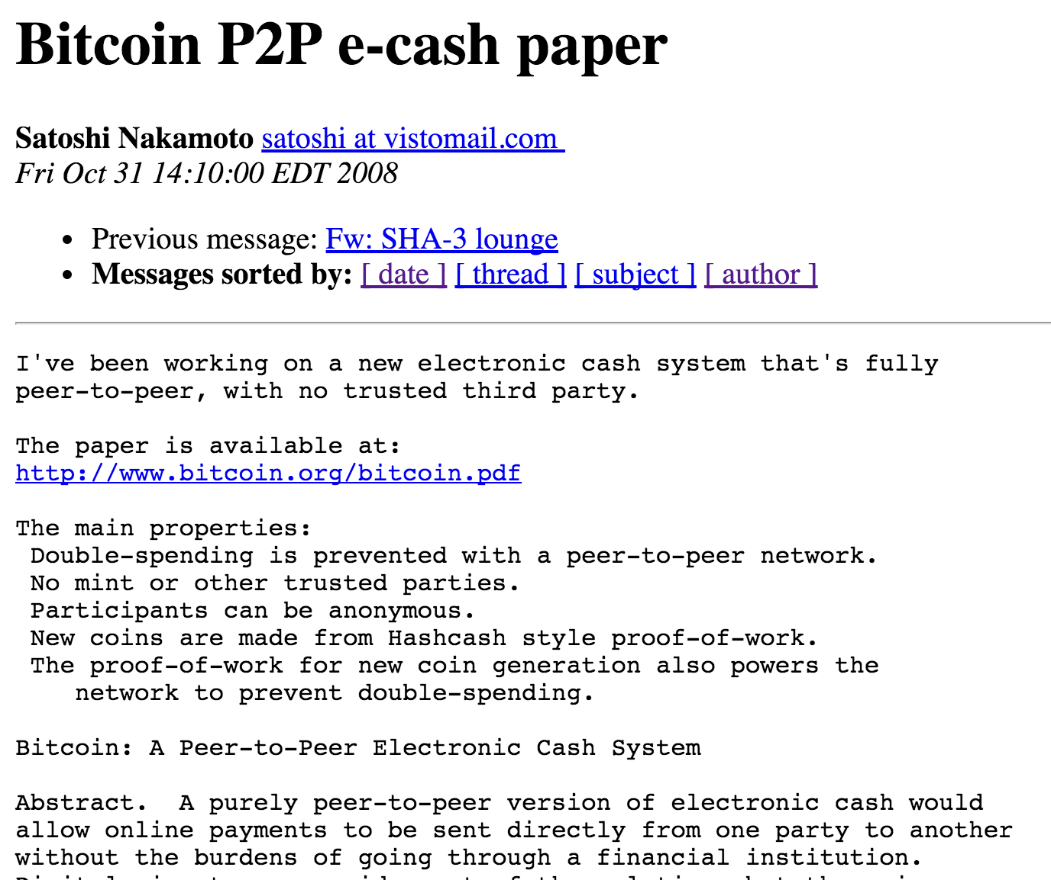
Satoshi’s Solution

Slide 19
Blockchain
B0
H(B0)
Nonce
H(B1)
Nonce
H(B2)
Nonce
Transactions
Transactions
Transactions
Distributed ledger maintained by network of untrusted nodes
Blocks added require proof-of-work
Node’s agree to consensus: longest (most difficult) chain
Incentives designed to encourage network nodes to:
Validate and record transactions
Spend effort on extending consensus chain

Slide 20
Bitcoin
Transaction
Output 1: x₁, d₁
Input 1: v₁, a₁
Input 2: v₂, a₂
Output 2: x₂, d₂
…
…
transaction fees = sum(input values) – sum(output values)
(must be non-negative for valid transaction)

Slide 21
Bitcoin Script
Transaction
a0b6ea…..
Output 1: x₁, d₁
Input 1: v₁, a₁
Locking Script
Unlocking Script
OP_DATA <signature>
Output 2: x₂, d₂
…
If Bitcoin Address were just public key
OP_DATA <public key>
OP_CHECKSIG
Transaction
d8730d…
Locking Script
Unlocking Script

Slide 22
Bitcoin Script
Transaction
a0b6ea…..
Output 1: x₁, d₁
Input 1: v₁, a₁
Locking Script
OP_DATA <signature>
OP_DATA <public key>
Unlocking Script
Output 2: x₂, d₂
…
Bitcoin Address = H(public key)
OP_DUP
OP_HASH160
OP_DATA <bitcoin address>
OP_EQUALVERIFY
OP_CHECKSIG
Transaction
d8730d…
Locking Script
Unlocking Script

Slide 23
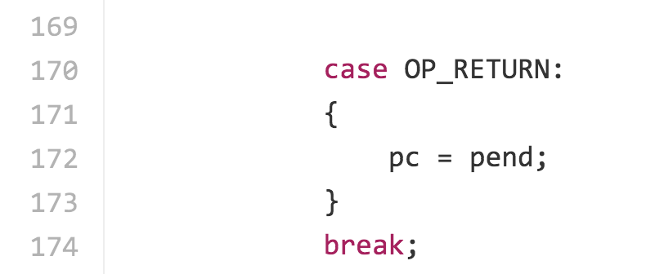
OP_RETURN (until July 2010)
https://github.com/bitcoin/bitcoin/blob/v0.1.5/script.cpp#L170
Universal Unlocking Script!
OP_DATA 1
OP_RETURN

Slide 24
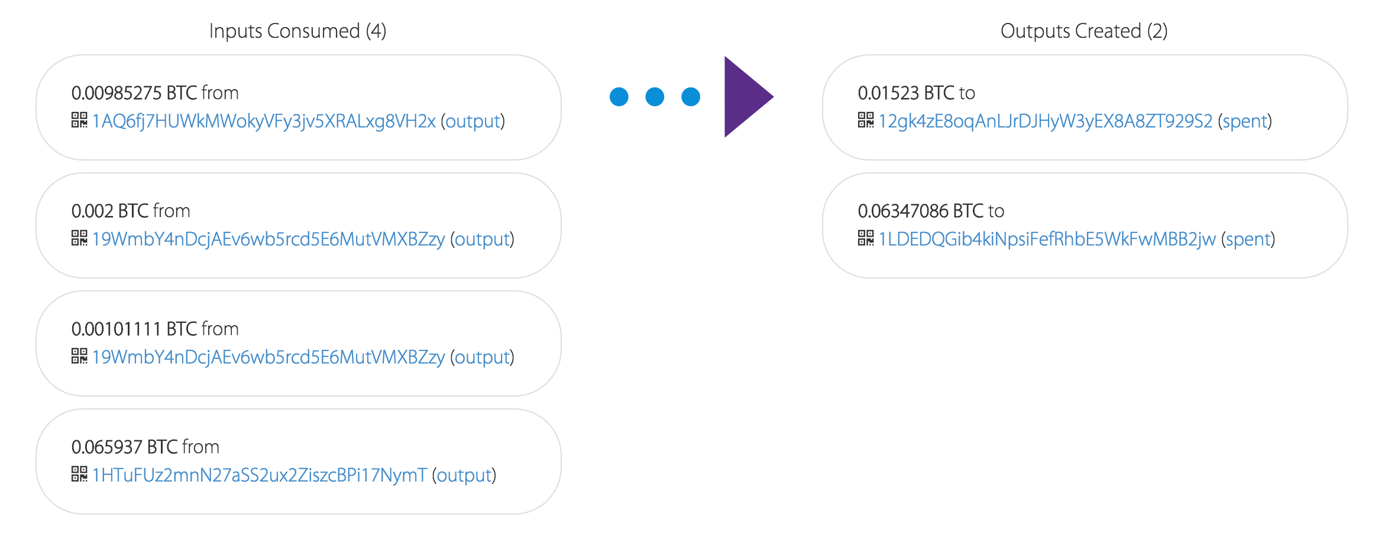
Example Transaction
Fees are optional…

Slide 25
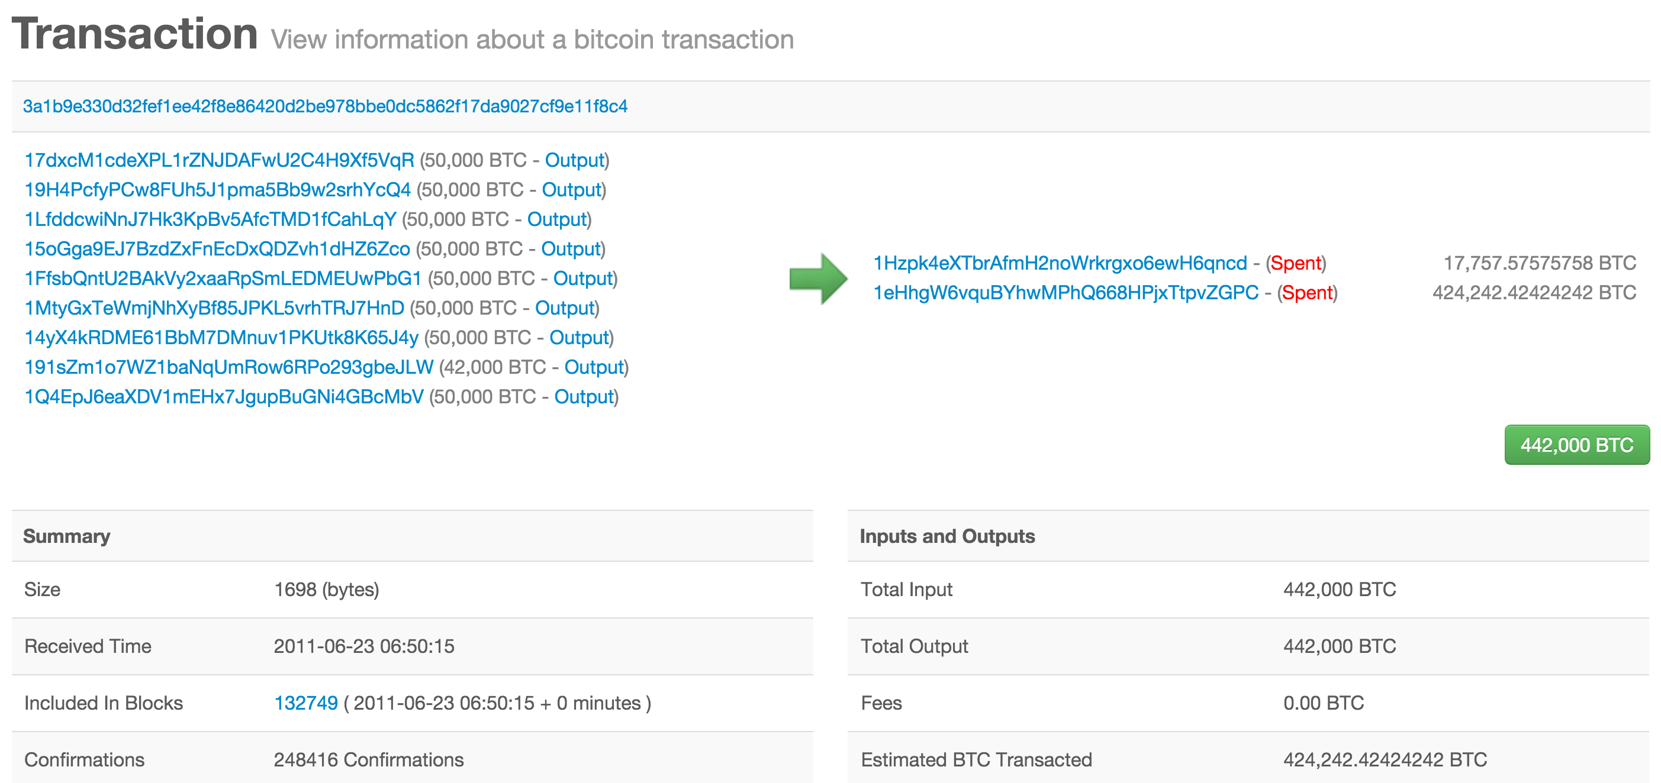

Slide 26
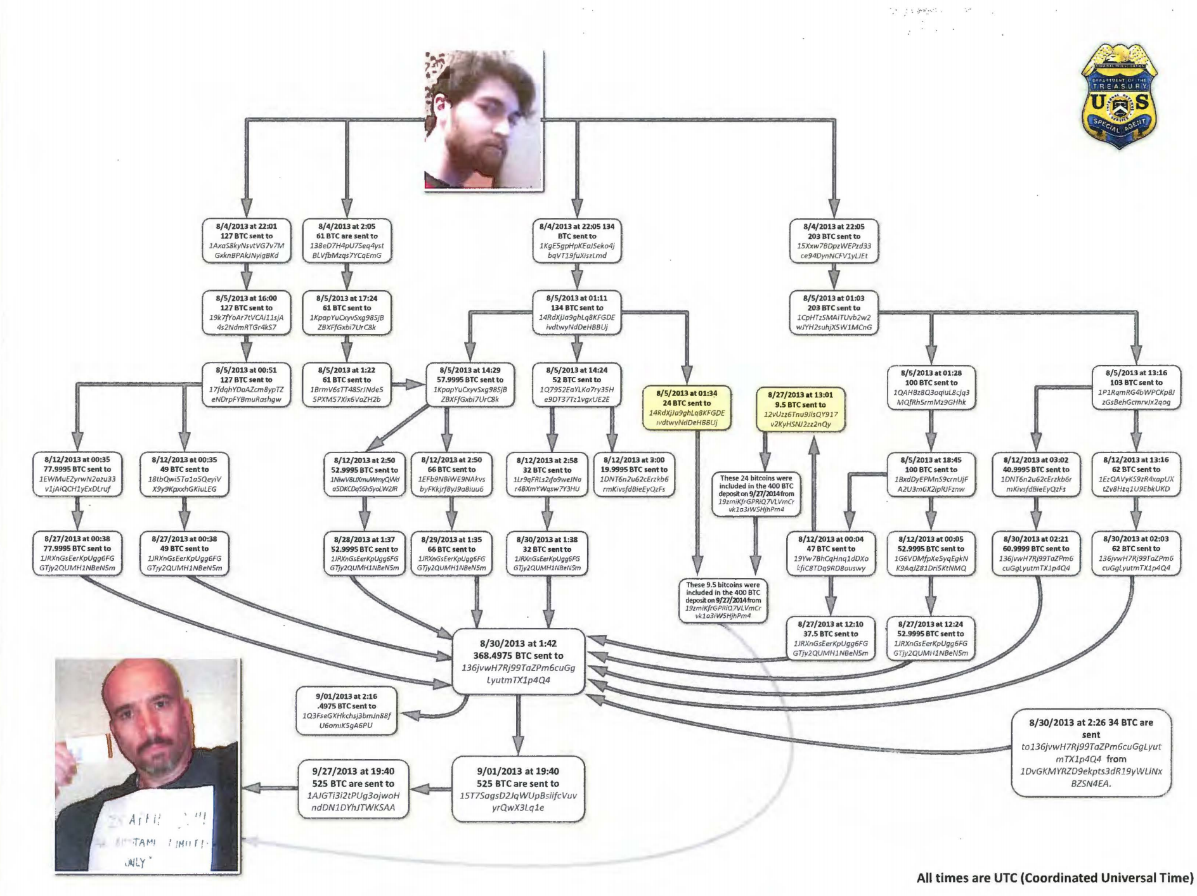
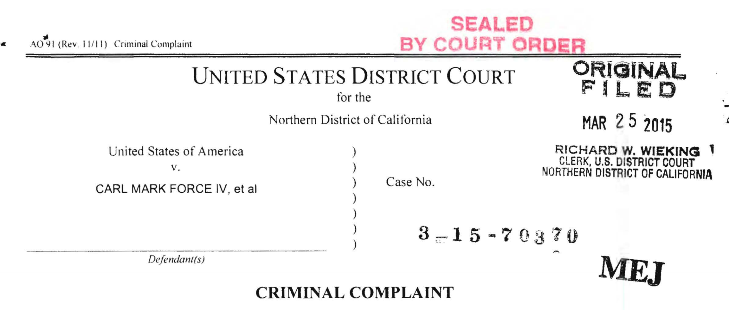
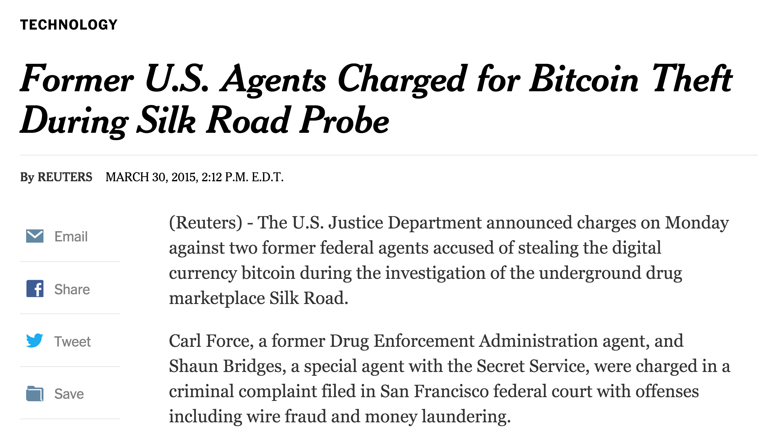
Exhibit B

Slide 27
Bitcoin
Transaction
Output 1: x₁, d₁
Input 1: v₁, a₁
Input 2: v₂, a₂
Output 2: x₂, d₂
…
…
transaction fees = sum(input values) – sum(output values)
(must be non-negative for valid transaction)
How is new bitcoin created?

Slide 28
Coinbase
Transaction
Output 1: x₁, d₁
Output 2: x₂, d₂
…
sum(output values) ≤ sum(transaction fees) + mining reward
mining reward = 50 BTC
2^{floor(block number / 210,000)}

Slide 29
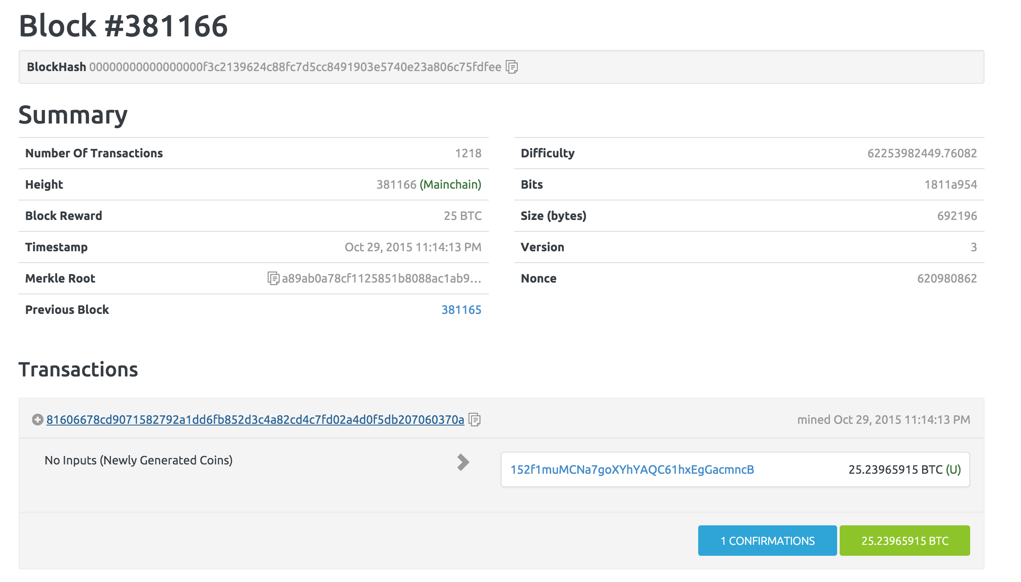

Slide 30
Bitcoin’s Proof-of-Work
B0
H(B0)
Nonce
H(B1)
Nonce
H(B2)
Nonce
Transactions
Transactions
Transactions
Find a nonce x such that:
SHA-256(SHA-256(r || x)) < T/d
r = header includes H(previous block)
root of Merkle tree of transactions

Slide 31
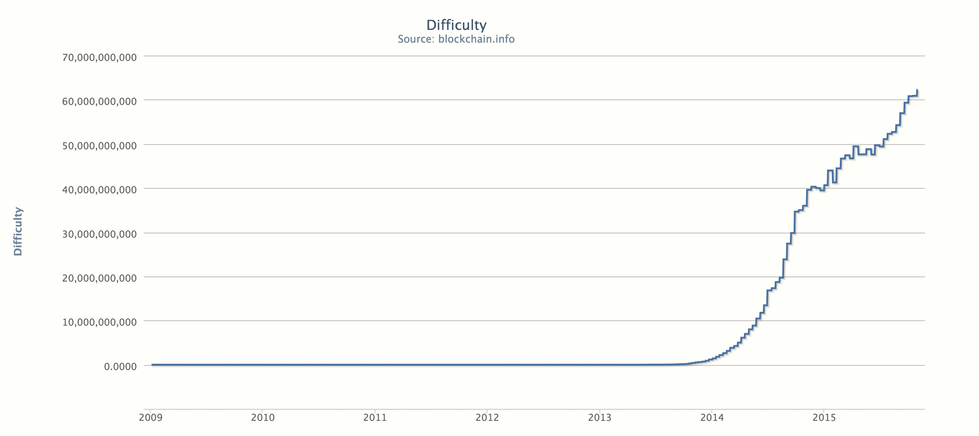
difficulty = 62,253,982,450
expected hashes = 2.67 * 10²⁰ ~ 2⁶⁸
“number of grains of sand on earth”

Slide 32
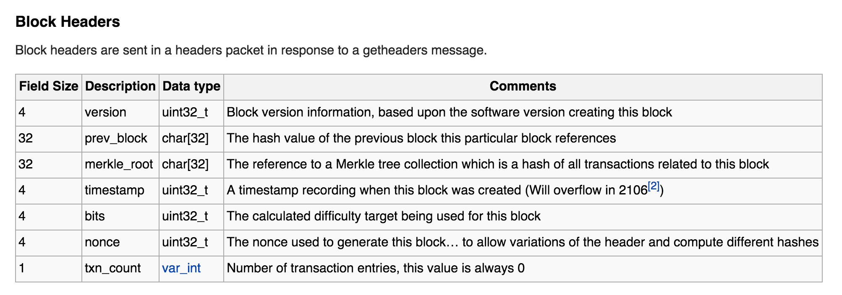
Actual Bitcoin Block
https://en.bitcoin.it/wiki/Protocol_documentation#Block_Headers
Notes:
2^32 ~ 4B – not nearly enough! But, not just nonce to change

Slide 33
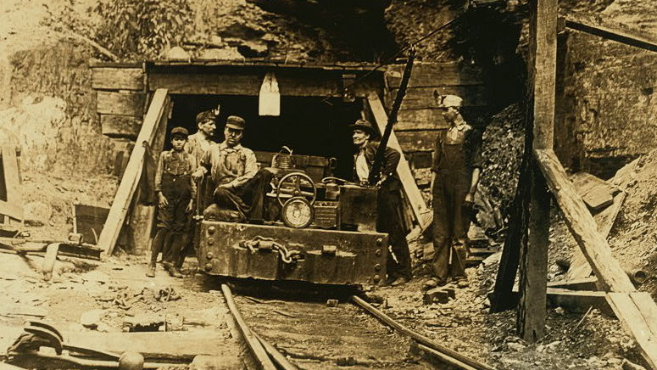
Mining

Slide 34
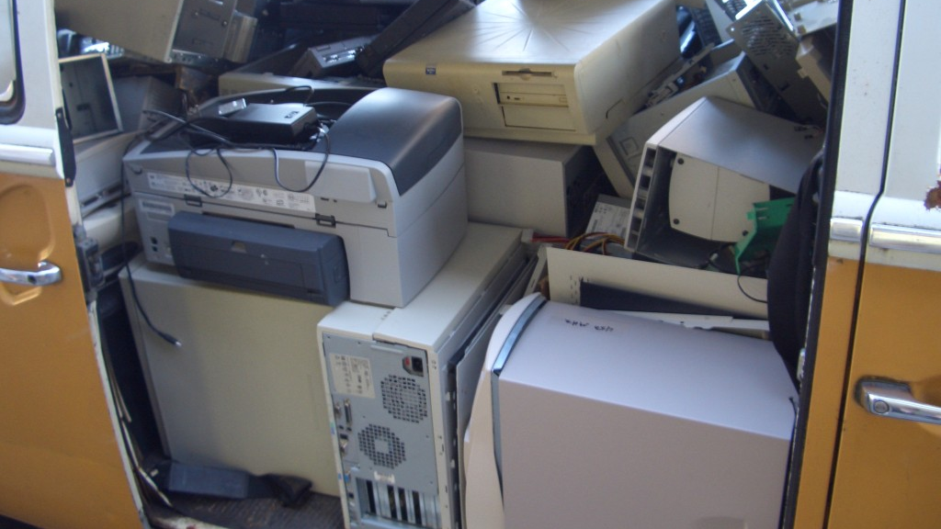
(General-Purpose)
Computers are Useless

Slide 35
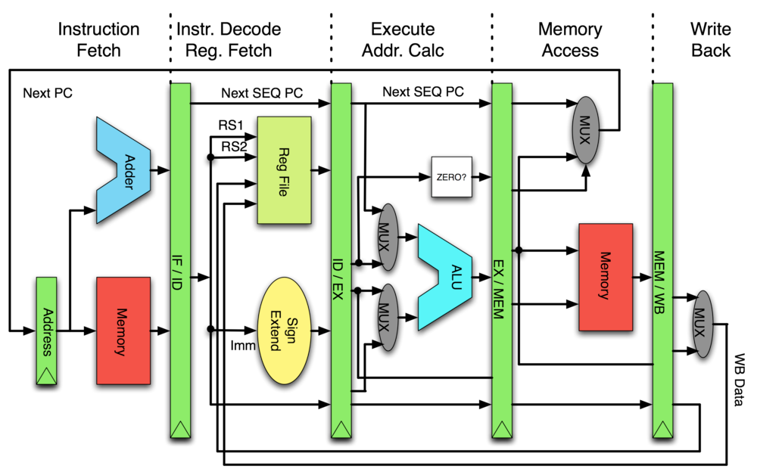
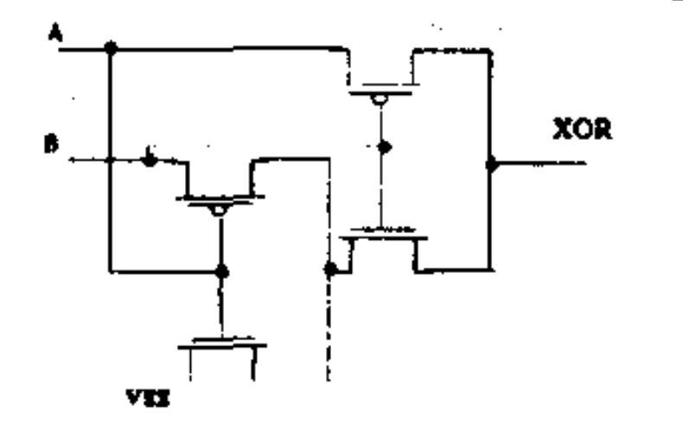
4 transistors XOR design
XOR two 32-bit values in CPU
XOR two 32-bit values in ASIC

Slide 36
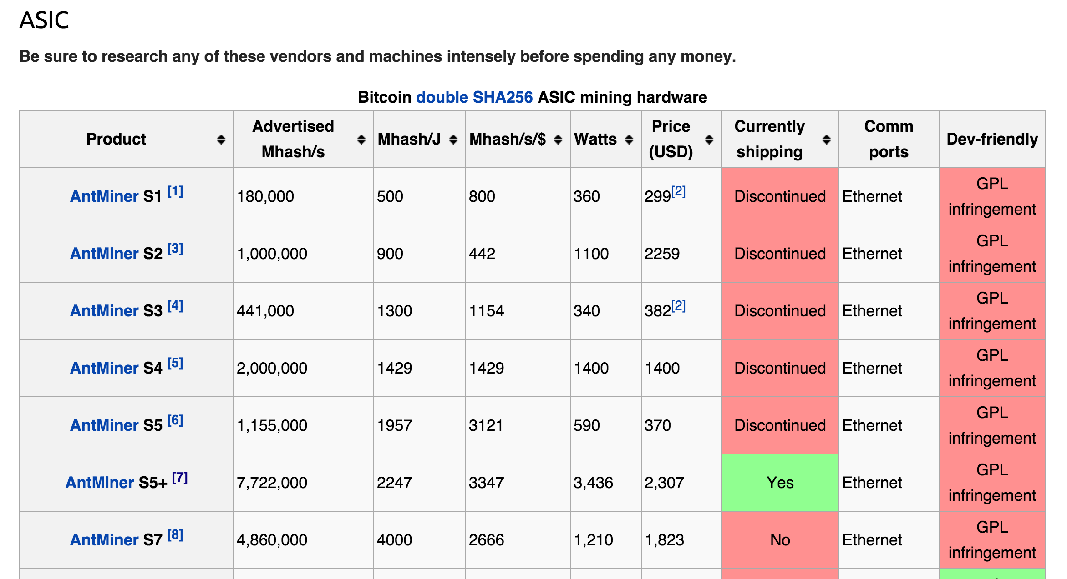
https://en.bitcoin.it/wiki/Mining_hardware_comparison
Notes:
1J ~ “lift an apple one meter”

Slide 37
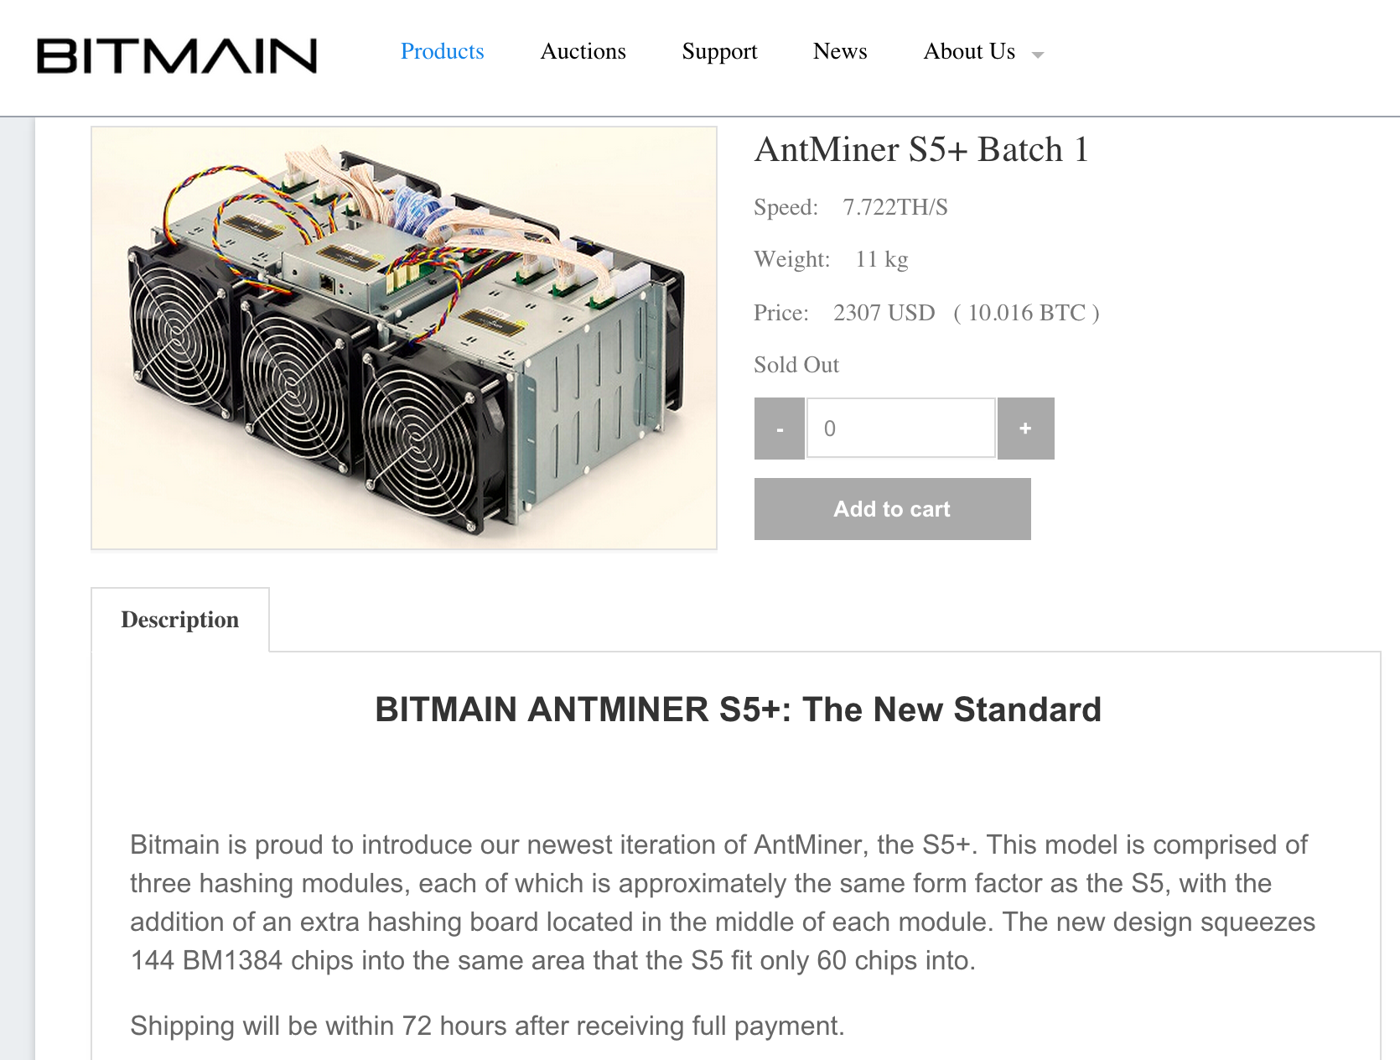

Slide 38
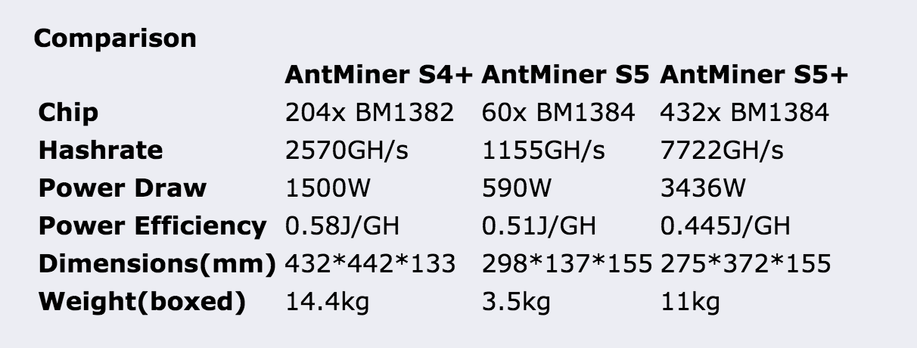

Slide 39
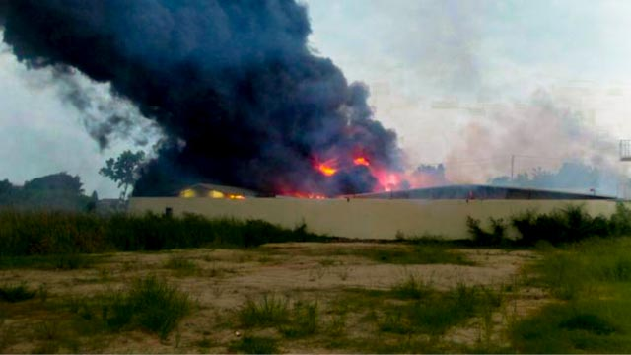
Fire at mining facility in Thailand, 14 Oct 2014
Photo credit: www.thairath.co.th

Slide 40
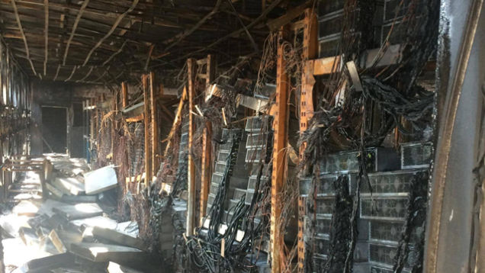

Slide 41
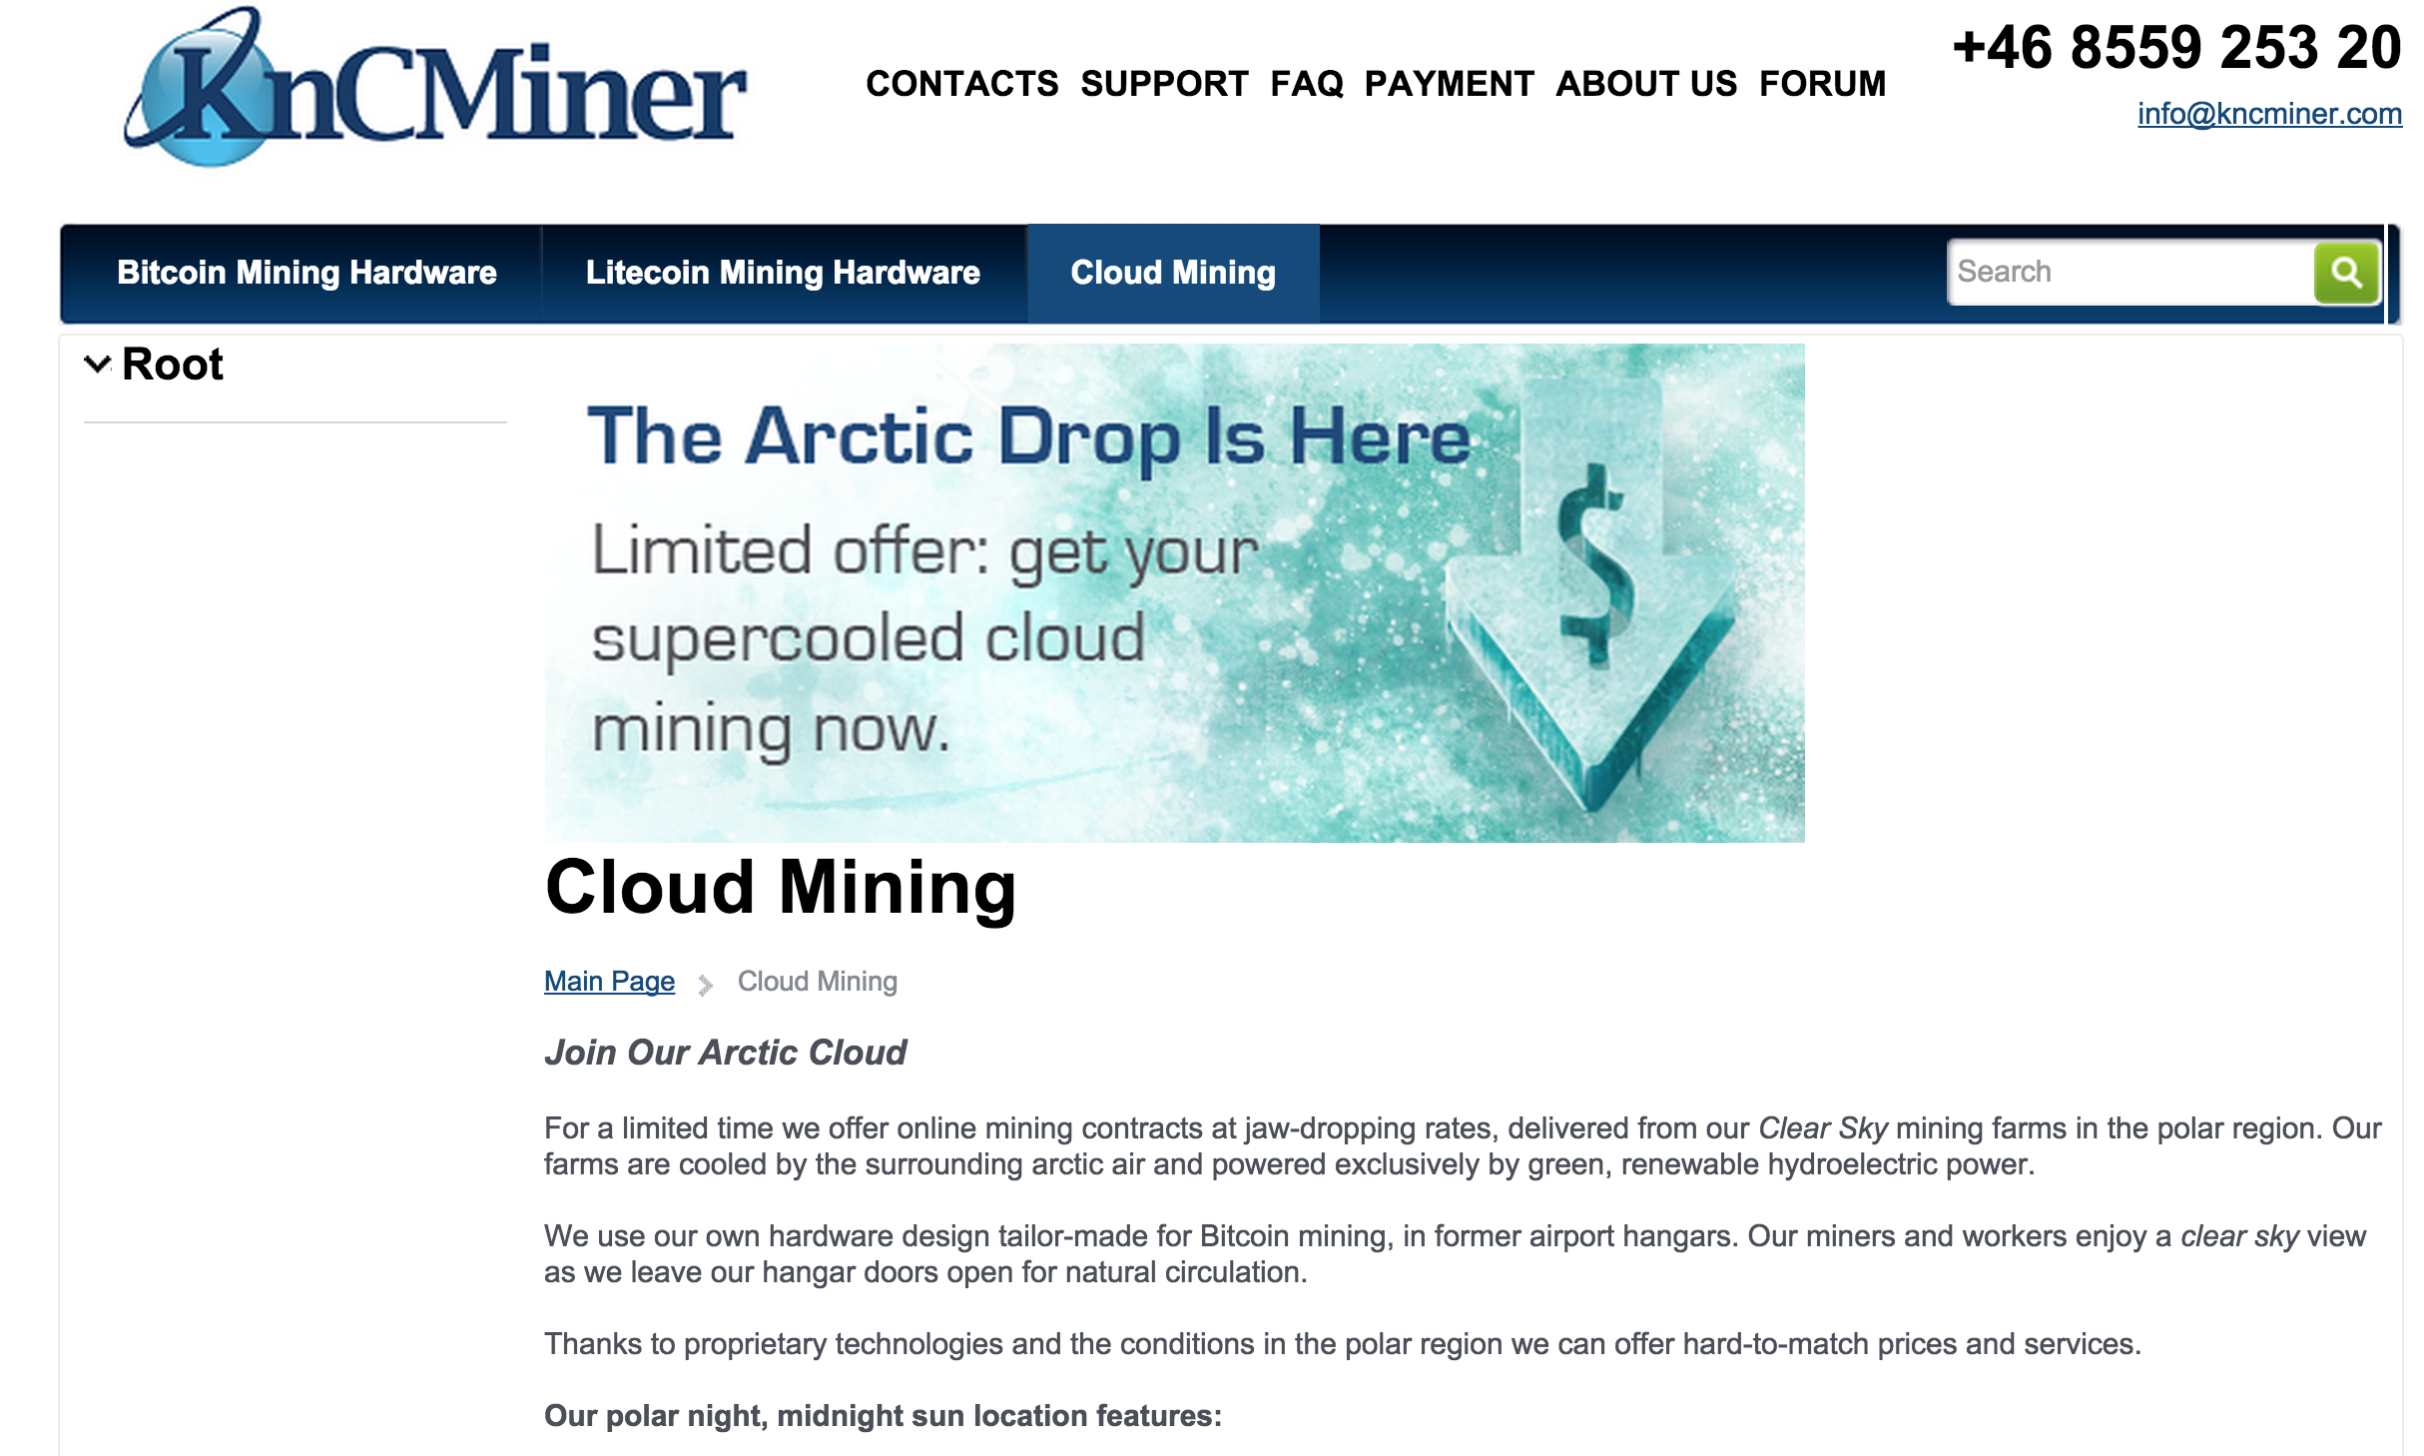

Slide 42
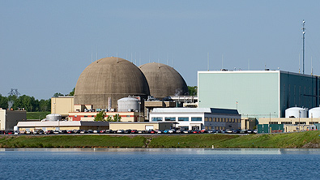
Entire bitcoin network: 1/10th Lake Anna Power Station

Slide 43
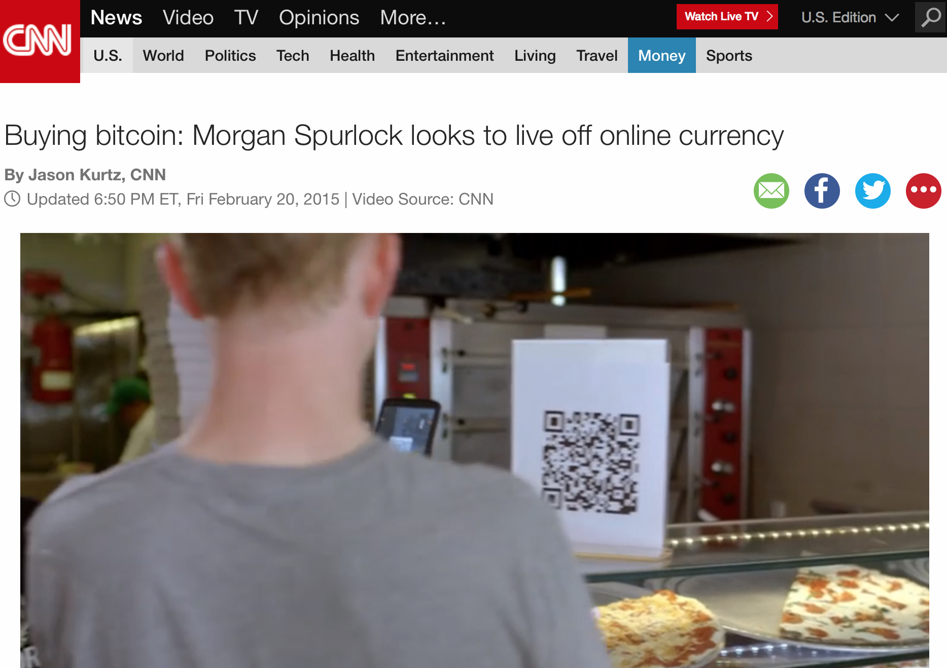
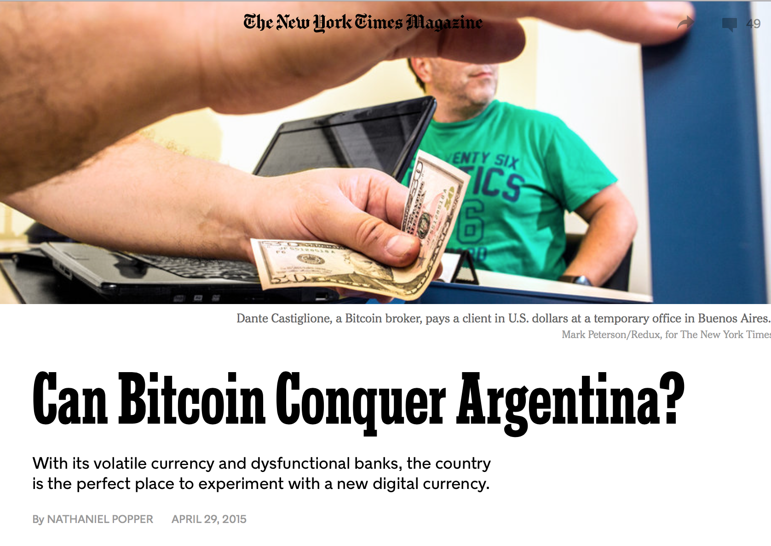
Bitcoin Hype!

Slide 44
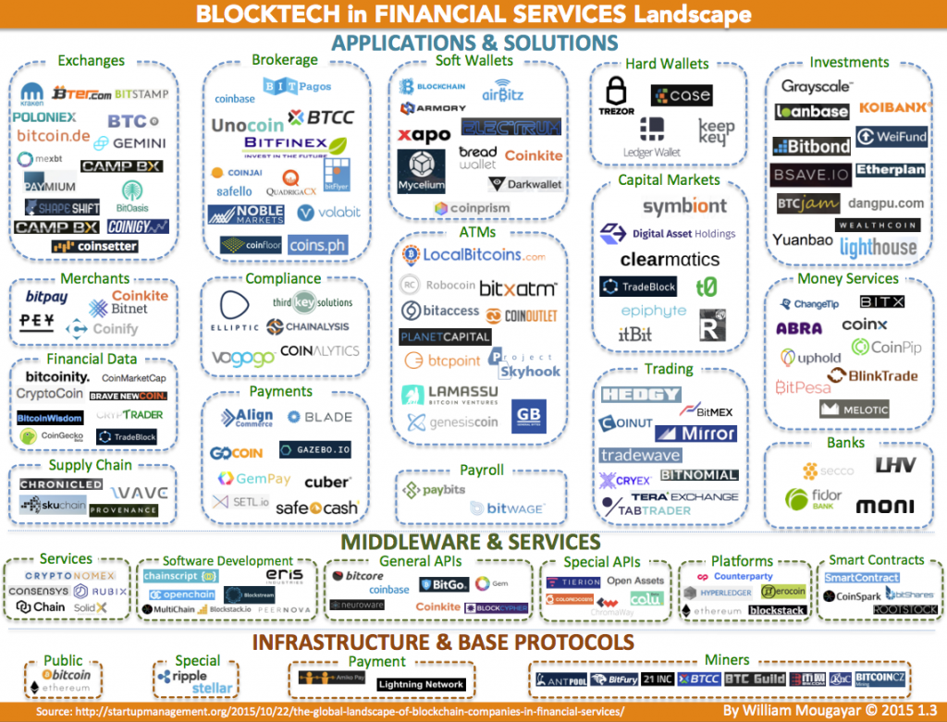
William Mougayar,
The Global Landscape of Blockchain Companies in Financial Services

Slide 45
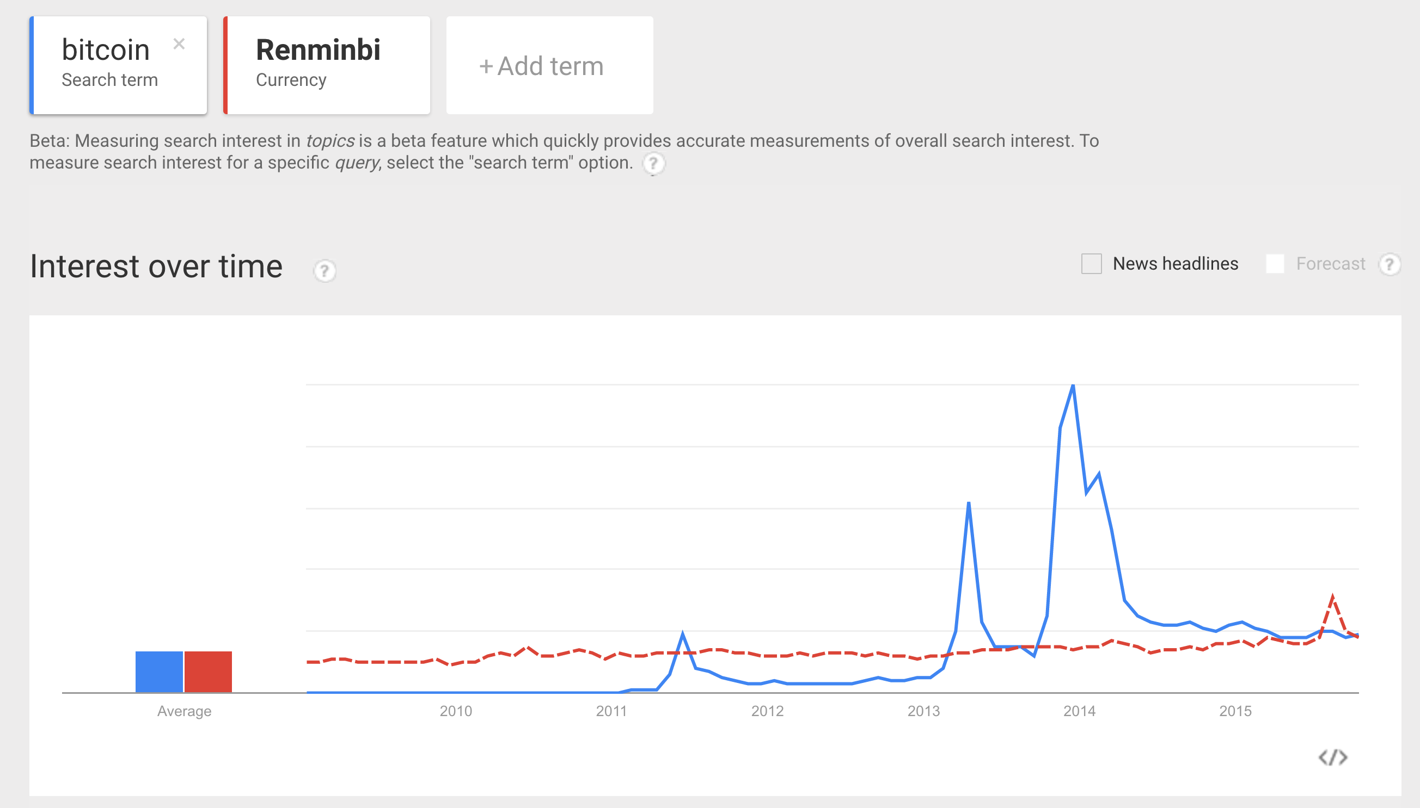
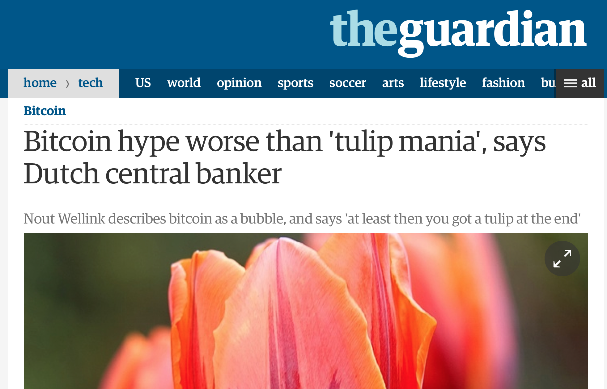
Google Trends
Dec 2013
Bitcoin
Renminbi

Slide 46
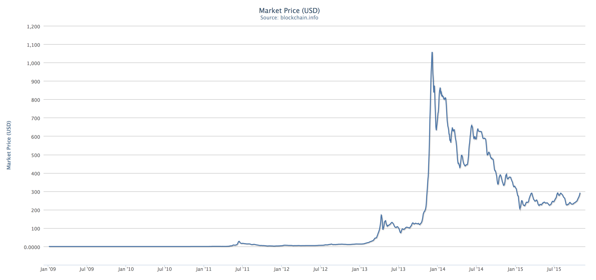
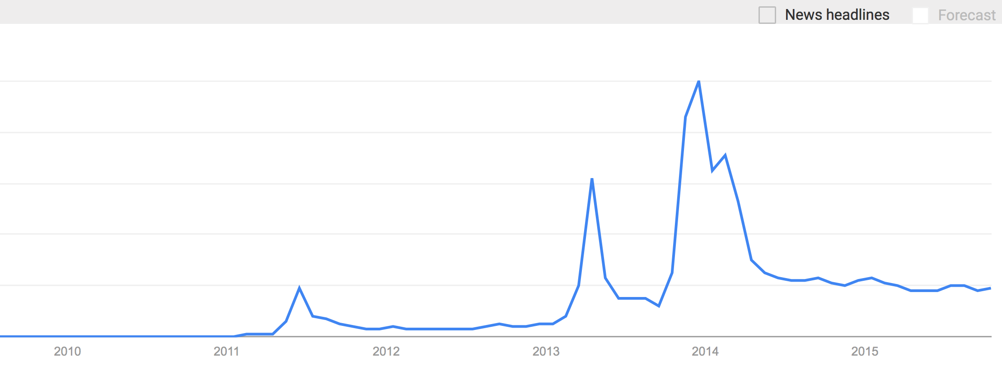
Bitcoin “Hype”
Bitcoin Market
Price (US$)

Slide 47
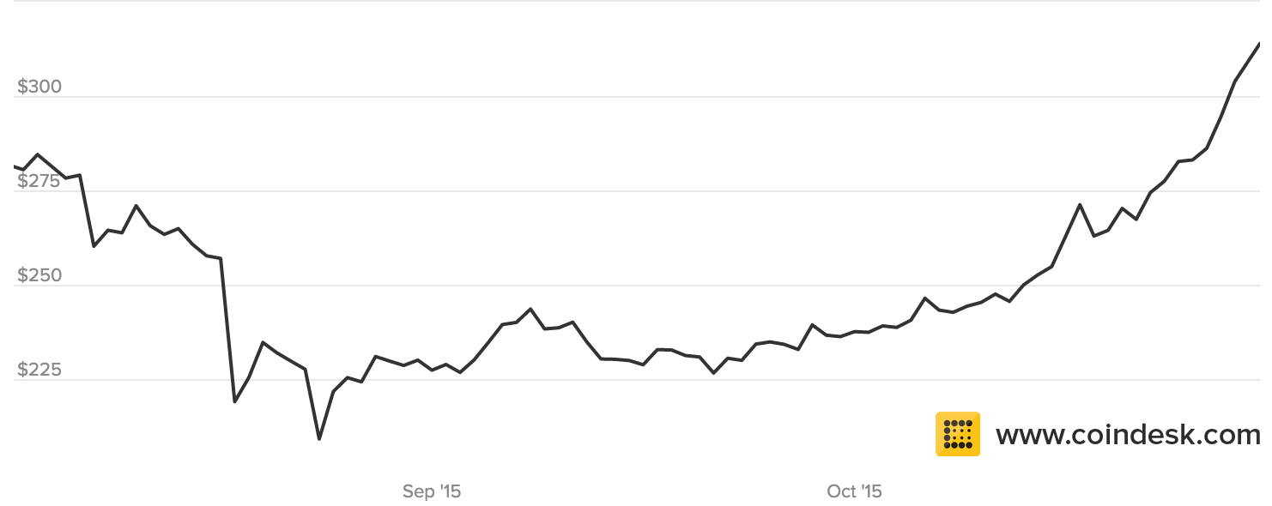
Reality Check
Bitcoin “Market Capitalization” = Number of Bitcoins ✕ Market Price
= 14,777,800 ✕ $314 = $4.64B

Slide 48
What does a $4.64B Market Cap company look like?

Slide 49

NASDAQ: WOOF
Market Cap: $4.4B
Average daily trading: $35M
Bitcoin
Market Cap: $4.6B
Average daily transactions: $50M (?)
Average daily US$ exchange value: $3M

Slide 50

Can Bitcoin Scale?

Slide 51
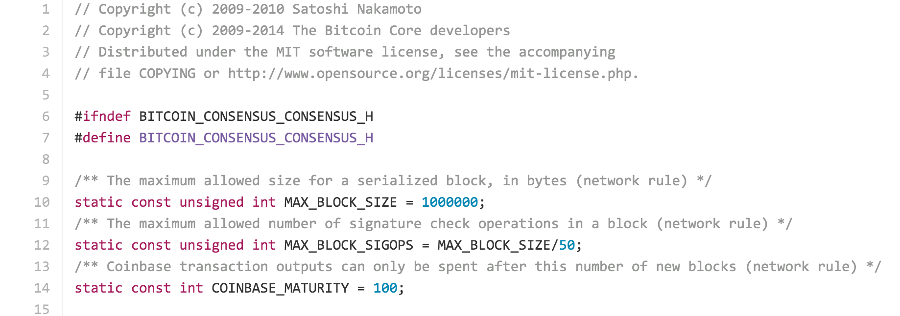
https://github.com/bitcoin/bitcoin/blob/master/src/consensus/consensus.h

Slide 52
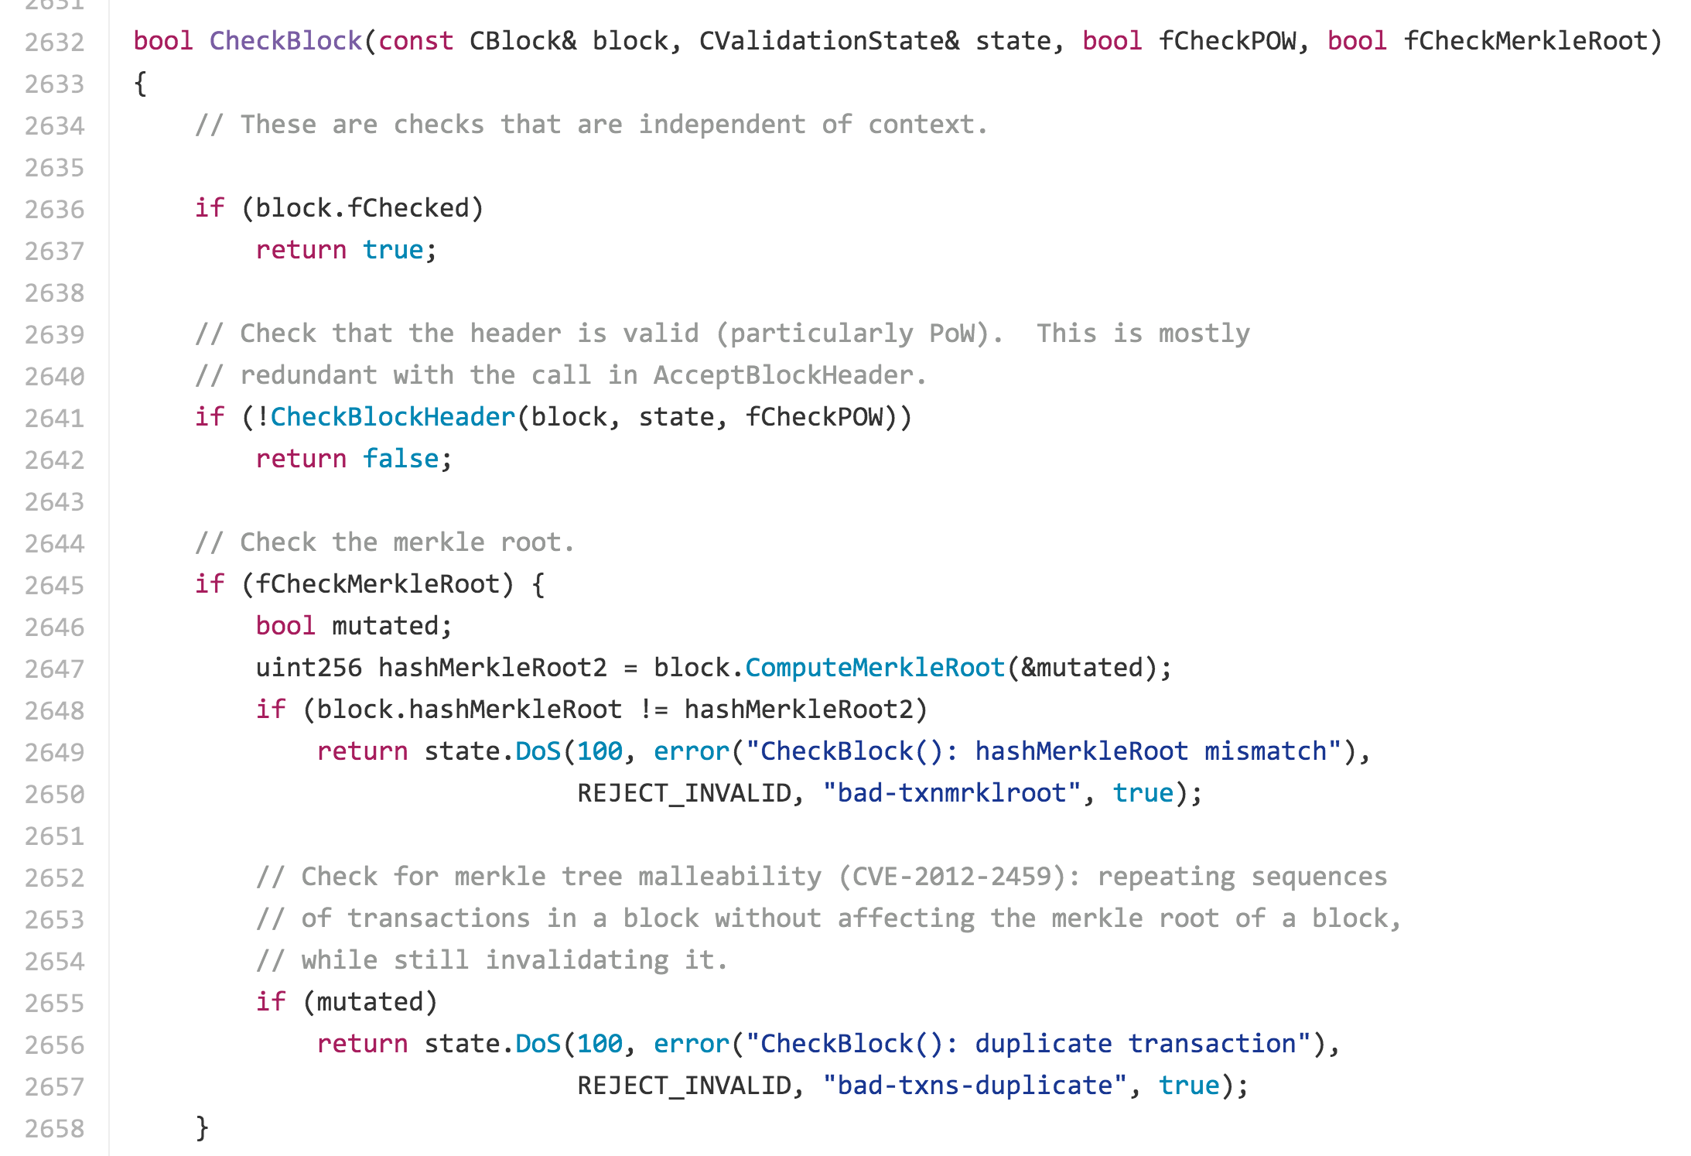
https://github.com/bitcoin/bitcoin/blob/master/src/main.cpp

Slide 53
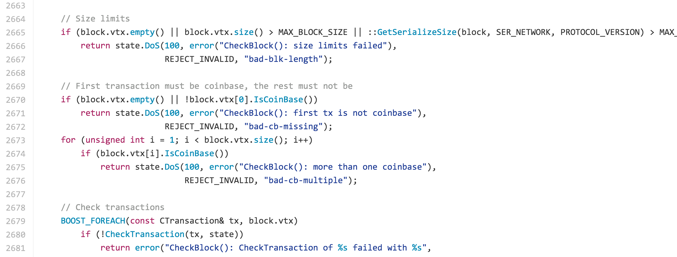
https://github.com/bitcoin/bitcoin/blob/master/src/main.cpp

Slide 54
Scale Today
Block Size = 1MB
Typical transaction size ~ 500 Bytes
Maximum of ~2000 transactions per block / 10 minutes
So, about 3-4 transactions per second

Slide 55

Scale Today
$1B / day =
Block Size = 1MB
Typical transaction size ~ 500 Bytes
Maximum of ~2000 transactions per block / 10 minutes
So, about 3-4 transactions per second
Cost to control bitcoin (assuming other miners are “rational”):
value per block-minute = $7500/10 minutes ~ $750/minute ~ $1M/day
to increase to $1B/day with current transaction rate:
$3472 fee per transaction (without losing transactions)
or 33 Billion transactions per day (with current $0.03 fee)

Slide 56
Scale Today
Block Size = 1MB
Typical transaction size ~ 500 Bytes
Maximum of ~2000 transactions per block / 10 minutes
So, about 3-4 transactions per second
Transactions per Day
VISA: 300M
Interbank: 100M
Cost to control bitcoin (assuming other miners are “rational”):
value per block-minute = $7500/10 minutes ~ $750/minute ~ $1M/day
to increase to $1B/day with current transaction rate:
$3472 fee per transaction (without losing transactions)
or 33 Billion transactions per day (with current $0.03 fee)

Slide 57
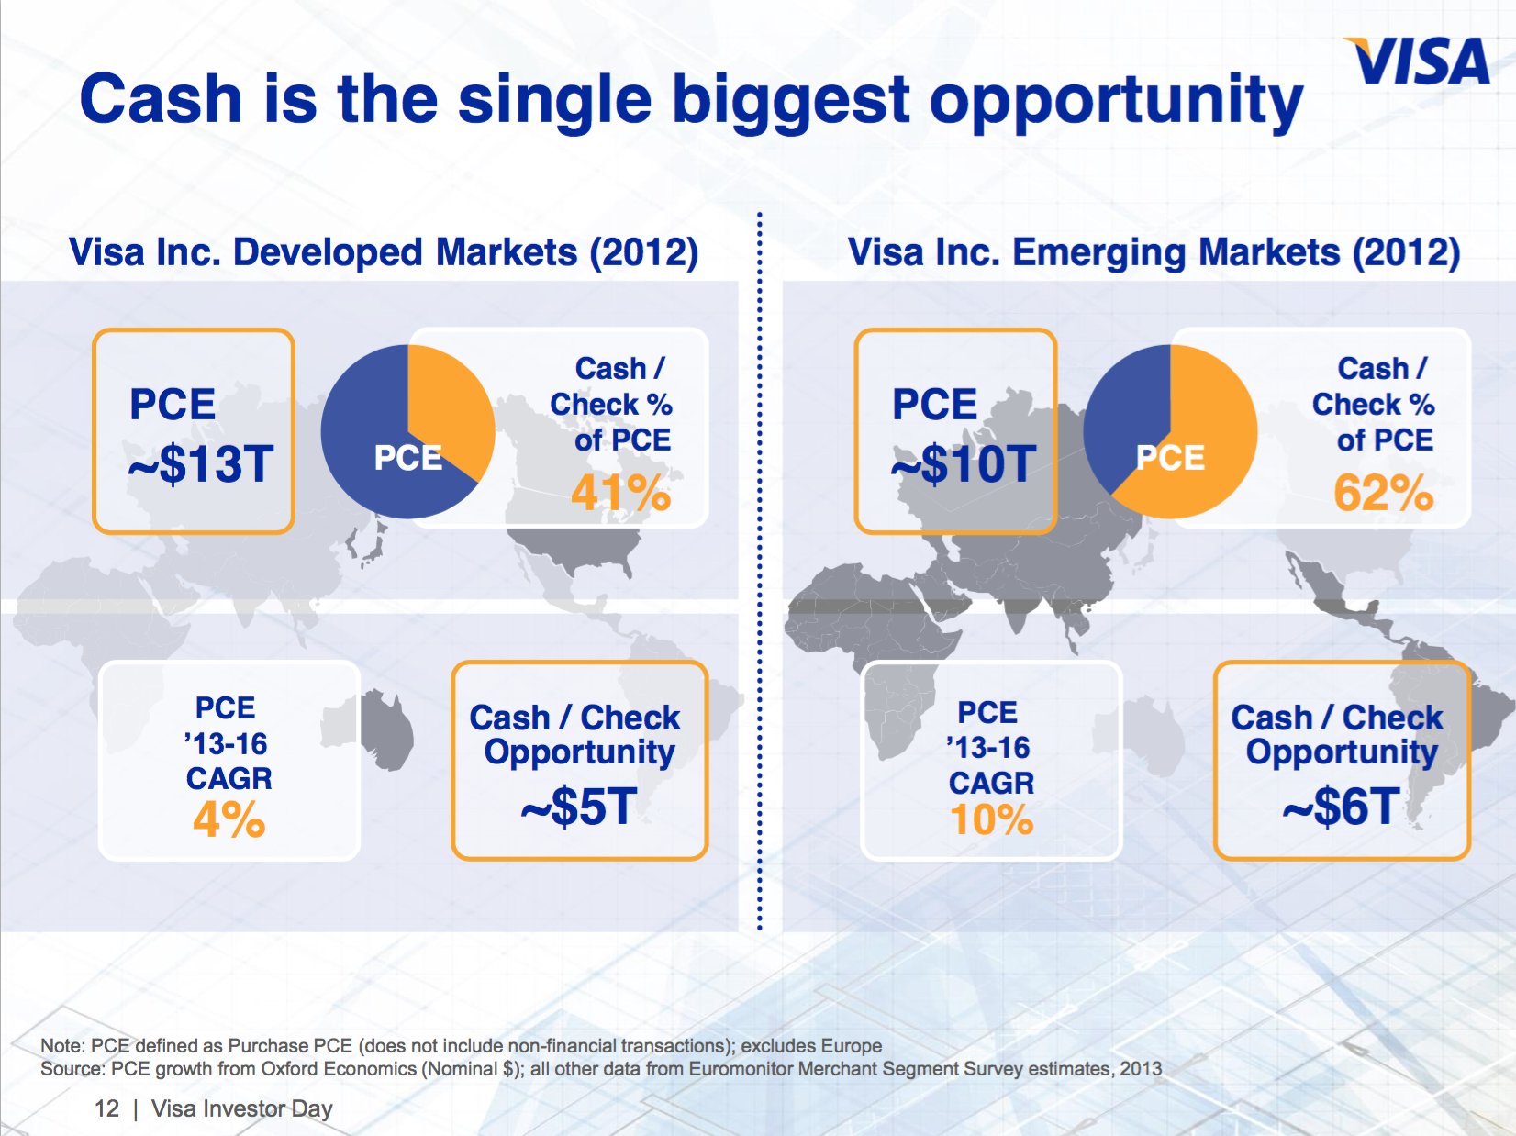
Scale Today
Block Size = 1MB
Typical transaction size ~ 500 Bytes
Maximum of ~2000 transactions per block / 10 minutes
So, about 3-4 transactions per second
Transactions per Day
VISA: 300M
Interbank: 100M
Cash: 20B?
Cost to control bitcoin (assuming other miners are “rational”):
value per block-minute = $7500/10 minutes ~ $750/minute ~ $1M/day
to increase to $1B/day with current transaction rate:
$3472 fee per transaction (without losing transactions)
or 33 Billion transactions per day (with current $0.03 fee)

Slide 58
Scale Today
Block Size = 1MB
Typical transaction size ~ 500 Bytes
Maximum of ~2000 transactions per block / 10 minutes
So, about 3-4 transactions per second
Transactions per Day
VISA: 300M
Interbank: 100M
Cash: 20B?
Facebook Likes: 4.5B
SMS Messages: 25B
WhatsApp Msg: 50B
Cost to control bitcoin (assuming other miners are “rational”):
value per block-minute = $7500/10 minutes ~ $750/minute ~ $1M/day
to increase to $1B/day with current transaction rate:
$3472 fee per transaction (without losing transactions)
or 33 Billion transactions per day (with current $0.03 fee)

Slide 59

Distributed microblogging
Nick Skelsey – Cofounder @ Soapbox Systems

