Slide 1

RFID Object Localization
Gabriel Robins and Kirti Chawla
Department of Computer Science
University of Virginia
robins@cs.virginia.edu kirti@cs.virginia.edu

Slide 2
Outline
What is Object Localization ?
Background
Motivation
Localizing Objects using RFID
Experimental Evaluation
Conclusion

Slide 3

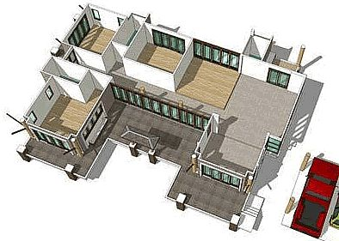
What is Object Localization ?
Objects
Environments
Goal: Find positions of objects in the environment
Problem: Devise an object localization approach with good performance and wide applicability

Slide 4
Current Situation
Lots of approaches and applications lead to vast disorganized research space
Satellites
Signal strength
Lasers
Signal arrival time
Ultrasound sensors
Signal arrival angle
Cameras
Signal phase
Technologies
Techniques
Stationary object localization
Inapplicable
Not general
Mismatched
Mobile object localization
Identify limitations
Determine suitability
Indoor localization
Outdoor localization
Applications

Slide 5
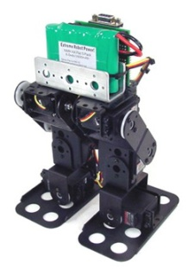
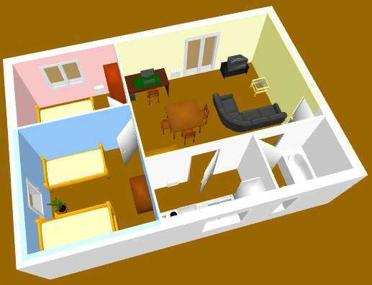
Localization Type
Self
Environmental
Self-aware of position
Processing capability
Not aware of position
Optional processing capability

Slide 6
Localization Technique
Signal arrival time
Signal arrival difference time
Signal strength
Signal arrival phase
Signal arrival angle
Landmarks
Analytics (combines above techniques with analytical methods)

Slide 7
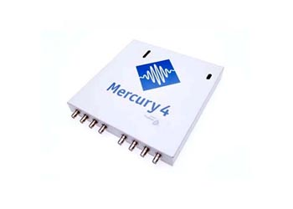
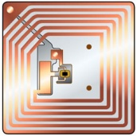
RFID Technology Primer
RFID reader
RFID tag
Inductive Coupling
Backscatter Coupling
Interact at various RF frequencies
Passive
Semi-passive
Active

Slide 8
Motivating RFID-based Localization
Low-visibility environments
Not direct line of sight
Beyond solid obstacles
Cost-effective
Adaptive to flexible application requirements
Good localization performance

Slide 9
State-of-the-art in RFID Localization
RFID –based localization approaches
Pure
Hybrid

Slide 10
Contributions
Pure RFID-based environmental localization framework with good performance and wide applicability
Key localization challenges that impact performance and applicability

Slide 11
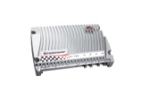

Power-Distance Relationship
Cannot determine tag position
Empirical power-distance relationship
Reader power
Distance
Tag power

Slide 12



Empirical Power-Distance Relationship
Insight: Tags with very similar behaviors are very close to each other

Slide 13
Tag Sensitivity
Key Challenges
Results
Variable sensitivities
13 %
Bin tags on sensitivity
Pile of tags
25 %
54 %
8 %
High sensitive
Average sensitive
Low sensitive

Slide 14
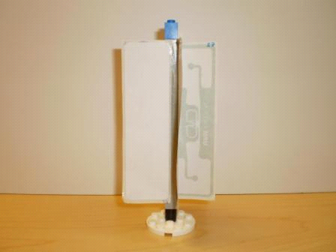
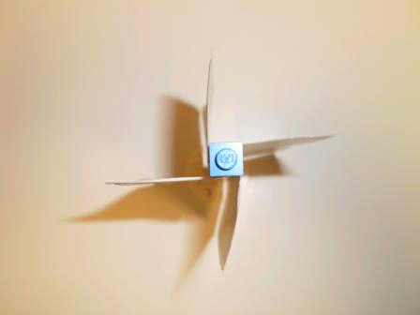
Reliability through Multi-tags
Results
Platform design
Insight: Multi-tags have better detectabilities (Bolotnyy and Robins, 2007) due to orientation and redundancy

Slide 15
Tag Localization Approach
Setup phase
Localization phase

Slide 16
Algorithm: Linear Search
Linearly increments the reader power from lowest to highest (LH) or highest to lowest (HL)
Reports the first power level at which a tag is detected as the minimum tag detection power level
Localizes the tags in a serial manner
Time-complexity is: O(# tags ⋅ power levels)

Slide 17
Algorithm: Binary Search
Exponentially converges to the minimum tag detection power level
Localizes the tags in a serial manner
Time-complexity is: O(# tags ⋅ log(power levels))

Slide 18
Algorithm: Parallel Search
Linearly decrements the reader power from highest to lowest power level
Reports the first power level at which a tag is detected as the minimum tag detection power level
Localizes the tags in a parallel manner
Time-complexity is: O(power levels)

Slide 19
Reader Localization Approach
Setup phase
Localization phase

Slide 20
Algorithm: Measure and Report
Reports a 2-tuple ⟨TagID, Timestamp⟩ after reading a neighborhood tag
Sorted timestamps identify object’s motion path
Time-complexity is: O(1)

Slide 21
Localization Error
Error-reducing Heuristics
Reference tag’s location as object’s location leads to error
Number of selection criteria

Slide 22
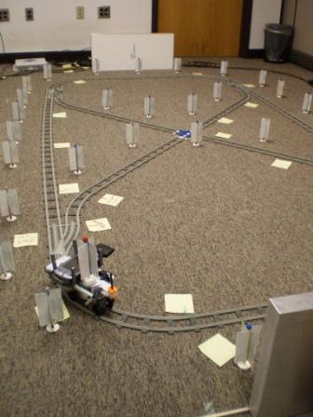
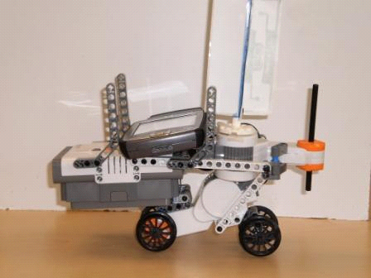
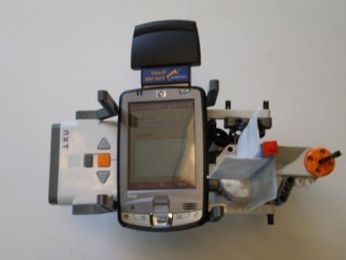
Experimental Setup
Track design
Mobile robot design
4
X-axis
1
3
2
Y-axis

Slide 23
Experimental Evaluation
Empirical power-distance relationship
Localization performance
Impact of number of tags on localization performance

Slide 24
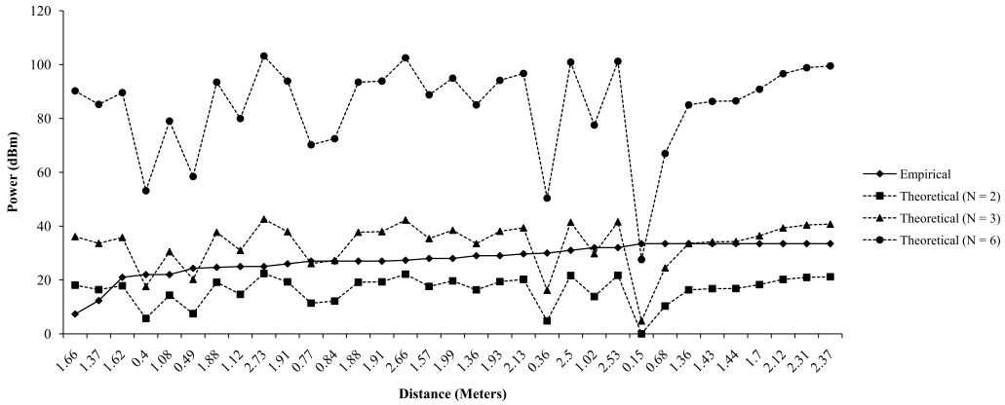
Empirical Power-Distance Relationship

Slide 25
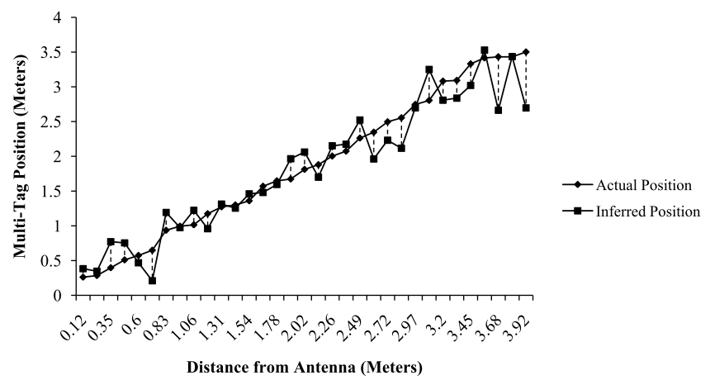
Localization Accuracy

Slide 26
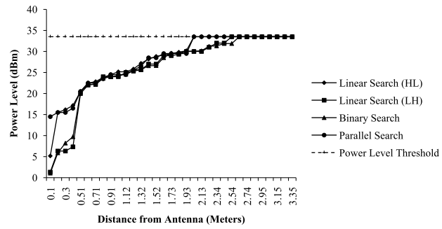
Algorithmic Variability

Slide 27
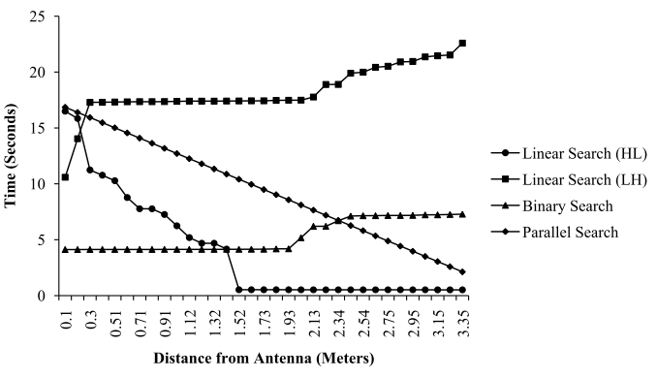
Localization Time

Slide 28
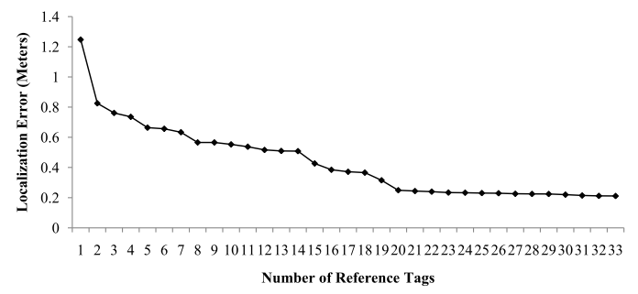
Performance Vs Number of Tags
Diminishing returns

Slide 29
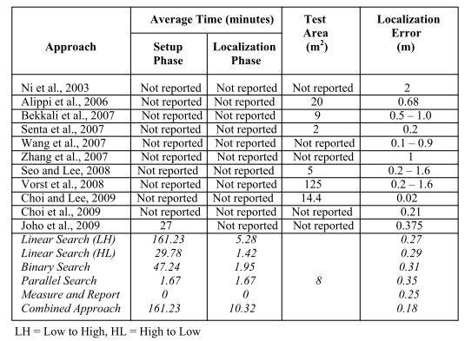
Comparison with Existing Approaches
Hybrid
Hybrid

Slide 30
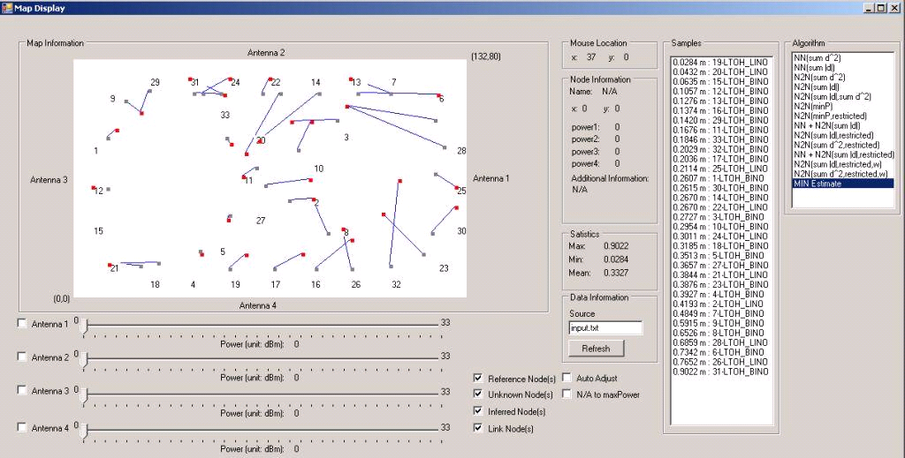
Visualization
Heuristics
Work area
Accuracy
Antenna control

Slide 31
Deliverables
Patent(s):
Kirti Chawla, and Gabriel Robins, Method, System and Computer Program Product for Low-Cost Power-Provident Object Localization using Ubiquitous RFID Infrastructure, UVA Patent Foundation, University of Virginia, 2010, US Patent Application Number: 61/386,646.
Journal Publication(s):
2. Kirti Chawla, and Gabriel Robins, An RFID-Based Object Localization Framework, International Journal of Radio Frequency Identiﬁcation Technology and Applications, Inderscience Publishers, 2011, Vol. 3, Nos. 1/2, pp. 2-30.
Conference Publication(s):
Kirti Chawla, Gabriel Robins, and Liuyi Zhang, Efficient RFID-Based Mobile Object Localization, Proceedings of IEEE International Conference on Wireless and Mobile Computing, Networking and Communications, 2010, Canada, pp. 683-690.
Kirti Chawla, Gabriel Robins, and Liuyi Zhang, Object Localization using RFID, Proceedings of IEEE International Symposium on Wireless Pervasive Computing, 2010, Italy, pp. 301-306.
Grant(s):
5. Gabriel Robins (PI), NSF Grant on RFID Pending

Slide 32
Conclusion
Pure RFID-based object localization framework
Key localization challenges
Power-distance relationship is a reliable indicator
Extendible to other scenarios

Slide 33
Thank You

Slide 34
Backup Slides

Slide 35
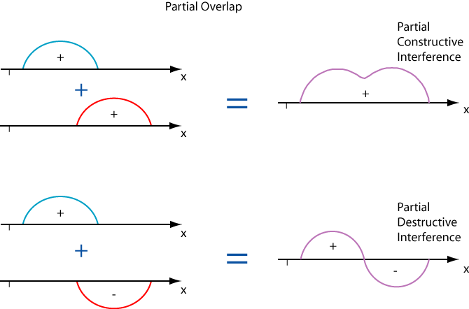



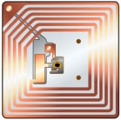




Key Localization Challenges
Back
RF interference
Occlusions
Tag sensitivity
Tag spatiality
Tag orientation
Reader locality

Slide 36
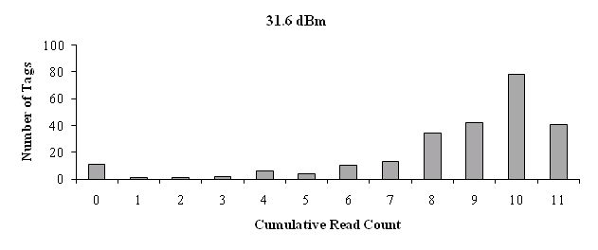
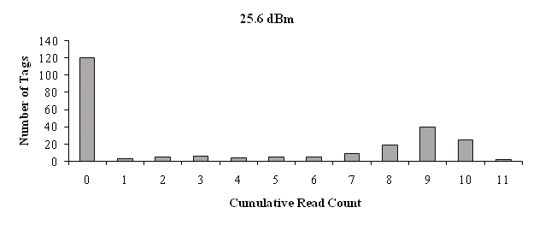
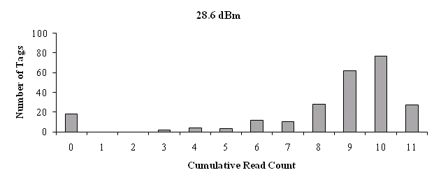
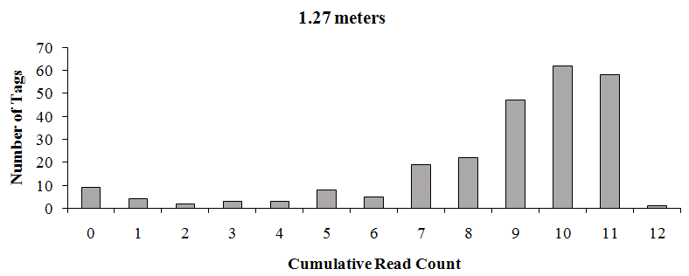
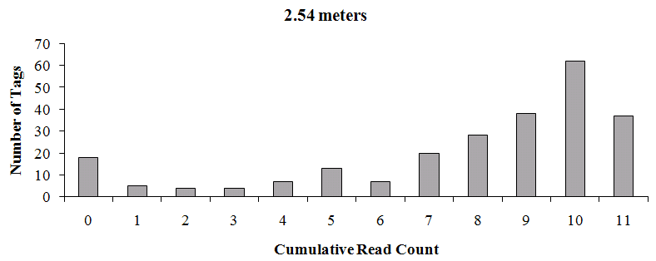
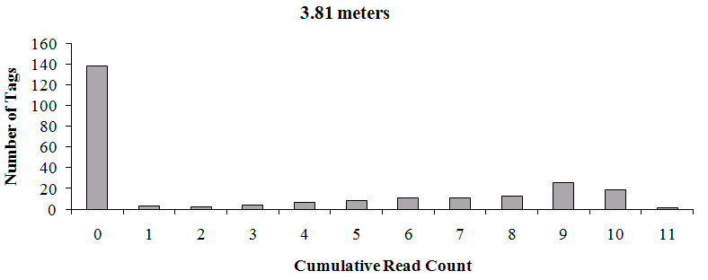
Single Tag Calibration
Back
Constant distance/Variable power
Variable distance/Constant power

Slide 37
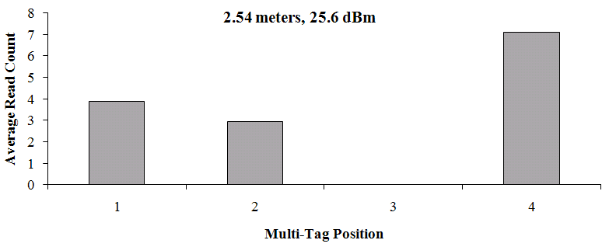
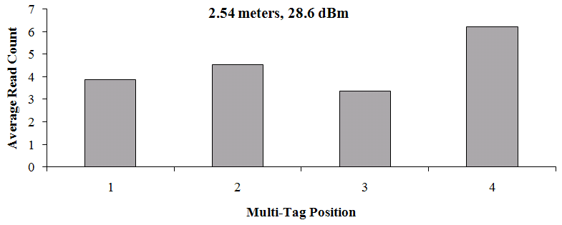
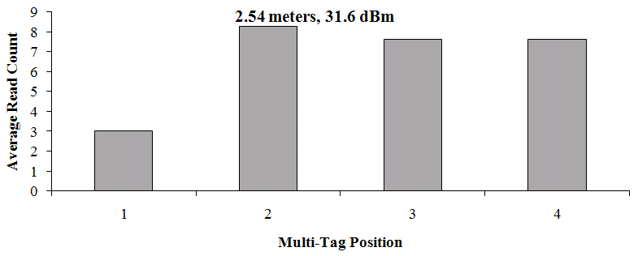
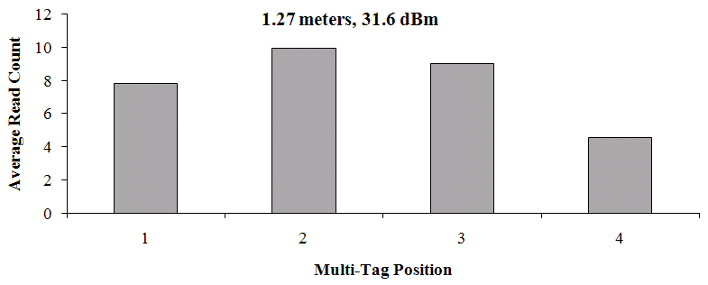
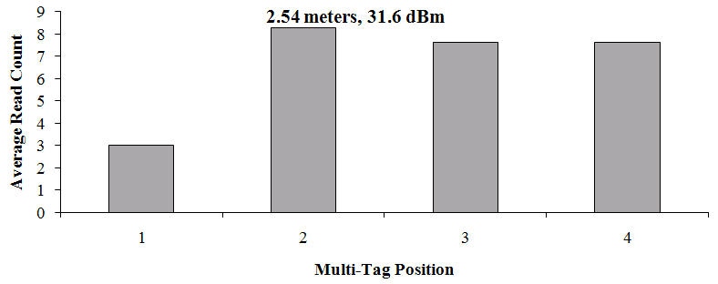
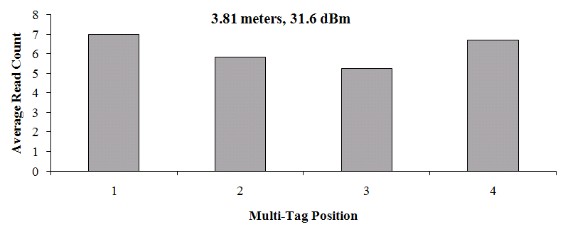
Multi-Tag Calibration: Proximity
Back
Constant distance/Variable power
Variable distance/Constant power

Slide 38
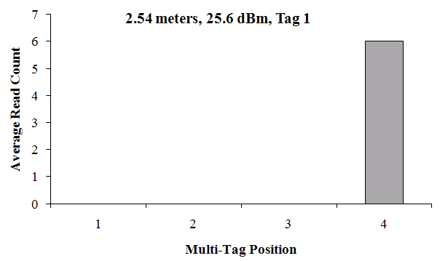
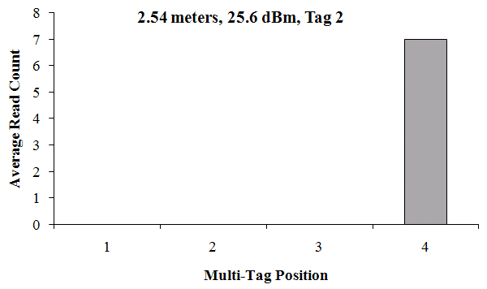
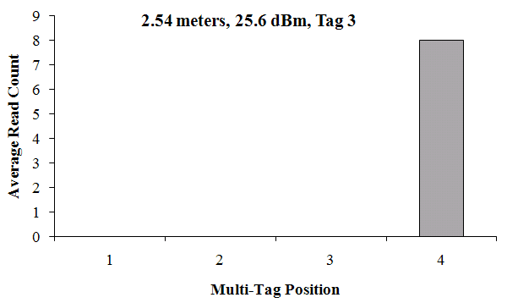
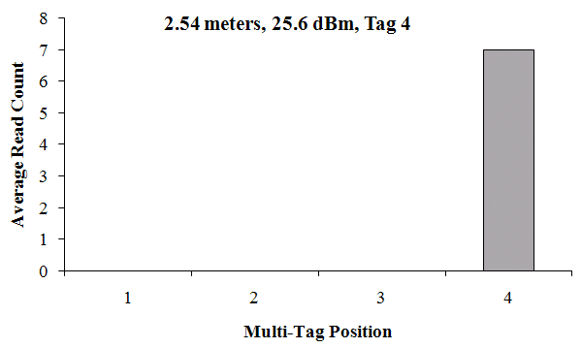
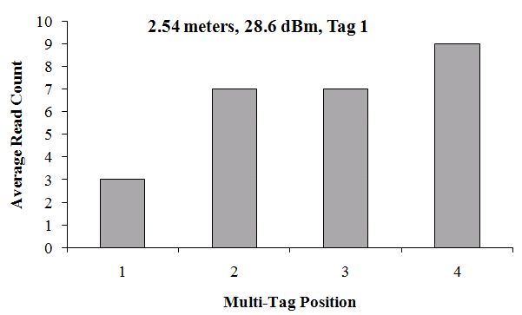
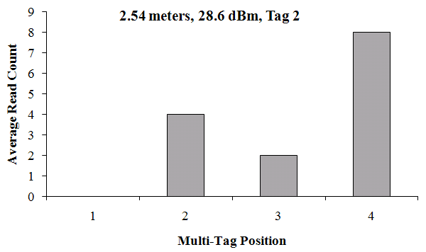
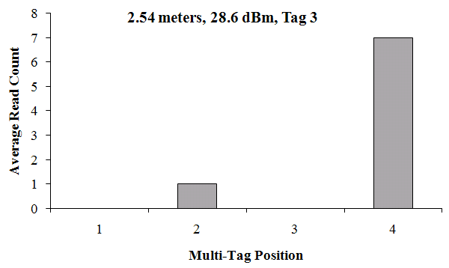
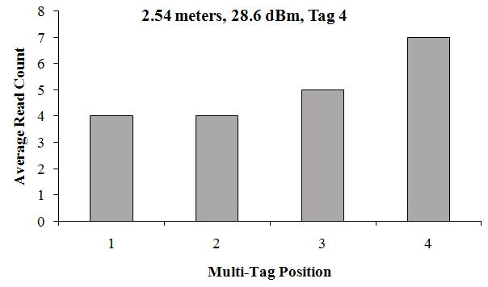
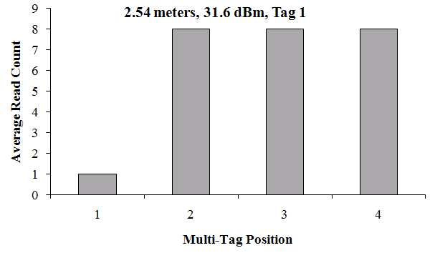
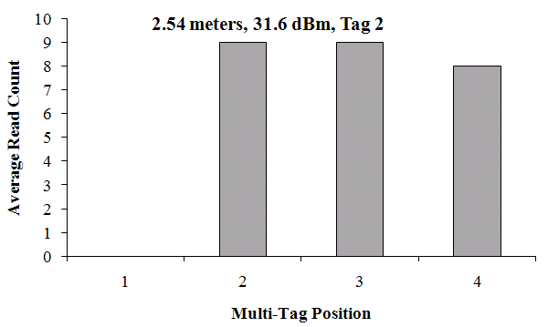
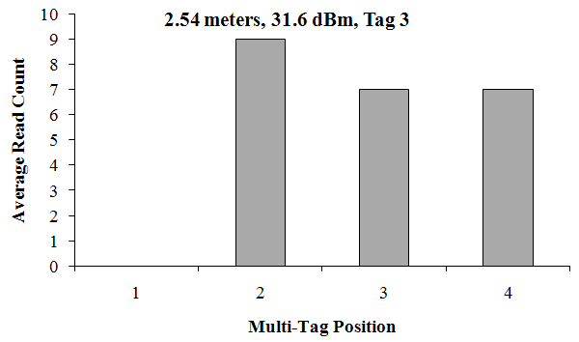
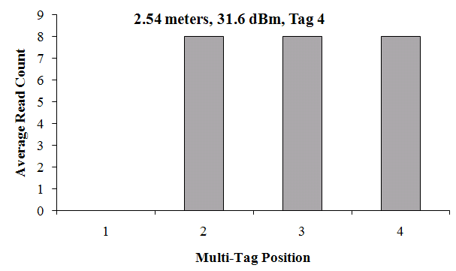
Multi-Tag Calibration: Rotation 1
Back
Constant distance/Variable power

Slide 39
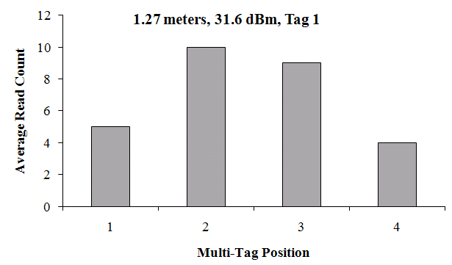
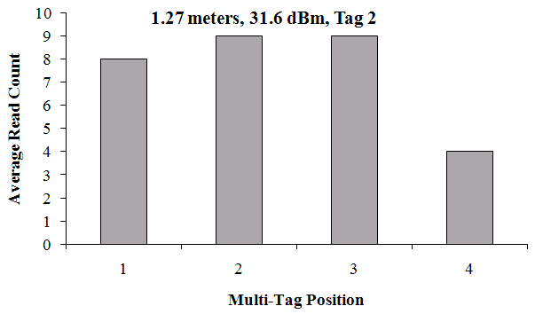
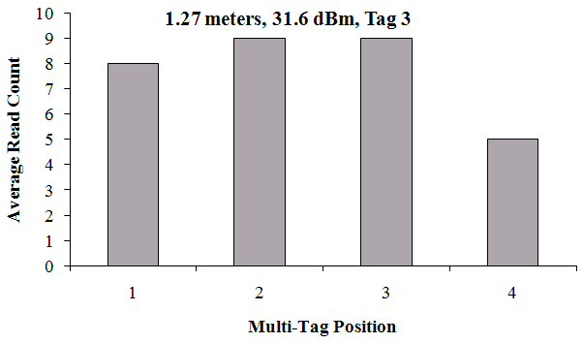
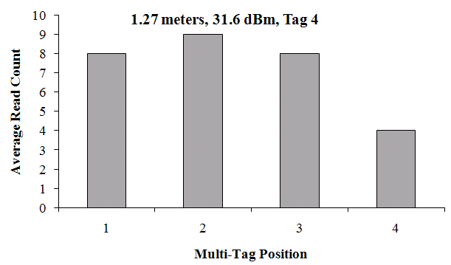
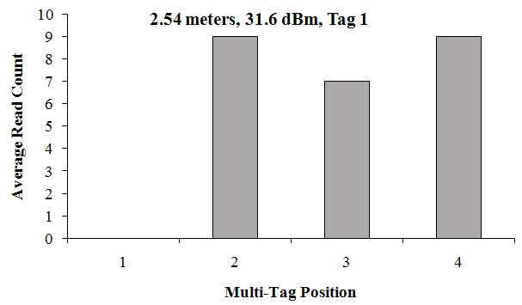
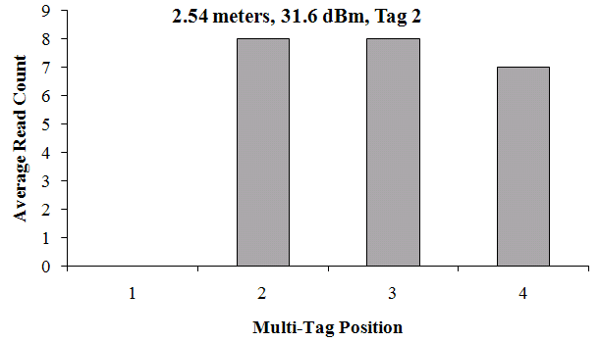






Multi-Tag Calibration: Rotation 2
Back
Variable distance/Constant power

Slide 40
Error-Reducing Heuristics
Back
Heuristics: Absolute difference

Slide 41
Error-Reducing Heuristics
Back
Heuristics: Minimum power reader selection

Slide 42
Error-Reducing Heuristics
Back
Heuristics: Root sum square absolute difference

Slide 43
Error-Reducing Heuristics
Back
Absolute difference
Minimum power reader selection
Localization error
Meta-Heuristic
Root sum square absolute difference
Other heuristics

