Slide 1

RFID Object Localization
Gabriel Robins and Kirti Chawla
Department of Computer Science
robins@cs.virginia.edu kirti@cs.virginia.edu

Slide 2
Outline
Problem: Object Localization
Prior Art
RFID Technology Primer
Our Localization Approach
Commercial Product
Applications
Technology Commercialization

Slide 3
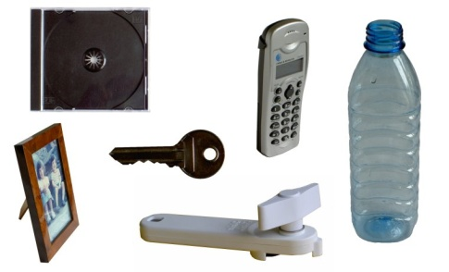
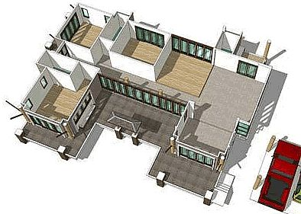

The Problem of Locating Objects
Objects
Environments
Goal: Develop an approach to find positions of objects in any environment.
Key factors: Good Performance, wide applicability, and avoid shortcomings of prior approaches

Slide 4
Prior Art
Solutions utilize different technologies (e.g., lasers, cameras, ultrasonics, etc.) and techniques
Several limiting constraints
Inapplicable, mismatched, and adhoc solutions

Slide 5
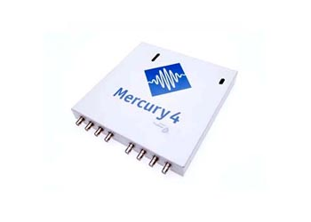

RFID Technology Primer
RFID reader
RFID tag
Interacts at various RF frequencies
Passive, semi-passive,
and active

Slide 6





Our Localization Approach
Setup phase
Localization phase

Slide 7
Commercial Product
Software that embodies localization algorithms, performance enhancing techniques and user-interface
Deployment and optimization techniques
Compatible with all standard RFID hardware
Improves with advances in RFID technology

Slide 8
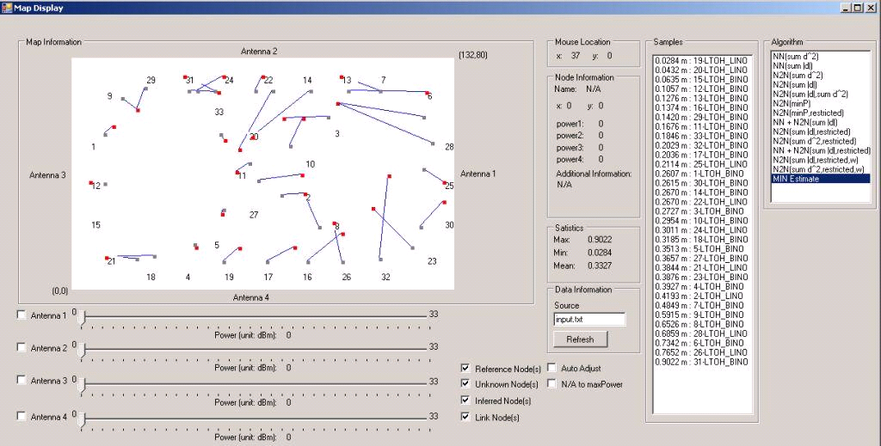
Visualization
Heuristics
Work area
Accuracy
Antenna control

Slide 9
Applications
Tier-I:
  Locating objects (e.g., people, pets, etc.) in different environments (e.g., hospitals, hotels, etc.)
Tier-II:
  Energy management in buildings
  Location-based advertisements
  Assisted living for elders
  many more…

Slide 10
Research Deliverables
Journal Publication
  Kirti Chawla, and Gabriel Robins, An RFID-Based Object Localization Framework, International Journal of Radio Frequency Identiﬁcation Technology and Applications, Inderscience Publishers, 2011, Vol. 3, Nos. 1/2, pp. 2-30.
Conference Publications
  Kirti Chawla, Gabriel Robins, and Liuyi Zhang, Efficient RFID-Based Mobile Object Localization, Proceedings of IEEE International Conference on Wireless and Mobile Computing, Networking and Communications, 2010, Canada, pp. 683-690.
  Kirti Chawla, Gabriel Robins, and Liuyi Zhang, Object Localization using RFID, Proceedings of IEEE International Symposium on Wireless Pervasive Computing, 2010, Italy, pp. 301-306.

Slide 11
Technology Commercialization
Provisional patent application filed on 09/27/2010
Formed a startup Diorama Technologies with non-exclusive commercialization rights
Software copyrighted to further enhance commercial potential
20+ companies based in US, UK and India showed interest
Leverage UVa Alumni Mentorship Program (T100)

Slide 12
Questions

