Slide 1
Gender & Computing
Joanne McGrath Cohoon

Slide 2
What now?
A few reasons girls should study CS
Some reasons few of them do
What can we do about it?
Contribute to a resource for high school teachers

Slide 3
Flexible, creative, rewarding career; unmet need; gender equity; enhanced innovation
Why should girls study CS?

Slide 4
Many Total Job Openings Predicted for 2016

Slide 5
Relatively Low Unemployment Rates

Slide 6
IT occupations are well-paid
Source: Bureau of Labor Statistics

Slide 7
Workforce needs will be unmet

Slide 8
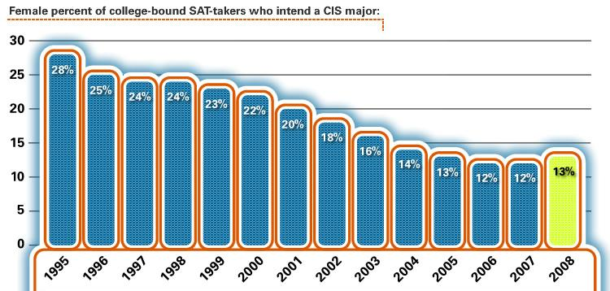
Few HS Girls Plan a Computing Career
Calculated with data from the College Board

Slide 9
Only CS is getting worse
Calculated using IPEDS data from the U.S. Dept of Education

Slide 10
Why do few females pursue computing?
Stereotypes reduce confidence and interest
Educational policies allow choices influenced by stereotypes
Lack of support and encouragement
Lack of information
Unconscious bias

Slide 11
Improve the situation by recruiting
Students & their influencers
Messages that persuade and stick
Media that get attention
more on this topic tomorrow

Slide 12
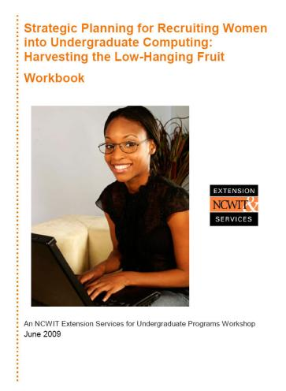
NCWIT resources can help with recruiting
For more resources, see ncwit.org/resources.res.html

Slide 13
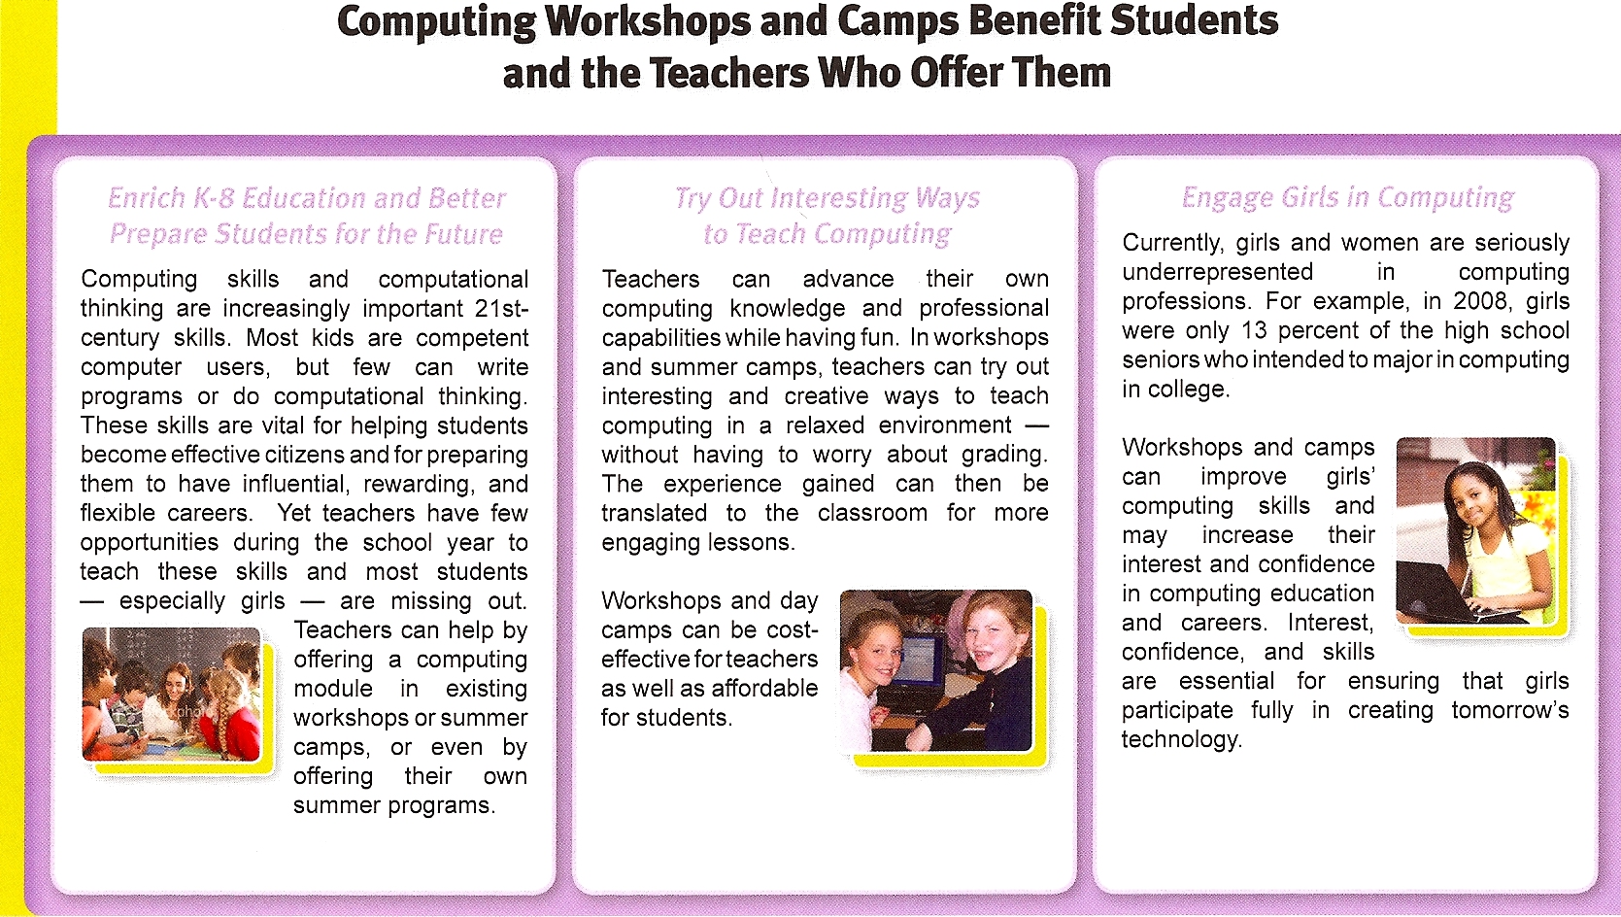
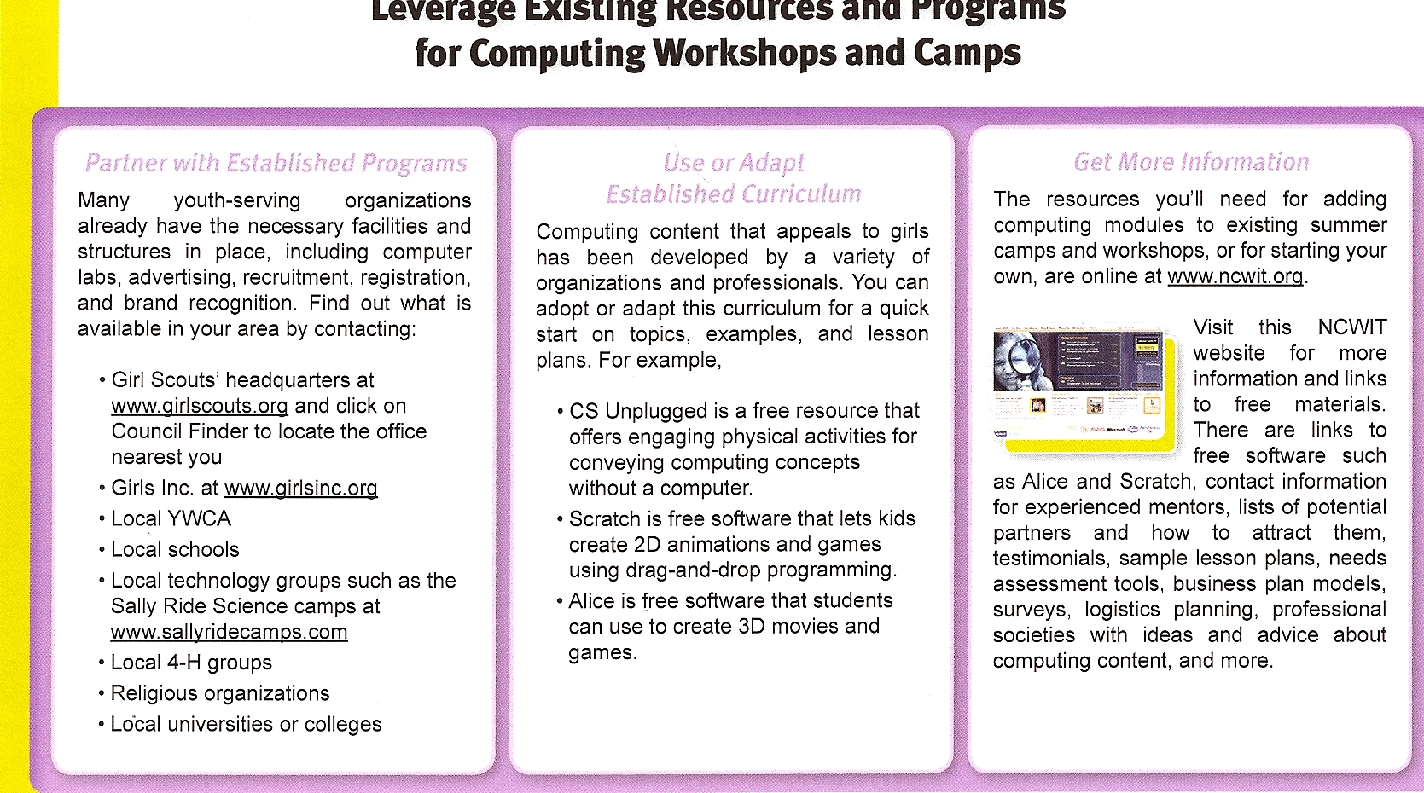
Help develop a new resource for recruiting
Aimed at motivating teachers to offer computer science in “camps”

Slide 14
Jot down your answers to these questions
How appealing/unappealing is this card to you?
If given this card, how likely is it you would read it?
How engaging is each section of the card?
After reading the card, what, if anything, would you do as a result?
What change would most improve this card?

Slide 15
Thank you for your help!

