Slide 1
DRAFT The Importance of Teaching Computer Science in High School
J. McGrath Cohoon
Senior Research Scientist
National Center for Women & Information Technology
University of Virginia

Slide 2
Why study computer science (CS)?
Flexible, creative, rewarding careers
Unmet workforce need

Slide 3
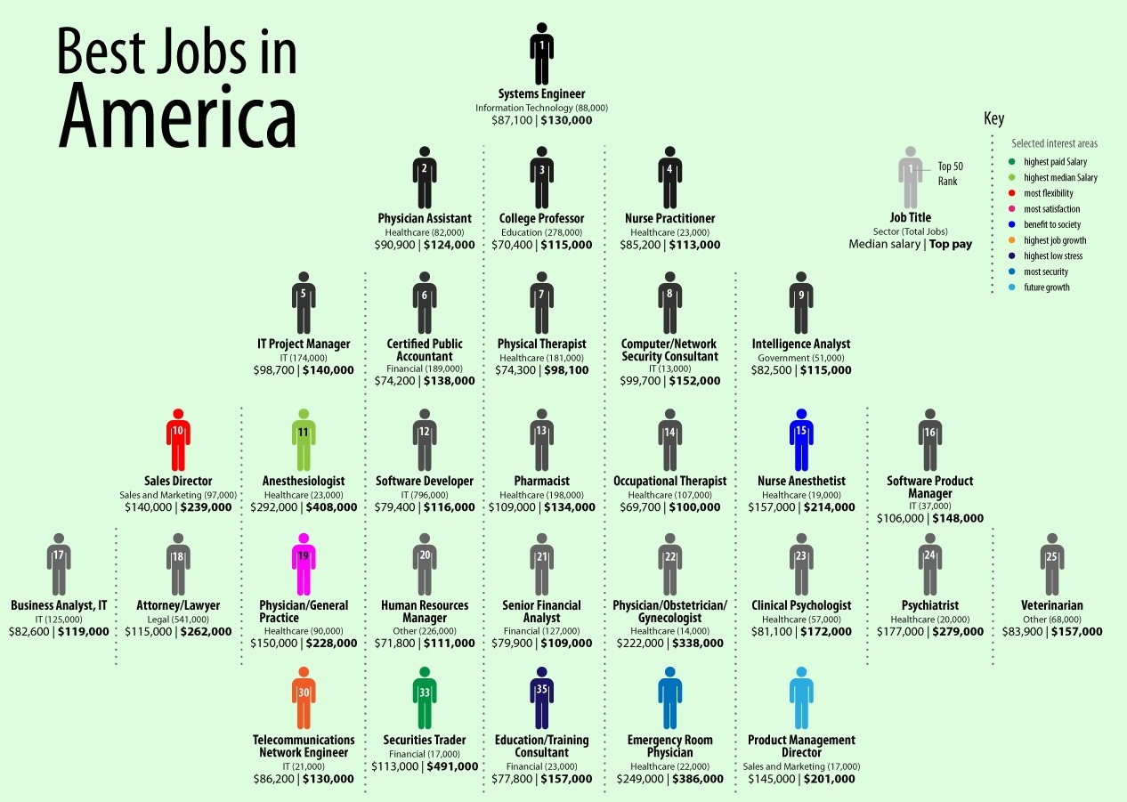
Great Career!
3/2010
BLS, CNNMoney, Payscale data from Focus

Slide 4
Three of the top ten occupations are computing
Systems Engineer:
IT Project Manager:
Network Security Consultant:
Manage large complex projects
Plan, organize, and oversee the team on a computing project
Protect important computer systems from infiltration
Notes:
These are real people in these jobs (in order of jobs listed). Photos copied from CNNMoney.com website on Best Jobs in America.

Slide 5
Computing occupations are well paid
Source: Bureau of Labor Statistics (BLS)

Slide 6
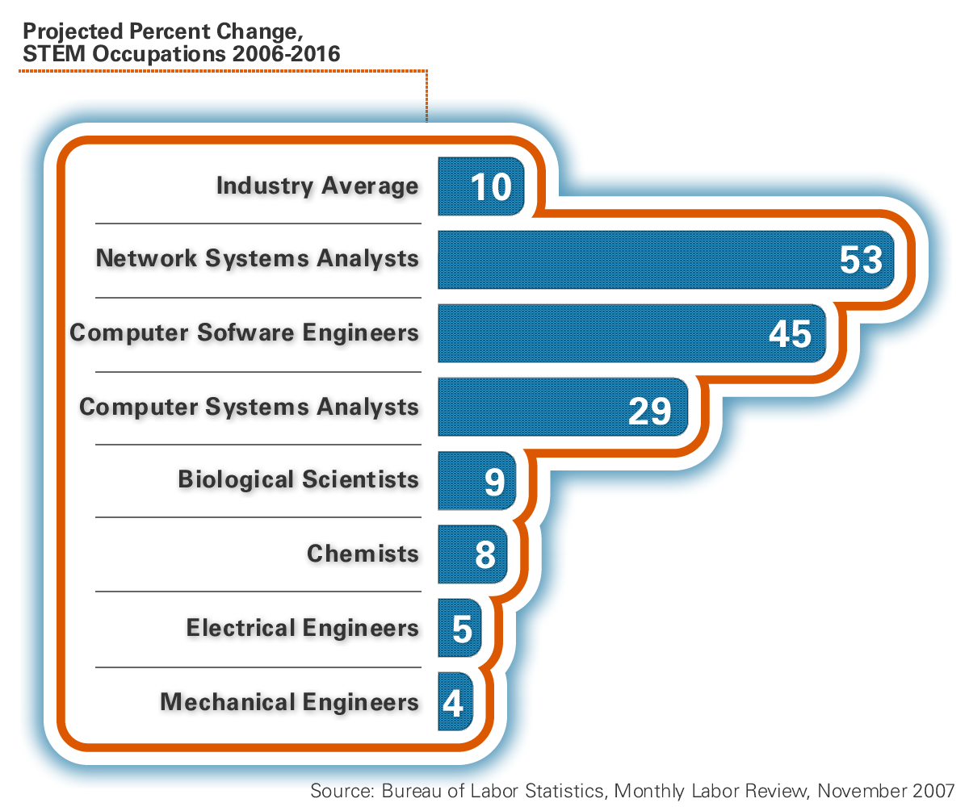
Computing is where the jobs are going to be

Slide 7
CS outpaces other expected total job openings
Bachelor Level STEM Jobs due to Growth and Replacement for 2018

Slide 8
…unless we attract more students
Workforce needs will go unmet

Slide 9
Why offer CS in high school?

Slide 10
CS teaches vital 21st century skills
Design, logical reasoning, and problem solving
Creating and adapting, not just using, technology

Slide 11
Colleges often expect familiarity
Students are more likely to succeed in computing if they have positive early experiences

Slide 12
Contribute to local economy

Slide 13
NCWIT has free resources for more information Talking Points Cards Programs in a Box Practice Sheets Facts & Figures
Notes:
NCWIT has developed resources based on research for K-12, Undergraduate, Graduate, and Career stages

Slide 14
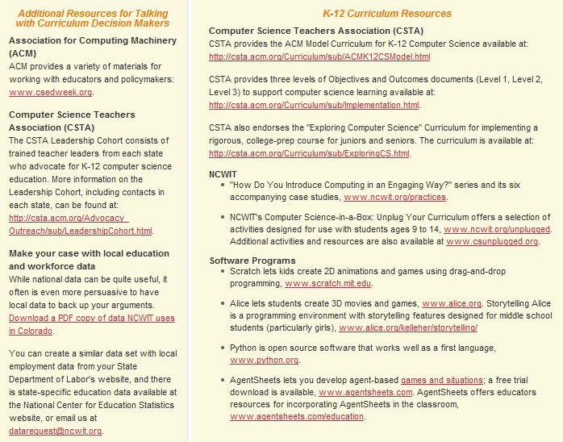
More Resources for HS Policymakers

Slide 15
Encourage your students to find out more

Slide 16
Questions
Notes:
Are there any additional questions?

