Slide 1
Pedagogy in the City
Leigh Ann Sudol-DeLyser
Academy for Software Engineering
NYC Foundation for CS Education

Slide 2
Inclusive Pedagogy
Pedagogy in the City
Leigh Ann Sudol-DeLyser
Academy for Software Engineering
NYC Foundation for CS Education

Slide 3



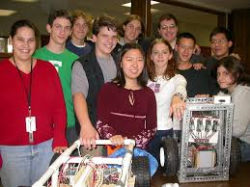

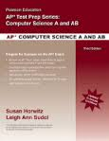



My Journey

Slide 4
A Change in Perception
“If you add up all of the ‘underrepresented minorities’ in computer science - it is 70% of the population” - Jan Cuny, NSF

Slide 5
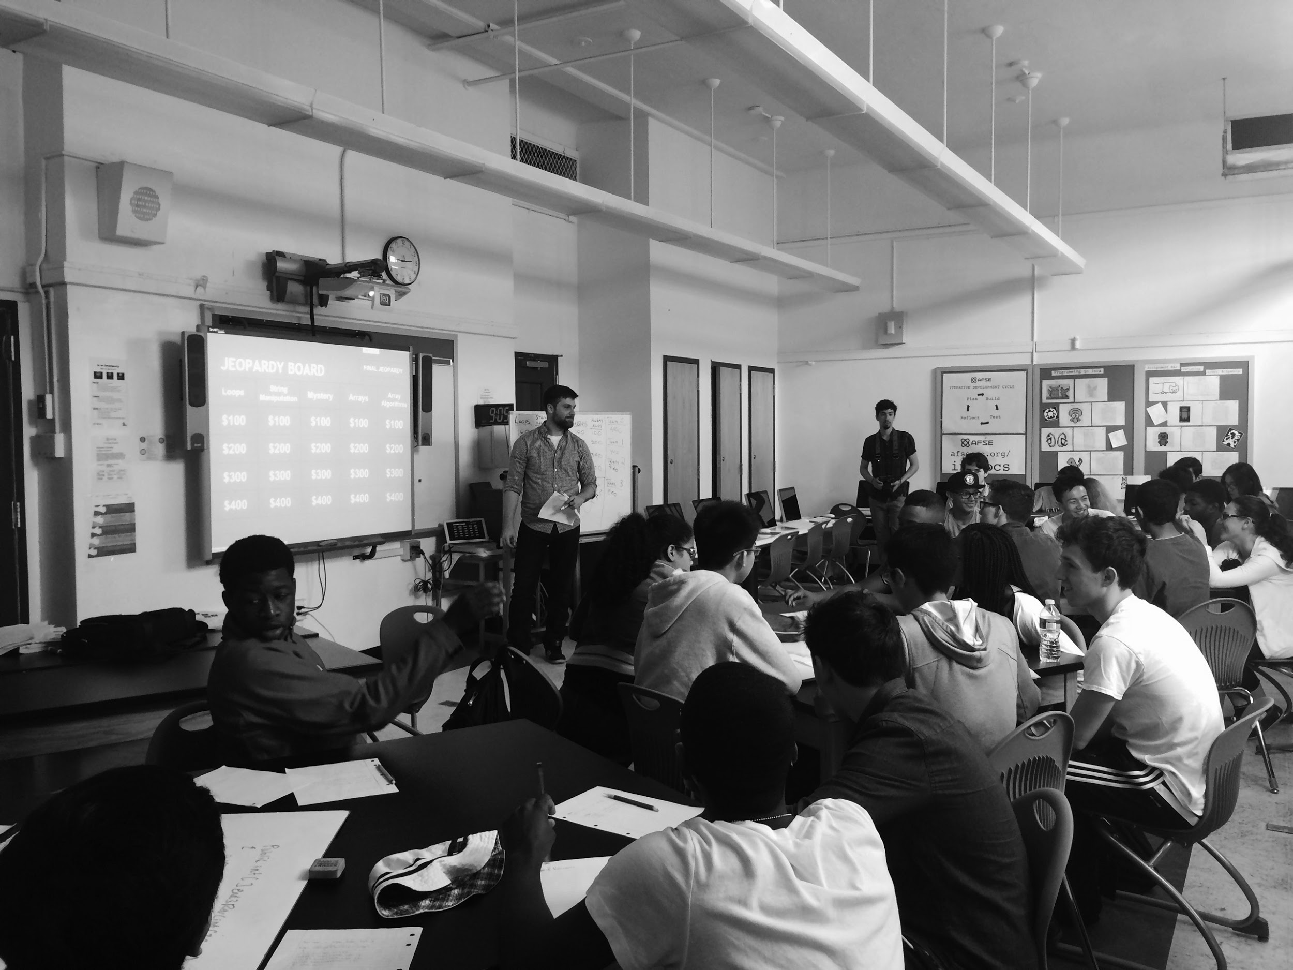
NYC Foundation for CS Education
CSNYC's mission is to ensure that all of New York City’s 1.1 million public school students have access to a high-quality computer science education that puts them on pathway to college and career success.

Slide 6
NYC is Scale
Enrollment: 1,122,783
Schools: 1,704
Teachers: 89,000+

Slide 7
NYC is Diverse
Ethnicity:
Asian: 15.3% Black: 27.8%
Hispanic: 40.4% White: 14.7%
Other: 1.4%

Slide 8
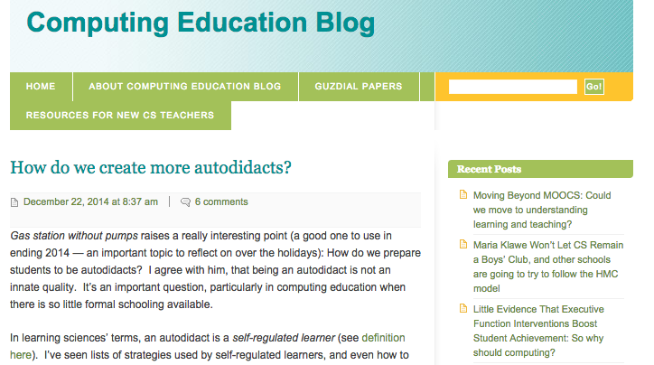
The myth of CS “Ability”

Slide 9
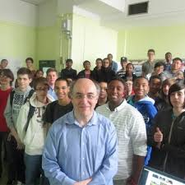
“We often mistake prior academic preparation for ability” – Jane Margolis

Slide 10
Diversity Means Addressing the Needs of All Learners
Providing context and motivation are just one aspect of educating for a diverse audience.
Your students may not learn the way you did.
Your expert blind spots may be making it harder.
We can learn from other domains:
  Sentence starters in ELA
  Other SPED practices
Notes:
Rose’s keyboarding examples.

Slide 11


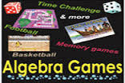
The Myth of Context
If learning was just about finding an engaging context then Math would have the Algebra thing all wrapped up.
Notes:
Does engagment help? YES! Is it the solution to all of our problems? No. Good pedagogy, curricular supports and recognizing the socio and emotional baggage students bring to the classroom is important.

Slide 12
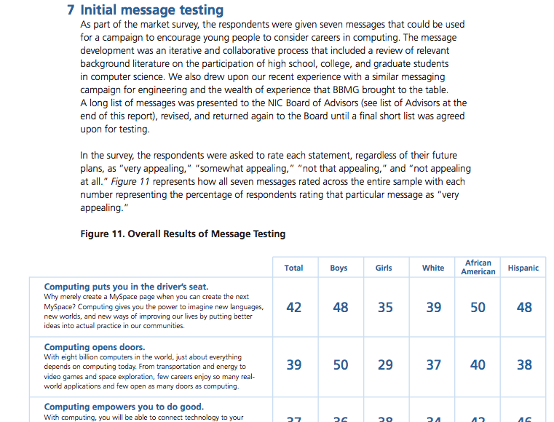
New Image of Computing

Slide 13
Addressing the Socio-Emotional Baggage
Self Efficacy
Persistence
Learning Habits
Identity
Notes:
SE: I can’t do this so I won’t try
Persistance: Its too hard, I give up
Learning Habits: But I watched you teach it, and I still don’t know what to do (no questions, no notes)
Identity: I don’t look like a computer scientist

Slide 14
Self Efficacy
Is the extent or strength of one’s belief in one’s own ability to complete tasks and reach goals.
Provide clear learning objectives and opportunities for students to demonstrate mastery.
Explicitly connect student work to stated objectives.
Explicitly teach goal setting and help students recognize when they satisfy subgoals which lead to productive outcomes.

Slide 15
Persistence
The quality of lasting or enduring tenaciously
Self-distraction is often evidence of a roadblock or struggle the student is having.
Continuously touch base with students, making sure they know the expected task or goal and that they are not quietly struggling.

Slide 16
Learning Habits
The general strategies used by students to acquire and retain knowledge.
Diverse learners often come from educational backgrounds that do not emphasize strong habits.
Provide scaffolded notes (copies of notes with sections removed to be filled in) and opportunities for students to practice skills and knowledge retrieval.
Be consistent in your own habits.

Slide 17
Identity
The condition of being oneself or itself, and not another.
Provide opportunities for students to identify with other successful students or adults.
Use activities that help students find commonalities (interests or characteristics) with others in computing.
Support both the identification of skill identity and personal identity.

Slide 18
The Bait and Switch
“Computer Science was fun when I was young, and then it was hard” - Luther, yesterday
Interest vs. Pride
They are not the same!

Slide 19
Four Phase Model of Interest Development
Triggered Situational Interest
Maintained Situational Interest
Emerging Individual Interest
Well Developed Individual Interest
Notes:
---- Maintained Situational
Julia is in her last term of college. While nervously waiting for a medical appointment, she picks up and flips through a magazine. Her attention is drawn to an article about a man who is an engineer and who recently gave up his partnership in a successful consulting practice to become a facilitator. A facilitator is a person who tries to help people or groups resolve conflicts before they go to litigation. Julia likes the idea of working with people and wants to read more even though she has never heard of the occupation of facilitator before now. Meanwhile, she is called to meet the doctor. She carefully marks the page she is reading and leaves the magazine on the table. Following her appointment, she goes back to the table, finds the magazine, and sits down to finish reading the article.
--- Emerging Individual
Once she returns to reading the article, Julia makes notes and decides to follow up on what she has read. She makes plans to go to the library, search the Internet, and talk to her advisor about her options.
---- Triggered situational
A few days later, John, another student who is also waiting to see a doctor, picks up the same magazine. He flips through the pages, stopping at the same article, and reads intently until he hears his name called. In contrast to Julia, however, John does not finish the article. Once John is called in to meet with the doctor, his reading is interrupted, and his triggered situational interest for the article ceases. John, like Julia, picked up the magazine and initially felt some curiosity about what a facilitator might do. Because he exerted no effort to learn more about facilitation or to finish reading the article after meeting with the doctor, in his situation the triggered situational interest is not maintained.

Slide 20
Explicit Inclusion vs. Implicit Exclusion

Slide 21
Pedagogical Approaches
Near Peer Feedback - Warm feedback and feature requests
Multiple Exit Points - Differentiated Assessment
Use of Peer Experts - “Sue has already solved that - ask her”
Counting Hands - Acknowledge but still provide wait time.
Walk a path - Everyone gets help
Notes:
Near peers communicate value
multiple exit points - help indicate levels of success
Peer experts - everyone gets something sometime.

Slide 22
Your Favorites?

Slide 23
Resources
www.afsenyc.org/introcs
www.afsenyc.org/PIJ
www.afsenyc.org/csp
www.bootstrapworld.com
CS Teaching Tips (csteachingtips.org)
http://tinyurl.com/APToyNight
csadvocate.org/blog (me)
Notes:
chorlte, barbara’s book

