Slide 1
Gender & Computing: Why it matters
UVA Tapestry Workshop
2014
Joanne McGrath Cohoon
UVA Associate Professor
NCWIT Senior Research Scientist
Notes:
1

Slide 2
Computing is about creation and problem solving
Computer science studies computers and problem-solving processes, including their
Principles
Designs
Applications
Impact
It is an intellectual activity that asks questions like
Which information is relevant to solving a problem?
How do data become knowledge?
What method will solve this type of problem?

Slide 3
Computing occupations pay well

Slide 4
Computing occupations let you have a life

Slide 5
But Computing has a problem - it only attracts a narrow range of people

Slide 6
So, why should that matter? Why does it matter to you?

Slide 7
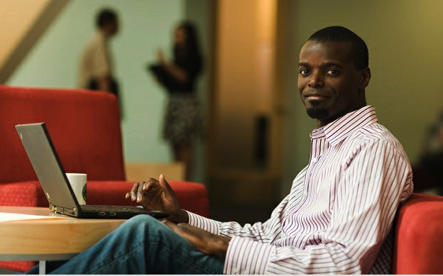
Because inclusion and diversity are right
Everyone should have access to meaningful, rewarding occupations

Slide 8
BLS Projected 2022 employment for jobs requiring college degree only

Slide 9
Because we produce too few… 30% of jobs; but 3% of likely degrees
Down from 5% in 2012

Slide 11
More than double graduates IF CS drew from the majority

Slide 12
Why in HS?

Slide 13
High School is an important time for developing education & career goals
Majority of college students majoring in STEM make that choice during high school
-Maltese & Tai 2011

Slide 14
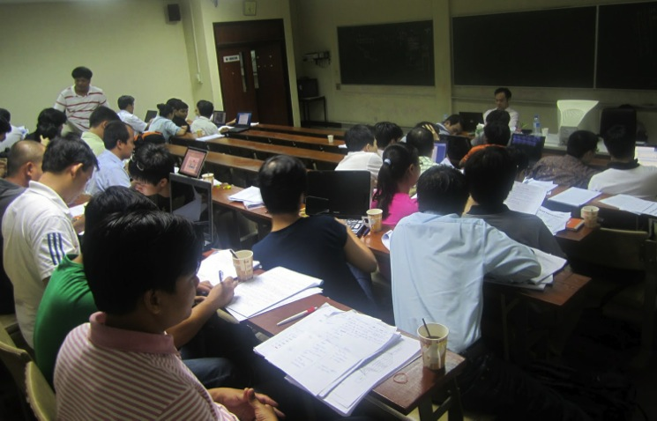
Experience increases success
Experienced students get better grades in Intro CS
Experience typically assumed

Slide 15
AP-Takers are more likely to major

Slide 16
Conclusion
Teachers can create an environment that fosters ability, learning, and persistence
Notes:
Or unintentionally inhibit those characteristics in women and minorities

Slide 17
Problems attendees are facing
admin student told cannot skip pre-req
existing prereqs not make sense
only AP, some are scared because of that
non-existent prereqs listed on official forms
all four grades in one course, easy to focus on best accidentally
some students don't self-advocate
classes have reputation of being too hard and not fun enough
classes are too hard and not fun enough
gets lost - science? math? elective? (in school)
what kind of credit, what is CS, (in state)
feeling of competition with other electives (zero-sum)
band, orchestra, etc: no room
path for not academically inclined students (especially minorities)
"If I take that, 'everybody' will think I'm a nerd"
counselors says (CS easier than pre-calc) and (CS too hard)
counselors only send you the socially awkward
parents don't understand "on the computer" != computing able
even educated parents don't understand CS is profitable and good for their kids
important but not for me
only particular grades let into class by administration

Slide 18
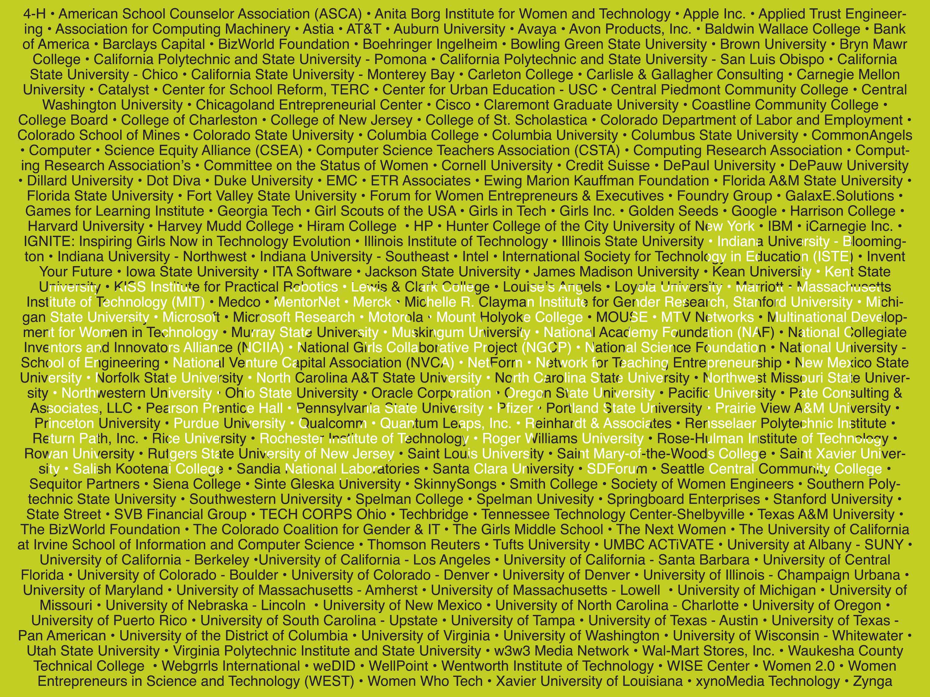
NCWIT is the National Center for Women & Information Technology
Mobilizing for Change: NCWIT
Our coalition includes more than 250 universities, corporations, and non-profits.
Notes:
PART 6: WOMEN AND COMPUTING, cont.,
WHO BRINGS YOU THIS CAMPAIGN, WHY. Say:. So this is where NCWIT steps in. We look forward to bringing more women into the technology sector and into these good jobs. NCWIT, the National Center for Women & Information Technology is a group of alliances representing over 250 nonprofits, education institutions, corporations and start-ups that hold a shared vision for greater diversity in IT. Each group has projects intended to reform conditions in their sector.

Slide 19
FOR MORE INFORMATION
Join the C4C campaign by contacting
Jane Krauss jkrauss@ncwit.org
Visit NCWIT www.ncwit.org/c4c

