Slide 1
Software Design Process

Slide 2
A Software Design Process
Define
Many equivalent processes
Methodologies emphasize different paths
Strategize
Code
Test
Deliver
User Test
Notes:
The software design process uses a lot of iteration, meaning steps are repeated. Categorizing the process into six steps is arbitrary-- the software design process could be broken down into 10 steps or 4 steps, for example. The same process can be described in many ways, with varying numbers and names for steps. We’ll use these 6 steps for the sake of uniformity throughout the lesson.
The paths through the process, however, can vary. Different methodologies emphasize different paths through the process. “Waterfall” design and “Agile” design are two design methodologies.
The graphic representation of the design process shown here is only one example of a design process. However, consistent use of one design process gives students a solid foundation onto which they can build their own preferred design process as their design skills develop.
The process shown on this slide and the Scrum methodology shown in slide 10 will be used throughout this course for consistency.

Slide 3
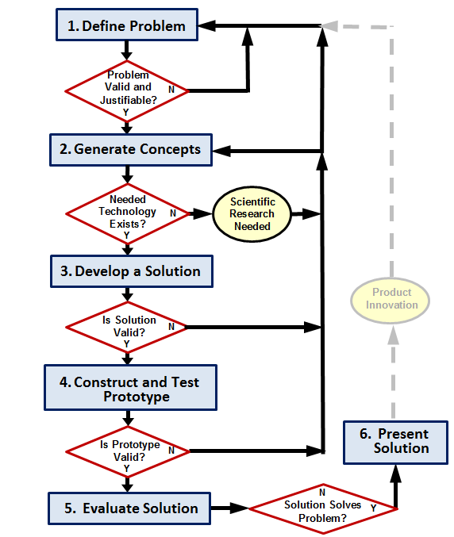
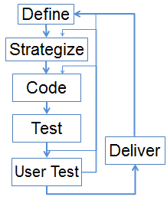
An Engineering Design Process
Notes:
On the right is the design process used across all PLTW Pathway to Engineering courses. The software design process on the left matches the engineering design process. The steps can be named more specific to software development or to call out specific elements of the general engineering design process on the right, but the process is the same.

Slide 4
An Engineering Design Process
DON’T
Natural Language is Imprecise
Define
Elicitation – Understand the problem
Specification – Describe the problem
Validation – Agree on the nature of the problem
Negotiation – Agree on the boundaries of the problem
Requirements– Contract for the customer and starting point for development
SWEAT THE DETAILS
WITH CODE
Notes:
Defining the problem is a key step. Indeed, “requirements engineering” is a whole job in and of itself. When a customer says “These two input fields should be the same,” do they mean the contents should be the same? The font? For all users or for any given user?
These terms from requirement engineering are included here only to say: “Defining the problem can be complicated!”
Agile development, the process emphasized in this course, plays down this part of the process because the client can better communicate what they want once they have it in hand.

Slide 5
Development Methodologies
Waterfall Design:
Old methodology
Managers with dozens of developers
Infrequent client input
Agile Design:
Modern methodology
Teams of 5-9, less hierarchical
Frequent client input
Examples: Scrum, XP
Notes:
Different methodologies emphasize different paths through this process. We will contrast two methodologies: the “old” one from the 1970-1980s, and the modern one that dominated the software industry in the 1990s.

Slide 6
Waterfall Design
Define
Cycle in 1+ years
Each step done before next begins
Whole-product delivery
Strategize
Code
Contested
Test
User Test
Deliver
Notes:
Waterfall development, the first method developed for hundreds of programmers to collaborate on a project, was used by NASA and Defense, for example. One single pass through the big loop from define to deliver was performed, completing each step entirely before beginning the next. This is the traditional method but has been criticized because it does not provide enough feedback among the stakeholders. Clients got a finished product that wasn’t what they wanted because they lacked an opportunity to see early versions. Developers were assigned to create code for misconceived solutions because they didn’t have the opportunity to inform the definition of the solution. Knowing about these problems with the waterfall methodology inspires developers to be more flexible during the design process.

Slide 7
Agile Design, Kin of Lean Manufacturing
Cycle in 1-4 weeks
Reflect on process
Incremental product delivery
Self-organized teams
Define
Strategize
Code
Test
Deliver
User Test
Notes:
With the Agile development protocol common in industry today, development teams run through the whole process frequently, with many opportunities for feedback. With Agile development, the entire cycle is iterated many times. Extreme Programming (XP) a methodology that is a special type of Agile development, emphasizes the path from coding to testing by writing code for the tests before writing code to pass the tests, also known as Test Driven Design. We will use Scrum, another type of Agile development, that follows a specific process for planning and reflecting on work. At first it may seem to students that interacting with a client more frequently will result in more headaches and what is commonly referred to as “project creep.” The truth is that when software is reviewed frequently, the resulting creep is minor and problems are easy to fix. However, allowing a team of developers to work unchecked for months or years actually allows the end product to creep further away from the client’s expectations, resulting in very serious problems at the end of the process.

Slide 8
Scrum: A Framework for Agile
Roles:
Product Owner – represents client
Scrum Master – removes impediments
Team Member – develops software in sprints
Self-organized teams
Clear, short-term goals
Members see each other’s progress
Safe to give feedback
Notes:
Scrum is one framework for Agile. The product owner is someone on the team, not the client. But they represent the client’s needs. You will typically have a student from another team stand in for this role for your team. Similarly, you will sometimes need to provide this service to another team in your class.
The Scrum Master is not a manager; she/he facilitates the meetings and helps the team members stick to the process. The teacher will play this role for all the teams at once at first. As they become familiar with the process, students will step up to serve as scrum masters within their own team.

Slide 9
Scrum: A Framework for Agile
See scrumreferencecard.com
Sprint Planning
Backlog Grooming
Code & Test
8-hour cycle
Scrum Stand Up
40-hour cycle
Sprint Review
Sprint Retrospective
Notes:
A jigsaw activity for students to become familiarized with James (2012) Scrum Reference Card would be helpful. A “jigsaw” activity has a team of 3 or 4 participants or pairs of participants. Students will split up a larger reading and then summarize their piece to the team.

Slide 10
The CSE Scrum Design Process
1 session
Sprint Planning
Backlog Grooming
3 sessions
Code & Test
Do twice
1 session
Scrum Stand Up
CSE
Problem
Cycle
Sprint Review
1 session
“session”
= ~45 min
Sprint Retrospective
Notes:
In the CSE Problems, students with create a backlog and plan the first sprint. Although a team of professional software developers would work a full day between stand ups, students will work just a few hours before each of two stand ups. While a sprint review meeting would happen on a weekly basis in a professional team, students will experience a review after only two days’ worth of stand ups. The review at the end 10-12 sessions of CSE will incorporate a presentation to the class, with retrospective and the backlog grooming completed by students as follow up. The backlog should be deposited along with the results of the sprint for others to build on. To communicate the cyclic nature, students are encouraged to conduct an additional sprint on another team’s prior work by forking the previous team’s Scratch or GitHub repository and beginning with the backlog.

Slide 11
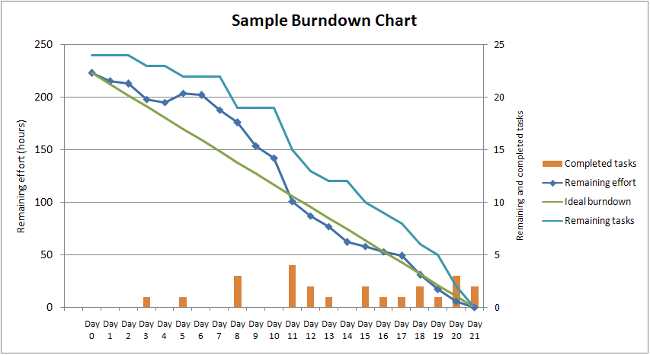
Tasks Completed as Scrum Progresses
http://en.wikipedia.org/wiki/File:SampleBurndownChart.png
Notes:
Keep in mind that we will only have 10 class sessions, amounting to about 8 hours, to work on a problem. As shown in this Burndown chart, the accomplishments of a professional team of 5-9 developers during the first 8 hour day are small!

Slide 12
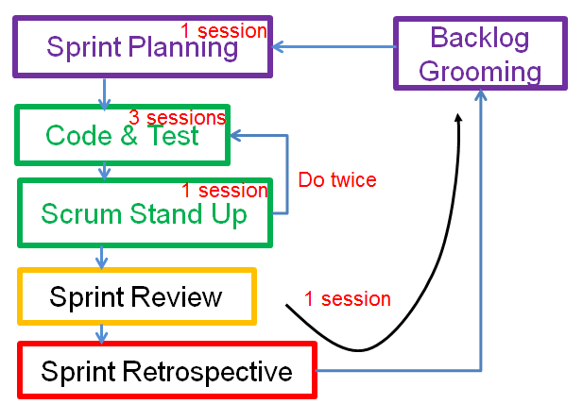
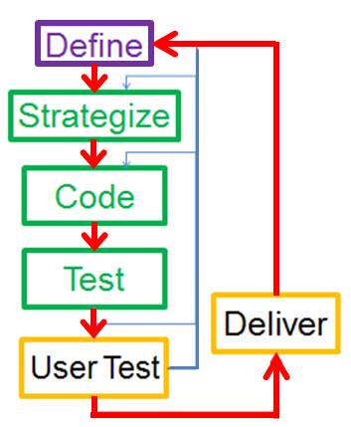
The CSE Scrum Design Process
Notes:
All PLTW Pathway to Engineering courses use the same Design Process. How does the simulation of Scrum map onto the Design Process used throughout the PLTW Pathway to Engineering? It’s shown by color coding here. For now don’t worry about it. Reflect on how they both describe the process you went through after you’ve experienced it.

