Slide 1
What is Computer Science?
… and why should you care?

Slide 2
What is a “computer”
Oxford English Dictionary (partial entries)
  A person who makes calculations
  A device for facilitating calculations
  Device used to [do long list of things with] information according to variable instructions

Slide 3
Variable Instructions
I can give it inputs that change how it reacts to future inputs
Many approximately “universal”
  Universal = can teach it to do anything
  “Approximately” because memory is limited

Slide 4
How many computers have you used in the past two weeks?

Slide 5
How many computers?
Car
Microwave oven
Laptop computer
Cell phone
Thermostat
This classroom
Power meter
Cash register
Crosswalk signal
Your apartment
Used to access a single web page

Slide 6
So many…
Why so many?
Any risks to having them everywhere?

Slide 8
What is programming?
Teaching a computer what it should do
Are computers good students?

Slide 9
What is programming?
Teaching a computer what it should do
Are computers good students?
  Never forget anything
  Make no mistakes
  Incredibly stupid
The lessons we teach it called “code”

Slide 10
What is “Hacking”
Several uses
  Rapid development of code
  Sloppy development of code
  Trying to break other people’s code (next slide)

Slide 11
What is (malicious) Hacking?
Most programs: “do X, Y, Z, and don’t listen to anyone else telling you to do differently”
“don’t listen to anyone else” is hard to say
  We won’t even try this semester
Hacking = finding ways to get other people’s code to listen to you

Slide 12
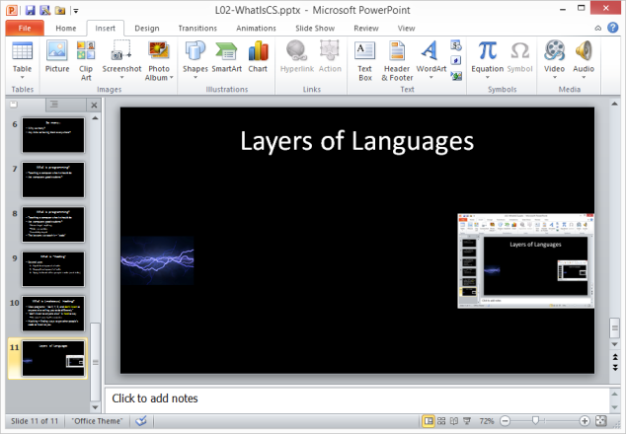

Layers of Languages

Slide 13
Why “language”?
It’s how we know how to teach
  Plus it’s traditional, keyboards are fast, …
Syntax, Semantics, Vocabulary
  “Flow run ghxsr fla"vor toast-toats olg”
  “Put the tire in itself for chanting sneezes”
  “Prandial soleation is gauche”

Slide 14
Why “code”?
section .data
str: db 'Hello world!', 0Ah
str_len: equ $ - str
section .text
global _start
_start:
mov eax, 4
mov ebx, 1
mov ecx, str
mov edx, str_len
int 80h
mov eax, 1
mov ebx, 0
int 80h
public class Hi {
public static void main(String[] args) {
System.out.println(“Hello world!“);
}
}
Lots of languages, all look like some kind of code
  But designed (i.e., simple rules)
We’ll learn “Java”

Slide 15

Program Flow
Semantics Errors
(Exceptions)
Syntax Errors
Java source code
Compile
Byte code
Run
Behavior
Vocabulary Errors
Logic Mistakes

Slide 16
We write Java (source code)
It is “compiled” to “byte code” by “compiler”
  Unless syntax wrong; then get syntax error
  Or vocabulary wrong; then “unknown symbol” error
Byte code is “run” or “executed” by “java virtual machine”
  Unless semantics wrong; then get runtime Exception
Program does something
  Might do “wrong” thing; called a logic error

