Slide 1
CS6456: Graduate Operating Systems
Brad Campbell – bradjc@virginia.edu
https://www.cs.virginia.edu/~bjc8c/class/cs6456-f19/
Slides modified from CS162 at UCB

Slide 2
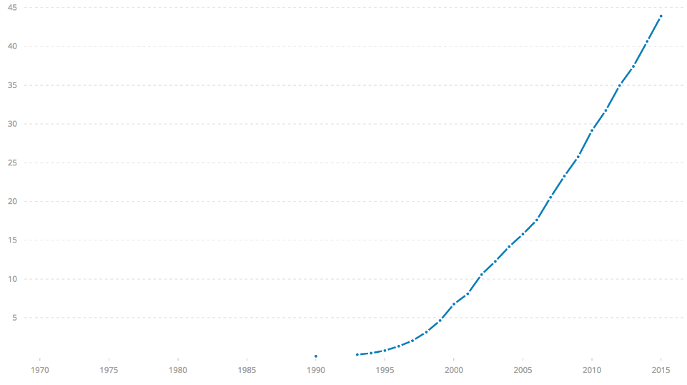
Challenge: Huge Scale
% of world’s
population
3.8 B
ARPANet
Internet
WWW
2.0 B 1/26/11
RFC 675 TCP/IP
HTTP 0.9
1969
1974
1990
2017

Slide 3
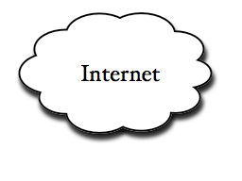
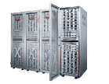
Example: What's in a search query?
DNS
Servers
Datacenter
DNS
request
create
result
page
Search
Index
Page store
Load
balancer
Ad Server
Complex interaction of multiple components in multiple administrative domains
Systems, services, protocols, …

Slide 4
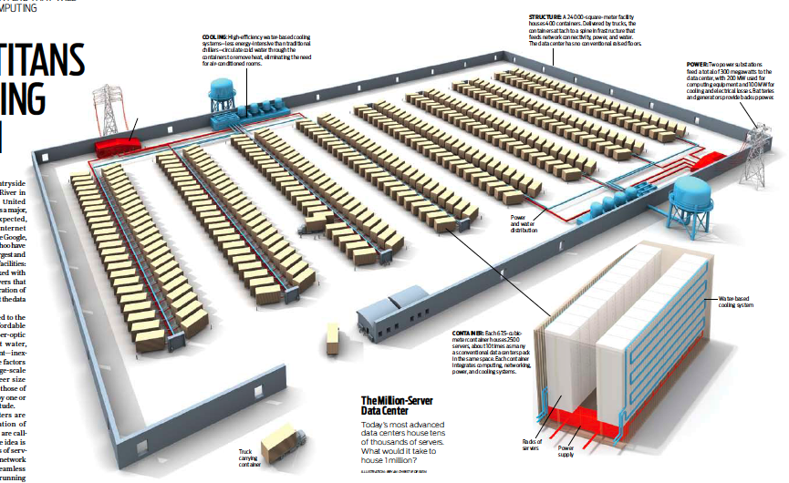
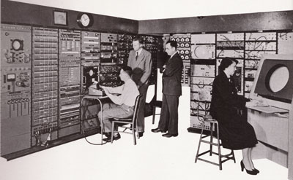
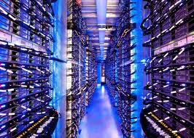
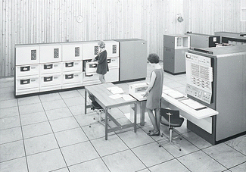
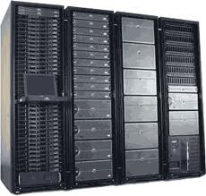
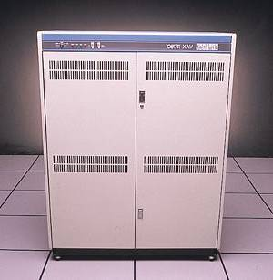
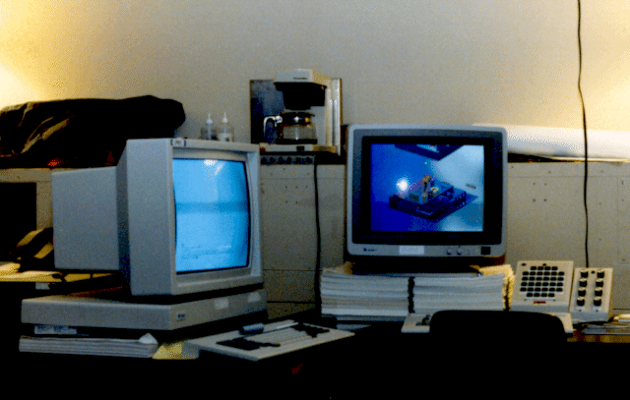
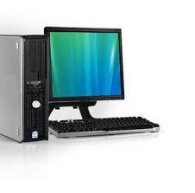
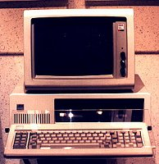
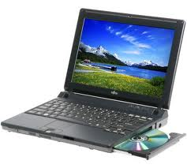
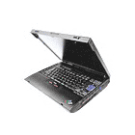
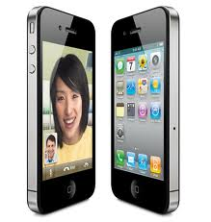
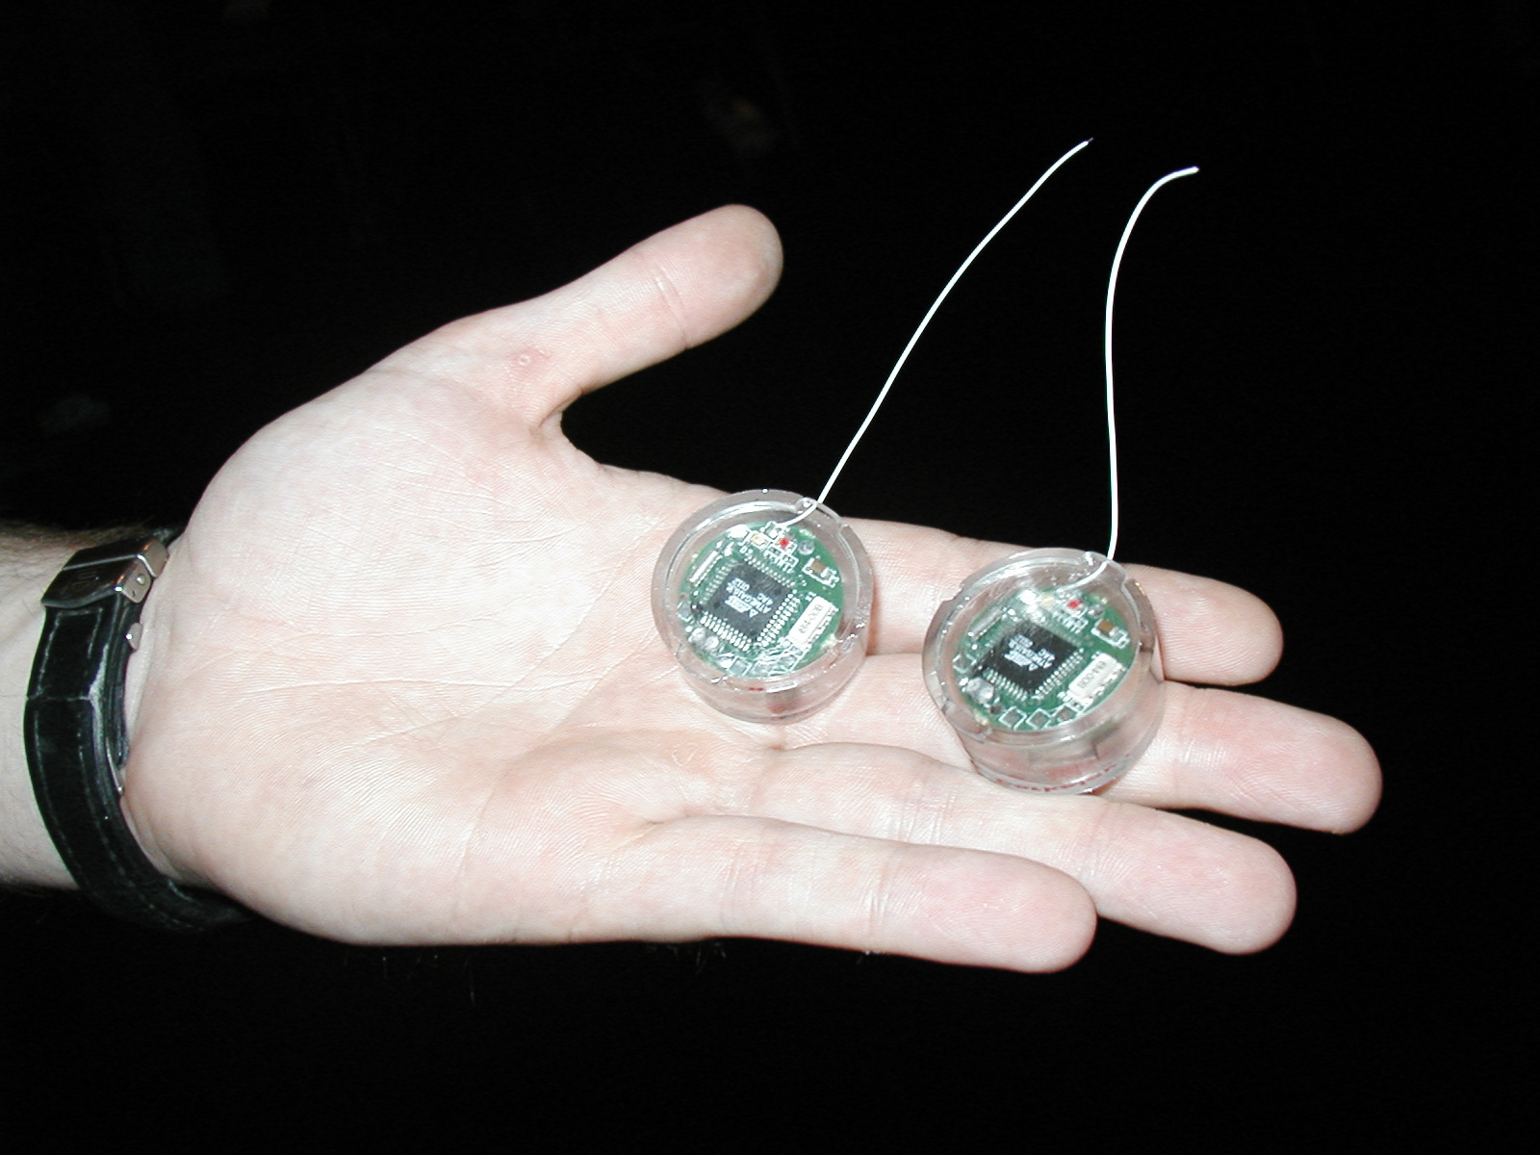
Challenge: Variety and Number of Devices
Computers
Per Person
Number crunching, Data Storage, Massive Services,
Mining
1:10⁶
Mainframe
Mini
1:10³
Workstation
Productivity,
Interactive
PC
Laptop
1:1
PDA
Cell
Streaming from/to the physical world
10³:1
years
Mote!

Slide 5
Challenge: Range of Timescales
Jeff Dean: "Numbers Everyone Should Know"

Slide 6
Operating systems are crucial to addressing these challenges!
Provide consistent abstractions to apps, even on different hardware
File systems
Processes, threads
VM, containers
Naming system
Manage resources shared among multiple applications:
Memory, CPU, storage, …
Achieve the above by implementing specific algorithms and techniques:
Scheduling
Concurrency
Transactions
Security

Slide 7
Aside: Systems Programming
What makes something a system?
Frame of mind: meticulous error handling, anticipating all possible failure cases, defending against malicious/careless users
An important part of this class!

Slide 8
What is an operating system?
Layer of software that provides application software access to hardware resources
Convenient abstraction of complex hardware
Protected access to shared resources
Security
Basic Services – Communication, Storage, …
apps
OS
Hardware

Slide 9
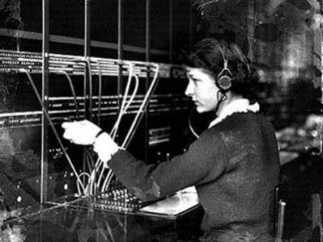
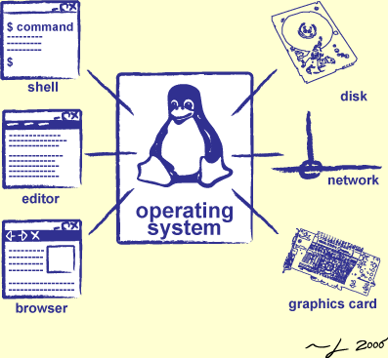
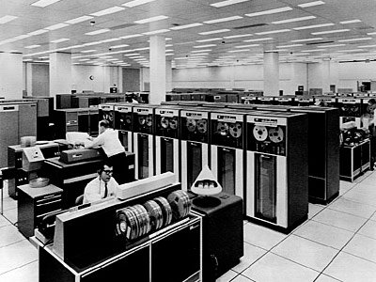
Operators Through History
Switchboard Operator
Computer Operators

Slide 10
What is an operating system?
Provides user programs with a more convenient abstract machine interface rather than the underlying physical machine

Slide 11
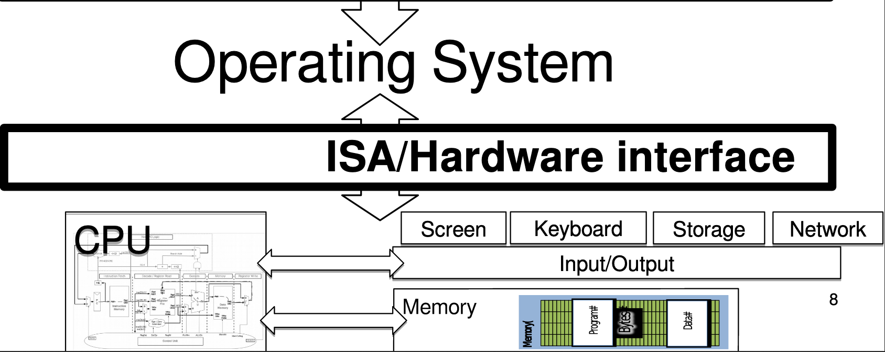
OS "Virtual Machine" Interface

Slide 12
Application View of the World
Application's "machine" is the OS
No hardware details (future-proof)
More useful interfaces than raw hardware

Slide 13
OS View of the World
Operating system translates from hardware interface
to application interface

Slide 14
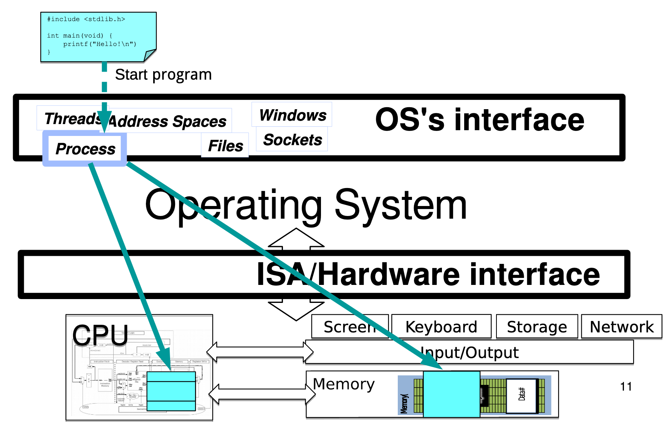
Abstraction: Program → Process

Slide 15
Multiple Processes: Context Switch

Slide 16
Abstraction: Input / Output

Slide 17
Security & Protection

Slide 18
Security & Protection

Slide 19
Course Logistics

Slide 20
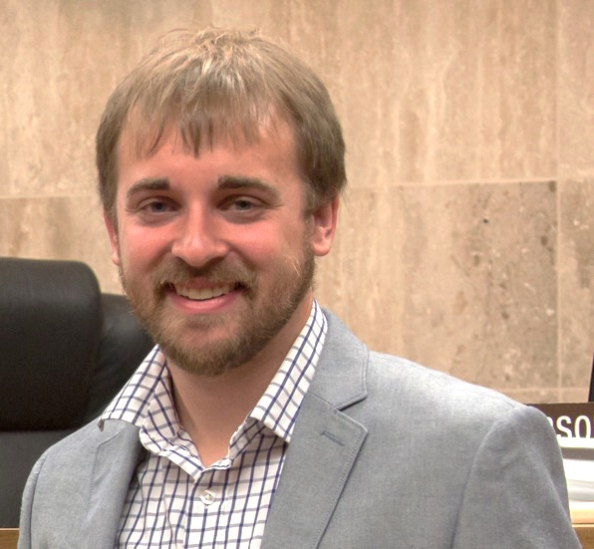
A little about me
Brad Campbell
Assistant professor
Joint appointment: 75% CS, 25% ECE
Link Lab
bradjc@virginia.edu
Ph.D. from the University of Michigan
Research interests
Energy-harvesting systems
Embedded operating systems
New sensing systems
IoT systems programming

Slide 21
This course, roughly
One third: Operating systems fundamentals
Primarily lecture based
Two thirds: Advanced topics
OS in different application areas
OS with new hardware
Lecture + discussion + readings

Slide 22
Assessments
Five homeworks
Mostly programming based
Individual
Take-home final exam
Short answer, mostly over the second half material

Slide 23
Grading
HW1: 15%
HW2: 15%
HW3: 15%
HW4: 15%
HW5: 15%
Final: 25%

Slide 24
Overview

Slide 25
What is an operating system?
Referee
Resource sharing, protection, isolation
Illusionist: clean, easy to use abstractions
Infinite memory, dedicated machine
Higher level objects: files, users, message
Masking limitations, virtualization
Glue: Common Services
Storage
Window system
Networking
Authorization

Slide 26
Unifying Theme: Complexity
All definitions of operating systems are about hiding complexity

Slide 27
The Challenge of Complexity
Competing applications with
Unexpected failures
Even malicious intentions…
Varying hardware with
Evolving interfaces
Unexpected failures
Not feasible to test all possible configurations!

Slide 28
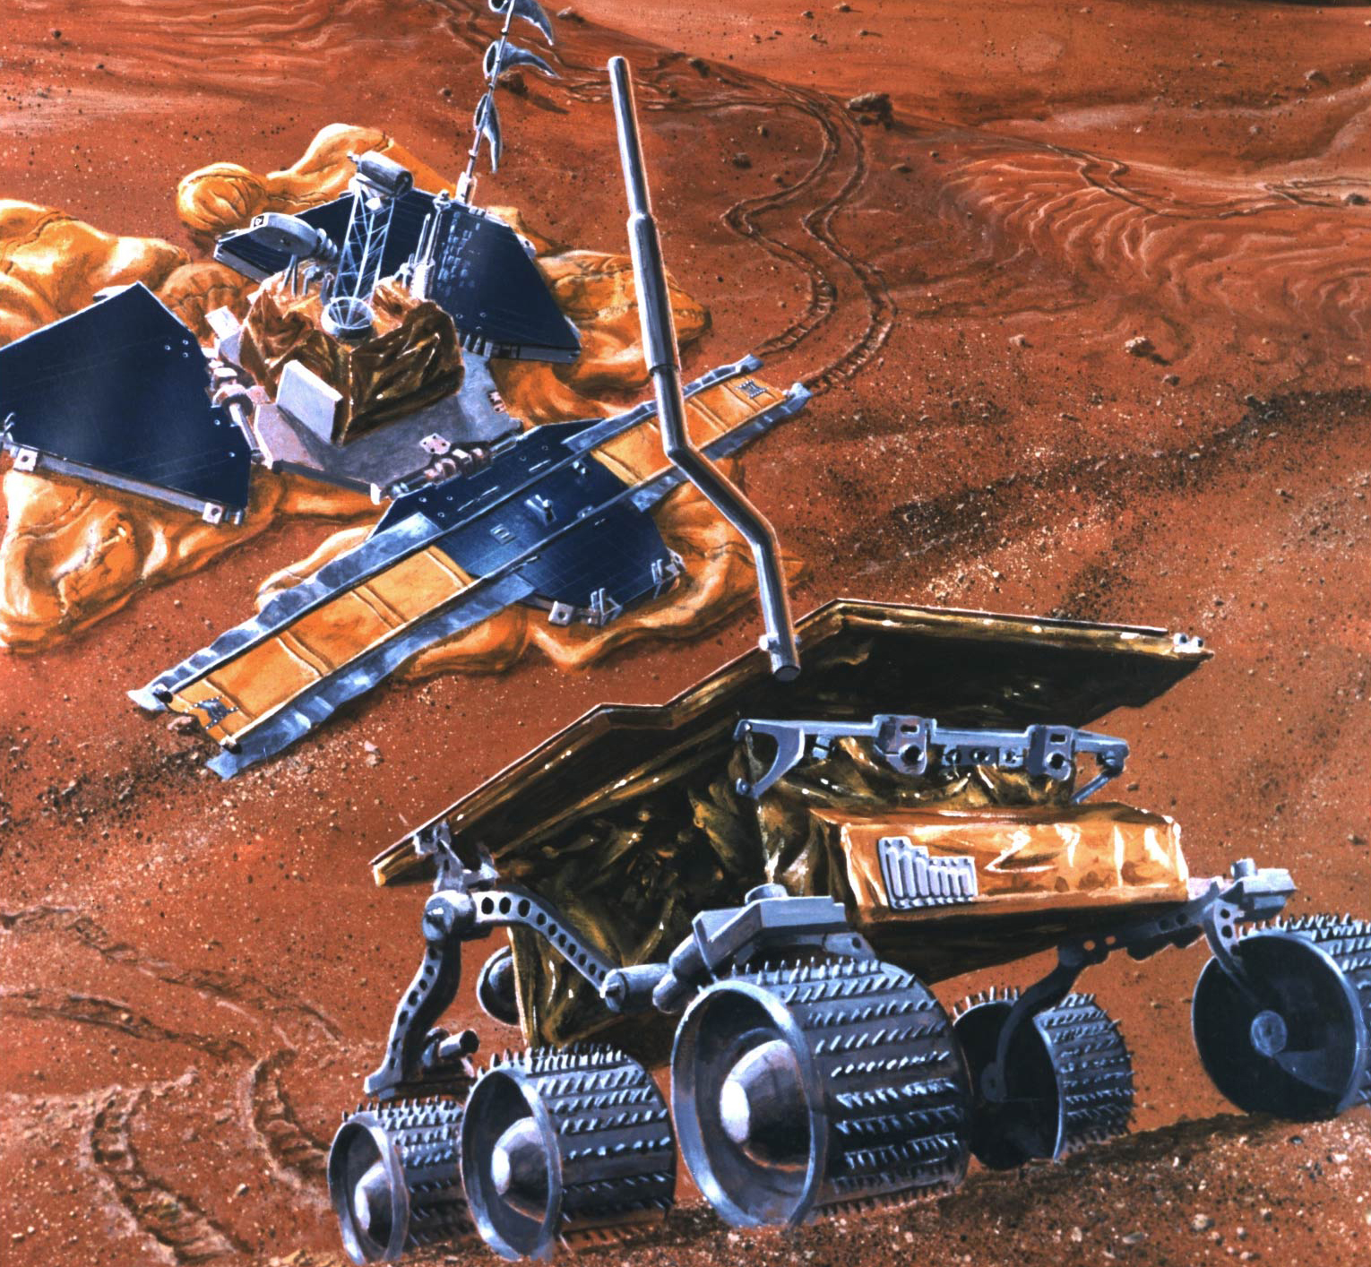
Complexity Example: Mars Pathfinder
Lots of types of hardware: Radios, science experiments, batteries, solar panels, motors and robotic equipment
Unique reliability requirements
No reset button, must reboot automatically when necessary
Must always be able to receive commands from Earth
Remote debugging
Software will crash, how is that handled?
Need to debug from Earth
Time-critical functions
Stop before hitting a Mars boulder
Earth communications

Slide 29
Complexity: Variety
Different CPUs: x86, PowerPC, ARM, MIPS
Different amounts of memory, disk space
Different types of devices
Mice, keyboards, sensors, cameras
Different networking equipment
Cable, DSL, Wireless, Ethernet

Slide 30
Questions
Does the programmer need to write a single program that performs many independent activities?
Does every program have to be altered for every piece of hardware?
Does a faulty program crash everything?
Does every program have access to all hardware?
Hopefully, no!

Slide 31
Unifying Theme: Helping the Programmer
Write program once for lots of hardware
Without reimplementing common functionality
Run alongside other programs, possibly communicating and cooperating with them (safely)
One program crashing doesn't crash everything

Slide 32
Abstract Virtual Machine Goals
Application
Operating System
Hardware
Virtual Machine Interface
Physical Machine Interface
OS Goals:
Remove software/hardware quirks (fight complexity)
Optimize for convenience, utilization, reliability, … (help the programmer)
For any OS area (e.g. file systems, virtual memory, networking, scheduling):
What hardware interface to handle? (physical reality)
What’s software interface to provide? (nicer abstraction)

Slide 33
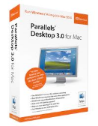
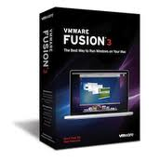
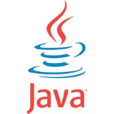
Aside: Virtual Machines
Software emulation of an abstract machine
Give programs illusion they own the machine
Make it look like hardware has features you want
Two types of “Virtual Machines”
Process VM: supports the execution of a single program; this functionality typically provided by OS
System VM: supports the execution of an entire OS and its applications (e.g., VMWare Fusion, Virtual box, Parallels Desktop, Xen)

Slide 34
Process VMs
Each process thinks…
It has all memory, CPU time, devices, …
All devices have the same convenient interface
Device interfaces more powerful than raw hardware
Bitmapped display ⇒ windowing system
Ethernet card ⇒ reliable, ordered, networking (TCP/IP)
Fault Isolation
Processes unable to directly impact other processes
Bugs cannot crash whole machine
Portability
Write your program for the OS rather than the raw hardware

Slide 35
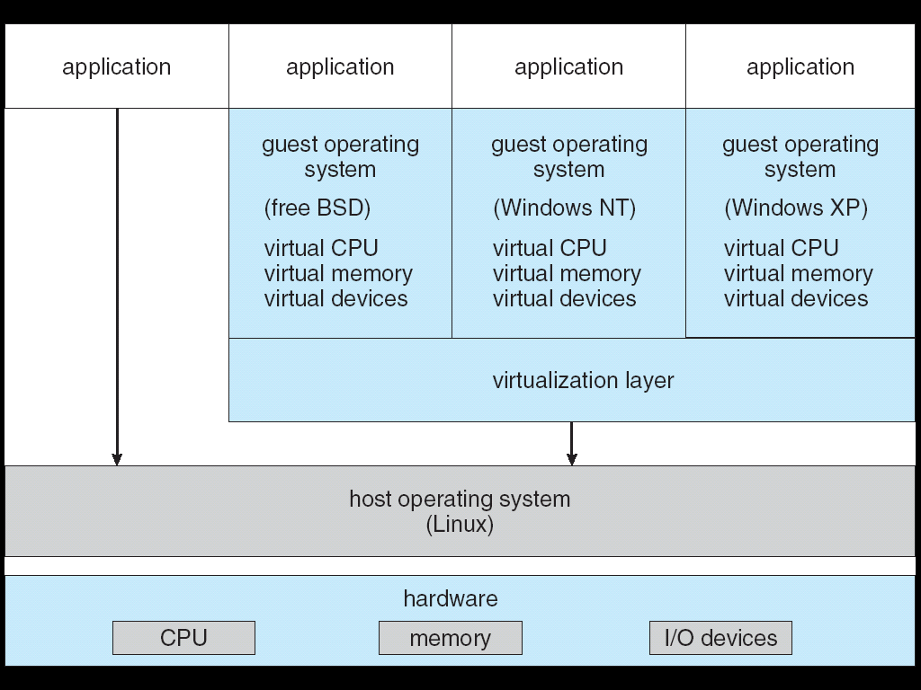
System Virtual Machines: Layers of OSs
Run entire operating systems
Good for OS development, portability, fault containment
Interface closer to raw HW
To aid porting/running OSs built to use raw HW
Different kind of "application developer" to design for

Slide 36
What is an Operating System,… Really?
Always:
Memory Management
I/O Management
CPU Scheduling
Communications?
Multitasking/multiprogramming?
Maybe:
File System?
Multimedia Support?
User Interface?
Web Browser?

Slide 37
What is an OS?
No universally accepted definition
“Everything a vendor ships when you order an operating system” is good approximation
But varies wildly!
“The one program running at all times on the computer” is the kernel
Everything else is either a system program (ships with the operating system) or an application program

Slide 38
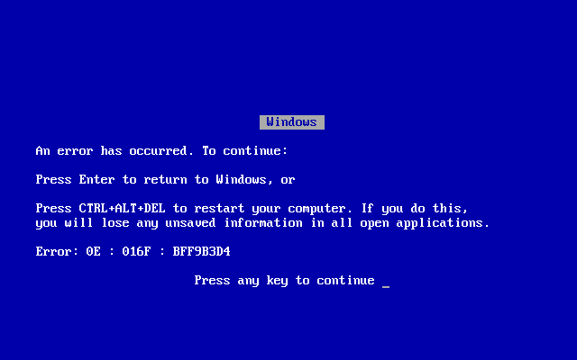
OS Goal: Protecting Processes & The Kernel
Run multiple applications and:
Keep them from interfering with or crashing the operating system
Keep them from interfering with or crashing each other

Slide 39
How do we achieve this?
Two main hardware mechanisms:
Memory address translation
Dual mode operation
Use these to enact a simple policy: Programs are not allowed to read or write the memory of other programs or of the OS

Slide 40
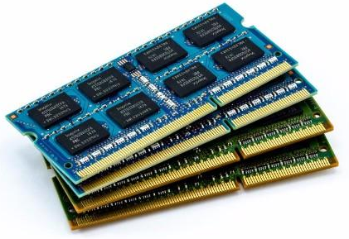
Address Translation
Abstraction: Address Space
Group of memory addresses usable by something
Each process and the kernel have distinct address spaces
Illusion of owning all memory
Mechanism: Address translation
Translate virtual addresses (used internally and emitted by CPU) to physical addresses
Usually performed in hardware by memory management unit (MMU)
CPU
Virtual Address
Physical Address
MMU

Slide 41
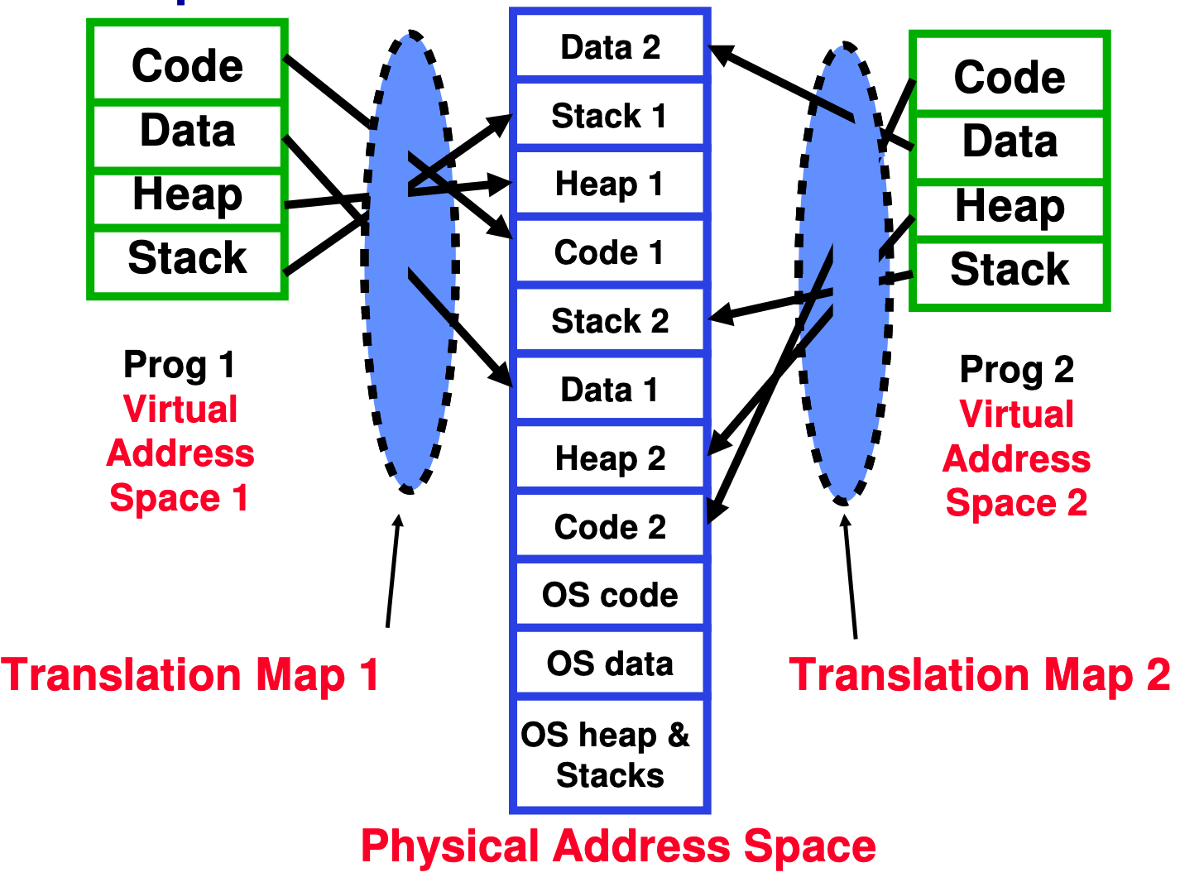
Example of Address Translation

Slide 42
Address Translation Details
Does this get us our desired policy?
Can't read or write if no translation to the physical memory
Problem: What if user code changes the page table pointer?

Slide 43
Dual Mode Operation
Hardware provides at least two modes:
Kernel Mode (or "supervisor" / "protected" mode)
User Mode
Certain operations are prohibited when running in user mode
Changing the page table pointer
Carefully controlled transitions between user mode and kernel mode
System calls, interrupts, exceptions

Slide 44
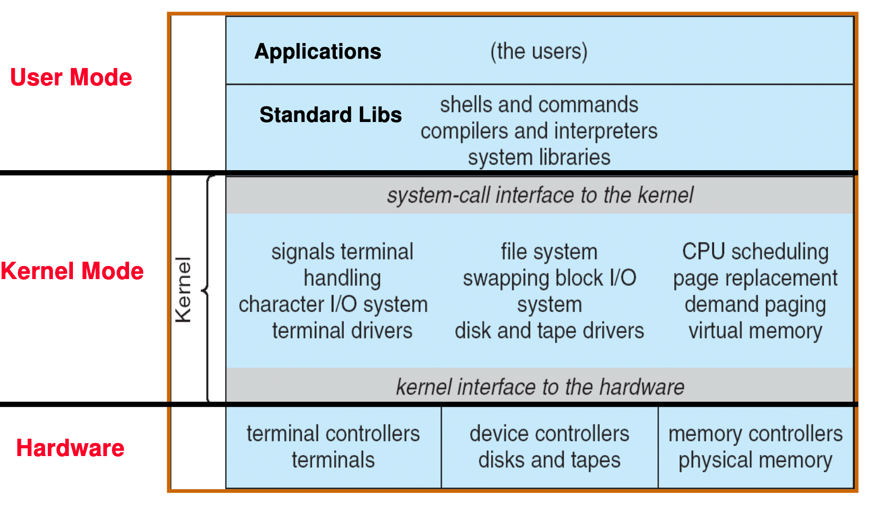
UNIX OS Structure

Slide 45
Conclusion
Operating systems:
Provide a virtual machine abstraction to handle diverse hardware
Coordinate resources and protect users from each other
Simplify application development by providing standard services
Provide fault containment, fault tolerance, and fault recovery

