Slide 1
CS6456: Graduate Operating Systems
Brad Campbell – bradjc@virginia.edu
https://www.cs.virginia.edu/~bjc8c/class/cs6456-f19/
Slides modified from CS162 at UCB

Slide 2
Recall: What is an OS?
Referee
  Resource sharing, protection, isolation
Illusionist: clean, easy to use abstractions
    Infinite memory, dedicated machine
    Higher level objects: files, users, messages
    Masking limitations, virtualization
Glue: Common Services
    Storage
    Window system
    Networking
    Authorization

Slide 3
Recall: Virtual Machines
Definition: Software emulation of abstract machine
  Programs believe they own the machine
  Simulated "hardware" has the features we want
Two types:
  Process VM: Run a single program in the VM, e.g. an OS
  System VM: Run entire OS & its apps in the VM, e.g. Virtualbox, VMWare, Xen

Slide 4
Recall: Protecting Processes
Use two features offered by hardware:
  Dual Mode Operation
    Processes run in user or kernel mode
    Some operations prohibited in user mode
  Address Translation
    Each process has a distinct and isolated address space
    Hardware translates from virtual to physical addresses
Policy: No program can read or write memory of another program or of the OS

Slide 5
Four Fundamental OS Concepts
Thread: Execution Context
  Program Counter, Registers, Execution Flags, Stack
Address space (with translation)
  Program's view of memory is distinct from physical machine
Process: an instance of a running program
  Address Space + One or more Threads
Dual mode operation / Protection
  Only the “system” can access certain resources
  Combined with translation, isolates programs from each other

Slide 6

OS Bottom Line: Run Programs
0xFFF…
Executable
Program Source
OS
int main()
{ … ;
}
compiler
data
Load & Execute
stack
editor
Memory
instructions
heap
a.out
data
foo.c
instructions
Load instruction and data segments of executable file into memory
Create stack and heap
“Transfer control to program”
Provide services to program
While protecting OS and program
0x000…
PC:
registers
Processor

Slide 7
Four Fundamental OS Concepts
Thread: Execution Context
  Program Counter, Registers, Execution Flags, Stack
Address space (with translation)
  Program's view of memory is distinct from physical machine
Process: an instance of a running program
  Address Space + One or more Threads
Dual mode operation / Protection
  Only the “system” can access certain resources
  Combined with translation, isolates programs from each other

Slide 8
Threads of Control
Definition: A single, unique execution context
  Program counter, registers, stack
A thread is executing on a processor when it is resident in that processor's registers
Registers hold the root state of the thread:
  The rest is "in memory"
  Including program counter – the currently executing instruction
Registers point to thread state in memory:
  Stack pointer to the top of the thread's (own) stack

Slide 9
Multiprogramming - Multiple Threads of Control
Thrd. 1
Thrd. 2
Thrd. n
stack
…
heap
Static Data
OS
code
stack
heap
Static Data
code
stack
heap
Static Data
code

Slide 10
Illusion of Multiple Processors
vCPU1
vCPU2
vCPU3
vCPU1
vCPU2
vCPU3
vCPU1
vCPU2
Shared Memory
Time
Multiple threads: Multiplex hardware in time
Contents of virtual core (thread):
  Program counter, stack pointer
  Registers
Where is it?
  On the real (physical) core, or
  Saved in memory – called the Thread Control Block (TCB)

Slide 11
Very Simple Multiprogramming
All vCPU's share non-CPU resources
  Memory, I/O Devices
Each thread can read/write data of others
Threads can overwrite OS functions
Unusable? No. This approach is used in
  Embedded applications (but not all!)
  MacOS 1-9/Windows 3.1 (switch only with voluntary yield)
  Windows 95-ME (switch with yield or timer)

Slide 12
Four Fundamental OS Concepts
Thread: Execution Context
  Program Counter, Registers, Execution Flags, Stack
Address space (with translation)
  Program's view of memory is distinct from physical machine
Process: an instance of a running program
  Address Space + One or more Threads
Dual mode operation / Protection
  Only the “system” can access certain resources
  Combined with translation, isolates programs from each other

Slide 13
Second OS Concept: Address Space
Definition: Set of accessible addresses and the state associated with them
  2³² = ~4 billion on a 32-bit machine
What happens when you read or write to an address?
  Perhaps nothing
  Perhaps acts like regular memory
  Perhaps causes I/O operation
    (Memory-mapped I/O)
  Crash
  Communicate with another program
0xFFF…
stack
heap
Static Data
code
0x000…

Slide 14
Address Space: In a Picture
0xFFF…
stack
PC:
SP:
heap
Processor
registers
Static Data
instruction
Code Segment
0x000…

Slide 15
Address Space Translation
Program operates in an address space that is distinct from the physical memory space of the machine
“physical address”
0x000…
“virtual address”
Processor
translator
Memory
0xFFF…

Slide 16
Virtual Address Translation/Paging
Gives every process the whole address range
Breaks memory into pages (~4K chunks)
Allows unallocated "holes" and other tricks

Slide 17
Four Fundamental OS Concepts
Thread: Execution Context
  Program Counter, Registers, Execution Flags, Stack
Address space (with translation)
  Program's view of memory is distinct from physical machine
Process: an instance of a running program
  Address Space + One or more Threads
Dual mode operation / Protection
  Only the “system” can access certain resources
  Combined with translation, isolates programs from each other

Slide 18
The Process
Definition: execution environment with restricted rights
  Address Space with One or More Threads
  Owns memory (address space)
  Owns file descriptors, file system context, …
  Encapsulate one or more threads sharing process resources
Why processes?
  Protected from each other!
  OS Protected from them
Tradeoff: protection vs. efficiency
    Threads more efficient than processes (more later)
Application: one or more processes

Slide 19
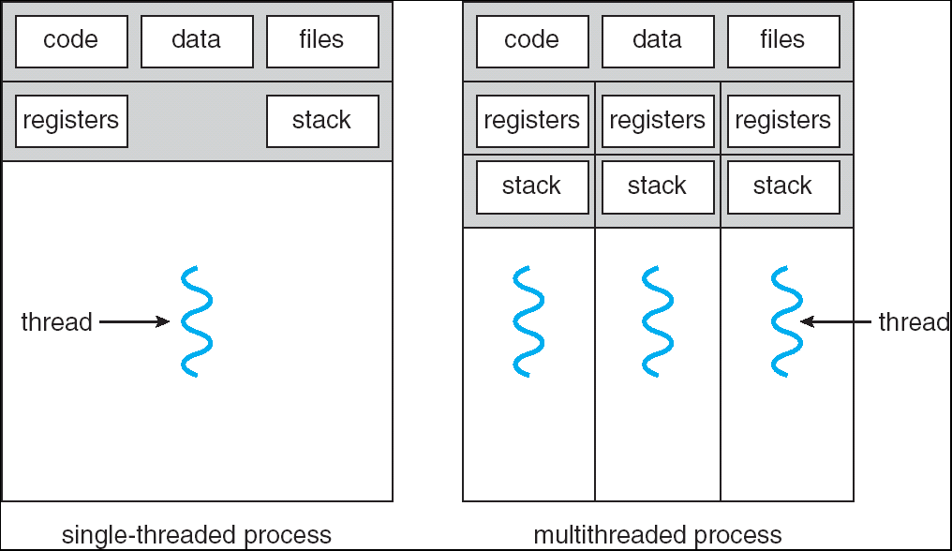
Single and Multithreaded Processes
Threads encapsulate concurrency: “Active” component
Address spaces encapsulate protection: “Passive” part
  Keeps buggy program from trashing the system
Why have multiple threads per address space?

Slide 20
Protection
Why?
  Reliability: buggy programs only hurt themselves
  Security and privacy: trust programs less
  Fairness: enforce shares of disk, CPU
Mechanisms:
  Address translation: address space only contains its own data
  Privileged instructions, registers
  Syscall processing (e.g., enforce file access rights)

Slide 21
Four Fundamental OS Concepts
Thread: Execution Context
  Program Counter, Registers, Execution Flags, Stack
Address space (with translation)
  Program's view of memory is distinct from physical machine
Process: an instance of a running program
  Address Space + One or more Threads
Dual mode operation / Protection
  Only the “system” can access certain resources
  Combined with translation, isolates programs from each other

Slide 22
Dual Mode Operation: HW Support
1 bit of state (user/kernel mode bit)
  Always?
Certain actions only permitted in kernel mode
User->Kernel mode sets kernel mode, saves user PC
  Only transition to OS-designated addresses
  OS can save the rest of the user state if necessary
Kernel->User mode sets user mode, restores user PC

Slide 23
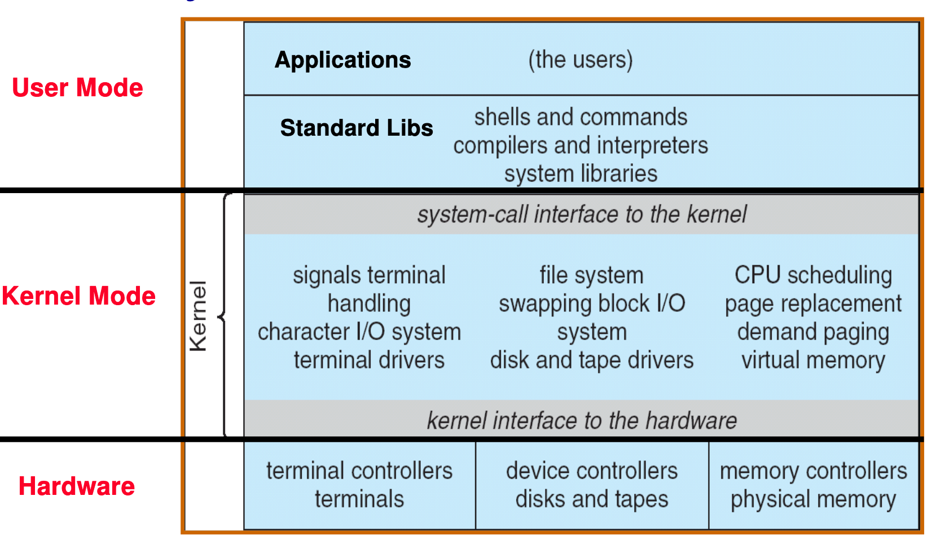
UNIX Structure

Slide 24
3 Types of U→K Mode Switches
System Call (syscall)
  "Function call" into the kernel
  Example: exit, read
  Kernel reads syscall id # and arguments from user registers
Interrupt
  External asynchronous events: Timer, I/O
Trap or Exception
  Special event in process
  Protection violation (segfault), divide by zero
All 3 are an implicit transfer of control

Slide 25
Where do mode transfers go?
Cannot let user program specify (why?)
Solution: Interrupt Vector
Address and properties of each interrupt handler
interrupt number (i)
intrpHandler_i () {
…
}

Slide 26
Implementing Safe Kernel Mode Transfers
Carefully constructed kernel code packs up the user process state and sets it aside
Must handle weird/buggy/malicious user state
  Syscalls with null pointers
  Return instruction out of bounds
  User stack pointer out of bounds
Should be impossible for buggy or malicious user program to cause the kernel to corrupt itself
User program should not know interrupt has occurred (transparency)
  Can a user program find out?

Slide 27
The Kernel Stack
Two-stack model
  Each OS thread has kernel stack (located in kernel memory) plus user stack (located in user memory)
Place to save user registers during interrupt

Slide 28
Before Interrupt

Slide 29
During Interrupt

Slide 30
How do we take interrupts safely?
Interrupt vector
  Limited number of entry points into kernel
Kernel interrupt stack
  Handler works regardless of state of user code
Interrupt masking
  Handler is non-blocking
Atomic transfer of control
  “Single instruction”-like to change:
    Program counter
    Stack pointer
    Memory protection
    Kernel/user mode
Transparent restartable execution
  User program does not know interrupt occurred

Slide 31
Kernel System Call Handler
Vector through well-defined syscall entry points!
  Table mapping system call number to handler
Locate arguments
  In registers or on user (!) stack
Copy arguments
  From user memory into kernel memory – carefully checking locations!
  Protect kernel from malicious code evading checks
Validate arguments
  Protect kernel from errors in user code
Copy results back
  Into user memory – carefully checking locations!

Slide 32
Four Fundamental OS Concepts
Thread: Execution Context
  Program Counter, Registers, Execution Flags, Stack
Address space (with translation)
  Program's view of memory is distinct from physical machine
Process: an instance of a running program
  Address Space + One or more Threads
Dual mode operation / Protection
  Only the “system” can access certain resources
  Combined with translation, isolates programs from each other

Slide 33
Putting It Together:
Mode Transfer & Translation
Mode transfer should change address translation mapping
Examples:
  Ignore base and bound in kernel mode
  Page tables with "kernel mode only" bits

Slide 34
OS Running
0000…
Proc 1
Proc 2
Proc n
code
…
Static Data
OS
heap
stack
sysmode
1
1000…
code
Static Data
heap
uPC
xxxx…
stack
1100…
PC
code
3000…
regs
Static Data
…
heap
stack
3080…
FFFF…

Slide 35
About to Switch
0000…
Proc 1
Proc 2
Proc n
code
…
Static Data
OS
heap
stack
sysmode
1
1000…
code
Static Data
heap
uPC
0001…
stack
1100…
PC
code
3000…
regs
00FF…
Static Data
…
heap
Privileged Inst: set special registers
stack
3080…
FFFF…

Slide 36
User Code Running
0000…
Proc 1
Proc 2
Proc n
code
…
Static Data
OS
heap
stack
sysmode
0
1000…
code
Static Data
heap
uPC
xxxx…
stack
1100…
PC
code
3000…
regs
Static Data
…
heap
stack
3080…
FFFF…

Slide 37
Handling Interrupt
0000…
Proc 1
Proc 2
Proc n
code
…
Static Data
OS
heap
stack
sysmode
1
1000…
code
Static Data
heap
uPC
0000 1234
stack
1100…
PC
IntrpVector[i]
code
3000…
regs
00FF…
Static Data
Save registers and set up system stack
…
heap
stack
3080…
FFFF…

Slide 38
How do we switch between processes?
We already have all the necessary machinery!
Just requires two mode transfers

Slide 39
Representing Processes: PCB
0000…
Proc 1
Proc 2
Proc n
code
RTU
…
Static Data
OS
heap
stack
sysmode
0
1000…
code
Base
1000 …
0000…
Static Data
Bound
1100 …
FFFF…
heap
1000 …
uPC
xxxxxx
1100 …
stack
1100…
PC
0000 100
0000 1234
code
3000…
regs
Static Data
…
heap
00FF…
stack
3080…
FFFF…

Slide 40
Process Control Block
Kernel representation of each process
  Status (running, ready, blocked)
  Register state (if not running)
  Thread control block(s)
  Process ID
  Execution time
  Memory translations
Scheduler maintains a data structure of PCBs
Scheduling algorithm: Which process should the OS run next?

Slide 41
Scheduler
if ( readyProcesses(PCBs) ) {
nextPCB = selectProcess(PCBs);
run( nextPCB );
} else {
run_idle_process();
}
Scheduling: Mechanism for deciding which processes/threads receive the CPU
Lots of different scheduling policies provide …
  Fairness or
  Realtime guarantees or
  Latency optimization or ..

Slide 42
Process Operations
Processes need to manipulate other processes:
  Start a new process
  Exit
  Wait for another process to terminate
Processes need to do various other tasks, e.g., I/O
How? System calls

Slide 43
What does "syscall" really mean?
Application programmers generally don’t write syscalls directly
Can’t in C without inline assembly, etc.
Instead, OS libraries do this on our behalf

Slide 44
OS Run-Time Library
Proc 1
Proc 2
Proc n
…
OS
Appln
login
Window Manager
…
OS library
OS library
OS library
OS

Slide 45
A Narrow Waist
Word Processing
Compilers
Web Browsers
Email
Databases
Web Servers
Application / Service
Portable OS Library
OS
User
System Call
Interface
System
Portable OS Kernel
Software
Platform support, Device Drivers
Hardware
x86
PowerPC
ARM
PCI
Ethernet (1Gbs/10Gbs)
802.11 a/g/n/ac
SCSI
Graphics
Thunderbolt

Slide 46
POSIX/Unix
Portable Operating System Interface [X?]
Defines “Unix”, derived from AT&T Unix
  Created to bring order to many Unix-derived OSs
Interface for application programmers (mostly)
Notes:
http://stallman.org/articles/posix.html

Slide 47
pid.c
#include <stdlib.h>
#include <stdio.h>
#include <unistd.h>
#include <sys/types.h>
int main(int argc, char *argv[]) {
/* get current process’s PID */
pid_t pid = getpid();
printf(“My pid: %d\n”, (int) pid);
exit(0);
}

Slide 48
Process Management
Syscalls:
  fork – copy the current process
  exec – change the program being run by the current process
  wait – wait for a process to finish
  kill – send a signal (interrupt-like notification) to another process
  sigaction – set handlers for signals
Lot of legacy here.
  Further reading: https://www.microsoft.com/en-us/research/uploads/prod/2019/04/fork-hotos19.pdf

Slide 49
Creating Processes
pid_t fork(); -- copy the current process
  New process has different pid
Return value from fork(): pid (like an integer)
  When > 0:
    Running in (original) Parent process
    return value is pid of new child
  When = 0:
    Running in new Child process
  When < 0:
    Error! Must handle somehow
    Running in original process
State of original process duplicated in both Parent and Child!
  Memory, File Descriptors (covered later), etc…

Slide 50
What happens when we use fork?
0000…
Parent
Child
code
Static Data
OS
heap
stack
1000 …
sysmode
1
1000…
code
1100 …
Base
1000 …
0000…
Static Data
0000 1234
Bound
1100 …
FFFF…
heap
regs
uPC
0000…
stack
1100…
00FF…
PC
code
3000…
3000 …
Static Data
3080 …
…
heap
0000 1234
stack
3080…
regs
FFFF…
00FF…

Slide 51
Example: fork1.c
#include <stdlib.h>
#include <stdio.h>
#include <unistd.h>
#include <sys/types.h>
int main(int argc, char *argv[]) {
pid_t cpid, mypid;
pid_t pid = getpid(); /* get current processes PID */
printf("Parent pid: %d\n", pid);
cpid = fork();
if (cpid > 0) { /* Parent Process */
mypid = getpid();
printf("[%d] parent of [%d]\n", mypid, cpid);
} else if (cpid == 0) { /* Child Process */
mypid = getpid();
printf("[%d] child\n", mypid);
} else {
perror("Fork failed");
}
}

Slide 52
Process Management
fork – copy the current process
exec – change the program being run by the current process
wait – wait for a process to finish
kill – send a signal (interrupt-like notification) to another process
sigaction – set handlers for signals

Slide 53
fork2.c
int status;
pid_t tcpid;
…
cpid = fork();
if (cpid > 0) { /* Parent Process */
mypid = getpid();
printf("[%d] parent of [%d]\n", mypid, cpid);
tcpid = wait(&status);
printf("[%d] bye %d(%d)\n", mypid, tcpid, status);
} else if (cpid == 0) { /* Child Process */
mypid = getpid();
printf("[%d] child\n", mypid);
}
…

Slide 54
Process Management
fork – copy the current process
exec – change the program being run by the current process
wait – wait for a process to finish
kill – send a signal (interrupt-like notification) to another process
sigaction – set handlers for signals

Slide 55
fork3.c
…
cpid = fork();
if (cpid > 0) { /* Parent Process */
tcpid = wait(&status);
} else if (cpid == 0) { /* Child Process */
char *args[] = {“ls”, “-l”, NULL};
execv(“/bin/ls”, args);
/* execv doesn’t return when it works.
So, if we got here, it failed! */
perror(“execv”);
exit(1);
}
…

Slide 56
Shell
Job control system
  Allows user to create/manage applications to do tasks
  User’s wrapper around process management functions
  Windows, OS X, Linux all have shells

Slide 57
Process Management

Slide 58
Process Management
fork – copy the current process
exec – change the program being run by the current process
wait – wait for a process to finish
kill – send a signal (interrupt-like notification) to another process
sigaction – set handlers for signals

Slide 59
inf_loop.c
#include <stdlib.h>
#include <stdio.h>
#include <sys/types.h>
#include <unistd.h>
#include <signal.h>
void signal_callback_handler(int signum) {
printf(“Caught signal!\n”);
exit(1);
}
int main() {
struct sigaction sa;
sa.sa_flags = 0;
sigemptyset(&sa.sa_mask);
sa.sa_handler = signal_callback_handler;
sigaction(SIGINT, &sa, NULL);
while (1) {}
}

Slide 60
Common POSIX Signals
SIGINT – control-C
SIGTERM – default for kill shell command
SIGSTP – control-Z (default action: stop process)
SIGKILL, SIGSTOP – terminate/stop process
  Can’t be changed with sigaction
  Why?

Slide 61
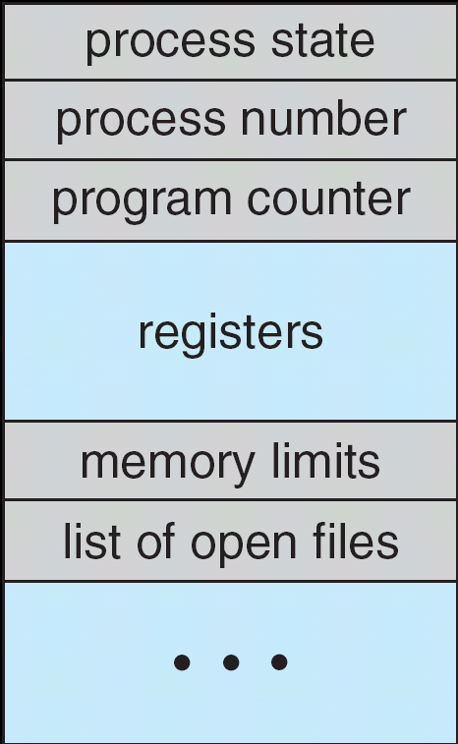
Multiplexing Processes
Snapshot of each process in its PCB
  Only one active at a time (per core…)
Give out CPU to different processes
  Scheduling
  Policy Decision
Give out non-CPU resources
  Memory/IO
  Another policy decision
Process
Control
Block

Slide 62
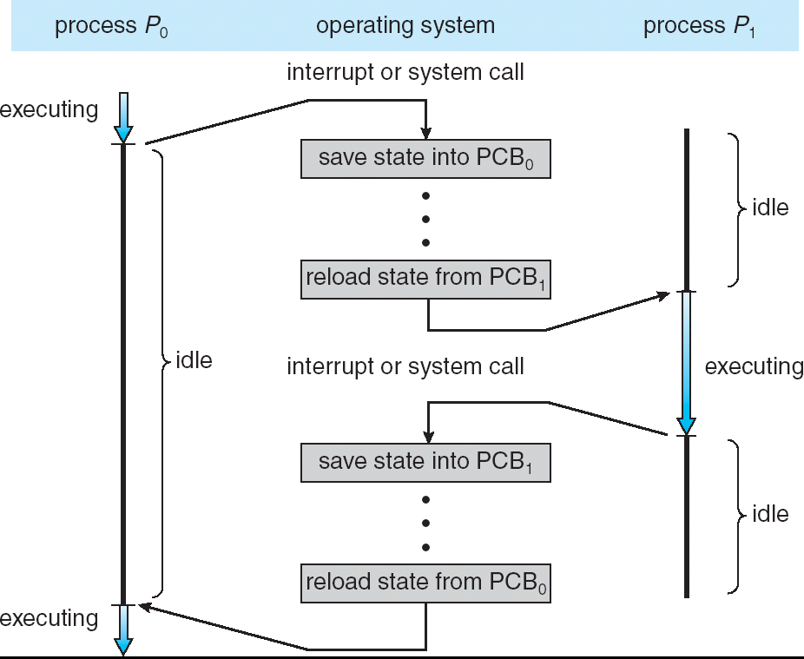
Context Switch
Overhead!

Slide 63
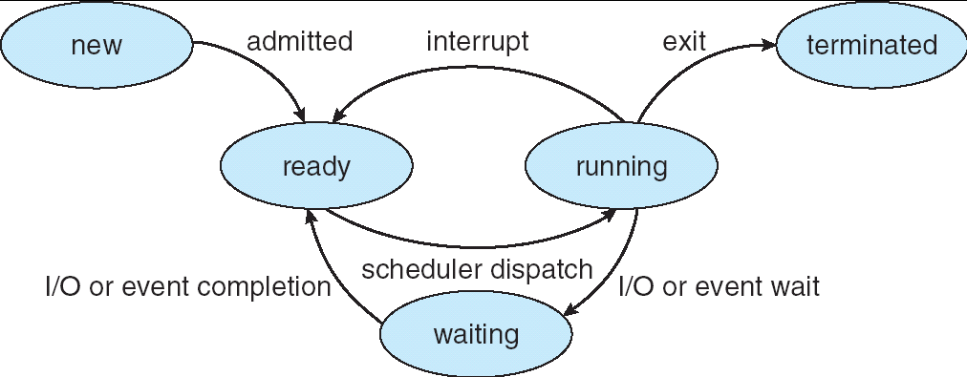
Lifecycle of a Process
As a process executes, it changes state:
  new: being created
  ready: waiting to run
  running: instructions executing on the CPU
  waiting: waiting for some event to occur (e.g., keypress)
  terminated: finished execution

Slide 64
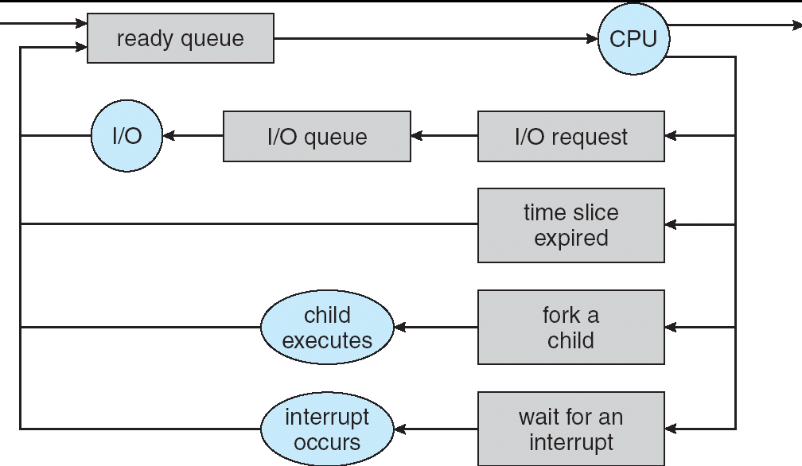
Scheduling: All About Queues
PCBs move from queue to queue
Scheduling: which order to remove from queue

Slide 65
Modern Processes: Multiple Threads
Thread: execution stream within a process
  Used to be called "lightweight processes"
  Shares address space with other threads belonging to the same process
Why separate concepts
of threads and processes?
  Threads: Concurrency
  Processes: Protection

Slide 66
So does the OS schedule processes or threads?
Usually it's threads (e.g., in Linux)
One point to notice: switching threads vs. switching processes incurs different costs:
  Switch threads: Save/restore registers
  Switch processes: Change active address space too!
    Expensive
    Disrupts caching

Slide 67
Thread vs. Process State
Process-wide state:
  Memory contents (global variables, heap)
  I/O bookkeeping
Thread-"private" state:
  CPU registers including program counter
  Execution stack
  Kept in Thread Control Block

Slide 68
Execution Stack Review
A(int tmp) {
if (tmp<2)
B();
printf(tmp);
}
B() {
C();
}
C() {
A(2);
}
A(1);
A: tmp=1
ret=exit
B: ret=A+2
C: ret=b+1
A: tmp=2
ret=C+1
Stack
Pointer
Stack Growth
Stack holds temporary results
Used to implement recursion

Slide 69
Shared vs. Per-Thread State

Slide 70
Memory Footprint: Two Threads
Two sets of CPU registers
Two sets of Stacks
Issues:
  How do we position stacks relative to
  each other?
  What maximum size should we choose
  for the stacks?
  What happens if threads violate this?
  How might you catch violations?
Stack 1
Stack 2
Address Space
Heap
Global Data
Code

Slide 71
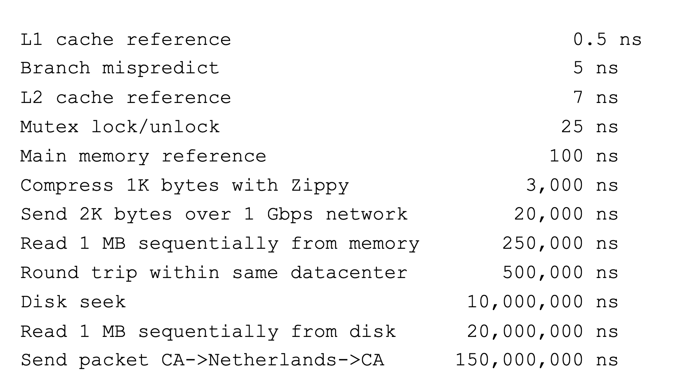
Threads Motivation
Back to Jeff Dean's "Numbers everyone should know"
Handle I/O in separate thread, avoid blocking other progress

Slide 72
Example for Threads
Imagine the following program:
main() {
…
ReadLargeFile(“pi.txt”);
RenderUserInterface();
}
What is the behavior here?
  Still respond to user input
  While reading file in the background

Slide 73
Dispatch Loop
Loop {
RunThread();
ChooseNextThread();
SaveStateOfCPU(curTCB);
LoadStateOfCPU(newTCB);
}
Conceptually all the OS executes
Infinite Loop
  When would we ever "exit?"
  Can we assume some thread is always ready?

Slide 74
Dispatch Loop
Loop {
RunThread();
ChooseNextThread();
SaveStateOfCPU(curTCB);
LoadStateOfCPU(newTCB);
}
How to run a new thread?
  Load thread's registers into CPU
  Load its environment (address space, if in different process)
  Jump to thread's PC
How does dispatch loop get control again?
  Thread returns control voluntarily – yield, I/O
  External events: thread is preempted

Slide 75
Voluntarily Giving Up Control
I/O – e.g. keypress
Waiting for a signal from another thread
  Thread makes system call to wait
Thread executes thread_yield()
  Relinquishes CPU but puts calling thread back on ready queue

Slide 76
Stack for Yielding Thread
ComputePI
yield
Trap to OS
kernel_yield
Stack growth
run_new_thread
switch
Cyan = User Stack; Red = Kernel Stack
run_new_thread() {
newThread = PickNewThread();
switch(curThread, newThread);
ThreadHouseKeeping(); /* Do any cleanup */
}

Slide 77
The Context Switch Itself
Switch(tCur,tNew) {
/* Unload old thread */
TCB[tCur].regs.r7 = CPU.r7;
…
TCB[tCur].regs.r0 = CPU.r0;
TCB[tCur].regs.sp = CPU.sp;
TCB[tCur].regs.retpc = CPU.retpc; /*return addr*/
/* Load and execute new thread */
CPU.r7 = TCB[tNew].regs.r7;
…
CPU.r0 = TCB[tNew].regs.r0;
CPU.sp = TCB[tNew].regs.sp;
CPU.retpc = TCB[tNew].regs.retpc;
return; /* Return to CPU.retpc */
}

Slide 78
Summary
Variety of process management syscalls
  fork, exec, wait, kill, sigaction
Process consists of two pieces
  Address Space (Protection)
  One or more threads (Concurrency)
Scheduling: Threads move between queues
Threads: multiple stacks per address space
  Context switch: Save/Restore registers, "return" from new thread's switch routine

