Slide 1
CS6456: Graduate Operating Systems
Brad Campbell – bradjc@virginia.edu
https://www.cs.virginia.edu/~bjc8c/class/cs6456-f19/
Some slides modified from CS162 at UCB

Slide 2
End-to-End Principle
Implementing complex functionality in the network:
Doesn’t reduce host implementation complexity
Does increase network complexity
Probably imposes delay and overhead on all applications, even if they don’t need functionality
However, implementing in network can enhance performance in some cases
  e.g., very lossy link

Slide 3
Conservative Interpretation of E2E
Don’t implement a function at the lower levels of the system unless it can be completely implemented at this level
Or: Unless you can relieve the burden from hosts, don’t bother

Slide 4
Moderate Interpretation
Think twice before implementing functionality in the network
If hosts can implement functionality correctly, implement it in a lower layer only as a performance enhancement
But do so only if it does not impose burden on applications that do not require that functionality
This is the interpretation we are using
Is this still valid?
  What about Denial of Service?
  What about privacy against intrusion?
  Perhaps there are things that must be in the network?

Slide 5
Remote Procedure Call (RPC)
Raw messaging is a bit too low-level for programming
  Must wrap up information into message at source
  Must decide what to do with message at destination
  May need to sit and wait for multiple messages to arrive
Another option: Remote Procedure Call (RPC)
  Calls a procedure on a remote machine
  Client calls:
  remoteFileSystem→Read("rutabaga");
  Translated automatically into call on server:
  fileSys→Read("rutabaga");

Slide 6
RPC Implementation
Request-response message passing (under covers!)
“Stub” provides glue on client/server
  Client stub is responsible for “marshalling” arguments and “unmarshalling” the return values
  Server-side stub is responsible for “unmarshalling” arguments and “marshalling” the return values.
Marshalling involves (depending on system)
  Converting values to a canonical form, serializing objects, copying arguments passed by reference, etc.

Slide 7
RPC Information Flow
bundle
args
Client
(caller)
call
Client
Stub
send
Packet
Handler
return
receive
unbundle
ret vals
mbox2
Machine A
Network
Network
Machine B
bundle
ret vals
mbox1
Server
(callee)
return
Server
Stub
send
Packet
Handler
call
receive
unbundle
args
Notes:
…so from the perspective of the calling code on the client, this just looks like a regular procedure call.

Slide 8
RPC Details
Equivalence with regular procedure call
  Parameters ⇔ Request Message
  Result ⇔ Reply message
  Name of Procedure: Passed in request message
  Return Address: mbox2 (client return mail box)
Stub generator: Compiler that generates stubs
  Input: interface definitions in an “interface definition language (IDL)”
    Contains, among other things, types of arguments/return
  Output: stub code in the appropriate source language
    Code for client to pack message, send it off, wait for result, unpack result and return to caller
    Code for server to unpack message, call procedure, pack results, send them off
Notes:
…
- You might imagine that this stub code, to marshal arguments and make requests over the network, looks similar for many different remote function calls. We can actually generate it automatically, with a compiler!

Slide 9
RPC Details
Cross-platform issues:
  What if client/server machines are different architectures/ languages?
    Convert everything to/from some canonical form
    Tag every item with an indication of how it is encoded (avoids unnecessary conversions)

Slide 10
Problems with RPC: Non-Atomic Failures
Different failure modes in dist. system than on a single machine
Consider many different types of failures
  User-level bug causes address space to crash
  Machine failure, kernel bug causes all processes on same machine to fail
  Some machine is compromised by malicious party
Before RPC: whole system would crash/die
After RPC: One machine crashes/compromised while others keep working
Can easily result in inconsistent view of the world
  Did my cached data get written back or not?
  Did server do what I requested or not?

Slide 11
Problems with RPC: Performance
Cost of Procedure call « same-machine RPC « network RPC
Means programmers must be aware that RPC is not free
  Caching can help, but may make failure handling complex

Slide 12
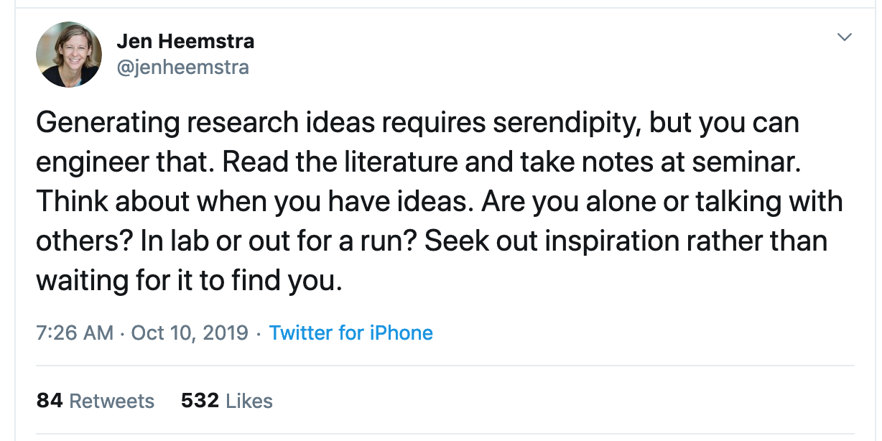

Slide 13
Important “ilities”
Availability: probability that the system can accept and process requests
Durability: the ability of a system to recover data despite faults
Reliability: the ability of a system or component to perform its required functions under stated conditions for a specified period of time (IEEE definition)

Slide 14
One Approach: Geographic Replication
Highly durable: Hard to destroy all copies
Highly available for reads: Just talk to any copy
What about for writes? Need every copy online to update all together?
Replica/Frag #1
Replica/Frag #2
Replica/Frag #n

Slide 15
Centralized vs Distributed
Server
Client/Server Model
Peer-to-Peer Model
Centralized System: Major functions performed on one physical computer
Distributed System: Physically separate computers working together to perform a single task

Slide 16
Parallel vs Distributed
Distributed: different machines responsible for different parts of task
  Usually no centralized state
  Usually about different responsibilities or redundancy
Parallel: different parts of same task performed on different machines
  Usually about performance

Slide 17
Distributed: Why?
Simple, cheaper components
Easy to add capability incrementally
Let multiple users cooperate (maybe)
  Physical components owned by different users
  Enable collaboration between diverse users

Slide 18
The Promise of Dist. Systems
Availability: One machine goes down, overall system stays up
Durability: One machine loses data, but system does not lose anything
Security: Easier to secure each component of the system individually?

Slide 19
Distributed: Worst-Case Reality
Availability: Failure in one machine brings down entire system
Durability: Any machine can lose your data
Security: More components means more points of attack

Slide 20
Distributed Systems Goal
Transparency: Hide "distributed-ness" from any external observer, make system simpler
Types
  Location: Location of resources is invisible
  Migration: Resources can move without user knowing
  Replication: Invisible extra copies of resources (for reliability, performance)
  Parallelism: Job split into multiple pieces, but looks like a single task
  Fault Tolerance: Components fail without users knowing

Slide 21
Challenge of Coordination
Components communicate over the network
  Send messages between machines
Need to use messages to agree on system state
  This issue does not exist in a centralized system

Slide 22
CAP Theorem
Originally proposed by Eric Brewer (Berkeley)
Consistency – changes appear to everyone in same sequential order
Availability – can get a result at any time
Partition Tolerance – system continues to work even when one part of network can't communicate with the other
Impossible to achieve all 3 at the same time (pick two)

Slide 23
CAP Theorem Example
What do we do if a network partition occurs?
Prefer Availability: Allow the state at some nodes to disagree with the state at other nodes (AP)
Prefer Consistency: Reject requests until the partition is resolved (CP)
Partition B
Partition A

Slide 24
Consistency Preferred
Block writes until all nodes able to agree
Consistent: Reads never return wrong values
Not Available: Writes block until partition is resolved and unanimous approval is possible

Slide 25
What about AP Systems?
Partition occurs, but both groups of nodes continue to accept requests
Consequence: State might diverge between the two groups (e.g., different updates are executed)
When communication is restored, there needs to be an explicit recovery process
  Resolve conflicting updates so everyone agrees on system state once again

Slide 26
General’s Paradox
Two generals located on opposite sides of their enemy’s position
Can only communicate via messengers
Messengers go through enemy territory: might be captured
Problem: Need to coordinate time of attack
  Two generals lose unless they attack at same time
  If they attack at same time, they win

Slide 27
General’s Paradox
Can messages over an unreliable network be used to guarantee two entities do something simultaneously?
No, even if all messages go through
11 am ok?
General 1
Yes, 11 works
General 2
So, 11 it is?
Yeah, but what if you
Don’t get this ack?

Slide 28
Two-Phase Commit
We can’t solve the General’s Paradox
  No simultaneous action
  But we can solve a related problem
Distributed Transaction: Two (or more) machines agree to do something or not do it atomically
Extra tool: Persistent Log
  If machine fails, it will remember what happened
  Assume log itself can’t be corrupted

Slide 29
Two-Phase Commit: Setup
One machine (coordinator) initiates the protocol
It asks every machine to vote on transaction
Two possible votes:
  Commit
  Abort
Commit transaction only if unanimous approval

Slide 30
Two-Phase Commit: Preparing
Agree to Commit
Machine has guaranteed that it will accept transaction
Must be recorded in log so machine will remember this decision if it fails and restarts
Agree to Abort
Machine has guaranteed that it will never accept this transaction
Must be recorded in log so machine will remember this decision if it fails and restarts

Slide 31
Two-Phase Commit: Finishing
Commit Transaction
Coordinator learns all machines have agreed to commit
Apply transaction, inform voters
Record decision in local log
Abort Transaction
Coordinator learns at least on machine has voted to abort
Do not apply transaction, inform voters
Record decision in local log

Slide 32
Formalizing Two-Phase Commit
N workers (replicas): actually perform transaction
One coordinator (may also serve a worker)
  Asks each worker to vote on transaction
  Tells every machine result of the vote (workers don’t need to ask each other)

Slide 33
Messages in Two-Phase Commit
Coordinator → Worker
VOTE-REQ
Worker → Coordinator
VOTE-COMMIT
VOTE-ABORT
Coordinator → Worker
GLOBAL-COMMIT
GLOBAL-ABORT

Slide 34
Messages in Two-Phase Commit
Coordinator → Worker
VOTE-REQ
Worker → Coordinator
VOTE-COMMIT
VOTE-ABORT
Coordinator → Worker
GLOBAL-COMMIT
GLOBAL-ABORT
No taking back: always logged before sending
Actual result of transaction attempt

Slide 35
Detailed Algorithm
Coordinator Algorithm
Worker Algorithm
  Coordinator sends VOTE-REQ to all workers
Wait for VOTE-REQ from coordinator
If ready, send VOTE-COMMIT to coordinator
If not ready, send VOTE-ABORT to coordinator
  And immediately abort
  If receive VOTE-COMMIT from all N workers, send GLOBAL-COMMIT to all workers
  If doesn’t receive VOTE-COMMIT from all N workers, send GLOBAL-ABORT to all workers
If receive GLOBAL-COMMIT then commit
If receive GLOBAL-ABORT then abort

Slide 36
Example: Failure-Free 2PC
coordinator
VOTE-REQ
GLOBAL-COMMIT
worker 1
worker 2
VOTE-COMMIT
worker 3
time

Slide 37
Example: Failure-Free 2PC
coordinator
VOTE-REQ
VOTE-ABORT
GLOBAL-ABORT
worker 1
worker 2
VOTE-COMMIT
worker 3
time

Slide 38
Example of Worker Failure
INIT
WAIT
coordinator
ABORT
COMM
timeout
GLOBAL-ABORT
VOTE-REQ
worker 1
VOTE-COMMIT
worker 2
worker 3
time

Slide 39
Example of Coordinator Failure (1)
INIT
READY
coordinator
ABORT
COMM
VOTE-REQ
timeout
worker 1
VOTE-ABORT
worker 2
timeout
timeout
worker 3

Slide 40
Example of Coordinator Failure
INIT
READY
ABORT
COMM
coordinator
restarted
VOTE-REQ
worker 1
VOTE-COMMIT
GLOBAL-ABORT
worker 2
block waiting for coordinator
worker 3

Slide 41
Failure Recovery
Nodes need to know what state they are in when they come back from a failure
How? Log events on local hard disk
Then we have the following recovery rules:
  Coordinator aborts transaction if it was in the INIT, WAIT, or ABORT states
  Coordinator commits transaction if it was in COMMIT
  Worker aborts if in INIT or ABORT states
  Worker commits if it was in COMMIT state
  Worker asks coordinator what to do if in READY state

Slide 42
Blocking for Coordinator to Recover
A worker waiting for global decision can ask fellow workers about their state
  If another worker is in ABORT or
  COMMIT state then coordinator
  must have sent GLOBAL-*
    Thus, worker can safely
    abort or commit, respectively
  If another worker is still in
  INIT state then both workers
  can decide to abort
  If all workers are in ready, need to BLOCK (don’t know if coordinator wanted to abort or commit)
INIT
Recv: VOTE-REQ
Send: VOTE-ABORT
Recv: VOTE-REQ
Send: VOTE-COMMIT
READY
Recv: GLOBAL-ABORT
Recv: GLOBAL-COMMIT
ABORT
COMMIT

Slide 43
Blocking
What if both coordinator and a worker fail?
The remaining workers can still consult each other
But they can’t reach a conclusion on what to do!
Why?
If all workers in INIT, we still don’t know state of failed worker w
w may have been first to be notified of a commit, and then coordinator and w crashed

Slide 44
Blocking for Coordinator
What if both coordinator and a worker fail?
The remaining workers can still consult each other
But they can’t reach a conclusion on what to do!
This problem motivated Three Phase Commit

Slide 45
Paxos: fault tolerant agreement
Paxos lets all nodes agree on the same value despite node failures, network failures and delays
High-level process:
  One (or more) node decides to be the leader
  Leader proposes a value and solicits acceptance from others
  Leader announces result or try again

Slide 46
Google Spanner
James C. Corbett, Jeffrey Dean, Michael Epstein, Andrew Fikes, Christopher Frost, J. J. Furman, Sanjay Ghemawat, Andrey Gubarev, Christopher Heiser, Peter Hochschild, Wilson Hsieh, Sebastian Kanthak, Eugene Kogan, Hongyi Li, Alexander Lloyd, Sergey Melnik, David Mwaura, David Nagle, Sean Quinlan, Rajesh Rao, Lindsay Rolig, Yasushi Saito, Michal Szymaniak, Christopher Taylor, Ruth Wang, and Dale Woodford. 2012. Spanner: Google's globally-distributed database. In Proceedings of the 10th USENIX conference on Operating Systems Design and Implementation (OSDI'12). USENIX Association, Berkeley, CA, USA, 251-264.

Slide 47
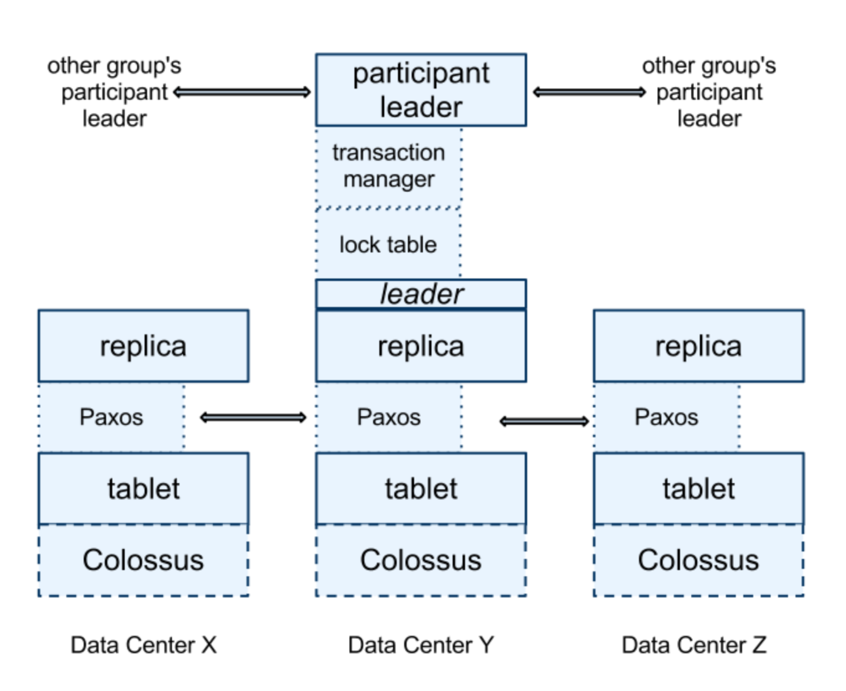
Basic Spanner Operation
Data replicated across datacenters
Paxos groups support transactions
On commit:
  Grab Paxos lock
  Paxos algorithm decides consensus
  If all agree, transaction is committeed

Slide 48
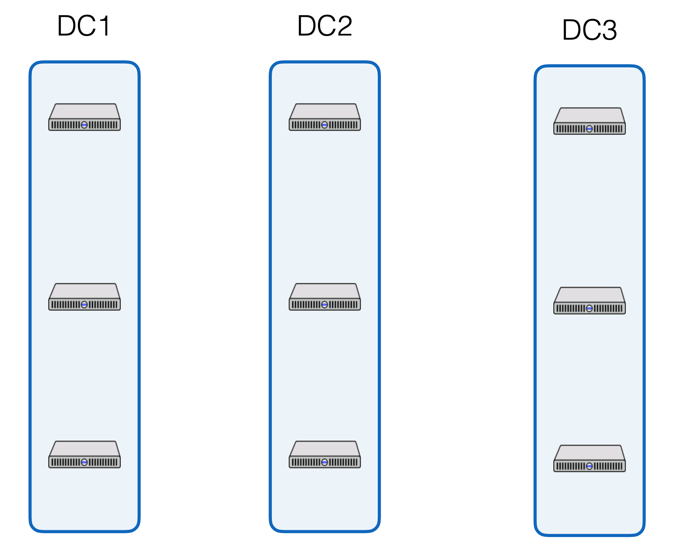
Spanner Operation
Paxos
Paxos
2PC

Slide 49
Base operation great for writes…
What about reads?
Reads are dominant operations
  e.g., FB’s TAO had 500 reads : 1 write [ATC 2013]
  e.g., Google Ads (F1) on Spanner from 1? DC in 24h:
  21.5B reads
  31.2M single-shard transactions
  32.1M multi-shard transactions
Want efficient read transactions

Slide 50
Make Read-Only Txns Efficient
Ideal: Read-only transactions that are non-blocking
  Arrive at shard, read data, send data back
Goal 1: Lock-free read-only transactions
Goal 2: Non-blocking stale read-only txns

Slide 51
TrueTime
“Global wall-clock time” with bounded uncertainty
  ε is worst-case clock divergence
  Timestamps become intervals, not single values
TT.now()
time
earliest
latest
2*ε
  Consider event e_{now} which invoked tt = TT.now():
  Guarantee: tt.earliest <= t_{abs}(e_{now}) <= tt.latest

Slide 52
TrueTime for Read-Only Txns
Assign all transactions a wall-clock commit time (s)
  All replicas of all shards track how up-to-date they are with
  t_{safe}: all transactions with s < t_{safe} have committed on this machine
Goal 1: Lock-free read-only transactions
  Current time ≤ TT.now.latest()
  s_{read} = TT.now.latest()
  wait until s_{read} < t_{safe}
  Read data as of s_{read}
Goal 2: Non-blocking stale read-only txns
  Similar to above, except explicitly choose time in the past
  (Trades away consistency for better perf, e.g., lower latency)

Slide 53
Timestamps and TrueTime
Acquired locks
Release locks
T
Pick s > TT.now().latest
s
Wait until TT.now().earliest > s
Commit wait
average ε
average ε
Key: Need to ensure that all future transactions will get a higher timestamp
  Commit wait ensures this
Notes:
Pick s > TT.now().latest ensures s, the commit time, is > the start time of the transaction (just like read-only transactions)
Commit wait, until TT.now().earliest > s, ensures that s is < the end time of the transaction
(DRAW NEXT PART OUT ON BOARD)
Now a read-only transaction that starts after a transactions end will definitely see it, without locks!:
txn_end < read_begin (definition)
read_begin < s_read (picking of s_read)
s_txn < txn_end (commit wait)
=> s_txn < s_read, read_only transaction will see all required transactions, without locks!!

Slide 54
Commit wait
What does this mean for performance?
  Larger TrueTime uncertainty bound
    longer commit wait
  Longer commit wait
    locks held longer
    can’t process conflicting transactions
    lower throughput
  i.e., if time is less certain, Spanner is slower!

