Slide 1
CS6456: Graduate Operating Systems
Brad Campbell – bradjc@virginia.edu
https://www.cs.virginia.edu/~bjc8c/class/cs6456-f19/

Slide 2
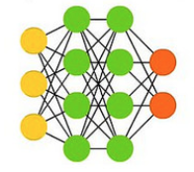
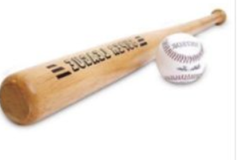
Background: Machine Learning
images, labels = train_data_load()
model = NeuralNetwork()
model.train(images, labels)
new_label = model.inference(new_image)
Training
Training set¹
Baseball-bat
Model
1 Caltech-256 dataset

Slide 3
Background: Machine Learning
Most widely used training algorithm: Gradient Descent.
Given model $f$, data set ${\left\{x_{i}, y_{i}\right\}}_{i=1}^{N}$
Minimize the distance between predicted labels and true labels:
$$\min{\frac{1}{N}\sum_{i=1}^{N}{distance(f\left(x_{i}\right), y_{i})} }$$
Gradient of function
The most common way to solve the minimization is gradient descent: update towards the negative gradient direction;
E.g., linear function $f_{ω}\left(x\right)=ω^{T}x$, least square distance: $distance\left(a, b\right)={\left(a−b\right)}^{2}$:
The gradient $∇f_{ω}\left(x\right)=2\left(ω^{T}x−y\right)x$, has the same dimensionality with $ω$

Slide 4
Background: Machine Learning
Gradient Descent:
Model $f_{ω}$ is parameterized by $ω∈R^{p}$;
The gradient on $x_{i}$: $∇f_{ω}(x_{i})$ has the the same dimensionality $p$, computing it dominates the cost of training.
$η>0$ is the update rate
Can be parallelized
Synchronous method:
Updates to $ω$ do not break the dependency of the FOR loop.
Asynchronous method:
Updates to $ω$ ignore the dependency of the FOR loop.
FOR t = 1:T
$Δω=η\frac{1}{N}\sum_{i}{∇f_{ω}(x_{i})}$ //compute update
$ω−=Δω$ //apply update
END

Slide 5
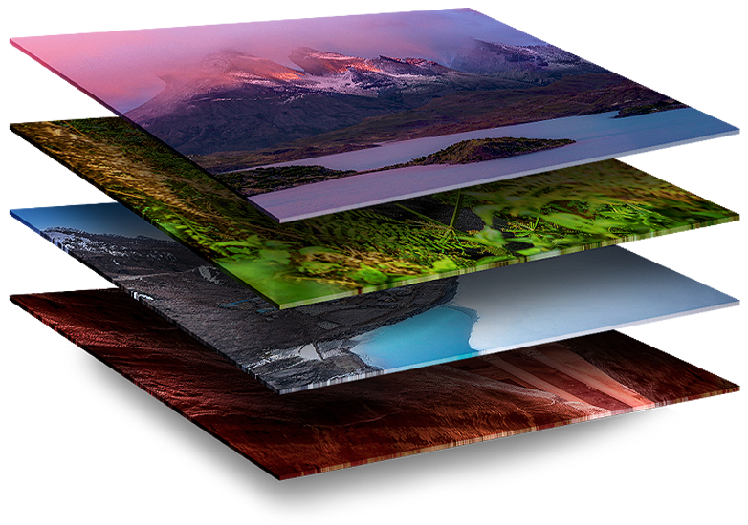
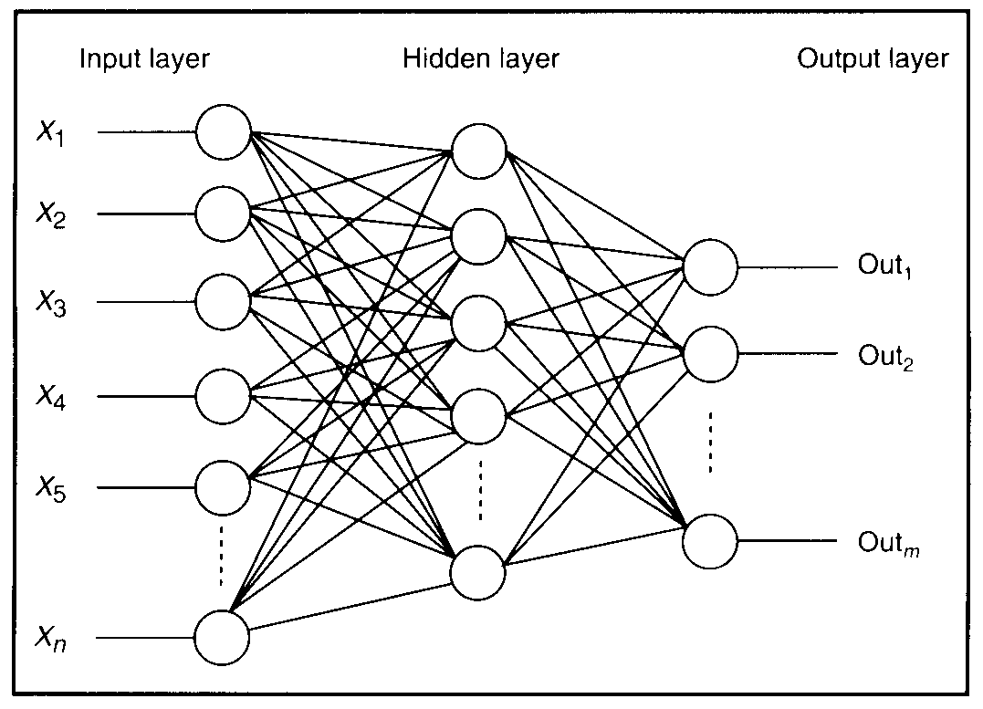
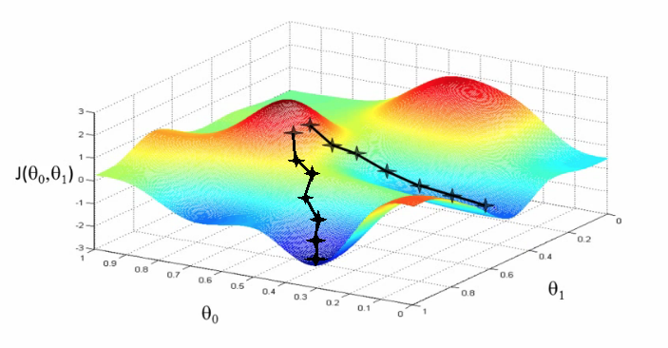
Background: NN Training
Process:
Take input image
Compute loss function (forward pass)
Compute error gradients (backward pass)
Update weights
Repeat
Problem:
Training process is usually time consuming, especially when training set / model size is large

Slide 6
Today: Systems to answer…
How to create ML models
How to create ML models even faster
How to check if ML models are any good

Slide 7
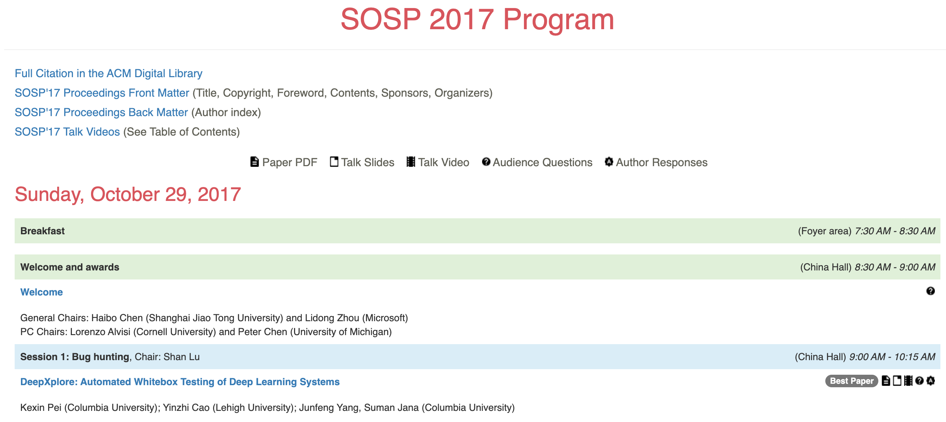
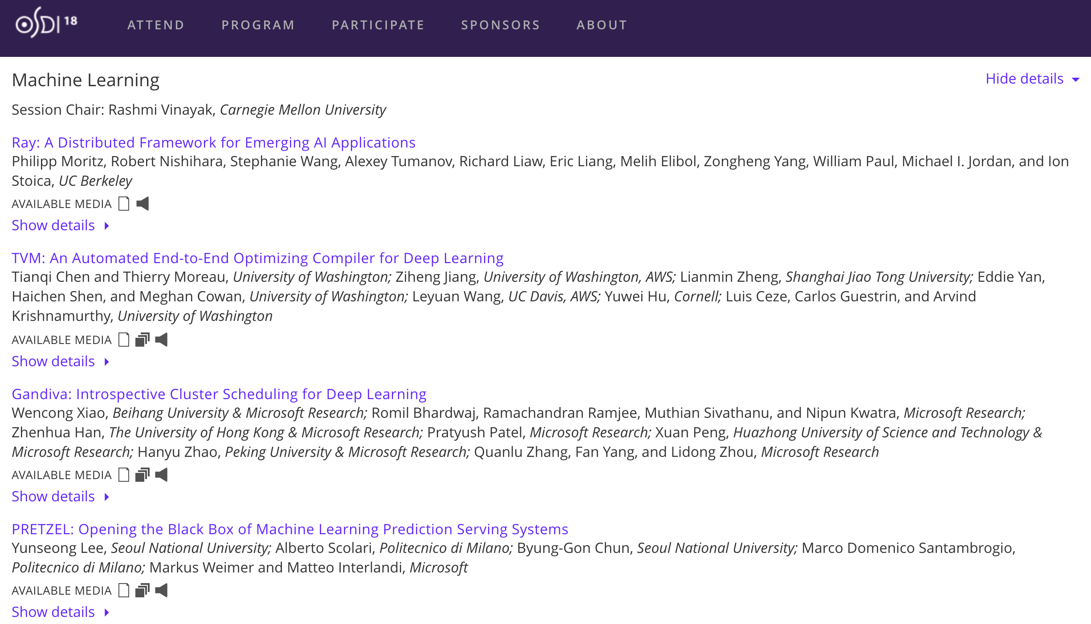
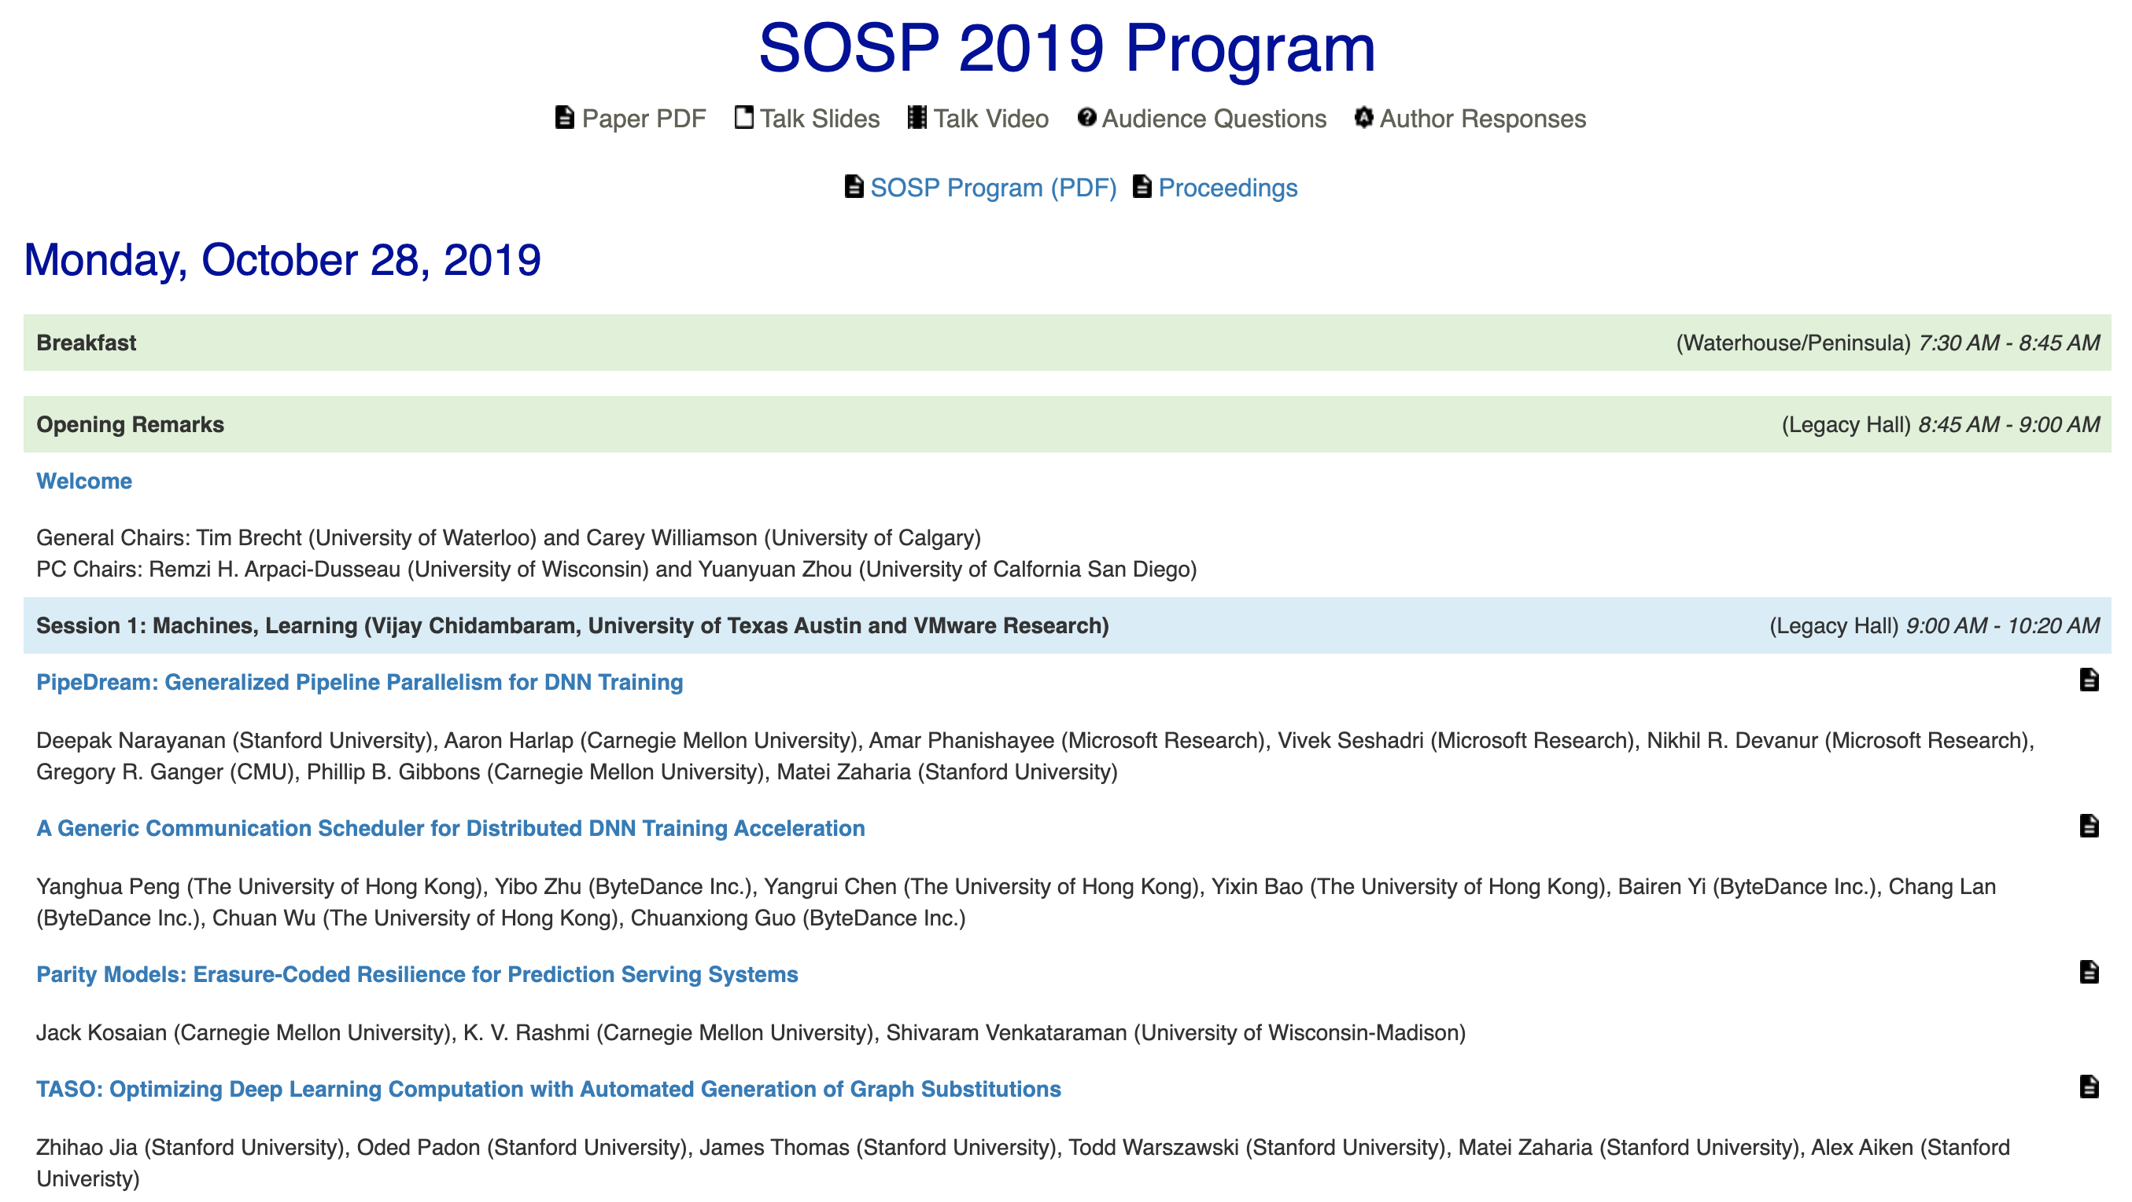
Is running or training ML an OS problem?
SOSP = Symposium on Operating System Principles OSDI = Operating System Design and Implementation

Slide 8
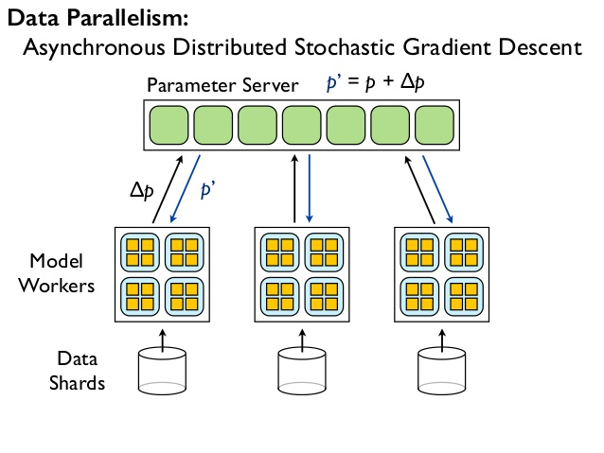
Background: Dist Belief, parameter-server arch
Jeffrey Dean, Greg S. Corrado, Rajat Monga, Kai Chen, Matthieu Devin, Quoc V. Le, Mark Z. Mao, Marc'Aurelio Ranzato, Andrew Senior, Paul Tucker, Ke Yang, and Andrew Y. Ng. 2012. Large scale distributed deep networks. NIPS’12.
Notes:
PSA:
two disjoint sets of processes:
stateless worker processes that perform the bulk of the computation when training a model
stateful parameter server processes that maintain the current version of the model parameters.
The user defines a neural network as a DAG of layers that terminates with a loss function.
A layer is a composition of mathematical operators:
for example, a fully connected layer multiplies its input by a weight matrix
adds a bias vector, and applies a non-linear function (such as a sigmoid) to the result.
A loss function is a scalar function that quantifies the difference between the predicted value (for a given input data point) and the ground truth.
In a fully connected layer, the weight matrix and bias vector are parameters, which a learning algorithm will update in order to minimize the value of the loss function.
DistBelief uses the DAG structure and knowledge of the layers’ semantics to compute gradients for each of the model parameters, via backpropagation [63].
Because the parameter updates in many algorithms are commutative and have weak consistency requirements [61], the worker processes can compute updates independently and write back “delta” updates to each parameter server, which combines the updates with its current state.

Slide 9
Background: Shortcomings of DistBelief
Difficulty of implementing new layers
C++ classes implement layers
Configuration file defines DNN architecture
Not flexible enough for researchers
Refining Algorithms
SGD is the heart of the training -- finalized in the parameter server
Need atomicity for some techniques -- get/put interface cannot accommodate
Supporting new algorithms
If it doesn’t conform to feed-forward, it doesn’t map well to DistBelief (EM, RF, RL, AdvMl)
Scaling down to other environments
Designed to run on distributed cluster of multi-cores
Augmented for GPGPU support for Conv NN
Notes:
Defining new layers For efficiency, we implemented DistBelief layers as C++ classes. Using a separate, less familiar programming language for implementing layers is a barrier for machine learning researchers who seek to experiment with new layer architectures, such as sampled softmax classifiers [37] and attention modules [53].
Refining the training algorithms Many neural networks are trained using stochastic gradient descent (SGD), which iteratively refines the parameters of the network by moving them in the direction that maximally decreases the value of the loss function. Several refinements to SGD accelerate convergence by changing the update rule [23, 66]. Researchers often want to experiment with new optimization methods, but doing that in DistBelief involves modifying the parameter server implementation. Moreover, the get() and put() interface for the parameter server is not ideal for all optimization methods: sometimes a set of related parameters must be updated atomically, and in many cases it would be more efficient to offload computation onto the parameter server, and thereby reduce the amount of network traffic.
Defining new training algorithms DistBelief workers follow a fixed execution pattern: read a batch of input data and the current parameter values, compute the loss function (a forward pass through the network), compute gradients for each of the parameter (a backward pass), and write the gradients back to the parameter server. This pattern works for training simple feed-forward neural networks, but fails for more advanced models, such as recurrent neural networks, which contain loops [39]; adversarial networks, in which two related networks are trained alternately [26]; and reinforcement learning models, where the loss function is computed by some agent in a separate system, such as a video game emulator [54]. Moreover, there are many other machine learning algorithms—such as expectation maximization, decision forest training, and latent Dirichlet allocation—that do not fit the same mold as neural network training, but could also benefit from a common, well-optimized distributed runtime.

Slide 10
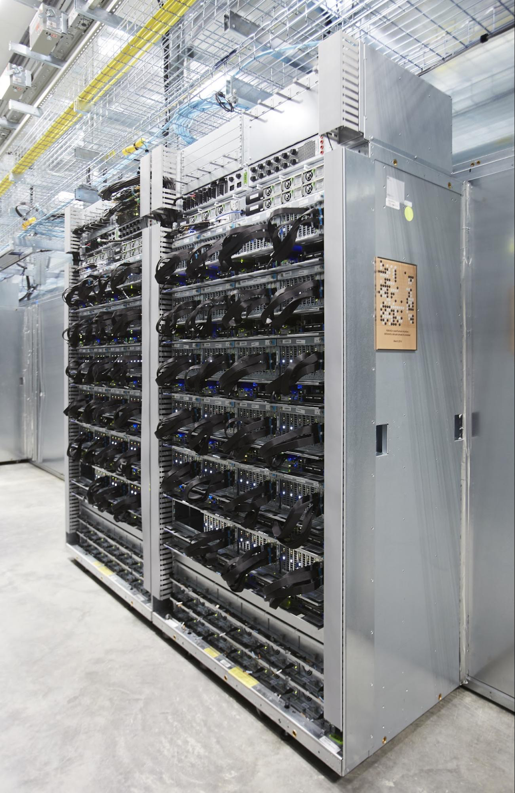
TensorFlow: Solution Strategy
Execution Flexibility via DataFlow abstraction
Makes it easy to extract the parallelism
Provides DFGs for primitive operators
Softmax, convolution, MM, …
Makes it easy to experiment with novel layers
Automatic gradient calculation
Deferred execution
Offload the larger chunks where possible...
Common Abstraction for Accelerators
Easy to integrate new accelerators into the fold
The operators are specialized for different devices
Common data primitive : Tensor
Notes:
1
Both TensorFlow and DistBelief use a dataflow representation for their models, but the most striking difference is that a DistBelief model comprises relatively few complex “layers”, whereas the corresponding TensorFlow model represents individual mathematical operators (such as matrix multiplication, convolution, etc.) as nodes in the dataflow graph. This approach makes it easier for users to compose novel layers using a high-level scripting interface. Many optimization algorithms require each layer to have defined gradients, and building layers out of simple operators makes it easy to differentiate these models automatically (§4.1). In addition to the functional operators, we represent mutable state, and the operations that update it, as nodes in the dataflow graph, thus
2
A typical TensorFlow application has two distinct phases: the first phase defines the program (e.g., a neural network to be trained and the update rules) as a symbolic dataflow graph with placeholders for the input data and variables that represent the state; and the second phase executes an optimized version of the program on the set of available devices. By deferring the execution until the entire program is available, TensorFlow can optimize the execution phase by using global information about the computation. For example, TensorFlow achieves high GPU utilization by using the graph’s dependency structure to issue a sequence of kernels to the GPU without waiting for intermediate results.
3
At a minimum, a device must implement methods for (i) issuing a kernel for execution, (ii) allocating memory for inputs and outputs, and (iii) transferring buffers to and from host memory. Each operator (e.g., matrix multiplication) can have multiple specialized implementations for different devices. As a result, the same program can easily target GPUs, TPUs, or mobile CPUs as required for training, serving, and offline inference.
4.
TensorFlow uses tensors of primitive values as a common interchange format that all devices understand. At the lowest level, all tensors in TensorFlow are dense; sparse tensors can be represented in terms of dense ones (§3.1). This decision ensures that the lowest levels of the system have simple implementations for memory allocation and serialization, thus reducing the framework overhead. Tensors also enable other optimizations for memory management and communication, such as RDMA and direct GPU-to-GPU transfer.
The main consequence of these principles is that in TensorFlow there is no such thing as a parameter server. On a cluster, we deploy TensorFlow as a set of tasks (named processes that can communicate over a network) that each export the same graph execution API and contain one or more devices. Typically a subset of those tasks assumes the role that a parameter server plays in other systems [11, 14, 20, 49], and we therefore call them PS tasks; the others are worker tasks. However, since a PS task is capable of running arbitrary TensorFlow graphs, it is more flexible than a conventional parameter server: users can program it with the same scripting interface that they use to define models. This flexibility is the key difference between TensorFlow and contemporary systems, and in the rest of the paper we will discuss some of the applications that this flexibility enables.

Slide 11
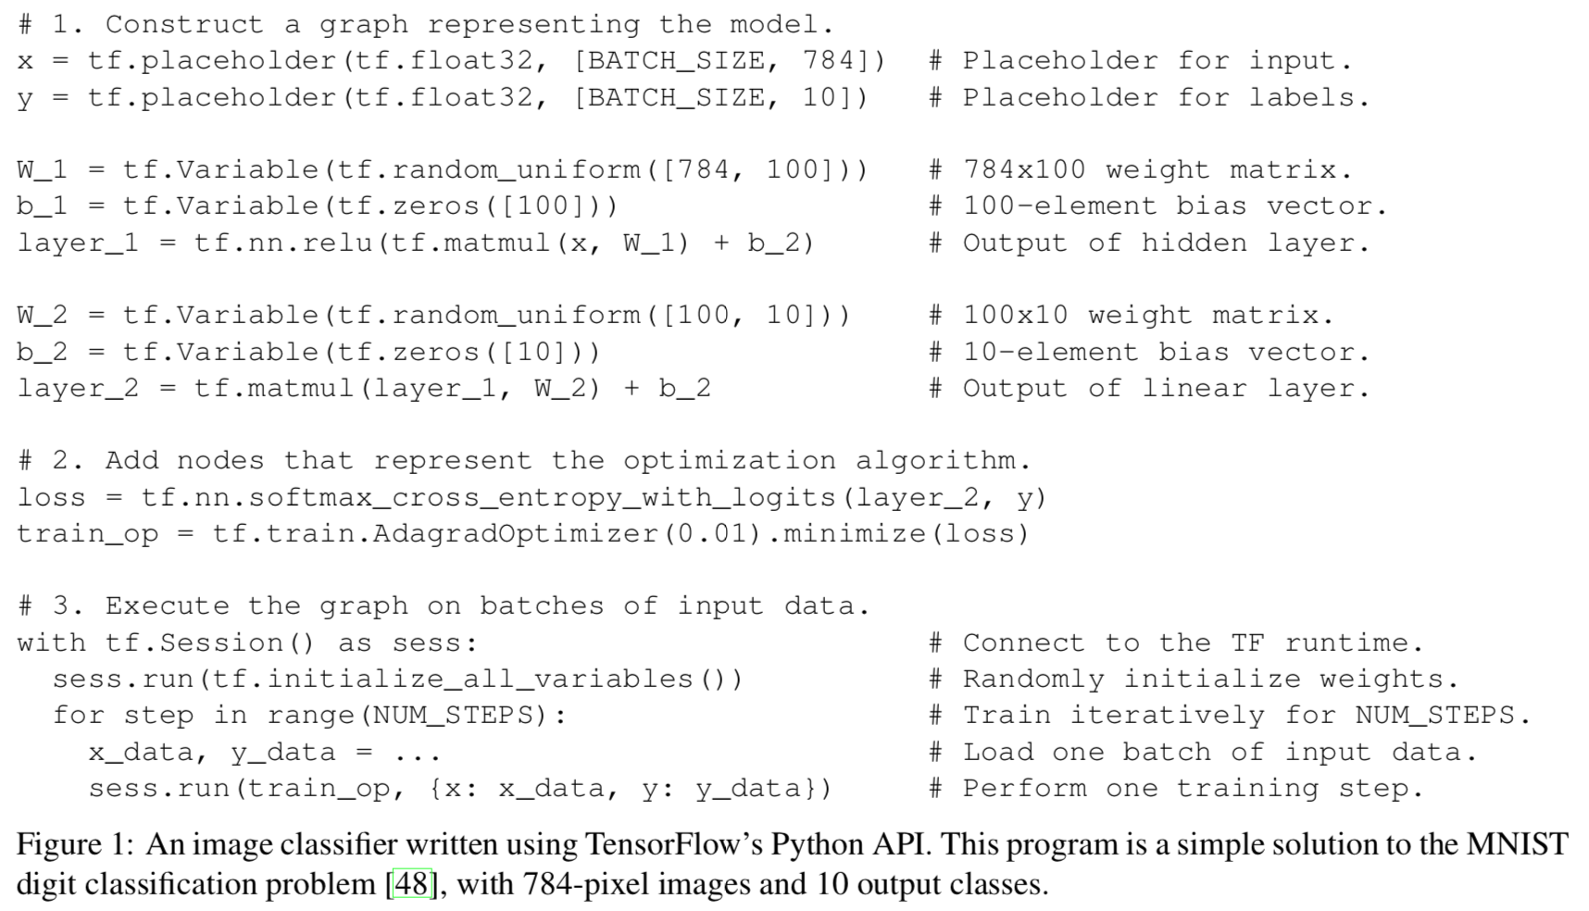
TensorFlow API Example

Slide 12
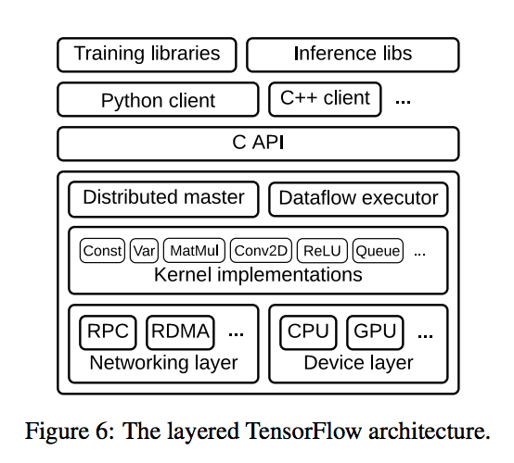
TensorFlow Implementation

Slide 13
Execution Model
Single DFG represents all computation and state for ML algorithm
Input preprocessing, mathematical operators, parameters, parameter update rules
Communication explicit, simplifying scheduling and partitioning

Slide 14
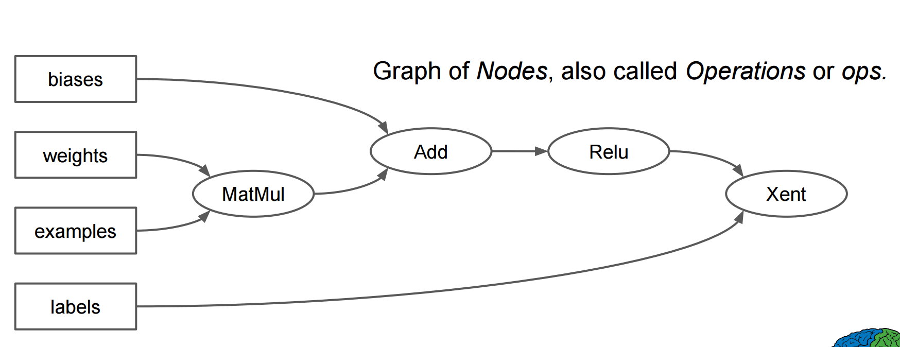
Computation is a DFG

Slide 15
Execution Model
Single DFG represents all computation and state for ML algorithm
Input preprocessing, mathematical operators, parameters, parameter update rules
Communication explicit, simplifying scheduling and partitioning
Differences with existing DF systems:
Concurrent execution on overlapping subgraphs supported
Individual vertices contain sharable, mutable state

Slide 16
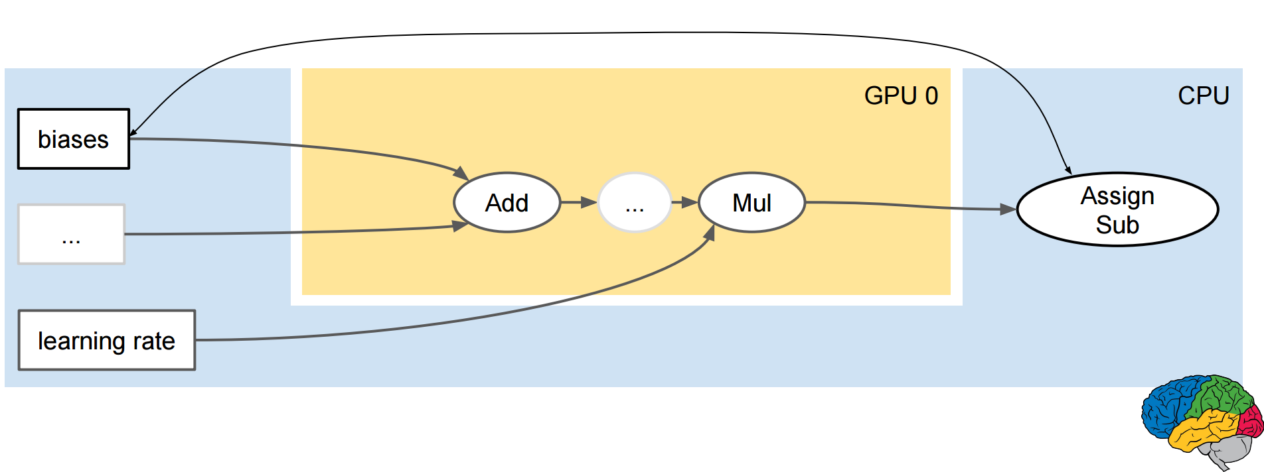
Communication is explicit...
TensorFlow handles the glue

Slide 17
Fault Tolerance
Days or many hours to train models -- fault tolerance is key
Don’t need perfect recovery mechanisms
Strong consistency is not needed for ML
User-level checkpointing operations and client library for configuration
SAVE/RESTORE

Slide 18
Time-to-Quality vs Time-per-Update
Synchronous updates can be delayed by stragglers
SGD found to be robust to asynchrony
Asynchronous = better utilization...
But with GPGPUs fewer machines needed, less coordination overhead
Asynchronous operation can suffer from stale updates
TensorFlow can handle Asynch or Synch updates...
Also, synchronous + backup workers
Idea: have K backup workers and N workers, then simply take updates from first N workers that complete

Slide 19
How to evaluate this?

Slide 20
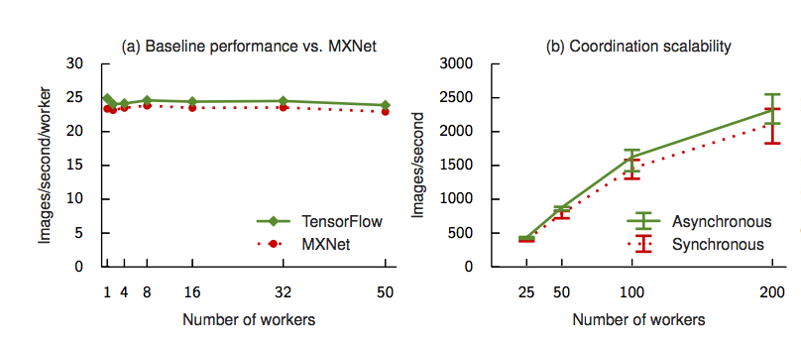

Slide 22
TVM: An automated end-to-end optimizing compiler for Deep learning
Tianqi Chen and Thierry Moreau, University of Washington; Ziheng Jiang, University of Washington, AWS; Lianmin Zheng, Shanghai Jiao Tong University; Eddie Yan, Haichen Shen, and Meghan Cowan, University of Washington; Leyuan Wang, UC Davis, AWS; Yuwei Hu, Cornell; Luis Ceze, Carlos Guestrin, and Arvind Krishnamurthy, University of Washington
OSDI’18

Slide 48
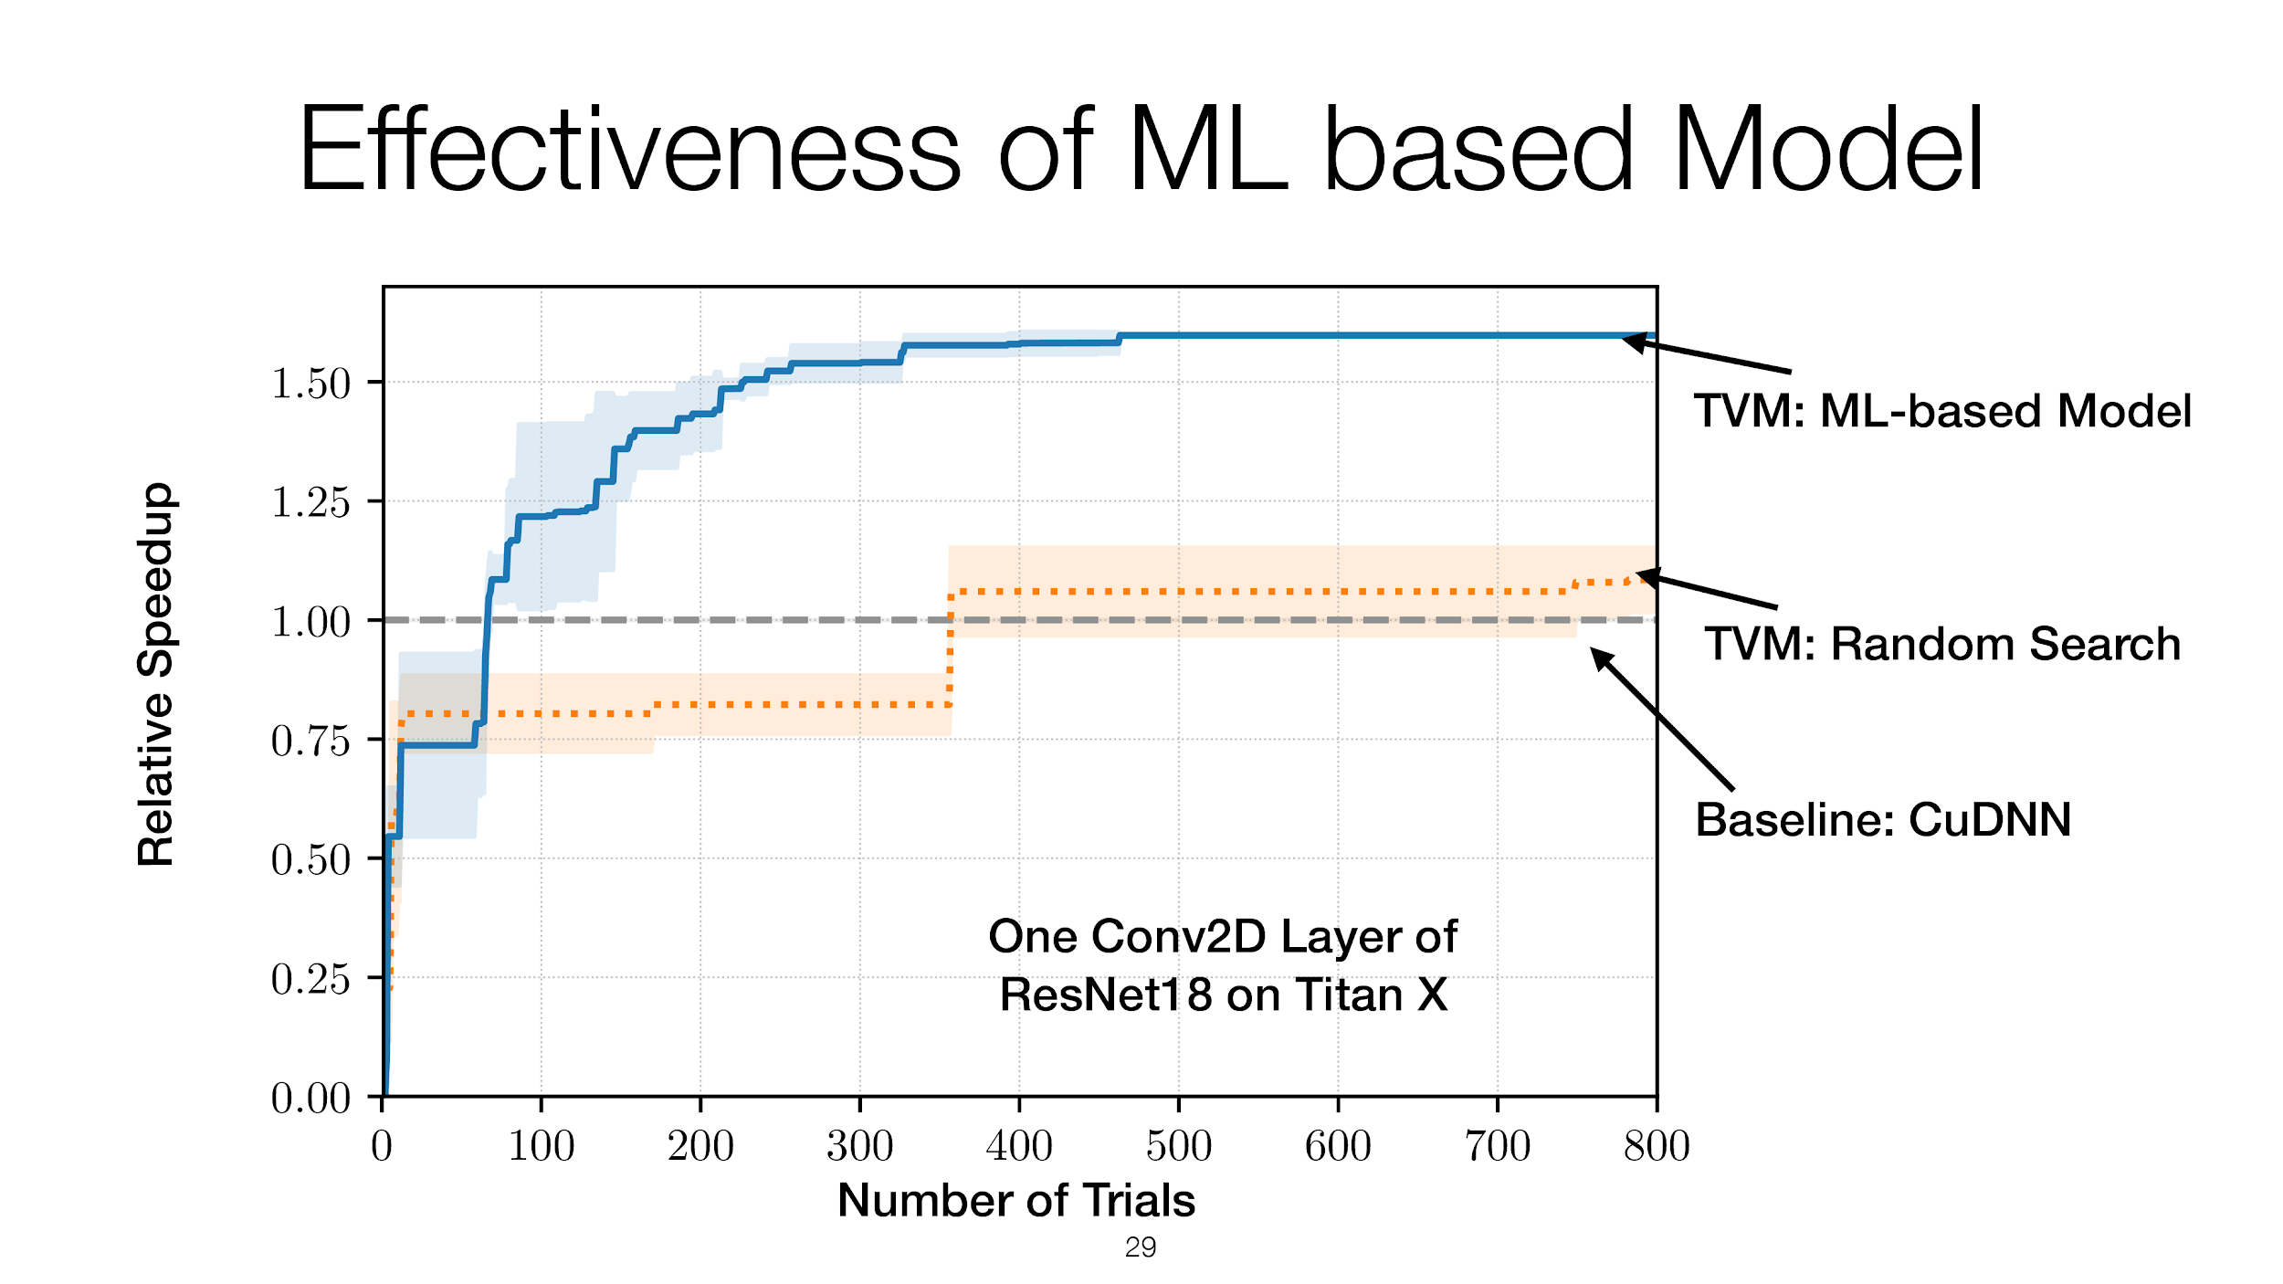

Slide 50
DeepXplore: Automated Whitebox Testing of Deep Learning Systems
Kexin Pei¹, Yinzhi Cao², Junfeng Yang¹, Suman Jana¹
¹Columbia University, ²Lehigh University
SOSP’17

Slide 51
Deep learning (DL) has matched human performance!
Image recognition, speech recognition, machine translation, intrusion detection...
Wide deployment in real-world systems

Slide 52
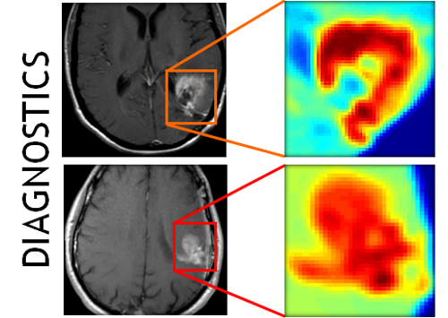
Deep learning is increasingly used in safety-critical systems
Deep learning correctness and security is crucial
Self-driving car
Medical diagnosis
Malware detection

Slide 53
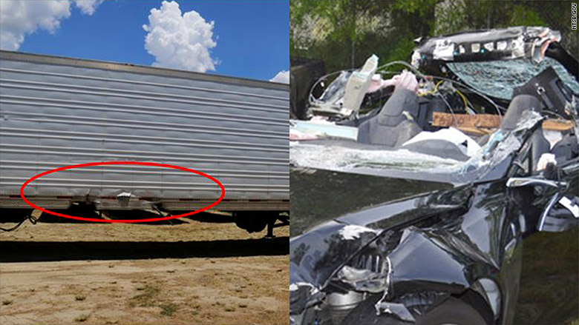
Unreliable deep learning contributed to Tesla fatal crash
Tesla autopilot failed to recognize a white truck against bright sky leading to fatal crash

Slide 54
Existing DL testing methods are seriously limited
Common practice: measure accuracy on a test input set of randomly chosen data
Problem 1: how good is the coverage of the test set?
DL decision logic is incredibly complex
More fundamentally, what is testing coverage metric for DL?
Problem 2: it requires expensive labeling effort
Data in test set must be manually labelled
To enlarge the test set, we need to manually label more data

Slide 55
Existing DL testing methods are seriously limited (cont.)
Adversarial testing (Szegedy et al. ICLR’14): find corner-case inputs imperceptible to human but induce errors
Problem 1: how good is the coverage of the test set?
Problem 2: it requires expensive labeling effort
Problem 3: Not realistic. (Theoretical, assumes a very powerful adversary. [Sharif et al. CCS’16])
School bus
Carefully crafted noise
Ostrich

Slide 56
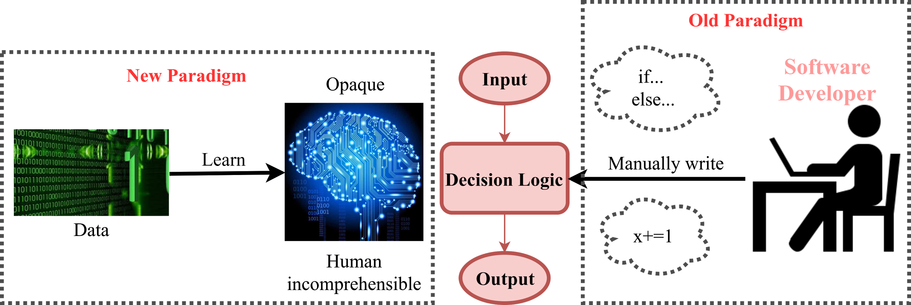
Many traditional software testing techniques don’t apply to deep learning
Deep learning decision logic is embedded in neurons and layers, not in code
x=0
If (x==8)
x+=1
x+=2
Neural network
Traditional program
(control flow graph)

Slide 57
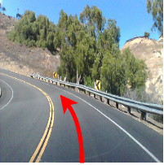
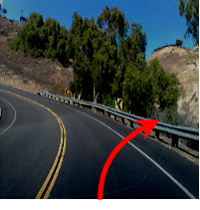
Quick Summary of DeepXplore
The first step towards systematic testing of Deep Neural Nets (DNNs)
Neuron coverage: first testing coverage metric for deep nerual net
Automated: cross-check multiple DNNs
Realistic: physically realizable transformations
Effective:
15 State-of-the-art DNNs on 5 large datasets (ImageNet, Self-driving cars, PDF/Android malware)
Numerous corner-case errors
50% more neuron coverage than existing testing
No accident
DeepXplore
Darker: Accident

Slide 58
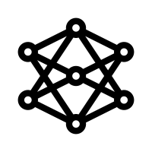
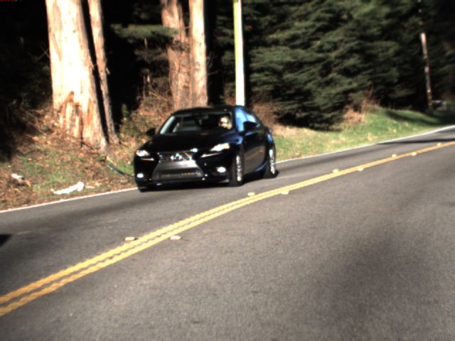
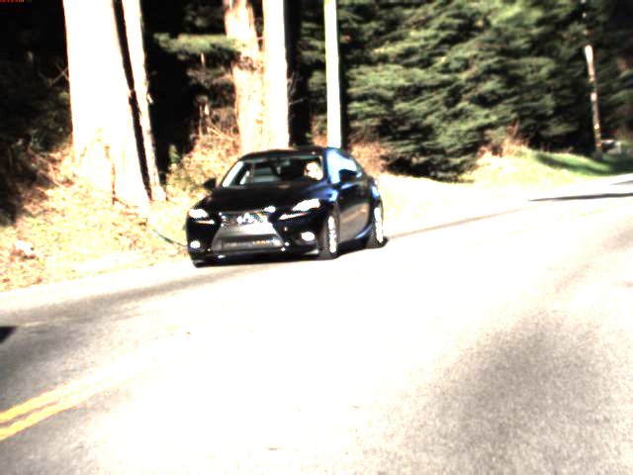
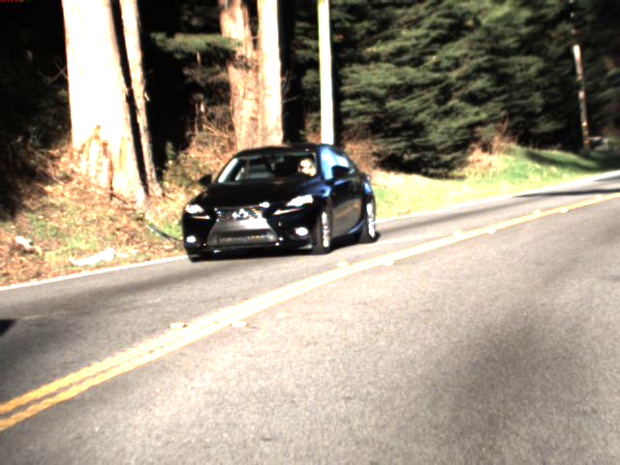
How DeepXplore works?
Feed into multiple DNNs
DNN1
Seed inputs without labels
Testing as an optimization problem
Right
23^{O}
25^{O}
20^{O}
DNN2
Objectives:
Maximize differences & neuron coverage
under realistic constraints
(e.g., lighting)
Right
22^{O}
24^{O}
20^{O}
DNN3
Right
Left
Mutate using gradient descent (DNNs are differentiable)
12^{O}
21^{O}
10^{O}
On new input, activate different neurons

Slide 59
How to achieve multiple goals simultaneously
Goal 1: systematically find corner cases
Generate inputs that maximize neuron coverage
Goal 2: find DNN errors without manual labels
Differential testing: use multiple DNNs as cross-referencing oracles
Goal 3: generate realistic test inputs
Domain-specific constraints
DNNs are differentiable → use gradient descent to solve the optimization problem
Apply mutation w.r.t input with realistic constraints
See paper for details
Objectives:
Maximize corner-case differences & neuron coverage
under realistic constraints
(e.g., lighting)
Testing DNNs is an optimization problem

Slide 60
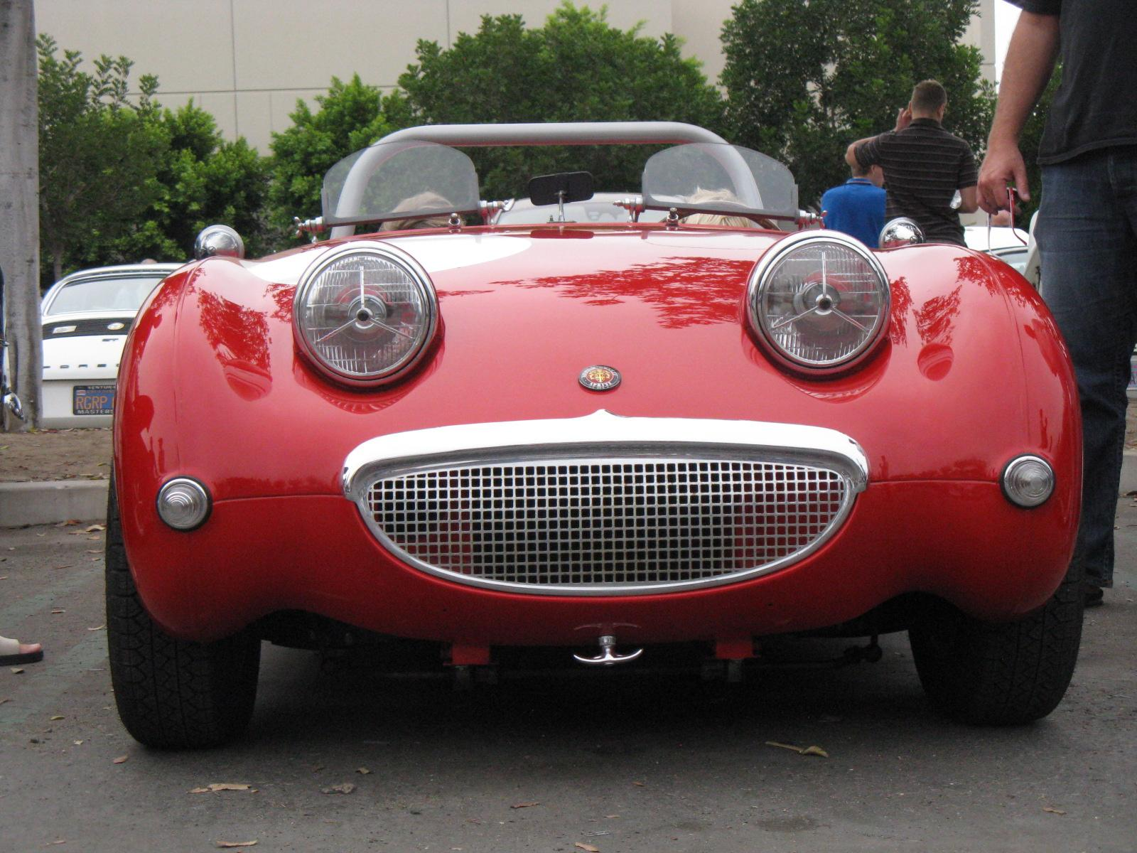
Neuron coverage → how much decision logic exercised
Neuron coverage = # neurons activated / # total neurons
Intuition: layerwise feature detection (Lee et al. ICML’09)
Nose
f: ReLU max(x,0)
3
hedge
...
Car
2
f(1)
...
Eyes
...
1
-11
1
1
vedge
...
Face
3
Activation threshold=0.75
2
Wheel
[3,1,2] [2,-11,1]^{T}=1
Neuron coverage: 4/7=57%
.

Slide 61
Implementation
DeepXplore
Keras 2.0.3
Efficient gradient computation &
support for intercepting outputs of intermediate neurons for calculating neuron coverage
TensorFlow 1.0.1
CPU
GPU
Linux

Slide 62
Evaluation setup and results summary
Dataset | Description | DNNs | Original random testing accuracy | Avg. neuron coverage improvement over random/adversarial | Avg. Violations found by DeepXplore (2000 seeds)
MNIST | Handwritten digits | LeNet variants | 98.63% | 30.5% → 70% | 1,289
ImageNet | General Images in 1000 categories | VGG16, VGG19, ResNet15 | 93.91% | 1% → 69% | 1,980
Driving | Udacity self-driving car competition dataset | Nvidia Dave-2 variants | 99.94% | 3.2% → 59% | 1,839
Contagio/VirusTotal | PDF malware | Fully connected | 96.29% | 18% → 70% | 1,048
Drebin | Android malware | Fully connected | 96.03% | 18.5% → 40% | 2,000

Slide 63
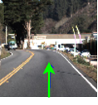
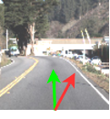
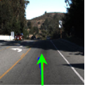
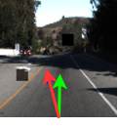
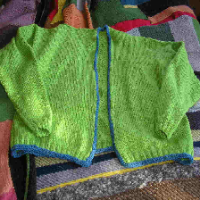
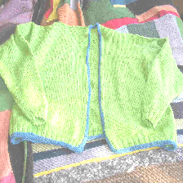
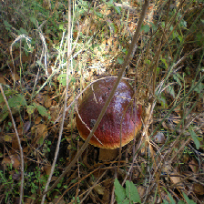
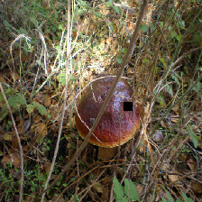
Sample corner-case errors for images
Driving:
Driving:
Go straight
Turn right
Go straight
Turn left
ImageNet:
ImageNet:
Light cardigan
Diaper
bolete
buckeye
MNIST:
MNIST:
6
2
5
3

Slide 64
Limitations of Approach
Common to all differential testing solutions
We must have at least two DNNs with the same functionality
Can only detect an erroneous behavior if at least one DNN produces different results that the other DNNs

