Slide 1
CS6456: Graduate Operating Systems
Brad Campbell – bradjc@virginia.edu
https://www.cs.virginia.edu/~bjc8c/class/cs6456-f19/

Slide 2
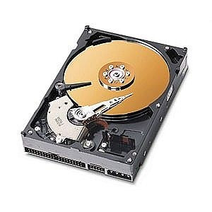
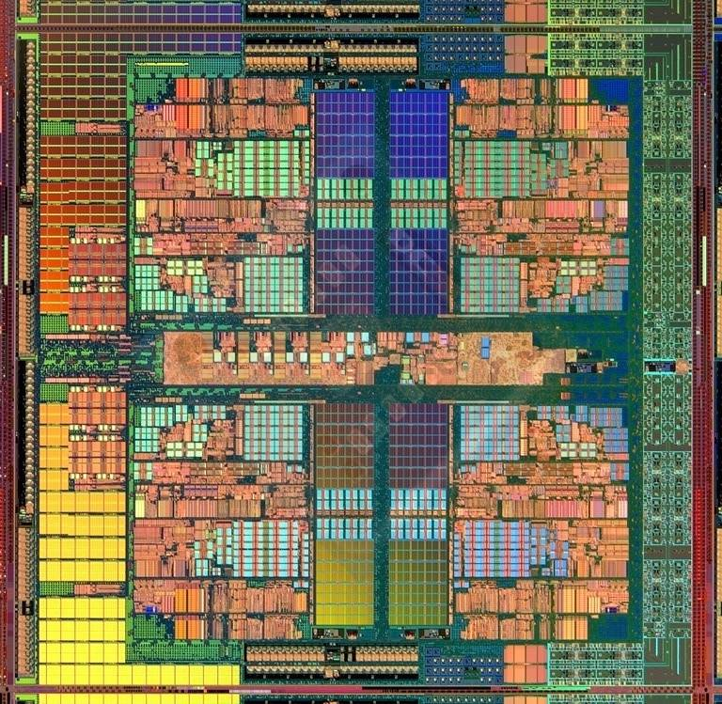
The Main Memory System
Main memory is a critical component of all computing systems: server, mobile, embedded, desktop, sensor
Main memory system must scale (in size, technology, efficiency, cost, and management algorithms) to maintain performance growth and technology scaling benefits
Processor
and caches
Main Memory
Storage (SSD/HDD)

Slide 3
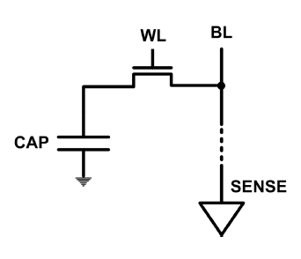
The DRAM Scaling Problem
DRAM stores charge in a capacitor (charge-based memory)
Capacitor must be large enough for reliable sensing
Access transistor should be large enough for low leakage and high retention time
Scaling beyond 40-35nm (2013) is challenging [ITRS, 2009]
As DRAM cell becomes smaller, it becomes more vulnerable

Slide 4
Today
What is Rowhammer
Various defenses
Probabalistic
Detect and React
Protect everything!

Slide 5
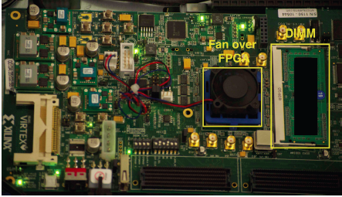
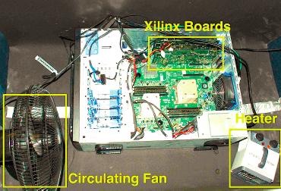
Testing DRAM Scaling Issues …
An Experimental Study of Data Retention Behavior in Modern DRAM Devices: Implications for Retention Time Profiling Mechanisms (Liu et al., ISCA 2013)
The Efficacy of Error Mitigation Techniques for DRAM Retention Failures: A Comparative Experimental Study
(Khan et al., SIGMETRICS 2014)
Flipping Bits in Memory Without Accessing Them: An Experimental Study of DRAM Disturbance Errors (Kim et al., ISCA 2014)
Adaptive-Latency DRAM: Optimizing DRAM Timing for the Common-Case (Lee et al., HPCA 2015)
AVATAR: A Variable-Retention-Time (VRT) Aware Refresh for DRAM Systems (Qureshi et al., DSN 2015)

Slide 6
Modern DRAM is Prone to Disturbance Errors
Row of Cells
Wordline
Row
Victim Row
Row
Hammered Row
V_{LOW}
Opened
V_{HIGH}
Closed
Row
Victim Row
Row
Repeatedly opening and closing a row enough times within a refresh interval induces disturbance errors in adjacent rows in most real DRAM chips you can buy today
Flipping Bits in Memory Without Accessing Them: An Experimental Study of DRAM Disturbance Errors, (Kim et al., ISCA 2014)

Slide 7
Threat overview
DRAM Bank
Process 1
Process n
…
Linux
OS State
Processor
Corrupt
…
Notes:
Finally we present a robust a software-based rowhammering attack mitigation technique, ANVIL. Anvil detects rowhammering attacks by monitoring cache misses out of the LLC using existing performance counter features. Up

Slide 8
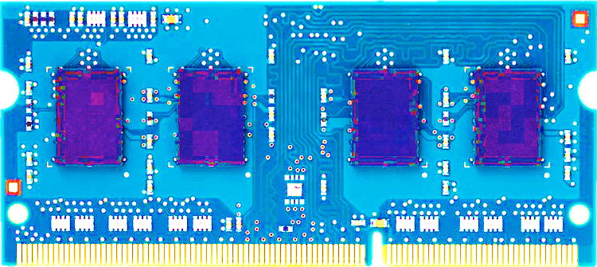
Most DRAM Modules Are Vulnerable
A company
B company
C company
86%
(37/43)
83%
(45/54)
88%
(28/32)
Up to
1.0×10⁷ errors
Up to
2.7×10⁶ errors
Up to
3.3×10⁵ errors
Flipping Bits in Memory Without Accessing Them: An Experimental Study of DRAM Disturbance Errors, (Kim et al., ISCA 2014)

Slide 9
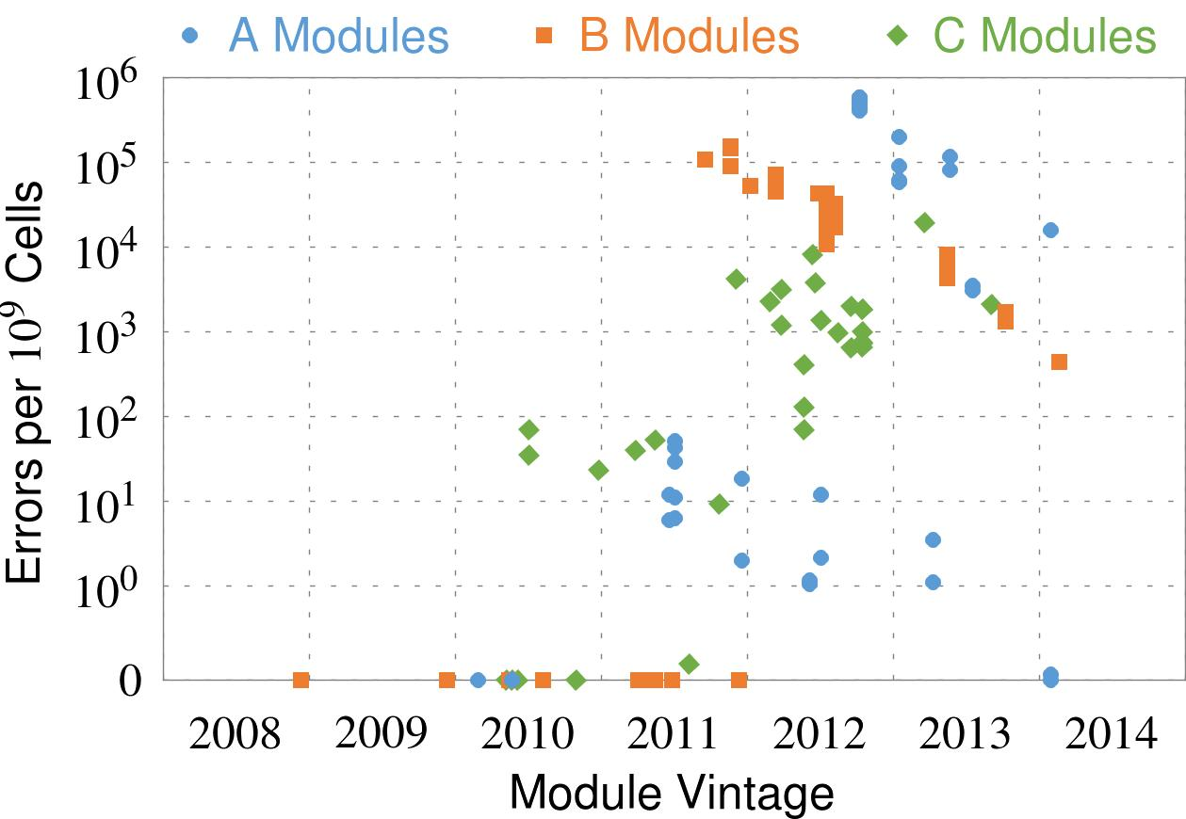
Recent DRAM Is More Vulnerable
First
Appearance
All modules from 2012–2013 are vulnerable
Notes:
In this figure, the x-axis is the module manufacture date. And the y-axis is the number of errors in a module, normalized to one billion cells. In 2008 and 2009, there are no errors. But, in 2010, we first start to see errors in C modules. After 2010, the errors start to proliferate. For A and B modules, we first start to see errors in 2011. In particular, all modules from 2012 and 2013 are vulnerable.

Slide 10
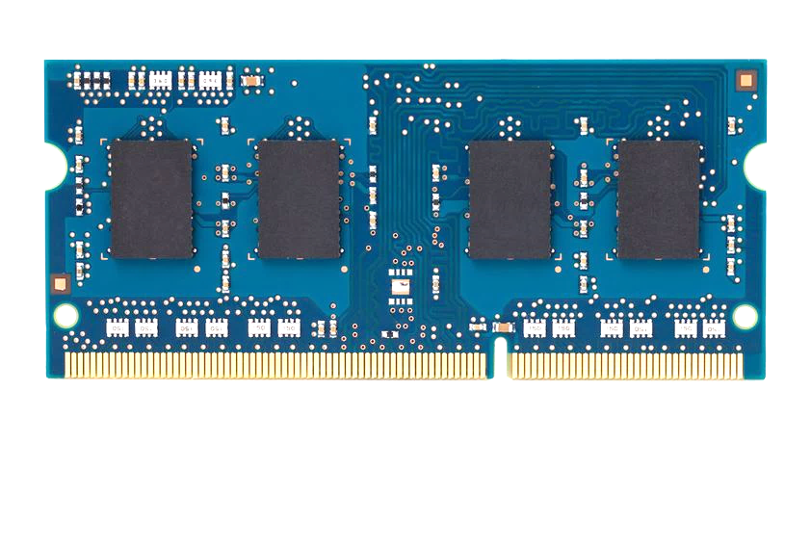
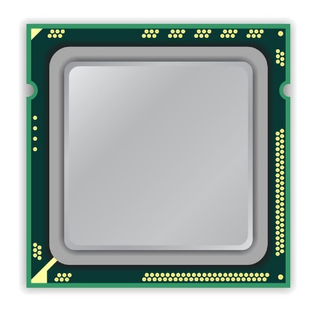
A Simple Program Can Induce Many Errors
CPU
DRAM Module
loop:
mov (X), %eax
mov (Y), %ebx
clflush (X)
clflush (Y)
mfence
jmp loop
X
Y
Download from: https://github.com/CMU-SAFARI/rowhammer
Notes:
We demonstrate the errors on multiple x86 systems. Shown to the bottom-left is a “disturbance kernel”. When executed, it forces two rows to be opened and closed one after the other – over and over again. Consequently, it induces many errors in the module.

Slide 11
A Simple Program Can Induce Many Errors
CPU
DRAM Module
Avoid cache hits
Flush X from cache
Avoid row hits to X
Read Y in another row
X
Y
Download from: https://github.com/CMU-SAFARI/rowhammer
Notes:
We demonstrate the errors on multiple x86 systems. Shown to the bottom-left is a “disturbance kernel”. When executed, it forces two rows to be opened and closed one after the other – over and over again. Consequently, it induces many errors in the module.

Slide 12
A Simple Program Can Induce Many Errors
CPU
DRAM Module
loop:
mov (X), %eax
mov (Y), %ebx
clflush (X)
clflush (Y)
mfence
jmp loop
X
Y
Download from: https://github.com/CMU-SAFARI/rowhammer
Notes:
We demonstrate the errors on multiple x86 systems. Shown to the bottom-left is a “disturbance kernel”. When executed, it forces two rows to be opened and closed one after the other – over and over again. Consequently, it induces many errors in the module.

Slide 13
A Simple Program Can Induce Many Errors
CPU
DRAM Module
loop:
mov (X), %eax
mov (Y), %ebx
clflush (X)
clflush (Y)
mfence
jmp loop
X
Y
Download from: https://github.com/CMU-SAFARI/rowhammer
Notes:
We demonstrate the errors on multiple x86 systems. Shown to the bottom-left is a “disturbance kernel”. When executed, it forces two rows to be opened and closed one after the other – over and over again. Consequently, it induces many errors in the module.

Slide 14
A Simple Program Can Induce Many Errors
CPU
DRAM Module
loop:
mov (X), %eax
mov (Y), %ebx
clflush (X)
clflush (Y)
mfence
jmp loop
X
Y
Download from: https://github.com/CMU-SAFARI/rowhammer
Notes:
We demonstrate the errors on multiple x86 systems. Shown to the bottom-left is a “disturbance kernel”. When executed, it forces two rows to be opened and closed one after the other – over and over again. Consequently, it induces many errors in the module.

Slide 15
Observed Errors in Real Systems
A real reliability & security issue
In a more controlled environment, we can induce as many as ten million disturbance errors
CPU Architecture | Errors | Access-Rate
Intel Haswell (2013) | 22.9K | 12.3M/sec
Intel Ivy Bridge (2012) | 20.7K | 11.7M/sec
Intel Sandy Bridge (2011) | 16.1K | 11.6M/sec
AMD Piledriver (2012) | 59 | 6.1M/sec
Kim+, “Flipping Bits in Memory Without Accessing Them: An Experimental Study of DRAM Disturbance Errors,” ISCA 2014.
Notes:
When we executed the code on four different processors, all four of them yielded errors. Intel Haswell has the most errors, at 23 thousand, because it has the highest rate of accessing DRAM.
Later on, I’ll show that we can induce as many as ten million disturbance errors in a more controlled environment.
From this, we conclude that disturbance errors are a serious reliability issue.

Slide 16
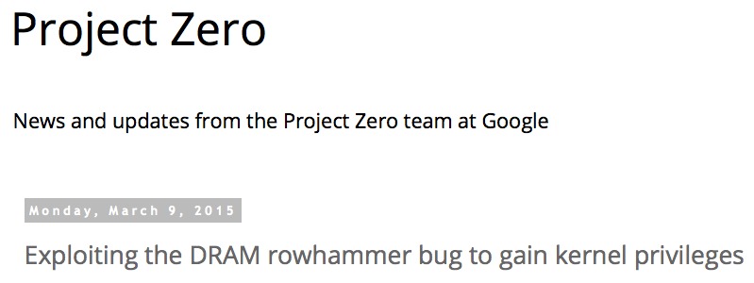
One Can Take Over an Otherwise-Secure System
Flipping Bits in Memory Without Accessing Them: An Experimental Study of DRAM Disturbance Errors (Kim et al., ISCA 2014)
Exploiting the DRAM rowhammer bug to gain kernel privileges (Seaborn, 2015)

Slide 17
RowHammer Security Attack Example
“Rowhammer” is a problem with some recent DRAM devices in which repeatedly accessing a row of memory can cause bit flips in adjacent rows (Kim et al., ISCA 2014).
Flipping Bits in Memory Without Accessing Them: An Experimental Study of DRAM Disturbance Errors (Kim et al., ISCA 2014)
We tested a selection of laptops and found that a subset of them exhibited the problem.
We built two working privilege escalation exploits that use this effect.
Exploiting the DRAM rowhammer bug to gain kernel privileges (Seaborn, 2015)
One exploit uses rowhammer-induced bit flips to gain kernel privileges on x86-64 Linux when run as an unprivileged userland process.
When run on a machine vulnerable to the rowhammer problem, the process was able to induce bit flips in page table entries (PTEs).
It was able to use this to gain write access to its own page table, and hence gain read-write access to all of physical memory.
Exploiting the DRAM rowhammer bug to gain kernel privileges (Seaborn, 2015)

Slide 18
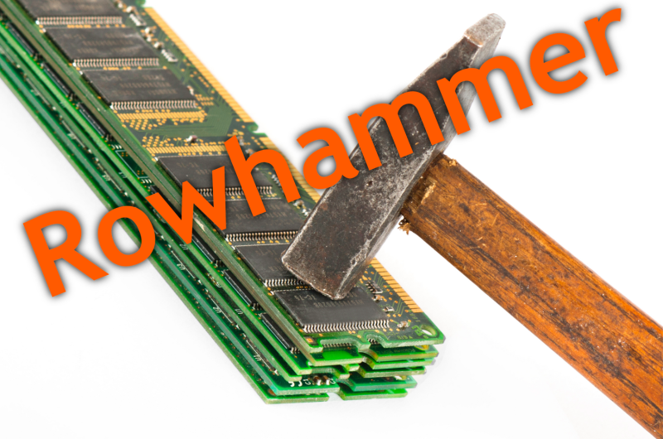
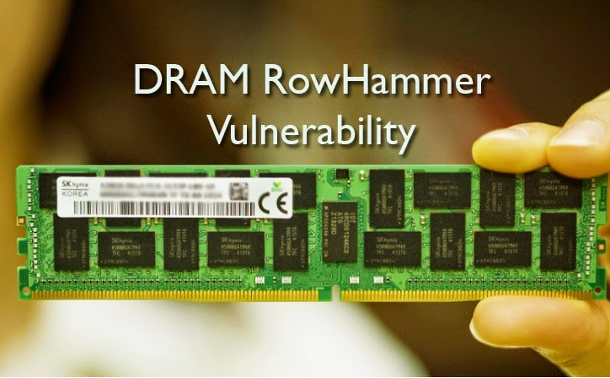
Security Implications
Notes:
Picture from the article:
http://thehackernews.com/2015/03/dram-rowhammer-vulnerability.html

Slide 19
Root Causes of Disturbance Errors
Cause 1: Electromagnetic coupling
Toggling the wordline voltage briefly increases the voltage of adjacent wordlines
Slightly opens adjacent rows → Charge leakage
Cause 2: Conductive bridges
Cause 3: Hot-carrier injection
Confirmed by at least one manufacturer
Notes:
Why do the errors occur? We see three possible causes.
First, there could electromagnetic coupling between adjacent wordlines. When the voltage of one is toggled, it could briefly increase the voltage of the other and facilitate the leakage of charge.
Two other possibilities are conductive bridges and hot-carrier injection.
At least one manufacturer confirmed that these three could play a role in the disturbance errors we see them today.

Slide 20
Experimental DRAM Testing Infrastructure
Temperature
Controller
FPGAs
Heater
FPGAs
PC
Kim+, “Flipping Bits in Memory Without Accessing Them: An Experimental Study of DRAM Disturbance Errors,” ISCA 2014.

Slide 21
RowHammer Characterization Results
Most Modules Are at Risk
Errors vs. Vintage
Error = Charge Loss
Adjacency: Aggressor & Victim
Sensitivity Studies
Other Results in Paper
Solution Space
Flipping Bits in Memory Without Accessing Them: An Experimental Study of DRAM Disturbance Errors, (Kim et al., ISCA 2014)
Notes:
Now I will present the characterization results, one-by-one.
First, I show that most modules are at risk. Second, I show the number of errors in a module as a function of the manufacture date. Third, I show that the errors are symptomatic of charge loss. Fourth, I show that an aggressor induces errors in adjacent rows. Fifth, I show several sensitivity studies. And, finally, I briefly describe other results in the paper.

Slide 22
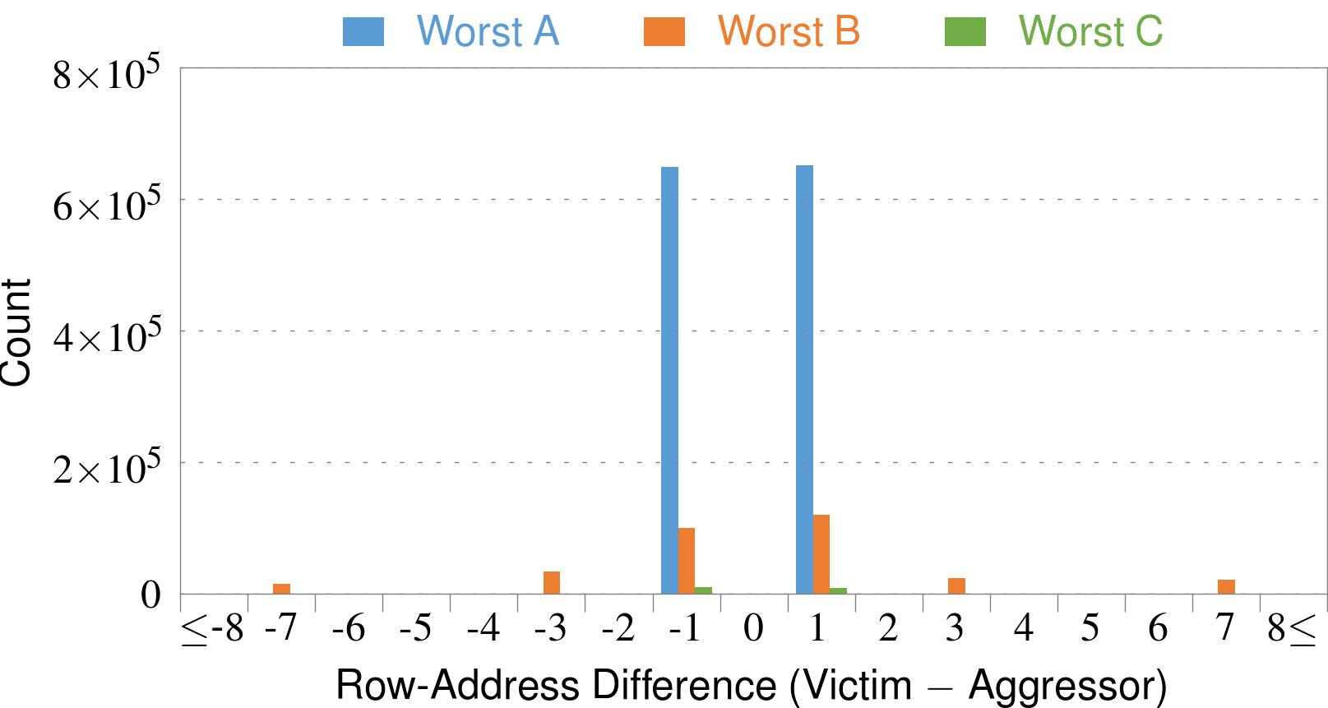
4. Adjacency: Aggressor & Victim
Adjacent
Adjacent
Adjacent
Non-Adjacent
Non-Adjacent
Note: For three modules with the most errors (only first bank)
Most aggressors & victims are adjacent
Notes:
In this figure, the x-axis is the row-address difference between an aggressor and its victims. And the y-axis is the number of victim-aggressor pairs that correspond to the row-address difference. For all three modules, we see strong peaks at plus/minus 1. This implies that aggressors and victims have consecutive row-addresses, in other words, they are adjacent.
However, the figure also shows some victims that are not adjacent to the aggressor. We believe this could be caused by two reasons. First, depending on the mapping, two rows that are physically adjacent within the DRAM chip may not have consecutive row-addresses. Second, fault rows are often re-mapped to spare rows that may reside on a different portion of the DRAM chip.
Nevertheless, we conclude that the vast majority of aggressors & victims are adjacent.

Slide 23
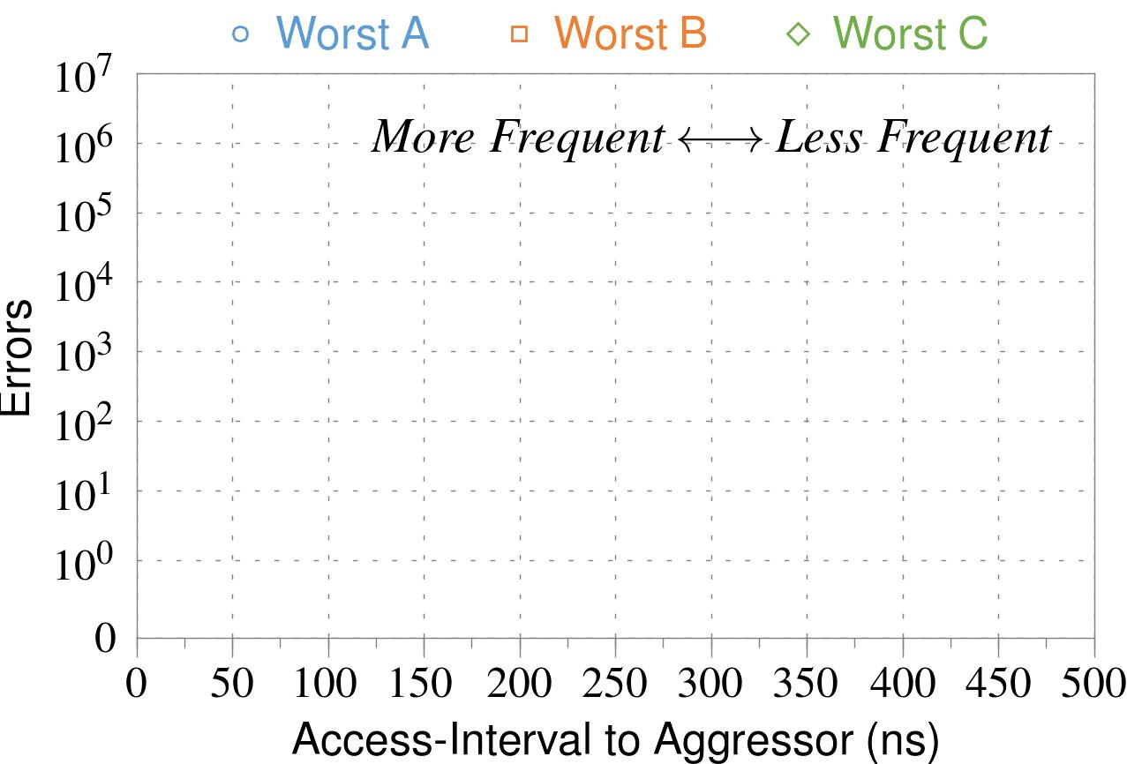
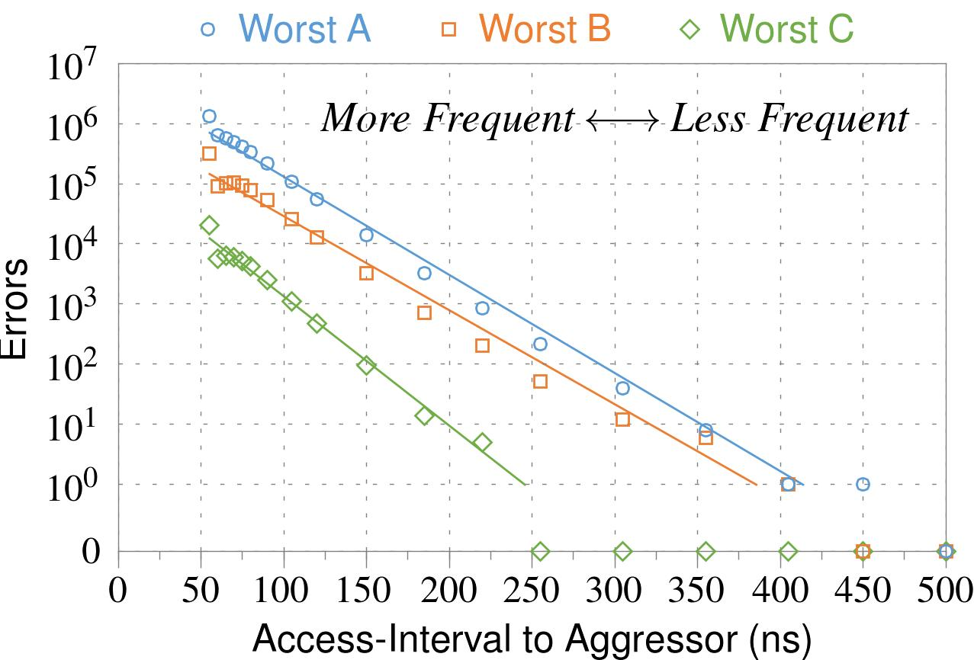
❶ Access Interval (Aggressor)
Not Allowed
500ns
55ns
Note: For three modules with the most errors (only first bank)
Less frequent accesses → Fewer errors
Notes:
In this figure, the x-axis is the interval at which we access the aggressor. And the y-axis is the number of errors. To comply with the DRAM standard, we employ a default value of 55ns in our experiments. However, as we increase the access-interval, we see that the number of errors decreases. In particular, at 500ns, there are no errors for all three modules.
From this, we conclude that less frequent accesses induce fewer errors.

Slide 24
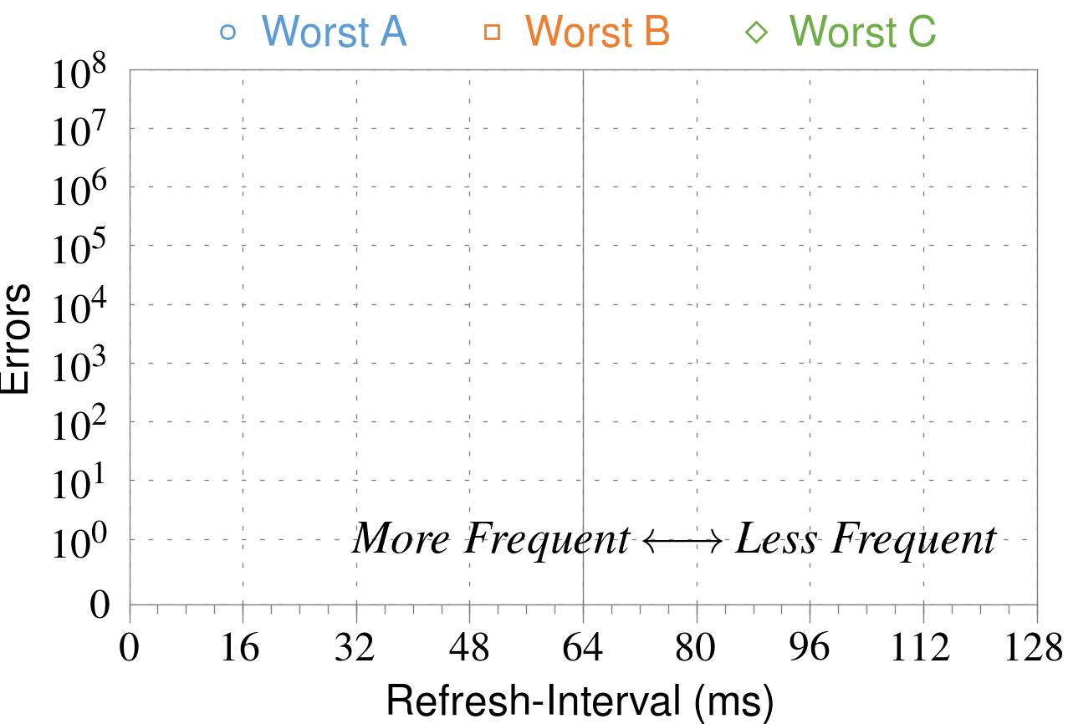
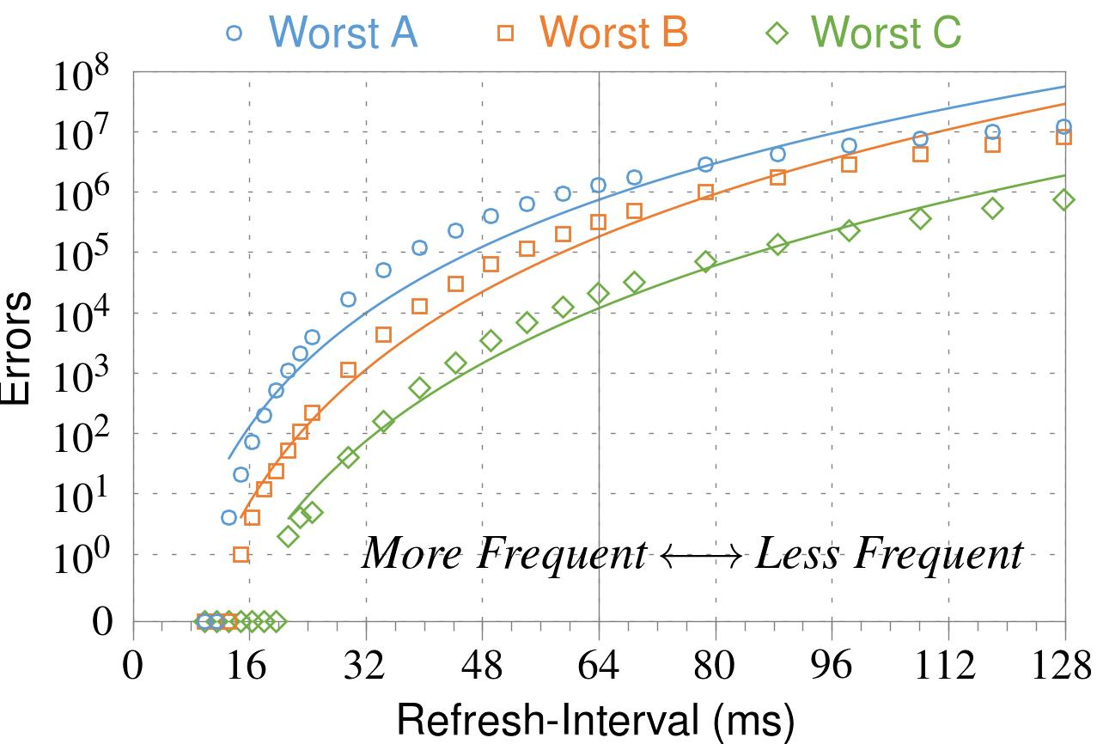
❷ Refresh Interval
~7x frequent
64ms
Note: Using three modules with the most errors (only first bank)
More frequent refreshes → Fewer errors
Notes:
In this figure, the x-axis is the refresh-interval. And the y-axis is the number of errors. To comply with the DRAM standard, we employ a default value of 64ms in our experiments. However, as we decrease the refresh-interval, we see that the number of errors decreases. In particular, when the refresh is shortened by 7x, there are no errors for all three modules.
From this, we conclude that more frequent accesses induce fewer errors.

Slide 25
❸ Data Pattern
Solid
RowStripe
111111
111111
111111
000000
111111
111111
10x Errors
111111
000000
~Solid
~RowStripe
000000
000000
000000
111111
000000
000000
000000
111111
Errors affected by data stored in other cells
Notes:
We tested the modules with four different data-patterns: Solid, inverse Solid, RowStripe, and inverse RowStripe. Solid and inverse Solid give us full coverage since each cell is tested with both 1s and 0s. And the same applies to RowStripe and its inverse.
However, we found that the rowstripe pattern had 10 times as more errors than the solid pattern. We also tested many other data-patterns, including random, but found RowStripe to induce the most errors.
Therefore, we conclude that errors are affected by data stored in other cells due to differences in coupling effects between the cells.

Slide 26
6. Other Results (in Paper)
Victim Cells ≠ Weak Cells (i.e., leaky cells)
Almost no overlap between them
Errors not strongly affected by temperature
Default temperature: 50°C
At 30°C and 70°C, number of errors changes <15%
Errors are repeatable
Across ten iterations of testing, >70% of victim cells had errors in every iteration
Notes:
First, we show that victim cells are not weak cells, which are cells that are inherently leaky. According to our experiments, we saw almost no overlap between them.
Second, we show that errors are not strongly affected by temperature. In all of the tests so far, we set the temperature to 50 degrees Celsius. But even when we changed the temperature by 20 degrees, the number of errors changed by less than 15 percent.
Third, we show that errors are repeatable. Across ten iterations of testing, more than 70% of victim cells had errors in every iteration.

Slide 27
6. Other Results (in Paper) cont’d
As many as 4 errors per cache-line
Simple ECC (e.g., SECDED) cannot prevent all errors
Number of cells & rows affected by aggressor
Victims cells per aggressor: ≤110
Victims rows per aggressor: ≤9
Cells affected by two aggressors on either side
Very small fraction of victim cells (<100) have an error when either one of the aggressors is toggled
Notes:
Fourth, we show that there are as many as four errors per cacheline. From this, we conclude that simple ECC schemes (for example, SECDED) cannot prevent all errors.
Fifth, we show that the number of cells & rows affected by an aggressor can be as high as 110 or 9, respectively.
Lastly, we show that a very small fraction of victim cells experience an error when either one of the aggressors is toggled.

Slide 28
Some Potential Solutions
Cost
Make better DRAM chips
Power, Performance
Refresh frequently
Cost, Power
Sophisticated ECC
Cost, Power, Complexity
Access counters
Notes:
Here is a list of four potential solutions to disturbance errors: making better DRAM chips, refreshing more frequently, employing sophisticated ECC schemes, and using hardware counters to track the number of accesses to different rows.
However, all of these solutions incur a large overhead in terms cost, power, performance, and/or complexity.

Slide 29
How Do We Solve The Problem?
Fix it: Make DRAM and controllers more intelligent
New interfaces, functions, architectures: system-DRAM codesign
Eliminate or minimize it: Replace or (more likely) augment DRAM with a different technology
New technologies and system-wide rethinking of memory & storage
Embrace it: Design heterogeneous memories (none of which are perfect) and map data intelligently across them
New models for data management and maybe usage
…
Problems
Algorithms
Programs
User
Runtime System
(VM, OS, MM)
ISA
Microarchitecture
Logic
Devices
Solutions (to memory scaling) require
software/hardware/device cooperation

Slide 30
Naive Solutions
❶ Throttle accesses to same row
Limit access-interval: ≥500ns
Limit number of accesses: ≤128K (=64ms/500ns)
❷ Refresh more frequently
Shorten refresh-interval by ~7x
Both naive solutions introduce significant overhead in performance and power
Notes:
Based on what we learned from the sensitivity studies, there are two naive solutions that immediately present themselves.
First, we can throttle accesses to the same row. If the access-interval is greater than 500ns, I showed how errors are not induced. We can achieve the same effect by limiting the maximum number of accesses to the same row to be less than 128K, within a refresh interval.
Second, we can refresh the module more frequently. If the refresh-interval is shortened by 7x, I showed how errors can be prevented.
However, both naive solutions introduce significant overhead in both performance and power. Later on, I will propose a much more efficient solution.

Slide 31
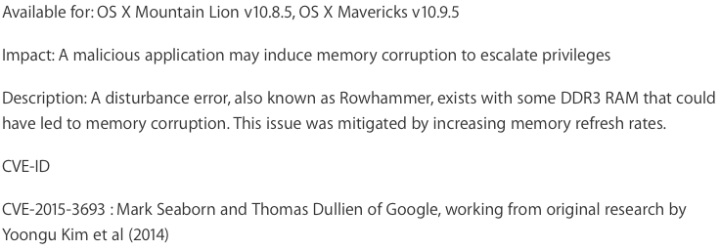
Apple’s Patch for RowHammer
https://support.apple.com/en-gb/HT204934
HP and Lenovo released similar patches

Slide 32
One Solution: PARA: Probabilistic Adjacent Row Activation
Key Idea
After closing a row, we activate (i.e., refresh) one of its neighbors with a low probability: p = 0.005
Reliability Guarantee
When p=0.005, errors in one year: 9.4×10⁻¹⁴
By adjusting the value of p, we can vary the strength of protection against errors
Notes:
We provide a more efficient solution, called PARA, which stands for probabilistic adjacent row activation.
The key idea is thus: after closing a row, we activate (i.e., refresh) one of its neighbors with a low probability, for example, p equal to 0.005.
PARA provides a strong reliability guarantee even under the worst-case access patterns to DRAM. When we set p to 0.005, the expected number of errors in one year is 9.4 times 10 to the negative 14. This probability is much lower the failure rate of other hardware components, for example, the hard-disk drive.
And by adjusting the value of p, PARA can provide an arbitrarily strong-degree of protection against errors.

Slide 33
Advantages of PARA
PARA refreshes rows infrequently
Low power
Low performance-overhead
Average slowdown: 0.20% (for 29 benchmarks)
Maximum slowdown: 0.75%
PARA is stateless
Low cost
Low complexity
PARA is an effective and low-overhead solution to prevent disturbance errors
Notes:
PARA has many advantages. Since it refreshes row infrequently, it has low power and low performance-overhead. Simulated across 29 benchmarks, we saw an average of only 0.2% slowdown and a maximum of only 0.75% slowdown.
In addition, due to its stateless nature, PARA has low cost and complexity.
Therefore, PARA is an effective and low-overhead solution to prevent disturbance errors.

Slide 35
ANVIL: Software-Based Protection Against Next-Generation Rowhammer Attacks
Zelalem Aweke†, Salessawi Yitbarek†, Rui Qiao‡, Reetuparna Das†, Matthew Hicks†, Yossi Oren∗, and Todd Austin†
† University of Michigan ‡ Stony Brook University ∗ Ben-Gurion University of the Negev
ASPLOS 2016, Atlanta, GA, April 6, 2016

Slide 36
ANVIL setup
DRAM Bank
Process 1
Process n
…
Linux
ANVIL
Processor
H/W Performance Counters
…
Notes:
Finally we present a robust a software-based rowhammering attack mitigation technique, ANVIL. Anvil detects rowhammering attacks by monitoring cache misses out of the LLC using existing performance counter features. Up

Slide 37
Intuition
An attacking process using Rowhammer will lead to predictable patterns
Need cache misses to ensure DRAM is accessed
Many accesses to the the same or nearby DRAM rows

Slide 38
Our Solution: ANVIL
DRAM Bank
Process 1
Process n
…
Linux
ANVIL
Processor
H/W Performance Counters
…
Notes:
Finally we show a robust ANVIL a software-based rowhammering attack mitigation technique. Anvil detects rowhammering attacks by monitoring cache misses out of the LLC using existing performance counter features. Up

Slide 39
Alternative Rowhammer Mitigations
Double refresh rate
Lessens time to produce bit flips
e.g. HP, Lenovo
Shown to be ineffective
Disallow CLFLUSH instruction
No quick access to DRAM due to caches
e.g. Google Chrome
Is this technique effective?
Notes:
One proposal to mitigate rowhammering techniques is doubling the DRAM refresh rate (or reducing the refresh period from 64ms to 32ms). This reduces the time available for Rowhammering, but as Kim et. al‘s study showed and as we confirm in this work, bit flips can be induced in a time much less than 32ms.
Another approach is disallowing the CLFLUSH instruction which is used by all rowhammering attacks to accelerate the Rowhammering process. For example, Google’s Native Client, which is part of Google Chrome, does this. But does this technique really STOP rowhammering attacks? The answer is no.

Slide 40
CLFLUSH-free Rowhammer Attack
Rowhammering creates locality that caches filter
Use conflicting misses out of the last-level cache (LLC) to access DRAM
Create eviction set
Create access pattern that misses on target address
DRAM Bank
L3 Cache
…
Row 0
Aggressor Row1
CPU
L1 Cache
L2 Cache
Row 1
Victim Row
Row 2
Aggressor Row2
…
Row-buffer
Notes:
The challenge here is the high locality of aggressor row accesses which is filtered by caches. Modern high end processors typically include three levels of cache. We need a way of bypassing the caches without explicitly flushing them. One way of doing this is using conflicting misses out of the last-level cache. We do this by first creating an eviction set that contains addresses that belong to the same cache set. Then we create a memory access pattern that allows us to miss the LLC at our desired addresses.

Slide 41
CLFLUSH-free Rowhammer Attack
Eviction Set
DRAM Bank
A0
…
X1
Row 0
Aggressor Row1
Inclusive LLC
X2
…
Row 1
Victim Row
…
Row 2
Set X
…
Aggressor Row2
Xn
…
Row-buffer
Eviction set size depends on number of ways in cache set
Notes:
Let us take for example a case where we have an Inclusive LLC (meaning the LLC contains copies of upper levels of caches, such that evicting data from the LLC also evicts the corresponding data in L1 and L2 caches). Also let us assume a double-sided Rowhammering attack, where Row0 and Row 2 are aggressor rows and Row 1 is a victim row. Our goal here is to repeatedly access Row 0 and Row2 without using the CLFLUSH instruction. Here I will only show an example for Row 0, but same principle works for Row2 as well.
So the first step is creating an eviction set (CLICK) by first picking an address that maps to an Row 0. (CLICK) Let’s say this address maps to setx in the LLC. (CLICK) Then we add more addresses into the eviction set by picking addresses that map to setx in the LLC. The number of addresses depends on the number of ways? In the LLC. (CLICK)Then after creating the eviction set we can accesses data at each addresses one by one to evict data at the aggressor address in the LLC and access the aggressor row.

Slide 42
CLFLUSH-free Rowhammer Attack
Eviction Set
DRAM Bank
A0
…
X1
Row 0
Aggressor Row1
Inclusive LLC
X2
…
Row 1
Victim Row
…
Row 2
Set X
…
Aggressor Row2
Xn
…
Row-buffer
Eviction set size depends on number of ways in cache set

Slide 43
CLFLUSH-free Rowhammer Attack
Eviction Set
DRAM Bank
A0
…
X1
Row 0
Aggressor Row1
Inclusive LLC
X2
…
Row 1
Victim Row
…
Row 2
Set X
…
Aggressor Row2
Xn
…
Row-buffer
Eviction set size depends on number of ways in cache set

Slide 44
CLFLUSH-free Rowhammer Attack
Eviction Set
DRAM Bank
A0
…
X1
Row 0
Aggressor Row1
Inclusive LLC
X2
…
Row 1
Victim Row
…
Row 2
Set X
…
Aggressor Row2
Xn
…
Row-buffer
Eviction set size depends on number of ways in cache set

Slide 45
CLFLUSH-free Rowhammer Attack
Eviction Set
DRAM Bank
A0
…
X1
Row 0
Aggressor Row1
Inclusive LLC
X2
…
Row 1
Victim Row
…
Row 2
Set X
…
Aggressor Row2
A0
Xn
…
Row-buffer
Eviction set size depends on number of ways in cache set

Slide 46
CLFLUSH-free Rowhammer Attack
Eviction Set
DRAM Bank
A0
…
X1
Row 0
Aggressor Row1
Inclusive LLC
X2
…
Row 1
Victim Row
…
Row 2
Set X
…
Aggressor Row2
A0
Xn
…
Row-buffer
Eviction set size depends on number of ways in cache set

Slide 47
CLFLUSH-free Rowhammer Attack
Eviction Set
DRAM Bank
A0
…
X1
Row 0
Aggressor Row1
Inclusive LLC
X2
…
Row 1
Victim Row
…
Row 2
Set X
…
Aggressor Row2
A0
Xn
…
Row-buffer
Eviction set size depends on number of ways in cache set

Slide 48
CLFLUSH-free Rowhammer Attack
Eviction Set
DRAM Bank
A0
…
X1
Row 0
Aggressor Row1
Inclusive LLC
X2
…
Row 1
Victim Row
…
Row 2
Set X
…
Aggressor Row2
Xn
…
Row-buffer
Eviction set size depends on number of ways in cache set

Slide 49
CLFLUSH-free Rowhammer Attack: Implementation
Test hardware – Intel Sandy Bridge
12-way inclusive LLC
13 addresses in the eviction set
(A0 and X1 – X12)
Efficient access pattern – a function of replacement policy
Sandy Bridge uses Bit-PLRU policy
Miss
Hit
Miss
Hit
A0→X1…→X9→X10→X11→X1…→X9→X12
Measured A0 to A0 latency :≈340 ns at 2.6GHz
49
Notes:
We implemented the CLFLUSH-free rowhammering attack on an Intel processor with Sandy Bridge microarchitecture. The processor has a 12-way inclusive last level cache, therefore the eviction set contains 12 addresses in addition to the target aggressor address (A0).
The next question is, what access pattern should we use so that we can achieve thousands of aggressor row accesses within a refresh period. An efficient access pattern exhibits the minimum number of unnecessary LLC misses. To achieve an efficient access pattern, it is important to know the LLC replacement policy. However, the cache replacement policy for Sandy Bridge is not publicly disclosed, so we did an offline analysis using CPU performance counters to identify the policy. Through our analysis, we found that Sandy Bridge uses a variant of LRU policy called Bit-PLRU.
Under Bit-PLRU, this pattern provides an efficient access to the aggressor row, only missing at the aggressor address and one additional address. On our test machine this access pattern gave an average of 340 ns per aggressor row address.

Slide 50
Experimental Evaluations
Test platform
Intel Sandy Bridge, Core i5-2540M processor
Ubuntu 14.04 LTS
Hammer Technique | Minimum No. of Row Accesses to bit flip | Time to First Bit Flip
Single-sided with CLFLUSH | 400k | 58ms
Double-sided with CLFLUSH | 220K | 15ms
Double-sided without CLFLUSH | 220K | 45ms
Double-sided with CLFLUSH can produce bit flips with in 4x refresh rate
Notes:
We evaluated three types of Rowhammering techniques based the number of row accesses required to induce bit flips and the time before the first bit flip. We used an Intel Core i5-2540M processor running Ubuntu 14.04 for our evaluation. As you can see from the results, double-sided Rowhammering requires much less number of accesses as compared to single-sided Rowhammering, that is why our CLFLUSH-free Rowhammering performs better than the CLFLUSH-based single sided Rowhammering. Another thing to note here is that the CLFLUSH-based double-sided Rowhammering only required 15ms for the first bit flip, which means even if the refresh rate is increased by 4X there is still a possibility of inducing bit flips.

Slide 51
Detecting Rowhammering Attacks
Thousands of aggressor row accesses within a refresh period
High LLC miss rate
High memory access locality
Need to flush row-buffer
High bank locality
Notes:
If we look at a Rowhammering attack characteristics, we can see that it has some peculiar behavior. It requires thousands of the same aggressor row accesses within a refresh period, therefore we expect a high LLC miss rate and a high memory access locality. This contradicts with regular memory access characteristics where high memory access locality should result in low LLC miss rate. Also, due to the need to flush the row buffer, Rowhammering exhibits a high bank locality among DRAM accesses. Therefore, we can use these characteristics to detect Rowhammering attacks. All we need is an efficient way of detecting these behaviors, and as it turned out performance counters on modern CPUs can provide us with this capability.

Slide 52
Software-based Rowhammering Attack Detection
Process 1
Process n
ANVIL resides in the Kernel to allow:
Unfettered access to performance counters
Access to all DRAM
Performance counters available on Intel Sandy Bridge and later microarchitectures
Similar capabilities on AMD processors
Linux
ANVIL
Software
Linear Address
L3 Miss Count
Selective Refresh
Processor
H/W Performance Counters
DRAM
Hardware
Notes:
So based on this idea, we propose ANVIL, a software based rowhammering detection and protection mechanism. ANVIL gets LLC miss rate and memory access locality information from hardware performance counters in the processor. It processes this information to determine if there is a rowhammering activity. Once it detects a potential rowhammering activity, it protects potential victim rows by selectively refreshing them. The refreshing is done by simply reading a word from the potential victim rows.
The performance counter features we use are available on Intel Sandy Bridge and later microarchtectures. AMD processors also include similar features, therefore ANVIL can be implemented on such processors.
ANVIL is a Kernel extension, therefore it has unlimited access to performance counters and information about currently running processes.

Slide 53
ANVIL’s Detection Process
Monitor LLC Miss Rate
Phase 1: Monitor LLC Miss Rate
Is miss rate high enough ?
Solution: Monitor LLC miss count
High Miss Rate?
No
Yes
Sample LLC Miss Addresses
Phase 2: Sample LLC Miss Addresses
Do misses have high row and bank locality?
Solution: Sample misses out of LLC
Determine DRAM Rows of Samples
High Row Locality?
No
Phase 3: Remedy
How to protect potential victim rows?
Solution: Selectively refresh rows
Yes
Determine Potential Victim DRAM Rows
Selectively Refresh Potential Victim DRAM Rows
Notes:
This flow chart shows ANVIL’s detection process in some detail. The detection process has two phases. [In the first phase, ANVIL analyses the LLC miss rate looking for a rate high enough that could potentially rowhammer the DRAM. In the second phase samples of memory accesses that missed the LLC are analyzed to see if there is a high locality.] Normally ANVIL stays in the first phase using the LLC miss count to determine the miss rate over a fixed amount of time. If the rate is low, ANVIL stays in the first phase reinitiating the process over and over again. Once the rate crosses a threshold high enough to potentially be a rowhammer, phase two samples DRAM row accesses looking for high row locality. If there is a high row locality, then ANVIL considers it as rowhammering and initiates a selective refresh on the potential victim rows. Once the locality is gone, we shift back to phase one looking for high miss rate again.

Slide 54
Experimental Evaluation
Test platform
Intel Sandy Bridge, Core i5-2540M processor
Ubuntu 14.04 LTS with Linux 4.0.0
Benchmarks
Rowhammering programs
CLFLUSH_hammer and CLFLUSH-free_hammer
SPEC2006 integer benchmarks
Notes:
We implemented ANVIL as a kernel module and tested it on Sandy Bridge based processor running Ubuntu 14.04 with Linux 4.0. We tested for rowhammer detection accuracy and overhead incurred by the detection process. To test for detection accuracy we used two rowhammering programs, one with CLFLUSH instruction and another with out. We used SPEC integer benchmarks to measure ANVIL’s overhead.

Slide 55
Rowhammer Detection
ANVIL-baseline parameters
Detection for lightly and heavily loaded conditions
LLC_MISS_THRESHOLD | 20K
Miss Count Duration (tc) | 6ms
Sampling Duration (ts) | 6ms
rowhammer + mcf + libquantum + omnetpp
Benchmark | Max. Time to Detect | Min. Time to Flip | Refreshes per 64ms | Total Bit Flips
CLFLUSH (Heavily loaded) | 13.2 ms | 15ms | 12.35 | 0
CLFLUSH (Lightly loaded) | 12.8 ms | 15ms | 10.3 | 0
CLFLUSH-free (Heavily loaded) | 38.09 ms | 45ms | 4.53 | 0
CLFLUSH (Lightly loaded) | 23.53 ms | 45ms | 5.10 | 0
<
<
<
<
Notes:
For our tests we set some parameter of ANVIL as shown in the table. The first parameter is the LLC miss threshold that would trigger the second phase of detection. The next two parameters determine the durations for the two phases. These values are set based on our empirical analysis of rowhammering programs [ i.e. the minimum number of memory accesses and the amount of time required to flip bits]
We tested the detection process for two settings. The first is when the rowhammring program is the only running program and the second is when some other programs from SPEC benchmarks run along with the rowhammering program. The second column in the second table shows the average time required to detect rowhammering, including the time required to perform selective refresh. As you can see from the results, ANVIL can detect rowhammering well a head of the time required to flip bits, therefore eliminating all potential bit flips. Another thing to note here is that the selective refresh rate is so small that, even if there are false positives, the protection maechanism can not accidentally rowhammer the potential victim rows.

Slide 56
Performance Impact on Non-malicious Programs
Average overhead of 1.17%
Can detect rowhammering that is 2x faster than can be prevented by double refresh rate
Paper details detection of more aggressive future attacks
Notes:
We also measured the performance overhead of ANVIL and compared it with the overhead of doubling the DRAM refresh rate. We used the same settings for ANVIL as the previous slide. As you can see from the graph, ANVIL has an average overhead of approximately 1% which is almost the same as that of doubling the refresh rate. But the advantage of ANVIL is that it can detect rowhammering that is twice as fast as that can be prevented by doubling refresh.
[Now there were some selective refreshes for these applications as well potentially due to false positives but the refresh rate is almost 0 and most importantly the refreshs are harmless.]
Finally, you might ask what happens if an attacker finds an efficient way of rowhammering. Well, ANVIL can adapt to such types of attacks by increasing the detection rate with a small increase in overhead . We have done analysis of such an accelerated detection process and I invite to look at our paper to find out more.

Slide 57
Conclusion
Existing rowhammer mitigation mechanisms are insufficient
Doubling refresh rate - Efficient rowhammering
Disallowing CLFLUSH - CLFLUSH-free rowhammering
Software-based mitigation using existing H/W performance counters can provide effective protection with low overhead
Notes:
So in conclusion, currently deployed rowhammering mitigation techniques, namely doubling the refresh rate and disallowing CLFLUSH instruction are not sufficient. Software-based mitigation using existing performance counters can provide better protection with low overhead.

Slide 62
