Slide 1
CS6456: Graduate Operating Systems
Brad Campbell – bradjc@virginia.edu
https://www.cs.virginia.edu/~bjc8c/class/cs6456-f19/

Slide 2
What does “Real Time” mean?
In computing broadly
Real time = the time measured by a physical clock
Real time operation generally means the execution keeps up with the pace of events
A speech or video sample of 1 second, if processed in 1 second or in less
In real time systems
Task execution meets specific deadlines

Slide 3
Real Time Operating System
Real Time Tasks
Process control in industrial plants
Robotics
Air Traffic control
Telecommunications
Weapon guidance system e.g. Guided missiles
Medical diagnostic and life support system
Automatic engine control system
Real time data base
Mars Rovers
Curiosity : OS – VxWorks, Processor BEA’s RAD 750

Slide 4
Terms and definitions
Release time (or ready time): This is the time instant at which a task(process) is ready or eligible for execution
Schedule Time: This is the time instant when a task gets its chance to execute
Completion time: This is the time instant when task completes its execution
Deadline: This is the instant of time by which the execution of task should be completed
Runtime: The time taken without interruption to complete the task, after the task is released

Slide 5
Today
Intro to real time systems and real time scheduling
Hardware support
Mixed criticality systems

Slide 6
Terms and Definitions
Tardiness: Specifies the amount of time by which a task misses its deadline. Its is equal to the difference between completion time and deadline
Laxity: Is defined as deadline minus remaining computation time. The laxity of task is the maximum amount of time it can wait and still meets its deadline

Slide 7
Soft and Hard Real Time tasks
Hard real time task:
Task must complete before or at deadline.
Value of completing the task after deadline is zero.
Software real time
Missing deadline incurs a penalty
Penalty increases as tardiness increases

Slide 8
Examples
Types of Real Time Tasks
Hard Real-time task
Air traffic control
Vehicle subsystems control
Nuclear power plant control
Soft Real-time Task
Multimedia transmission and reception
Networking, telecom (cellular) networks
Web sites and services
Computer games.
Firm Real Task
Periodic Task
Aperiodic Task
Sporadic Task
Preemptible/Non-Preemptible Tasks

Slide 9
Scheduling concerns
Scheduling in Real time in operating systems:
No of tasks
Resource Requirements
Release Time
Execution time
Deadlines
Examples:
Rate Monotonic Algorithm
Earliest Deadline First Algorithm

Slide 10
RTOS Scheduling Classification
Real Time Scheduling
Off-line
On-line
Static Priority
Dynamic Priority
Pre-emptive
Non Pre-emptive
Planning Based
Best Effort

Slide 11
Off Line Scheduling (Pre runtime scheduling)
Generate scheduling information prior to system execution (Deterministic System Model)
This scheduling is based on:
Release time
Deadlines
Execution
Disadvantage: Inflexibility, if any parameter changes, the policy will have to be recomputed

Slide 12
On-Line Scheduling
Number and types of tasks, associated parameters are not known in advance.
Scheduling must accommodate dynamic changes
Online Scheduling are of two types:
Static Priority
Dynamic Priority

Slide 13
Real-Time Scheduling
Real-time tasks execute repeatedly (usually are periodic) under some time constraint
Task
Task
Task
Time
0ms
5ms
10ms
E.g., a task is released to execute every 5 msec,
and each invocation has a deadline of 5 msec
Separate priority range from the nice priorities for CFS:
Priorities are from 1 (low) to 99 (high), highest ones need root

Slide 14
Conflicts with traditional kernel scheduling
Deadlines vs. fairness
For example, if a user accessed the kernel: “can you guarantee my task will run for 1 second at every 5 second interval?”
Challenges:
Linux uses proportional sharing – so the answer is highly dependent on other system activity
What if another process boosts its priority?
What if another process is starved?

Slide 15
Real-Time OS Support
Goal is to achieve predictable execution:
Other sources of uncertainty (and solutions):
Interrupts (can mask some interrupts)
Migrations (can pin tasks to cores)
OS latency, jitter, and kernel non-preemptibility (real-time scheduling)
Ideal:
Real world:
Preempt
Migrate

Slide 16
Five real-time scheduling classes
First-in, First-out scheduling
Round robin scheduling
Preemptive fixed priority scheduling
Most frequent first
Earliest deadline first

Slide 17
FIFO Scheduling
First-in, First-out scheduling
The first enqueued task of highest priority executes to completion
A task will only relinquish a processor when it completes, yields, or blocks
Only a higher priority SCHED_FIFO or SCHED_RR task can preempt a SCHED_FIFO task – all others will be starved as it runs
Task 1
Task 2
Task 3
Time

Slide 18
Round Robin Scheduling
Round-robin scheduling
Same as SCHED_FIFO but with timeslices
Among tasks of equal priority:
Rotate through all tasks
Each task gets a fixed time slice
Only a higher priority SCHED_FIFO or SCHED_RR task can preempt a SCHED_FIFO
Tasks of equal priority preempt each other after timeslice expiration
Task 1
Task 2
Task 3
Task 1
Task 2
Task 3
Task 1
Task 2
Task 3
Time

Slide 19
Preemptive Fixed Priority Scheduling
High Priority Task
Time
Low Priority Task

Slide 20
Preemptive Fixed Priority Scheduling
High Priority Task
Time
Low Priority Task

Slide 21
Preemptive Fixed Priority Scheduling
High & low priority jobs arrived together
High & low priority jobs arrived together
High Priority Task
Time
Low Priority Task

Slide 22
Preemptive Fixed Priority Scheduling
High priority job is executed first
High Priority Task
Time
Low Priority Task

Slide 23
Preemptive Fixed Priority Scheduling
High Priority Task
Low priority job is executed later
Time
Low Priority Task

Slide 24
Preemptive Fixed Priority Scheduling
High priority job arrived
High Priority Task
Time
Low Priority Task

Slide 25
Preemptive Fixed Priority Scheduling
Preempts low priority job
High Priority Task
Time
Low Priority Task

Slide 26
Preemptive Fixed Priority Scheduling
High Priority Task
Lower priority job resumes later
Time
Low Priority Task

Slide 27
Preemptive Fixed Priority Scheduling
High Priority Task
Time
Low Priority Task

Slide 28
Preemptive Fixed Priority Scheduling
High Priority Task
Time
Low Priority Task

Slide 29
Rate Montonic Scheduling
A priority is assigned based on the inverse of its period
Shorter periods = higher priority
Longer periods = lower priority
P₁ is assigned a higher priority than P₂.

Slide 30
Missed Deadlines with Rate Monotonic Scheduling

Slide 31
EDF Scheduling
Earliest Deadline First (EDF) scheduling
Simple, yet effective
Whichever task has next deadline gets to run
Theory exists to analyze such systems
Task 1
Deadline: 5 Exec time: 4
Task 2
Deadline: 8 Exec time: 3
Task 3
Deadline: 12 Exec time: 2
Task 1
Task 2
Task 3
Time 0
5
8
12

Slide 33
The ARPA-MT Embedded Project
Focuses on providing specialized, time predictable, power efficient systems for hard real time systems
Uses a multiprocessor based implementation
Design process focused on WCET determinism, task scheduling and resource assignment
Xilinx XC3S1500 Spartan-3 FPGA used in implementation
Oliveira, A. S. R.; Almeida, L; Ferrari, A. B.; , "The ARPA-MT Embedded SMT Processor and Its RTOS Hardware Accelerator," IEEE Transactions on Industrial Electronics

Slide 34
Increasing Execution Time Determinism
Uses a simple pipelining for instructions from each task and avoids complex superscalar techniques
Simultaneous task execution using SMT
Fine-grained time sharing of the processor
Interleaving order of issued instructions from tasks reduces global processor stalls caused by data and control hazards
Increasing processor availability by reducing context switching and operating system overhead using an “Operating System Co-Processor”
Insight: push scheduling logic into hardware

Slide 35
The ARPA-MT Processors
Three Processors:
Design based off the MIPS32 architecture using SMT
Focus will be on Co-Processor-2
CPU – MIPS32
Integer instruction set
Co-Processor-0
Memory manager
Exception Processing
Co-Processor-2
RTOS hardware support
Interrupt handling
Uses the five tradition pipeline stages (IF, ID, EX, MA, WB)
High resolution real-time clock
Notes:
MIPS32 chosen for its simplicity and tool availability
CPU duplicates the IF and ID stages for each thread within the processor (SMT)

Slide 36
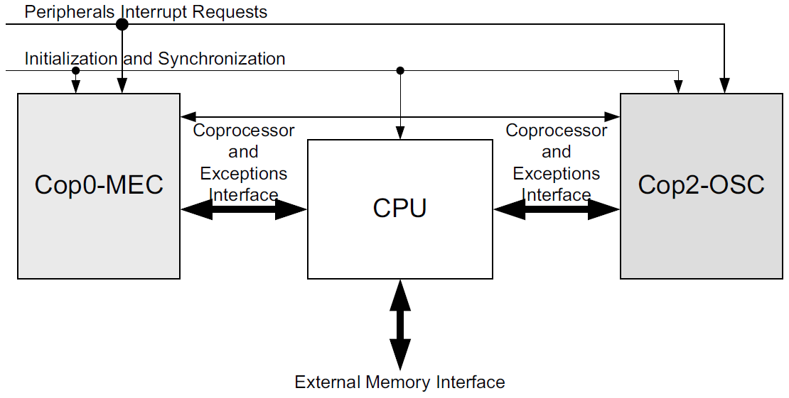
Processor Architecture

Slide 37
Co-Processor-2: The Task Handling Unit
All tasks are managed by a module called the Task Handling Unit
The Task Handling Unit performs the following:
Task handling
Implementation of specialized instructions
Scheduling
Dispatching
Management of interrupts
Timing constraints verification
Table storage for task parameters (TCB)

Slide 38
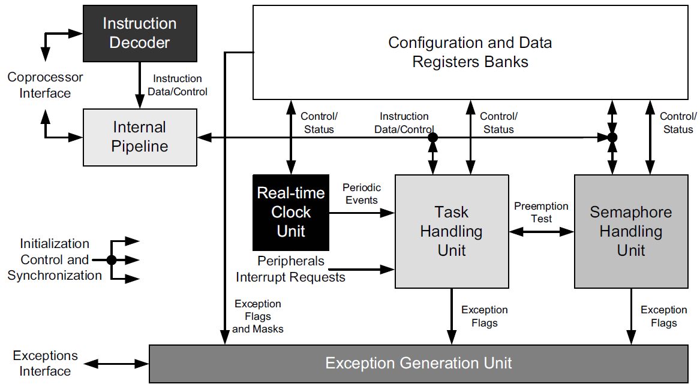
Co-Processor-2: Block Diagram

Slide 39
Co-Processor-2: Time & Event Management
A task can be event or time triggered
The Real-time Clock Unit
Generates periodic events assigned by the programmer
Triggers other scheduled tasks (most likely garbage handling)
External events are managed again by the Task Handling unit

Slide 40
Co-Processor-2: Task Management [5]
Application timing constraints are transparent to this processor allowing for real-time task management
Hard real-time tasks can be periodic or aperiodic
Task are synchronized using:
Pre-emption (LIFO or stack resource synchronization)
Binary semaphores (for simple access to shared resources)
Notes:
All task types: non-real time, soft-real time and hard-real time were considered in the design

Slide 41
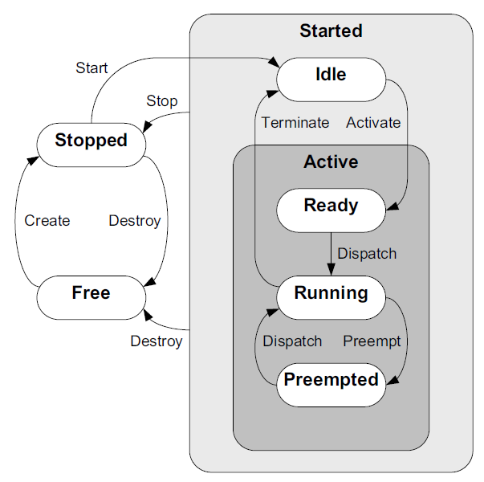
Co-Processor-2: Task States and Transitions [5]
Two important states are excluded from this processors design
Blocked
Suspended/sleeping
Blocking is bad
Wait/Sleep states can be simulated using timers
Notes:
Pre-emption: LIFO protocol used to lock and unlock a shared resource. A running task is only pre-empted an active task has all the resources it needs. Non-blocking.
The pre-emption strategy:
Reduces the blocking time of tasks with high priority
Prevents deadlocks
Allows for the use of RM and EDF (discussed in next slide)
“Blocking is bad” – there’s more to this statement
Blocking doesn’t make sense for Stack Resource Policy (SRP) protocol used for shared resources (synchronization)

Slide 42
Co-Processor-2: Scheduling [5]
Scheduling is done in hardware using priority criticality
Scheduling Decisions (in ascending order of priority):
Non real-time: First Come First Serve (FCFS)
Soft real-time: Rate Monotonic policy (RM)
Hard real-time: Earliest Deadline First (EDF)
In the case of EDF:
As a task comes closer to its deadline, its priority is raised
Maximizes processor utilization and ensure deadlines met

Slide 43
Co-Processor-2: Time & Event Management [5]
A task can be event or time triggered
The Real-time Clock Unit
Generates periodic events assigned by the programmer
Triggers other scheduled tasks (most likely garbage handling)
External events are managed again by the Task Handling unit

Slide 44
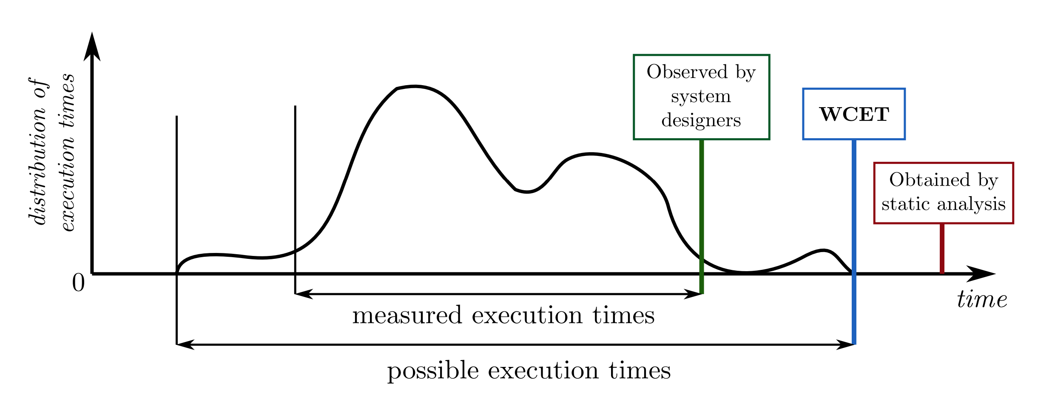
Real time systems: all about guarantees
A lot of real time scheduling is based on assumptions
Periodic tasks
Known priorities
Known runtimes
What happens when we don’t know how long something will execute?
Runtime can vary
Still want to meet deadlines
Mixed criticality embraces this uncertainty

Slide 45
Mixed Criticality - The Vestal Model
Introduces the notion that confidence in a software task’s Worst Case Execution Time (WCET) – C – is proportional to its criticality
Higher criticality. Higher analysis effort. More pessimistic WCET
C_{A} ≥ C_{B} ≥ C_{C} ≥ C_{D} ≥ C_{E}
Focusing on a dual criticality system…academic works and models that build off Vestal’s seminal work essentially treat each task as having a WCET for each criticality
High DAL tasks => C_{HI} and C_{LO}
Low DAL tasks => C_{LO}
The question is how to utilise the spare execution time – [C_{HI} - C_{LO}]
Notes:
Vestal’s work noted that low DAL tasks have been developed against lighter standards, therefore we have less confidence in their WCET
We would extend this to also state we have less confidence in their correct operation
However the potential uses for MCS go beyond simply supporting ‘less important’ tasks.
We have a number of tasks we would consider to be high criticality, because of the effect their failure would have the on the system, however we can afford for them to be disabled for short periods of time. For instance recording error logs in non-volatile memory, a time consuming but still important process.
Therefore it is very important that we address exactly what we mean by a ‘low-DAL’ task
Ultimately it provides two main advantages - cost reduction and flexibility
Less processors, easier proof of schedulability

Slide 46
Mixed Criticality intuition
Sometimes requires this much time
Typically only requires this amount of time
However we don’t want to be wrong, so we say it needs this much time
Task 1
Time
The longer the difference here, then implicitly the higher the criticality

Slide 47
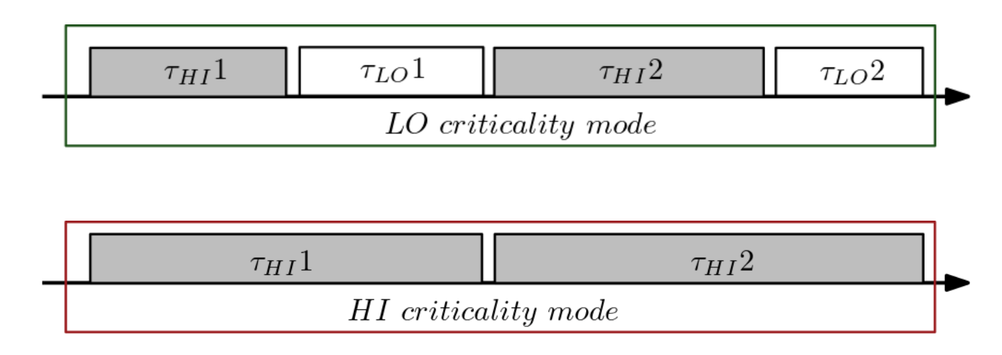
LO and HI criticality modes
Ci(LO): Max. observed execution time (system designers).
Ci(HI): Upper-bounded execution time (static analysis).

Slide 48
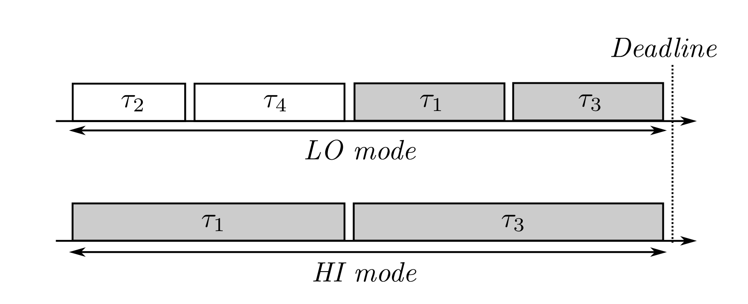
Scheduling with mode changes

Slide 49
Robust Mixed-Criticality
Normal mode
F hi-criticality tasks can exceed C_{LO}
Resilient mode
Up to M tasks can exceed C_{LO}
Each robust task can skip up to S jobs
High-criticality mode
Low-criticality tasks are not released
On an idle tick the counters for jobs skipped (JF) are reset
If C_{Hi} is exceeded then there is a power cycle

Slide 50
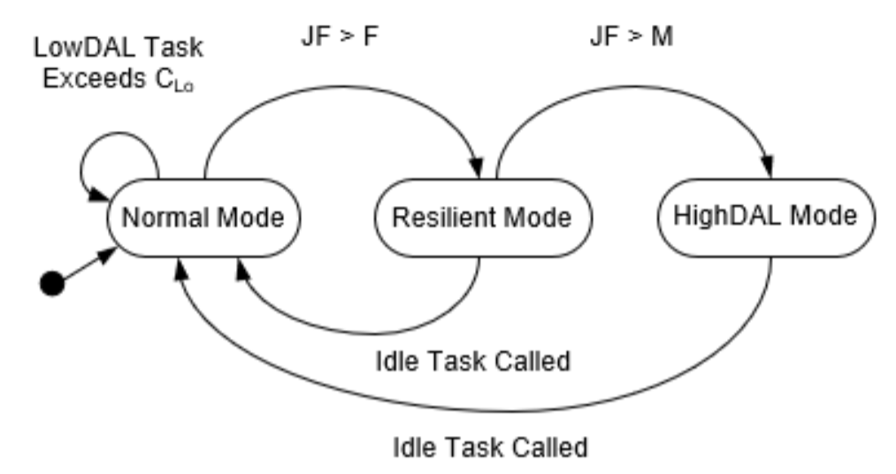
Robust Mixed Criticality
A robust task is one that can safely drop a non-started job
A fault is measured when one task overruns its C_{LO}
JF Records the number of Job Failures
An error is registered when one or many tasks fail to comply with their timing requirements
A resilient system is one which employs graceful degradation (if necessary through the control of robust tasks) in order to cope with one or many faults, thus aiming to avoid errors.
Notes:
Remind that AMC will never come back from HighDAL mode

Slide 51
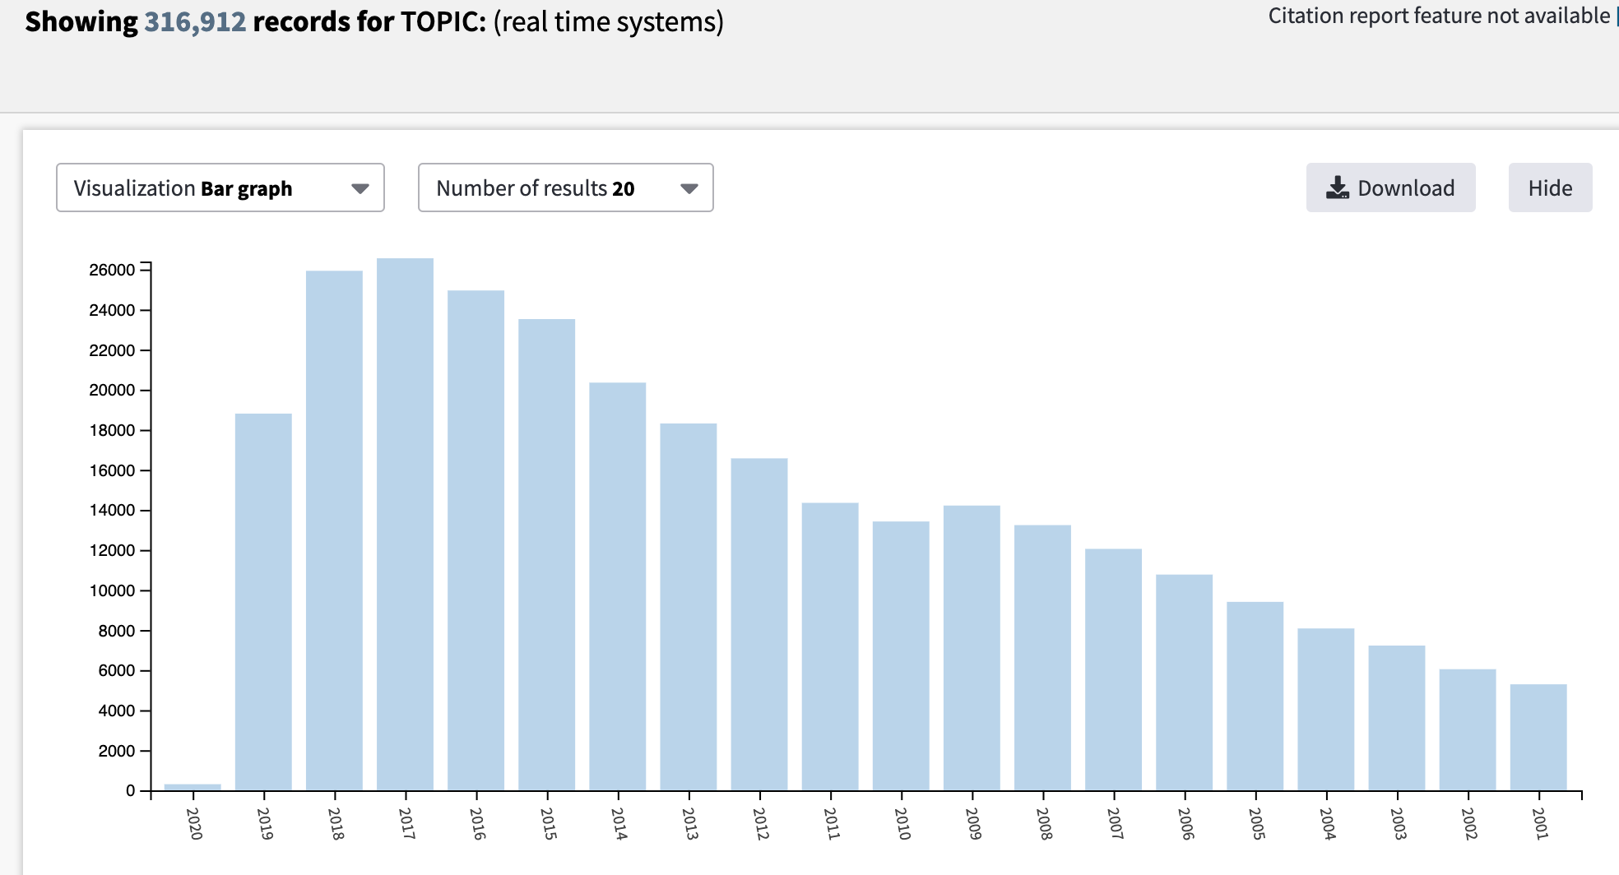
RTOS Publications
time

