Slide 1
CS6456: Graduate Operating Systems
Brad Campbell – bradjc@virginia.edu
https://www.cs.virginia.edu/~bjc8c/class/cs6456-s20/
Slides modified from CS162 at UCB

Slide 2
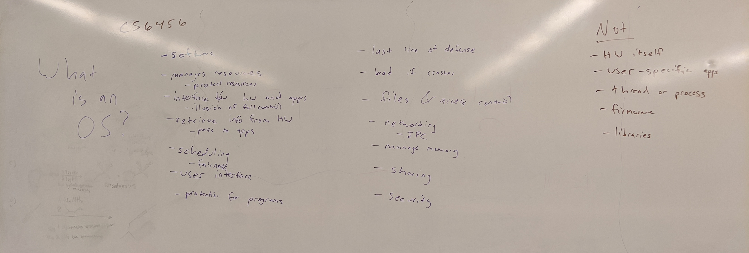
What is an OS?

Slide 3
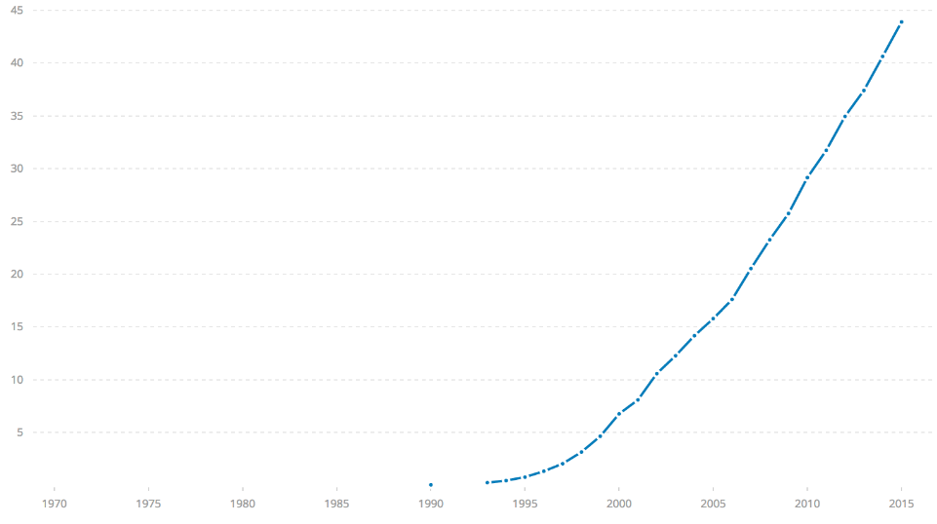




Challenge: Huge Scale
% of world’s
population
3.8 B
ARPANet
Internet
WWW
2.0 B 1/26/11
RFC 675 TCP/IP
HTTP 0.9
1969
1974
1990
2017

Slide 4

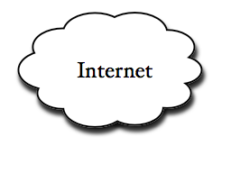
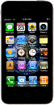

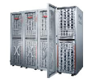
Example: What's in a search query?
DNS
Servers
Datacenter
DNS
request
create
result
page
Search
Index
Page store
Load
balancer
Ad Server
Complex interaction of multiple components in multiple administrative domains
  Systems, services, protocols, …

Slide 5
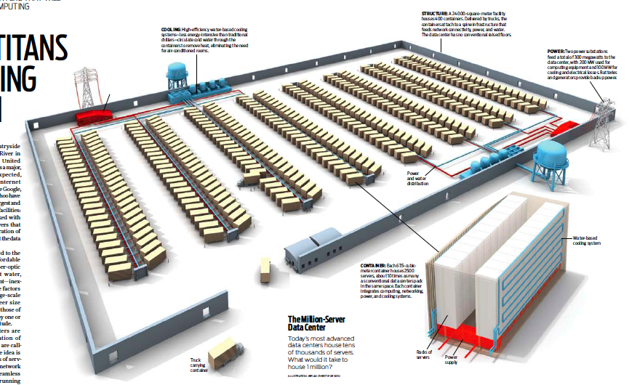
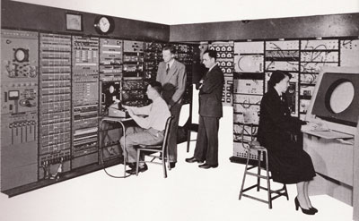
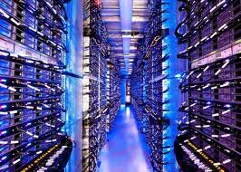
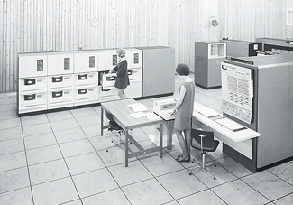
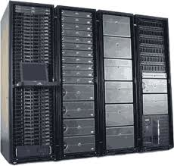
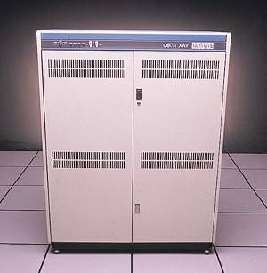
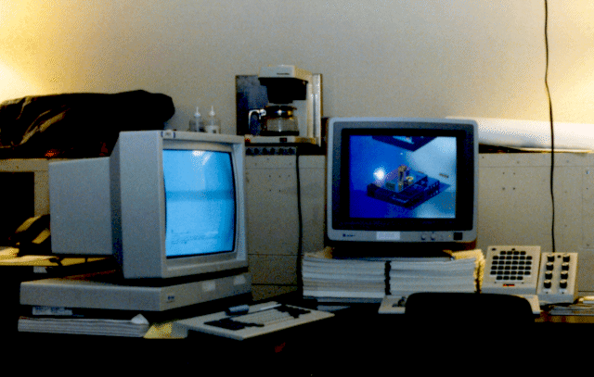
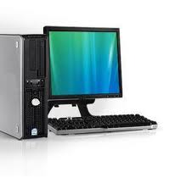
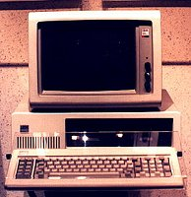
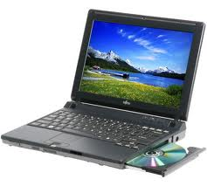
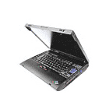
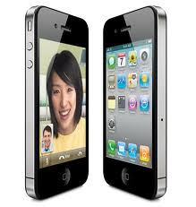


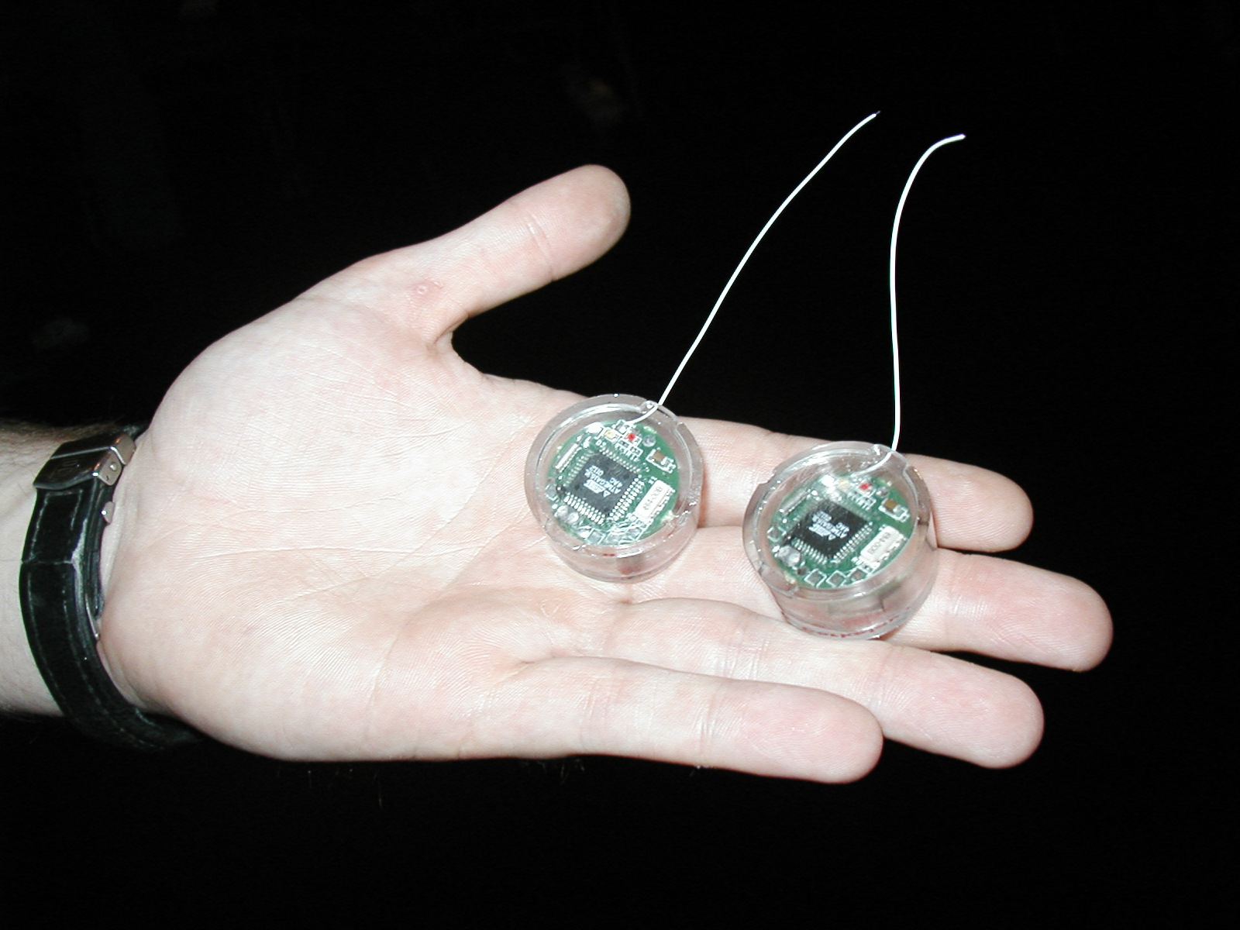
Challenge: Variety and Number of Devices
Computers
Per Person
Number crunching, Data Storage, Massive Services,
Mining
1:10⁶
Mainframe
Mini
1:10³
Workstation
Productivity,
Interactive
PC
Laptop
1:1
PDA
Cell
Streaming from/to the physical world
10³:1
years
Mote!

Slide 6
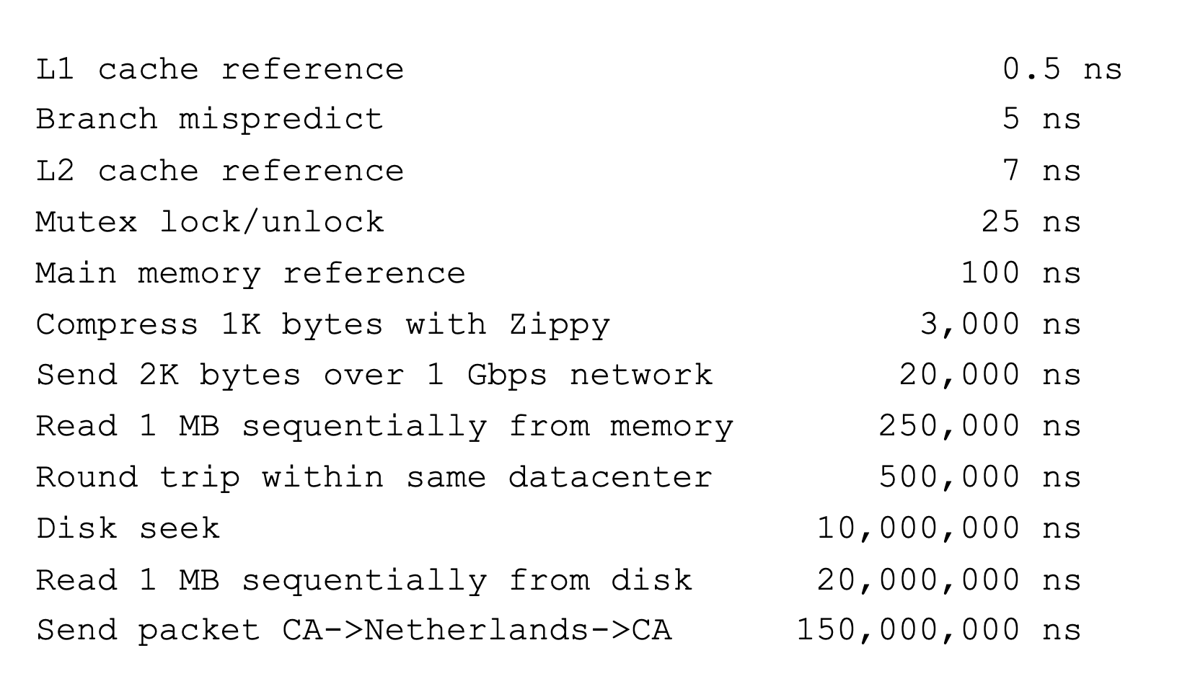
Challenge: Range of Timescales
Jeff Dean: "Numbers Everyone Should Know"

Slide 7
Operating systems are crucial to addressing these challenges!
Provide consistent abstractions to apps, even on different hardware
  File systems
  Processes, threads
  VM, containers
  Naming system
Manage resources shared among multiple applications:
  Memory, CPU, storage, …
Achieve the above by implementing specific algorithms and techniques:
  Scheduling
  Concurrency
  Transactions
  Security

Slide 8
Aside: Systems Programming
What makes something a system?
Frame of mind: meticulous error handling, anticipating all possible failure cases, defending against malicious/careless users
An important part of this class!

Slide 9
What is an operating system?
Layer of software that provides application software access to hardware resources
  Convenient abstraction of complex hardware
  Protected access to shared resources
  Security
  Basic Services – Communication, Storage, …
apps
OS
Hardware

Slide 10
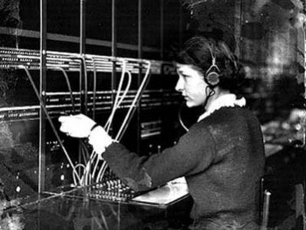
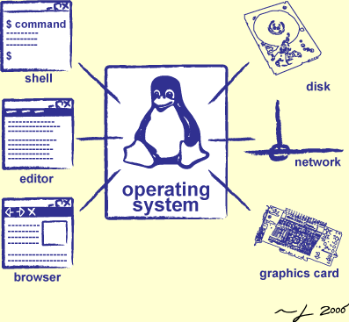
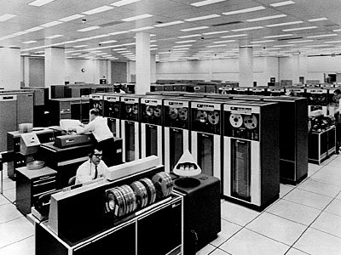
Operators Through History
Switchboard Operator
Computer Operators

Slide 11
What is an operating system?
Provides user programs with a more convenient abstract machine interface rather than the underlying physical machine

Slide 12
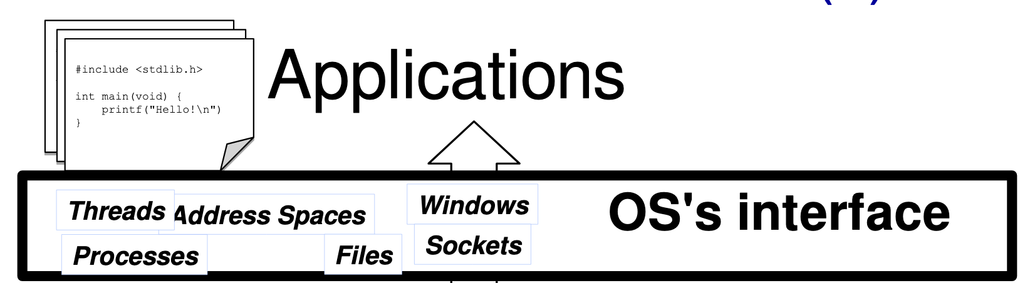
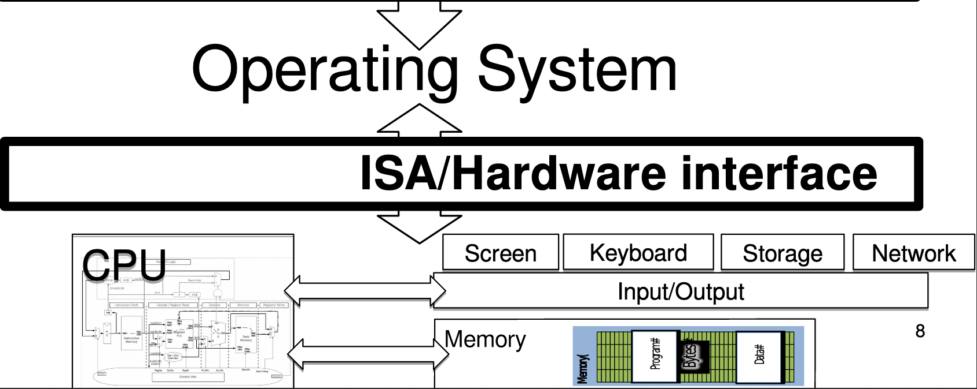
OS "Virtual Machine" Interface

Slide 13
Application View of the World
Application's "machine" is the OS
No hardware details (future-proof)
More useful interfaces than raw hardware

Slide 14
OS View of the World
Operating system translates from hardware interface
to application interface

Slide 15
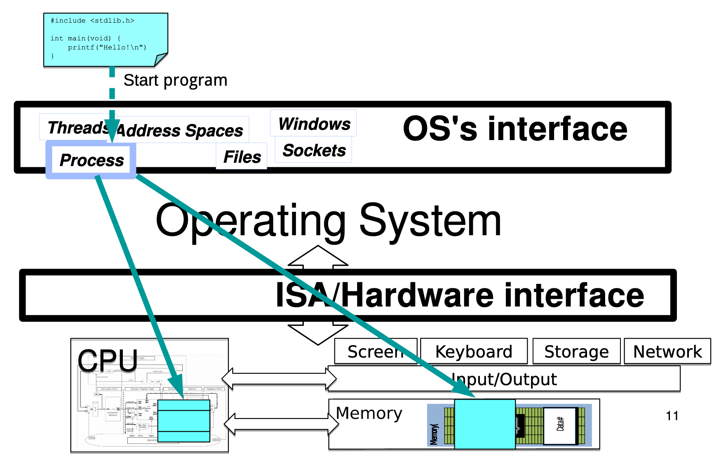
Abstraction: Program → Process

Slide 16
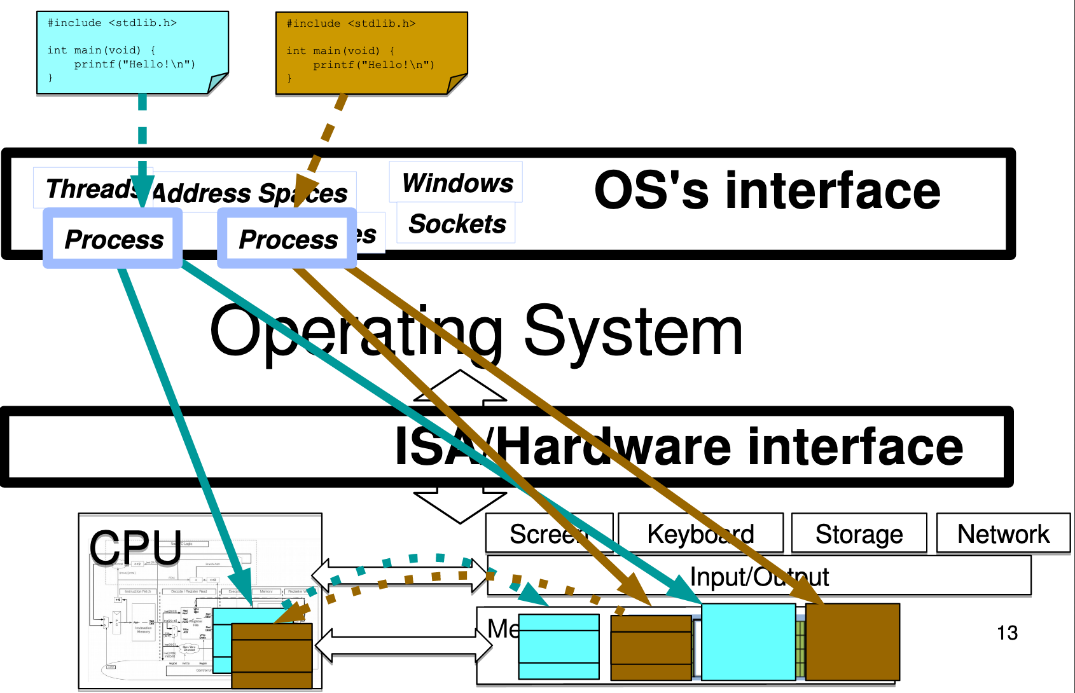
Multiple Processes: Context Switch

Slide 17
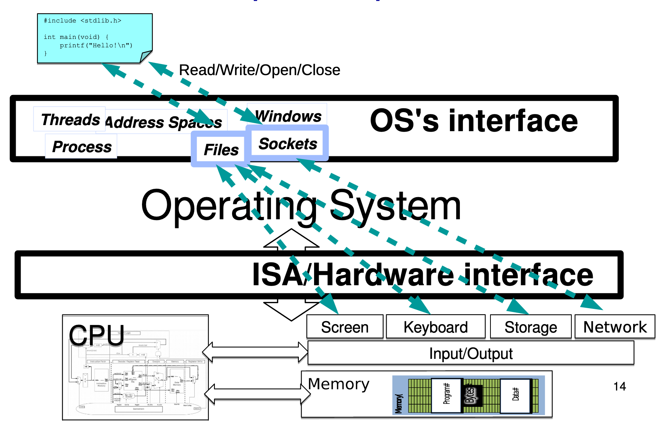
Abstraction: Input / Output

Slide 18
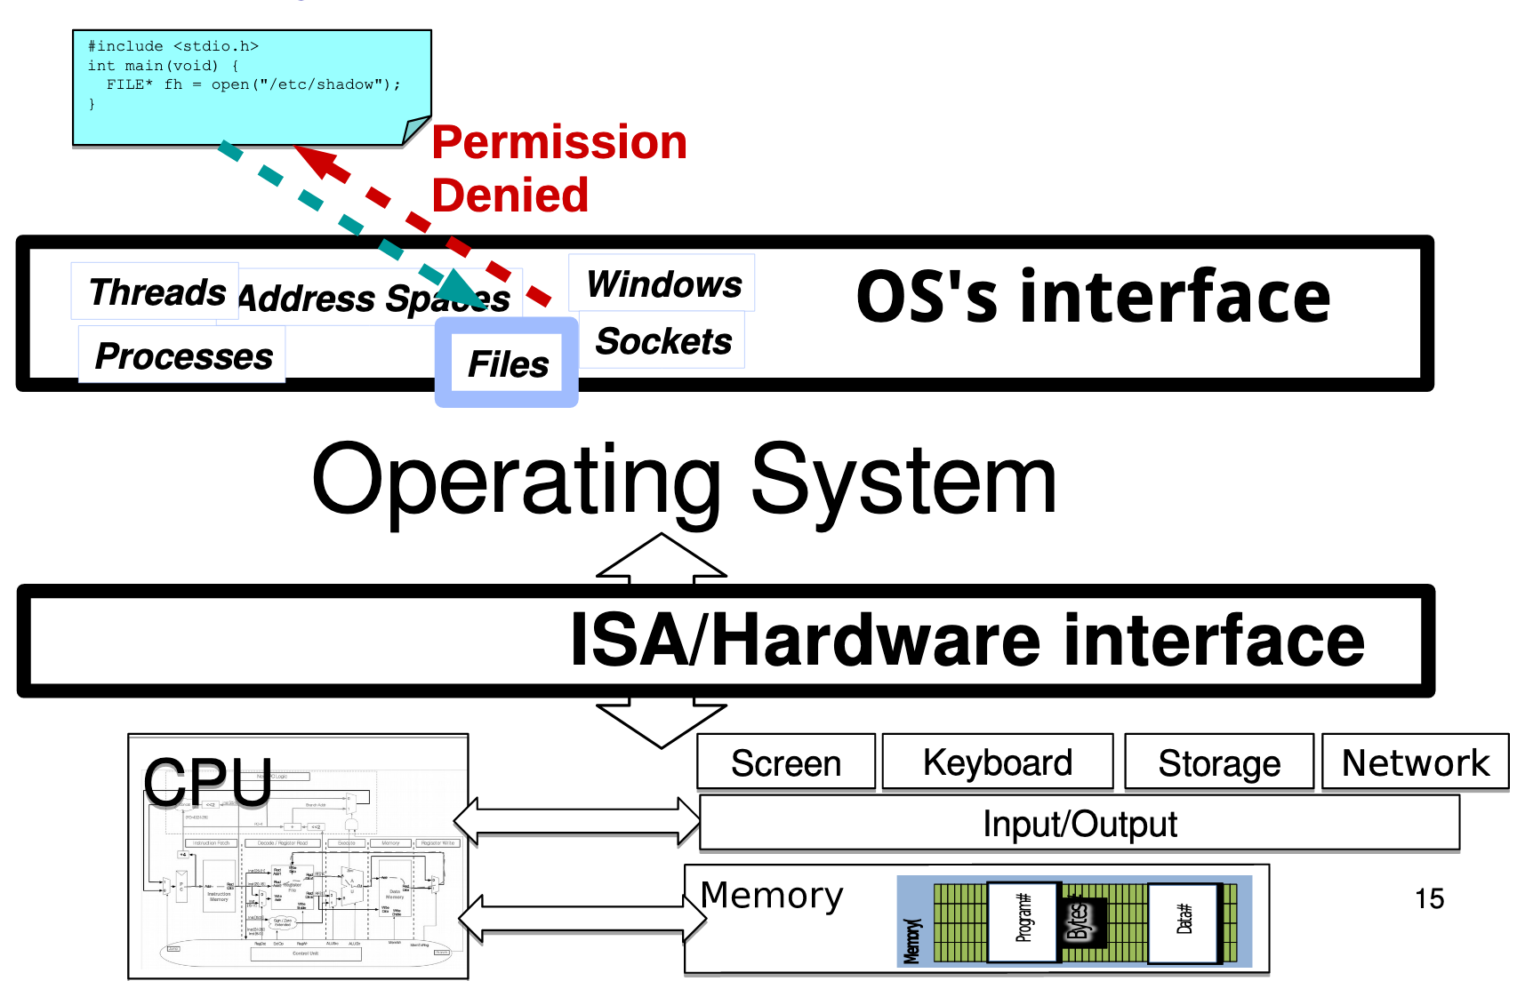
Security & Protection

Slide 19
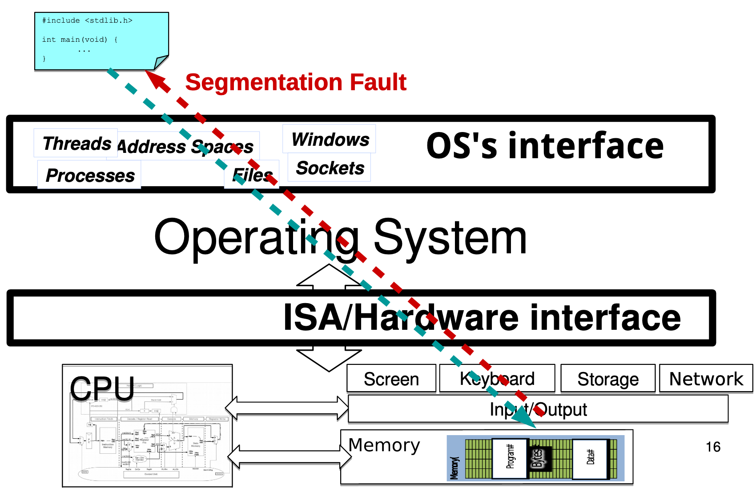
Security & Protection

Slide 20
Course Logistics

Slide 21
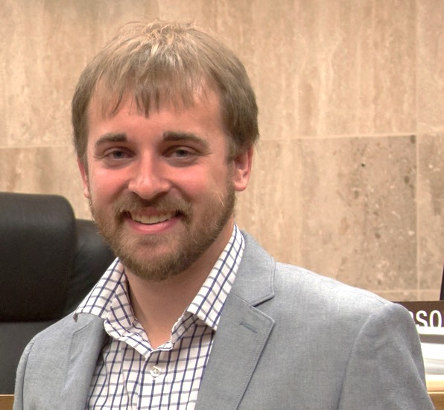
A little about me
Brad Campbell
  Assistant professor
    Joint appointment: 75% CS, 25% ECE
    Link Lab
  bradjc@virginia.edu
Ph.D. from the University of Michigan
Research interests
  Energy-harvesting systems
  Embedded operating systems
  New sensing systems
  IoT systems programming

Slide 22
This course, roughly
One third: Operating systems fundamentals
  Primarily lecture based
Two thirds: Advanced topics
  OS in different application areas
  OS with new hardware
  Lecture + discussion + readings

Slide 23
Assessments
Five homeworks
  Mostly programming based
  Individual
Choice of:
  In-class design questions
  OR
  Take-home final exam
    Short answer, mostly over the second half material

Slide 24
Grading
HW1: 15%
HW2: 15%
HW3: 15%
HW4: 15%
HW5: 15%
In class design or Final: 25%

Slide 25
Why homeworks?
Get hands on experience!
  Actually implement and test systems, learn how to design a solution and debug problems.
Evaluate your own solution
  How does it perform?
  What metrics matter?

Slide 26
Why in-class design questions?
Operating systems, and systems generally, are all about design tradeoffs.
During class we will explore these design tradeoffs by working through design problems.
  Can then compare alternatives.
  Understand strengths, weaknesses, costs, benefits.

Slide 27
Why take home final exam?
If you want to teach yourself the class, I guess.
Will be difficult.

Slide 28
Overview

Slide 29
What is an operating system?
Referee
  Resource sharing, protection, isolation
Illusionist: clean, easy to use abstractions
    Infinite memory, dedicated machine
    Higher level objects: files, users, message
    Masking limitations, virtualization
Glue: Common Services
    Storage
    Window system
    Networking
    Authorization

Slide 30
Unifying Theme: Complexity
All definitions of operating systems are about hiding complexity

Slide 31
The Challenge of Complexity
Competing applications with
  Unexpected failures
  Even malicious intentions…
Varying hardware with
  Evolving interfaces
  Unexpected failures
Not feasible to test all possible configurations!

Slide 32
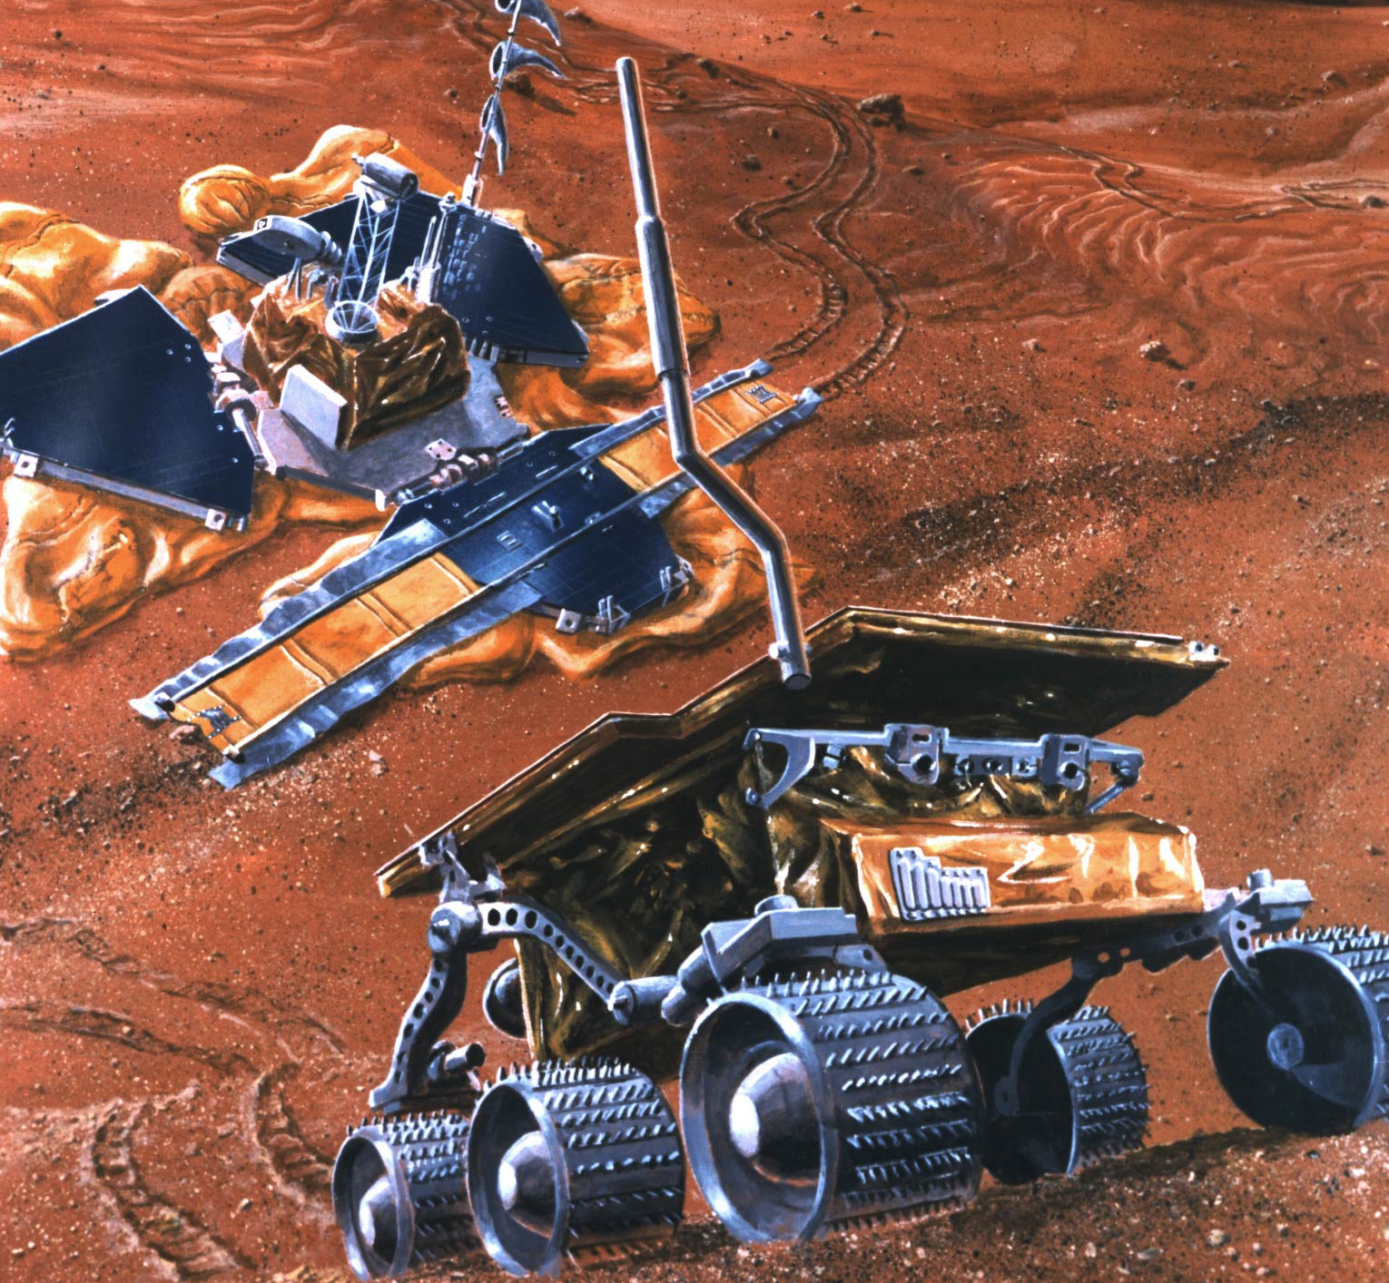
Complexity Example: Mars Pathfinder
Lots of types of hardware: Radios, science experiments, batteries, solar panels, motors and robotic equipment
Unique reliability requirements
  No reset button, must reboot automatically when necessary
  Must always be able to receive commands from Earth
Remote debugging
  Software will crash, how is that handled?
  Need to debug from Earth
Time-critical functions
  Stop before hitting a Mars boulder
  Earth communications

Slide 33
Complexity: Variety
Different CPUs: x86, PowerPC, ARM, MIPS
Different amounts of memory, disk space
Different types of devices
  Mice, keyboards, sensors, cameras
Different networking equipment
  Cable, DSL, Wireless, Ethernet

Slide 34
Questions
Does the programmer need to write a single program that performs many independent activities?
Does every program have to be altered for every piece of hardware?
Does a faulty program crash everything?
Does every program have access to all hardware?
Hopefully, no!

Slide 35
Unifying Theme: Helping the Programmer
Write program once for lots of hardware
Without reimplementing common functionality
Run alongside other programs, possibly communicating and cooperating with them (safely)
One program crashing doesn't crash everything

Slide 36
Abstract Virtual Machine Goals
Application
Operating System
Hardware
Virtual Machine Interface
Physical Machine Interface
OS Goals:
  Remove software/hardware quirks (fight complexity)
  Optimize for convenience, utilization, reliability, … (help the programmer)
For any OS area (e.g. file systems, virtual memory, networking, scheduling):
  What hardware interface to handle? (physical reality)
  What’s software interface to provide? (nicer abstraction)

Slide 37
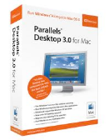
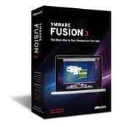

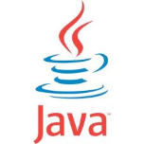
Aside: Virtual Machines
Software emulation of an abstract machine
  Give programs illusion they own the machine
  Make it look like hardware has features you want
Two types of “Virtual Machines”
  Process VM: supports the execution of a single program; this functionality typically provided by OS
  System VM: supports the execution of an entire OS and its applications (e.g., VMWare Fusion, Virtual box, Parallels Desktop, Xen)

Slide 38
Process VMs
Each process thinks…
  It has all memory, CPU time, devices, …
  All devices have the same convenient interface
  Device interfaces more powerful than raw hardware
    Bitmapped display ⇒ windowing system
    Ethernet card ⇒ reliable, ordered, networking (TCP/IP)
Fault Isolation
  Processes unable to directly impact other processes
  Bugs cannot crash whole machine
Portability
  Write your program for the OS rather than the raw hardware

Slide 39
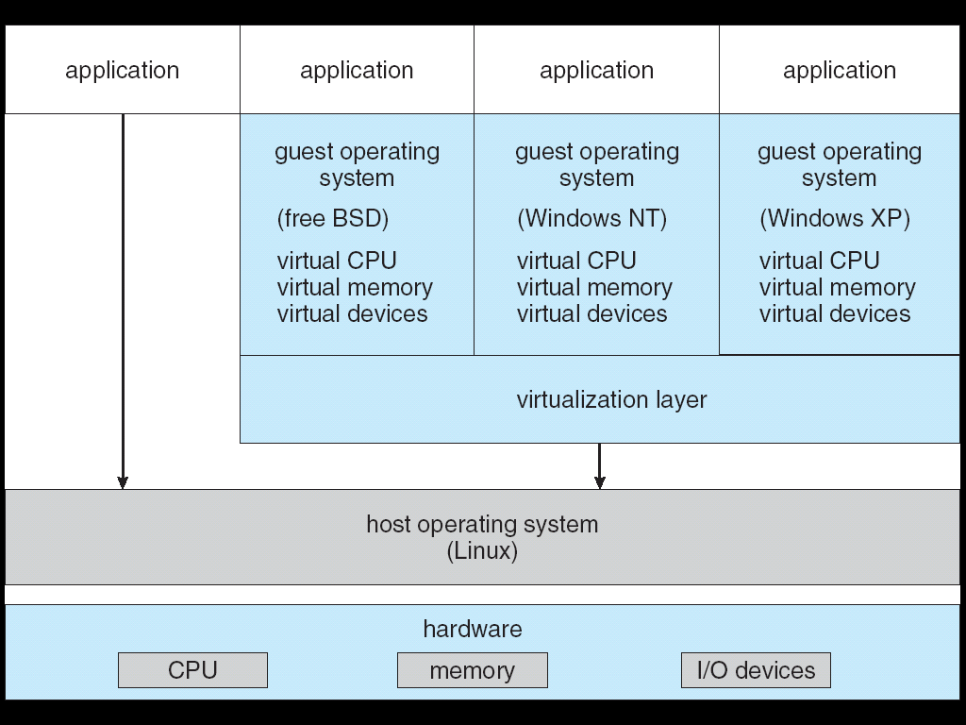
System Virtual Machines: Layers of OSs
Run entire operating systems
  Good for OS development, portability, fault containment
Interface closer to raw HW
  To aid porting/running OSs built to use raw HW
  Different kind of "application developer" to design for

Slide 40
What is an Operating System,… Really?
Always:
  Memory Management
  I/O Management
  CPU Scheduling
  Communications?
  Multitasking/multiprogramming?
Maybe:
  File System?
  Multimedia Support?
  User Interface?
  Web Browser?

Slide 41
What is an OS?
No universally accepted definition
“Everything a vendor ships when you order an operating system” is good approximation
  But varies wildly!
“The one program running at all times on the computer” is the kernel
  Everything else is either a system program (ships with the operating system) or an application program

Slide 42
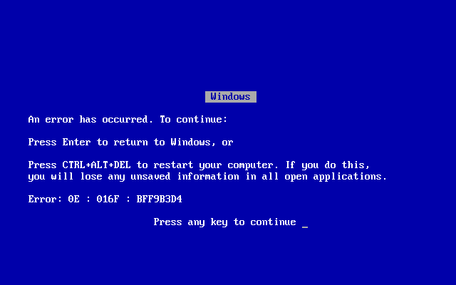
OS Goal: Protecting Processes & The Kernel
Run multiple applications and:
  Keep them from interfering with or crashing the operating system
  Keep them from interfering with or crashing each other

Slide 43
How do we achieve this?
Two main hardware mechanisms:
  Memory address translation
  Dual mode operation
Use these to enact a simple policy: Programs are not allowed to read or write the memory of other programs or of the OS

Slide 44
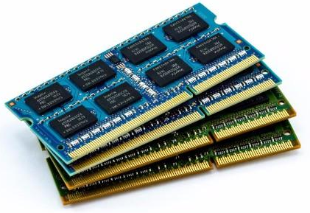
Address Translation
Abstraction: Address Space
  Group of memory addresses usable by something
  Each process and the kernel have distinct address spaces
  Illusion of owning all memory
Mechanism: Address translation
  Translate virtual addresses (used internally and emitted by CPU) to physical addresses
  Usually performed in hardware by memory management unit (MMU)
CPU
Virtual
Address
Physical
Address
MMU

Slide 45
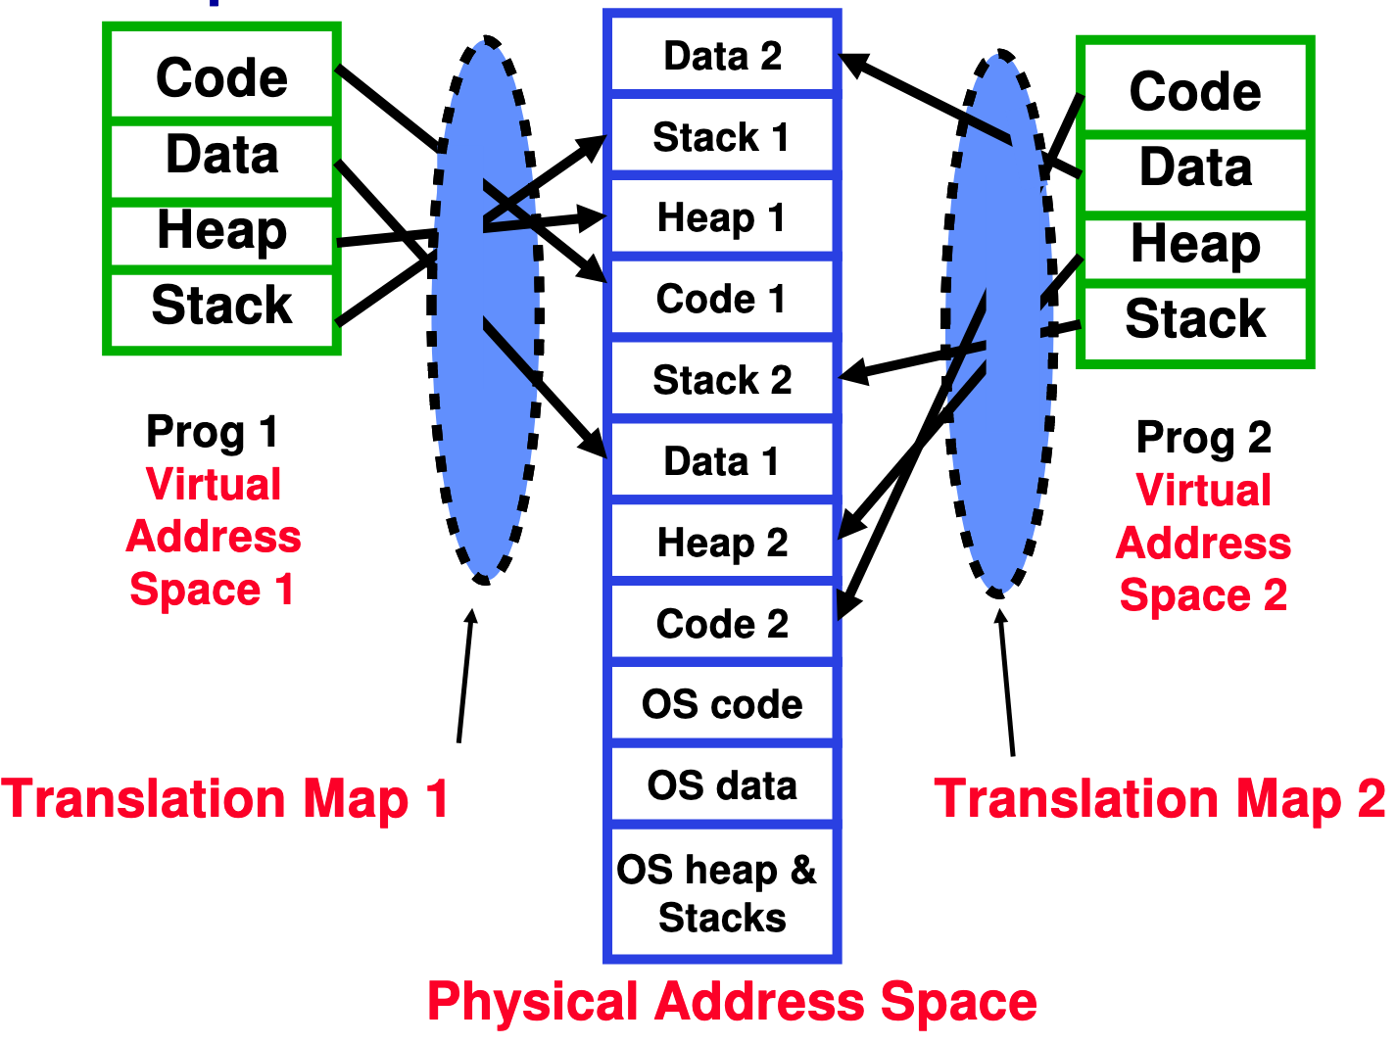
Example of Address Translation

Slide 46
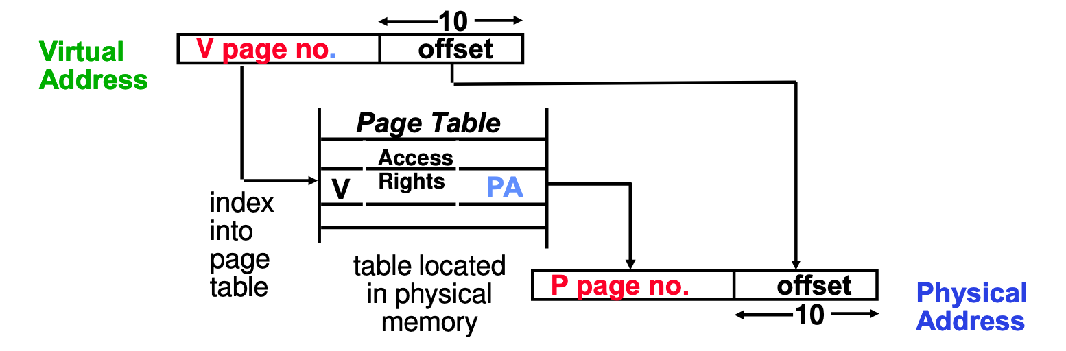
Address Translation Details
Does this get us our desired policy?
  Can't read or write if no translation to the physical memory
Problem: What if user code changes the page table pointer?

Slide 47
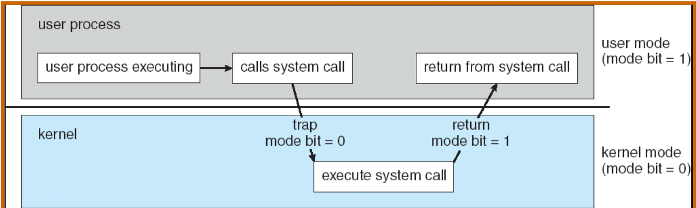
Dual Mode Operation
Hardware provides at least two modes:
  Kernel Mode (or "supervisor" / "protected" mode)
  User Mode
Certain operations are prohibited when running in user mode
  Changing the page table pointer
Carefully controlled transitions between user mode and kernel mode
  System calls, interrupts, exceptions

Slide 48
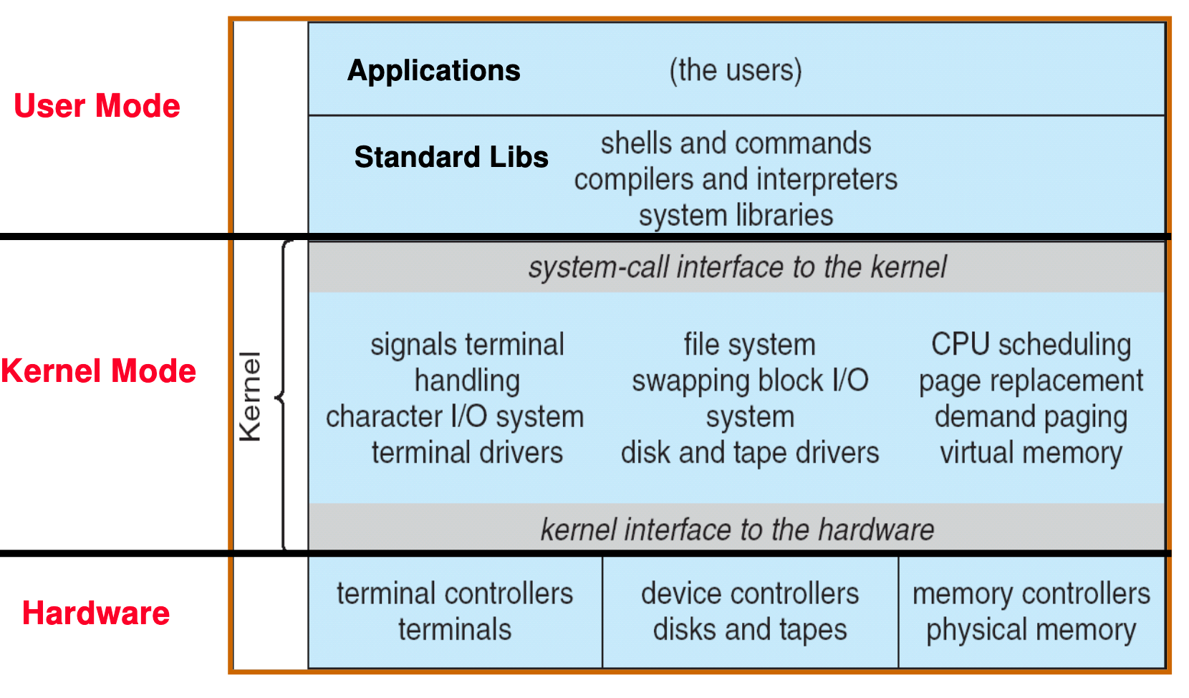
UNIX OS Structure

Slide 49
Conclusion
Operating systems:
Provide a virtual machine abstraction to handle diverse hardware
Coordinate resources and protect users from each other
Simplify application development by providing standard services
Provide fault containment, fault tolerance, and fault recovery

