Slide 1
CS6456: Graduate Operating Systems
Brad Campbell – bradjc@virginia.edu
https://www.cs.virginia.edu/~bjc8c/class/cs6456-f19/

Slide 2
Problem
Operating systems are large
They continue to evolve and grow
    … and are worked on by many people
(Like all other programs) they contain bugs
How to organize them so that bugs do not
    … bring down systems
    … impede normal operation
    … etc.

Slide 3
Operating System Structures
Monolithic systems
    Formerly called “the big mess”
Layered systems
Microkernel based systems
Exokernels

Slide 4
Operating System Structures
Monolithic systems
    Formerly called “the big mess”
Layered systems
Microkernel based systems
Exokernels
A faulty driver or component
can corrupt any data in kernel
  Arbitrary damage
  Stop system anywhere
  … etc.

Slide 5
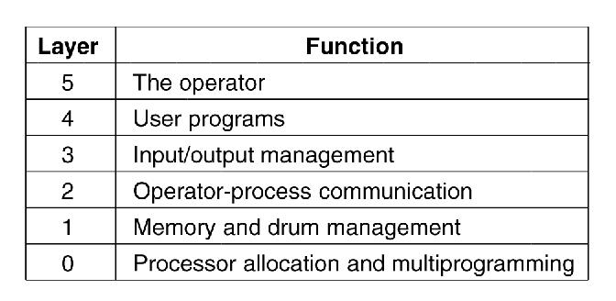
Layered Systems
Figure 1-25. Structure of the THE operating system.

Slide 6
Layered Systems
Simple
Elegant
Incredibly naïve
Figure 1-25. Structure of the THE operating system.

Slide 7
Microkernel — An Organizing Principle
Partition OS kernel into lots of small, independent pieces
Put pieces in separate “processes”
    Isolated from each other except for message passing
Keep kernel mode code to a minimum
Concept emerged in 1970s
    MACH at CMU (Rick Rashid)
    NEXT computer
    Apple Mac-OS

Slide 8
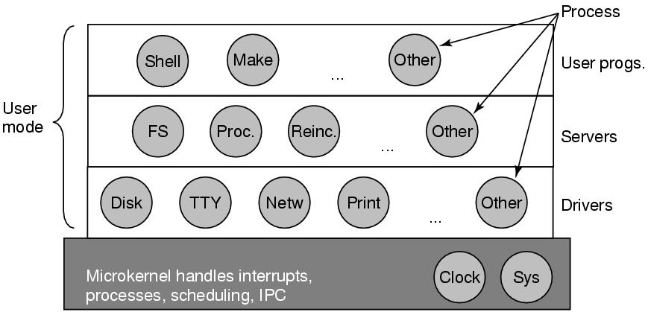
Microkernel Example
Works great on a PDP-11
  Memory addressable device registers
  Minimal interrupt handling, scheduling, IPC, etc
  No virtual memory management
Figure 1-26. Structure of the MINIX 3 system.

Slide 9
Major Advantages
Modularity
Flexibility and extensibility
  Easier to replace modules – fewer dependencies
  Different servers can implement the same service in different ways
Safety (each server is protected by the OS from other servers)
Servers are largely hardware independent
Correctness
  Easier to verify a small kernel
  Servers are isolated; errors in one don’t affect others

Slide 10
Major Disadvantages of Early Microkernels
Slow – due to “cross-domain” information transfers?
  Server-to-OS, OS-to-server IPC is thought to be a major source of inefficiency
Much faster to communicate between two modules that are both in OS

Slide 11
Microkernel Issues
Virtual memory management
    Needs to interact directly with scheduler
    Page faults, etc.
Kernel support for user-space threads
Fast I/O devices
    Quick, responsive interrupts
    Top- and bottom-halves for interrupt handlers
Interprocess communication

Slide 12
Example Systems
Windows NT: introduced HAL layer to support hardware independence.
  Other layers not very small
Amoeba (Tanenbaum’s research based OS)
Chorus
Mach (CMU and DARPA) – was the basis for the MAC OS/X and GNU HURD
L4 is a family of publicly available microkernels

Slide 13
Microkernels
A good idea in the 1970s and 80s
Not up to demands of modern processors
    Virtual memory
    Heavy caching
Not up to demand of modern operating systems
L4 microkernel
  “shows that it is possible to achieve well performing μ-kernels through processor-specific implementations of processor-independent abstractions.”

Slide 14
Former Microkernel Resurrection
Mobile phones, PDAs, handheld devices
    Fixed or limited functionality
    No general purpose files
    No dynamic virtual memory
⇒
    Simple context switches
    All code already in memory
    Easy IPC

Slide 15
Motivation for Extensibility
The traditional OS
  provides various abstractions of system resources (virtual address spaces, processes, files, interprocess communication)
  Provides general-purpose resource management algorithms
System calls define user interface to OS
Able to handle most applications, but handles no applications perfectly because there’s no easy way to specialize the OS to individual needs.
Make operating systems more responsive to applications’ needs; e.g.,
  Do your own scheduling
  Choose your own page replacement algorithm

Slide 16
Cost of High-Level Abstractions
OS use of high-level abstractions hides info that applications could use to manage their own resources; e.g.
  Database systems may be forced to build random-access files on top of the OS file system
Performance and functionality are limited
A large, unmodifiable OS can’t easily incorporate new research developments.

Slide 17
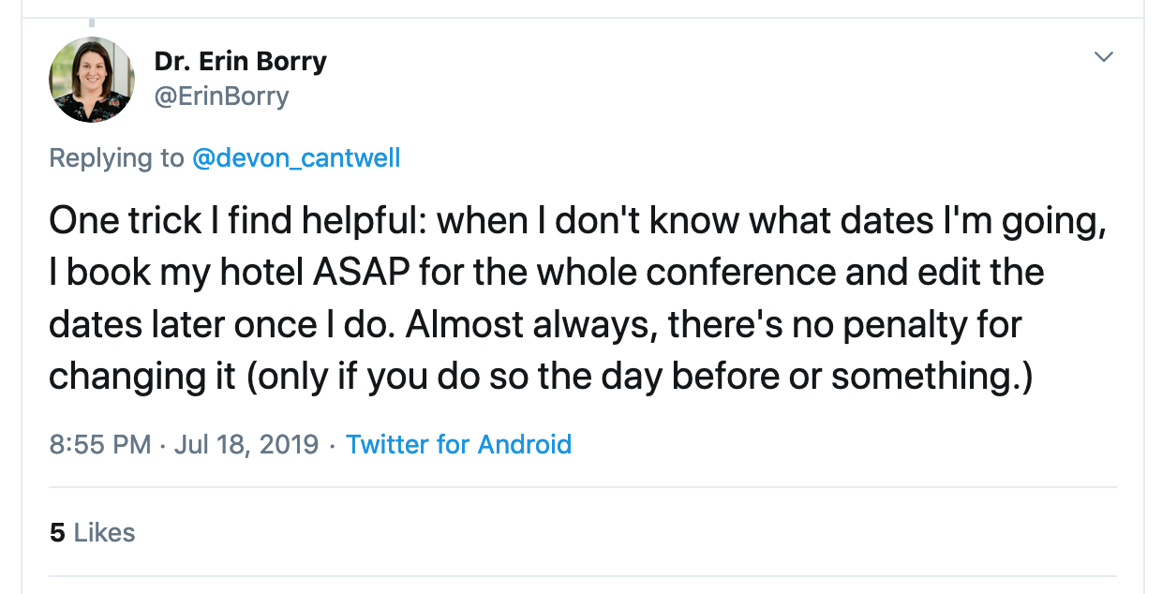

Slide 18
Exokernels
Are a type of OS architecture, not a specific example.
They separate resource allocation & protection (in the kernel) from resource management (done at user level with user-level library operating systems)
  Aegis is an example exokernel;
  EXOS is an example library OS.

Slide 19
Extensibility Mechanisms
Exokernels rely on application-specific library operating systems to provide user modifications.
SPIN relies on application-specific kernel extensions for the same purpose.
Exokernels are incomplete without a library OS; SPIN is a complete OS that can be modified/extended.

Slide 20
What an Exokernel Does
Multiplexes the hardware directly
  Instead of providing an abstraction of the hardware an exokernel makes specific hardware resources directly available to user level applications; e.g., disk blocks instead of files
Provides primitives for secure management of physical resources; applications use them to develop appropriate abstractions.
https://pdos.csail.mit.edu/archive/exo

Slide 21
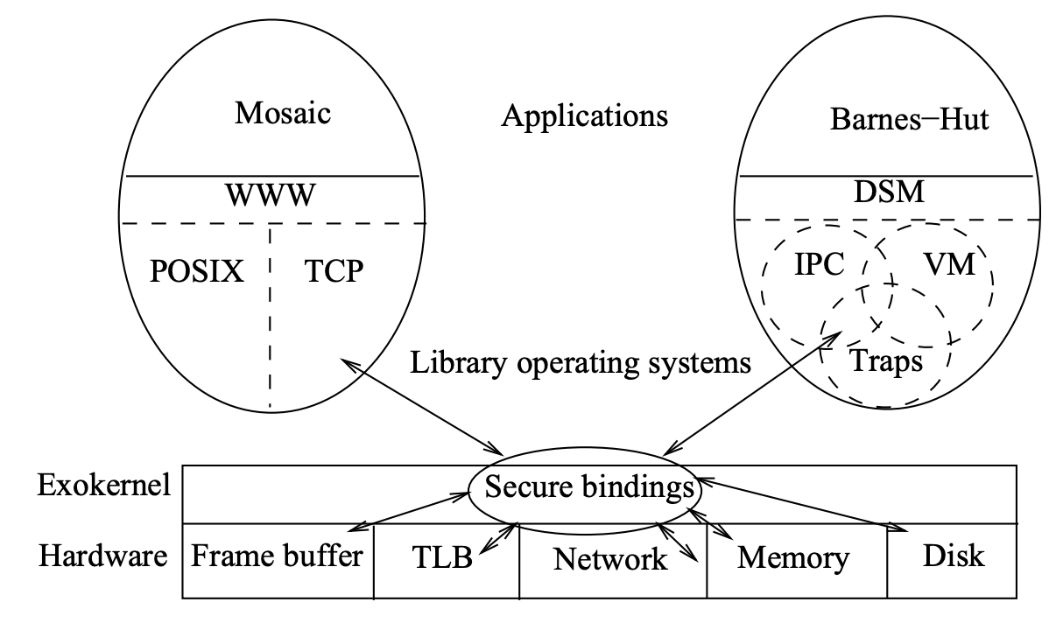
Exokernel Architecture

Slide 22
Secure Bindings
Secure bindings separate resource authorization from resource usage
Protection checks are applied at binding time; checks at resource access time become simple and straightforward.
“Simply put, a secure binding allows the kernel to protect resources without understanding them.”

Slide 23
Secure binding implementation
Leverage hardware features
  Ex: TLB entry
Maintain software cache
  Keep (resource name, owner) tuples
Run application code in kernel
  Exokernel runs code on behalf of the library OS in response to some event

Slide 24
Revocations
Exokernel asks that library OSes release certain resources
  Gives a chance for the library OS to gracefully handle the request
  Library OS informs the exokernel it has done so
Abort protocol
  What happens if the library OS doesn’t comply?
  “Instead, if a library operating system fails to comply with the revocation protocol, an exokernel simply breaks all existing secure bindings to the resource and informs thelibrary operating system.”

Slide 25
Library Operating Systems
Untrusted - Built on top of an exokernel
Can be tailored to a set of applications with similar requirements.
Run in user space – fewer system calls to the exokernel => enhanced performance.
Applications can interact with a library OS or interface directly to the exokernel.
Possible to provide a standard interface (e.g. POSIX) for a familiar look.

Slide 26
Summary
Exokernels are responsible for resource allocation/protection, user applications are responsible for resource management.
Exokernel primitives can be implemented efficiently because they are simple
  Low-level multiplexing of hardware is fast.
Library OSs enable applications to create appropriate abstractions.
Secure bindings provide protections

Slide 27
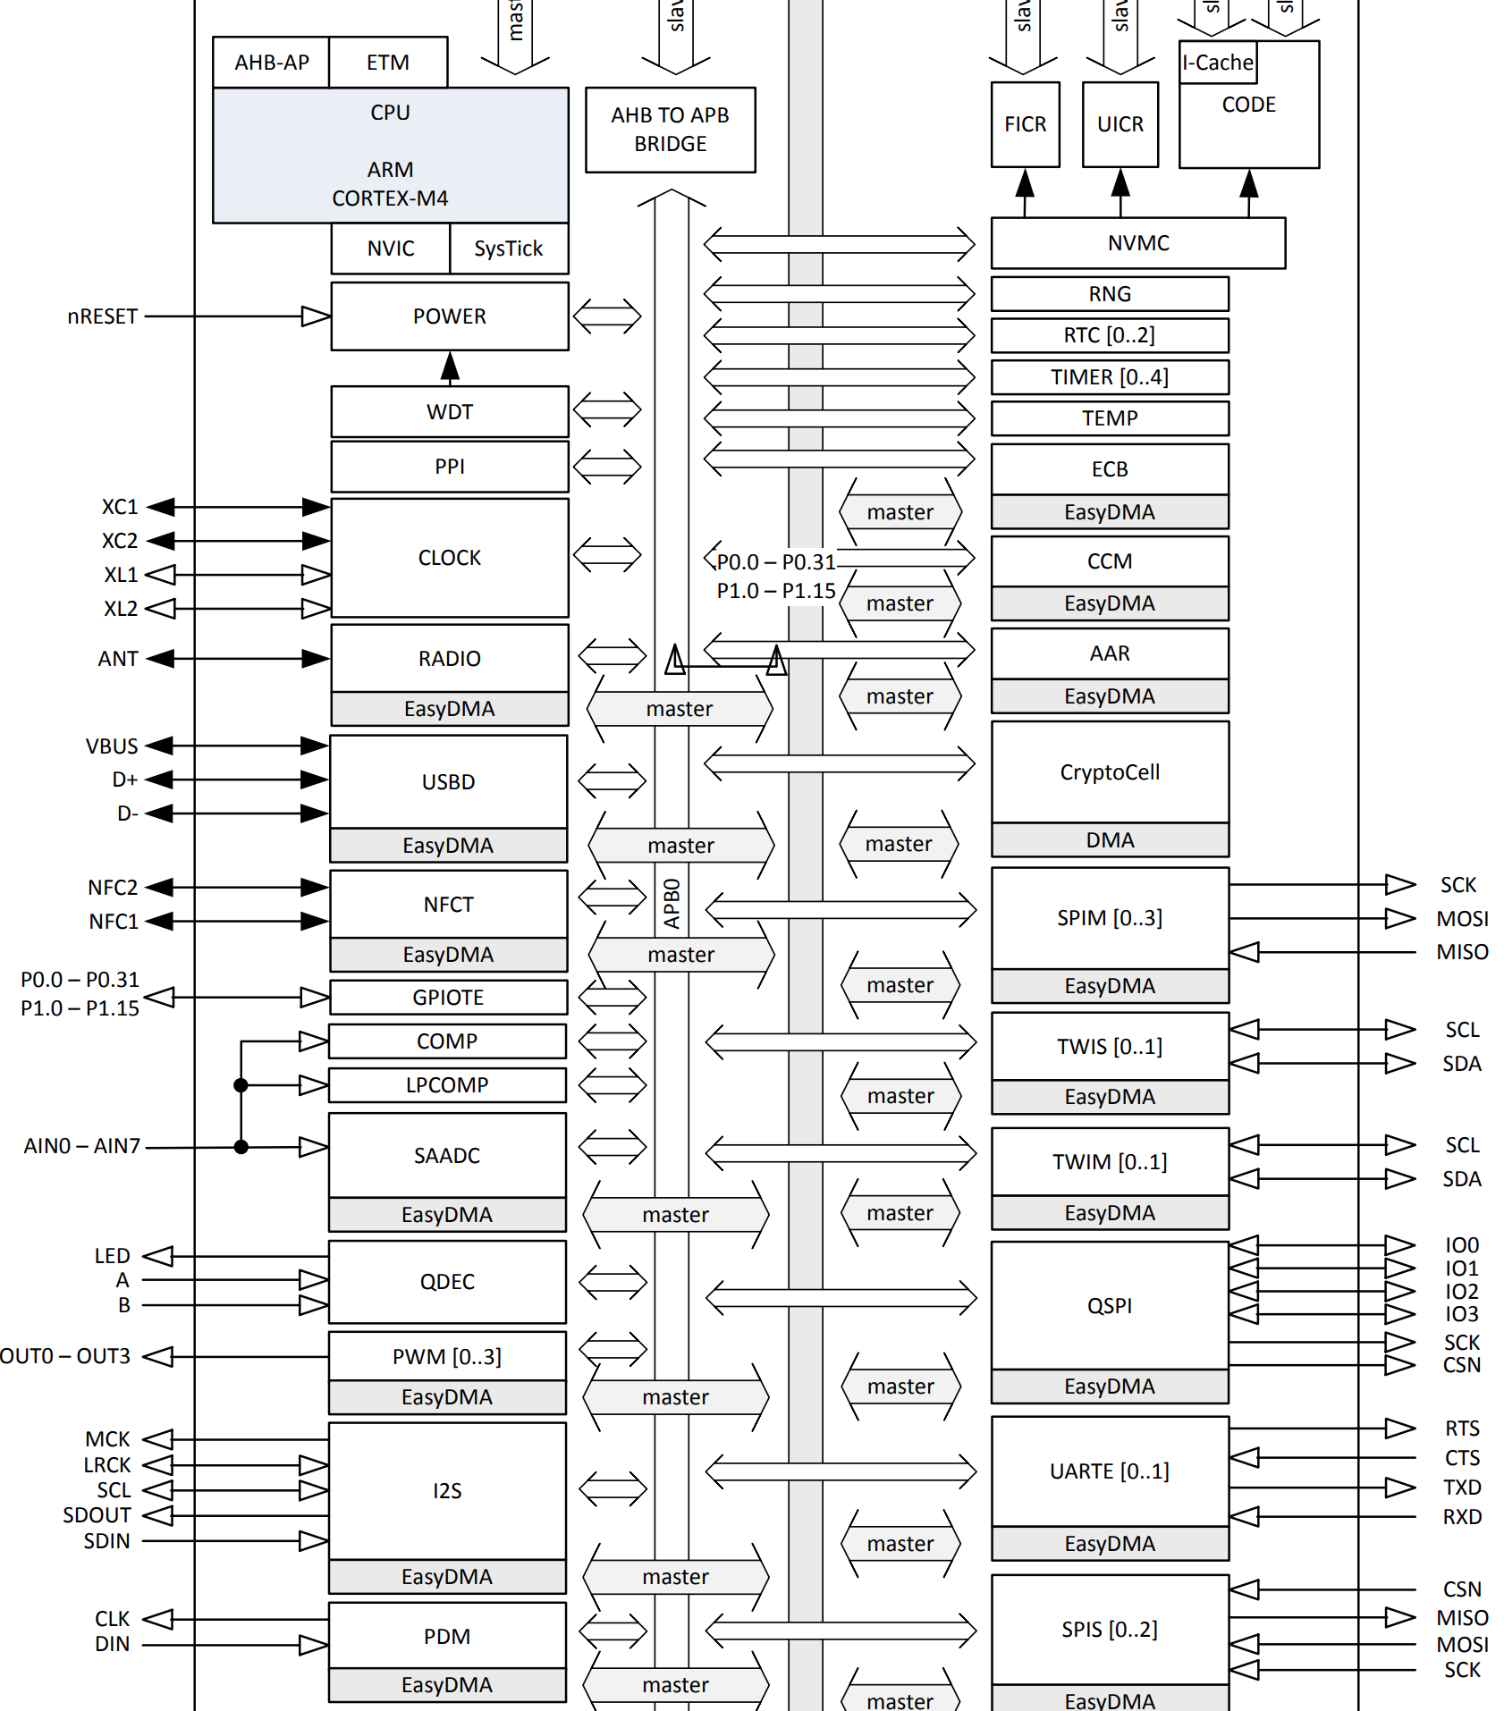
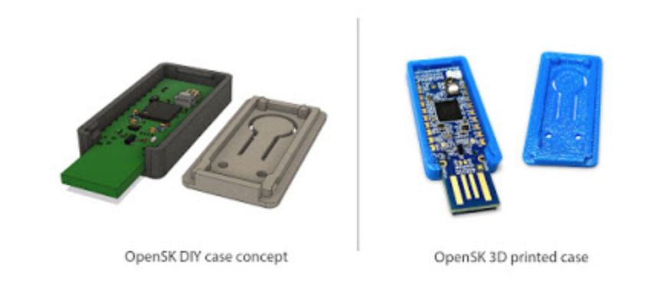
Let’s design an OS!
Example: security key
Hardware: CryptoCell
  NIST SP800-90A and SP800-90B compliant random number generator
  AES-128: ECB, CBC, CMAC/CBC-MAC, CTR, CCM/CCM*
  SHA-1, SHA-2 up to 256 bits
  Keyed-hash message authentication code (HMAC)
  RSA up to 2048-bit key size
  ECC support for most used curves, among others P-256 (secp256r1)
Applications
  2FA
  Encrypted temperature measurements

