Slide 1
CS6456: Graduate Operating Systems
Brad Campbell – bradjc@virginia.edu
https://www.cs.virginia.edu/~bjc8c/class/cs6456-f19/

Slide 2
The Multikernel: A new OS architecture for scalable multicore systems
New hardware brings diversity
Diversity in systems, diversity in cores, diversity in multiprocessor architectures
How to program with increasingly complex architectures and memory layouts?
Notes:
Previous OS abstractions only had one unit of computation - the CPU. Systems have lots of heterogenous computation hardware: CPUs, GPUs, ASIC/FPGA, programmable NICs….
These different kinds of “processors” should be handled by the OS the same way that CPUs are
Interconnect topology is nearing a breaking point - using message-passing with a single shared interconnect causes serious congestion issues. Using hardware cache coherence to support a shared memory abstraction only exacerbates problems
A multikernel treats the physical system as an interconnected network of cores. OS functionality is implemented as a distributed system using message passing. Shared memory is supported using replication and two-phase commits

Slide 3
Multikernel Key Points
Make all inter-core communication explicit.
Make OS structure hardware-neutral.
View state as replicated instead of shared.

Slide 4
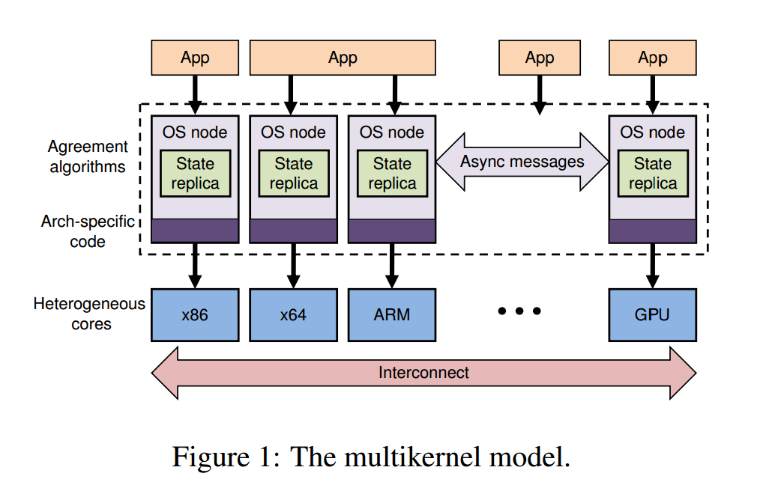

Slide 5
Make all inter-core communication explicit.
Inter-core communiation uses explicit messages
Avoids shared memory
Multiprocessors look more and more like networks
Using messages allows easy pipelining/batching
Makes interconnect use more efficient
Automated analysis/formal verification
Calculi for reasoning about concurrency

Slide 6
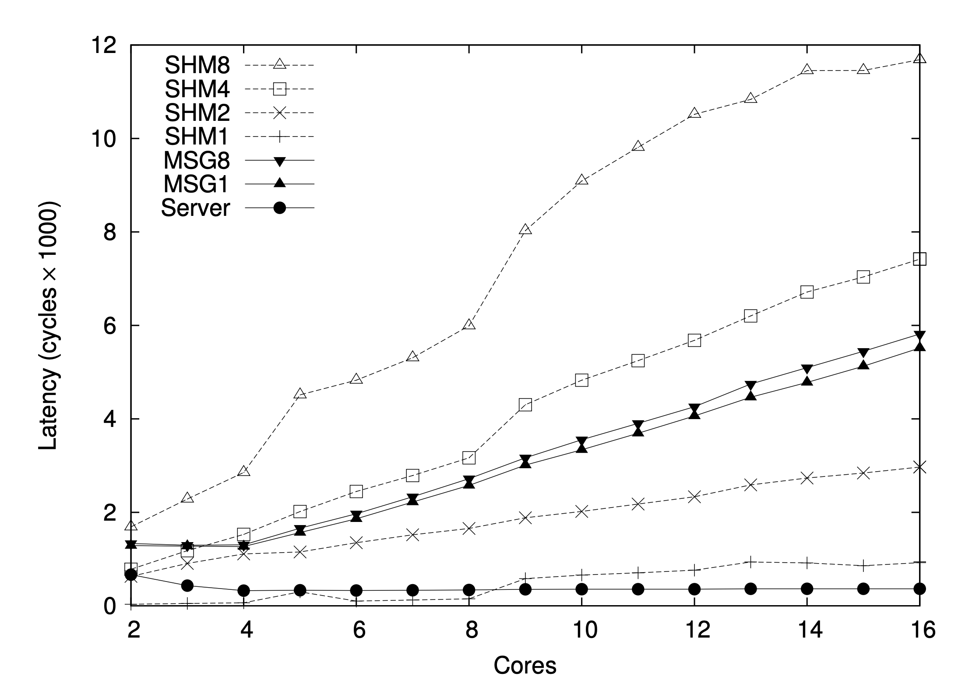
Argument: message passing cheaper than shared memory

Slide 7
Make OS structure hardware-neutral.
Separate OS structure from physical instantiation: abstraction!
Only message transport and hardware interfaces are machine-specific
Minimizes code change to OS
Separate IPC protocols from hardware implementation
Performance/extensibility benefits

Slide 8
View state as replicated instead of shared.
Shared state is accessed as a local replica
Shared state consistency through messages
Consistency reqs tunable using diff protocols
Reduces interconnect traffic and synchronization overhead
Fault-tolerant to failures in CPUs

Slide 9
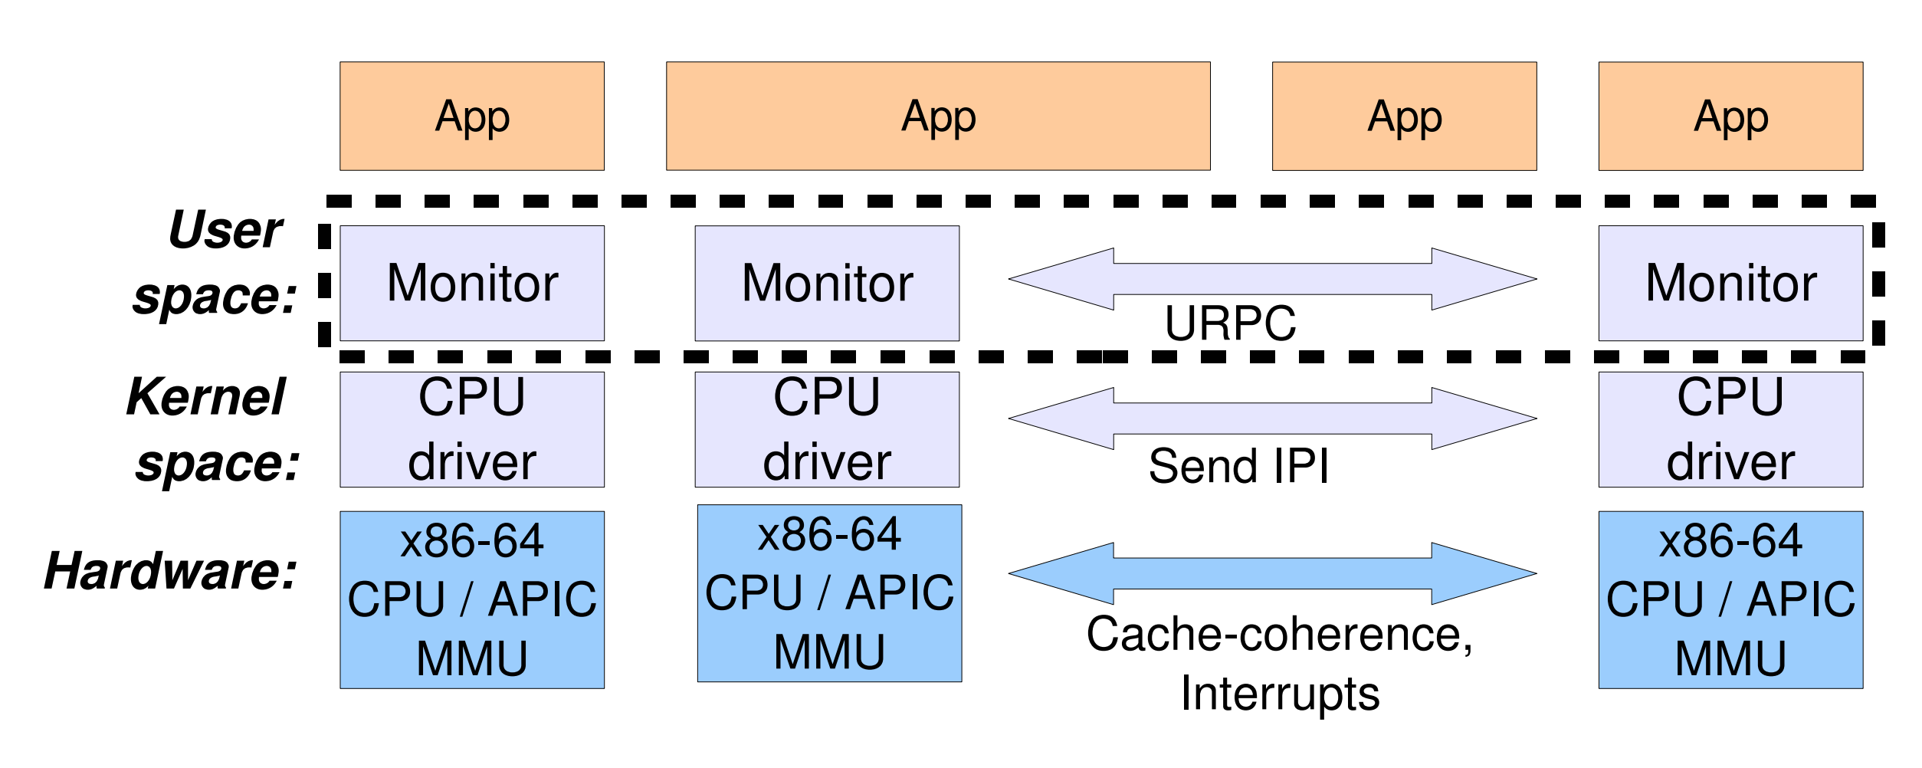
Barrelfish Implementation

Slide 10
CPU Drivers
Very hardware specific
Exokernel like resource abstraction and protection
Including hardware interrupts
Provides IPC for just the single core

Slide 11
Monitors
Responsible for coordination across cores
Provide inter-core communication and message queues
Maintain replicated state
Provides OS-like management of system

Slide 12
Processes
Set of dispatcher objects, one per core
Still have virtual memory
Thread Pool
Scheduler
Dispatcher
Dispatcher
Dispatcher
Core 1
Core 2
Core 3

Slide 13
Knowledge core
Represent system properties as logic expressions
Also can include runtime measurements
Helps with mapping runtime needs to differing physical hardware

Slide 14
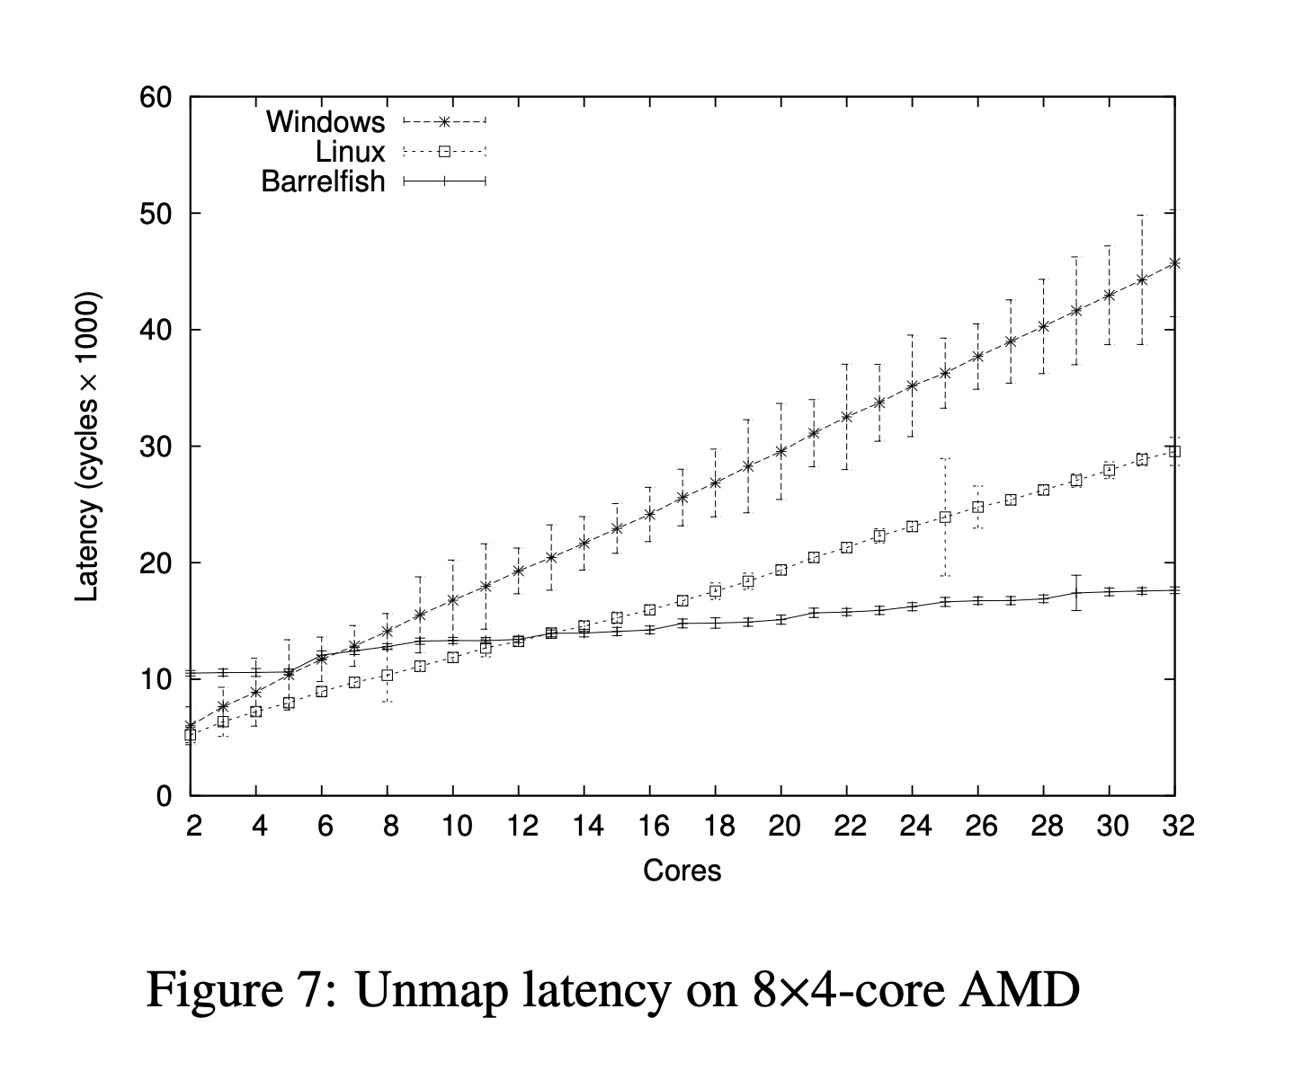
Does it work?

Slide 15
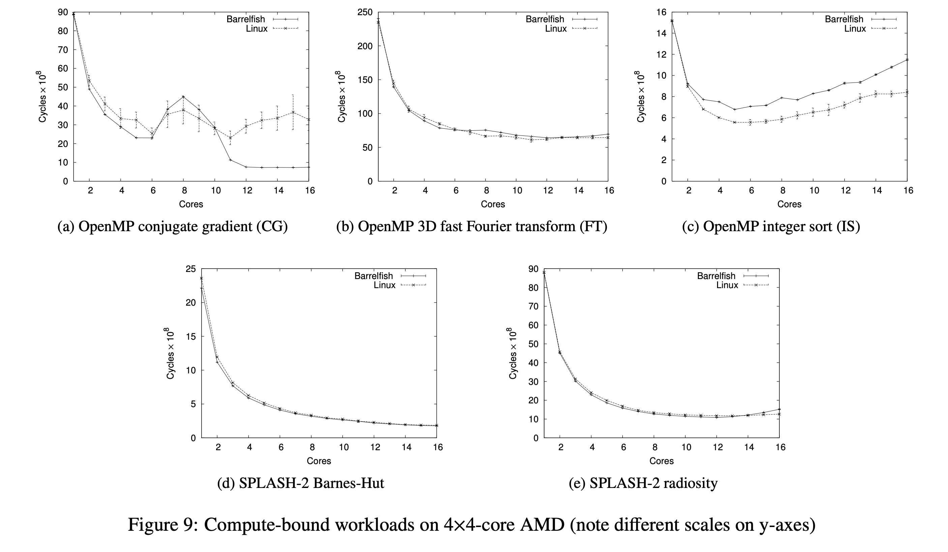
Does it work?

Slide 16
Question 1
How would you implement a scheduler in a multikernel environment?

Slide 17
Question 2
Should smartphones run a multikernel OS?

