Slide 1
CS6456: Graduate Operating Systems
Brad Campbell – bradjc@virginia.edu
https://www.cs.virginia.edu/~bjc8c/class/cs6456-f19/

Slide 2
What is virtualization?
Virtualization is the ability to run multiple operating systems on a single physical system and share the underlying hardware resources¹
Allows one computer to provide the appearance of many computers.
Goals:
  Provide flexibility for users
  Amortize hardware costs
  Isolate completely separate users
¹ VMWare white paper, Virtualization Overview

Slide 3
Formal Requirements for Virtualizable Third Generation Architectures
“First, the VMM provides an environment for programs which is essentially identical with the original machine;
second, programs run in this environment show at worst only minor decreases in speed;
and last, the VMM is in complete control of system resources.”

Slide 4
Native and Hosted VM Systems
Guest Applications
Guest OS
VMM
Host OS
Hardware
Guest Applications
Guest OS
VMM
Host OS
Hardware
Guest Applications
Guest OS
VMM
Hardware
Applications
OS
Hardware
Nonprivileged
modes
Privileged
modes
Traditional
Uniprocessor
System
Native
VM System
User-mode
Hosted
VM System
Dual-mode
Hosted
VM System

Slide 5
VMM Platform Types
Hosted Architecture
Install as application on existing x86 “host” OS, e.g. Windows, Linux, OS X
Small context-switching driver
Leverage host I/O stack and resource management
Examples: VMware Player/Workstation/Server, Microsoft Virtual PC/Server, Parallels Desktop
Bare-Metal Architecture
“Hypervisor” installs directly on hardware
Acknowledged as preferred architecture for high-end servers
Examples: VMware ESX Server, Xen, Microsoft Viridian (2008)

Slide 6
Virtualization: rejuvenation
1960’s: first track of virtualization
  Time and resource sharing on expensive mainframes
  IBM VM/370
Late 1970s and early 1980s: became unpopular
  Cheap hardware and multiprocessing OS
Late 1990s: became popular again
  Wide variety of OS and hardware configurations
  VMWare
Since 2000: hot and important
  Cloud computing
  Docker containers

Slide 7
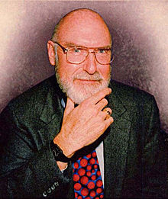
IBM VM/370
Robert Jay Creasy (1939-2005)
  Project leader of the first full virtualization hypervisor: IBM CP-40, a core component in the VM system
  The first VM system: VM/370

Slide 8
IBM VM/370
Conversational Monitor System (CMS)
Specialized VM subsystem (RSCS, RACF, GCS)
Mainstream OS (MVS, DOS/VSE etc.)
Another copy of VM
Virtual machines
Hypervisor
Control Program (CP)
Hardware
System/370

Slide 9
IBM VM/370
Technology: trap-and-emulate
Application
Normal
Kernel
Privileged
Trap
Emulate
CP

Slide 10
Trap and Emulate Virtualization on x86 architecture
Challenges
  Correctness: not all privileged instructions produce traps!
    Example: popf
      popf does different things in kernel mode vs. user mode
  Performance:
    System calls: traps in both enter and exit (10X)
    I/O performance: high CPU overhead
    Virtual memory: no software-controlled TLB

Slide 11
Virtualization on x86 architecture
Solutions:
  Dynamic binary translation & shadow page table
  Para-virtualization (Xen)
  Hardware extension

Slide 12
Dynamic binary translation
Idea: intercept privileged instructions by changing the binary
Cannot patch the guest kernel directly (would be visible to guests)
Solution: make a copy, change it, and execute it from there
  Use a cache to improve the performance

Slide 13
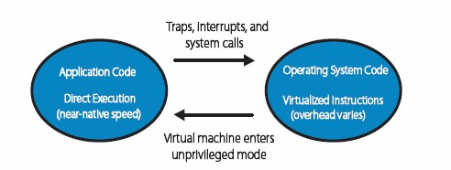
Binary translation
Directly execute unprivileged guest application code
Will run at full speed until it traps, we get an interrupt, etc.
“Binary translate” all guest kernel code, run it unprivileged
Since x86 has non-virtualizable instructions, proactively transfer control to the VMM (no need for traps)
Safe instructions are emitted without change
For “unsafe” instructions, emit a controlled emulation sequence
VMM translation cache for good performance

Slide 14
How does VMWare do this?
Binary – input is x86 “hex”, not source
Dynamic – interleave translation and execution
On Demand – translate only what about to execute (lazy)
System Level – makes no assumptions about guest code
Subsetting – full x86 to safe subset
Adaptive – adjust translations based on guest behavior

Slide 15
Convert unsafe operations and cache them
Input: BB
55 ff 33 c7 03 ...
Each Translator Invocation
• Consume a basic block (BB)
• Produce a compiled code fragment (CCF)
Store CCF in Translation Cache
• Future reuse
• Capture working set of guest kernel
• Amortize translation costs
• Not “patching in place”
translator
Output: CCF
55 ff 33 c7 03 ...

Slide 16
Dynamic binary translation
Pros:
  Make x86 virtualizable
  Can reduce traps
Cons:
  Overhead
  Hard to improve system calls, I/O operations
  Hard to handle complex code

Slide 17
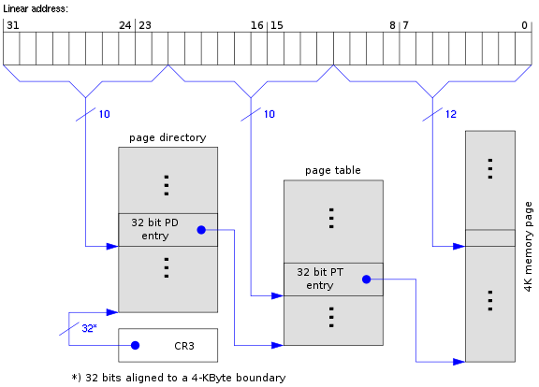
Shadow page table

Slide 18
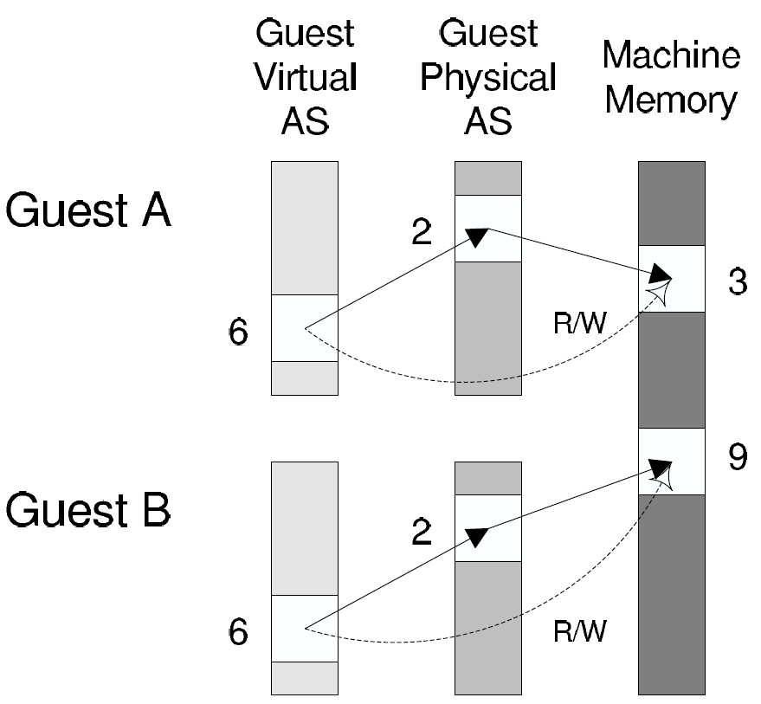
Shadow page table
Guest page table
Shadow page table

Slide 19
Shadow page table
Pros:
  Transparent to guest VMs
  Good performance when working set is stable
Cons:
  Big overhead of keeping two page tables consistent
  Introducing more issues: hidden fault, double paging …

Slide 20
Xen

Slide 21
Xen and the art of virtualization
SOSP’03
Very high impact (data collected in 2013)
8807
3090
2116

Slide 22
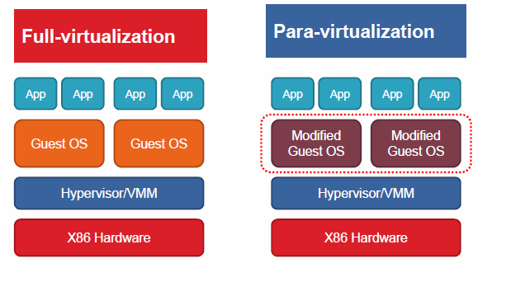
Para-virtualization
Full vs. para virtualization

Slide 23
Overview of the Xen approach
Support for unmodified application binaries (but not OS)
  Keep Application Binary Interface (ABI)
Modify guest OS to be aware of virtualization
  Get around issues of x86 architecture
  Better performance
Keep hypervisor as small as possible
  Device driver is in Dom0

Slide 24
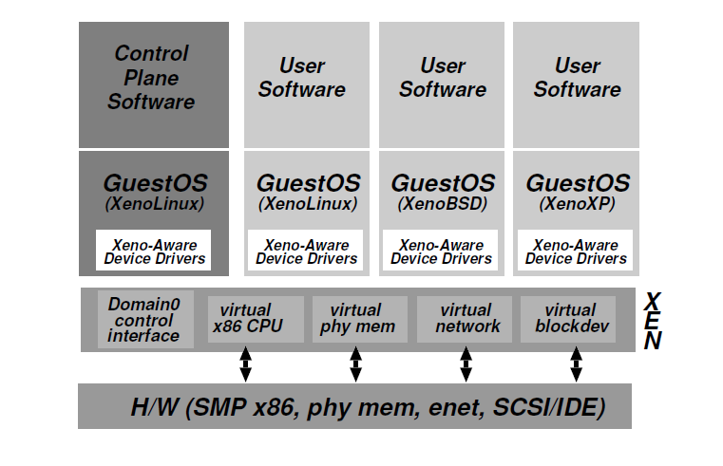
Xen architecture

Slide 25
Virtualization on x86 architecture
Challenges
  Correctness: not all privileged instructions produce traps!
    Example: popf
  Performance:
    System calls: traps in both enter and exit (10X)
    I/O performance: high CPU overhead
    Virtual memory: no software-controlled TLB

Slide 26
CPU virtualization
Protection
  Xen in ring0, guest kernel in ring1
  Privileged instructions are replaced with hypercalls
Exception and system calls
  Guest OS registers handles validated by Xen
  Allowing direct system call from app into guest OS
  Page fault: redirected by Xen

Slide 27
CPU virtualization (cont.)
Interrupts:
  Lightweight event system
Time:
  Interfaces for both real and virtual time

Slide 28
Memory virtualization
Xen exists in a 64MB section at the top of every address space
Guest sees real physical address
Guest kernels are responsible for allocating and managing the hardware page tables.
After registering the page table to Xen, all subsequent updates must be validated.

Slide 29
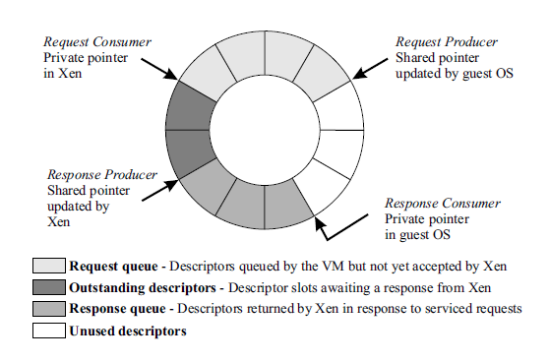
I/O virtualization
Shared-memory, asynchronous buffer descriptor rings

Slide 30
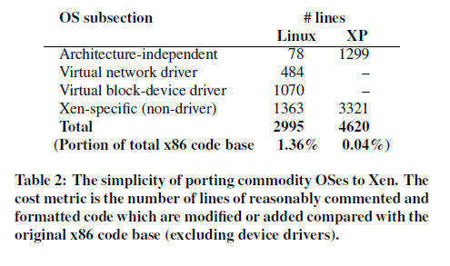
Porting effort is quite low

Slide 31
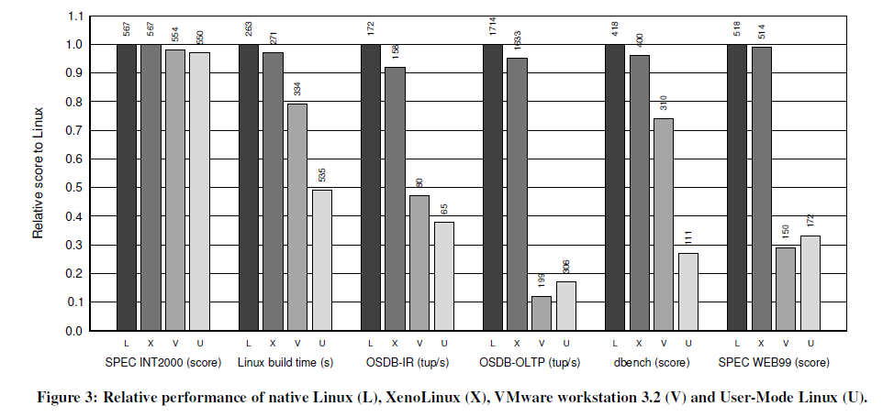
Evaluation

Slide 32
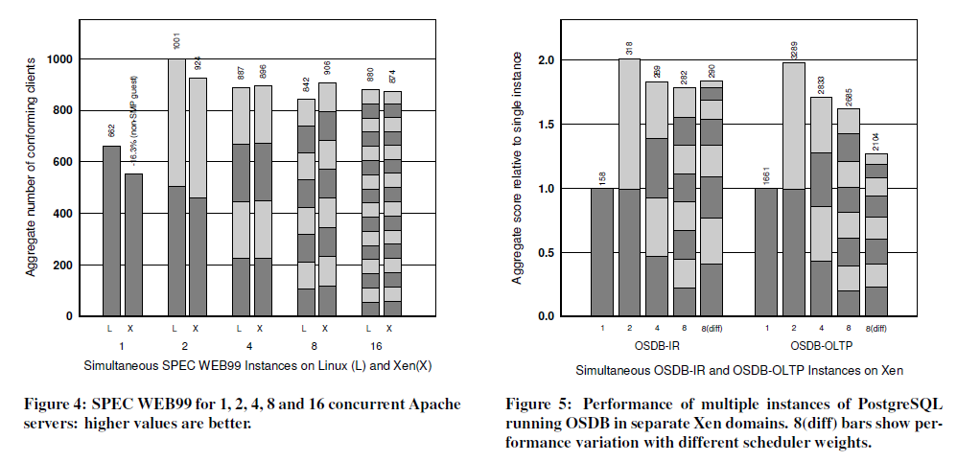
Evaluation

Slide 33
Conclusion
x86 architecture makes virtualization challenging
Full virtualization
  unmodified guest OS; good isolation
  Performance issue (especially I/O)
Para virtualization:
  Better performance (potentially)
  Need to update guest kernel
Full and para virtualization will keep evolving together

Slide 34
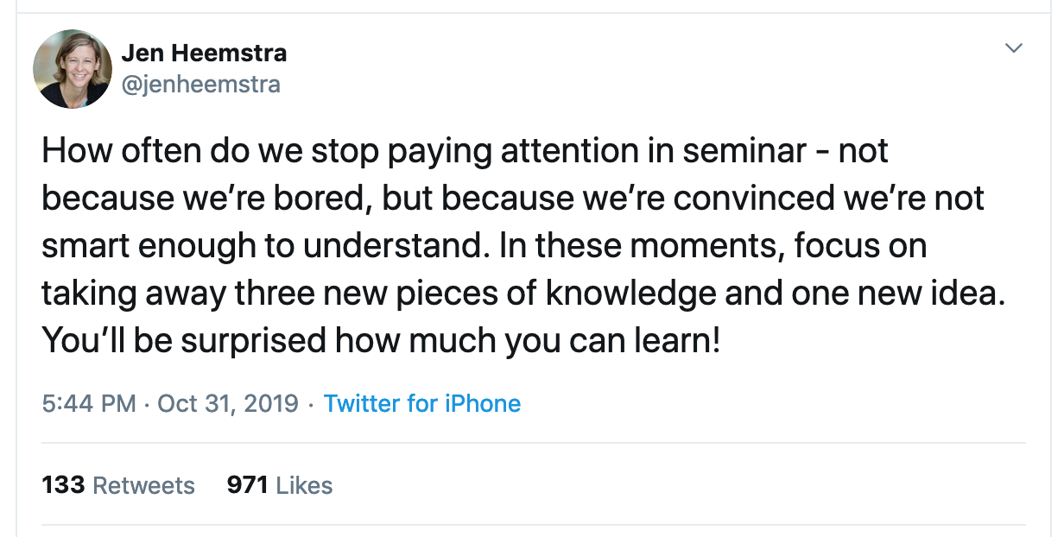
Corollary: How often do we lose our audience?
  My tip: put the point of the slide directly in the title
    “Evaluation”
    vs.
    “Xen is 1.1x to 3x more performant than VMWare”

Slide 35
Instead: Leverage hardware support
First generation - processor
Second generation - memory
Third generation – I/O device
  In progress

Slide 36
IA Protection Rings (CPL)
Actually, IA has four protection levels, not two (kernel/user).
IA/X86 rings (CPL)
  Ring 0 – “Kernel mode” (most privileged)
  Ring 3 – “User mode”
  Ring 1 & 2 – Other
Linux only uses 0 and 3.
  “Kernel vs. user mode”
Pre-VT Xen modified to run the guest OS kernel to Ring 1: reserve Ring 0 for hypervisor.
CPU Privilege Level (CPL)
[Fischbach]

Slide 37
Why aren’t (IA) rings good enough?
VM
CPL 3
guest kernel
CPL 1
hypervisor
CPL 0
???

Slide 38
A short list of pre-VT problems
Early IA hypervisors (VMware, Xen) had to emulate various machine behaviors and generally bend over backwards.
IA32 page protection does not distinguish CPL 0-2.
  Segment-grained memory protection only.
Ring aliasing: some IA instructions expose CPL to guest!
  Or fail silently…
Syscalls don’t work properly and require emulation.
  sysenter always transitions to CPL 0. (D’oh!)
  sysexit faults if the core is not in CPL 0.
Interrupts don’t work properly and require emulation.
  Interrupt disable/enable reserved to CPL0.

Slide 39
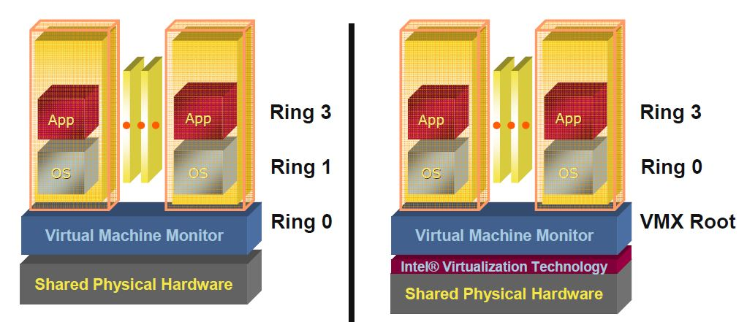
First generation: Intel VT-x & AMD SVM
Eliminating the need of binary translation or modifying OSes
Host mode
Guest mode
Ring3
Ring3
VMRUN
Ring2
Ring2
Ring1
VMEXIT
Ring1
Ring0
Ring0

Slide 40
VT in a Nutshell
New VM mode bit
  Orthogonal to CPL (e.g., kernel/user mode)
If VM mode is off → host mode
  Machine “looks just like it always did” (“VMX root”)
If VM bit is on → guest mode
  Machine is running a guest VM: “VMX non-root mode”
  Machine “looks just like it always did” to the guest, BUT:
  Various events trigger gated entry to hypervisor (in VMX root)
  A “virtualization intercept”: exit VM mode to VMM (VM Exit)
  Hypervisor (VMM) can control which events cause intercepts
  Hypervisor can examine/manipulate guest VM state and return to VM (VM Entry)

Slide 41
CPU Virtualization With VT-x
Two new VT-x operating modes
  Less-privileged mode
  (VMX non-root) for guest OSes
  More-privileged mode
  (VMX root) for VMM
Two new transitions
  VM entry to non-root operation
  VM exit to root operation
Virtual Machines (VMs)
Ring 3
Apps
Apps
Ring 0
OS
OS
VM Exit
VM Entry
VMX
Root
VM Monitor (VMM)
Execution controls determine when exits occur
  Access to privilege state, occurrence of exceptions, etc.
  Flexibility provided to minimize unwanted exits
VM Control Structure (VMCS) controls VT-x operation
  Also holds guest and host state

Slide 42
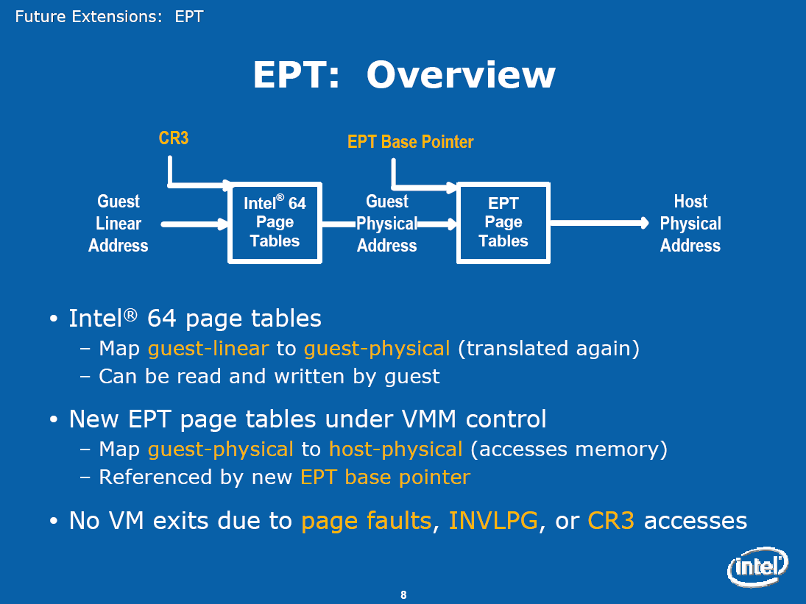
Second generation: Intel EPT & AMD NPT
Eliminating the need to shadow page table

Slide 43
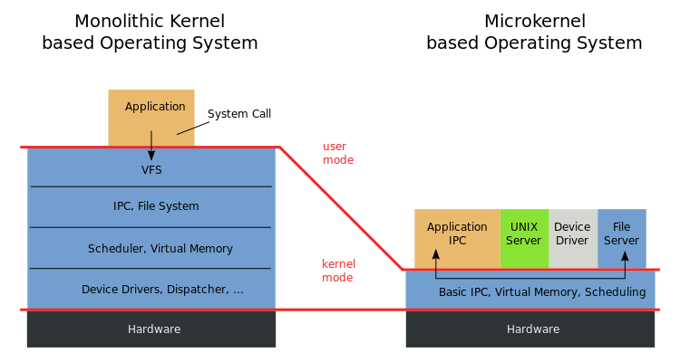
Microkernel vs. VMM(Xen)
Virtual Machine Monitor (VMM): “… software which transforms the single machine interface into the illusion of many. Each of these interfaces (virtual machines) is an efficient replica of the original computer system, complete with all of the processor instructions …“
-- Robert P. Goldberg. Survey of virtual machine research. 1974
Microkernel: "... to minimize the kernel and to implement whatever possible outside of the kernel…“
-- Jochen Liedtke. Towards real microkernels. 1996

Slide 44
Are Virtual Machine Monitors Microkernels Done Right?
Steven Hand, Andrew Wareld, Keir Fraser
HotOS’05
VMMs (especially Xen) are microkernels done right
  Avoid liability inversion:
    Microkernels depend on some user level components
  Make IPC performance irrelevant:
    IPC performance is the key in microkernels
  Treat the OS as a component
    Hard for microkernels to support legacy applications

Slide 45
Are Virtual Machine Monitors Microkernels Done Right?
VMMs (especially Xen) are microkernels done right.
  Avoid liability inversion:
    Microkernels depend on some user level components
  Make IPC performance irrelevant:
    IPC performance is the key in microkernels
  Treat the OS as a component
    Hard for microkernels to support legacy applications
Gernot Heiser, Volkmar Uhlig, Joshua LeVasseur
ACM SIGOPS’06
Really??
Xen also relies on Dom0!
Xen performs the same number of IPC!
Look at L4Linux!

Slide 46
Discussion
What is the difference between VMMs and microkernels?
Why do VMMs seem to be more successful than microkernels?

Slide 47
Conclusion (again)
Virtualization: creating a illusion of something
Virtualization is a principle approach in system design
  OS is virtualizing CPU, memory, I/O …
  VMM is virtualizing the whole architecture
  What else? What next?

Slide 48
Containers and isolation

Slide 49
Containers: idea
Run a process with a restricted view of system resources
  Hide other processes
  Limit access to system resources
Not full virtualization
  Process must use existing kernel and OS

Slide 50
Pre-container isolation features in Linux
chroot
  Set the current root directory for processes
  Added to Unix in 1979
Namespaces
  Provide processes with their own view of resources
    Process IDs, networking sockets, hostnames, etc.
  Akin to virtual address spaces
  Originally introduced in 2002
Copy-on-Write Filesystem
  Allow a process to view existing filesystem, but any modifications result in copies then updates
  Akin to virtual memory after fork

Slide 51
cgroups in Linux
Enforce policies to restrict how processes use resources
  Example: A process can only use 1 Mbps of network bandwidth
Policies are enforced on groups of processes
Controllers enforce various processes

Slide 52
cgroups are hierarchical
Resources inherited from parent groups
Processes can only be in leaf groups

Slide 53
Controllers enforce restrictions for cgroups
Different controllers for different system resources
Each provides a policy for how processes should be restricted

Slide 54
Controllers in Linux
io
  Limit I/O requests either capped per process or proportionally.
memory
  Enforce memory caps on processes
pids
  Limit number of new processes in a cgroup
perf_event
  Allow monitoring performance
rdma
  Limit remote DMA
cpu
  Limit CPU usage when CPU is busy
freezer
  Allow suspending all processes in a cgroup

Slide 55
cgroups + namespaces + CoW
Enable containerized processes on a shared kernel
Lightweight virtualization

Slide 56
Docker
Docker provides an interface on top of these underlying designs
  Popularized containers
Also includes packaging a filesystem in a docker image
  Provides more of a “virtual machine” notion
  But processes still running on existing kernel
Interesting case in commercializing
existing OS functionality

Slide 57
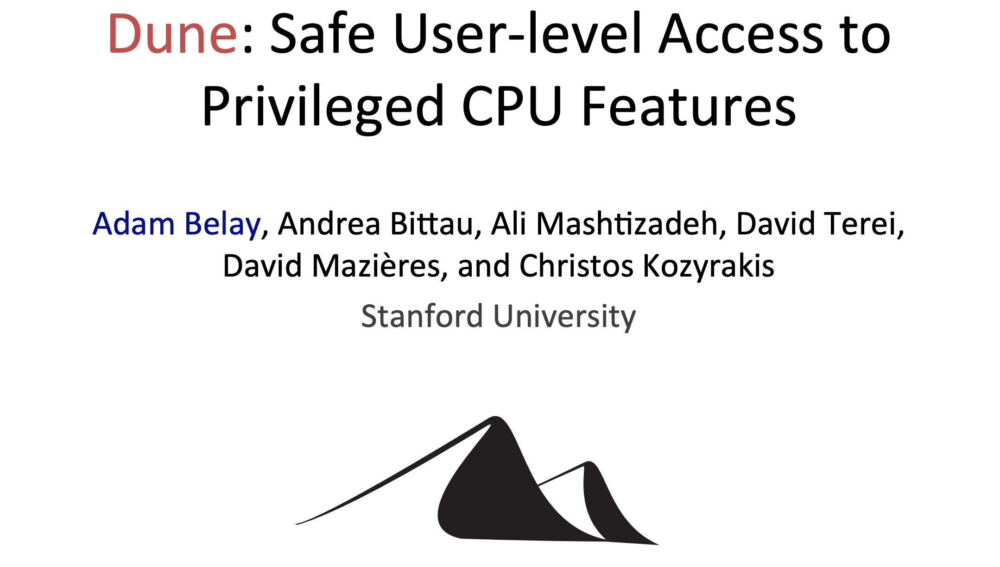
Third generation: Intel VT-d & AMD IOMMU
I/O device assignment
  VM owns real device
DMA remapping
  Support address translation for DMA
Interrupt remapping
  Routing device interrupt
OSDI’12

Slide 58
Run App as a “process” in guest mode, and let it use all CPLs.

Slide 59
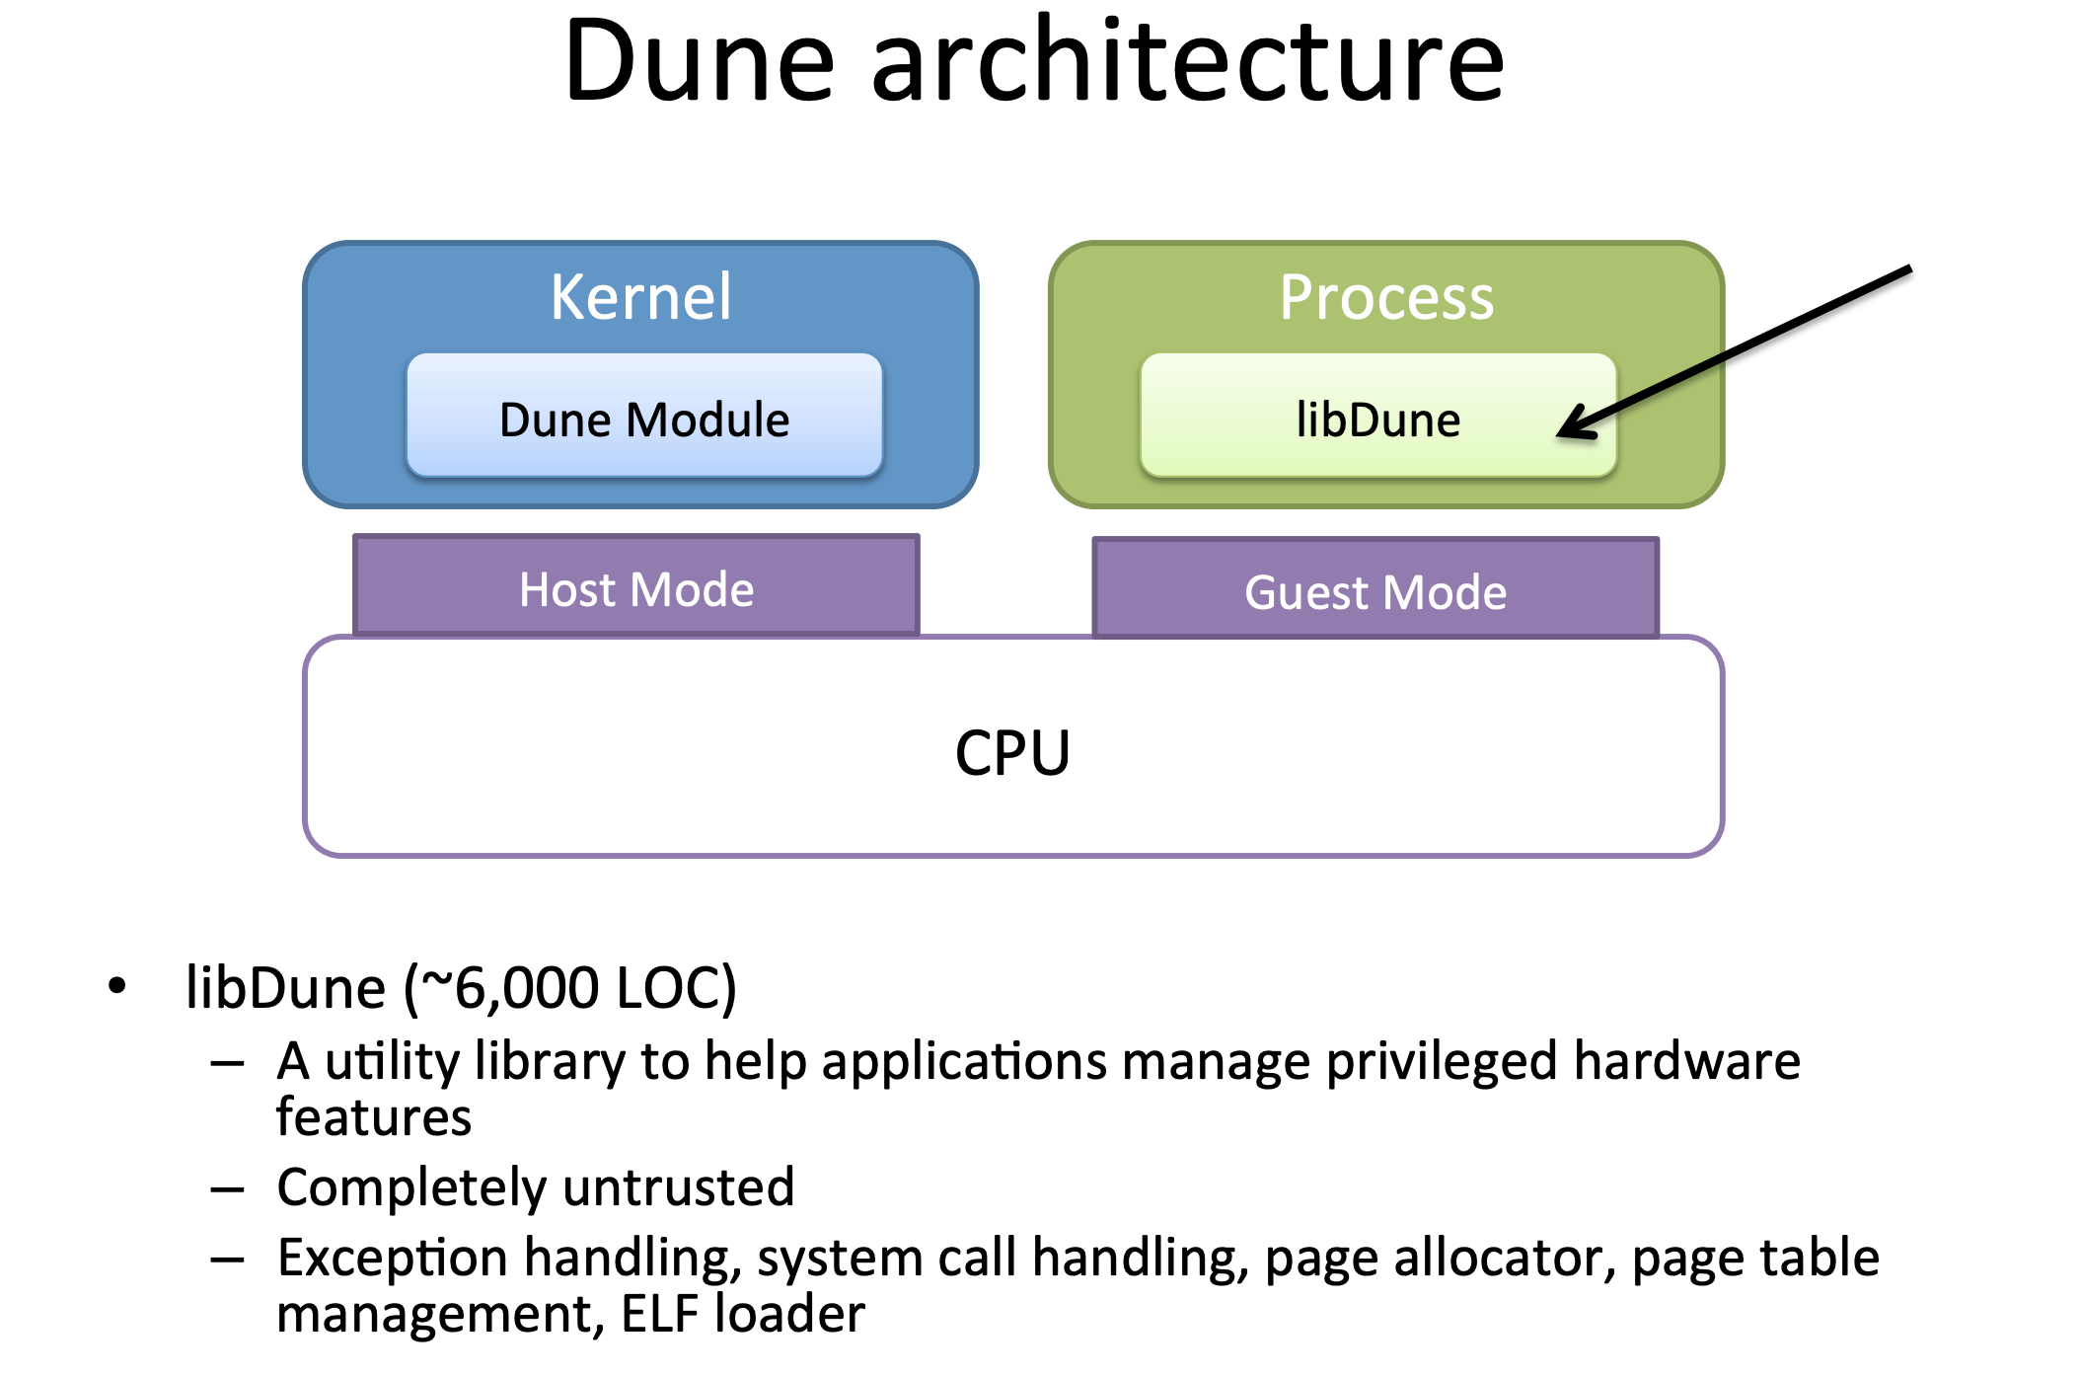

Slide 60
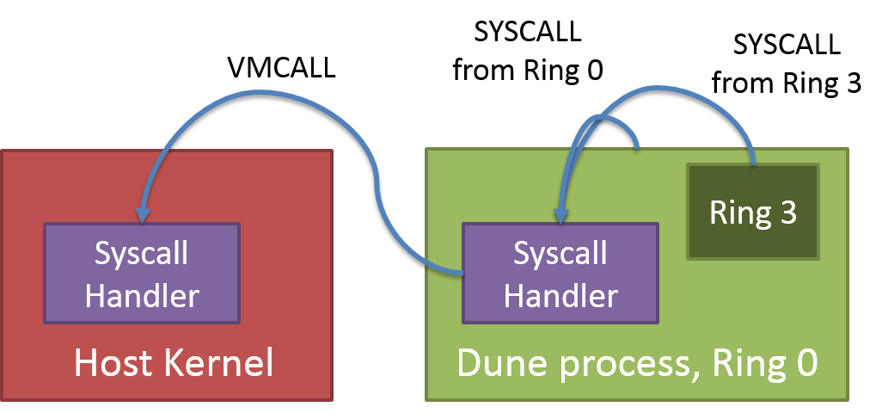
Hypervisor calls
VT VMCALL operation (an instruction) voluntarily traps to hypervisor.
Similar to SYSCALL to trap to kernel mode.
Not needed for transparent virtualization: but Dune uses it to call the “real” kernel.

