Slide 1
CS6501/ECE6501 IoT Sensors and Systems
September 11, 2017
Brad Campbell – bradjc@virginia.edu
http://www.cs.virginia.edu/~bjc8c/class/cs6501-f17/

Slide 2
SeaGlass: Enabling City-Wide IMSI-Catcher Detection
Peter Ney, Ian Smith, Gabriel Cadamuro, and Tadayoshi Kohno
Privacy Enhancing Technologies 2017

Slide 3
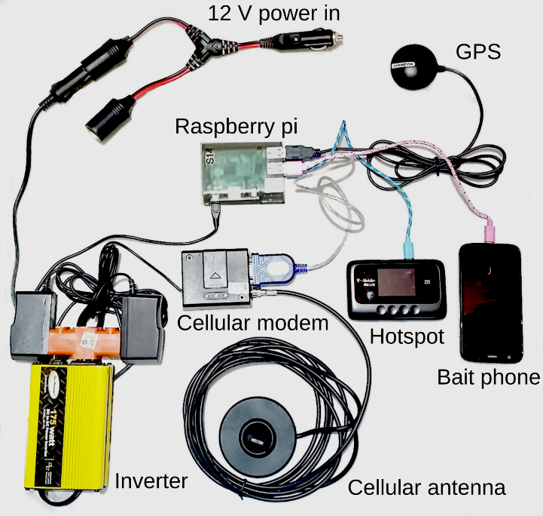

Slide 4
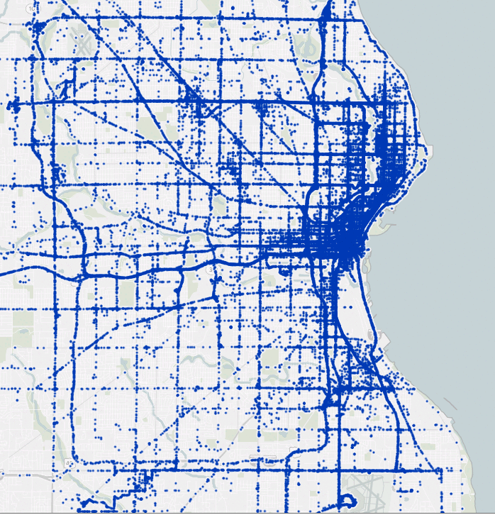

Slide 6
Why?
To try to detect IMSI-catchers
Generate a data set that is currently hidden from the public

Slide 7
Hypotheses
“We argue that the community—and those engaged in the policy debate surrounding cell-site simulator usage—would benefit from additional, independent sources of information on cell-site simulators.”
A crowd-sourced scan of normal 2G basestations will have predictable and stable characteristics, and anomalies in signal strength, duration, consistency, and settings can be detected and will identify IMSI-catchers.

Slide 8
How?

Slide 9
Challenges?
Why is this hard?
What would you have done differently?

Slide 10
Did they find one?

Slide 11
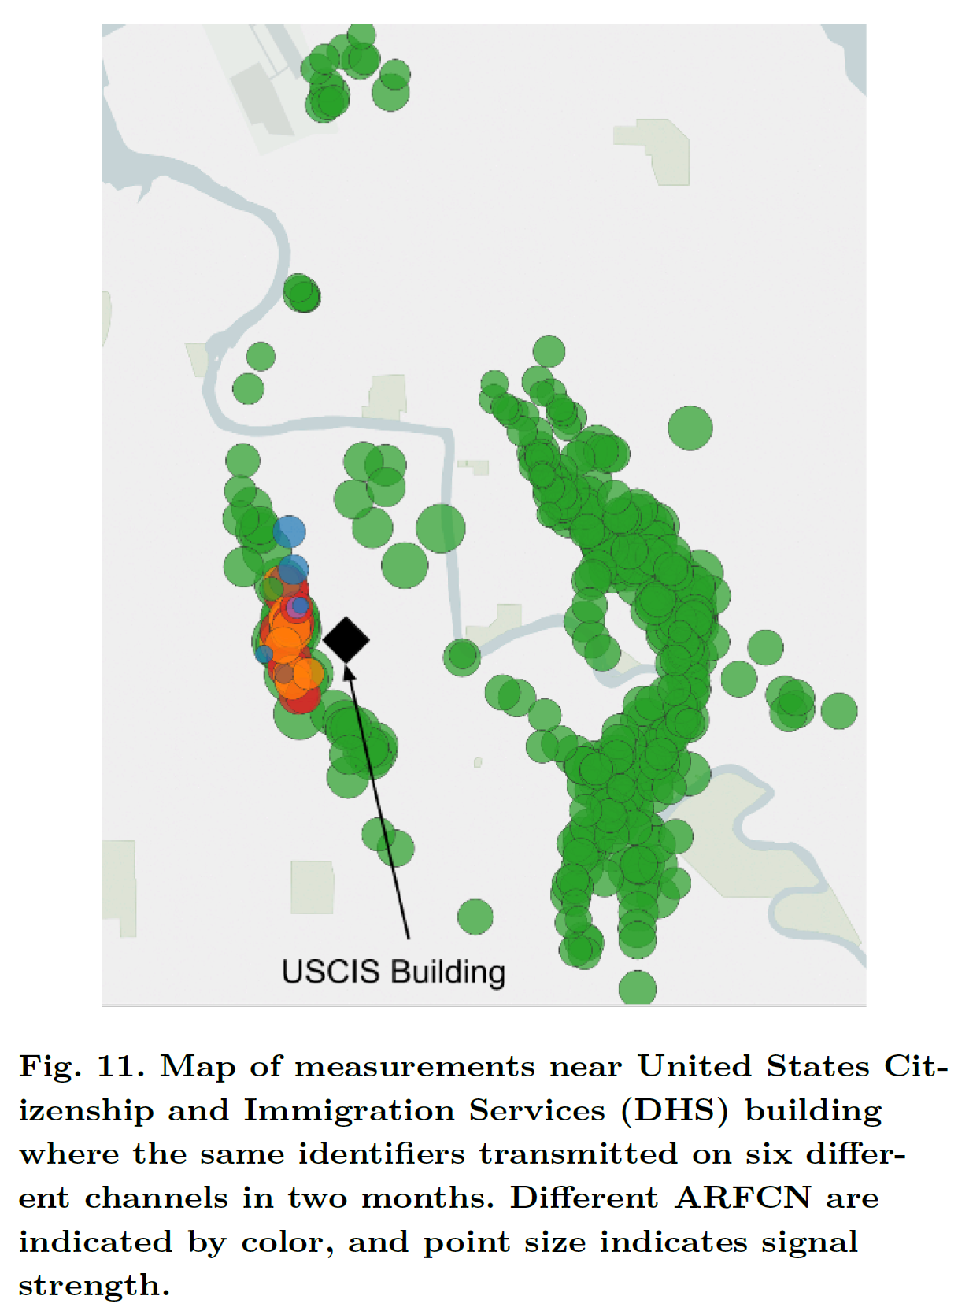

Slide 12
Other thoughts
Is 2G enough? What about Verizon?
Can you pay an Uber driver (with the sensor) to go to a spot to get more measurements?
Is four weeks enough?

Slide 13
Writing good captions

Slide 14
Captions (and figures) are important
Very few people will read a document in its entirety.
Easiest way to quickly “read” a paper is to look at the figures.
Putting key information in captions will get it to more readers.

Slide 15
Good captions do three things.
Identify what the figure is.
Explain what the figure is showing.
Tell you what the takeaway is.
This is the hard one!

Slide 16
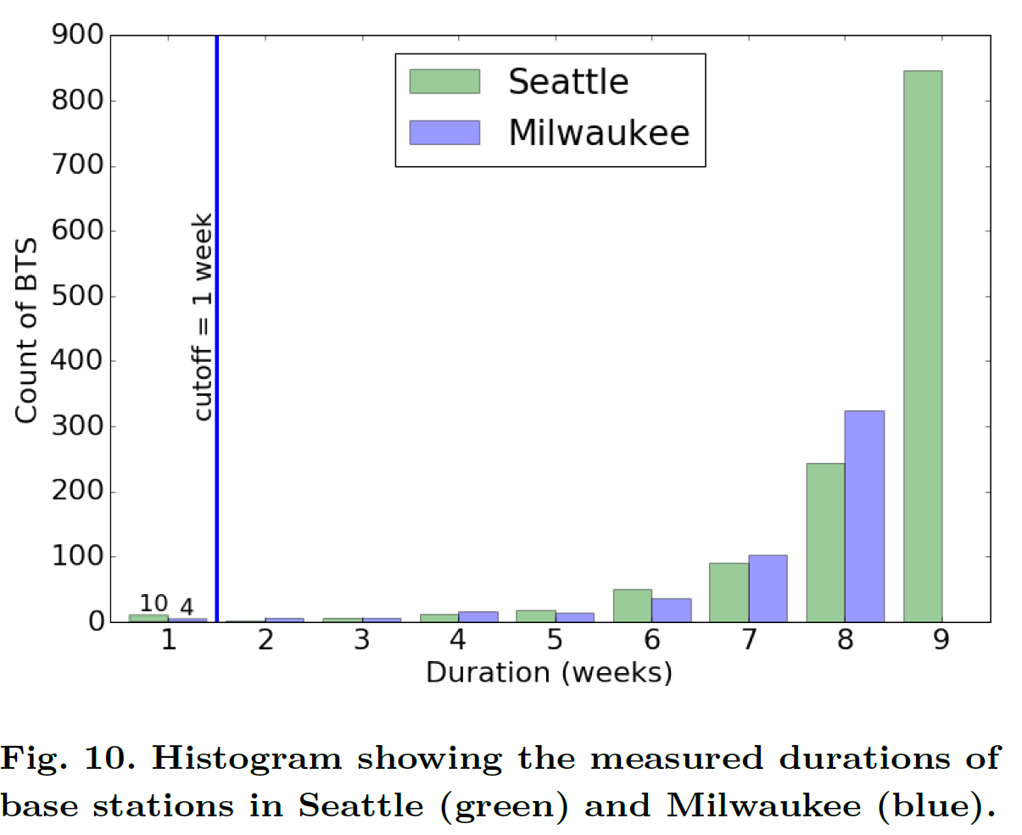
This is a bad caption

Slide 17
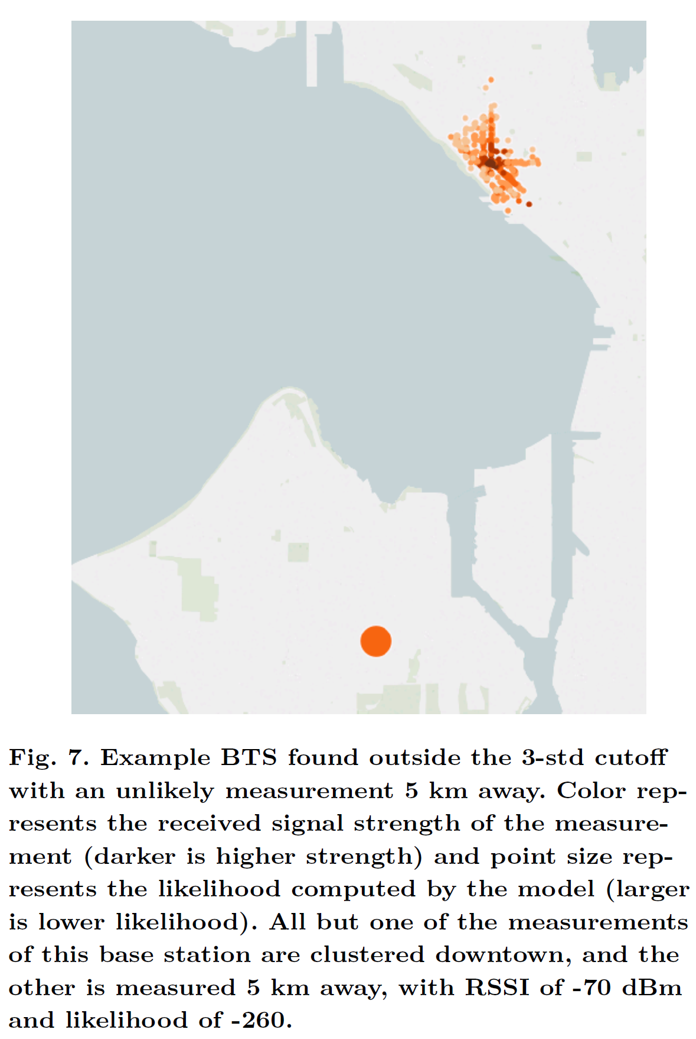
This is better

Slide 18
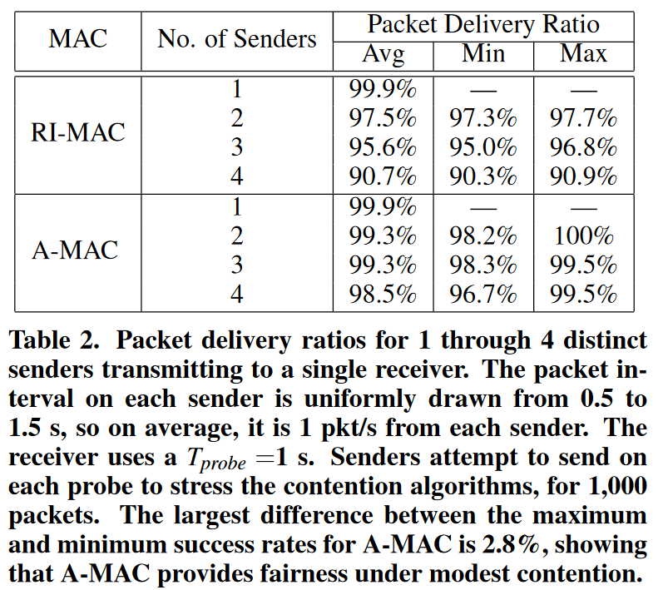
This is a good caption

Slide 19
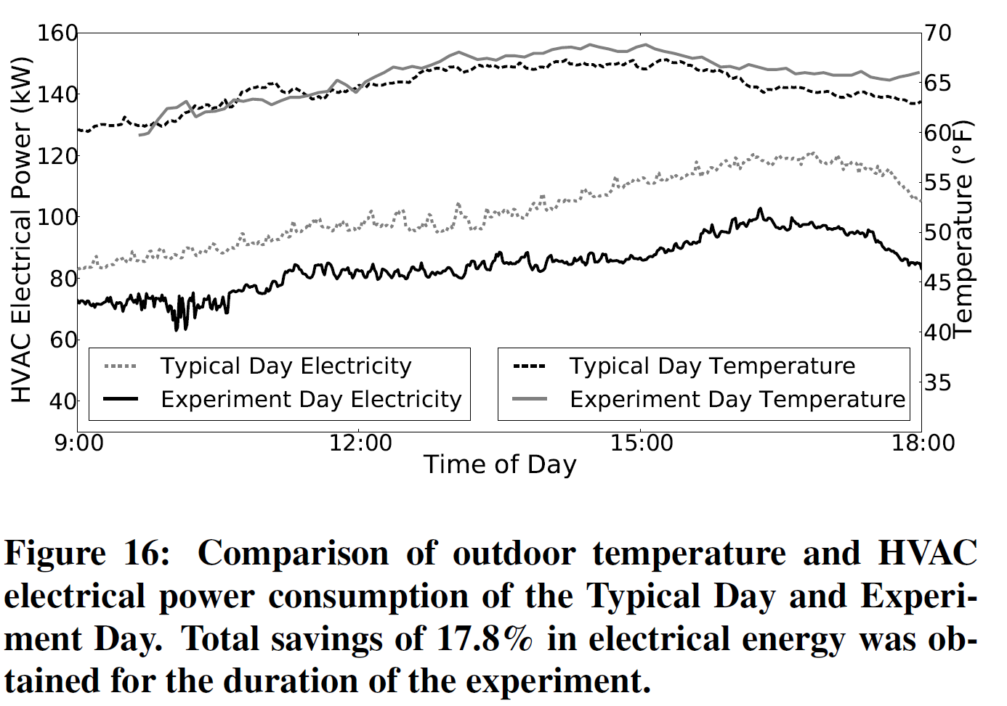
Thoughts?

Slide 20
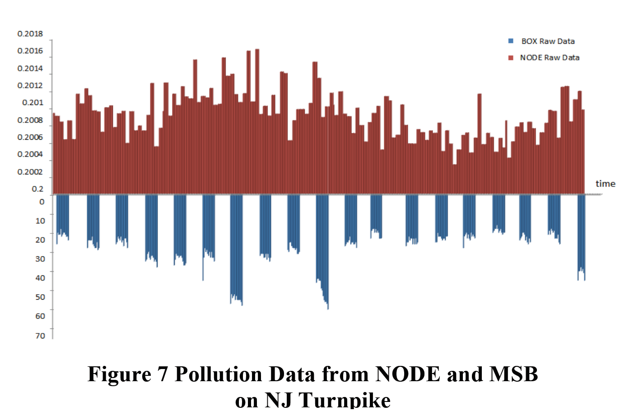
Thoughts?

Slide 21
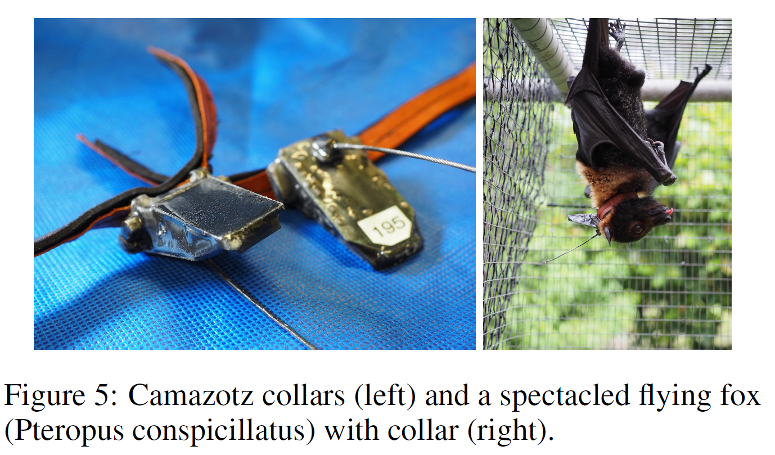
Thoughts?

Slide 22
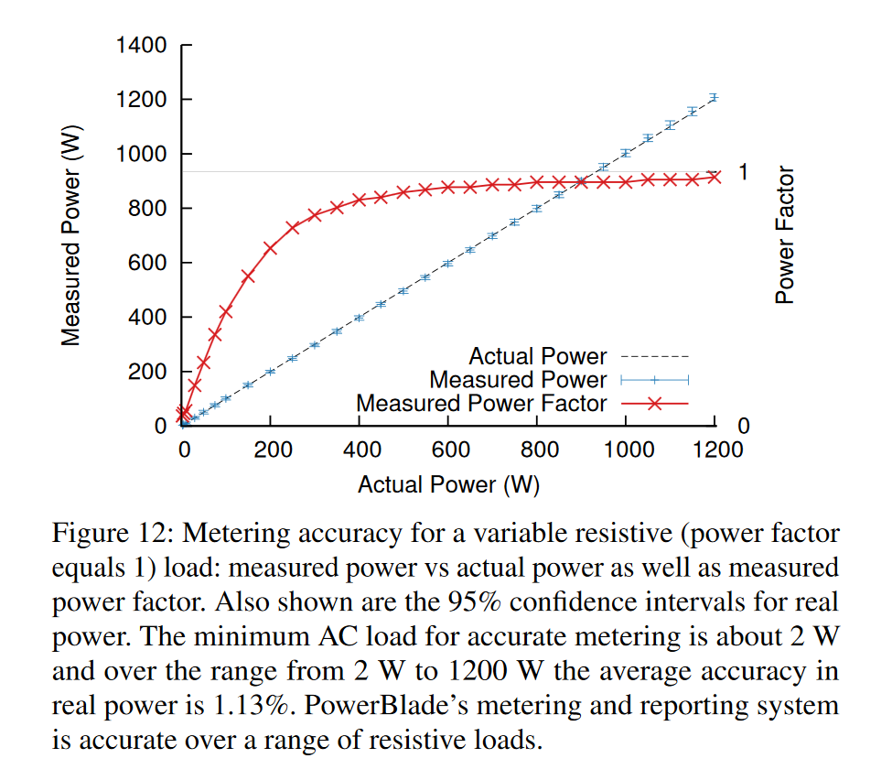
Thoughts?

