Slide 1
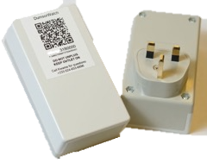
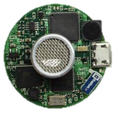
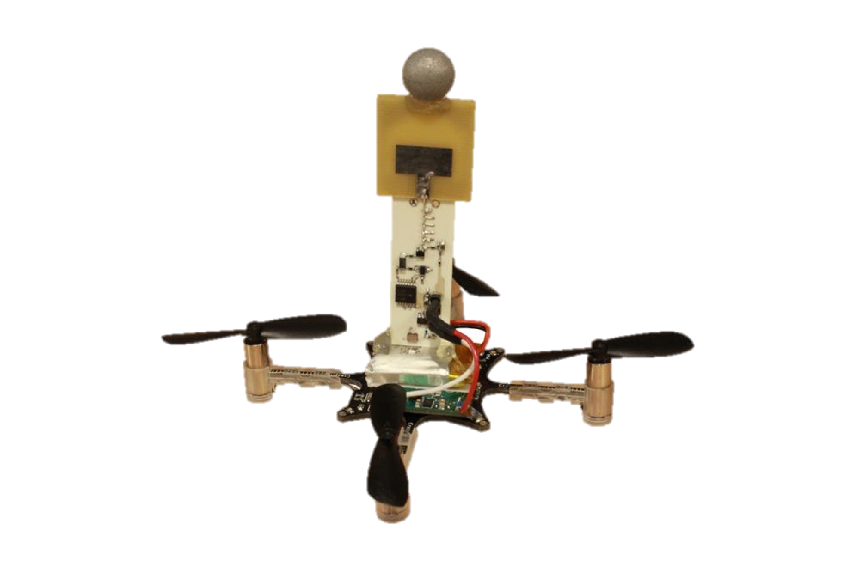
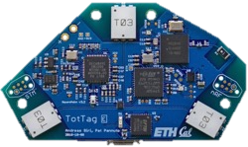
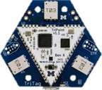
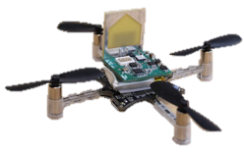
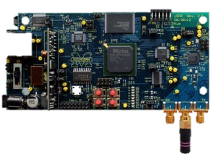
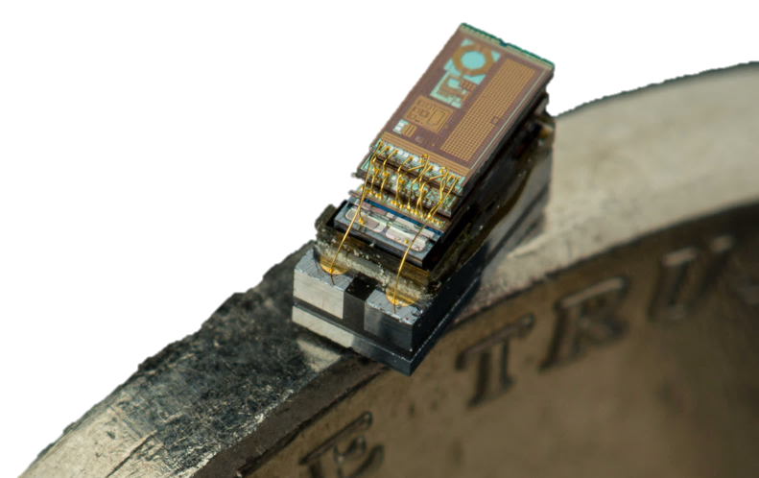

Wireless for the Internet of Things
CS/ECE 4501
Spring 2024
UVA
[Pannuto, Ghena, Campbell]

Slide 2
Today’s Goals
Give you a flavor of what you will learn this semester
Let you know what to expect in this class
Answer your questions

Slide 3
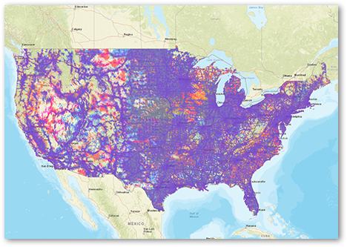
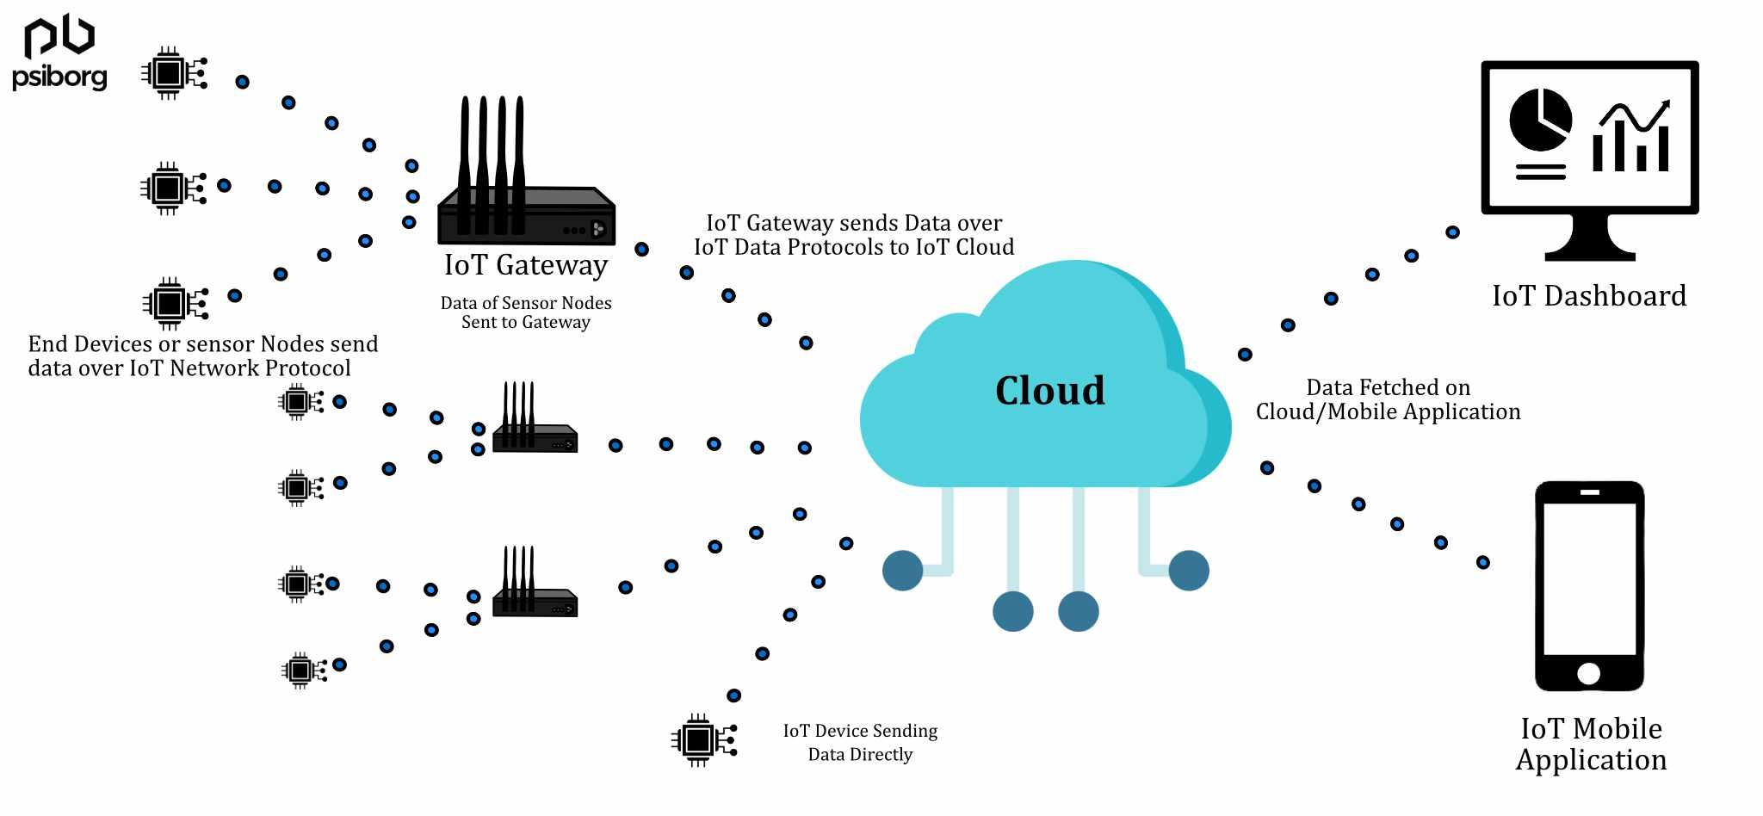
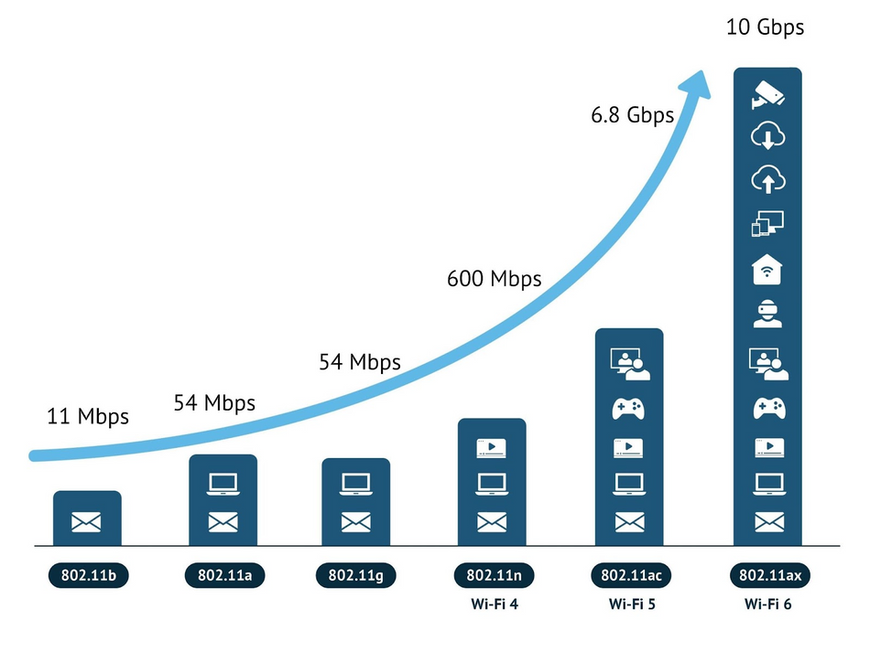
Wireless: a defining technology of the last 30+ years
pollev.com/wiot
LTE Coverage
Do you own a computer that isn’t wireless?
Do you know of any computers without wireless?
WiFi

Slide 4
What does this slide say?

Slide 5
What does this slide say?

Slide 6
And this one?

Slide 7
What about now?

Slide 8
👍♋■ ⮹□◆ ❒♏♋♎ ⧫♒♓⬧ ⬧●♓♎♏✍

Slide 9
APOVLQIZNLCLSMNFPURPCVUAIOQVCPQJLXPENXPPQWJKCI

Slide 10
class wireless we labs in projects . learn this with and

Slide 11
niektóre protokoły bezprzewodowe są lepsze niż inne
Notes:
Anyone speak Polish?

Slide 12
If I have a lot to tell you about this course, I might write like this.

Slide 13
How do you know what this slide says?

Slide 14
Computers face many of the same communication challenges we do
Layers for human communication
  Visual or audio signals (and others)
  Signal vs. noise
  Symbols and sounds
  Alphabet
  Language
  Grammar
Computers use layers for communication as well.
  This class: what are the layers?
  Importantly: why those layers?

Slide 15




$50
$50
$50
$120
$150
$120
$60
$60
$60
$30
$30
$30
$10
$10
$10

Slide 16
Which tool would you use?
What can we optimize for?
When would each be best?
  Sharpie?
  Quill?
  Fine point pens?

Slide 17
Perspective of this course
This class is about wireless protocols
  For a specific domain: the Internet of Things
So we’ll spend some amount of time discussing the Internet of Things and embedded systems

Slide 18

What is the IoT anyway?
Perhaps another good place to start
Let’s define “Internet of Things”
Notes:
Write properties that define IoT

Slide 19
Discussion: what is the Internet of Things?
Name a few Internet of Things devices
What are the qualities that designate those devices at “IoT”?

Slide 20
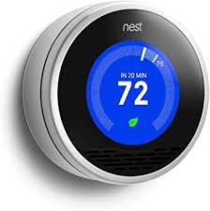
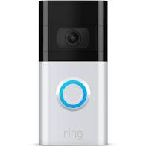



Discussion: what is the Internet of Things?
Name a few Internet of Things devices
What are the qualities that designate those devices at “IoT”?

Slide 21
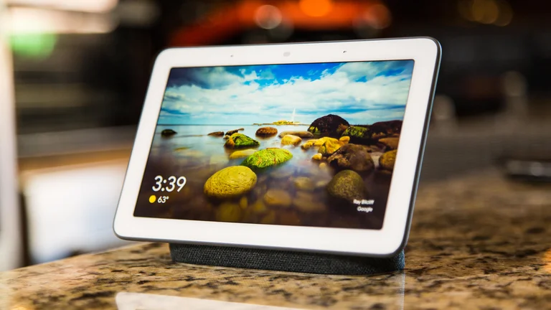
Thought experiment on capabilities
What if the Nest thermostat was powered by…
  a desktop: 8-core x86-64 processor, 32 GB RAM, 1 TB SSD
  a laptop?
  an iPad?
Would that still count as IoT?
Why don’t we see “desktop IoT” in practice?
“Google Nest Hub”

Slide 22
Thought experiment on energy
IoT devices include a mix of batteries, wall power, (and energy-harvesting)
Why do we put so much focus on systems with batteries?
  Why do they need batteries?

Slide 23
The two hardest things in embedded systems / IoT are power and communication
This class is about wireless technologies
  For resource-constrained systems, such as the IoT
We will focus on the tradeoffs between technologies
  How they balance differing constraints
    Power, spectrum, complexity, etc.
  And the technical foundations of these designs and differences

Slide 24
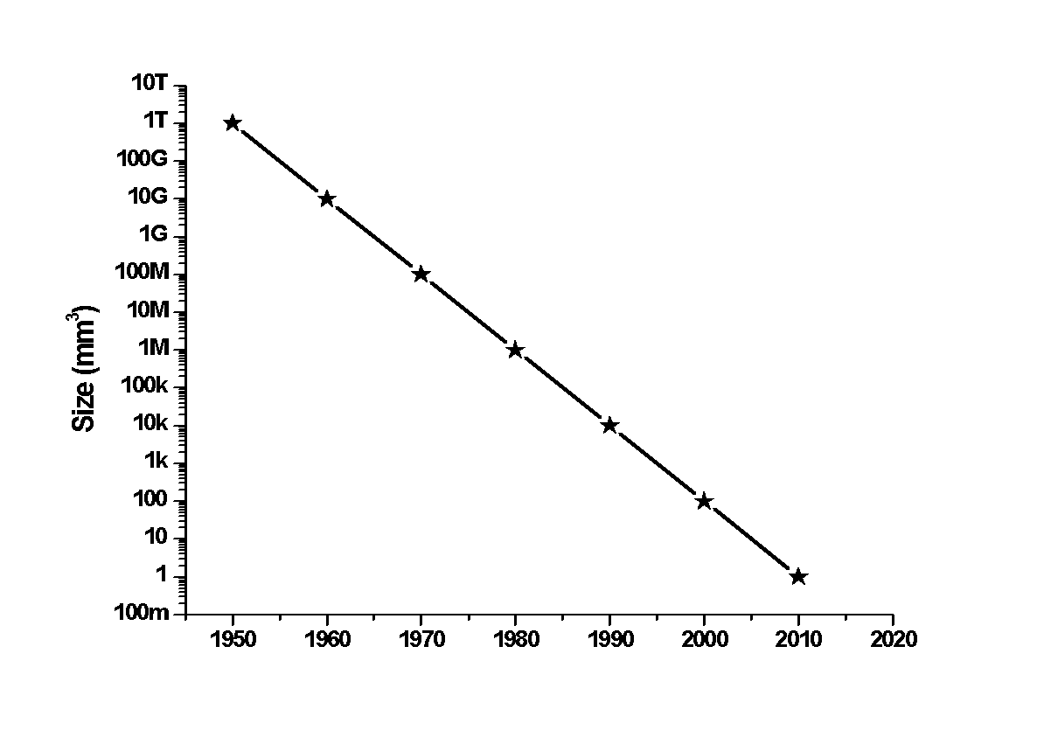

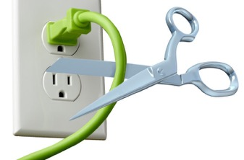
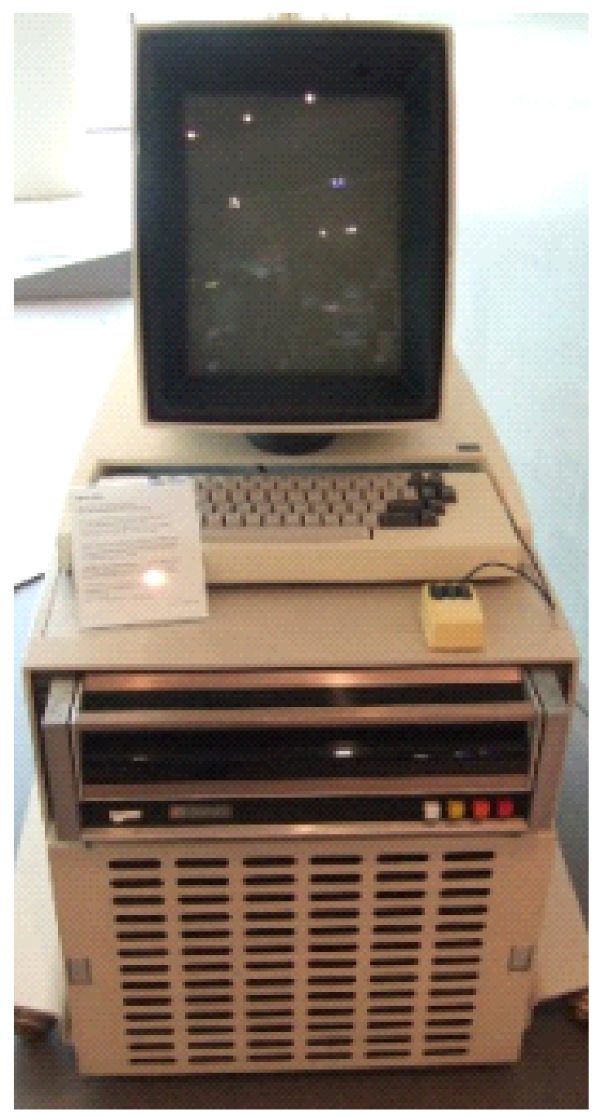
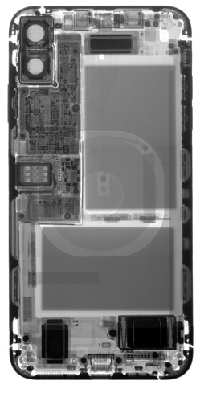
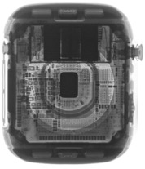
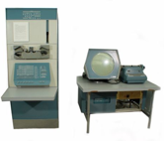




Energy is the defining constraint of emerging technologies
Mainframe
Computer
Workstation
By volume, the emerging computing classes are mostly energy storage
Volume is shrinking cubically
Laptop
Mini Computer
Battery
IoT/Wearable
Personal Computer
Smartphone
Notes:
Defining feature of modern computing classes is the amount of energy storage required to allow their operation
Clip art: http://www.ctecsolar.com/cut-cord-electric-company/
X-rays: iFixit teardowns

Slide 25
Internet of Things
“Expanding the reach of digital world”
Key features
  Computation
    Local to the device
    With some capability for arbitrary compute and storage
  Connectivity
    Almost certainly wireless
    Likely Internet, possibly local
  Interaction
    Sensing or Actuation
Secondary features
  Low energy
  (Relatively) Low cost

Slide 26
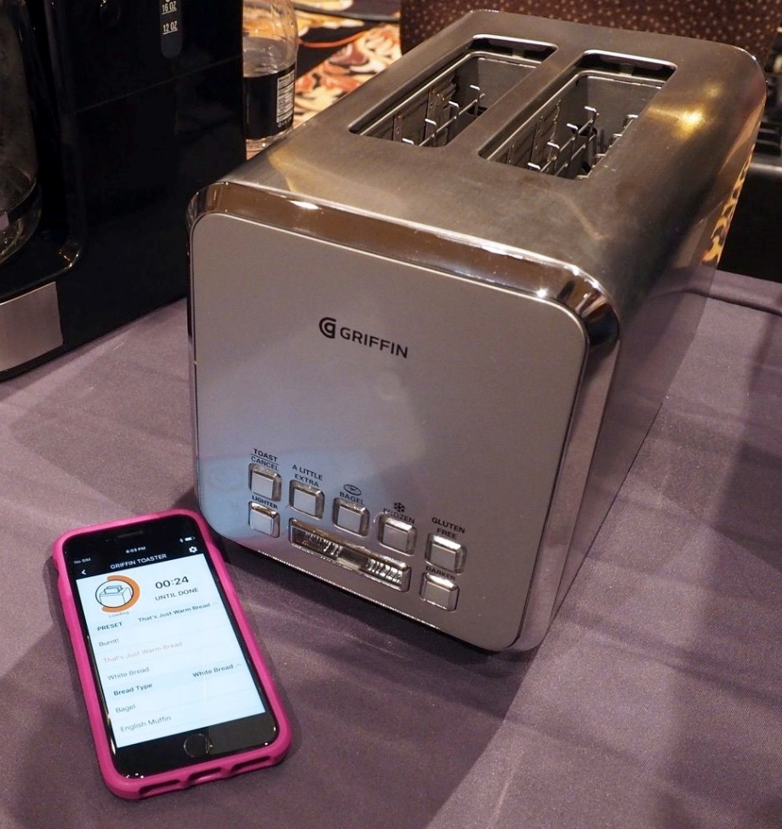
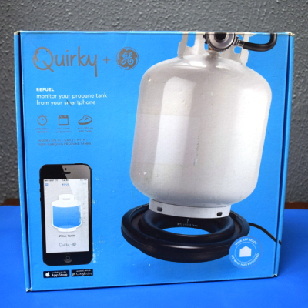

Warning: Internet of Crap

Slide 27
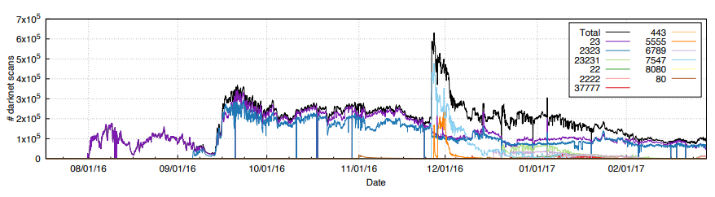
Internet of Insecure Crap
Mirai botnet (2016)
Takes control of up to 600,000 insecure connected devices
  IP-attached cameras, DVRs, routers, printers
Used to DoS websites

Slide 28
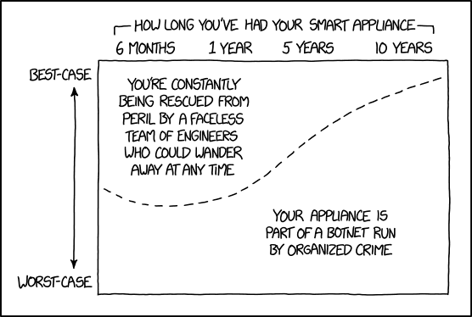
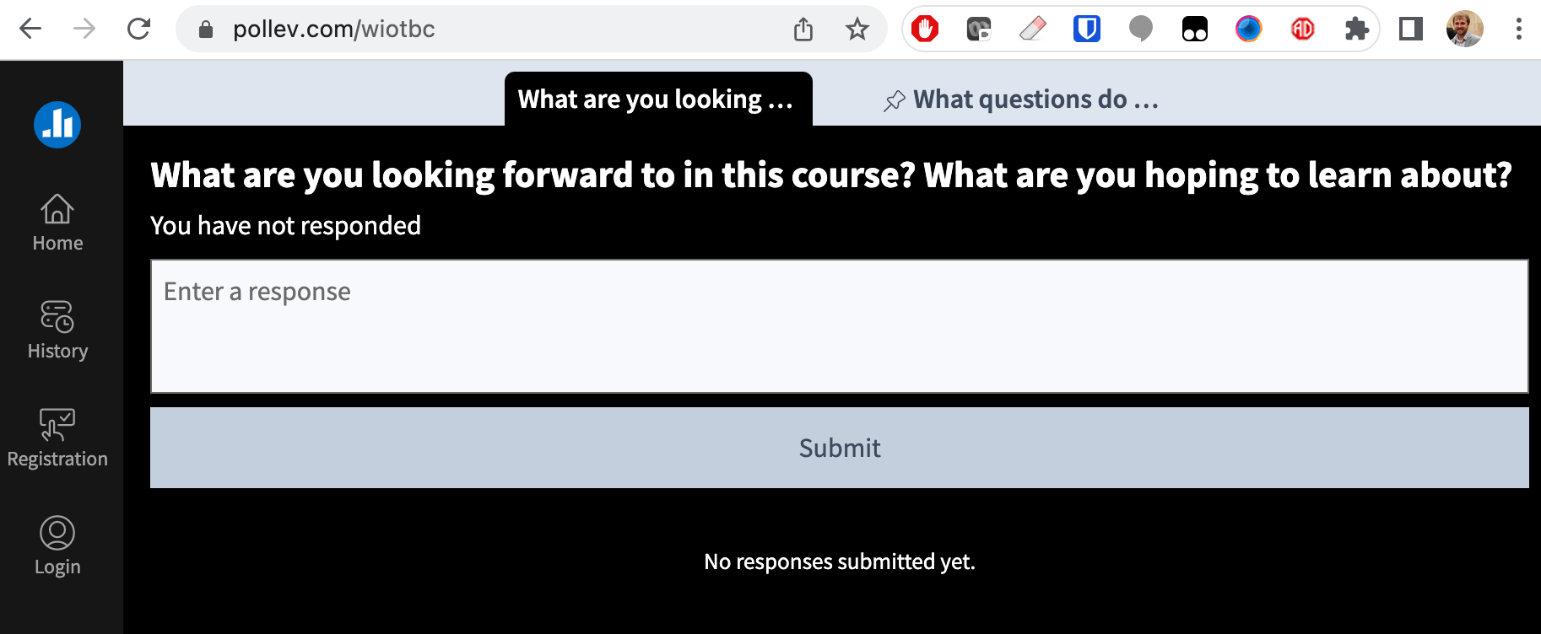
word cloud + xkcd
pollev.com/wiot
https://xkcd.com/1966/

Slide 29

Introductions: Brad Campbell
Assistant prof. in CS & ECE depts.
Moved to Charlottesville and joined UVA in 2017
Grew up in Michigan, Ph.D. from University of Michigan
Office in Link Lab (241 Olsson)
A couple things I enjoy
  Living a half hour from Shenandoah
  Riding my scooter to work
  New restaurants
  Running (kinda)

Slide 30
CS/ECE 4501
Wireless for the Internet of Things
You will learn the most influential wireless protocols used by IoT devices
  Ex: BLE, Zigbee, LoRa, WiFi, Thread, Matter
  Technically, this is a networking course focused on wireless networks
Things we won’t cover
  Digital wireless communication and the physical layer (take ECE 4784)
  Transceiver hardware design (take ECE 4501-Low Power Wireless Transceivers for IoT)
  Internet networking and TCP/IP (take CS/ECE 4457)
This is an experience- and design-oriented course
  Experience comes from labs and assignments
  Design comes from final project
  Lectures give you the foundation to understand what you are doing and how to make design decisions
    Minute-Quizzes keep you honest on lecture material

Slide 31
What to expect
Very curated and structured
(e.g. CS1)
Real world project at a job
Computing course structure and guidance
autograder
online documentation
detailed programming assignments
defining requirements and milestones
course-specific libraries
multiple solutions
full provided documentation
real-world software stacks
4000-level class
Goal is to help prepare you to engineer projects in the real world

Slide 32
What we want you to learn
Fundamentals of IoT wireless networks
  You are no doubt VERY well prepared to learn this
  Lecture, homework, labs
How to design a wireless system
  Domain expertise and intuition to assess needs and balance tradeoffs
  Labs, final project, exam
How to build and hack on real systems
  Experience learning and using existing software stack
  Labs, post labs, final project

Slide 33
what is learning anyway
Only a portion of learning in this course comes from me, standing here, telling you about IoT networks
“I’ve never learned this before!”
- Anonymous student
By doing - guided experimentation with wireless devices
Working as a team
  Wireless is boring with only one device!
Problem solving when writing code

Slide 34
What to expect (cont.)
Course
intensity
time
Front-loaded course
Final few weeks focused on final project

Slide 35
Quick Logistics
Most content is on the course website
  https://www.cs.virginia.edu/~bjc8c/class/wiot-s24/
  Assignments & grades on Canvas
This is an advanced course
  Target is upper-level undergraduate students
We will use Gradescope to submit assignments
We will use Slack for discussion

Slide 36
Highlights from the syllabus
Note: you need to read the actual syllabus!
In class:
  Mondays: Lecture and discussion about IoT communication technology
  Wednesdays: In-class labs
One in-class exam about 3/4 through the course
  Homeworks are practice for the exam
Final project
All labs (almost) and assignments, plus final project in teams of 3

Slide 37
Asking questions
In class
Office hours!
  Both instructors plus TAs
Slack
  Post questions
  Answer each other’s questions
  Information from the course staff
  Post private info just to course staff

Slide 38
Labs
Semi-guided efforts of getting wireless communication working on real hardware
  Wireshark
  Bluetooth
  802.15.4
  WiFi
  LoRa
Designed to be completed in class
Reports or lab deliverables due one week after lab

Slide 39
Pre-Labs
Absolutely essential to success in lab
Lab time is limited (just 75 minutes!)
  Must have pre-lab complete before lab to make lab successful
Pre-labs are due by the start of lab, no exceptions, no make-ups

Slide 40
Post labs
Post labs build upon the labs
Example activities in post labs:
  Continue building a wireless device
  Deploy a device somewhere to collect data
  Analyze the performance of your device
  Form networks with your wireless devices
Typically due two weeks after the relevant lab

Slide 41
Lab Cadence
Before start of lab: lab prep assignment due
Lab day: work on lab in-class in groups
1 week later:
  lab assignment due
  Pre lab graded (essentially binary grading)
2 weeks later:
  postlab assignment due (if exists)
  Lab assignment graded

Slide 42
Final Project
Larger project that integrates various wireless protocols you have learned
More open-ended than the assignments
  We will provide a few ideas
  Or your group can pursue your own idea
More details later in the semester
Our final exam slot (May 6) will be a demo/project share day

Slide 43
Collaboration policy
Labs: Yes, please!
In-class Labs are highly collaborative
You cannot talk to each other too much, help each other out in the labs
One Rule: Hands on your own keyboards
  Don’t copy/paste stuff
  Don’t do things for someone else, explain how to do it
  (As a team) write up your pre-labs, post-lab reports with all your own work

Slide 44
Collaboration policy
Post Labs + Final project: in your teams
Post labs and final project are done with your team
  Your team can talk to others, but don’t write anything down or look at anything they have written down

Slide 45
Collaboration policy
Homework + Exam: individual
These are done on your own
  You can talk to others, but don’t write anything down or look at anything they have written down
  You are encouraged to study for the exam together

Slide 46
Hey, what about that mini-quiz thing you snuck in there?
Lecture will begin with a "minute-quiz”
These will be (very) short and will cover material from the prior lecture, or possibly pre-lab, lab, post-lab, homework or other assignment
You should not need to study or worry about these – if you were there and paying attention, you'll be prepared
Grading
  Half points for just completing the quiz
  Half points based on correct answers
  Only need 75% of points over the semester for full credit

Slide 47
Interlude
I’m going to ask each table a question.
Everyone at the table needs to answer correctly.
Fastest table to have everyone answer wins.
If two people talk at the same time that table loses.
Take a minute or two to strategize

Slide 48
How to succeed in this course
Attendance is required
  In-class labs and team work requires you be physically here
Reach out to us if you are struggling or need help
  We want you to succeed
Be prepared to write embedded C code
  But, this isn’t an embedded programming class
Establish a strategy for collaborating in your group
  Labs and assignments will often have multiple roles

Slide 49
pollev.com/wiot
What percentage of your grade is labs + post labs?

Slide 50
Example C code
// Locate the index of the segment within the buffer with the given identifier.
int find_segment(uin8_t* buf, int len, uint8_t identifier, int* pos) {
int index = 0;
while ((index+2) <= len) {
uint8_t segment_length = buf[index];
uint8_t segment_id = buf[index + 1];
if (segment_id == identifier) {
*pos = index;
return 0;
}
index += (int) segment_length;
}
return -1;
}

Slide 51
Questions?
Note: HW1 due next week
  Meant to be a review
  Still somewhat challenging

