Slide 1
Wireless for the Internet of Things
Introduction to Networking
CS/ECE 4501
Spring 2024
UVA
[Pannuto, Ghena, Campbell]

Slide 2
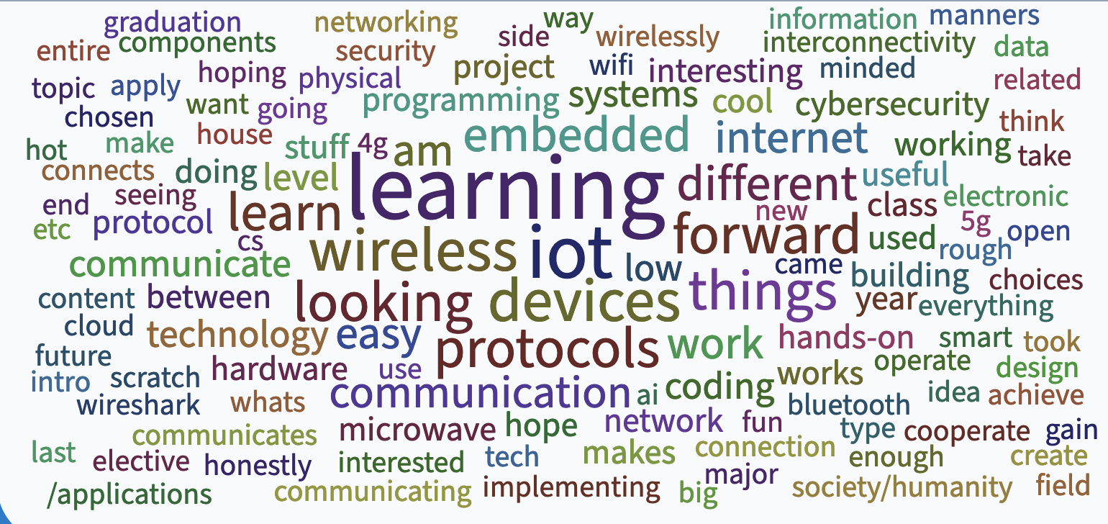

Slide 3
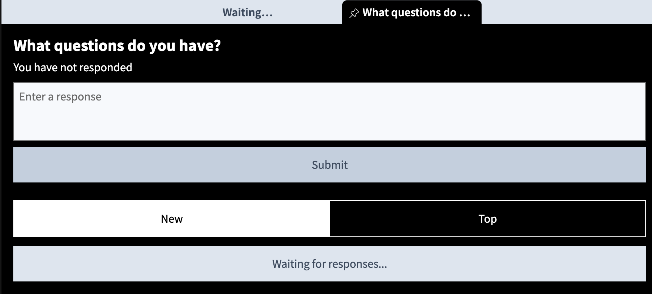
pollev.com/wiot

Slide 4
Today’s Goals
Introduce layered network architecture
Introduce internet structure and services
Provide enough general networking context for this class

Slide 5
Short term road map
This week
  Today: introduction to networking
  Wed: Wireshark lab
    Make sure to do prelab!
    This will be the only individual lab
Next week
  Mon: introduction to wireless
  Wed: introduction to Bluetooth
Next next week
  Mon: Bluetooth continued
  Wed: Bluetooth lab part A

Slide 6
Communication layers
Application
Transport
Network
Data Link
Physical
What goes on at each of these?

Slide 7
Internet protocol stack
application: supporting network applications
  IMAP, SMTP, HTTP
transport: process-process data transfer
  TCP, UDP
network: routing of datagrams from source to destination
  IP, routing protocols
link: data transfer between neighboring network elements
  Ethernet, 802.11 (WiFi), PPP
physical: bits “on the wire”
application
transport
network
link
physical

Slide 8
OSI model of communication layers
Application
Transport
  How to form connections between computers
  TCP and UDP
Network
  How to send packets between networks
  IP
Data Link
  How to send frames of data
  Ethernet, WiFi
Physical
  How to send individual bits
  Ethernet, WiFi
CS/ECE 4457
WIoT
ECE courses

Slide 9
Protocols are “layered”
Headers for each layer of communication wrap data
  Data is wrapped with header for the network to make a packet
  Packet is wrapped with header for the link to make a frame
Encapsulation is a key concept
Internet Packet
Data
Packet
Header
Frame
Header
Ethernet Frame

Slide 10


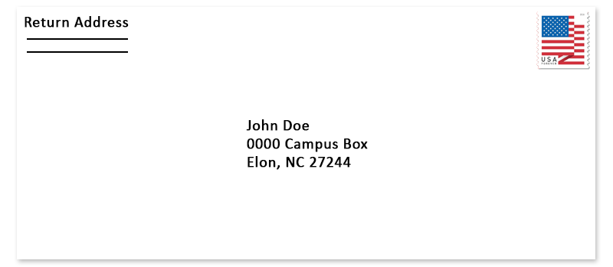

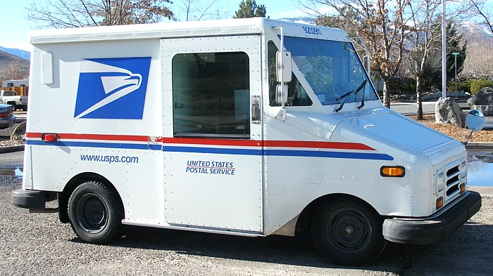


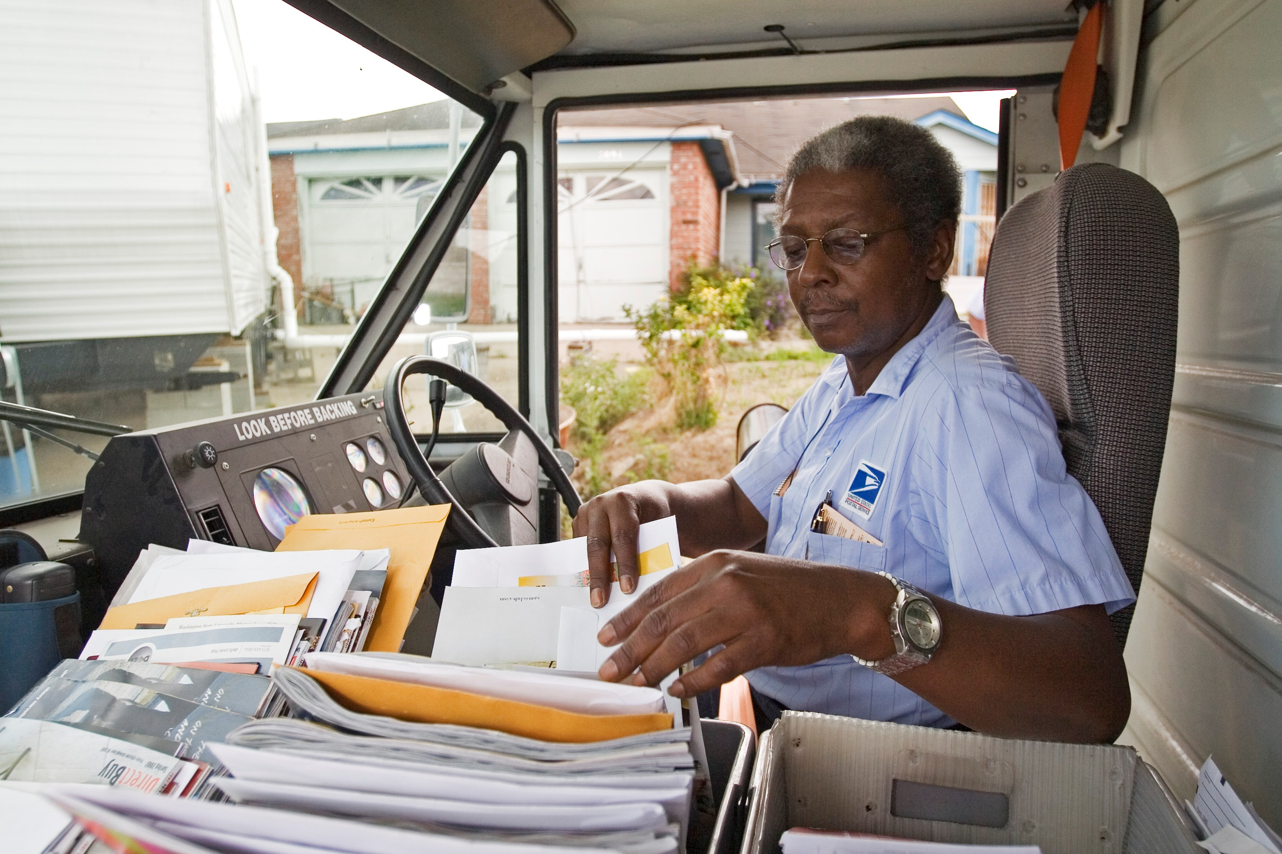
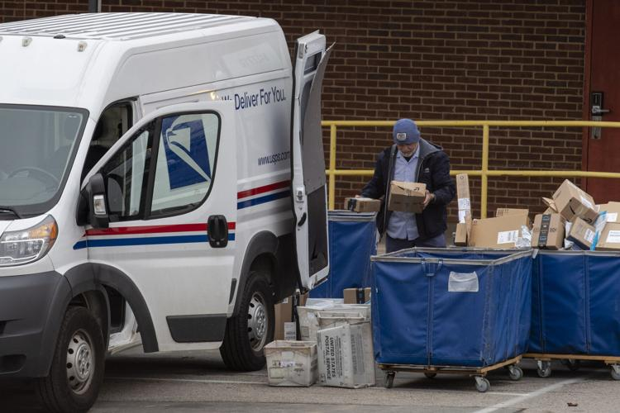
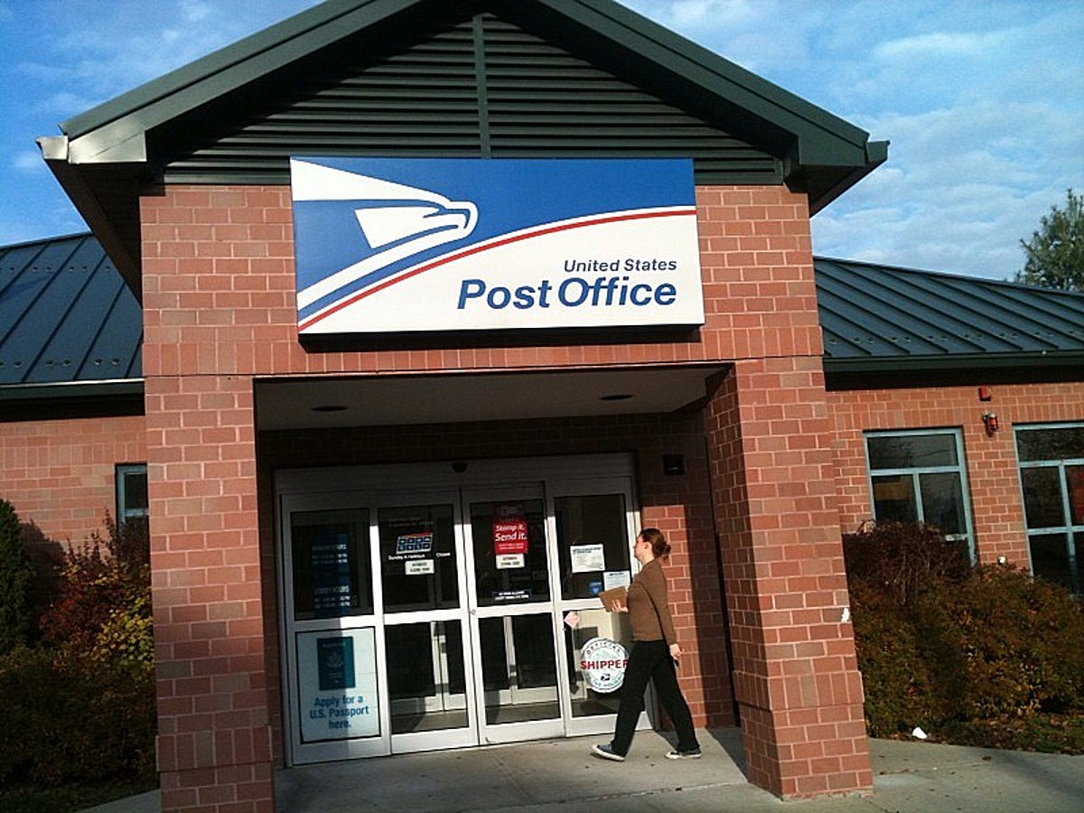
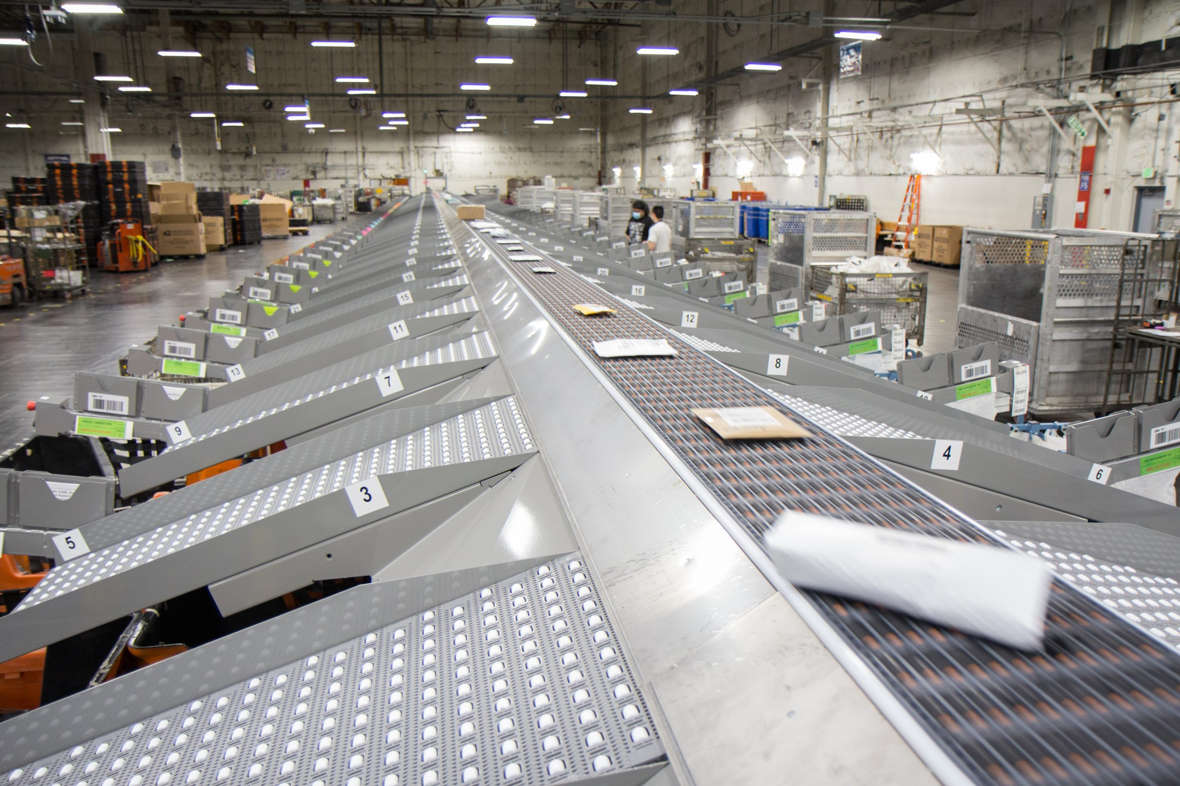
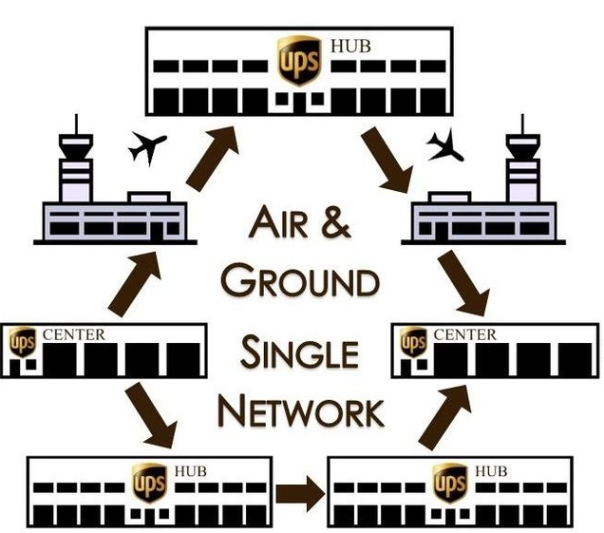
Analogy: Sending a letter
Application:
Purpose/type of letter
Transport:
Carrier service
Network:
Street Address
Link:
Transfer to
post office
Physical:
Moving tangible
object
Courier
Named recipient
Mailing/shipping
infrastructure

Slide 11

Host: sends packets of data
host sending function:
takes application message
(string of bits, really)
breaks into smaller chunks, known as packets, of length L bits
transmits packet into access network at transmission rate R
  link transmission rate, aka link capacity, aka link bandwidth
two packets,
L bits each
2
1
host
R: link transmission rate
packet
transmission
delay
time needed to
transmit L-bit
packet into link
L (bits)
R (bits/sec)
=
=

Slide 12
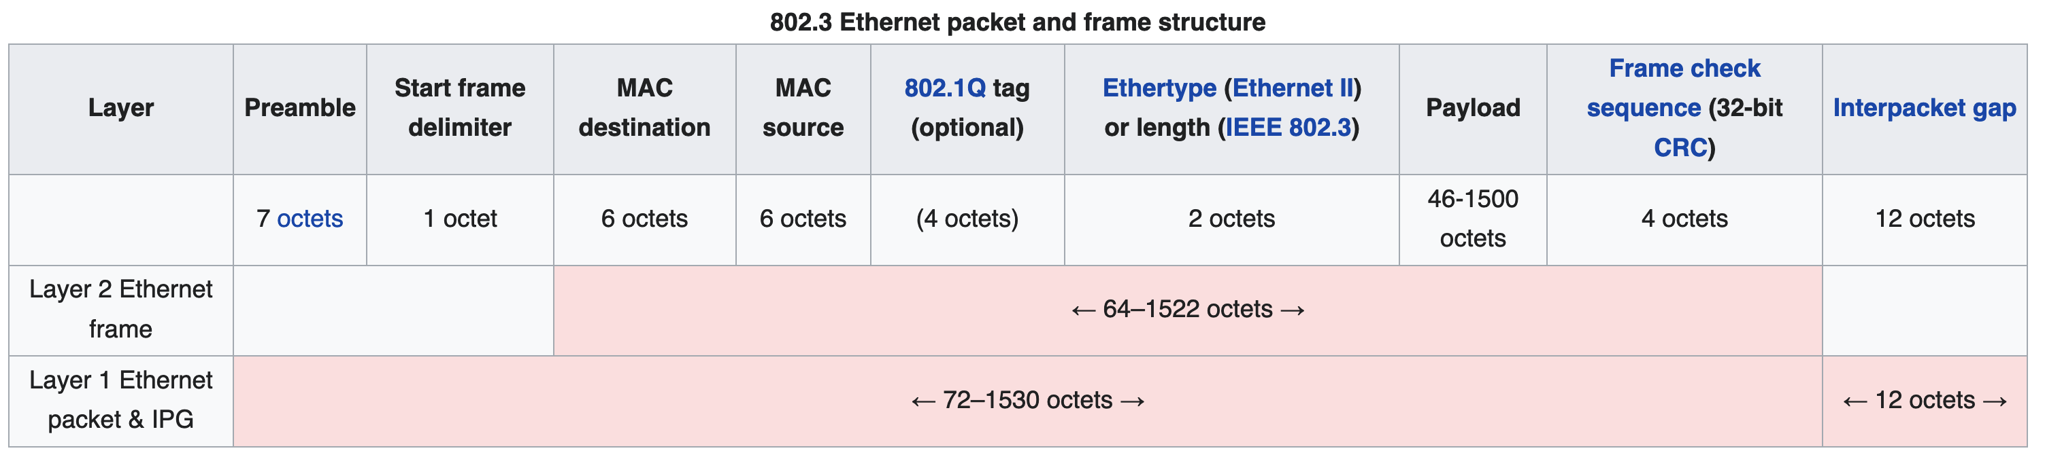
Protocols are “layered”
Headers for each layer of communication wrap data
  Data is wrapped with header for the network to make a packet
  Packet is wrapped with header for the link to make a frame
Internet Packet
Ethernet Frame

Slide 13

Encapsulation
source
message
M
application
transport
network
link
physical
segment
H_{t}
M
H_{t}
datagram
H_{n}
H_{n}
H_{t}
M
frame
H_{l}
H_{n}
H_{t}
M
link
physical
switch
destination
H_{n}
H_{t}
M
network
link
physical
M
application
transport
network
link
physical
H_{l}
H_{n}
H_{t}
M
H_{n}
H_{t}
M
H_{t}
M
H_{n}
H_{t}
M
H_{l}
H_{n}
H_{t}
M
router

Slide 14
Transmitting data between networks
LAN1
Host A
Host B
LAN2
client
server
(1)
data
(8)
data
protocol
software
protocol
software
internet packet
(2)
data
PH
(7)
data
PH
LAN1
adapter
LAN2
adapter
LAN1 frame
Router
(3)
data
PH
FH1
(6)
data
PH
FH2
LAN1
adapter
LAN2
adapter
PH: Internet packet header
FH: LAN frame header
LAN2 frame
(4)
data
PH
FH1
data
PH
FH2
(5)
protocol
software

Slide 15
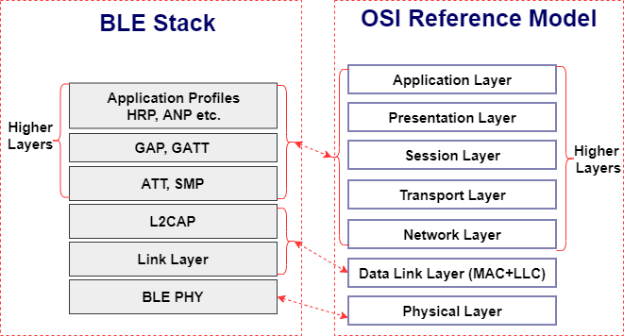
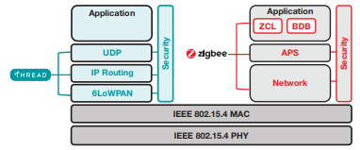
Model is not always reality
Wireless protocols don’t always split between layers cleanly
  Usually explain parts of physical, data link, and possibly upper layers
Model still helps conceptualize stack-up though
  Layering of some type still occurs

Slide 16
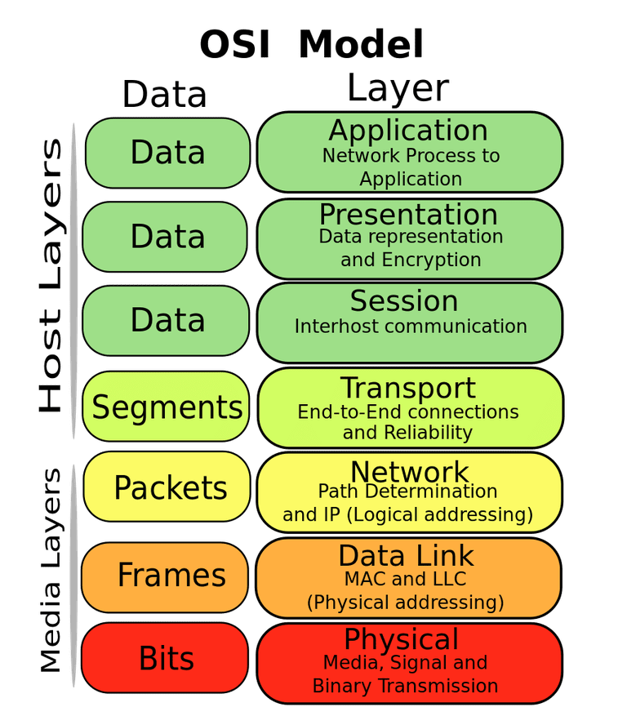
Layering for IoT (joke) (kind of)
MQTT
MQTT is a publish/subscribe message broker

Slide 17
Outline
OSI Layers
Internet Architecture (“The Upper Layers”)

Slide 18
Order the network layers
Pollev.com/wiot
application, link, network, physical, transport

Slide 19








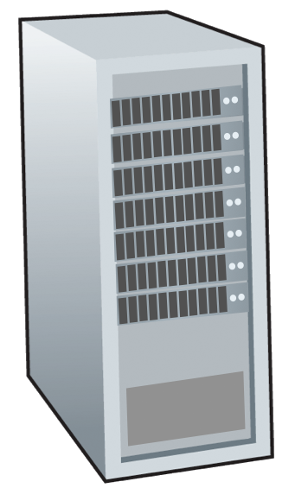







The Internet: a “nuts and bolts” view
Internet: “network of networks”
  Interconnected ISPs
mobile network
4G
national or global ISP
protocols are everywhere
  control sending, receiving of messages
  e.g., HTTP (Web), streaming video, Skype, TCP, IP, WiFi, 4G, Ethernet
IP
Streaming
video
Skype
local or regional ISP
home network
content
provider
network
Internet standards
  RFC: Request for Comments
  IETF: Internet Engineering Task Force
HTTP
datacenter
network
Ethernet
TCP
enterprise
network
WiFi

Slide 20
The global Internet
Most famous example of a network
Based on the TCP/IP protocol family
  Network Layer
    IP (Internet Protocol)
      Provides a naming scheme and unreliable delivery of packets from host-to-host
  Transport Layer
    UDP (Unreliable Datagram Protocol)
      Uses IP to provide unreliable data delivery from process-to-process
    TCP (Transmission Control Protocol)
      Uses IP to provide reliable data delivery from process-to-process
Accessed via a mix of Unix file I/O and the sockets interface

Slide 21
What’s a protocol?
Human protocols:
“what’s the time?”
“I have a question”
introductions
… specific messages sent
… specific actions taken when message received, or other events
Network protocols:
computers (devices) rather than humans
all communication activity in Internet governed by protocols
Protocols define the format, order of messages sent and received among network entities, and actions taken on msg transmission, receipt

Slide 22
Hardware and software organization of an Internet application
Internet client host
Internet server host
Client
User code
Server
Sockets interface
(system calls)
TCP/IP
Kernel code
TCP/IP
Hardware interface
(interrupts)
Network
adapter
Hardware
and firmware
Network
adapter
Global IP Internet

Slide 23
A programmer’s view of the internet
Hosts are mapped to a set of 32-bit IPv4 addresses
  52.87.65.167
The set of IP addresses is mapped to a set of identifiers called Internet domain names
  52.87.65.167 is mapped to linklab.virginia.edu
A process on one Internet host can communicate with a process on another Internet host over a connection

Slide 24
IP addresses
32-bit IP addresses are stored in an IP address struct
  IP addresses are always stored in memory in network byte order (big-endian)
    Remember: most computers use little-endian 😭
  True in general for any integer transferred in a packet header from
  one machine to another
    E.g., the port number used to identify an Internet connection
By convention, each byte in a 32-bit IP address is represented by its decimal value and separated by a period
    IP address: 0x8169071E = 129.105.7.30
/* Internet address structure */
struct in_addr {
uint32_t s_addr; /* network byte order (big-endian) */
};

Slide 25
Domain Naming System (DNS)
The Internet maintains a mapping between IP addresses and domain names in a huge worldwide distributed database
called DNS
Conceptually, programmers can view the DNS database as a collection of millions of host entries
  Each host entry defines the mapping between a set of domain names
  and IP addresses
A special name: localhost
  Refers back to the computer being used (IP address 127.0.0.1)

Slide 26
Internet connections
A socket is an endpoint of a connection
  Socket address is an IPaddress:port pair
    IP address identifies the computer
    Port identifies the process on the computer
Clients and servers communicate by sending streams of bytes over connections. Most connections are:
  Point-to-point: connects a pair of processes.
  Full-duplex: data can flow in both directions at the same time,
  [TCP adds] Reliable: stream of bytes sent by the source is eventually received by the destination in the same order it was sent.

Slide 27
Connection performance
Assume the maximum packet size is 128 bytes. You need to send 1 KB (1024 bytes). How long will this take on a 256 kbps link (ignoring other potential delays)?
  10 milliseconds
  32 milliseconds
  4 seconds
  32 seconds

Slide 28
Ports are used to identify services to the kernel
Server host 128.2.194.242
Client host
Service request for
128.2.194.242:80
(i.e., the Web server)
Web server
(port 80)
Client
Kernel
Echo server
(port 7)
Service request for
128.2.194.242:7
(i.e., the echo server)
Web server
(port 80)
Client
Kernel
Echo server
(port 7)

Slide 29
How does the Internet route packets?
(simplified…)
IP layer
  Describes the overall goal
    Packets from my computer <---> Google
Link layer (Ethernet)
  Describes individual links
    Packets from my computer <---> McCormick Router
Routing
  Get packets from one host to another

Slide 30
Addressing
How to solve the routing problem?
  I need to know how to get data from me to you
How does the post office work?
  I know where you live (your address)
    Zip Code
    City
    Street
    House Number
    Name

Slide 31
Addressing
Your computer moves all the time
  Home, school, Starbucks...

Slide 32
Addressing - Intranet and Internet
In general, network operators don’t change that often
Solution:
  Tie IP addresses to network operators
  Assign computers IPs as they join networks
  Ex: When you move apartments, you get a new address
Key Point:
  Networks “own” a block of IP address space
  “The Internet” is a network of networks

Slide 33
Getting an IP from your building’s network\
Rice hall router “owns” 128.143.67.0-255
  This is notated as 128.143.67.0/24
  The first 24 bits are fixed, remaining 8 bits assigned to devices
cs.virginia.edu “owns” 128.143.67.11
  128.143.67.11/32, usually omit the /32

Slide 34
Identifying your computer?
Every network card has its own MAC address
  IPs are (somewhat) dynamic, “owned” by local networks
  MACs are hardware and static, “owned” by specific computers
    Manufacturers own blocks of MACs, use them each time they make a device
Connecting to a network
  Your computer leases an IP from the local network
  Only the local router knows your MAC, everyone else sees your IP
    [n.b. this overview ignores NATs, which are commonplace today]

Slide 35

Routing
2.0.0.0/8
1.0.0.0/8
10.0.0.0/8
5.0.0.0/8
4.0.0.0/8

Slide 36
Routing
2.0.0.0/8
  →10.0.0.0/8
1.0.0.0/8
  →2.0.0.0/8
    →10.0.0.0/8
10.0.0.0/8
5.0.0.0/8
  →10.0.0.0/8
4.0.0.0/8
  →5.0.0.0/8
    →10.0.0.0/8

Slide 37
Routing - Adaptive
2.0.0.0/8
  →10.0.0.0/8
1.0.0.0/8
  →2.0.0.0/8
    →10.0.0.0/8
10.0.0.0/8
5.0.0.0/8
  →10.0.0.0/8
4.0.0.0/8
  →5.0.0.0/8
    →10.0.0.0/8

Slide 38
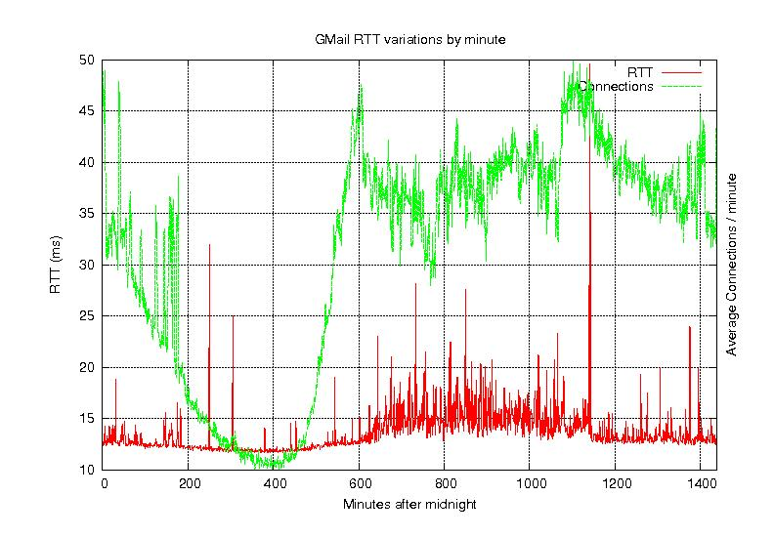
Routing – Congestion + Time

Slide 39
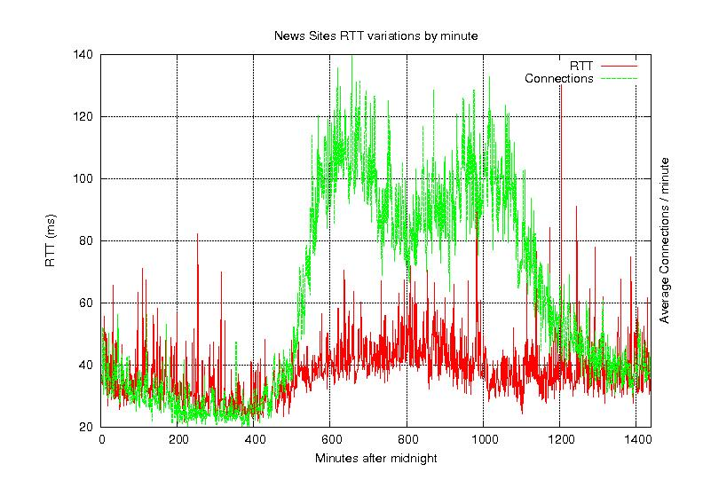
Routing – Congestion + Time

Slide 40
Routing – Other considerations [pre-2010, hah!]
Most ethernet packets have a Maximum Transmission Unit (MTU) of 1500 bytes
The fastest routers run at 10 GB/s
A 1 GHz processor can only do ~1000 instructions / packet
Tables must fit in cache
  Memory accesses would cost ~100 instructions each
$$\frac{1500{bytes}/{packet}}{1073741824{bytes}/{second}}≈{1.4x10}^{−6}{seconds}/{packet}$$

Slide 41
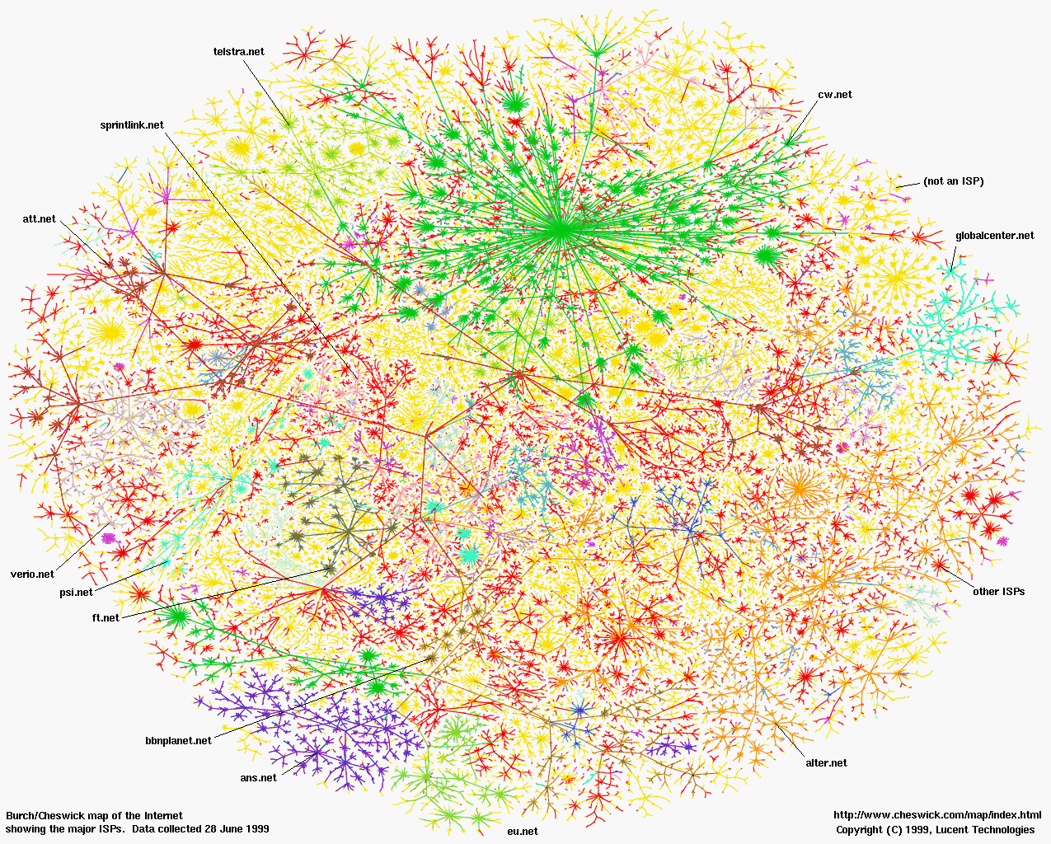
Some Perspective: North America (in June, 1999)

Slide 42
Internet structure: a “network of networks”
Networks of ISPs connect to provide global connectivity
…
…
access
net
access
net
access
net
access
net
access
net
IXP
access
net
access
net
ISP A
…
…
access
net
IXP
ISP B
access
net
ISP C
access
net
access
net
access
net
regional ISP
…
access
net
access
net
access
net
access
net
…

Slide 43

Some Perspective: The Internet

Slide 44
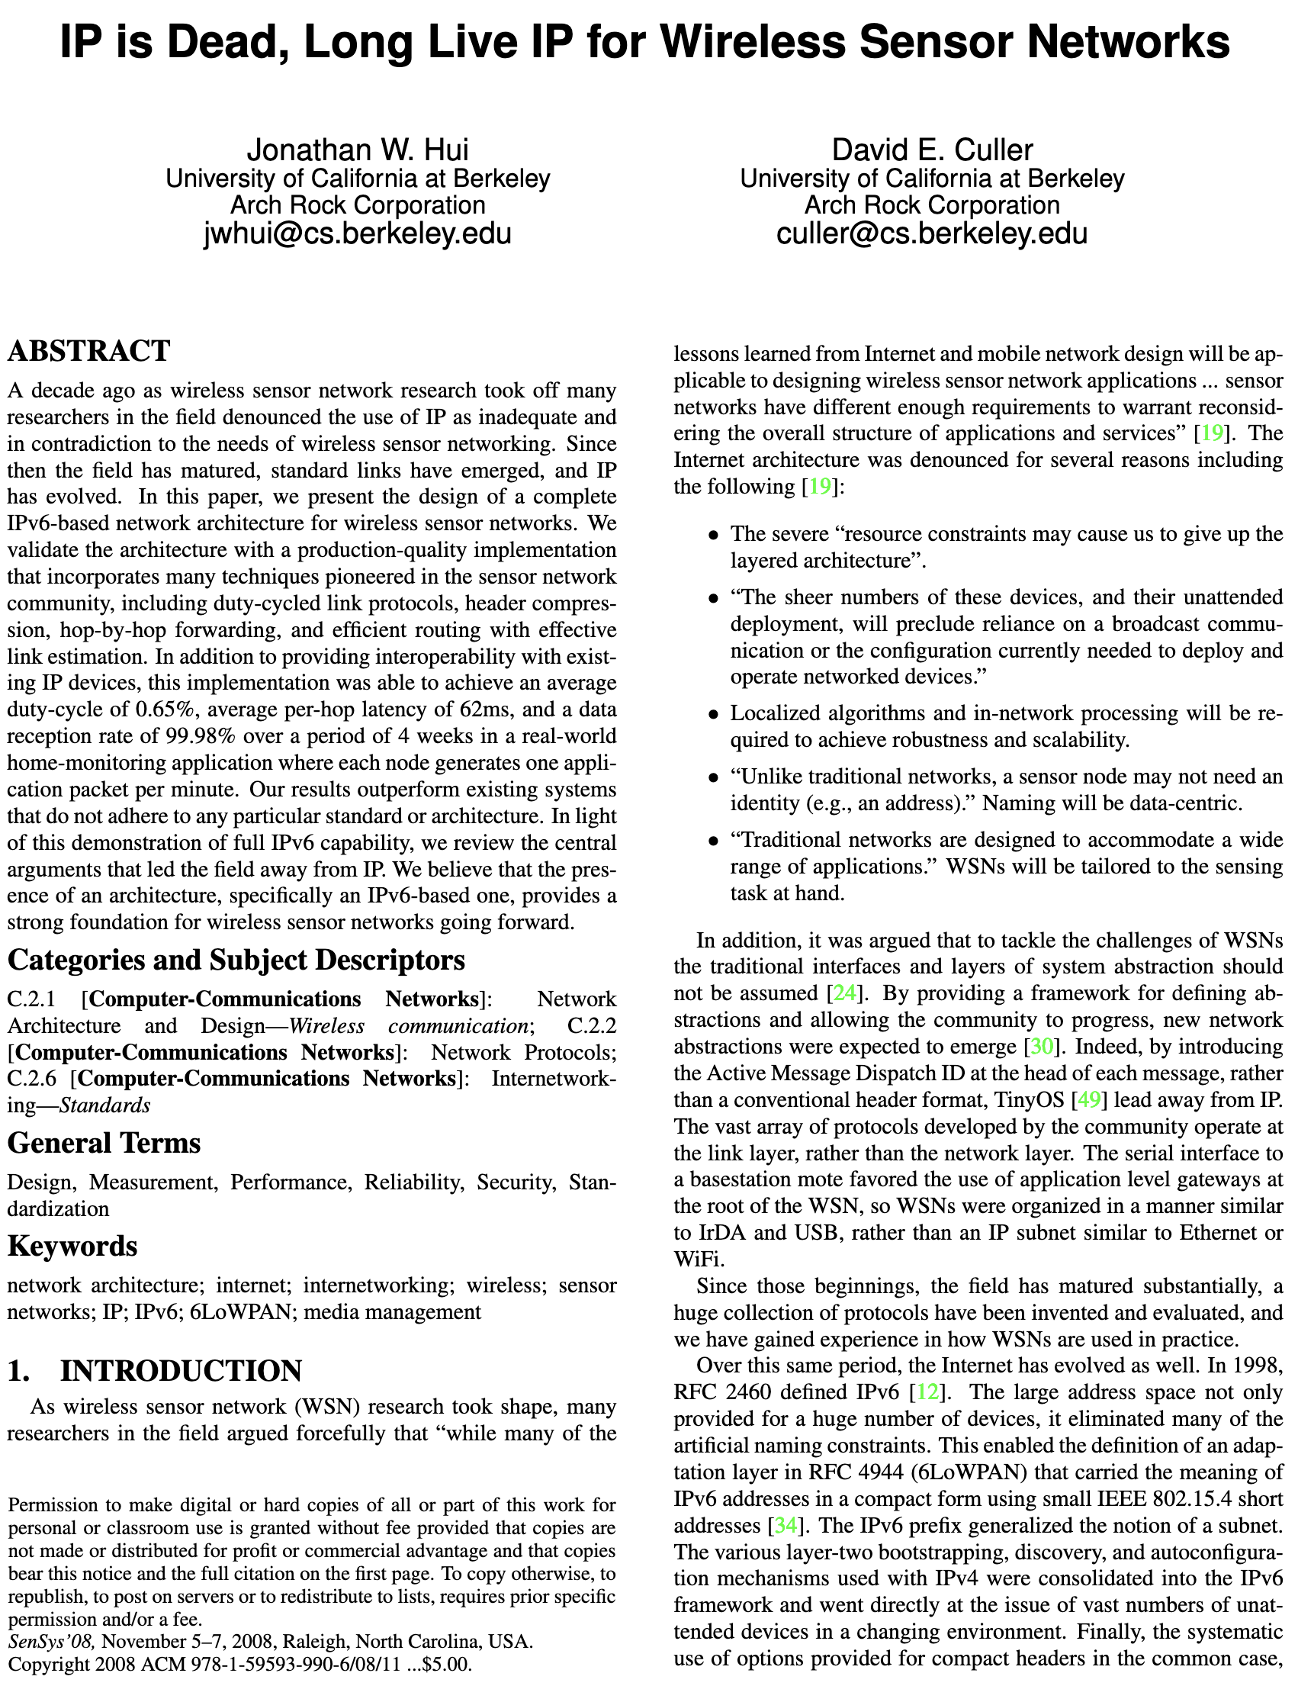
So how does the Internet of Things fit into the Internet?
“IP is the Narrow Waist of the Internet”
  IP is Dead, Long Live IP for Wireless Sensor Networks
A recurring theme in this class:
  How does this actually attach to the Internet
    Physically [hello Hue Hub, Wyze Hub, August Hub, …]
    Logically [are BLE devices really part of the internet?]

Slide 45
In which layer is…
Reliable transfer, ensuring packets successfully get from host to host?
DNS (Domain Name System), the database of mappings from domains to IP addresses.
Scheduling when a wireless device is allowed to "talk" (i.e. transmit packets).
The decision to route using Router A rather than Router B when forwarding packets.

Slide 46
What are the steps for viewing a website?
You enter a domain name for the website
Computer looks up domain name to get IP Address
Computer sends request to IP_address:80
Computer gets back data, which it renders into a website

Slide 47
ALL the layers
A “famous” interview question
  “What happens when you type google.com into your browser’s address bar and press enter?”
  https://github.com/alex/what-happens-when (11 pages!)
    Keyboard events
    Parsing URL
    DNS lookup
    Opening socket
    HTTP protocol
    HTML parsing
    GPU rendering

Slide 48
Lab 1: How does your Internet work?
What can you learn about the network around you?
Play with Wireshark
Protocol analysis, introspection

