Slide 1
Wireless for the Internet of Things Introduction to Wireless
Questions? pollev.com/wiot
While we get started, take the quiz on canvas!
CS/ECE 4501
Spring 2024
UVA
[Pannuto, Ghena, Campbell]

Slide 2
Today’s Goals
Introduce fundamentals of wireless communication
Give you a sense of the intuition behind why we have multiple IoT wireless protocols
Provide a foundation for why different IoT protocols have tradeoffs

Slide 3
Thinking back…
In the first class we discussed some elements of communication
Human communication
I argued many of the same concepts applied to computer communication
I asked “what does this slide say?”
Individually, try to recall the list we created
What elements are required for communication?
See what you can remember in two minutes

Slide 4
Computers face many of the same communication challenges we do
Layers for human communication
Visual or audio signals (and others)
Signal vs. noise
Symbols and sounds
Alphabet
Language
Grammar

Slide 5
Physical Layer
How bits are transmitted
Wireless makes this entirely different from wired cases
Important considerations
Signal strength
Modulation
Frequency
application
transport
network
link
physical

Slide 6
Model of RF communication
Energy that radiates spherically from an antenna
Attenuation with distance
Density of energy reduces over time, distance
Signal strength is reduced, errors go up
Three key features
Inherently broadcast
Error rates depend on distance
Spatial reuse of frequencies

Slide 7
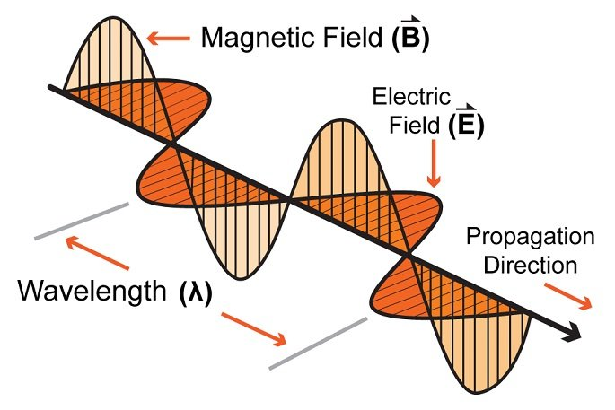
Signal qualities
Signal strength
The amount of energy transmitted/received
Signal frequency and bandwidth
Which “channel” the signal is sent on
Signal modulation
How data is encoded in the signal

Slide 8
Signal qualities
Signal strength
The amount of energy transmitted/received
Signal frequency and bandwidth
Which “channel” the signal is sent on
Signal modulation
How data is encoded in the signal

Slide 9
Signal strength is measured in decibels
Power is measured in watts or dBw or dBm
${PowerdBw=10∗log}_{10}({PowerWatts})$
${PowerdBm=10∗log}_{10}({Powermilliwatts})$
dBm is most relevant to the IoT domain
0 dBm equals 1 mW transmit power
Example
Max BLE transmit power for nRF52840: 8 dBm (6.31 mW)
Min BLE receive sensitivity for nRF52840: -95 dBm (316.2 fW)
Rules of thumb: +3 dB is double the power, 10 dB is 10x power

Slide 10
Signal strength varies significantly across technologies
Bluetooth Low Energy (local area)
nRF52840 transmit power: 8 dBm (6.31 mW)
nRF52840 receive sensitivity: -95 dBm (316.2 fW)
LoRa (wide area)
SX127X LoRa transmit power: 20 dBm (100 mW)
SX127X LoRa receive sensitivity: -148 dBm (1.6 attoWatt)

Slide 11
Propagation degrades RF signals
Attenuation in free space
Signals get weaker as they travel over long distances
Signal spreads out → free space path loss

Slide 12
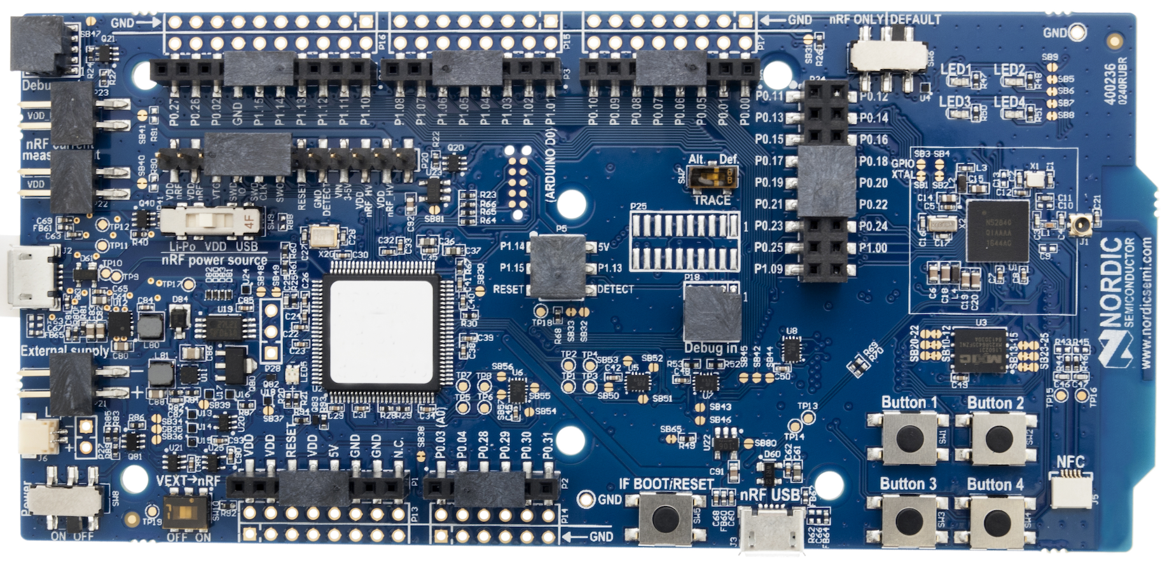
Some Intuitions for Signal Propagation, Power, Gain, etc.
We will use the nrf52840 in lab:
Max BLE transmit power for nRF52840: 8 dBm (6.31 mW)
Min BLE receive sensitivity for nRF52840: -95 dBm (316.2 fW)
6.31 mW

Slide 13
Some Intuitions for Signal Propagation, Power, Gain, etc.
We will use the nrf52840 in lab:
Max BLE transmit power for nRF52840: 8 dBm (6.31 mW)
Min BLE receive sensitivity for nRF52840: -95 dBm (316.2 fW)
.25 m

Slide 14
Some Intuitions for Signal Propagation, Power, Gain, etc.
We will use the nrf52840 in lab:
Max BLE transmit power for nRF52840: 8 dBm (6.31 mW)
Min BLE receive sensitivity for nRF52840: -95 dBm (316.2 fW)
1 m

Slide 15
Some Intuitions for Signal Propagation, Power, Gain, etc.
We will use the nrf52840 in lab:
Max BLE transmit power for nRF52840: 8 dBm (6.31 mW)
Min BLE receive sensitivity for nRF52840: -95 dBm (316.2 fW)
2 m

Slide 16
Some Intuitions for Signal Propagation, Power, Gain, etc.
We will use the nrf52840 in lab:
Max BLE transmit power for nRF52840: 8 dBm (6.31 mW)
Min BLE receive sensitivity for nRF52840: -95 dBm (316.2 fW)
2 m
46 dB path loss!
0.00016 mW

Slide 17
Okay.. So what’s the limit?
We will use the nrf52840 in lab:
Max BLE transmit power for nRF52840: 8 dBm (6.31 mW)
Min BLE receive sensitivity for nRF52840: -95 dBm (316.2 fW)
8 dBm – -95 dBm = 103 dB link margin
For FSPL alone for a 2.4 GHz signal, 103 dB is 1,400 m!
Bluetooth does not go 1.4 km…

Slide 18
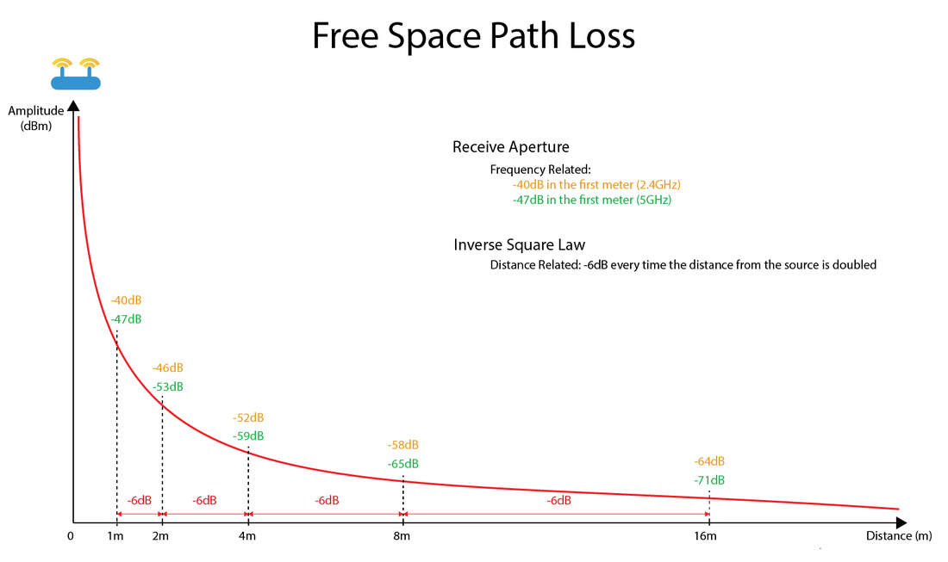
https://semfionetworks.com/blog/free-space-path-loss-diagrams/

Slide 19
Propagation is one thing that degrades RF signals
Attenuation in free space
Signals get weaker as they travel over long distances
Signal spreads out → free space path loss
Important: distance is NOT the only signal strength loss
Free space path loss calculation will not give you accurate range for a signal
Many other factors (e.g. physical obstacles, interference, reflections,…)
Precise quantitative details are in the EE domain
We will use quantitative examples to develop qualitative instincts in this class

Slide 20
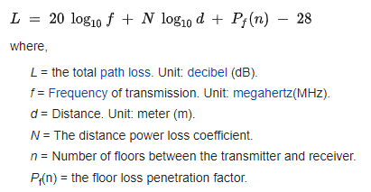
ITU model for Indoor Attenuation
Models like this are more trustworthy less bad than FSPL
https://en.wikipedia.org/wiki/ITU_model_for_indoor_attenuation
Notes:
ITU: International Telecommunication Union

Slide 21
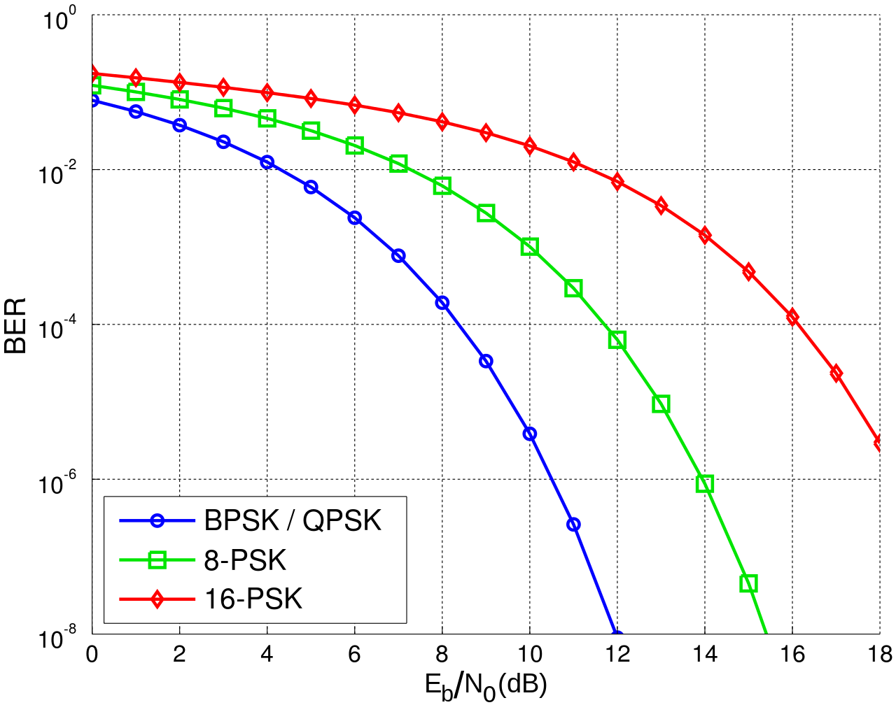
Lower received energy increases error rates
BER: Bit Error Rate
Odds that a transmitted bit will be received incorrectly
More Errors
Fewer Errors
Less Energy Received
More Energy Received

Slide 22
Signal qualities
Signal strength
The amount of energy transmitted/received
Signal frequency and bandwidth
Which “channel” the signal is sent on
Signal modulation
How data is encoded in the signal

Slide 23
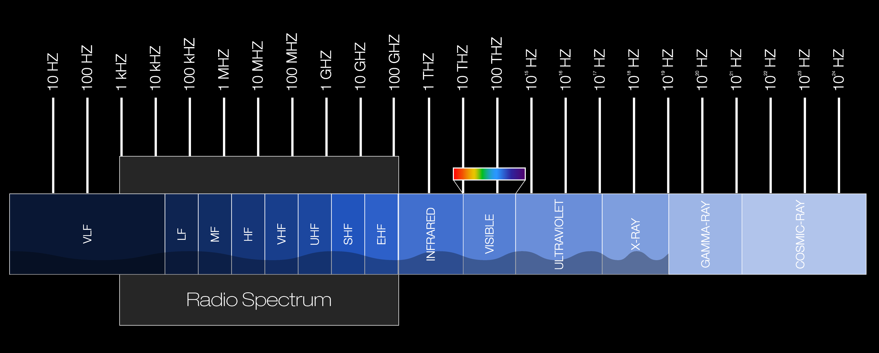
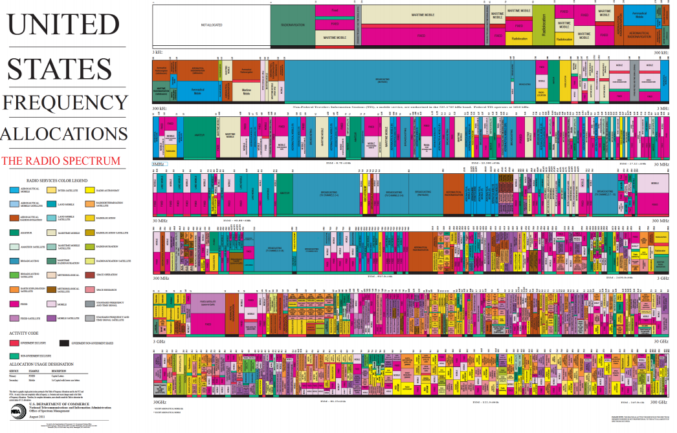
Frequency separation enables different wireless technologies to operate simultaneously

Slide 24
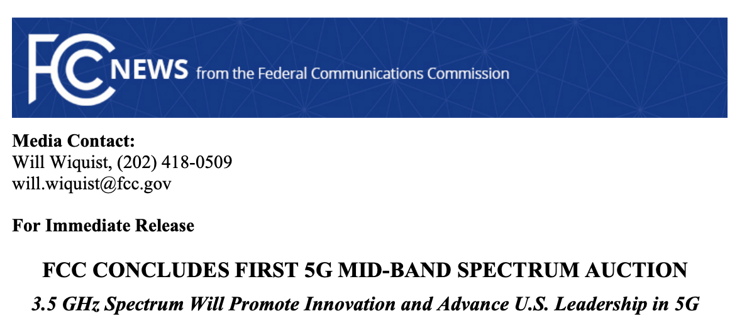
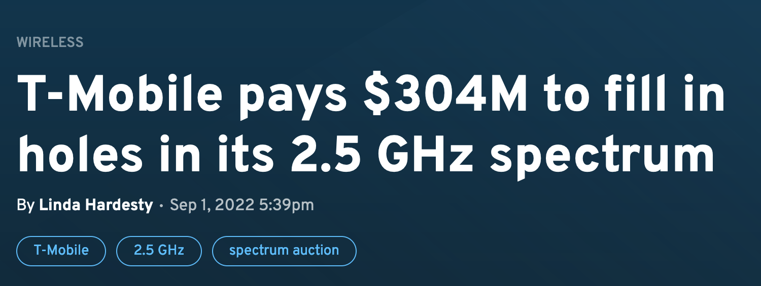
Wireless spectrum is limited...and valuable
FCC auctioned off 3.5 GHz spectrum in August 2020
70 MHz
$4.6 billion
FCC auctioned off 2.5 GHz spectrum in 2022
$427 million
https://www.fiercewireless.com/wireless/t-mobile-pays-304m-fill-holes-its-25-ghz-spectrum

Slide 25
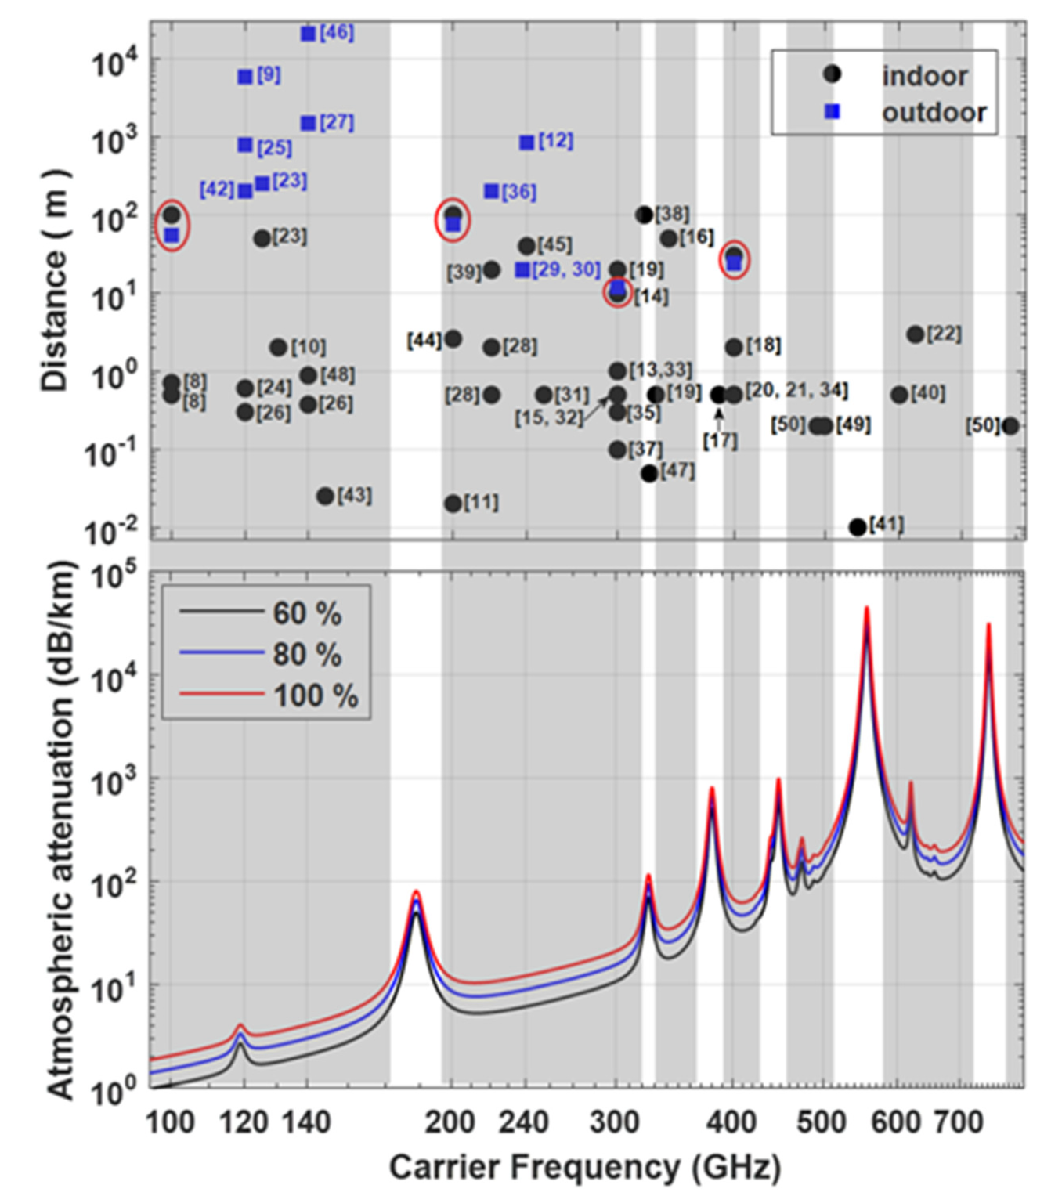
Intuition: frequency vs. range
Generally, higher frequency → shorter range
Ma, Jianjun & Shrestha, Rabi & Moeller, Lothar & Mittleman, Daniel. (2018). Invited Article: Channel performance for indoor and outdoor terahertz wireless links. APL Photonics. 3. 051601. 10.1063/1.5014037.

Slide 26
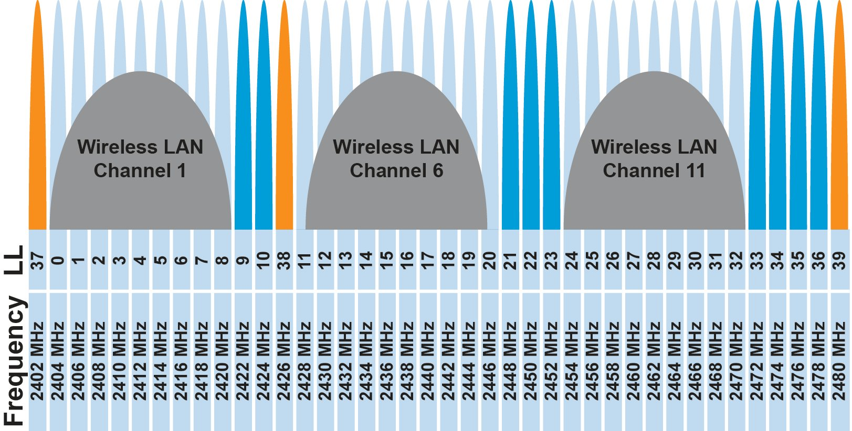
Unlicensed bands are where the IoT thrives
902 MHz – 928 MHz
LPWANs
2.4 GHz to 2.5 GHz
WiFi, BLE, Thread
5 GHz
Faster WiFi
Cellular uses licensed bands at great cost
Why?
No interference from other users!

Slide 27
Different technologies use spectrum in different ways
How spectrum is used affects: cost, robustness, throughput, distance, …
We will talk about how each technology uses spectrum, and implications
This graphic shows how BLE and WiFi interoperate; more on this next week

Slide 28
One Example / Bluetooth Preview: Frequency Hopping Spread Spectrum (FHSS)
Transmitter hops through a sequence of transmit channels
Spend some “dwell time” on each channel before hopping again
Receiver must know the hopping pattern
Avoid causing or receiving prolonged interference

Slide 29
Sidebar: inventor of FHSS – Hedy Lamarr
Actress and Inventor
Designed FHSS with George Antheil during WWII
Idea: torpedo control can’t be easily jammed if it jumps around
https://en.wikipedia.org/wiki/Hedy_Lamarr#Inventor

Slide 30
Signal qualities
Signal strength
The amount of energy transmitted/received
Signal frequency and bandwidth
Which “channel” the signal is sent on
Signal modulation
How data is encoded in the signal

Slide 31
Computers face many of the same communication challenges we do
Layers for human communication
Visual or audio signals (and others)
Signal vs. noise
Symbols and sounds
Alphabet
Language
Grammar

Slide 32
Computers face many of the same communication challenges we do
Layers for human communication
Visual or audio signals (and others) → EM spectrum waves
Signal vs. noise → signal strength
Symbols and sounds
Alphabet
Language → roughly akin to channel/frequency
Grammar

Slide 33
Computers face many of the same communication challenges we do
Layers for human communication
Visual or audio signals (and others) → EM spectrum waves
Signal vs. noise → signal strength
Symbols and sounds → modulation
Alphabet
Language → roughly akin to channel/frequency
Grammar

Slide 34
Signal qualities
Signal strength
The amount of energy transmitted/received
Signal frequency and bandwidth
Which “channel” the signal is sent on
Signal modulation
How data is encoded in the signal

Slide 35
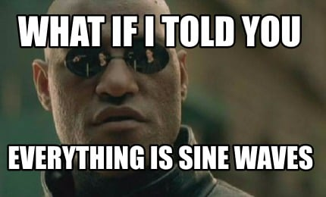
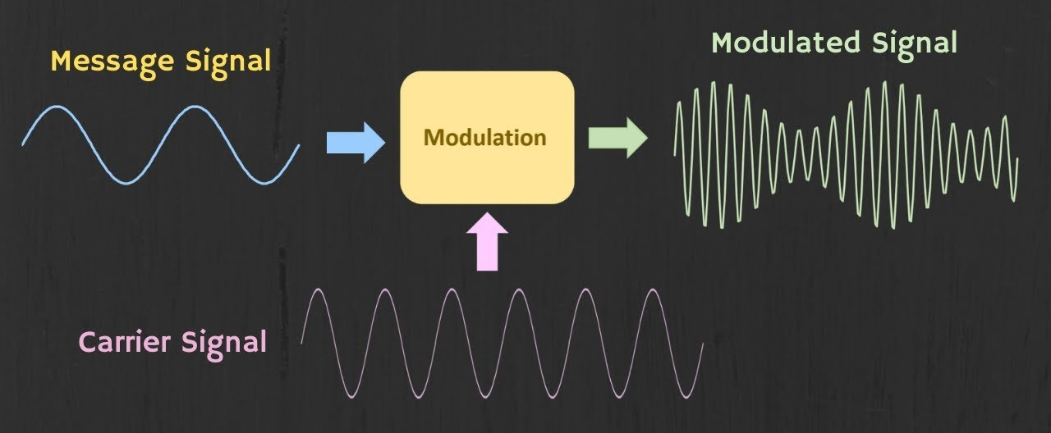
Modulation
Encoding signal data in an analog “carrier” signal
Carrier signal defines the frequency
Modulation scheme + data define bandwidth required

Slide 36
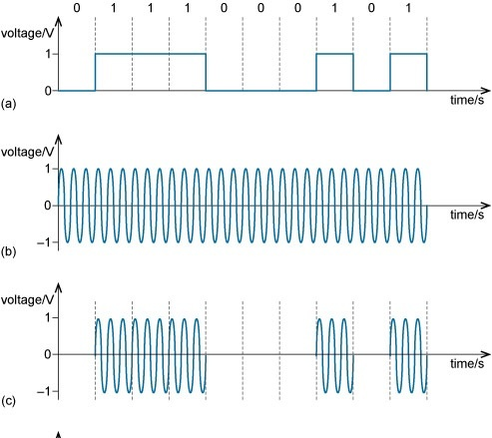
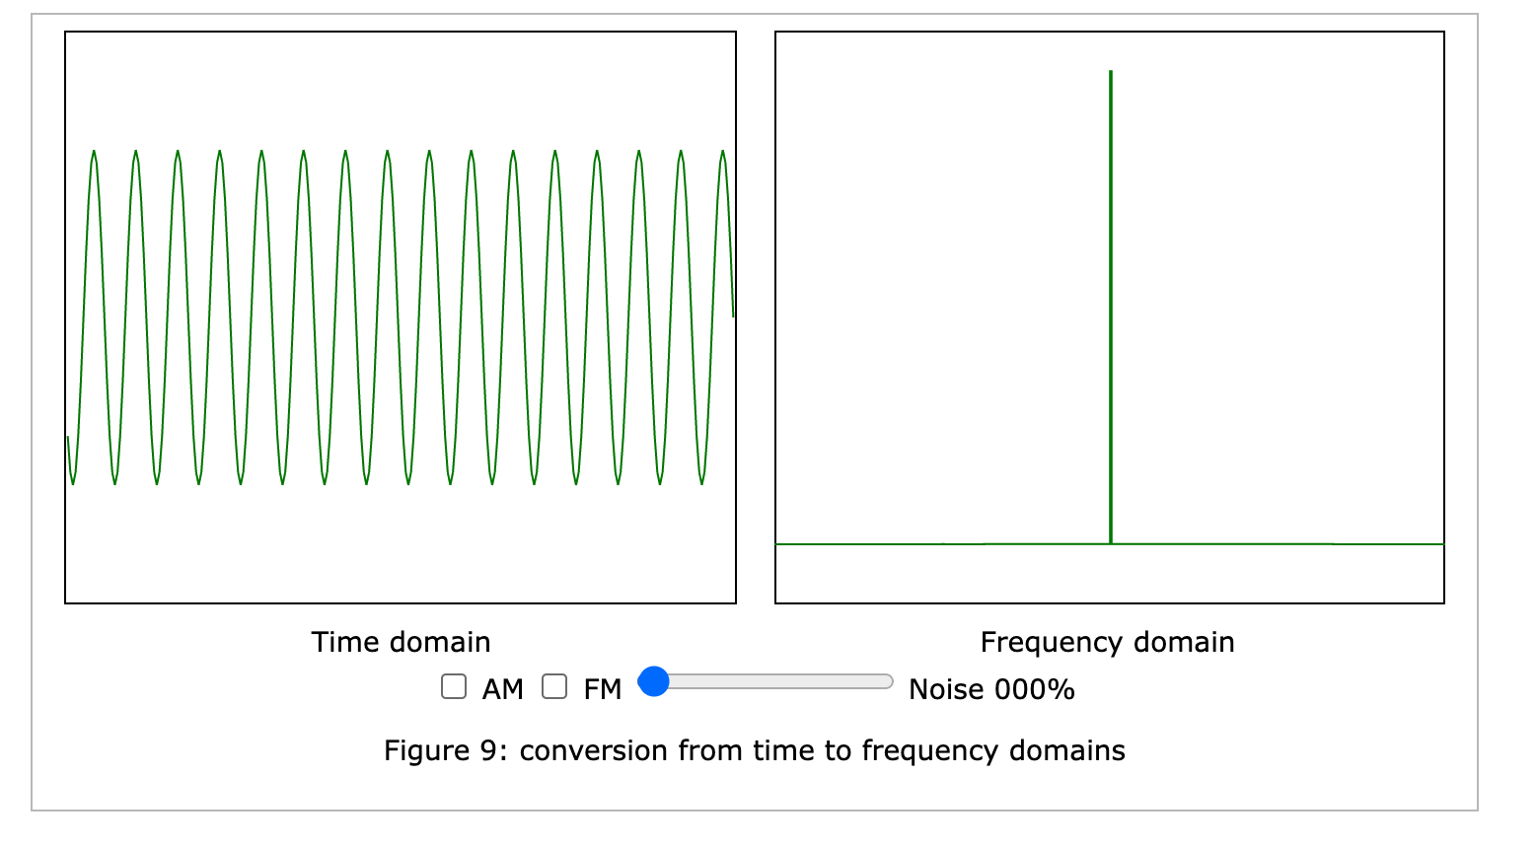
Modulation: On-Off keying
Intuition: when carrier is present → 1, no carrier → 0
Simple
Spectrum frugal
Issues
Desynchronization with runs of same value
Susceptible to noise

Slide 37
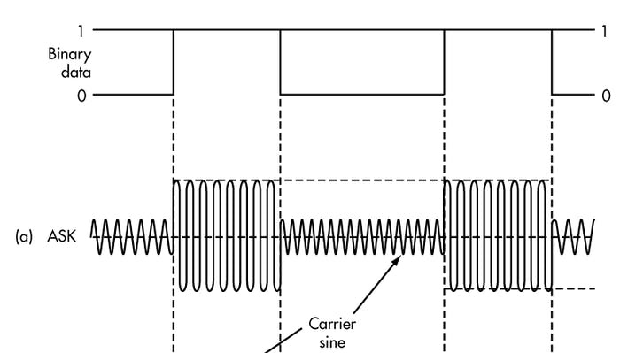
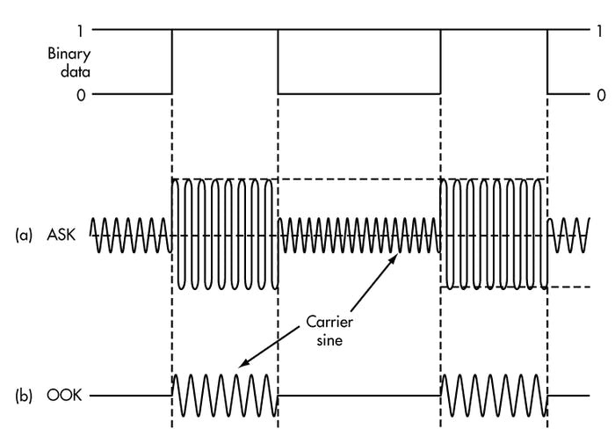
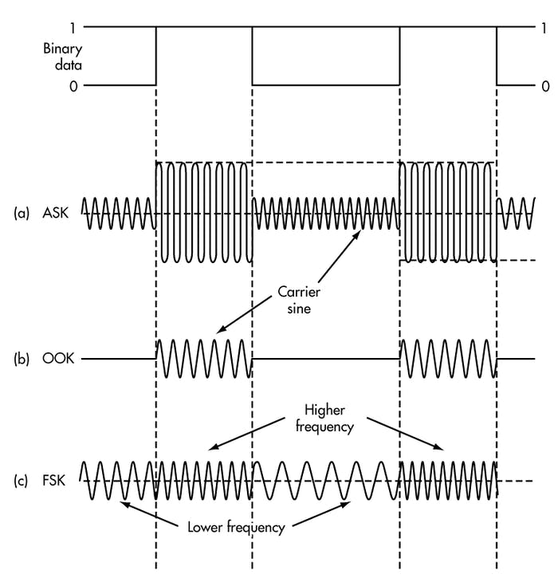
Modulation types
Encoding binary data on a signal
Amplitude-shift Keying (ASK)
Modify amplitude of carrier signal
On-Off Keying (OOK) is an extreme example
Frequency-shift Keying (FSK)
Modify frequency of carrier signal

Slide 38
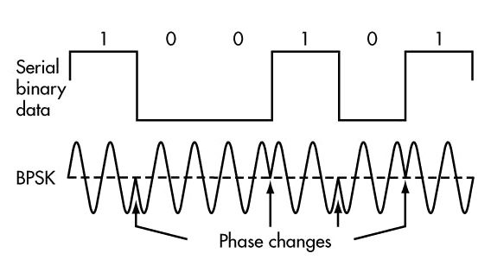
Modulation types
Phase-shift keying (PSK)
Modify phase of carrier signal
Usually differential: the change signifies data
More complicated possibilities exist
QAM (Quadrature Amplitude Modulation) combines amplitude and phase shift keying
Allows for more than one bit per “symbol”

Slide 39
Modulation tradeoffs
Various tradeoffs between different modulation schemes
Bandwidth requirements, transceiver hardware, immunity to noise, etc.
ASK (amplitude) is simple but susceptible to noise
Noise exists in the real world
FSK (frequency) is relatively simple and robust to noise, but uses more bandwidth
Bandwidth is limited, but still commonly used
PSK (phase) energy efficient and robust, but more complex hardware
More expensive hardware, but very commonly used

Slide 40
Signal qualities
Signal strength
The amount of energy transmitted/received
Signal frequency and bandwidth
Which “channel” the signal is sent on
Signal modulation
How data is encoded in the signal

Slide 41
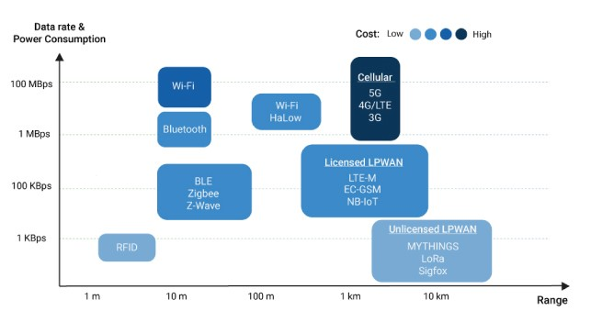
Range vs. Data Rate vs. Cost
https://behrtech.com/blog/6-leading-types-of-iot-wireless-tech-and-their-best-use-cases/

Slide 42
Outline
Physical Layer
Data Link Layer

Slide 43
Data Link Layer
Framing
Combine arbitrary bits into a “packet” of data
Logical link control
Manage transfer between transmitter and receiver
Error detection and correction
Media access
Controlling which device gets to transmit next
Inherently coupled to PHY and its decisions

Slide 44
Framing
Typical packet structure
Preamble - Existence of packet and synchronization of clocks
Header - Addresses, Type, Length
Data - Payload plus higher layer headers (e.g. IP packet)
Trailer - Padding, CRC
Wireless considerations
Control information for Physical Layer
Ensure robustness for header
Explicit multi-hop routing
Possibly different data rates for different parts of packet
Preamble | Destination Address | Source Address | Type and Length | Data | CRC

Slide 45
Error control: detection and recovery
Detection: only detect errors
Make sure corrupted packets get discarded
Cyclical Redundancy Checks
Detect single bit errors
Detect “burst” errors of several contiguous bits
Recovery: also try to recover from small bit errors
Forward error correction
Retransmissions
Far more important for wireless because the cost of transmission is higher

Slide 46
Medium Access Control
How does a network determine which transmitter gets to transmit?
Remember: the wireless medium is inherently broadcast
Two simultaneous transmitters may lose both packets

Slide 47
Thinking back…
You came up with a MAC protocol!
What was it?

Slide 48
Analogy: wireless medium as acoustic
How do we determine who gets to speak?
Two simultaneous speakers also lose both “transmissions”

Slide 49
Analogy: wireless medium as acoustic
How do we determine who gets to speak?
Two simultaneous speakers also lose both “transmissions”
Eye contact (or raise hand) → out-of-band communication
Wait until it’s quiet for some time → carrier sense multiple access
Strict turn order → time division multiple access
Just speak and hope it works → ALOHA
Everybody sing at different tones → frequency division multiple access (stretching the metaphor)
Everyone speak in different languages → code division multiple access
Others?

Slide 50
MAC protocol categorization
Medium Access Control Protocols
Contention-Based Protocols
Contention-Free Protocols
ALOHA
CSMA
FDMA
TDMA
Also, CDMA

Slide 51
ALOHA
ALOHAnet (1971)
University of Hawaii – Norman Abramson
First demonstration of wireless packet network
Rules
If you have data to send, send it
Two (or more) simultaneous transmissions will collide and be lost
Wait a duration of time for an acknowledgement
If transmission was lost, try sending again “later”
Want some kind of exponential backoff scheme with entropy here

Slide 52
Packet collisions
Each packet transmission has a window of vulnerability
Twice the on-air duration of a packet
Transmissions during the packet are bad
Transmissions before packet can also be bad
My blessed device
Interferer
time
My blessed device
Interferer
time

Slide 53
Slotted ALOHA
Split time into synchronized “slots”
Any device can transmit whenever it has data
But it must transmit at the start of a slot
And its transmission cannot be longer than a slot
Removes half of the possibilities for collisions!
At the cost of some synchronization method
time

Slide 54
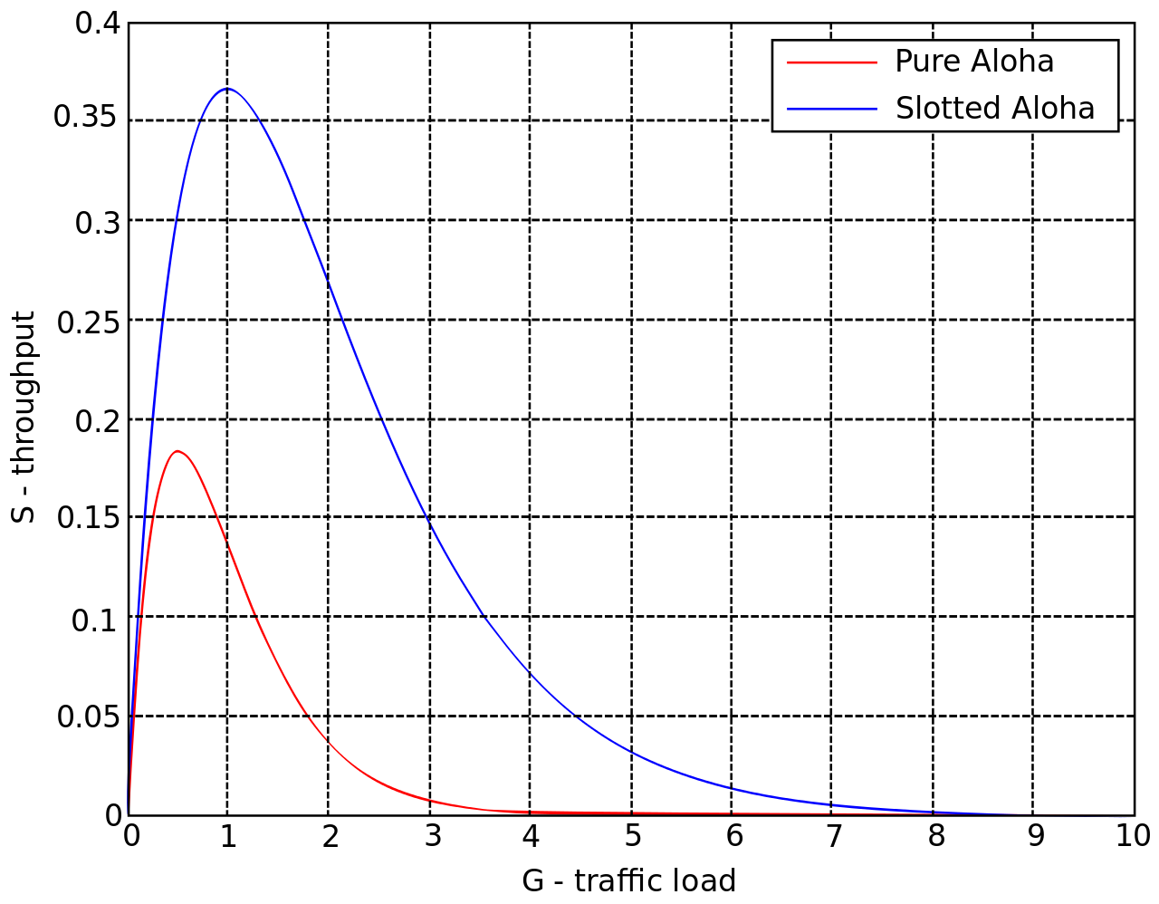
ALOHA throughput
It can be shown that traffic maxes out at
ALOHA: 18.4%
Slotted ALOHA: 36.8%
Assuming Poisson distribution of transmission attempts
Slotted throughput is double because the “before” collisions can no longer occur
(transmission events / time frame)

Slide 55
Capture effect
Actually, two packets at once isn’t always a total loss
The louder packet can still sometimes be heard if loud enough
How much louder?
Ballpark 12-14 dB
When does this work?
Depends on the radio hardware
Louder packet first almost always works
Louder packet second sometimes works

Slide 56
MAC protocol categorization
Medium Access Control Protocols
Contention-Based Protocols
Contention-Free Protocols
ALOHA
CSMA
FDMA
TDMA
Also, CDMA

Slide 57
CSMA/CA – Carrier Sense Multiple Access with Collision Avoidance
First listen for a duration and determine if anyone is transmitting
If idle, you can transmit
If busy, wait and try again later
“listen before send”
Can be combined with notion of slotting
If current slot is idle, transmit in next slot
If current slot is busy, follow some algorithm to try again later

Slide 58
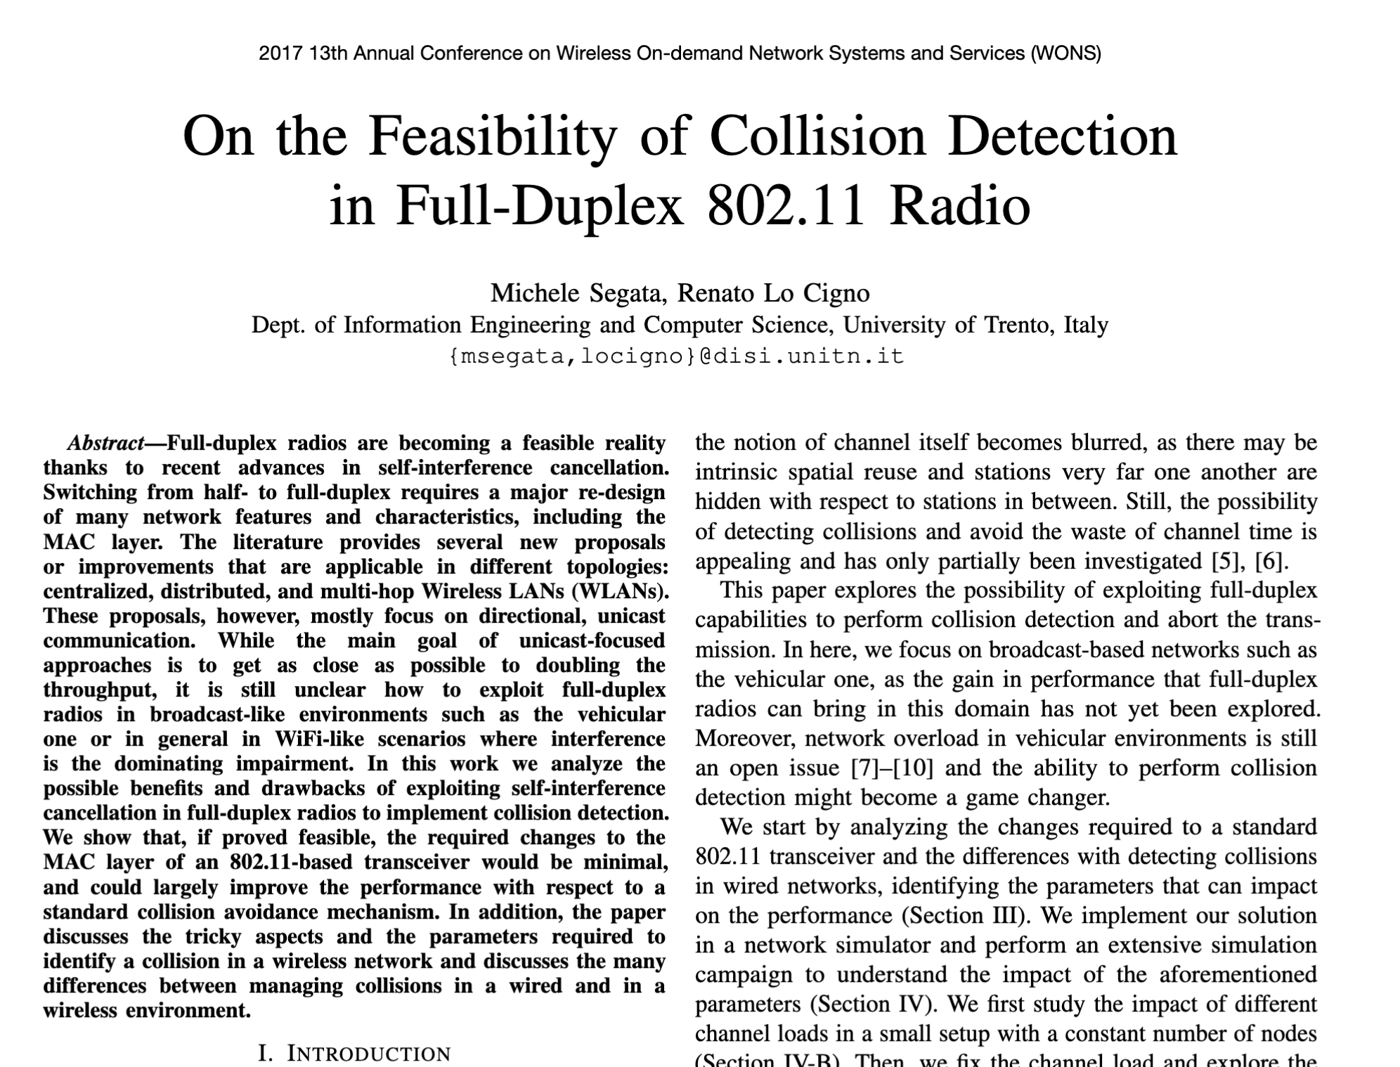
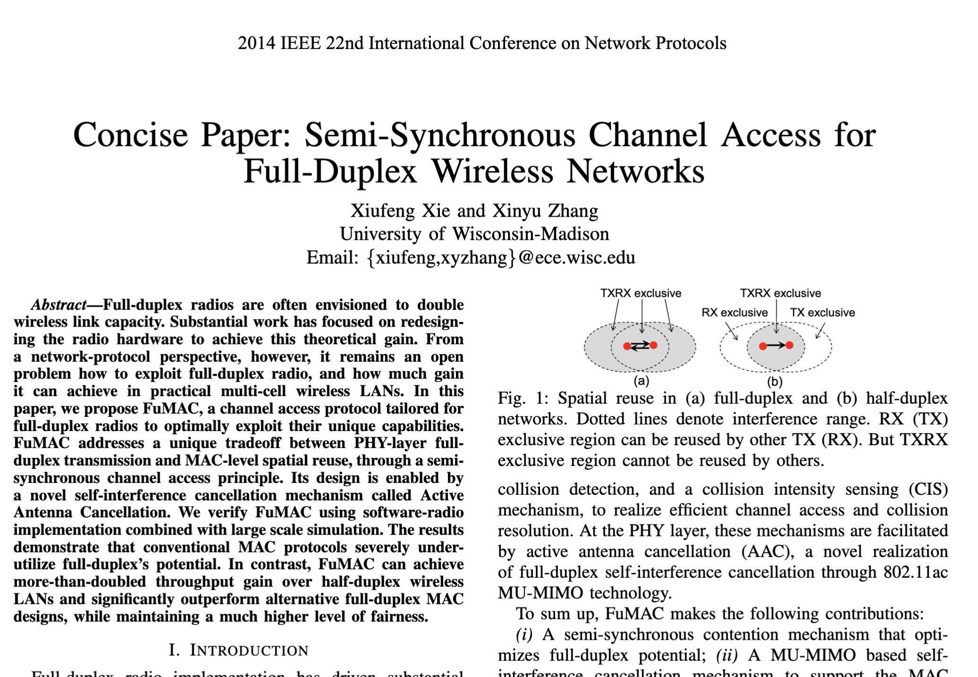
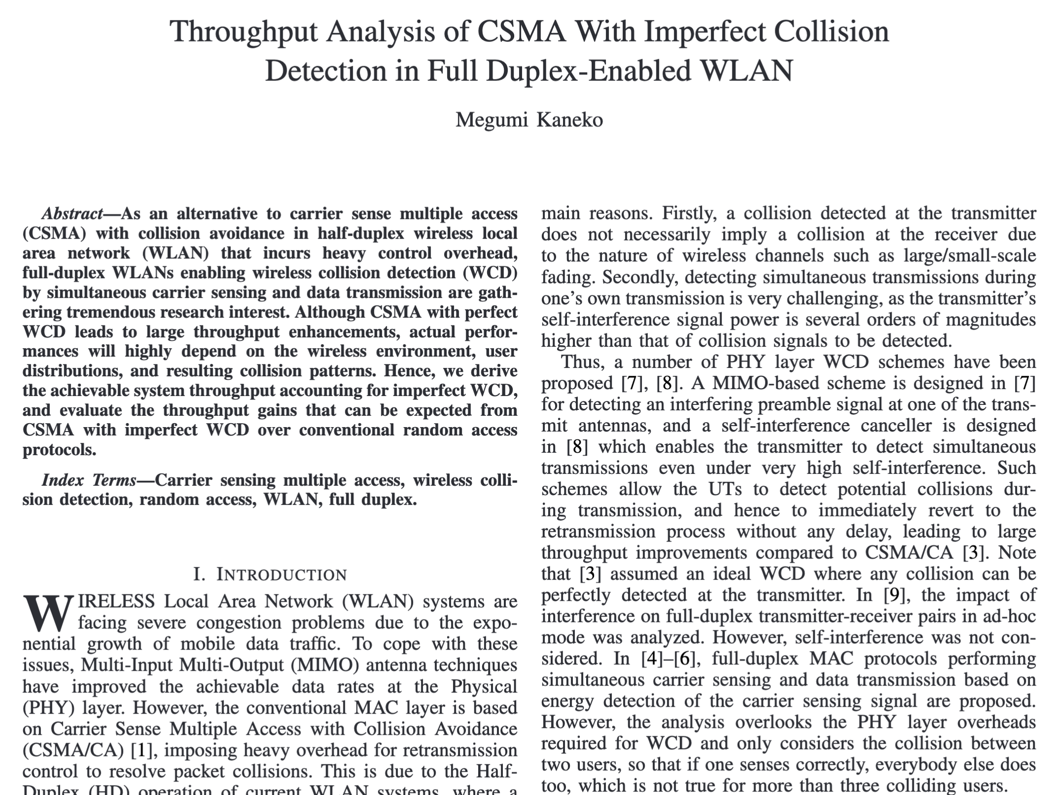
CSMA/CD – CSMA with Collision Detection
Detect collisions during your own transmission
Works great on wired mediums (Ethernet, I2C)
Somewhere between challenging and impossible for wireless
Transmit and receive are usually the same antenna
Receiving while transmitting would be drowned out by transmission
Remember: nrf52840 TX at 8 dBm and RX at -95 dBm

Slide 59
Hidden terminal problem
Device C
Device A
Device B

Slide 60
CSMA with RTS/CTS
Hidden terminal problem means that two transmitters might never be able to detect each other’s transmissions
A partial solution
When channel is idle, transmitter sends a short Request To Send (RTS)
Receiver will send a Clear To Send (CTS) to only one node at a time
RTS collisions are faster and less wasteful than hidden terminal collisions
Downside: overhead is high for waiting for CTS when contention is low

Slide 61
MAC protocol categorization
Medium Access Control Protocols
Contention-Based Protocols
Contention-Free Protocols
ALOHA
CSMA
FDMA
TDMA
Also, CDMA

Slide 62
Contention-free access control protocols
Goal: split up communication such that devices will not conflict
Can be predetermined or reservation-based
Devices might request to join the schedule and be given a slot
Devices lose their slot if it goes unused for some amount of time
Reservations often occur during a dedicated CSMA contention slot
Assignment of schedules can be complicated
Really efficient at creating a high-throughput network
Assuming they are all following the same protocol
Otherwise, interference can be very problematic

Slide 63
FDMA – Frequency Division Multiple Access
Split transmissions in frequency
Different carrier frequencies are independent
Fundamentally how RF spectrum is split
Technically, each device uses a separate, fixed frequency
Walkie-talkies
Conceptually, how RF channels work
WiFi networks pick different bands
802.15.4 picks a channel to communicate on

Slide 64
TDMA – Time Division Multiple Access
Split transmissions in time
Devices share the same channel
Splits time into fixed-length windows
Each device is assigned one or more windows
Can build a priority system here with uneven split among devices
Requires synchronization between devices
Often devices must listen periodically to resynchronize
Less efficient use of slots reduce synchronization
Large guard windows. E.g. 1.5 second slot for a 1 second transmission

Slide 65
CDMA – Code Division Multiple Access
Split transmissions in ‘codes’
Not new; original applications in radar and early satellite communications
Analogy: Multiple speakers in the same room all in different languages
[The human brain is crazy good at ignoring what it doesn’t understand ☺]
Requires signal power coordination
[everyone needs to speak ~the same volume]
Can be hard in uncontrolled / dynamic environments
Also can be more performant with highly synchronized clocks
i.e. if the code clock is known to both devices; intractable in mobile settings

Slide 66
Real-world protocol access control
ALOHA
BLE advertisements
Unlicensed LPWANs: Sigfox, LoRaWAN
CSMA
WiFi (slotted, CSMA/CA)
802.15.4
TDMA
BLE connections
Cellular LPWANs: LTE-M and NB-IoT
CDMA
Most modern cellular networks

