Slide 1
Wireless for the Internet of Things
Introduction to
Bluetooth Low Energy (BLE)
CS/ECE 4501
Spring 2024
UVA
Questions? pollev.com/wiot
Lab 2 Prelab posted
  Longest prelab of the semester. We will re-use the setup across the semester.
  We will distribute hardware on Monday
  You should get what you can setup now without the hardware
Call for groups will go out today
  Groups of 3
While we get started, take the quiz on canvas!
[Pannuto, Ghena, Campbell]

Slide 2
Today’s Goals
Introduction to Bluetooth Low Energy
What are the goals of the protocol?
What do the lower layers look like?
What roles do devices take?

Slide 3
Bluetooth Low Energy Resources
Good walkthrough of BLE:
  https://www.silabs.com/documents/public/user-guides/ug103-14-fundamentals-ble.pdf
[5.2 specification] [4.2 specification] (link to PDF download)
  Also: [Supplement v9]
More boots-on-the-ground view:
  https://inst.eecs.berkeley.edu/~ee290c/sp18/lec/Lecture7A.pdf
    From a team that has implemented BLE HW several times
  https://download.ni.com/evaluation/rf/intro_to_bluetooth_test.pdf

Slide 4
Outline
BLE Background
BLE Layers
  Physical Layer
  Link Layer
BLE roles
  Advertising
  Scanning

Slide 5
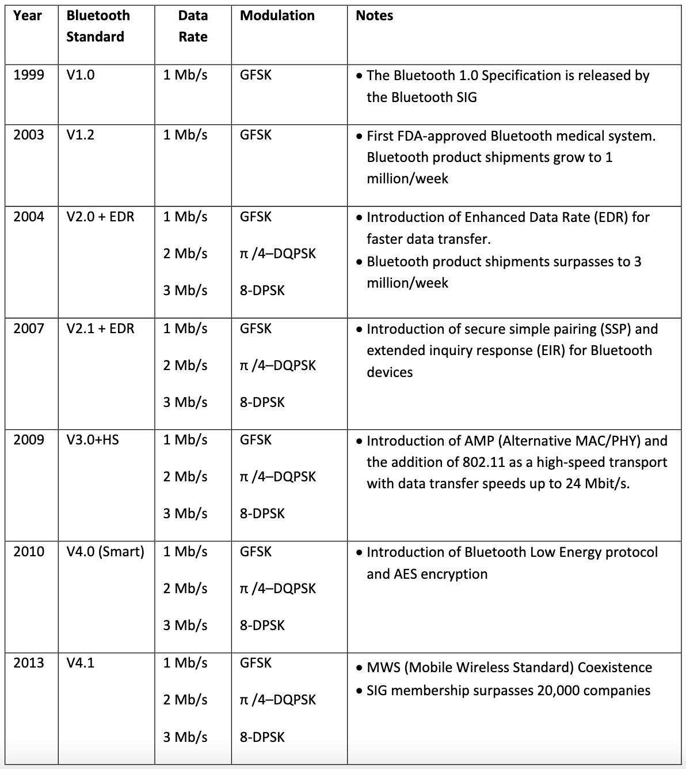
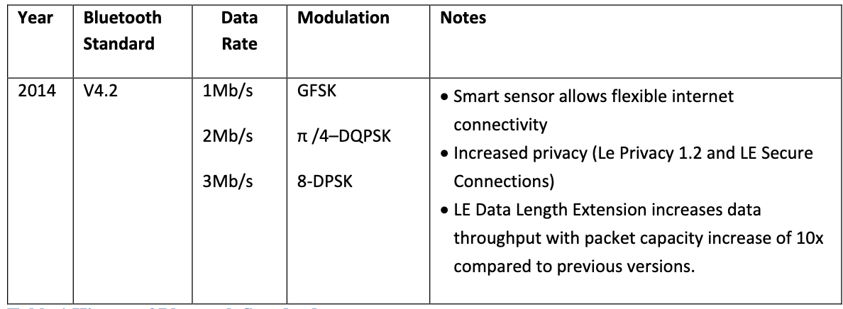
Bluetooth has a long history — the IoT is near-exclusively BLE (Bluetooth 4.0+)
Notes:
as opposed to Bluetooth Classic (<4.0)

Slide 6
Basics of Bluetooth Low Energy (BLE)
Direct device-to-device communication
  Usually: Computer to Thing
  Smartphone to device, Laptop to device, etc.
Focus on making the “Thing” really low energy
  Push energy-intensive requirements onto “Computer”
Devices (Computer or Thing) are servers with accessible fields
  Not the traditional send-explicit-packets interface you might be expecting
  Lower layers are still exchanging packets to make it work

Slide 7
A note on outdated notation
Master/Slave paradigm
  Master is the “Computer” and is in charge of interaction
  Slave is the “Device” and has little control over interaction parameters
  Really common notation in EE side of the world.
    Not intended to be harmful, but also literally inconsiderate.
Field is changing for the better. It’s going to take some time.
  Central/Peripheral
  Device/Peripheral
  Controller/Peripheral
  Primary/Secondary

Slide 8
BLE development
Research in early 2000s: Bluetooth Low End Extension and Wibree
Specification in 2009: Bluetooth version 4.0
Hardware support in 2011/12: iPhone 4s, Android 4.3, nRF51 series
4.1 and 4.2 (2014), 5.0 (2016, first in phones 2017, really 2019 though)
Notes:
https://www.makeuseof.com/what-is-ble-bluetooth-low-energy/

Slide 9
Bluetooth Specification
Problem: a bit overwhelming…
  5.2 spec: 3256 pages
  We only care about Vol 6: Low Energy Controller
    Part A: Physical Layer Specification
    Part B: Link Layer Specification
    CSS: Part A: Data Types Specification
    So ~250 pages
Tip: be willing to just ignore things when skimming specs
  5.2 spec covers BLE and Bluetooth Classic and a bunch of upper layer stuff that we never have to care about

Slide 10
BLE mechanisms
Advertising
  Discovery
  Advertisements – broadcast messages indicating device details
  Ephemeral, uni-directional communication from Advertiser to Scanner(s)
  ALOHA access control
Connections
  Interaction
  Bi-directional communication between Peripheral and Central
  Maintained for some duration
  TDMA access control
Notes:
Best effort access control vs more reliable

Slide 11
BLE network topology
Peripheral
Connection
Central & Scanner
Scanner
Connection
Peripheral
Advertisement
Advertisement
Advertisement
Advertisement
Advertiser
Advertiser
Advertiser

Slide 12
Multiple roles at the same time
Topology picture is a simplification of roles
A single device can have multiple roles simultaneously
  Scanning and Advertising simultaneously
  Peripheral and Scanner and Advertiser simultaneously
  Peripheral and Scanner and Central and Advertiser simultaneously
    Getting a bit out of hand though

Slide 13
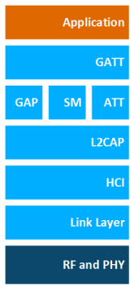
BLE Protocol Stack Layers
Host – Configuration and Server
  GAP – Generic Access Profile
    Configure advertising
  GATT – Generic ATTribute profile
    Configure connections
HCI - Host Controller Interface
Controller - Communication
  Link Layer – send packets
  RF and PHY – send bits
GAP
Host
Controller
Notes:
GATT: Generic Attribute Profile. The GATT is used to group individual attributes into logical services, for example the Heart Rate
Service, which exposes the operation of a heart rate sensor. In addition to the actual data, the GATT also provides information about
the attributes, that is, how they can be accessed and what security level is needed
ATT: Attribute Protocol. The attribute protocol provides means to transmit data between Bluetooth low energy devices. It relies on a
Bluetooth low energy connection and provides procedures to read, write, indicate, and notify attribute values over that connection.
ATT is used in most Bluetooth low energy applications and occasionally in BR/EDR applications.
SM: Security Manager. Provides means for bonding devices, encrypting and decrypting data, and enabling device privacy.
GAP: Generic Access Profile. The GAP layer provides means for Bluetooth low energy devices to advertise themselves or other
devices, make device discovery, open and manage connections, and broadcast data.
L2CAP: Logical Link Control and Adaptation Protocol. L2CAP acts as a protocol multiplexer and handles segmentation and reas-
sembly of packets. It also provides logical channels, which are multiplexed over one or more logical links. The L2CAP used in Blue-
tooth low energy technology is an optimized and simplified protocol based on the classic Bluetooth L2CAP. Typically, application
developers do not need to care about the details of interacting with the L2CAP layer. The interaction is handled by the Bluetooth
stack, and the details of the L2CAP operation are not covered in this document

Slide 14
Outline
BLE Background
BLE Layers
  Physical Layer
  Link Layer
BLE roles
  Advertising
  Scanning

Slide 15
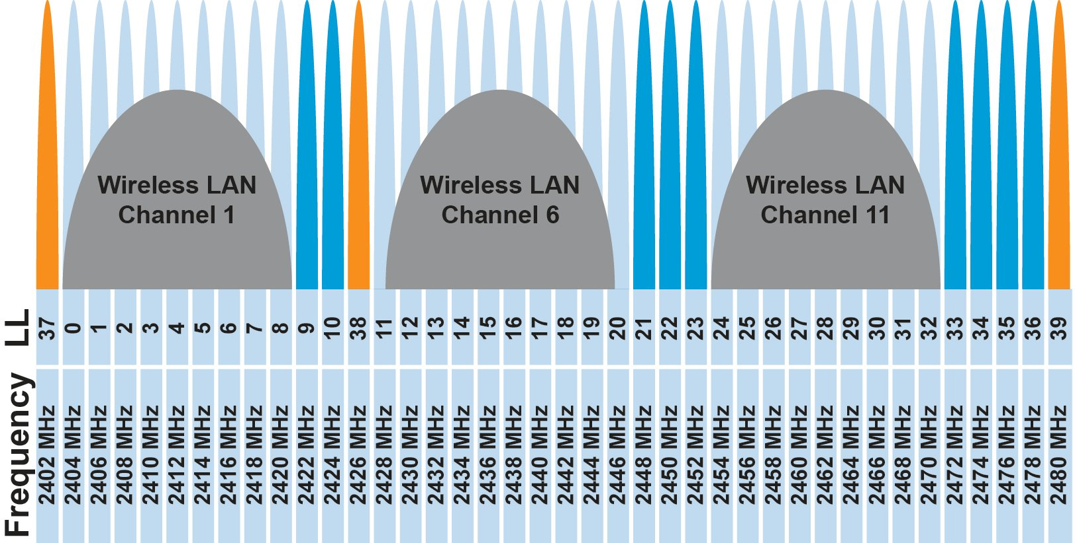
BLE frequency usage and channels
2.4 GHz carrier, forty 2-MHz channels, 1 Mbps data rate
  37, 38, 39 for advertising
  0-36 for connection (FHSS)
pollev.com/wiot
Why doesn’t BLE avoid WiFi altogether?
Can’t on 2.4 GHz

Slide 16
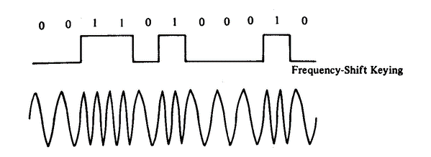
BLE modulation
Gaussian Frequency-Shift Keying (GFSK)
  Improvement on base Frequency-shift Keying
  Smoother transitions between bits -> reduces nearby interference

Slide 17
Gaussian FSK lessens spectral leakage, reduces bandwidth
FSK
GFSK
Notes:
Less Bandwidth usage
at the expense of some loss in intersymbol discriminability
Images from http://j3.rf-explorer.com/40-rfe/article/53-tutorial-how-to-use-rf-explorer-to-monitor-a-rfbee?start=4

Slide 18
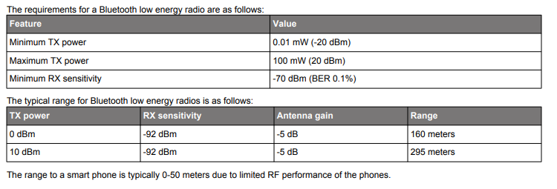
BLE signal strength
nRF52840 capabilities
  Transmit: up to 8 dBm
  Receive sensitivity: -95 dBm
Notes:
BER – bit error rate
+3 dB - double the power
+10 dB – 10x power
The effective antenna gain is relevant for both the transmitting and receiving antenna. The directional influence of an antenna is similar to speaking or listening through a cone to focus the energy of the sound.
Bluetooth® technology designers can choose to implement a variety of antenna options. Bluetooth devices typically achieve an antenna gain in the range of –10 dBi to +10 dBi.

Slide 19
Outline
BLE Background
BLE Layers
  Physical Layer
  Link Layer
BLE roles
  Advertising
  Scanning

Slide 20
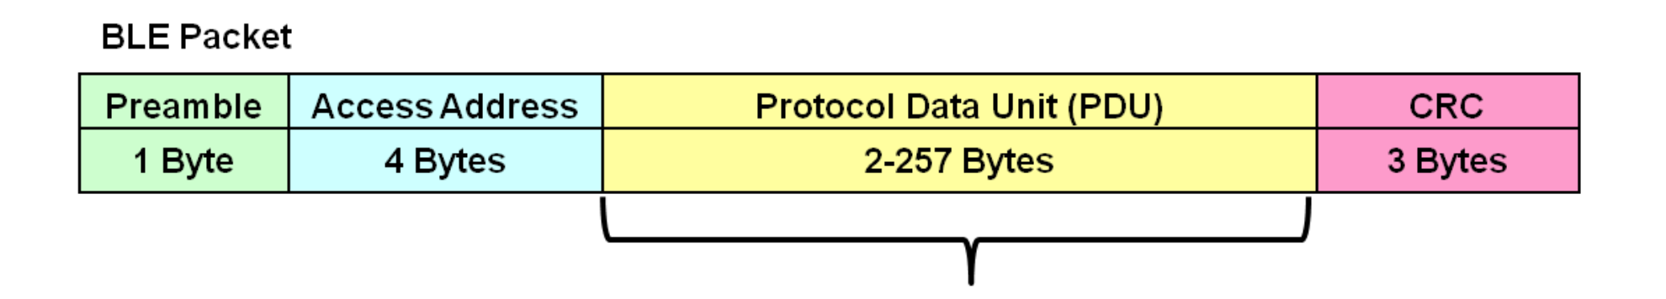
Link Layer Packet Structure
Same packet structure for both advertisements and connections
  Fields are filled in little endian
Access address unique for each connection (randomly chosen)
All Advertisements use the same AA: 0x8E89BED6
Data
Notes:
https://microchipdeveloper.com/wireless:ble-link-layer-packet-types

Slide 21
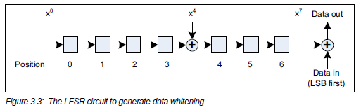
Data whitening
Avoid long series of repetitive bits (all zeros or all ones)
  Would cause RF noise to be more focused in one direction
  Radio hardware desires output to have zero DC-bias (or close to that)
  Great example of the PHY and MAC being interwoven in wireless

Slide 22
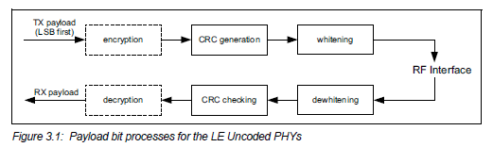
Bit processing pipeline

Slide 23
Outline
BLE Background
BLE Layers
  Physical Layer
  Link Layer
BLE roles
  Advertising
  Scanning

Slide 24
Advertising: BLE’s discovery mechanism
Make nearby devices aware of advertiser’s existence
Communicate some information from or about advertiser
Traditional purpose is to enable connections, but this is also useful for general communication
Advertisements
  Periodic broadcast messages with data
Scan Requests/Responses
  Scanner sends responses after getting a request
    Only occurs when scanner is listening
  Almost literally “bonus advertisement data”

Slide 25
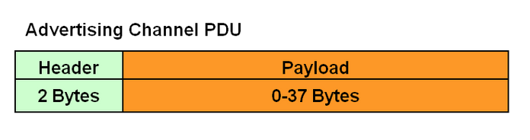
Advertising packet layering

Slide 26
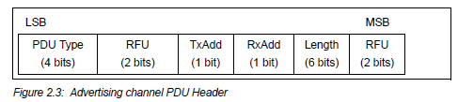
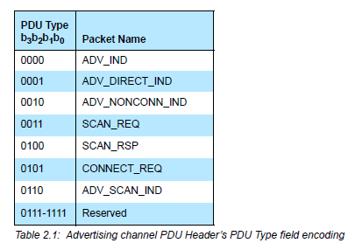
BLE advertising header
ADV_IND
  Advertisement
  Allows connections and scan requests
ADV_NONCONN_IND
  Advertisement
  No connections or scan requests
ADV_SCAN_IND
  Advertisement
  No connections but allows scan requests
SCAN_REQ
  Scan request
SCAN_RSP
  Scan response
Notes:
ADV_IND
Known as Advertising Indications (ADV_IND), where a peripheral device requests connection to any central device (i.e., not directed at a particular central device).
Example: A smart watch requesting connection to any central device.
ADV_DIRECT_IND
Similar to ADV_IND, yet the connection request is directed at a specific central device.
Example: A smart watch requesting connection to a specific central device.
ADV_NONCONN_IND
Non connectable devices, advertising information to any listening device.
Example: Beacons in museums defining proximity to specific exhibits.
ADV_SCAN_IND
Similar to ADV_NONCONN_IND, with the option additional information via scan responses.
Example: A warehouse pallet beacon allowing a central device to request additional information about the pallet.

Slide 27

Advertisement payloads
AdvA – address of the advertiser
  TxAdd bit from header specifies if this is a “public” or “random” address
Remaining up to 31 bytes are available for use

Slide 28
Advertiser addresses
Public and private address forms
Public
  48 bits: 24-bits of company ID, 24-bits of company assigned number
  Literally the same MAC address scheme as Ethernet and WiFi
Private
  Top two MSbs specify type
    46 bits of random
    46 bits of hash of an identity key
Why have the two types?
  Privacy

Slide 29
Advertisement Packet
Putting it all together, up to 47 bytes total:
BLE Packet
Advertising PDU
Preamble 1 Byte | Access Address 4 Bytes | Header 2 Bytes | Advertiser Address 6 Bytes | Advertiser Data (Payload) 0-31 Bytes | CRC 3 Bytes

Slide 30
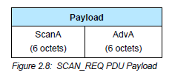
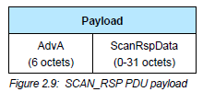
Scan Requests and Responses
Scan request
  Just the two addresses: the scanner’s and the advertiser’s
Scan response
  Identical to an advertisement
  But only occurs after a request

Slide 31
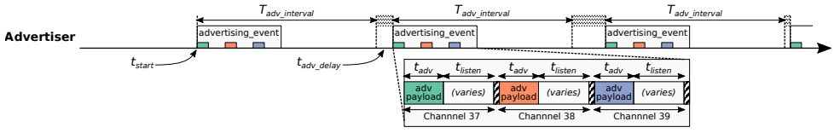
Advertising timing
Advertising Events occur periodically [20ms – 10.24 s] (or longer)
  User picks the rate as a tradeoff of energy and discovery latency
Plus a random delay after each instance [0-10ms]
  Why?
    Avoid repeat collisions.

Slide 32
Advertising event
Three transmissions, one on each advertising channel
  Always in the same order
Transmission, followed by listening window on that same channel
  Requests will be sent >=150 us (Inter-Frame Spacing, IFS) after Tx
  Followed by a retune to the next channel frequency
This short listen window is the magic “low energy” part

Slide 33
Preserving energy in communication
Most energy is spent listening
  This is due primarily to how long listening durations are compared to transmissions
Question: advertising vs. listening in BLE:
  How much more energy is used listening for 1 second versus transmitting 30 bytes three times?
    Radio uses 60 mW when active (TX or RX)
    1 Mbps data rate
  pollev.com/wiot

Slide 34
Preserving energy in communication
30 bytes = 240 bits
240 bits / 1 Mbps = 0.240 ms
1 s / 0.720 ms = 1389
1389x!!
Example: maximum-sized BLE transmission:
  47 bytes = 376 bits at 1 Mbps = 0.376 ms transmitting
  So listening for an entire second is >2500 times longer
  But listening for only 0.376 ms requires sub-ms synchronization between two device, which itself costs energy to manage…
  Instead, when advertising, nRF radios listen for ~0.200 ms, only after a transmission

Slide 35
Payload of an advertisement
What do you stick in the BLE payload anyways?
  Theoretically whatever you want, but that isn’t very compatible
  Point is to specify capabilities of the advertiser
Desire: specify payloads in such a way that all scanners can interpret what they mean about the device
  This is different from traditional internet packets
  Broadcasts are for anyone to hear, not a specific server/application
Ideas?

Slide 36
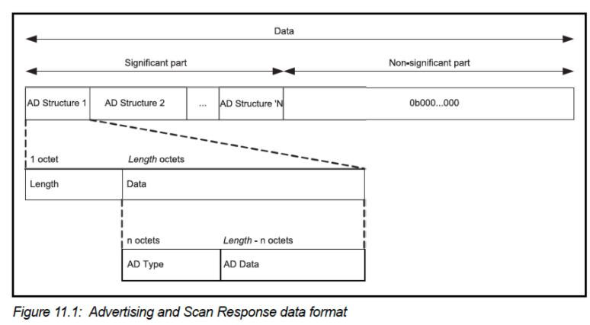
TLV Format
Type – Length – Value
  Actually, BLE does the length part first
  Scanner can hop through length/type pairs to find what interests it

Slide 37
Payload types
Listed in the Core Specification Supplement [Supplement v9]
  Each might have their own considerations about AD Data format
Flags (supported modes: BLE and Bluetooth) required by Apple?
Name
Service UUID
TX Power Level
Manufacturer-specific data
And about twenty others

Slide 38
Outline
BLE Background
BLE Layers
  Physical Layer
  Link Layer
BLE roles
  Advertising
  Scanning

Slide 39
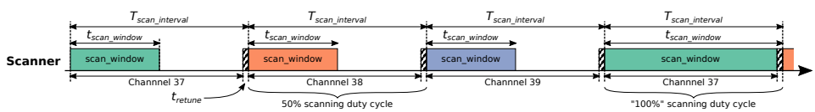
Scanning Pattern
Iterate through channels, listening for advertisements
  T_{scan_interval} controls rate at which channels are changed
  T_{scan_window} controls duty cycle of listening
Why listen at a low duty cycle?
  Save energy

Slide 40
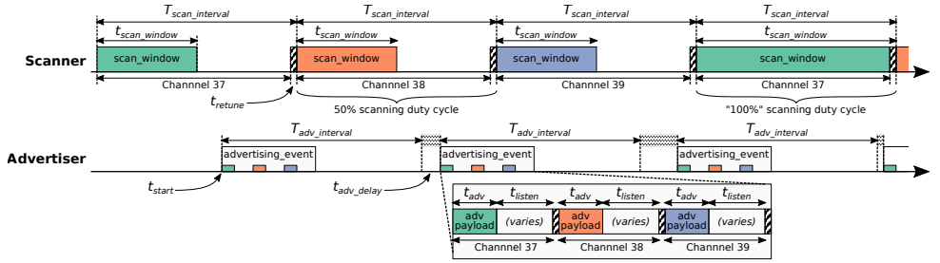
Putting it all together
Advertisements are received when the channel of the scan window and the channel of the advertisement overlap in time (and space)

Slide 41
A warning about scanning expectations
Scanners will NOT receive 100% of packets sent
  Even ignoring range issues
Packets are lost due to (in roughly descending order):
  Duty cycle
  Sharing 2.4 GHz antenna with WiFi
  Retune period after each scanning interval
  Dropped packets in the receive software
  Packet collisions

Slide 42
Next Time: Going deeper on advertisements
For those wanting more on BLE energy use
  Schrader, Raphael, et al. "Advertising power consumption of bluetooth low energy systems." 2016 3rd International Symposium on Wireless Systems within the Conferences on Intelligent Data Acquisition and Advanced Computing Systems (IDAACS-SWS). IEEE, 2016.

Slide 43
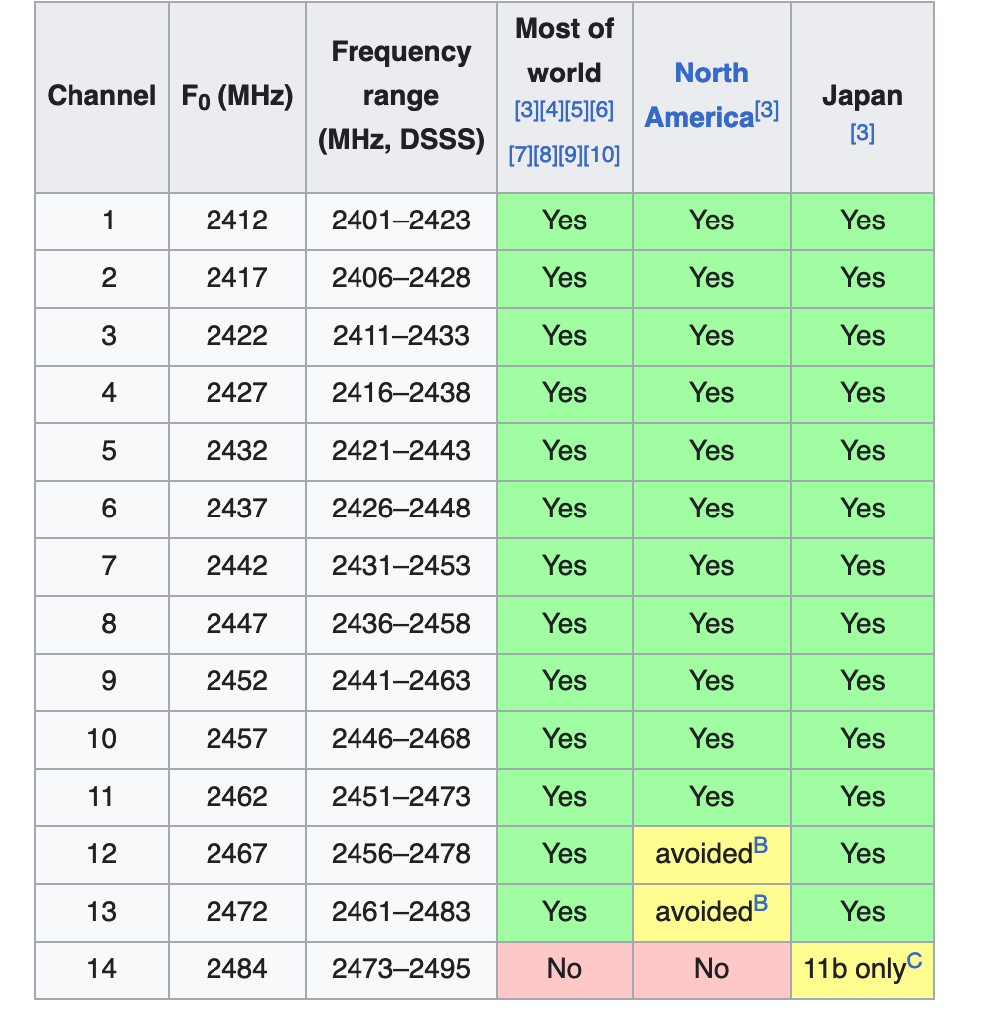

Slide 44
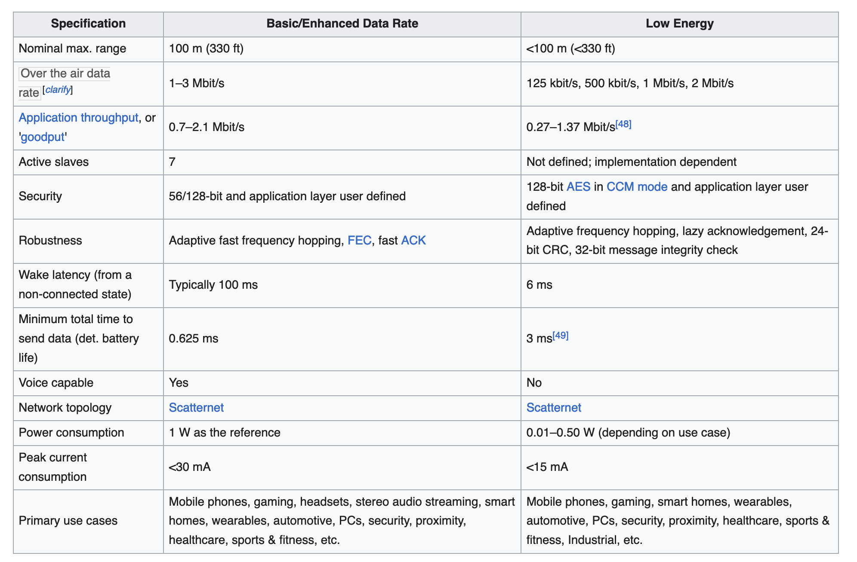
Notes:
~10mA for BLE

