Slide 1
Wireless for the Internet of Things
Thread Networking
CS/ECE 4501
Spring 2024
UVA
No quiz
[Pannuto, Ghena, Campbell]

Slide 2
Outline
802.15.4 Review
Thread Overview
Thread Addressing
Runtime Behavior
Using IP

Slide 3
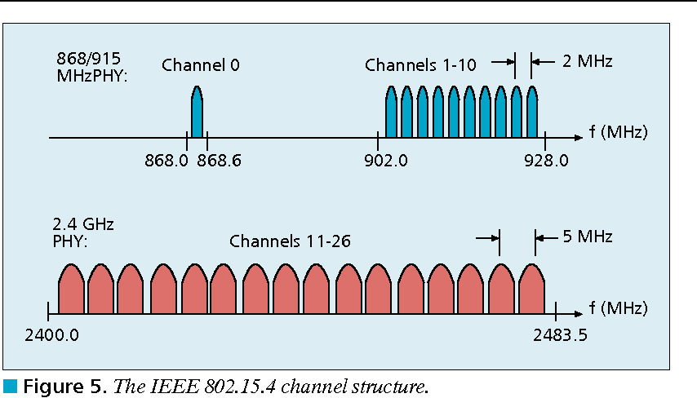
802.15.4 RF channels
27 channels across three bands
16 channels with 5 MHz channel separation at 2.4 GHz
?
?
?
?

Slide 4
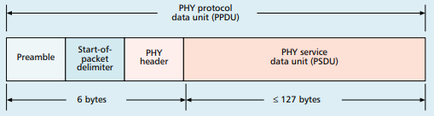
802.15.4 base packet format
Can have 127 byte data
?
Notes:
PHY Header
One field: length 0-127

Slide 5
MAC frame format
?
?
Frame control
  Header
?
?
Sequence number
8-bit monotonically increasing
Addressing fields
  PAN and addresses
  Varies based on frame type
Frame payload
  Depends on frame type
Frame check sequence
  16-bit CRC

Slide 6
Outline
802.15.4 Review
Thread Overview
Thread Addressing
Runtime Behavior
Using IP

Slide 7
What’s the need for Thread?
Born from Google’s Nest team
Requirements:
  IP-based: interoperate with rest of the Internet
  Scalable: hundreds of devices in a network
  Low power: years of operation on batteries
  Secure: authenticated and encrypted communication
  Reliability – mesh networking without single point of failure
2014: Thread Group alliance formed
  Goal: develop, maintain and drive adoption of Thread as an industry networking standard for IoT
Source: openthread.io, threadgroup.org

Slide 8
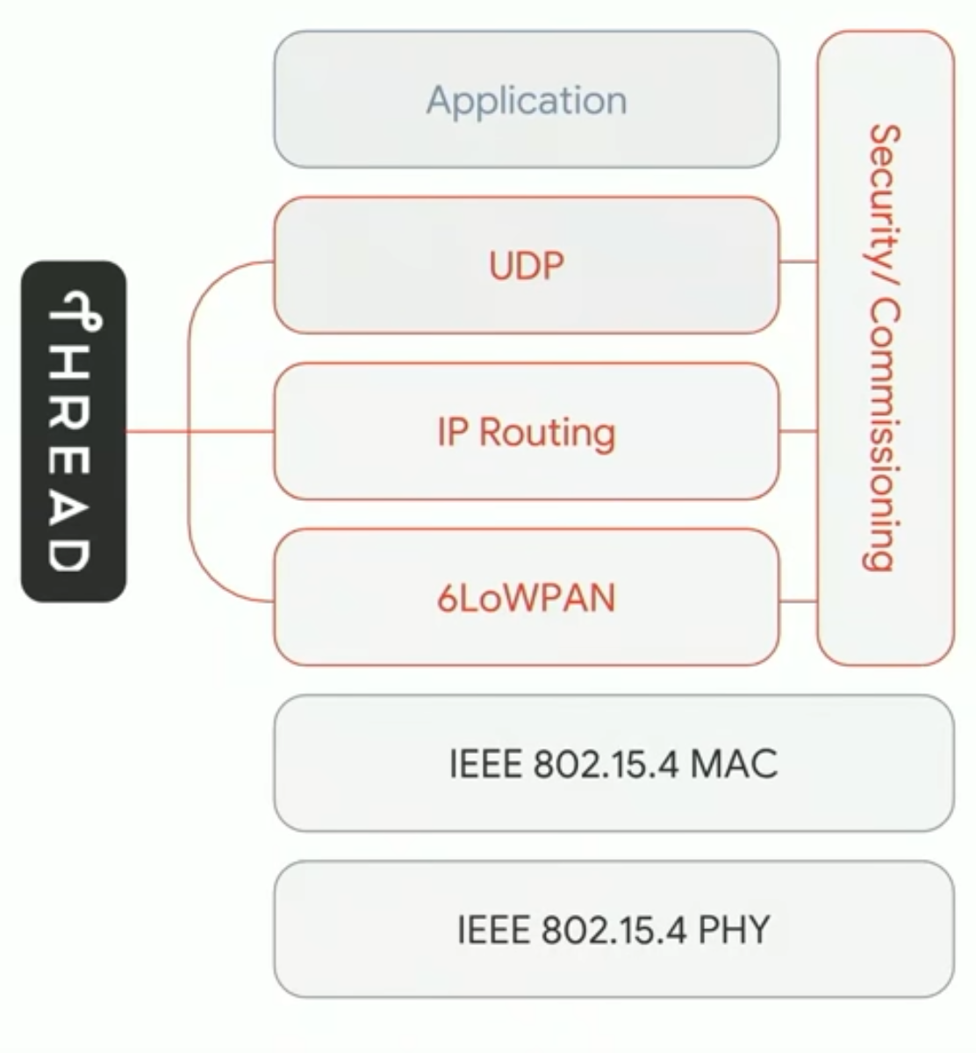
Thread overview
Build a networking layer on top of 15.4
  Reuses most of PHY and MAC
  Adds IP communication
  Handles addressing and mesh maintenance
Industry-focused, but based in academic research
Source: openthread.io, threadgroup.org

Slide 9
References on Thread
Request for specification: https://www.threadgroup.org/ThreadSpec
  Frustratingly locked down!
Overview on capabilities: https://openthread.io/guides/thread-primer
  Excellent overview
  Lifting heavily for these slides
Good overview on Thread Networking:
  https://www.threadgroup.org/support#Whitepapers
  Thread Networking Fundamentals

Slide 10
Changes to Physical Layer
Remove all non-2.4 GHz PHY options
Otherwise the same
  OQPSK
  16 channels, 5 MHz spacing
  Typical TX power 0 dBm
  Typical RX sensitivity -100 dBm

Slide 11
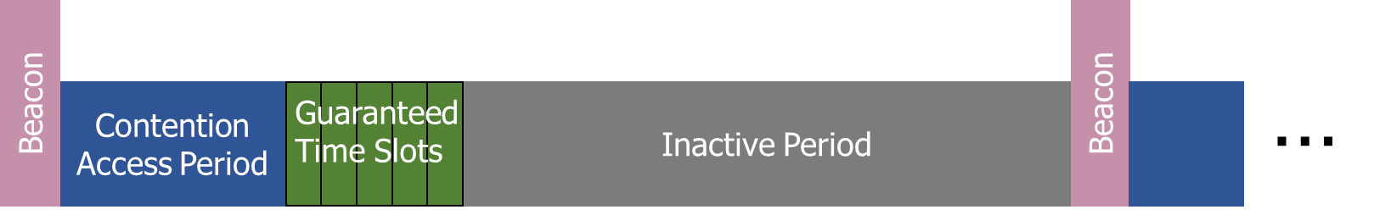
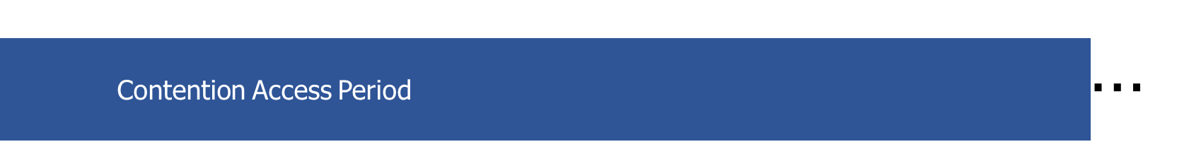
Changes to Link Layer and MAC
Non-beacon-enabled PAN only
  No superframe structure
  No periodic beacons
  No Guaranteed Time Slots
Throw out most existing MAC Commands
  Remove network joining/leaving
  Remove changing coordinators
  Remove Guaranteed Time Slot request
  Network joining will be handled at a higher layer

Slide 12
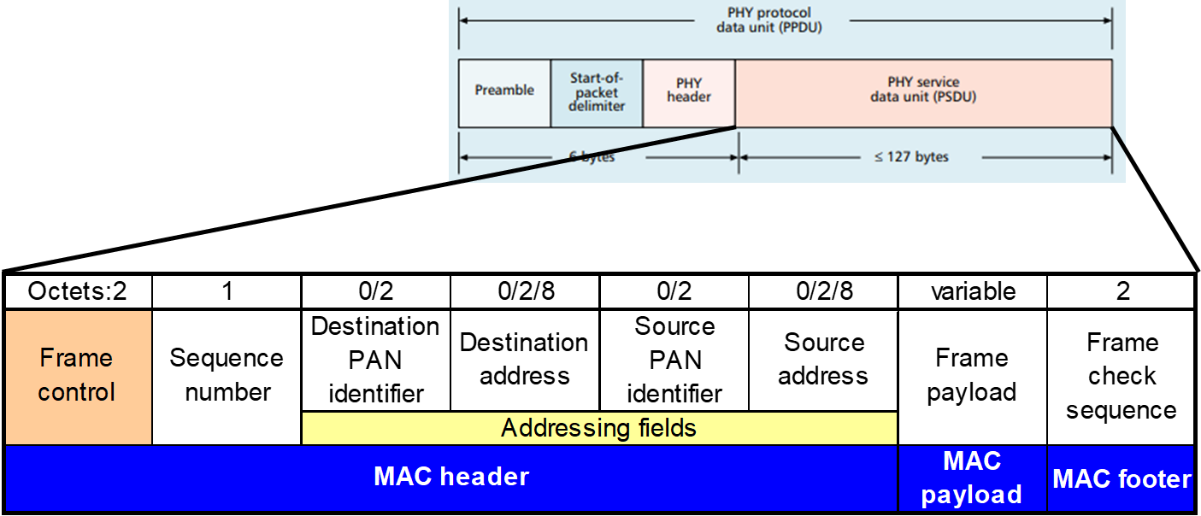
Changes to Link Layer and MAC
Keep unslotted CSMA/CA algorithm
Keep packet structure
Keep Frame Types
  Beacon
  MAC Command
    Beacon Request
    Data Request
  Data
  Acknowledgement
Notes:
Why remove periodic beacons but still retain beacon frames? We’ll see later!

Slide 13
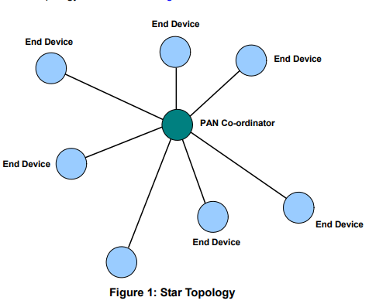
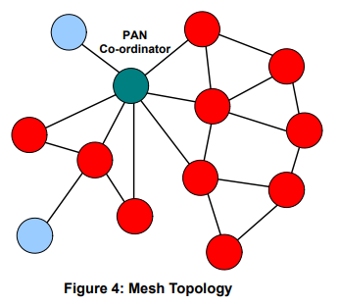
Thread networks use a mix of star and mesh topologies
Can be prone to single point of failure
- PAN coordinator still a single point of failure
- Lot more devices have to handle routing
Notes:
What are some issues with these topologies?
Central point of failure
Some nodes have to spend more energy communicating

Slide 14
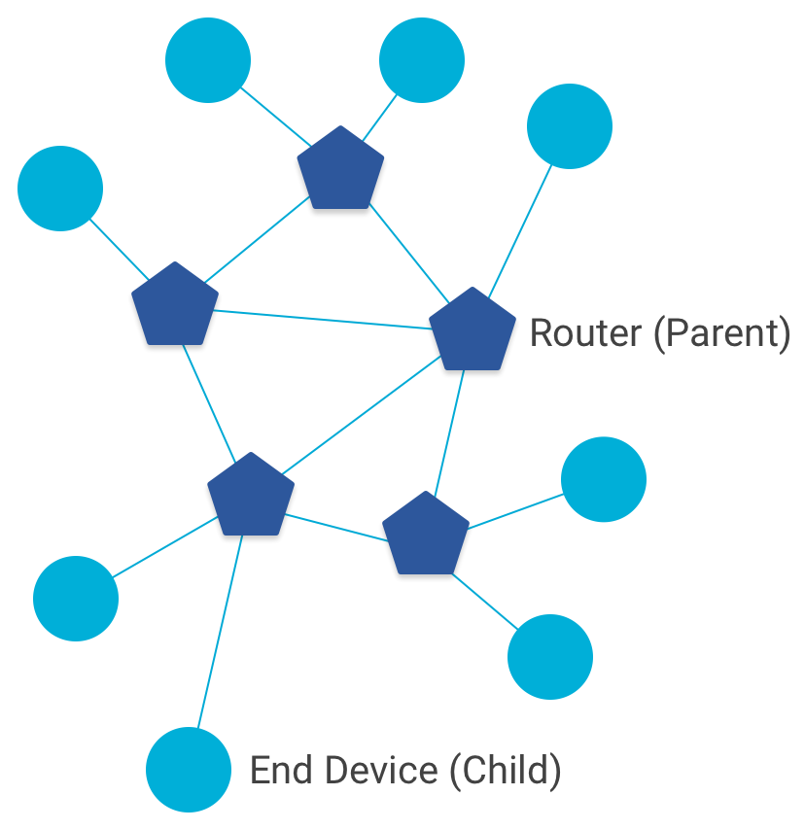
Thread networks use a mix of star and mesh topologies
Routers (parent)
  Mesh communication with other routers
  Radio always on
  Forwards packets for network devices
  Enables other devices to join network
  32 routers per network
End Devices (child)
  Communicates with one parent (router)
  Does not forward packets
  Can disable transceiver to save power
    Send packets periodically to avoid timeout
  511 end devices per router

Slide 15
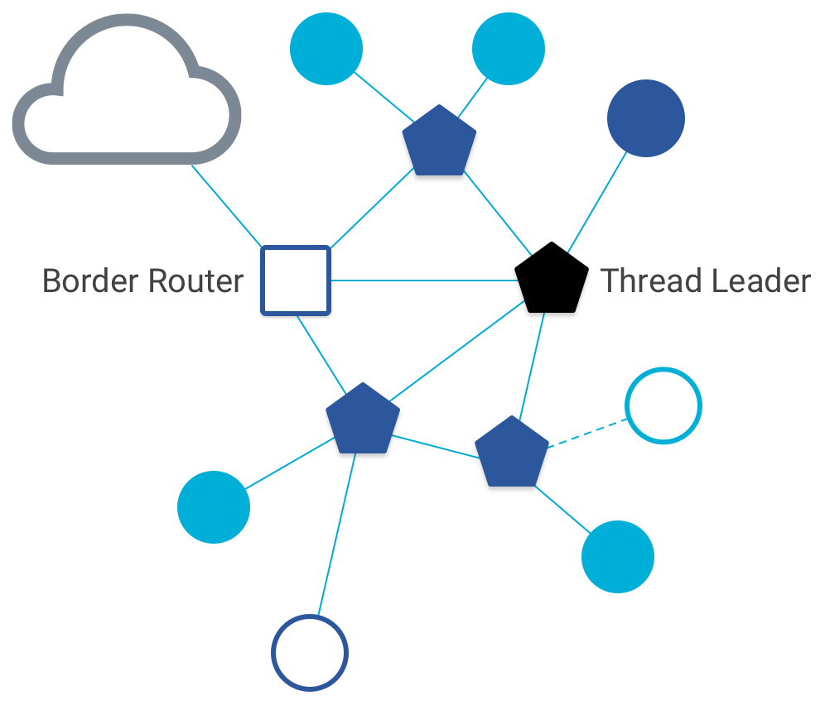
Other special roles
Thread leader
  Device in charge of making decisions
    Addresses, Joining details
  Automatically selected from routers
    One leader at any given time
    Additional leader is selected if the network partitions
Border router
  Router that also has connectivity to another network
    Commonly WiFi or Ethernet
  Provides external connectivity
  Multiple border routers may exist at once

Slide 16
Outline
802.15.4 Review
Thread Overview
Thread Addressing
Runtime Behavior
Using IP

Slide 17
Thread uses IPv6 for communication
Why IP?
  If Wireless Sensor Networks represent a future of billions of connected devices distributed throughout the physical world, then
    Shouldn’t they run standard protocols wherever possible?
  Why IPv6?
    Generalized, Flexible, Capable
Benefits
  Interoperability with normal computers and networks
  Reuse state of the art developed standards instead of remaking them
    Security, Naming, Discovery, Services
Costs
  Packet overhead can be high (will fix)
  Complexity for supporting protocols
Hui and Culler, “IP is Dead, Long Live IP for Wireless Sensor Networks”. 2008

Slide 18
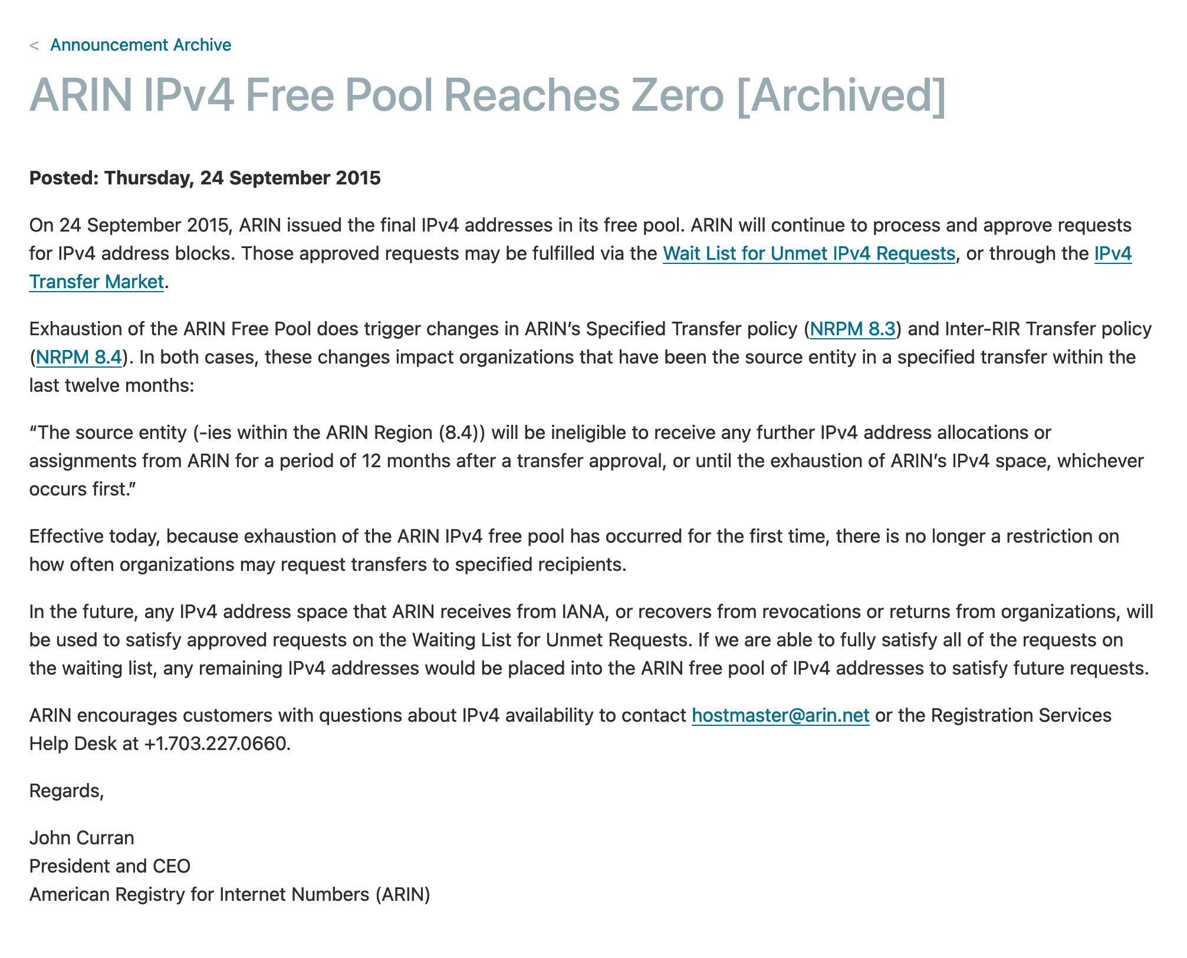

Slide 19
Background: IPv6
Replacement to Internet Protocol v4
  (Something unrelated used version number 5)
Extended addressing for devices
  32-bits for IPv4 addresses -> 128-bits for IPv6 addresses
  340 trillion, trillion, trillion addresses (> 100 x no. of atoms on the surface of the Earth)
  Example: a39b:239e:ffff:29a2:0021:20f1:aaa2:2112 (8 groups of 16 bits)
Supports multiple transmit models
  Broadcast: one-to-all
  Multicast: one-to-many
  Unicast: one-to-one
Various other improvements
Notes:
Show ipv4 and ipv6 addresses

Slide 20
Background: IPv6 address notation rules
Groups of zeros can be replaced with “::”
  Can only use “::” in one place in the address
Leading zeros in a 16-bit group can be omitted
  0000:0000:0000:0000:0000:0000:0000:0001
  2345:1001:0023:1003:0000:0000:0000:0000
  aecb:0222:0000:0000:0000:0000:0000:0010
Special addresses
  Localhost - ::1 (IPv4 version is 127.0.0.1)
  Link-Local Network - fe80:: (bottom 64-bits are ~device MAC address)
  Local Network – fc00:: and fd00::
  Global Addresses – 2000:: (various methods for allocating bottom bits)
→ ::1
→ 2345:1001:23:1003::
→ aecb:222::10

Slide 21
Background: IPv6 datagram format
Priority: like “type of service” in IPv4.
Flow label: ambiguous
Next header: TCP, UDP
Hop limit = TTL
version
priority
flow label
payload length
next header
hop limit
source address
(128 bits)
destination address
(128 bits)
data
(variable length, typically a TCP or UDP segment)
32 bits

Slide 22
Fitting an IPv6 datagram in an 802.15.4 frame
version
priority
flow label
payload length
next header
hop limit
source address
(128 bits)
destination address
(128 bits)
data
(variable length, typically a TCP or UDP segment)
32 bits
How many bytes for the IPv6 header?
How much for the MAC header + footer?
How much room do we get for payload?

Slide 23
IPv6 tricky to use directly with 802.15.4
Header overhead very high
  around half of bytes in PSDU, even more when security enabled
IP packets may be large, compared to 802.15.4 max frame size
  IPv6 requires all links support 1280 byte packets [RFC 2460]
Need some way to compress and fragment!

Slide 24
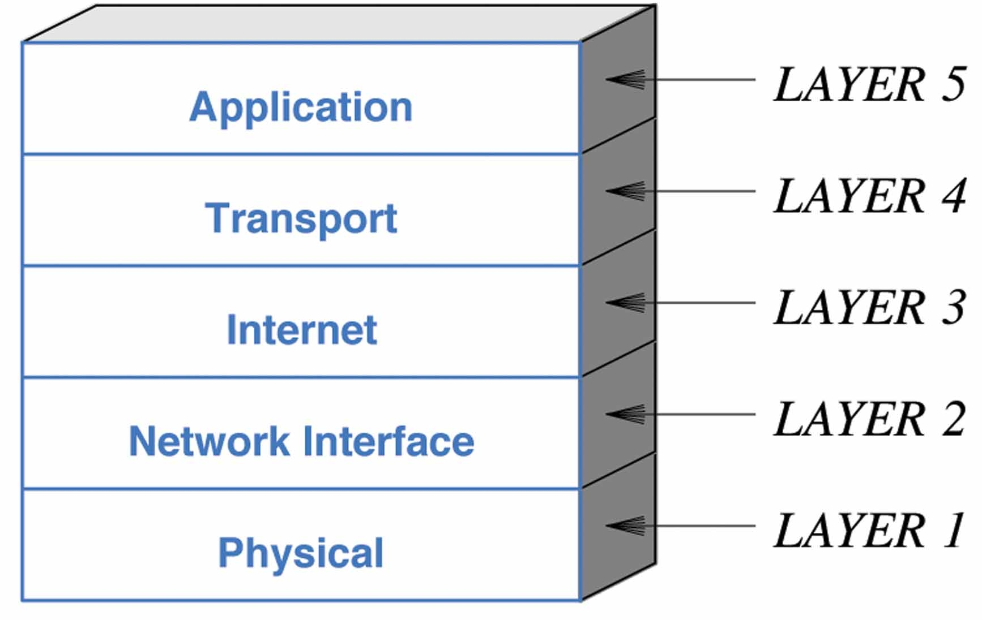
6LoWPAN
Method for running IPv6 over 802.15.4 links
  IPv6 over Low-Power Wireless Personal Area Networks
  IETF Standard (RFC4944 + updates in RFC6282)
Directly out of the research world (Jonathan Hui + David Culler)
  Research Paper: IP is Dead, Long Live IP for Wireless Sensor Networks
  Thesis of work: sensor networks can and should use IPv6
Important goals
  Compress IPv6 headers
  Handle fragmentation of packets
  Enable sending packets through mesh

Slide 25
6LoWPAN header compression
40 bytes of IPv6 header are a lot for a 127-byte payload
Most important goals
  Communication with devices in the 15.4 network should be low-overhead
  Communication outside of the 15.4 network should still minimize overhead where possible
Assume a bunch of common parameters to save space
  A bunch of options are set to default values
  Payload length can be re-determined from packet length
  Source/Destination addresses can often be reassembled from link layer data
    Plus information about network address assignment known by routers
Border router “inflates” the packet before sending externally
Notes:
Why is fragmentation needed?
Ipv6 minimum link MTU requirement is1280 bytes
In the layered archi-
tecture, this adaptation layer sits at layer 2.5 (between the link and
network).

Slide 26
Compression ideas?
version
priority
flow label
payload length
next header
hop limit
source address
(128 bits)
destination address
(128 bits)
data
(variable length, typically a TCP or UDP segment)
32 bits

Slide 27
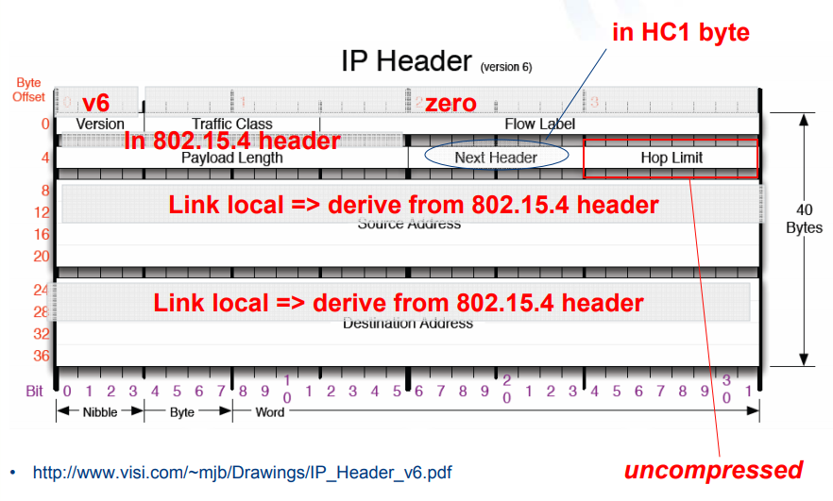
Example of compression
Note: Thread actually uses IPHC (not HC1) from rfc6282
Good example of Header compression: https://www.youtube.com/watch?v=wRdrCsgJekM

Slide 28
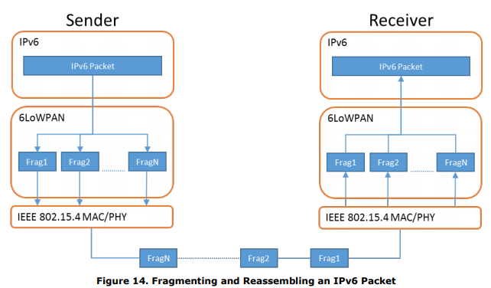
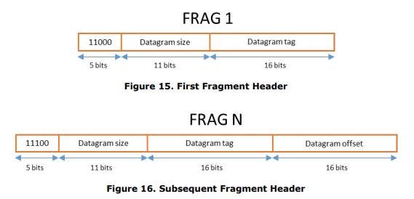
6LoWPAN fragmentation
Only the first packet of the fragments will hold the IPv6 header
  Tag, offset, and size are used to reconstruct

Slide 29

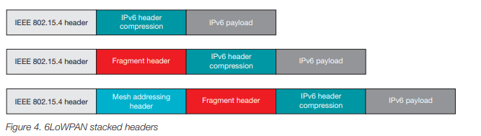
6LoWPAN mesh forwarding
Additional header with originator and final addresses
Which of these headers are used depends on the packet

Slide 30
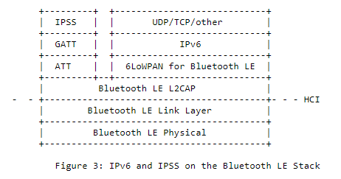
Sidebar: IPv6 over BLE
RFC7668 defines 6LoWPAN techniques for BLE connections

Slide 31
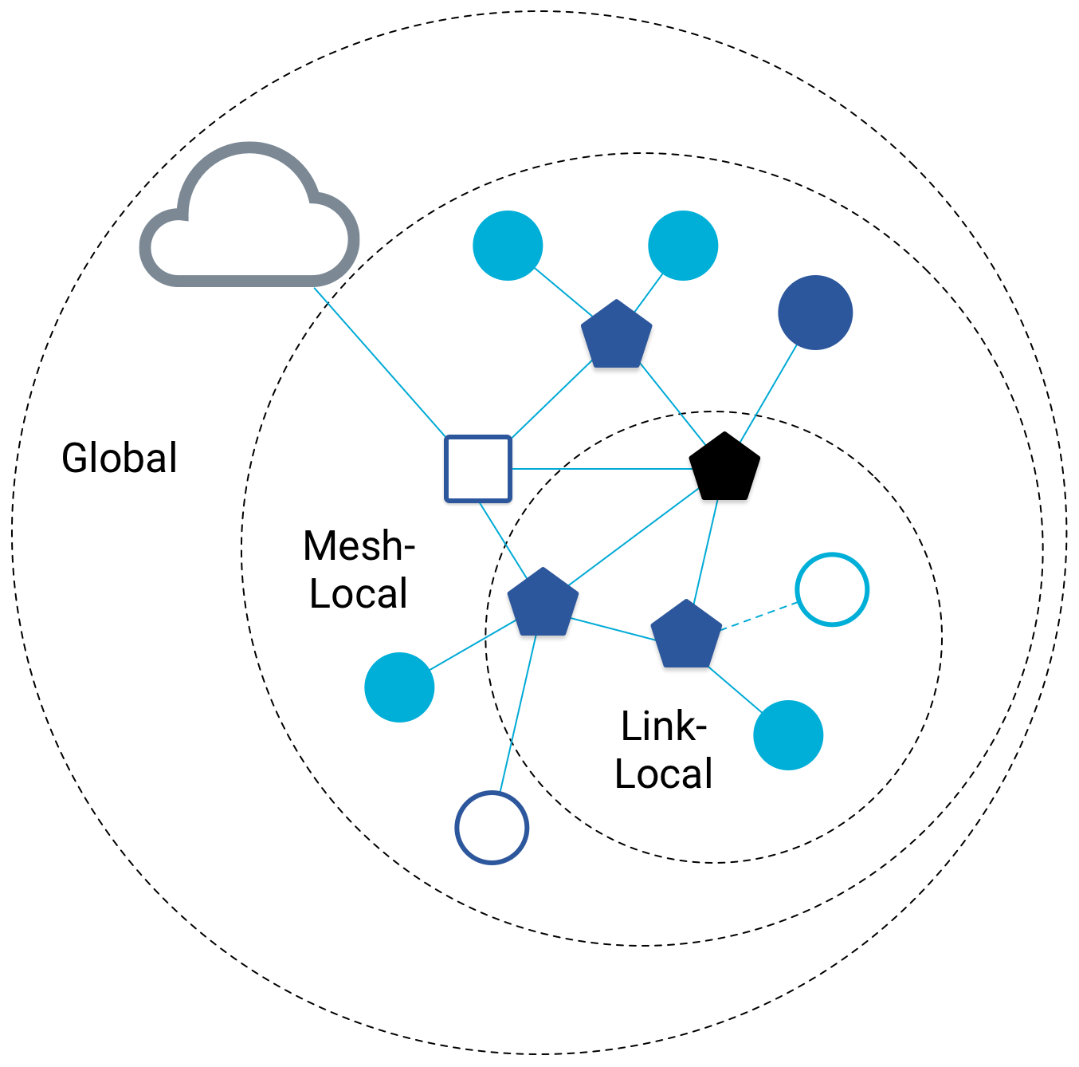
Benefit to IPv6: multiple address spaces per Thread device
Each device gets an IPv6 address for each way to contact it
  Link-local IP address
  Mesh-local IP address
  Global IP address
  Topology based IP address
  Role based IP address
Link-Local
  all devices reachable by a single radio transmission
Mesh-Local
  all devices reachable within the same Thread network
Global
  all interfaces reachable from outside a Thread network

Slide 32
Traditional addresses in Thread
Link-Local Addresses
  FE80::/16
  Bottommost 64-bits are EUI-64 (MAC address with 0xFFFE in the middle)
  Permanent for a given device (no matter the network)
  Used for low-layer interactions with neighbors (discovery, routing info)
Mesh-Local Addresses
  FD00::/8 (FD00:: and FC00:: are for local networks)
  Remaining bits are randomly chosen as part of joining the network
  Permanent while connection is maintained to a network
  Used for application-layer interactions
Global Addresses
  2000::/3
  Public address for communicating with broader internet through Border Router
  Various methods for allocation (SLAAC, DHCP, Manual)

Slide 33
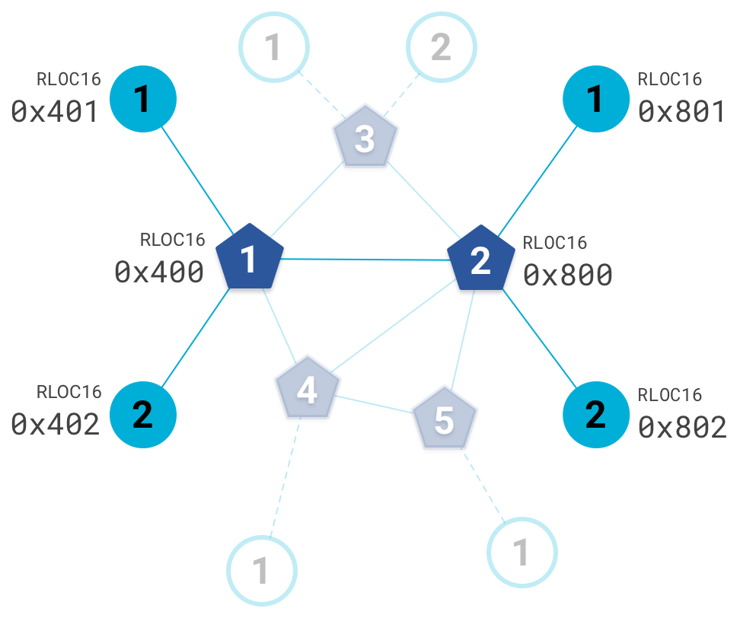
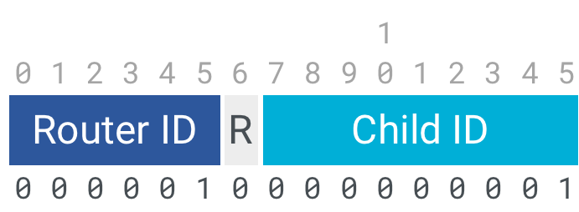
Topology-based addresses in Thread
FD00::00ff:fe00:RLOC16
  Same top bits as mesh-local
Routing Locator (RLOC)
  Router ID plus Child ID
Changes with network topology
  Used for routing packets
Notes:
A Thread Routing Locator (RLOC) is an IPv6 address that identifies the location of a Thread Interface within a Thread Network Partition. RLOCs are used for communicating control traffic and delivering IPv6 datagrams to their intended destinations. In general, applications do not see or use RLOCs.
R – reserved bit set to 0

Slide 34
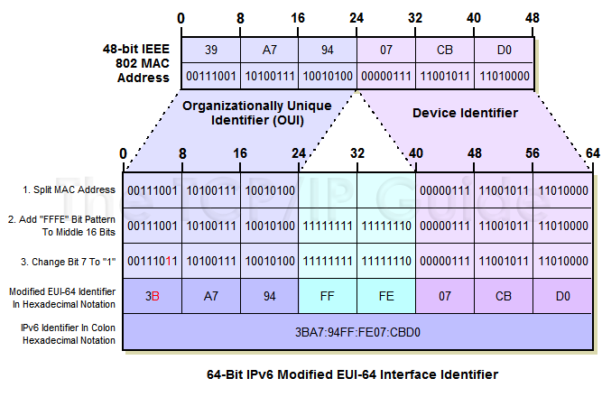
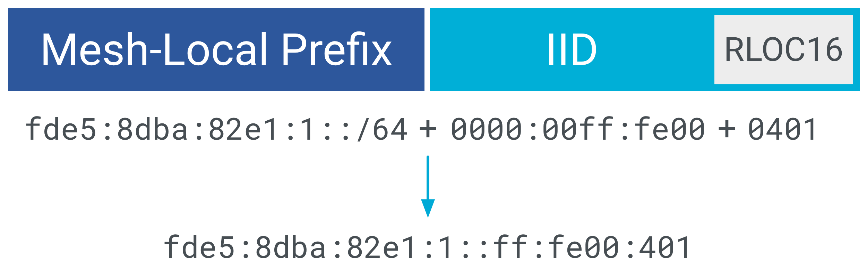
RLOC from RLOC16 and Mesh-Local Prefix
Notes:
The IID, combined with a Mesh-Local Prefix, results in the RLOC. For example, using a Mesh-Local Prefix of fde5:8dba:82e1:1::/64, the RLOC for a node where RLOC16 = 0x401 is:

Slide 35
Role-based addresses in Thread
Multicast
  FF02::1 – link-local, all listening devices
  FF02::2 – link-local, all routers/router-eligible
  FF03::1 – mesh-local, all listening devices
  FF03::2 – mesh-local, all routers/router-eligible
Anycast
  FD00::00FF:FE00:FCxx
    00 – Thread Leader
    01-0F – DHCPv6 Agent
    30-37 – Commissioner
    etc.

Slide 36
Why have all of these addresses?
Link-Local
  Example: fe80::54db:881c:3845:57f4
  IID Based on 802.15.4 Extended Address
  Used to discover neighbors, configure links, and exchange routing information
  Not a routable address
Mesh-Local EID (ML-EID)
  Example: fde5:8dba:82e1:1:416:993c:8399:35ab
  IID Random, chosen after commissioning is complete
  Does not change as the topology changes
  Should be used by applications

Slide 37
Why have all of these addresses?
Routing Locator (RLOC)
  Mesh-Local address
  Example: fde5:8dba:82e1:1::ff:fe00:1001
  Generated once a device attaches to a network
  Gives easy idea about routing!
  Changes as the topology changes
  Generally not used by applications
Anycast Locator (ALOC)

Slide 38
Break + Open Question
Why use Thread instead of basic 802.15.4?

Slide 39
Break + Open Question
Why use Thread instead of basic 802.15.4?
  Full specification of upper layers
    Clarifies how data is transmitted between devices on a network
    Cleans up a lot of things otherwise left implementation-dependent
  Interaction with the world outside of the sensor network!
    Gateway can be a dumb forwarder of packets
    Devices can directly talk to NTP servers or POST data to a website!

Slide 40
Outline
802.15.4 Review
Thread Overview
Thread Addressing
Runtime Behavior
Using IP

Slide 41
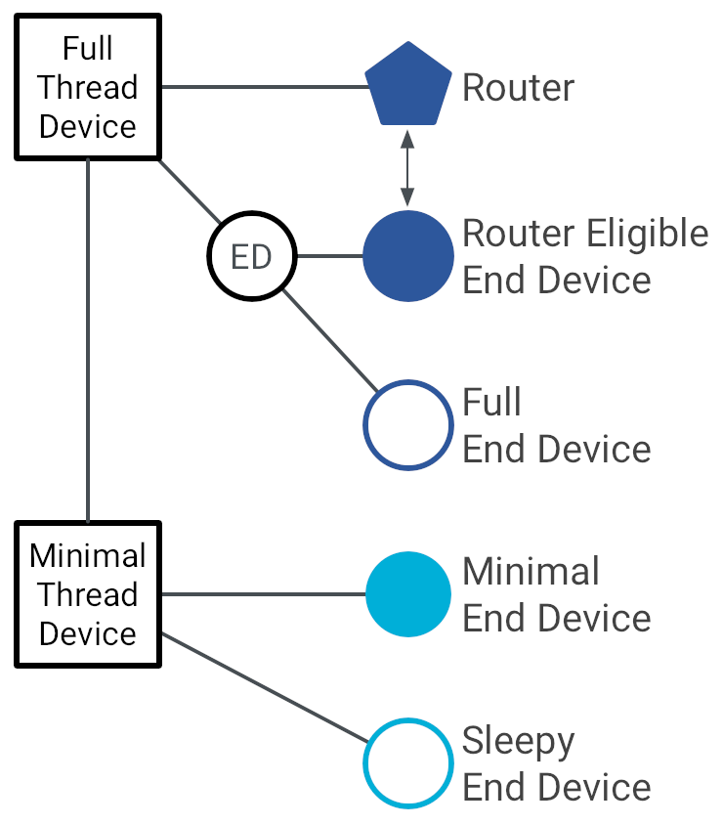
Thread device types
Full Thread Devices
  MAC: Always-on
  Participate in routing
  Examples:
    Routers
    Thread Leader
    Border Router
    Router-Eligible End Device (REED)
Minimal Thread Devices
  MAC: Can be low power
  Only send/receive to/from parent
  Examples:
    Minimal End Device (MED)
    Sleepy End Device (SED)

Slide 42
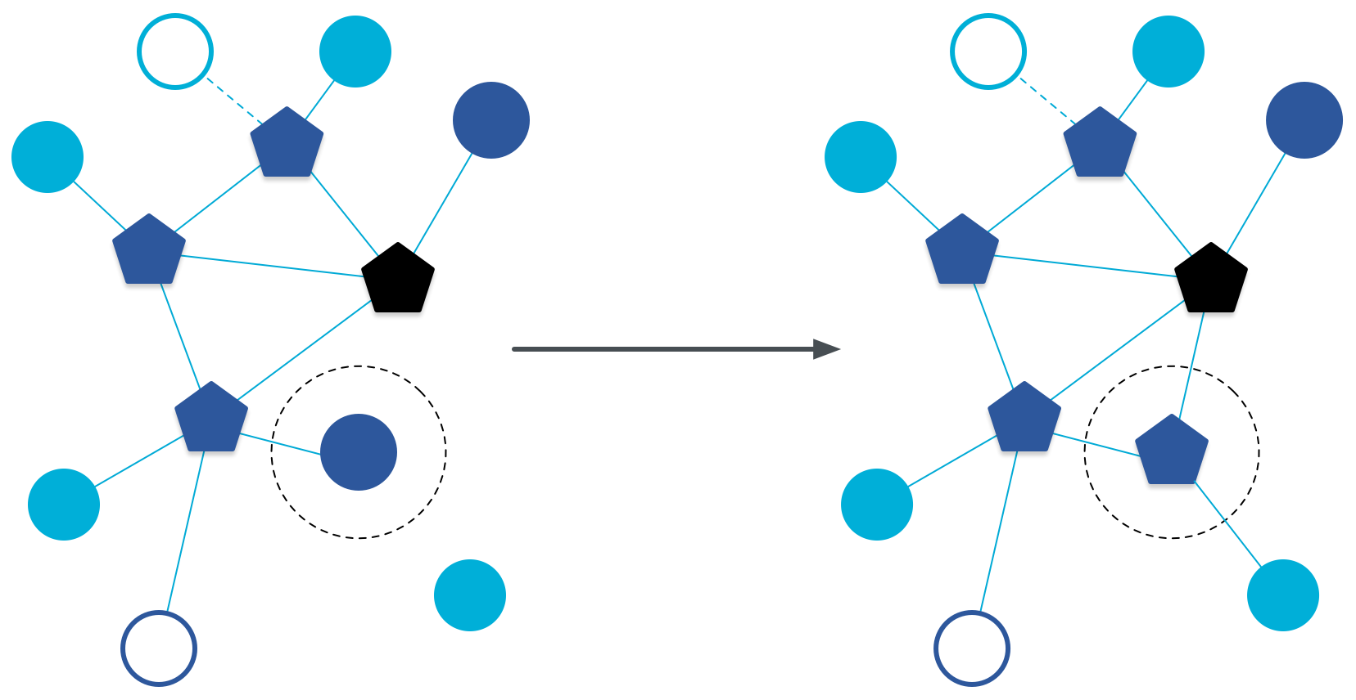
Router promotion
Router-Eligible End Device (REED)
  A router without any children
  Can operate as an end device with one connection (lower power)
  Promotes to a router when a joining end device relies on it
    If there is room for an additional router (max 32, typical 16-23)

Slide 43
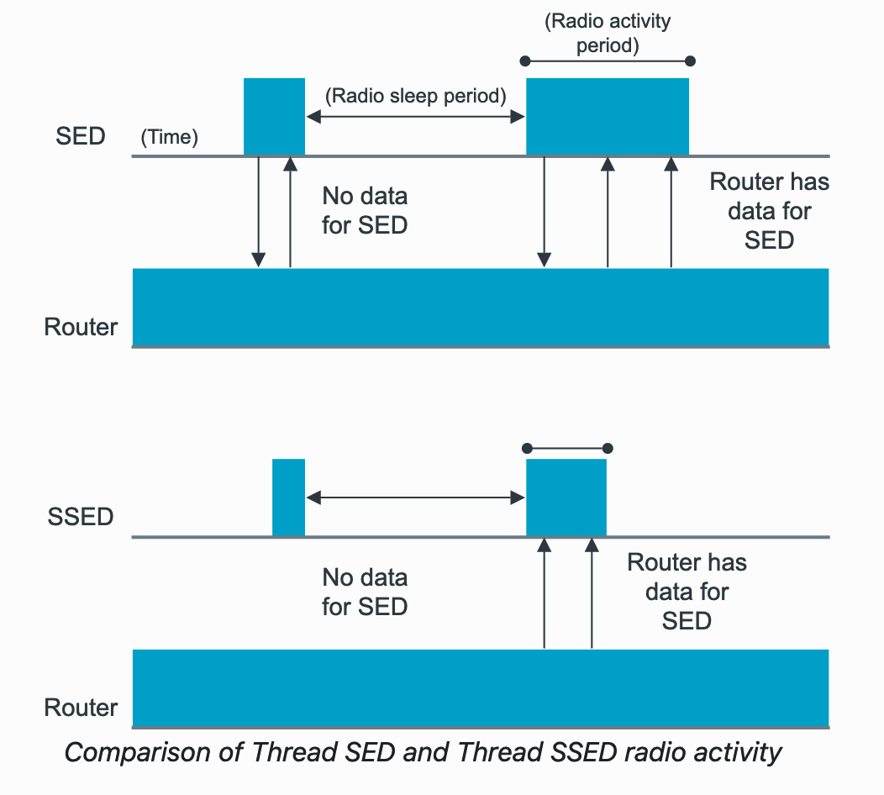
Sleepy End Devices
These are the low power devices
Periodically must exchange messages with Router
Sleepy End Device (SED)
  MAC:
    TX: Router always-on, so send as needed (ALOHA)
    RX: Periodically check in with router if new data pending
Synchronized Sleep End Device (SSED)
  MAC:
    TX: ALOHA
    RX: Listen during pre-configured windows
https://developer.nordicsemi.com/nRF_Connect_SDK/doc/latest/nrf/protocols/thread/sed_ssed.html

Slide 44
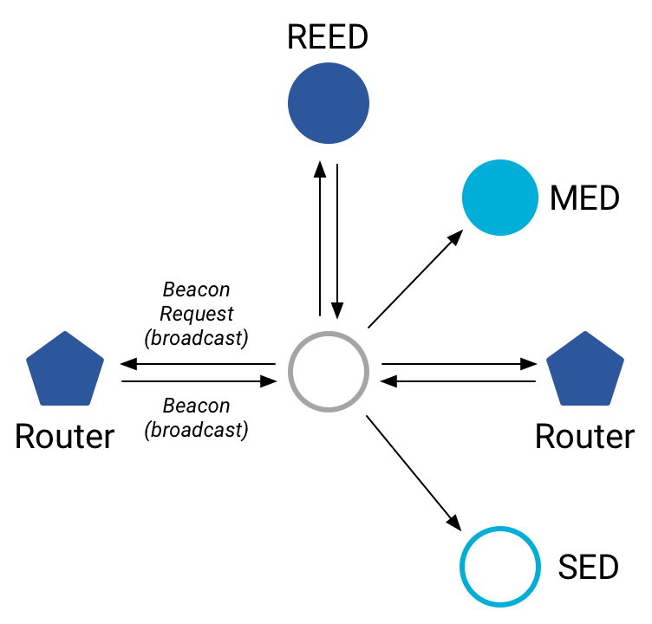
Discovering Thread networks
Beacon request MAC command
  Routers/Router-eligible devices respond
  Payload contains information about network
Thread network specification
  PAN ID – 16-bit ID
  XPAN ID – extended 64-bit ID
  Network Name – human-readable
Active scanning across channels can
quickly find all existing nearby networks

Slide 45
Creating a new network
Select a channel (possibly by scanning for availability)
Become a router
  Elect yourself as Thread Leader
  Respond to Beacon Requests from other devices
Further organization occurs through Mesh Link Establishment (MLE) protocol

Slide 46
Mesh Link Establishment (MLE)
Creating and configuring mesh links
  Payloads placed in UDP packets within IPv6 payloads
Commands for mesh
  Establish link
  Advertise link quality
  Connect to parent
TLVs (Type-Length-Value)
  Various data types that may be helpful within those packets
  Addresses, Link Quality, Routing Data, Timestamps
0 | Command Type | TLV | … | TLV
OR (secure version)
255 | Aux Header | Command Type | TLV | … | TLV | MIC
Notes:
0 Link Request. A request to establish a link to a neighbor. 1 Link Accept. Accept a requested link. 2 Link Accept and Request. Accept a requested link and request a link with the sender of the original request. 3 Link Reject. Reject a link request. 4 Advertisement. Inform neighbors of a device's link state. 5 Update. Informs of changes to link parameters shared by all nodes in a network. 6 Update Request. Request that an Update message be sent. The first four (Link Request, Link Accept, Link Accept and Request, and Link Reject) are collectively referred to as link configuration messages.

Slide 47
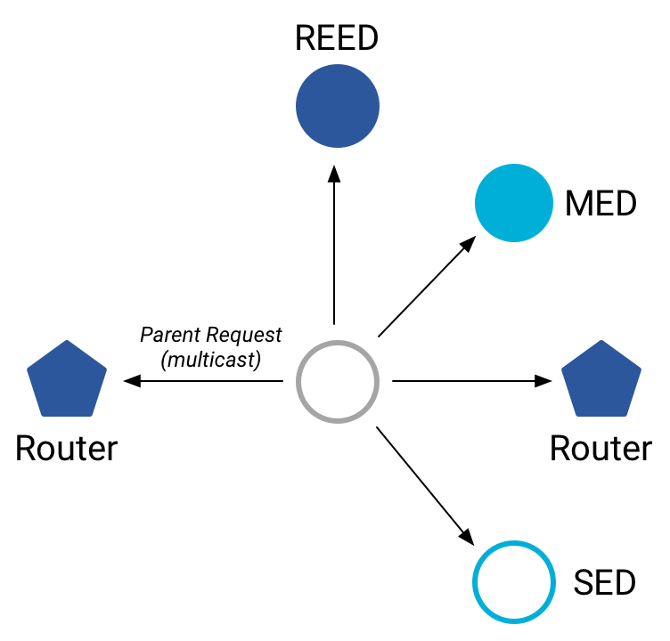
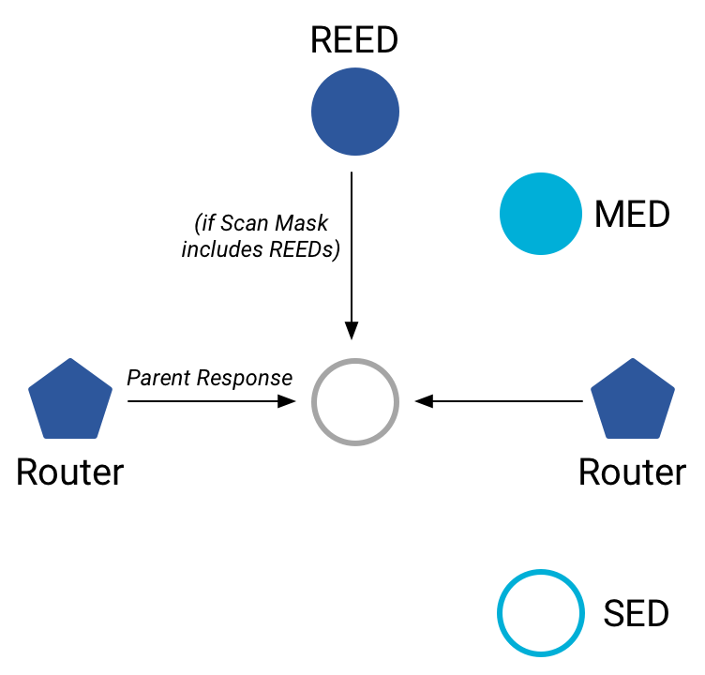
Joining an existing network
All devices join as a child of some existing router
Send a Parent Request (to all routers/router-eligible)
  Using the multicast, link-local address
Receive a Parent Response (from all routers/router-eligible separately)
  Contains information on link quality
Send a Child ID Request (to router with best link)
  Contains parameters about the new child device
Receive a Child ID Response (from that router)
  Contains address configurations

Slide 48
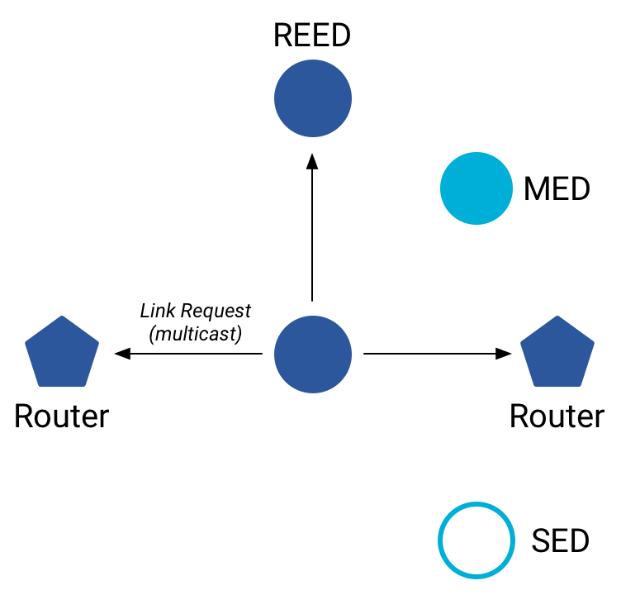
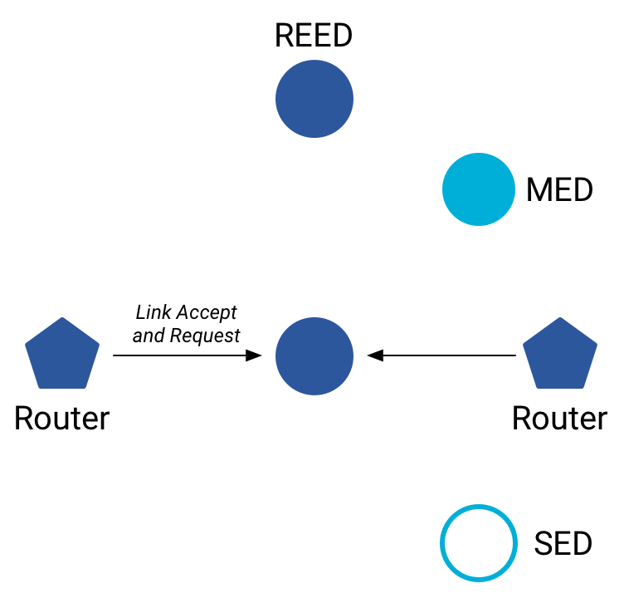
Becoming a router
Thread tries to maintain 16-23 routers (max 32)
  Goals: path diversity, extend connectivity
Send a Link Request (to all routers/router-eligible)
  Using the multicast, link-local address
Receive Link Accept and Request (from each router separately)
  Forms bi-directional link
Send a Link Accept (to each router individually)

Slide 49
Thread Routing
Uses Distance-vector routing
Routers periodically advertise routing costs to all other Routers and quality of one-hop links to neighbors
  Uses MLE messages
Cost to destination is the minimum of what all neighbors advertise to that destination plus your cost to that neighbor
Rate at which advertisements are sent is determined by an instance of the Trickle algorithm
Source: section 5.9 in spec

Slide 50
Each router stores neighbor and routing information
Each router stores a routing database which consists of:
  Router ID Set
    set of current valid router IDs
  Link Set
    Information about Routers that are/were recently neighbors
    <router_id, link_margin, incoming_quality, outgoing_quality, age>
  Route Set
    records route cost and next hop about other Routers that are, or recently were, reachable (had a finite routing cost) from this router
    <destination, next_hop, route_cost>

Slide 51
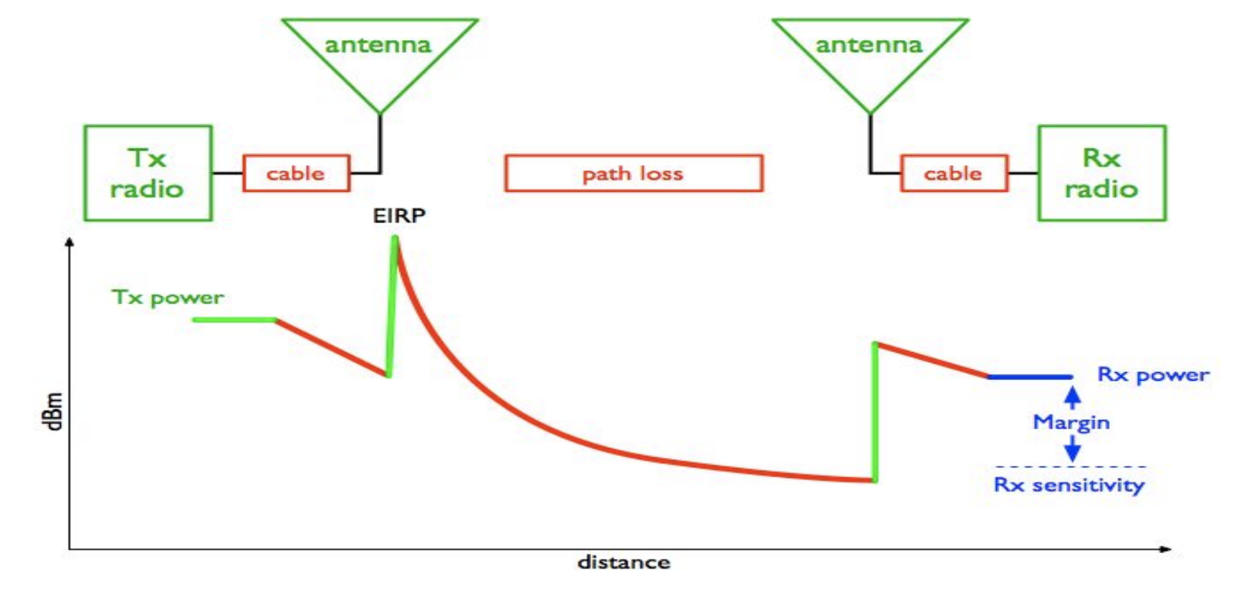
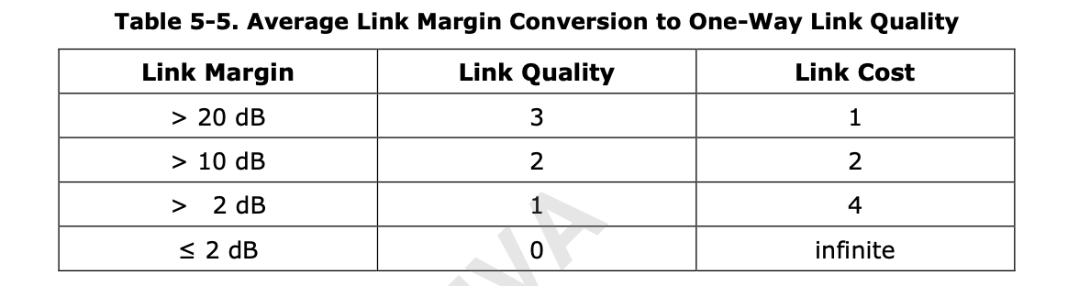
Routers use average link margin to compute Link Cost
Link Margin gives an indication about the quality of the link
Source: https://www.cdt21.com/design_guide/link-budget/

Slide 52
Routing Example
For Router 1
Router ID Set = {2, 3, 4, 5}
Link Set:
Router Id | RLOC16 | Quality In | Quality Out | Age
2 | 0x800 | 2 | 3 | 0
3 | .. | 3 | 3 | 14
4 | .. | 3 | 2 | 0
Route Set:
Destination | Next Hop | Route Cost
1 | 1 | 0
2 | 2 | 2
3 | 3 | 3
4 | 4 | 1
5 | 2 | 3

Slide 53
Thread commissioning

Slide 54
Outline
802.15.4 Review
Thread Overview
Thread Addressing
Runtime Behavior
Using IP

Slide 55
Communicating with IP
Any communication that layers on top of IP is now possible
  If there is a library to support it
Common choices
  UDP
    DNS – translate hostnames into IP addresses
    SNTP – get real-world time, accuracy better than 1 second
    CoAP – send and receive data

Slide 56
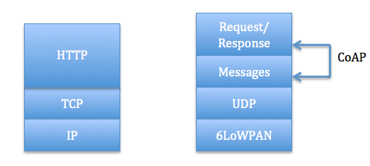
Constrained Application Protocol - CoAP
HTTP, but over UDP targeting less-capable devices
  Same REST architecture
  Adds capability for automatic retransmissions
CoAP Requests
  Have a type: GET, POST, PUT, DELETE
  Have a URL: /file/etc
  Have data up to 65 KB

Slide 57
Sensor networks don’t use TCP (yet?)
Uncommon choice: TCP
  Concerns: Too large, too slow, poorly suited to lossy networks
  Also concerning: We’re just replicating TCP poorly
    The debate is still very much open

Slide 58
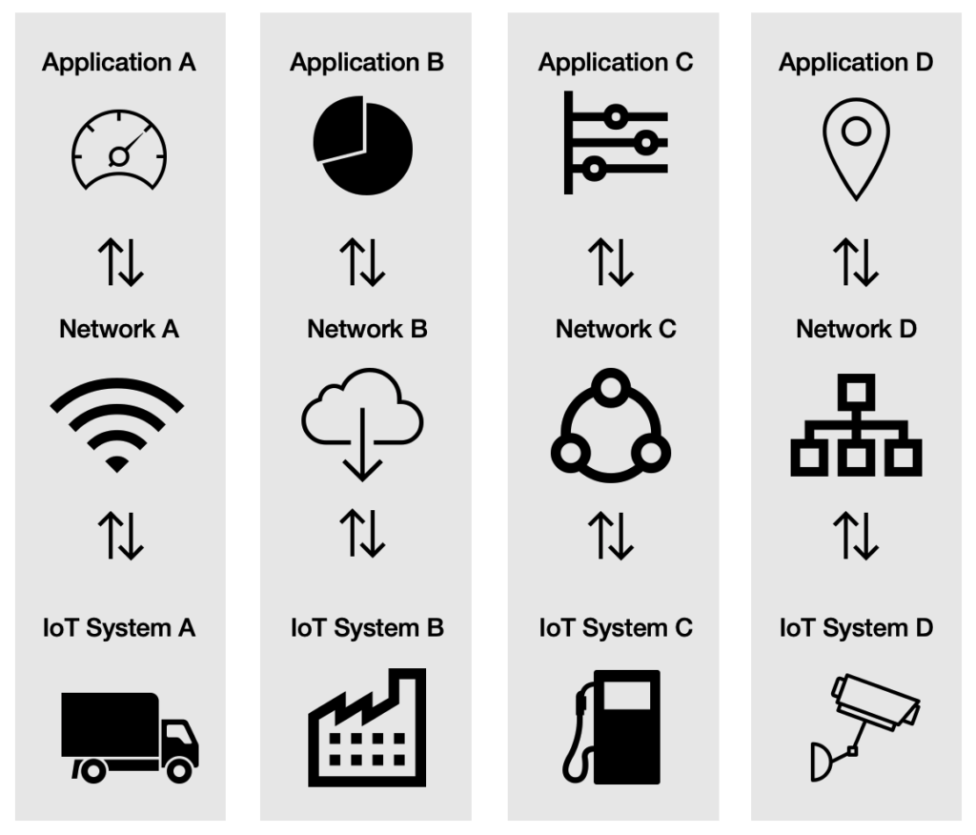
A problem: the siloed internet of things
Problem: companies are more interested in selling you the whole stack
  Which then makes it harder for devices to be interoperable
This is not Thread or IP-specific, but a problem all IoT devices are facing
Some concerns:
  What IP address do you send data to?
  Manufacturer’s server is an obvious choice
We will talk about the Matter standard

Slide 59
Outline
802.15.4 Review
Thread Overview
Thread Addressing
Runtime Behavior
Using IP

