Slide 1
Wireless for the Internet of Things NFC
CS/ECE 4501
Spring 2024
UVA
No quiz, kinda.
[Pannuto, Ghena, Campbell]

Slide 2
Protocols explored so far
BLE Advertisements
BLE Connections
IEEE 802.15.4 (raw)
Thread (based on 802.15.4)

Slide 3
Throughput vs. Range
Data
Throughput
Range

Slide 4
Complexity vs. Power
Sensor/Device Complexity
Power

Slide 5
Latency vs. Network Type
Time until first byte transferred
One-to-one
Network Type
Many-to-many

Slide 6
Comparing protocols
BLE Advertisements
BLE Connections
IEEE 802.15.4 (raw)
Thread (based on 802.15.4)
Time until first byte transferred
Data
Throughput
Sensor/Device Complexity
Power
One-to-one
Network Type
Many-to-many
Range
What protocol should I use?
I have two IoT devices: CO2 sensor and fan. I want the fan to turn on when CO2 rises above a threshold.
I have a sensor on a bus to measure bus occupancy and want to track bus use in real time.
I have a restaurant and I want my customers to be able to quickly load today’s menu.

Slide 7
Outline
Comparing networks
Backscatter and RFID
NFC

Slide 8
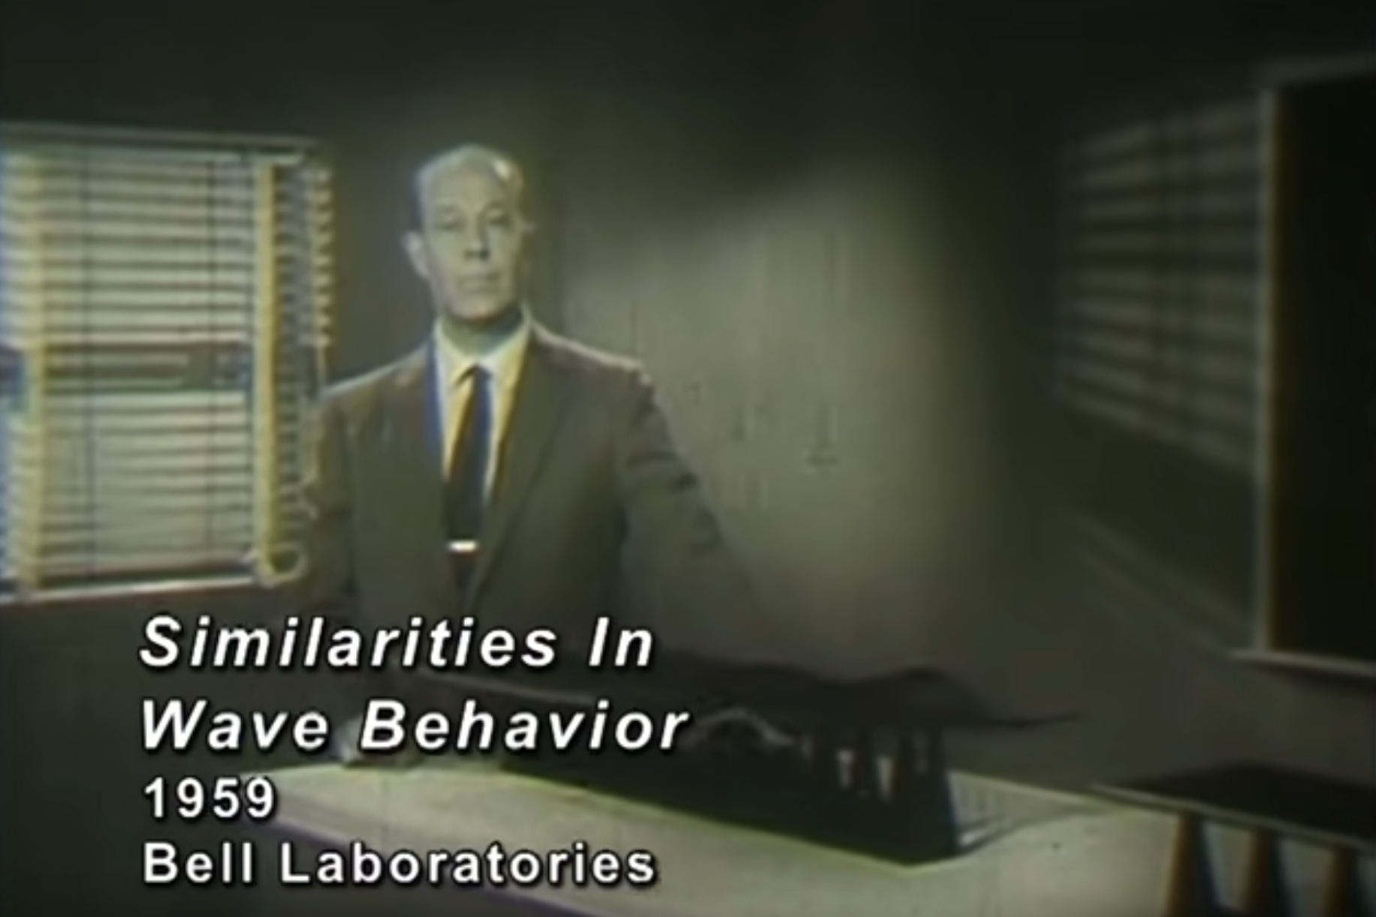
Resources
This Bell Labs instructional video from 1959 is excellent background:
https://www.youtube.com/watch?v=DovunOxlY1k

Slide 9
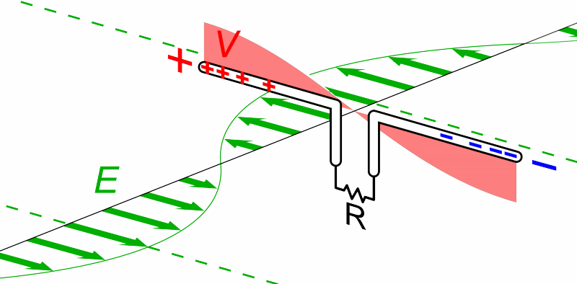
What does an antenna do?
Loosely: Converts between electric and magnetic waves
Animation by Chetvorno - Own work, CC0, https://commons.wikimedia.org/w/index.php?curid=40789783

Slide 10
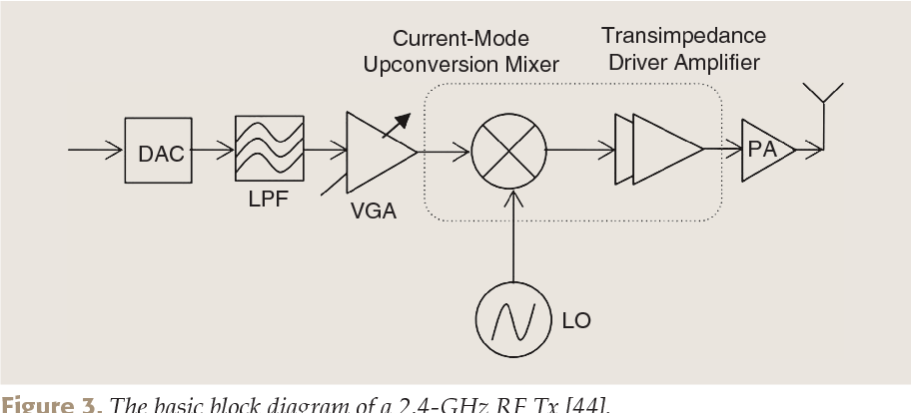
What generates electric waves?
RF front end
can be done with high-speed digital components (e.g. fast DACs)

Slide 11
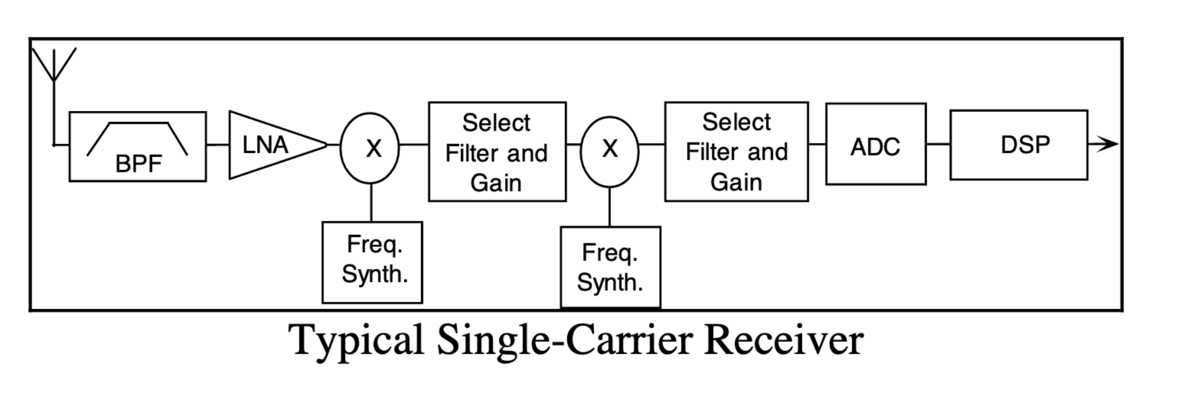
What receives electric waves?
Could be a high-speed ADC, more often with analog pieces in front:
Graphics from Analog Devices whitepaper: https://www.analog.com/media/en/technical-documentation/tech-articles/480501640radio101.pdf — significantly more detail here

Slide 12
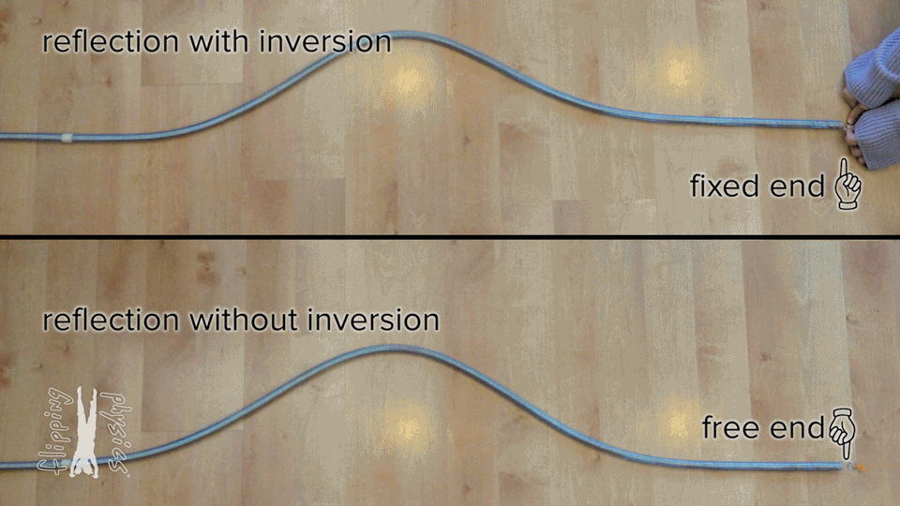
What happens if nothing ‘receives’ the wave?
From: https://www.flippingphysics.com/standing-waves.html

Slide 13
“Fixed end” and “Free end” in electronic transmission
~
Short Circuit = “Free End”
- Reflects wave
~
Open Circuit = “Fixed End”
- Inverts wave
~
Matched Load
- Absorbs wave (no reflection)

Slide 14
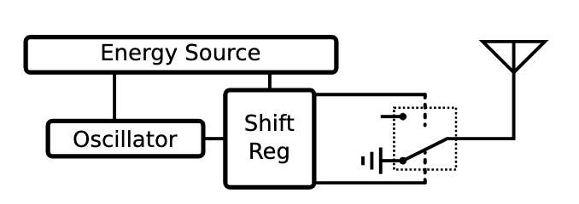
Backscatter systems reflect waves rather than generate waves — significant (10,000x or more) power savings
Simple versions just ‘reflect or don’t reflect’
Modern designs can do more advanced modulation as well
https://ieeexplore.ieee.org/stamp/stamp.jsp?arnumber=8368232

Slide 15
Backscatter is an old idea — history in spycraft!
1945: Leon Theremin* creates “The Thing” (aka Great Seal Bug)
*Yes, same guy who invented the instrument
Discovered when a British embassy radio operator heard recorded conversations

Slide 16
Outline
Comparing networks
Backscatter and RFID
NFC

Slide 17
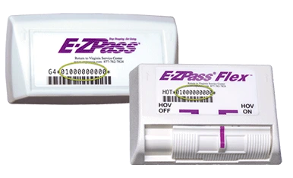
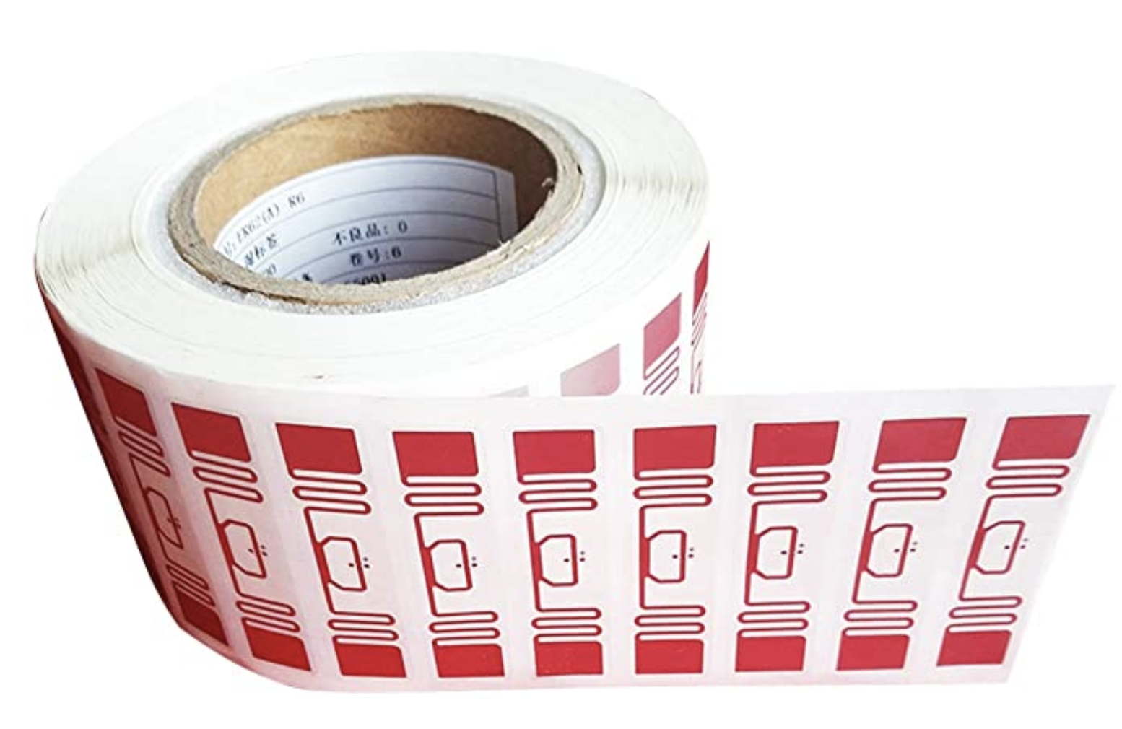
RFID is everywhere nowadays
Fundamental design principle is asymmetry
Extremely simple, cheap tags
Complex readers

Slide 18
A brief digression to be precise in terminology
RFID = Radio Frequency Identification = “a” communication standard
A ton through ~early 90’s; “EPC” ~= UPC, standardized; most now EPC Gen2
There are actually three types of “RFID” device
Passive Tags - harvest power from reader & reflect
Semi-Passive Tags - on-board power, but reflect data
Active Tags - on-board power that transmit data
These are ”backscatter” — which describes any communication via reflected RF
Notes:
The point: Papers misuse “RFID” to mean backscatter, and misuse “passive tag” to mean anything that doesn’t actively emit RF.
Most things that do backscatter don’t do the energy harvesting bit
Many papers that do backscatter describe themselves as RFID, but don’t follow any RFID communication standard

Slide 19
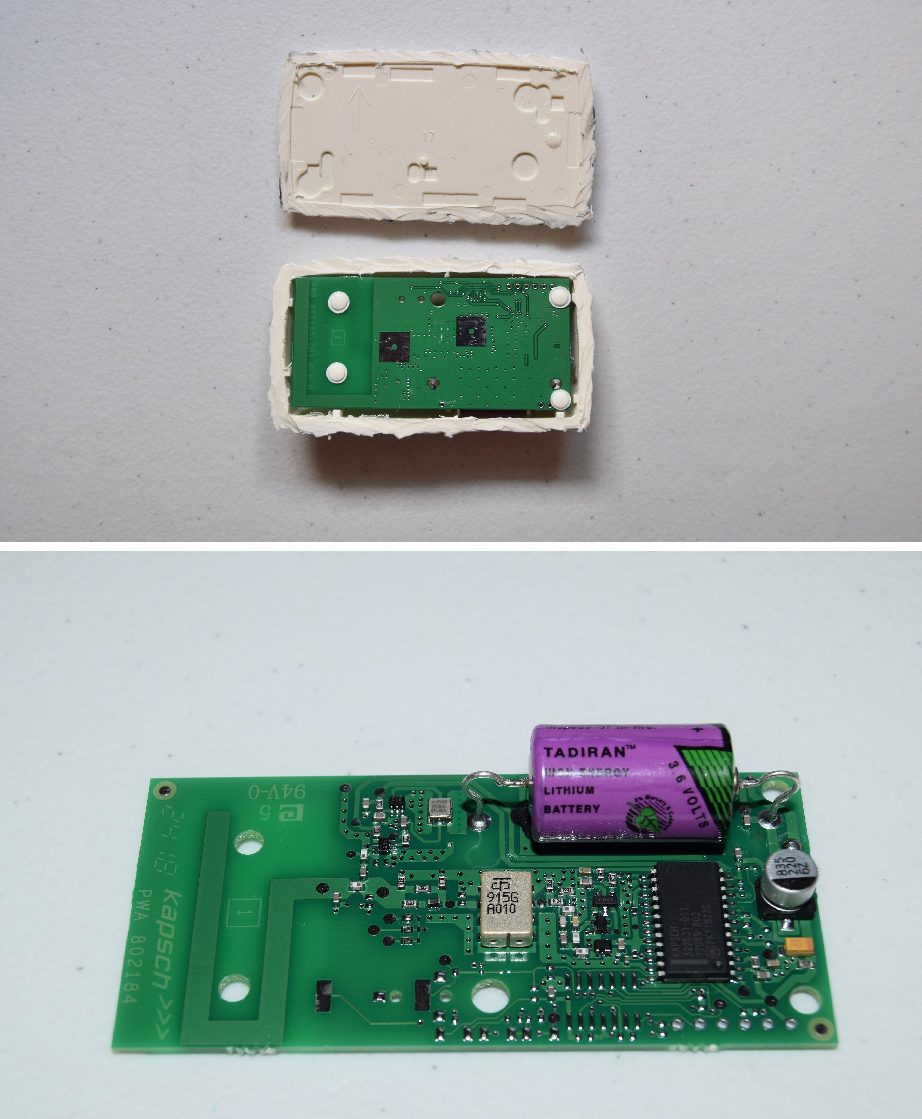
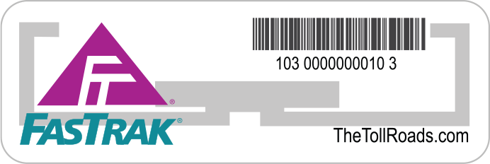
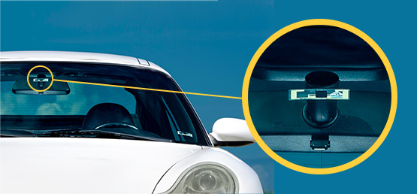
The meaningful difference is in how the tag devices power themselves
Even on simple designs, need some power:
Let’s look at E-ZPass again:

Slide 20
Let’s look at RFID standards to get a sense of the numbers
Low Frequency (~300 kHz) — mostly legacy
~10cm read range
High Frequency (3~30 MHz; often 13.56 MHz)
Passive: 4~7 m max
Semi-Passive: 10~30 m max
Active: 30+ m
Ultra-High Frequency (300 MHz ~ 3 GHz)
Passive: Up to 12 m
Active: Up to 100 m

Slide 21
Outline
Comparing networks
Backscatter and RFID
NFC

Slide 22
Applications of NFC

Slide 23
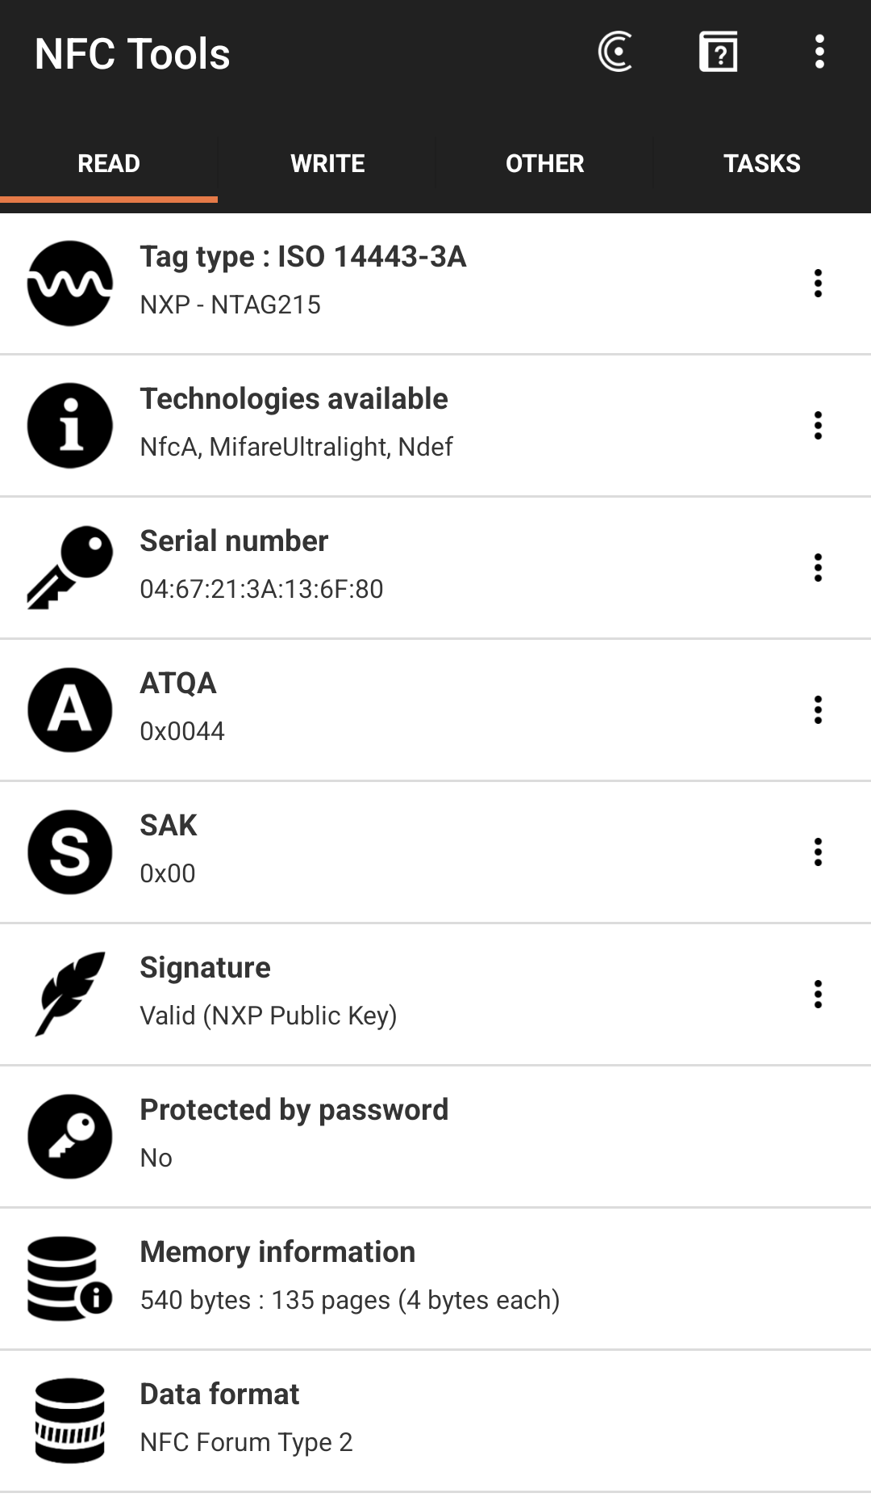
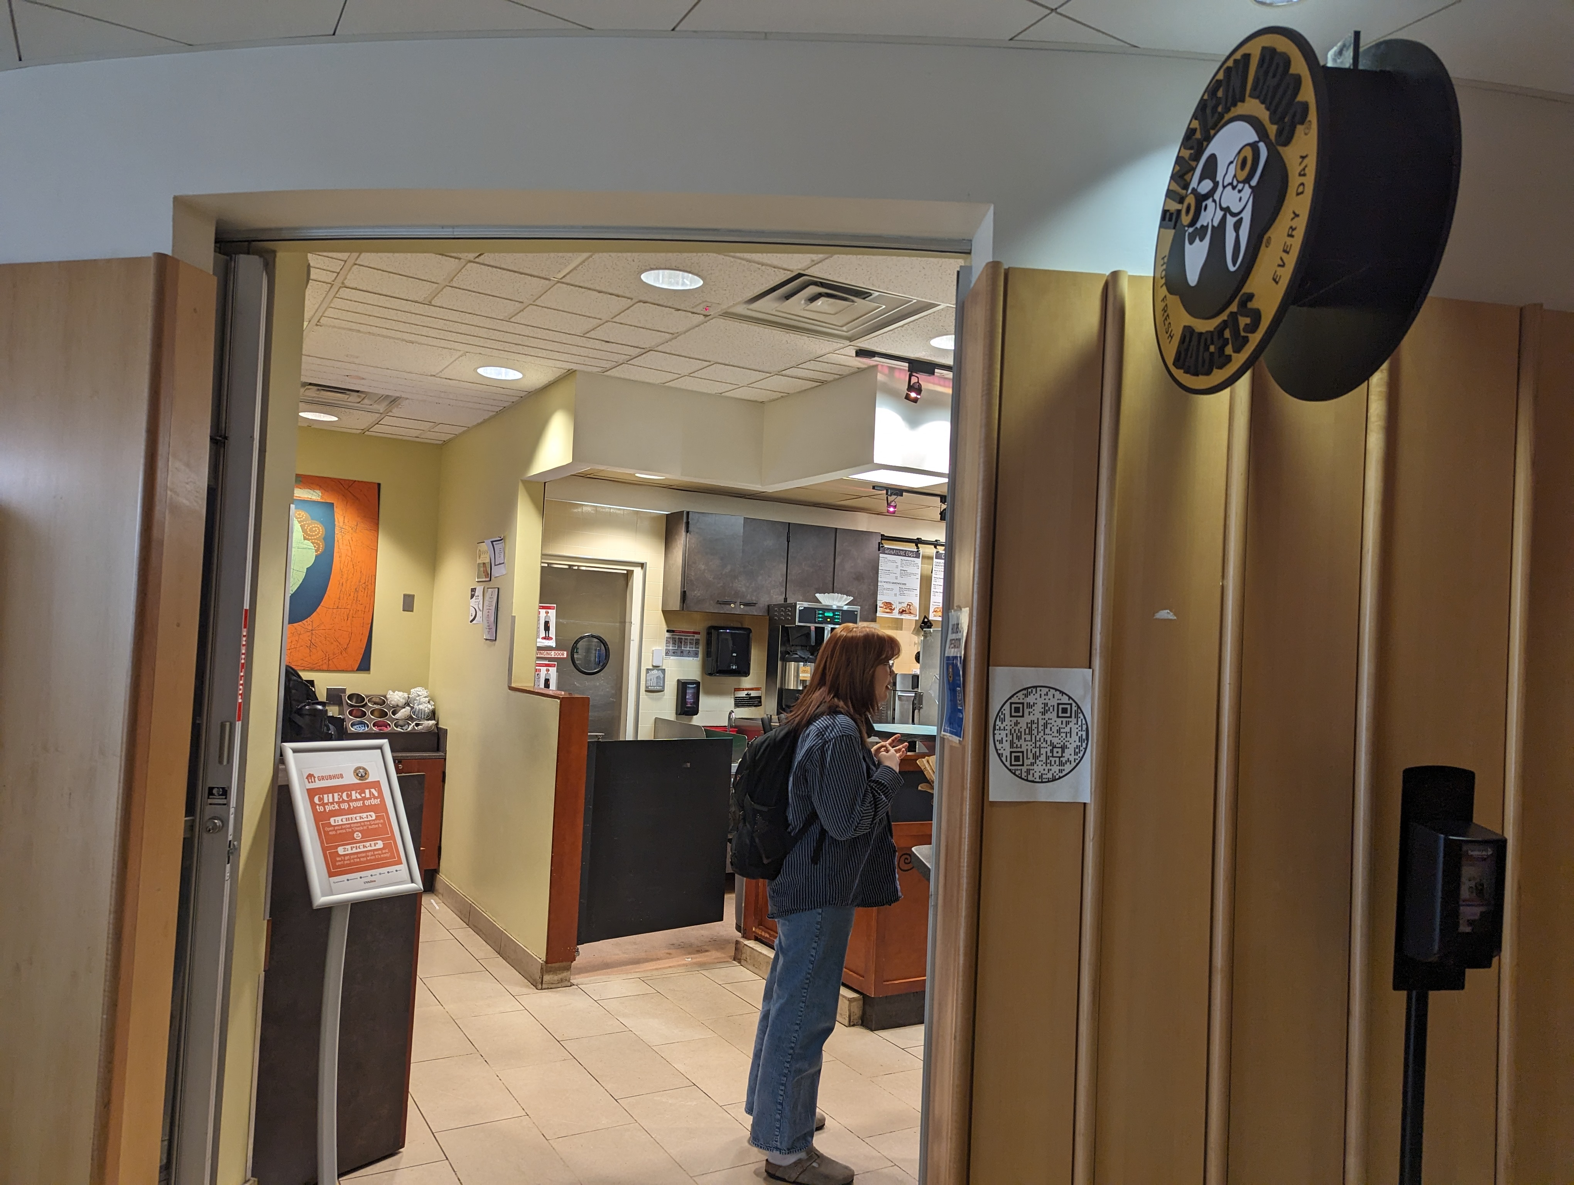

Slide 24
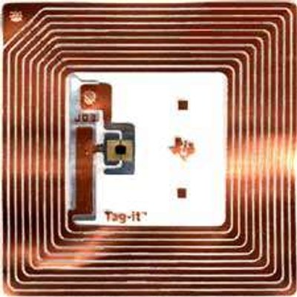
What is NFC?
NFC = Near Field Communication
A short-range wireless connectivity technology
Operates at 13.56 Mhz
Based on RFID technology
Data transfer rate: up to 424 kbits/second
< 20cm range
Reader & Tag communicate
Promoted by the NFC-Forum

Slide 25
NFC History
Year | Event
1983 | The first patent to be associated with RFID was granted to Charles Walton
2002 | NXP Semiconductors and Sony co-invent NFC
2004 | Nokia, Phillips and Sony established the NFC forum
2006 | Initial specifications for NFC Forum Tags and “Smart Poster” records
2006 | Nokia launches the first NFC phone (Nokia 6131)
2009 | NFC Forum releases Peer-to-Peer standards
2010 | Samsung, Nexus 5: First Android NFC phone shown
2010 | AT&T, Verizon, T-Mobile announces Softcard mobile payment joint venture
2011 | Google I/O “How to NFC” demonstrates NFC to initiates a game and to share a contact, URL, app, video, …
2011 | RIM is 1st company for its devices is certified by Mastercard worldwide, the functionality of PayPass
2012 | Samsung introduces TecTile, a set of NFC stickers and a companion App for Android to read/write TecTile
2012 | Sony introduces “Smart Tags” using NFC technology to change modes and profiles on Sony smart phone
2012 | Wired US is the 1st mass market publication to feature NFC enable advertisements
2013 | Samsung and Vise announces major partnership to develop mobile payments
2014 | Apple introduces iPhone 6 with Apple Pay using NFC Technology

Slide 26
NFC Operation
NFC communication between two devices is the same as traditional 13.56 MHz RFID.
The NFC network consists of two communication terminals:
The NFC Initiator/Reader to start the communication.
NFC initiator continuously emits RF carrier signals and keeps observing for modulation to occur. Detected modulation of the field would indicate of the presence of a target.
The Target/Tag receives the Initiator’s communication request and sends back a reply.
When the NFC target absorbs sufficient energy emitted by the reader, it starts sending modulated information back to the initiator.

Slide 27
NFC Active and Passive Devices
Active NFC device is usually a microcontroller based like a NFC enabled smartphone, would not only be able to collect information from NFC tags, but it would also be able to exchange information with other compatible phones or devices and could even alter the information on the NFC tag if authorized to make such changes.
A passive device, such as an NFC tag, contains information that other devices can read but does not read any information itself. NFC tag does not have its own power source.

Slide 28
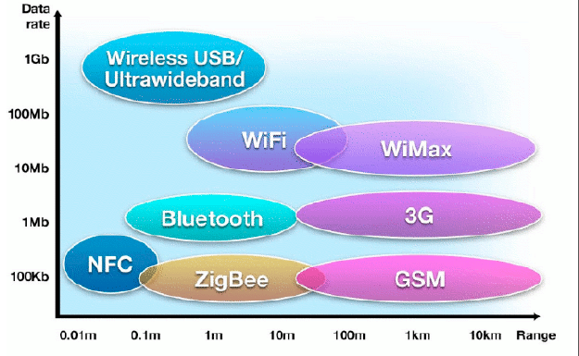
DATA RATE & RANGE

Slide 29
NFC RF signal coding
NFC employs two different coding systems on the RF signal to transfer data.
DATA RATE KBPS | ACTIVE DEVICE | PASSIVE DEVICE
106 | Modified Miller, 100%, ASK | Manchester, 10%, ASK
212 | Manchester, 10%, ASK | Manchester, 10%, ASK
424 | Manchester, 10%, ASK | Manchester, 10%, ASK
Modulation Index = (A-B)/(A+B) where A = Unmodulated signal amplitude B = Modulated signal amplitude Modulation Depth = B/A 10% ASK modulation means ASK modulation in which modulation index will range between 8% and 14%.
100% ASK means ASK modulation in which modulation and carrier amplitude are almost equal.

Slide 30
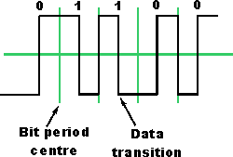
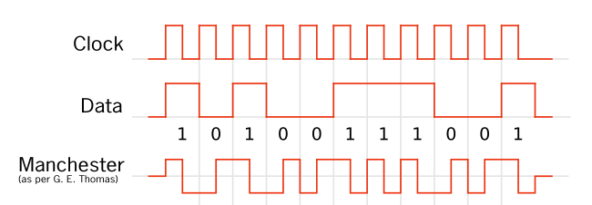
NFC and Manchester coding
Manchester coding maps bits to transitions
Bit 0 → low to high
Bit 1 → high to low
Prevents long runs of high or low values
Manchester coding used for NFC data transfer

Slide 31
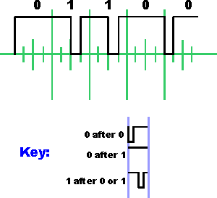
NFC and Modified Miller coding
Mapping bits to pulses
1 → Late low pulse
0 →
Following a 0: Early low pulse
Following a 1: Stay high
Mimics frequency modulation
Modified Miller coding used for NFC data transfer used for 106 kbps active device transfers

Slide 32
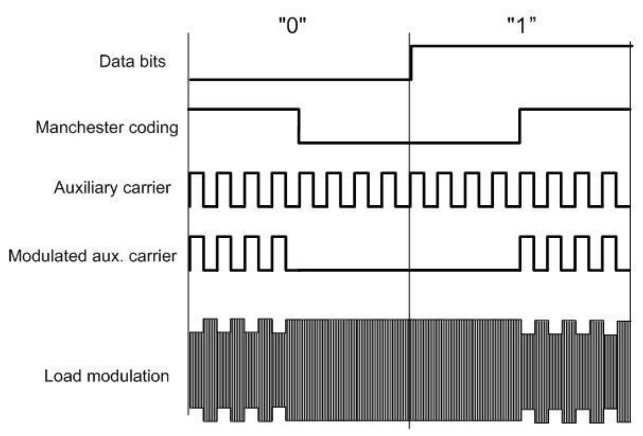
Manchester modulation NFC signal

Slide 33
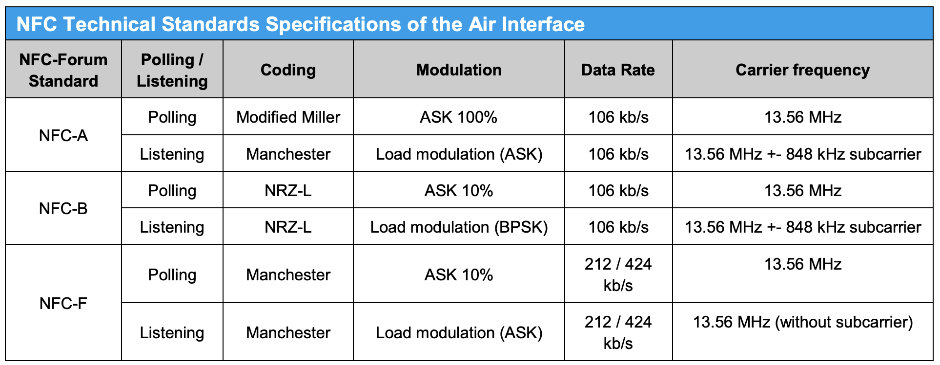
NFC Modes oh my!
There are three main operating modes for NFC:
Card emulation mode (passive mode): the NFC device behaves like an existing contactless card conforming to one of the legacy standards
Peer-to-peer mode: two NFC devices exchange information. The initiator device (polling device) requires less power compared to the reader/writer mode because the target (listener) uses its own power supply.
Reader/writer mode (active mode): the NFC device is active and reads or writes to a passive legacy RFID tag.

Slide 34
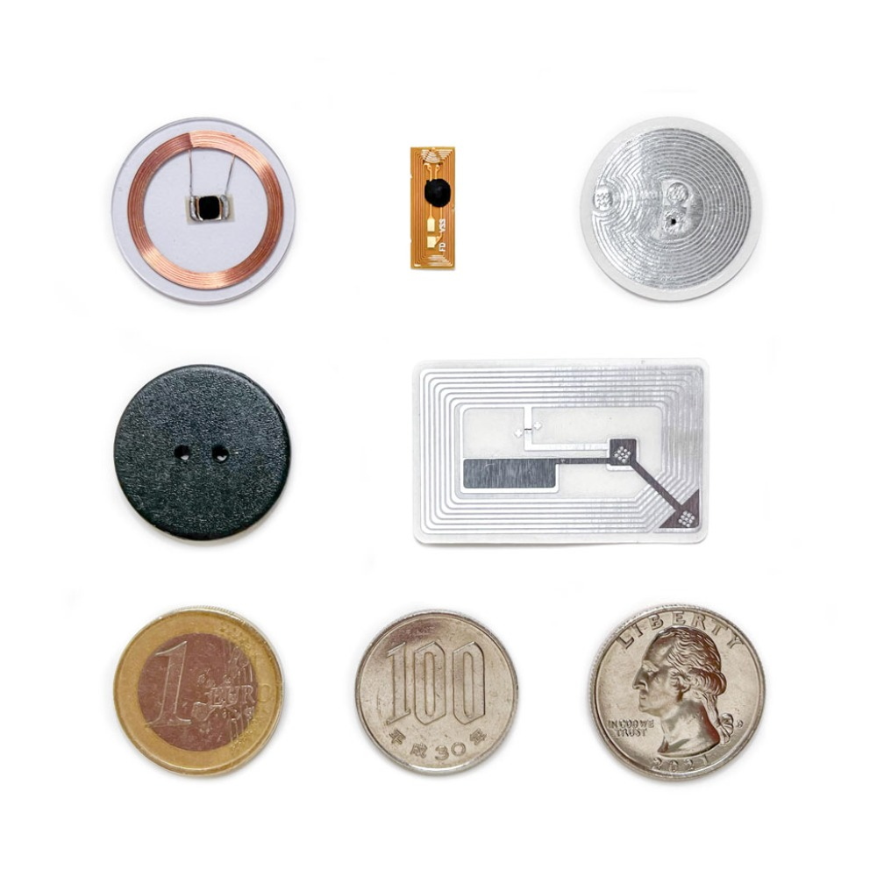
NFC Tags – Encoding data
NDEF (NFC Data Exchange Format) Structure
Binary format for data
Messages contains records
Each record has header
NFC read returns the NDEF message

Slide 35
NFC Forum NDEF record types
Record Type Definitions
RTD Technical - Specifies the format and rules for building standard record types used by NFC Forum application definitions and third parties that are based on the NDEF data format.
Text - Provides an efficient way to store text strings in multiple languages by using the RTD mechanism and NDEF format. An example of using this specification is included in the Smart Poster RTD.
URI - Provides an efficient way to store Uniform Resource Identifiers (URI) by using the RTD mechanism and NDEF format. An example of using this specification is included in the Smart Poster RTD.
Smart Poster - Defines an NFC Forum Well Known Type to put URLs, SMSs or phone numbers on an NFC tag, or to transport them between devices. The Smart Poster RTD builds on the RTD mechanism and NDEF format and uses the URI RTD and Text RTD as building blocks.
Generic Control - withdrawn
Signature - Specifies the format used when signing single or multiple NDEF records. Defines the required and optional signature RTD fields, and also provides a list of suitable signature algorithms and certificate types that can be used to create the signature. Does not define or mandate a specific PKI or certification system, or define a new algorithm for use with the Signature RTD.
PHDC - Addresses a need for an openly-defined standard for the exchange of personal health data between devices using Near Field Communication technology.
Derived types
Android Application NDEF Record
Application NDEF Record
Contact NDEF Record
Email NDEF Record
File NDEF Record
Geolocation NDEF Record
Phone NDEF Record
SMS NDEF Record
Website NDEF Record
WiFi NDEF Record

Slide 36
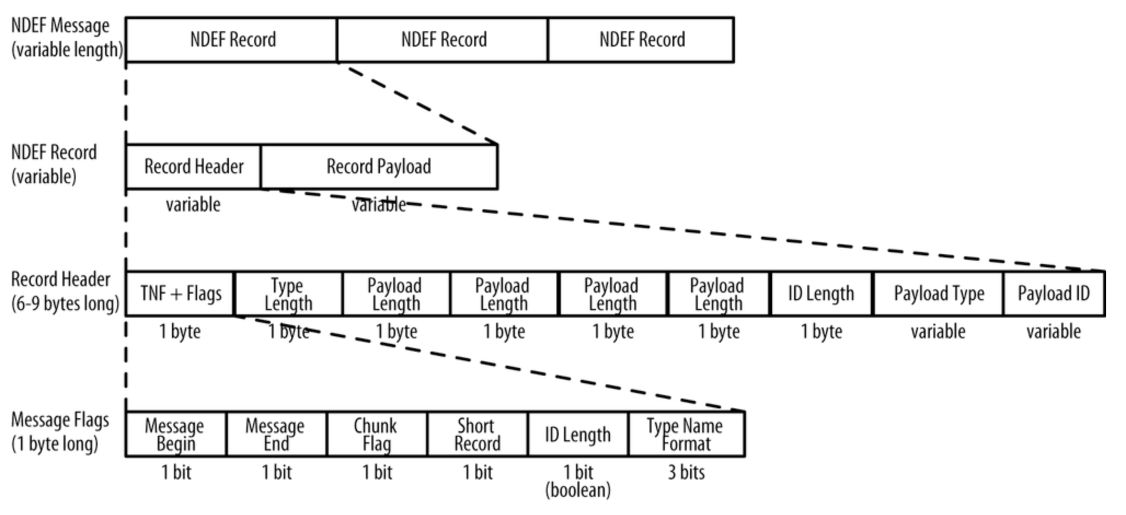
NDEF Format

Slide 37
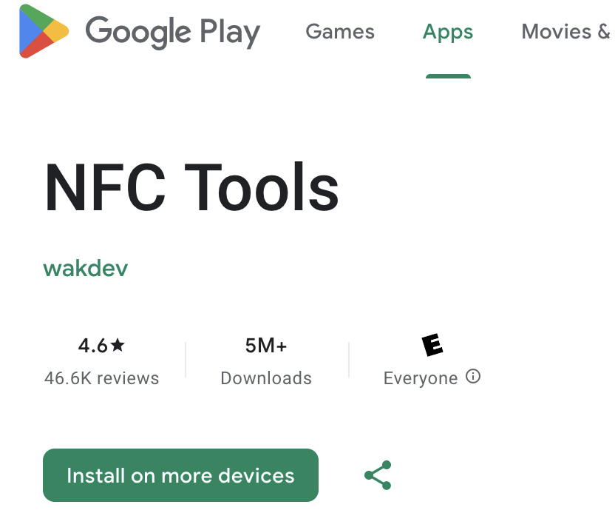
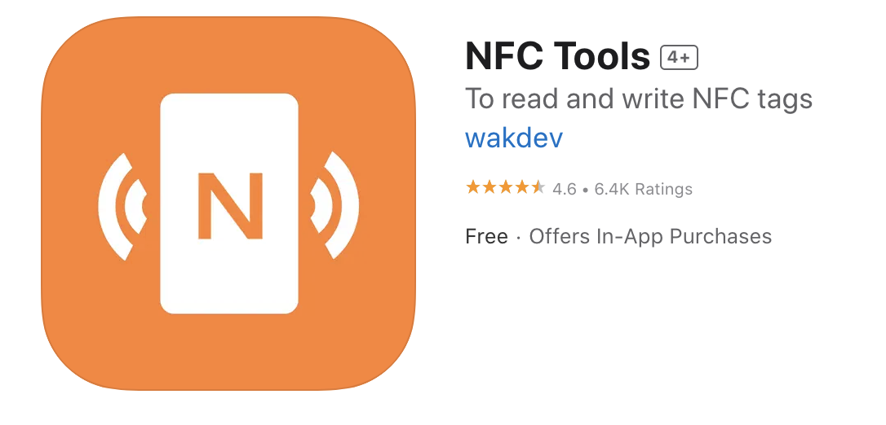
Let’s try it!
Install NFC tools
What NFC cards do you have?
I have a writeable NFC tag
Write something to the tag and pass to the next table

Slide 38
