Slide 1
Wireless for the Internet of Things LoRa
CS/ECE 4501
Spring 2024
UVA
While we get started, take the quiz on canvas!
[Pannuto, Ghena, Campbell]

Slide 2
Today’s Goals
Explore another point in the wireless design space
Introduce emerging protocol
Show how we are using LoRa

Slide 3
Outline
Wide-Area Network Background
LoRA
LoRaWAN
Charlottesville Deployment
The Things Network

Slide 4
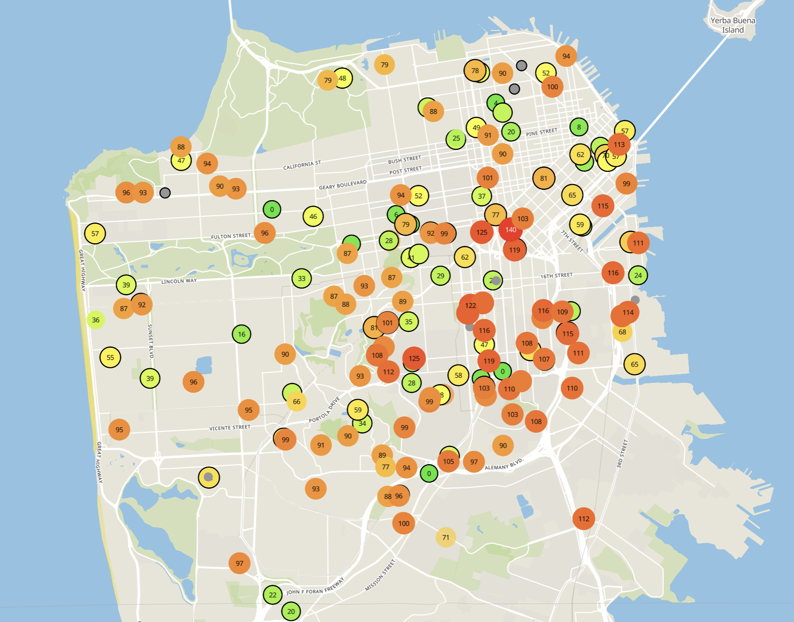
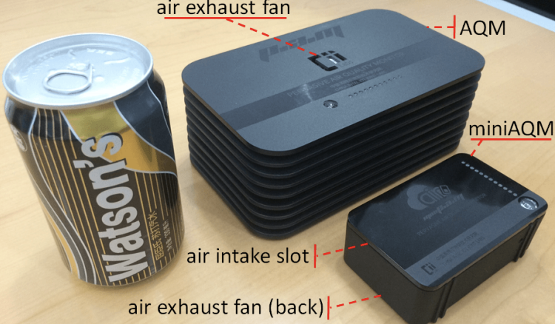
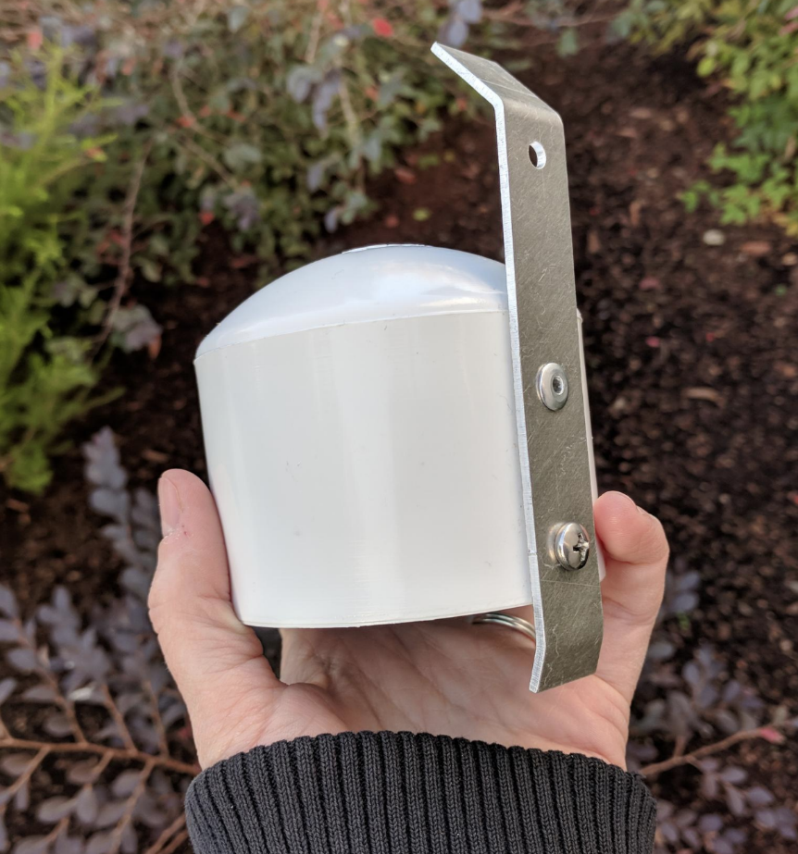
Example application: air quality monitoring
[1]
[2]
[2]
[1] Cheng et al. AirCloud: a cloud-based air-quality monitoring system for everyone. 2014. [2] Purple Air. 2019.

Slide 5
How do we collect data from MANY sensors?
Manually collect measurements
Connect it to WiFi (or Ethernet)
Pay for cellular access

Slide 6
2.4GHz protocols mostly used for indoor applications
Range for the wireless protocols we’ve looked at so far (best case)
BLE: 100m (~300ft)
802.15.4: 100m (~300ft)
NFC: 20cm (~1ft)

Slide 7
We need another network option
What requirements do we have?
Wide area of coverage
Deploy fewer gateways
Low power
So we can deploy on batteries
What requirements do we NOT have?
Doesn’t need high throughput
Sensor data is relatively small

Slide 8
Wide area networks
Communication at the region/city scale rather than the building/residence scale
Throughout cities
Agricultural deployments
Industrial facilities
City-scale sensing is one very popular domain
What might we want to sense throughout a city?

Slide 9
Long-range, low-data needs haven’t historically been met
WiFi
5G
4G
Higher Power & Higher Cost
3G
Data
Throughput
Bluetooth
2G
Low-Power Wide-Area Networks
BLE
NFC
802.15.4
Lower Power & Lower Cost
Range

Slide 10
LPWANs overview (common qualities)
Unlicensed 915 MHz band (902-928 MHz)
Higher power transmissions: ~20 dBm (100 mW)
Low data rate: 100 kbps or less
Range on the order of multiple kilometers
Simple ALOHA access control

Slide 11
Outline
Wide-Area Network Background
LoRA
LoRaWAN
Charlottesville Deployment
The Things Network

Slide 12
LoRa (Long Range)
Proprietary LoRa physical layer
Owned by Semtech
Low data rate (1-20 kbps) and long range (~5 km)
Most popular LPWAN protocol
Target of academic research
Industry involvement in hardware and deployments

Slide 13
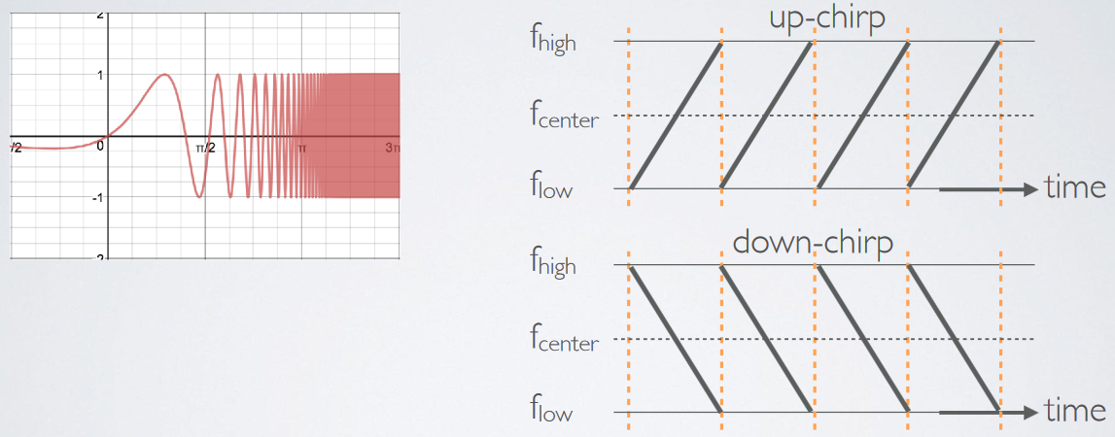
LoRa PHY uses a spread spectrum modulation technique
Chirp Spread Spectrum (CSS)
Modulation technique where frequency is varied linearly from (to) lowest to (from) highest within a channel

Slide 14
How does FSK, up-chirp, and down-chirp “sound” like?
Source: LoRa CHIRP by Richard Wenner

Slide 15
Data Modulation in Chirp Spread Spectrum
Data is modulated in the starting and ending points of chirp
Frequency increases linearly, modulo bounds of the channel
+
Input Binary Data

Slide 16
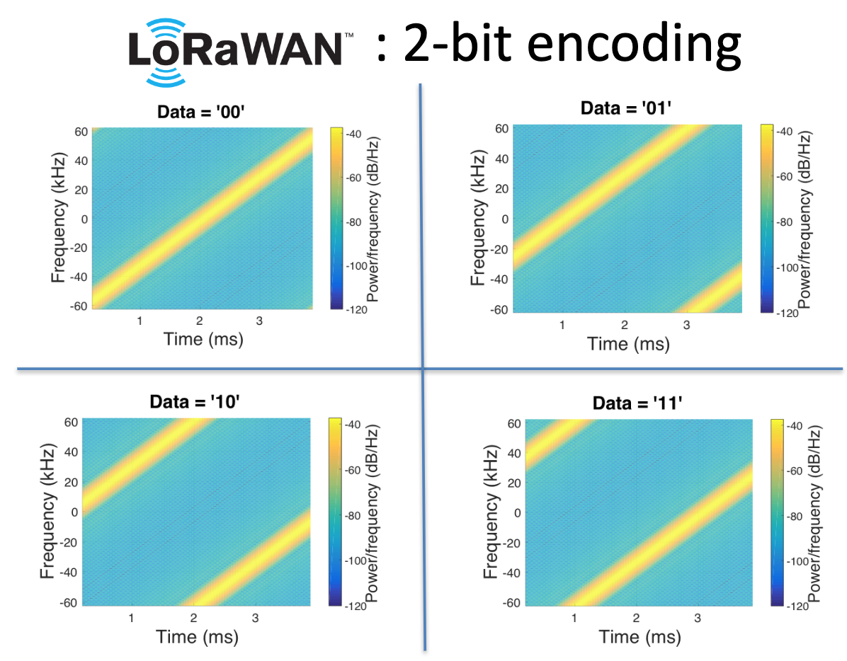
Data Modulation in Chirp Spread Spectrum
In general,
n bits => divide BW to 2^{n} initial frequencies
Remember, No. of symbols = 2^{n}
Source: https://swarunkumar.com/slides/choir-sigcomm2017.pdf

Slide 17
LoRa Modulated Signal
Source: https://youtu.be/lg0eZWZFKiE

Slide 18
CSS has a Spreading Factor which determines bit rate
Spreading Factor is essentially the rate-of-change of frequency (sweep rate)
Slope of the line
Lower values of spreading factor (steeper slope) are faster data rate
Important: different spreading factors are (mostly) orthogonal!
Two can overlap in time, space, and channel without a collision
LoRa has 6 spreading factors:
SF7 to SF12
Notes:
https://www.thethingsnetwork.org/docs/lorawan/spreading-factors/

Slide 19
LoRa channels (in the US)
Sixty-four, 125 kHz uplink channels
Frequency Hopping over the 64 uplink channels
Plus eight, 500 kHz overlapping uplink channels (not used in practice)
Eight, 500 kHz downlink channels

Slide 20
LoRa gateways
No synchronization with end devices
Instead listen to entire bandwidth simultaneously
Only 12 MHz total
Recognize preambles and allocate hardware to decode packet
Cheap gateways: 8 decoders
Good gateways: 64 decoders

Slide 21
LoRa data rates
Data Rate Index | Spreading Factor | Bit Rate
125 kHz Uplink Rates
0 | SF10, 125 kHz | 980 bps
1 | SF9, 125 kHz | 1760 bps
2 | SF8, 125 kHz | 3125 bps
3 | SF7, 125 kHz | 5470 bps
500 kHz Uplink Rates
4 | SF8, 500 kHz | 12500 bps
500 kHz Downlink Rates
8 | SF12, 500 kHz | 980 bps
9 | SF11, 500 kHz | 1760 bps
10 | SF10, 500 kHz | 3900 bps
11 | SF9, 500 kHz | 7000 bps
12 | SF8, 500 kHz | 12500 bps
13 | SF7, 500 kHz | 21900 bps
Data rate options depend on channel in use
Unbalanced uplink and downlink
64-channel uplink
1-5 kbps data rate
Allowable rates based on US dwell time restriction (400 ms)
Different in different regions
Notes:
Dwell time (or transmit time) is the amount of time needed to transmit on a frequency

Slide 22
LoRa link budget
Typical TX power 20 dBm
Up to 30 dBm for 64-channel hopping
Up to 26 dBm for 8-channel hopping
Receive sensitivity -119 dBm
Compare to -100 dBm for 802.15.4 and -95 dBm for BLE
Resulting range is about a kilometer in urban environments

Slide 23
Outline
Wide-Area Network Background
LoRA
LoRaWAN
Charlottesville Deployment
The Things Network

Slide 24
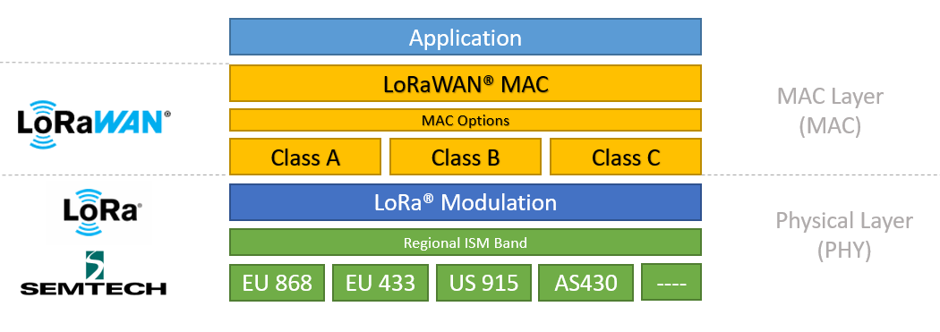
LoRa vs. LoRaWAN
LoRa: physical layer protocol
LoRaWAN: MAC and network layer
(In practice we often conflate LoRa and LoRaWAN.)
https://lora-developers.semtech.com/documentation/tech-papers-and-guides/lora-and-lorawan/

Slide 25
LoRaWAN MAC
Uplink: ALOHA - transmit whenever
Randomly split across 64 uplink channels (reduced odds of collision)
Devices a different spreading factors also do not collide
Packets are very long though: up to 400 ms in duration
Downlink: LoRaWAN has 3 types of device classes based on RX behavior (Class A, B, and C)
Notes:
Aloha: send without sensing, if collision, wait for random delay and then send again

Slide 26
LoRaWAN has Device Classes based on RX behavior
Listen-after-send (class A device)
Two windows for RX on different channels
Periodic listening (class B device)
Also has 2 RX windows after TX
Synchronized with periodic beacons
Has periodic ping slots (RX windows)
Gateway can reach without waiting for TX
Continuous listening (class C device)
Always-on receivers
Good Reference: https://www.thethingsnetwork.org/docs/lorawan/classes/

Slide 27
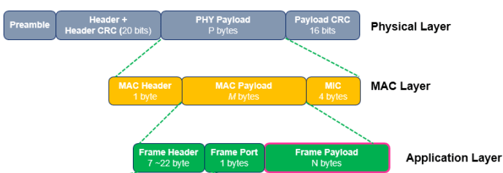
LoRaWAN packet format
Frame header includes device address
MAC Payload maximum size depends on data rate
Data Rate Index | MAC Payload Size
0 | 19 bytes
1 | 61 bytes
2 | 133 bytes
3 | 250 bytes
4 | 250 bytes

Slide 28
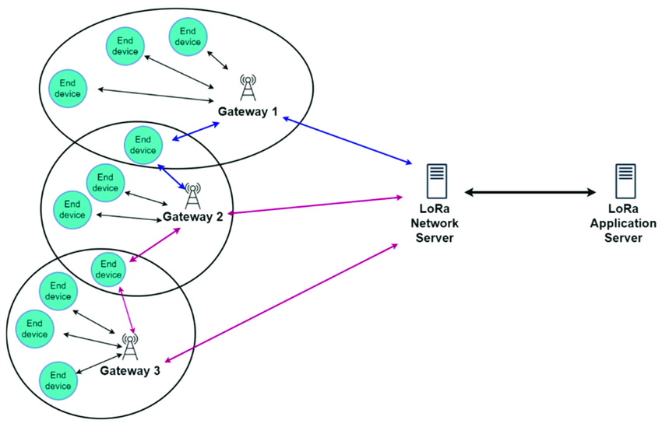
LoRaWAN star-of-stars topology
Each gateway is a star network
Many gateways connect to a LoRaWAN backend
https://www.researchgate.net/publication/360965985_LoRaWAN_Communication_Protocols_A_Comprehensive_Survey_under_an_Energy_Efficiency_Perspective

Slide 29
LoRaWAN device abstraction
LoRaWAN Network
Application Server

Slide 30
LoRaWAN network details

Slide 31
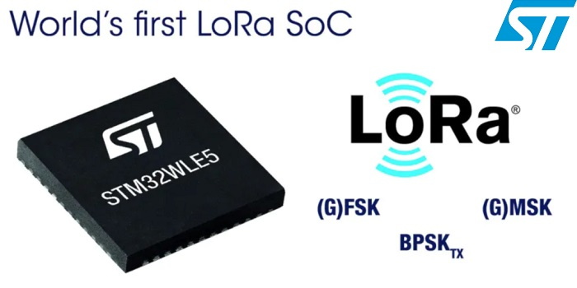
LoRaWAN hardware
Numerous hardware modules and development kits
Almost all use Semtech radio chips (Semtech owns LoRa PHY)
Recent addition: STM32WLE5 LoRa SoC
Cortex-M4 + LoRa radio (analogous to nRF52840)

Slide 32
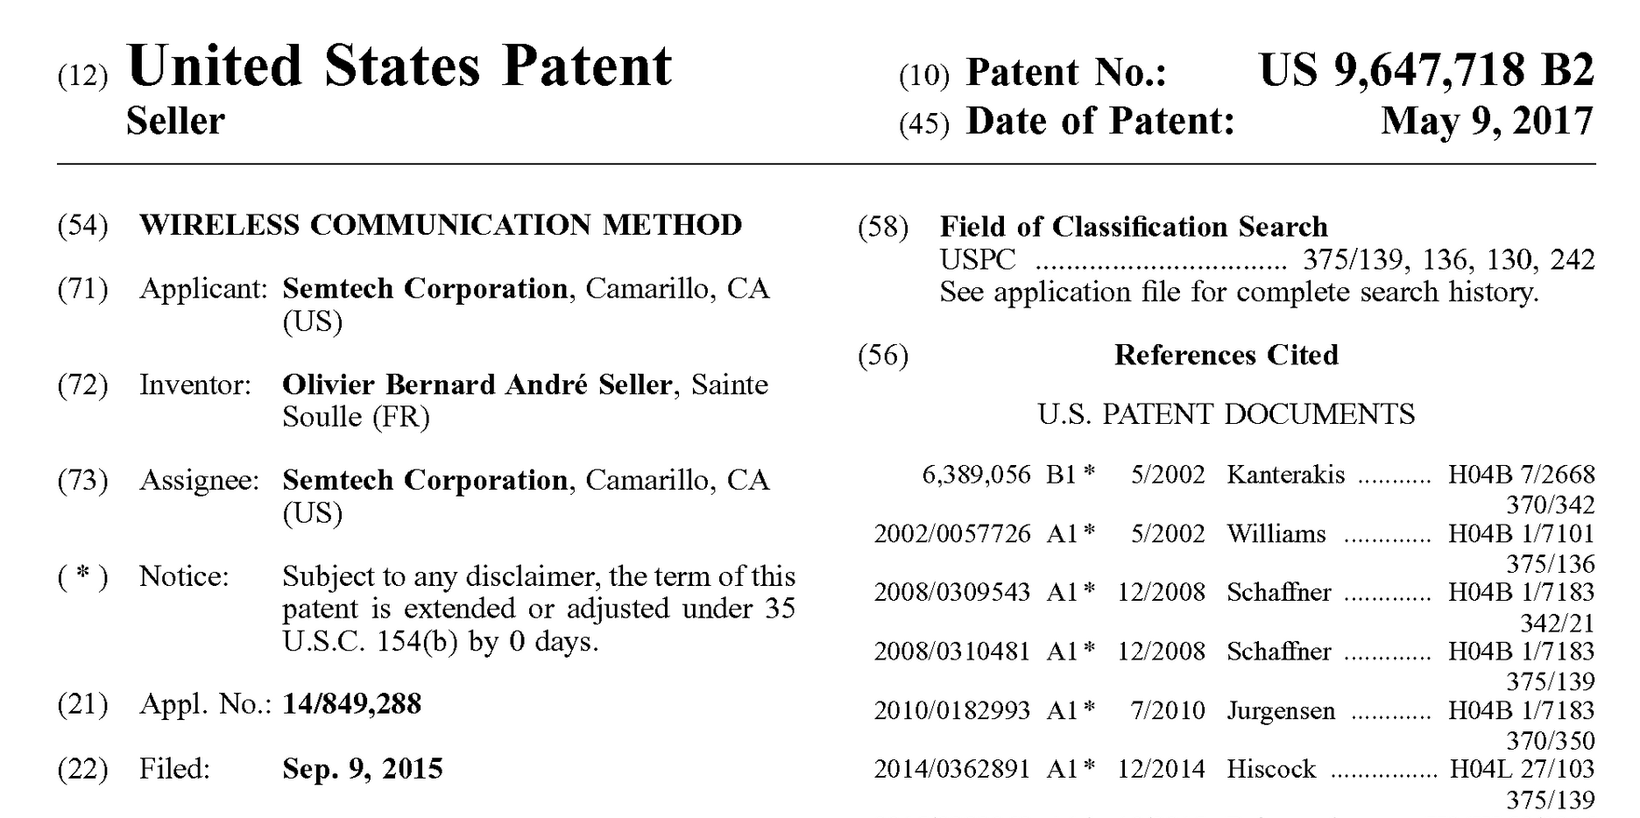
Note about LoRa hardware
LoRa PHY is patented
Hardware controlled by Semtech
Good for interoperability
Openness?
Innovation?

Slide 33
Joining a LoRaWAN network
Two modes:
OTAA (Over the air activation): Dynamic join procedure that sets up security keys
ABP (Activation By Personalization): Legacy approach with pre-shared security keys
OTAA Joining: two packets
Join-request: from end device to the Network Server
Join-accept: from Network Server to the end device

Slide 34
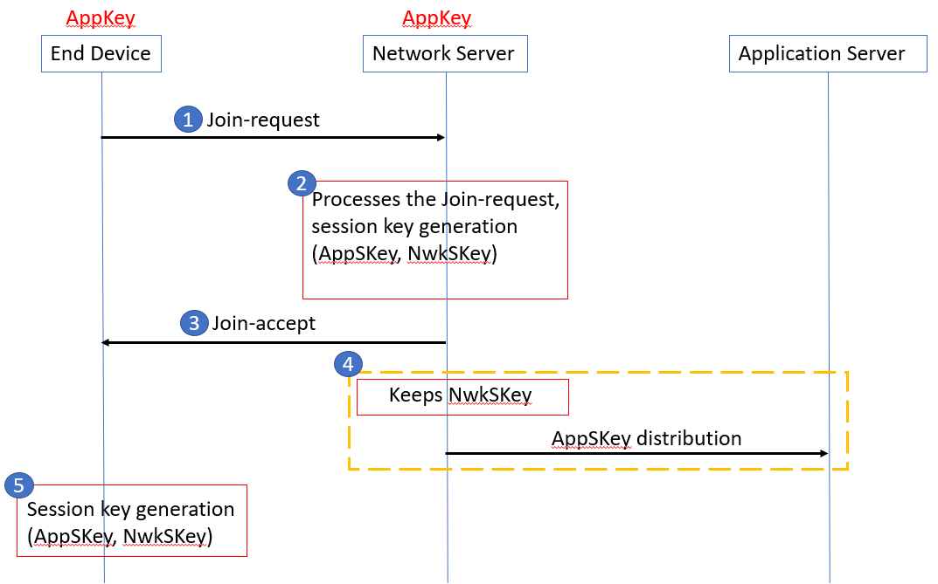
OTAA Join Procedure
Device knows three things:
AppEUI: Identifier for the application the device uses on the application server
DevEUI: Device ID
AppKey: AES-128 bit secret registered with the network server
Join Request
Device sends (AppEUI, DevEUI, Nonce) and MIC using AppKey
Join Accept
Network server responds with AppNonce encrypted with AppKey
Device and network server compute the same AppSKey to encrypt all future payloads

Slide 35
LoRaWAN network providers
You can always manage your own network
Buy a gateway and run whatever backend software you want
Managed network providers
The Things Network
MachineQ from Comcast

Slide 36
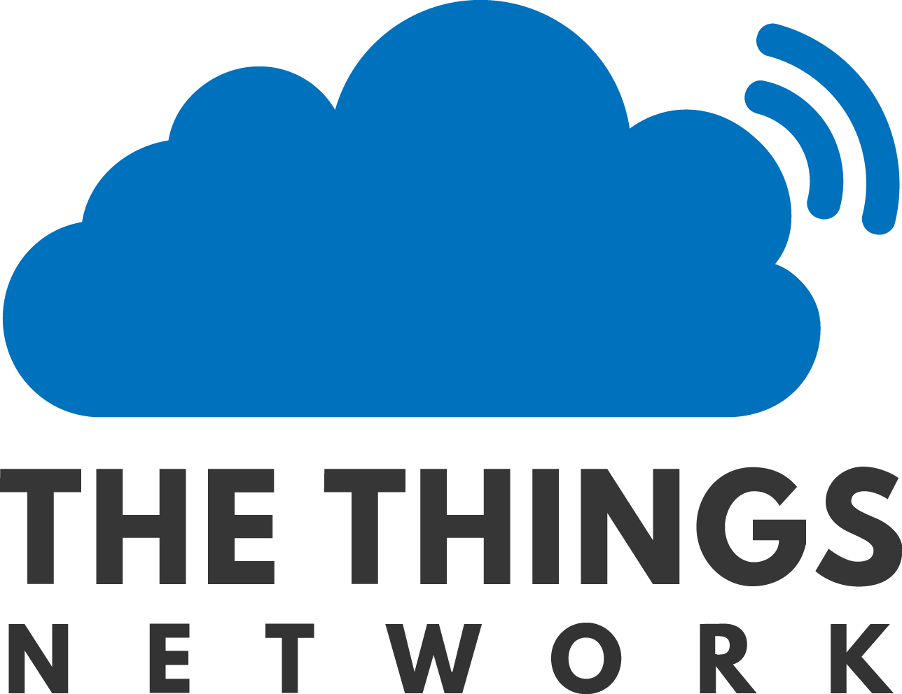
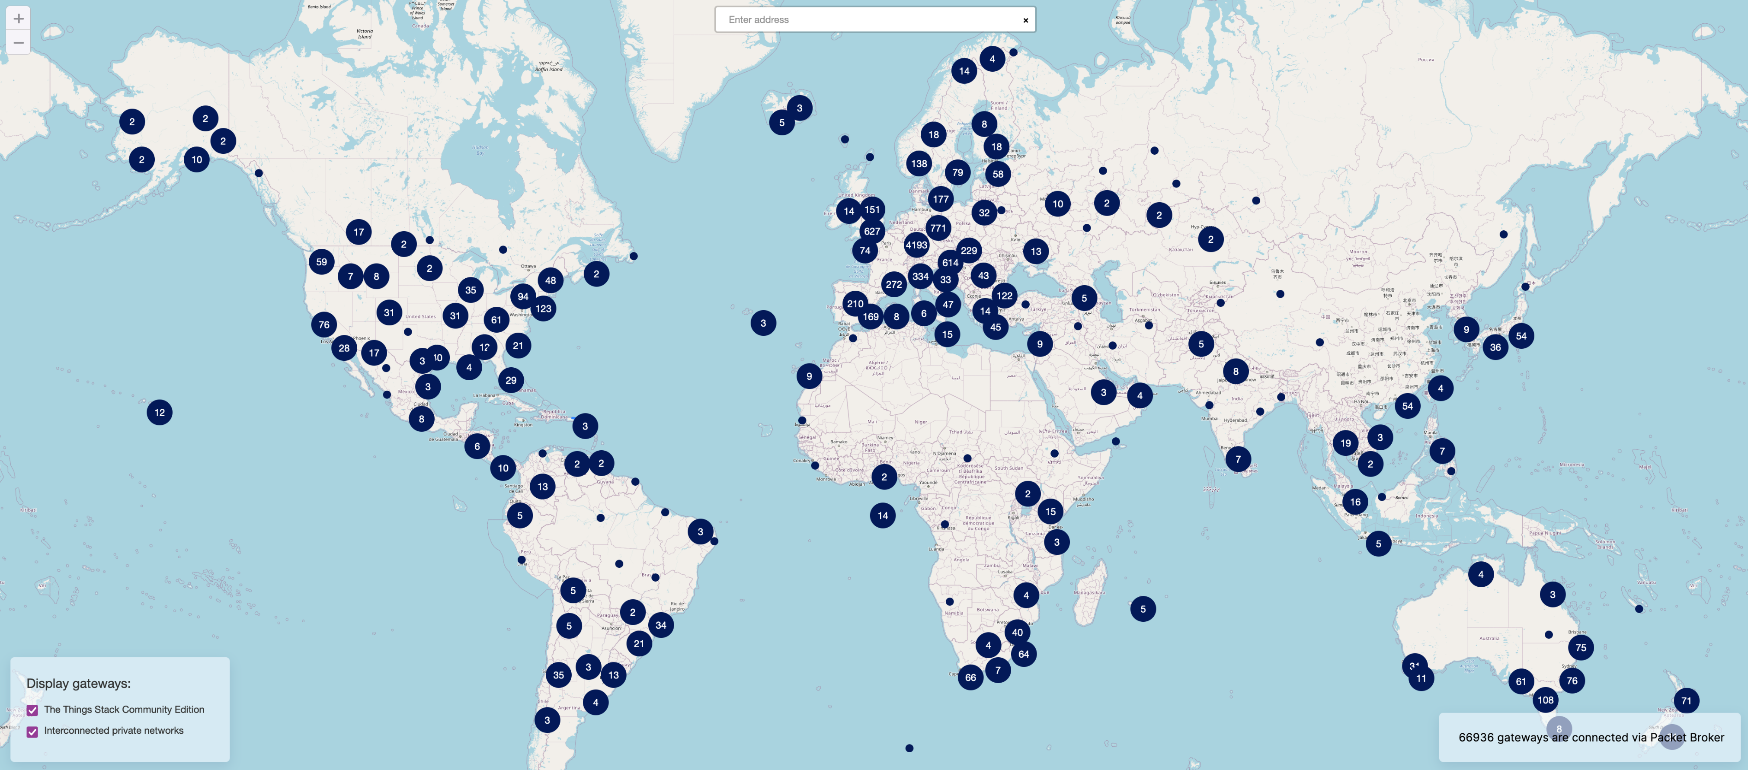
TTN Scale [Mar 2023]

Slide 37
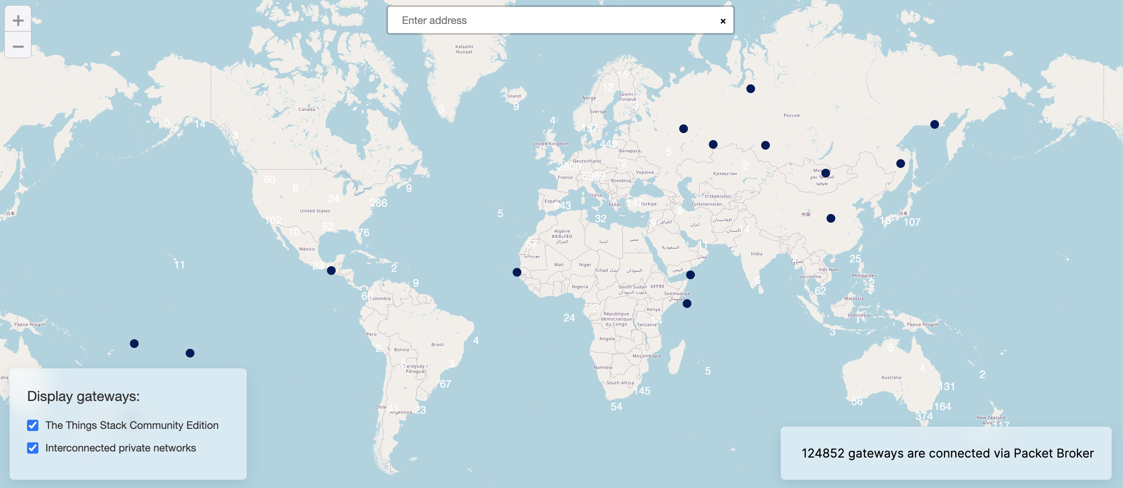
TTN Scale [Mar 2024]

Slide 38
Outline
Wide-Area Network Background
LoRA
LoRaWAN
Charlottesville Deployment
The Things Network

Slide 39
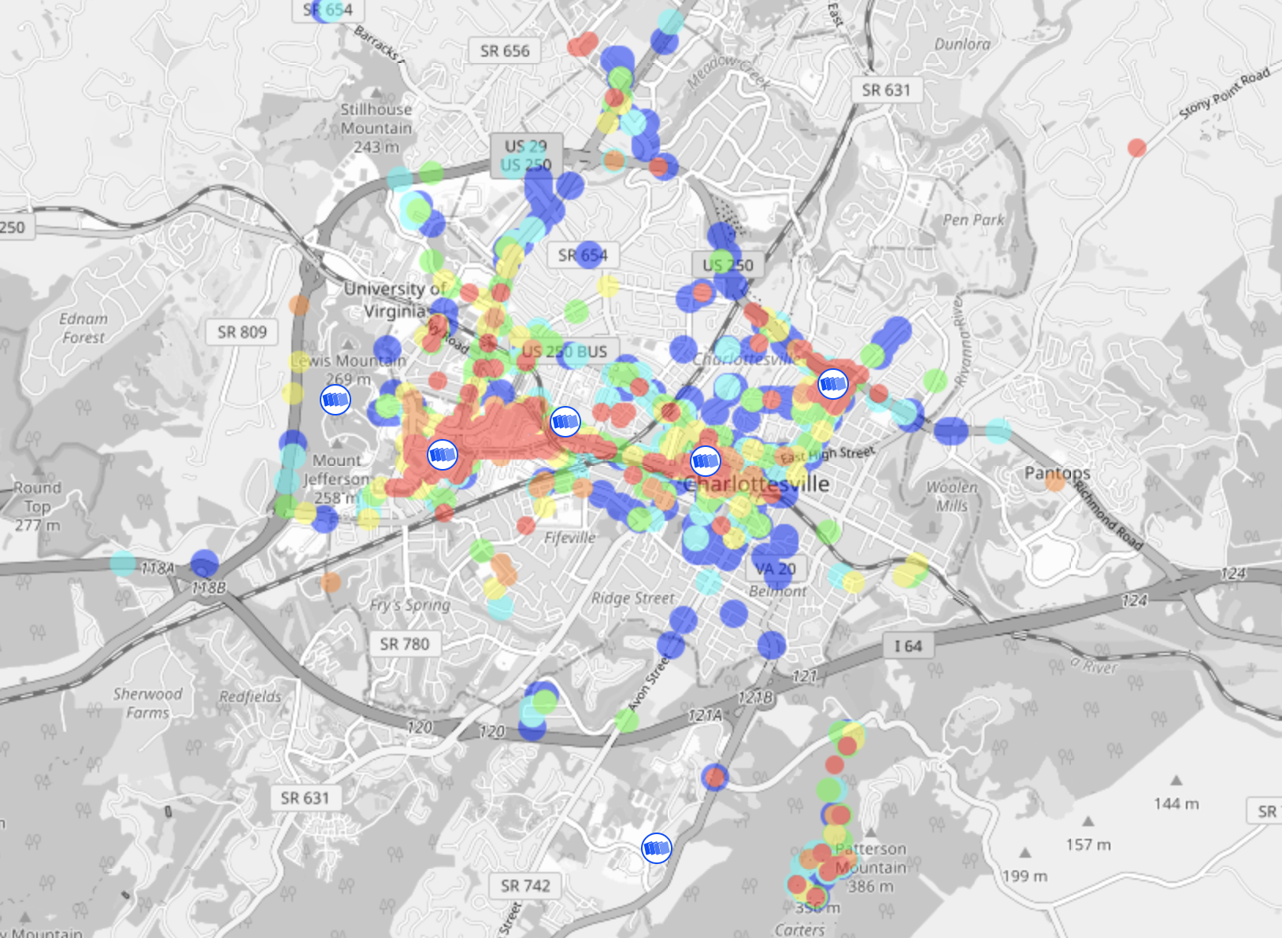
Charlottesville TTN Network

Slide 40
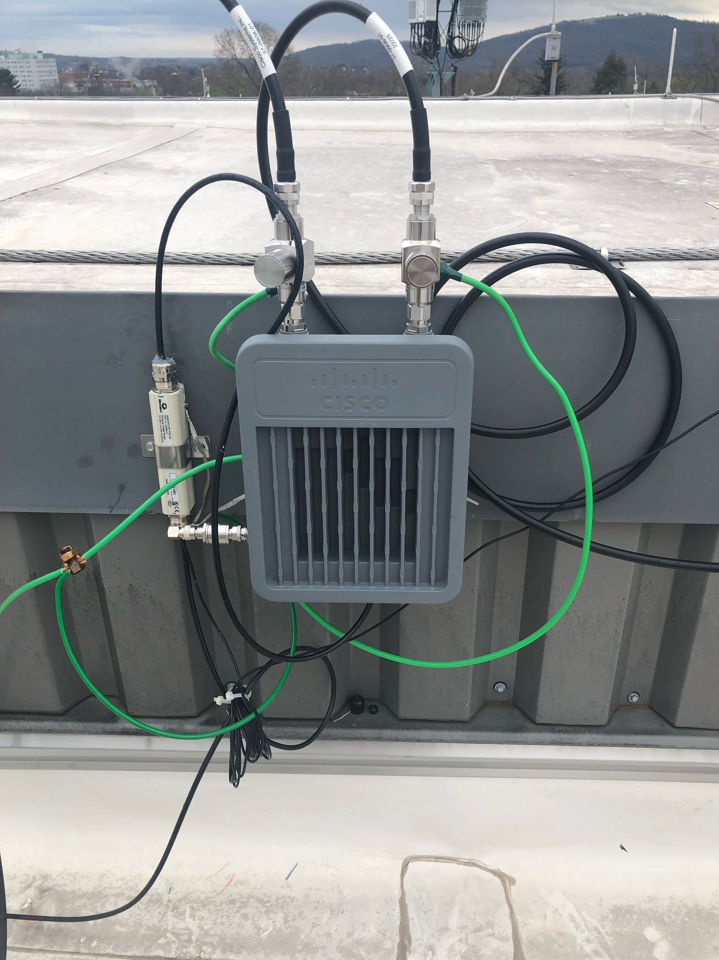
LoRa gateway operational at Rice Hall

Slide 41
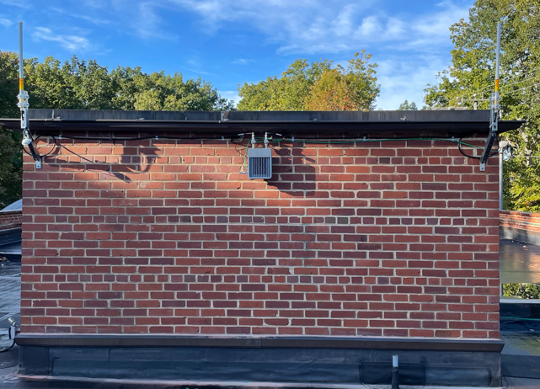
LoRaWAN Gateway Install – UVA Aerospace Research Lab

Slide 42
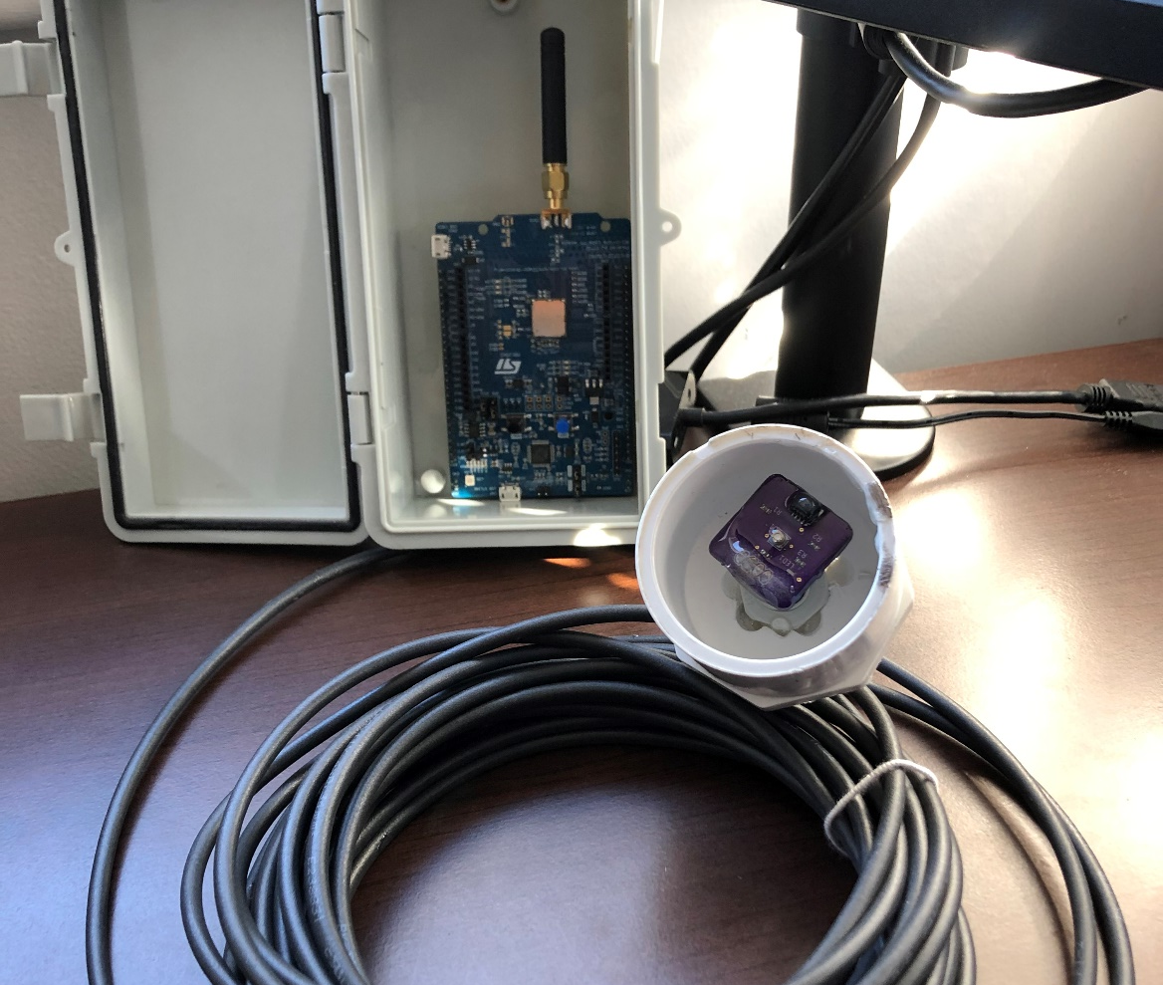
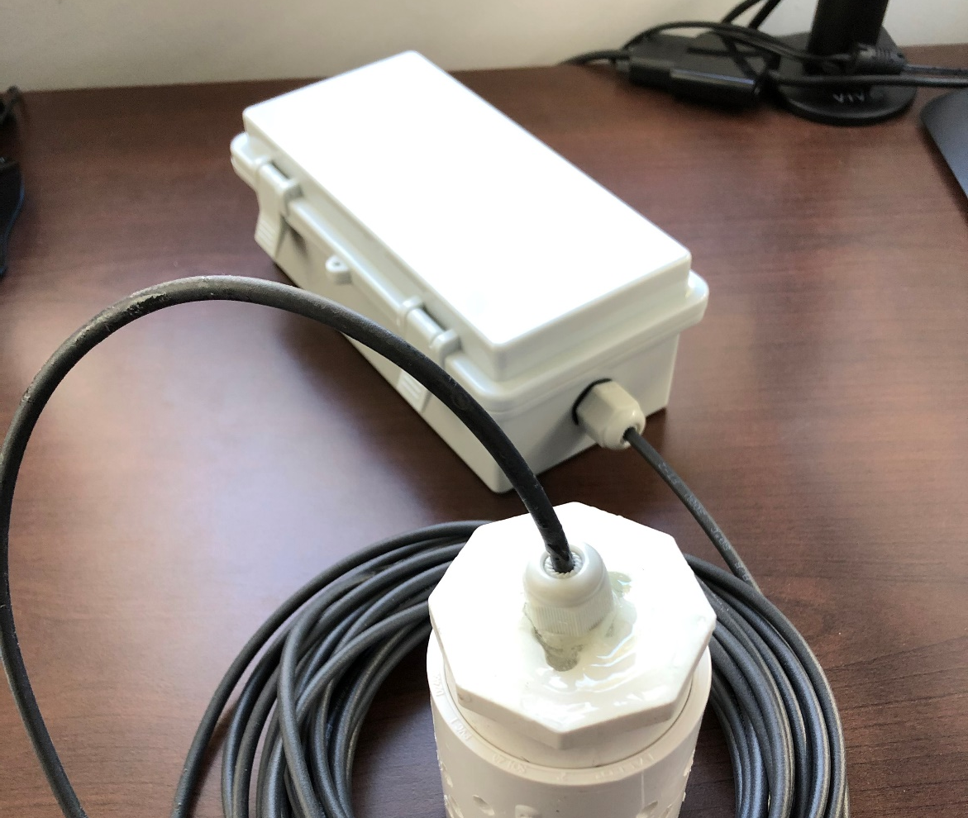
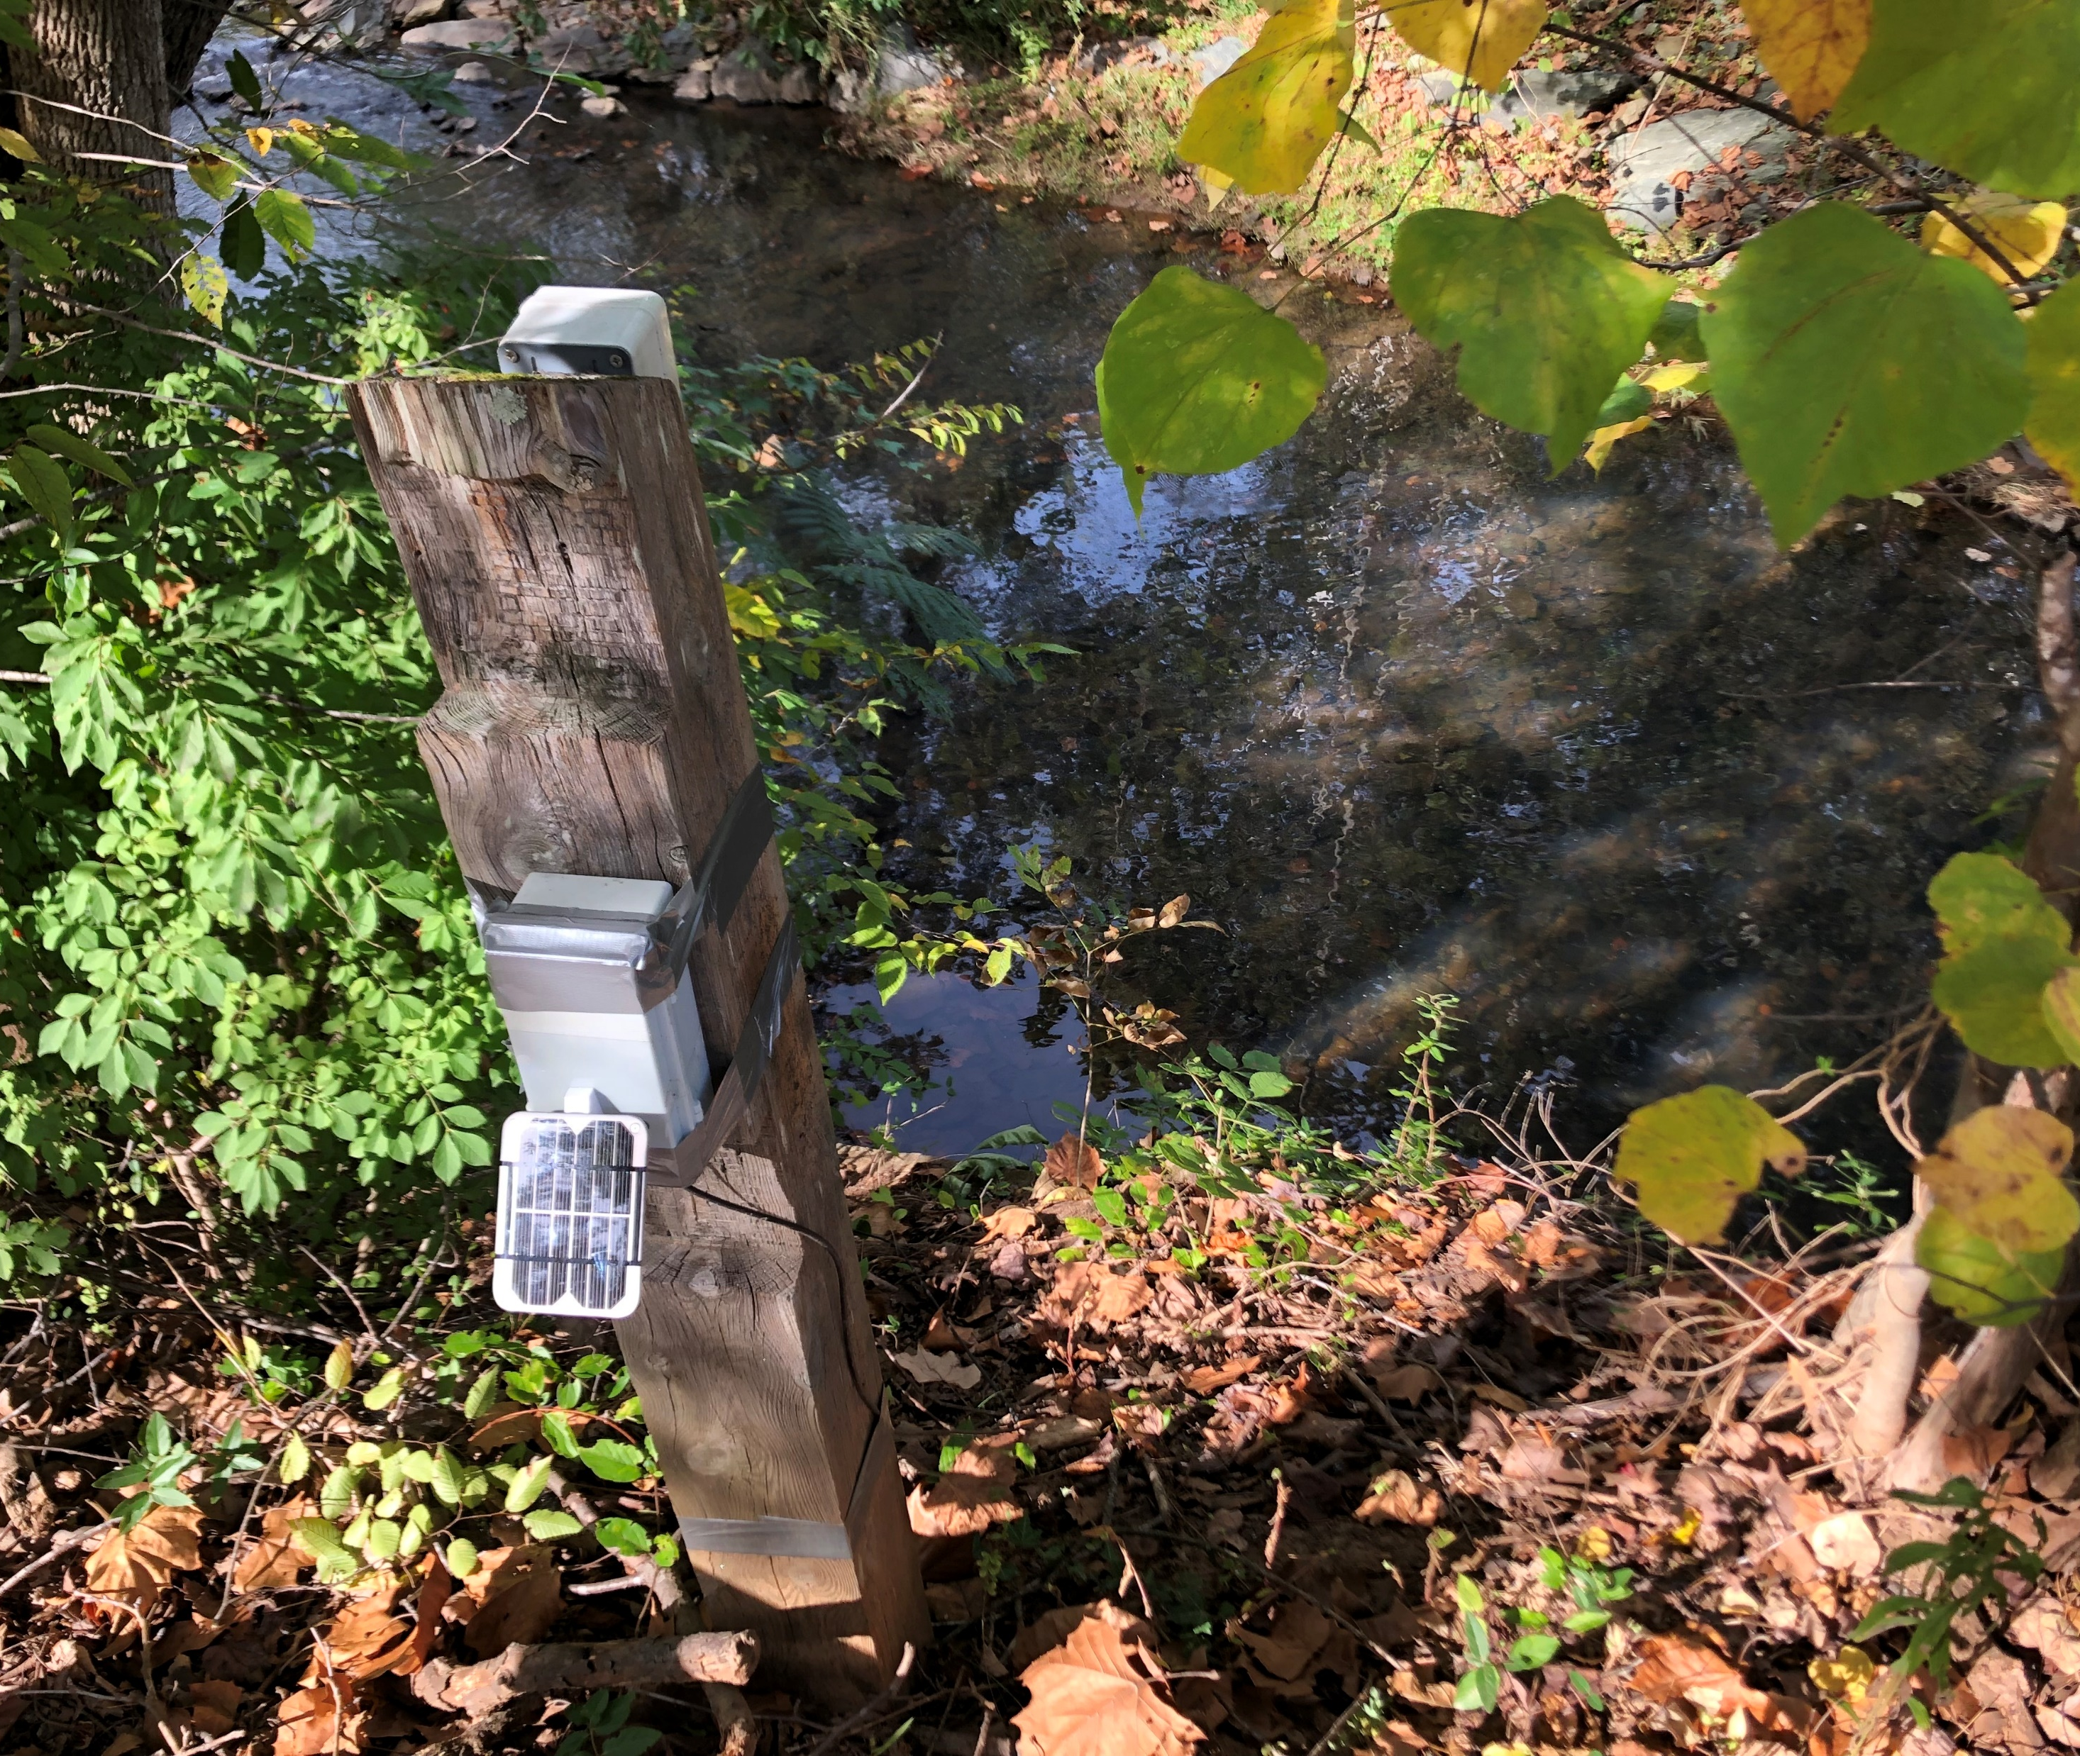
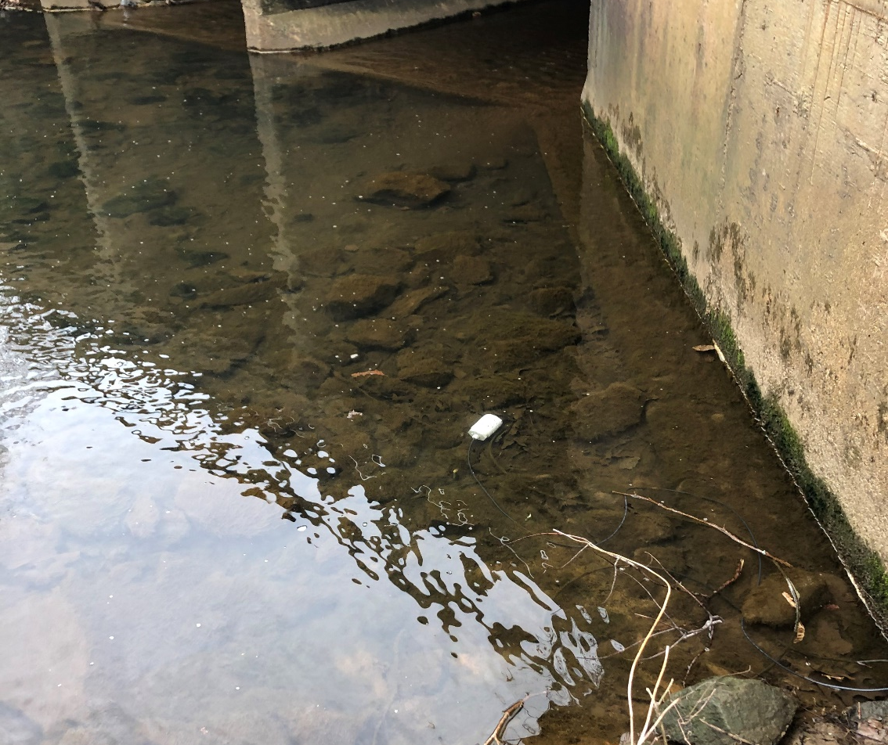
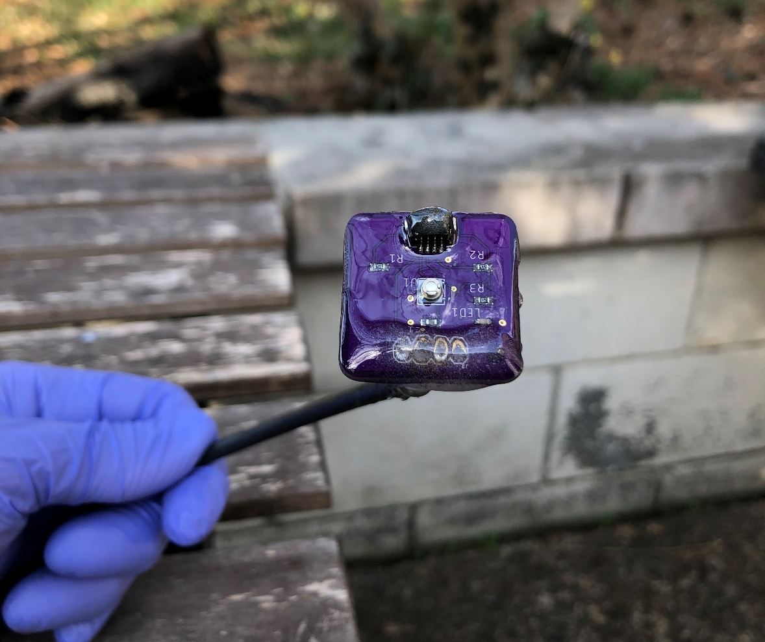
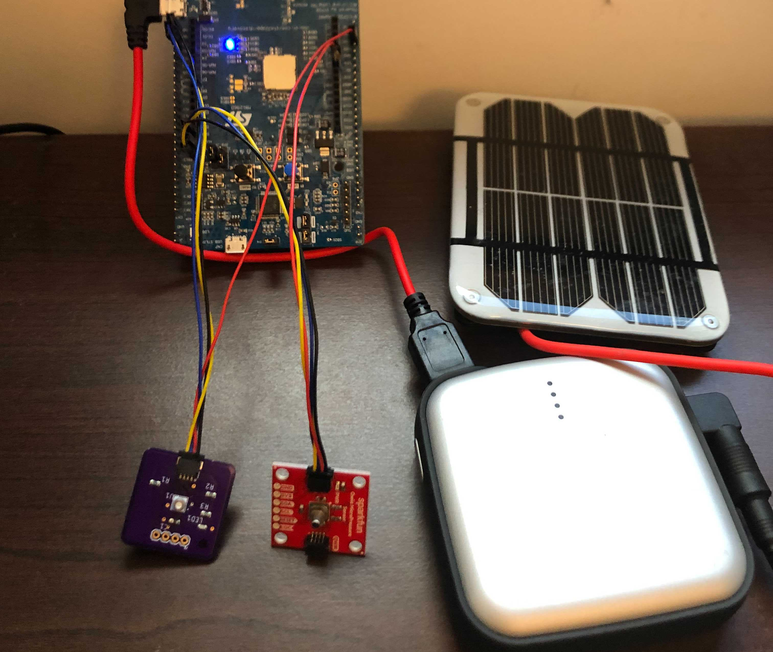
Water Level Sensor Prototype

Slide 43
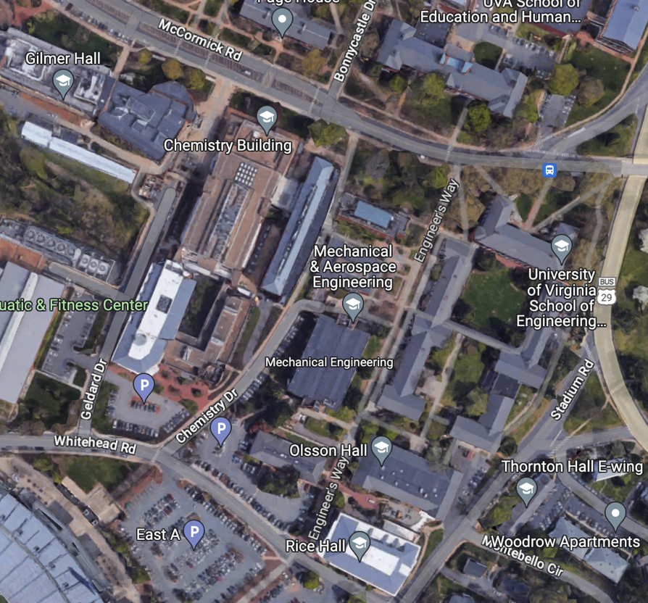
CO2, Temperature, and Humidity Sensors
LoRa gateway
335 m
Sensor nodes
Weather Station
55 m

Slide 44
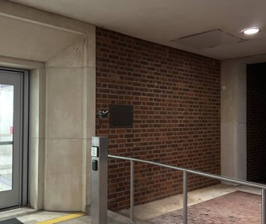
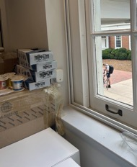
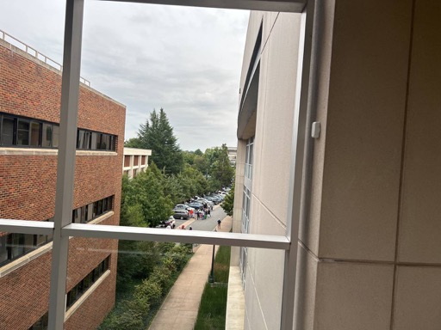
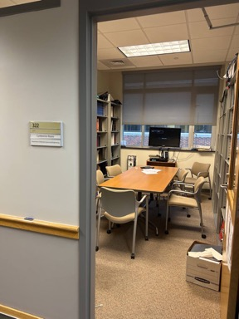
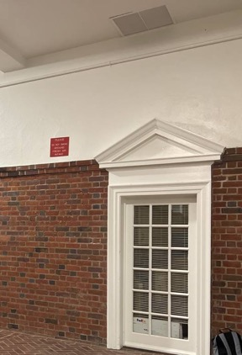
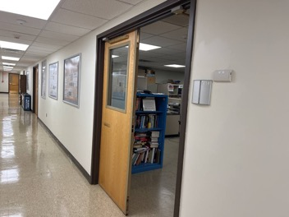
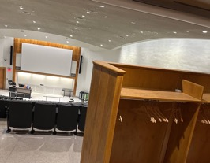
LoRaWAN Sensors @ UVA
Temperature, Humidity, CO2

Slide 45
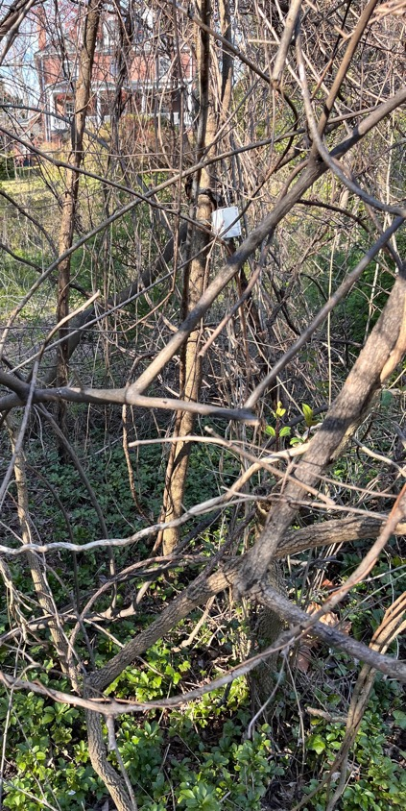
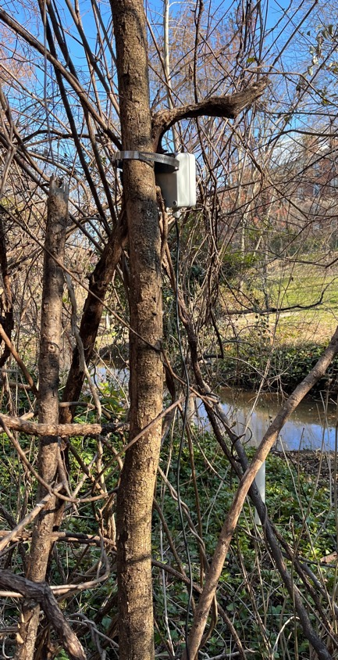
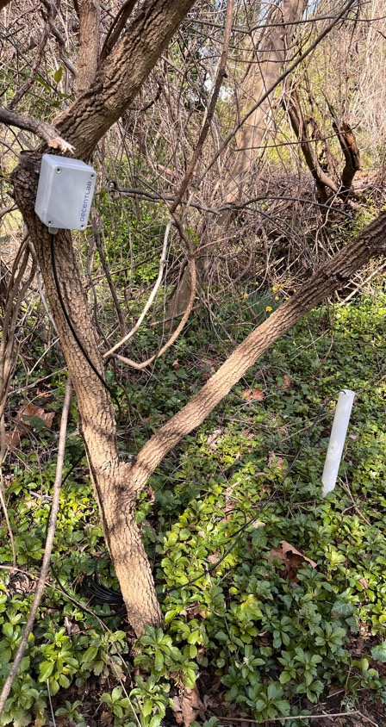
Outdoor sensors @ UVA
Water depth sensing at Dell Pond

Slide 46
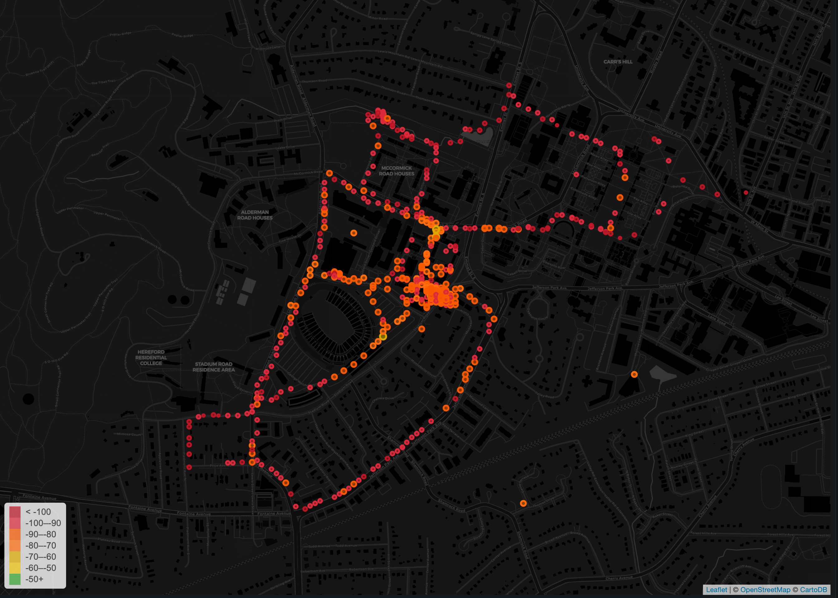
RSSI values from the LoRaWAN field test

Slide 47
Break + Open Question
What kinds of use cases exist for LoRaWAN?
What can you do with 1-5 kbps uplink, 1-22 kbps downlink?
Multiplied by 64 channels uplink, 8 channels downlink

Slide 48
Break + Open Question
What kinds of use cases exist for LoRaWAN?
What can you do with 1-5 kbps uplink, 1-22 kbps downlink?
Multiplied by 64 channels uplink, 8 channels downlink
Outdoor small-sized sensing seems possibly achievable!
With a low enough rate, it could support many devices
Code updates on devices could be tough

Slide 49
Outline
Wide-Area Network Background
LoRA
LoRaWAN
Charlottesville Deployment
The Things Network
Bonus: Research for Improving LoRaWAN

Slide 50
Unlicensed LPWANs is a very active research area
Active work on:
Better access control mechanisms
Increasing bandwidth by utilizing other spectrums like TV white spaces
Recover simultaneous transmissions
Goal: reduce re-transmissions, increase end-device sleep and battery life
Let’s look at some tricks people have done to recover simultaneous transmissions!

Slide 51
Resources
Swarun Kumar (CMU) - https://swarunkumar.com/lpwan.html
Choir
https://swarunkumar.com/papers/choir-sigcomm2017.pdf
https://swarunkumar.com/slides/choir-sigcomm2017.pdf
Charm
https://swarunkumar.com/papers/charm-ipsn2018.pdf
Opportunistic Packet Recovery
https://swarunkumar.com/papers/opr-mobisys2020.pdf

Slide 52
Can we distinguish data from LoRa chirps that have collided?

Slide 53
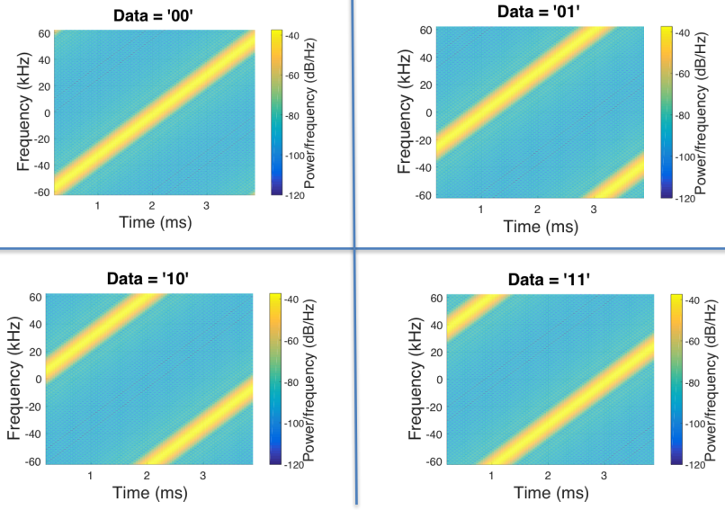
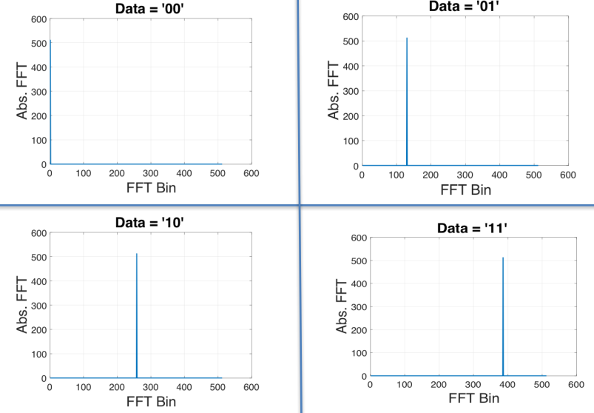
Choir concept
Yes! By applying signal processing to the problem
Data in time domain
Data in frequency domain

Slide 54
Background: Fast Fourier Transform (FFT)
Converts individual signal to its spectral components
https://www.nti-audio.com/en/support/know-how/fast-fourier-transform-fft
Interesting read: Cocktail Party Audio data separation using FFT

Slide 55
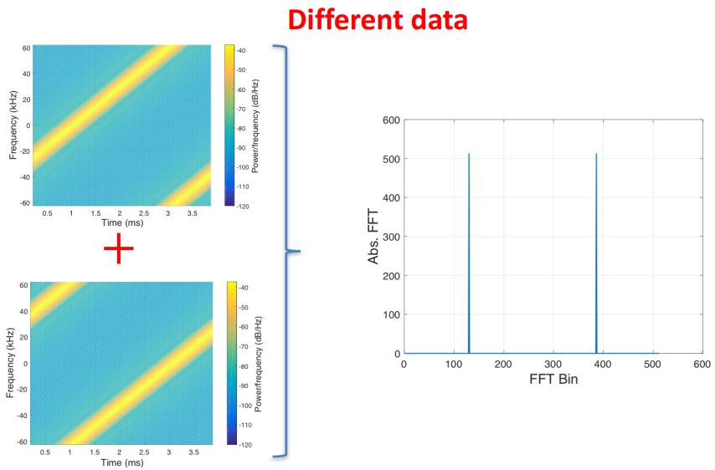
What happens when LoRa chirps collide?

Slide 56
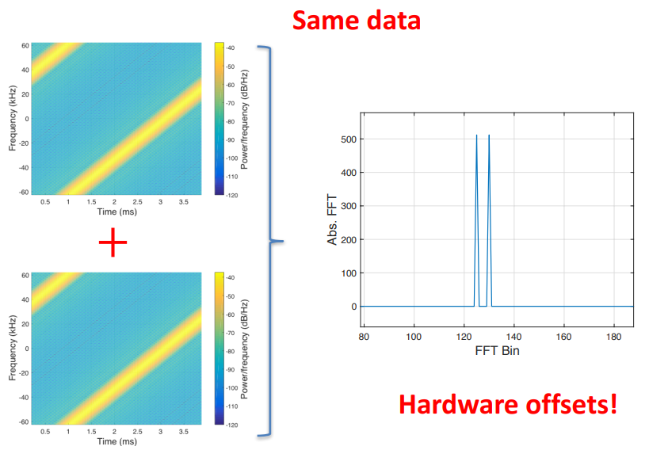
What happens when LoRa chirps collide?

Slide 57
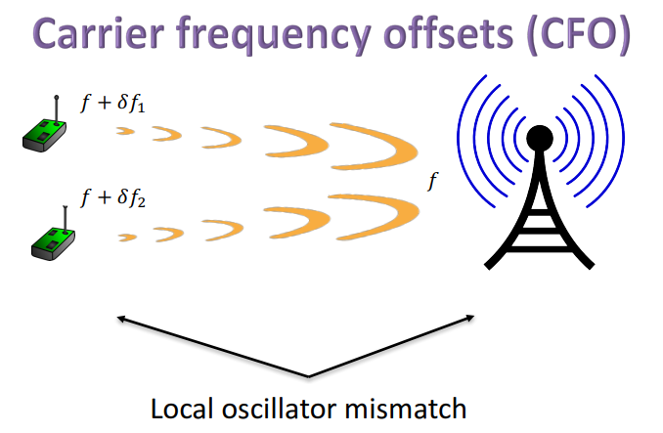
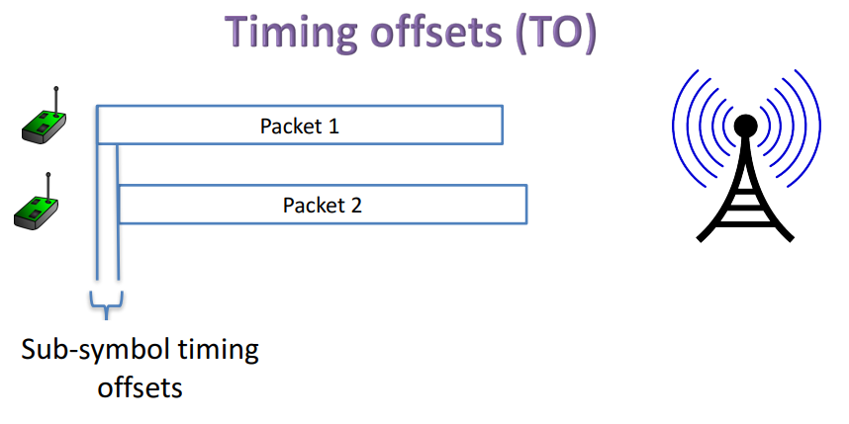
Imperfections in hardware create offsets

Slide 58
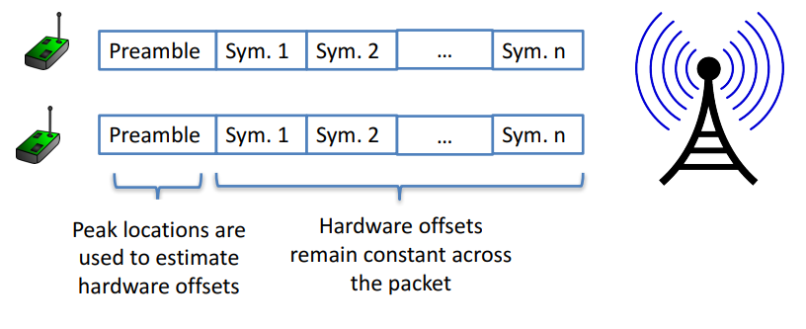
Decoding colliding packets

Slide 59
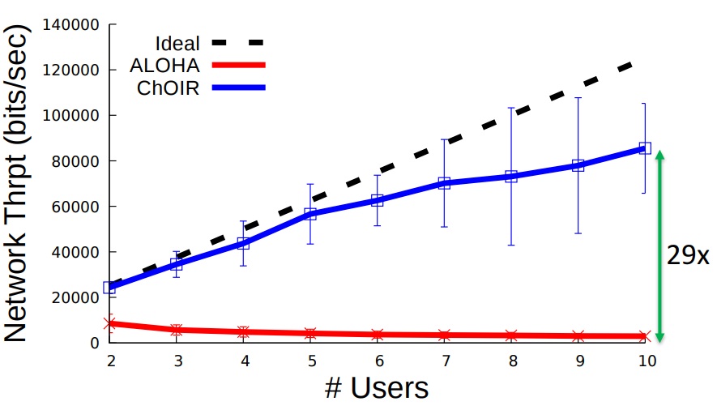
Choir results
Recovering collided packets resolves losses due to Aloha transmission!
Increases maximum throughput on the network considerably!
Does require modifications to hardware on gateways though

Slide 60
Can we recover weak LoRaWAN signals?

Slide 61
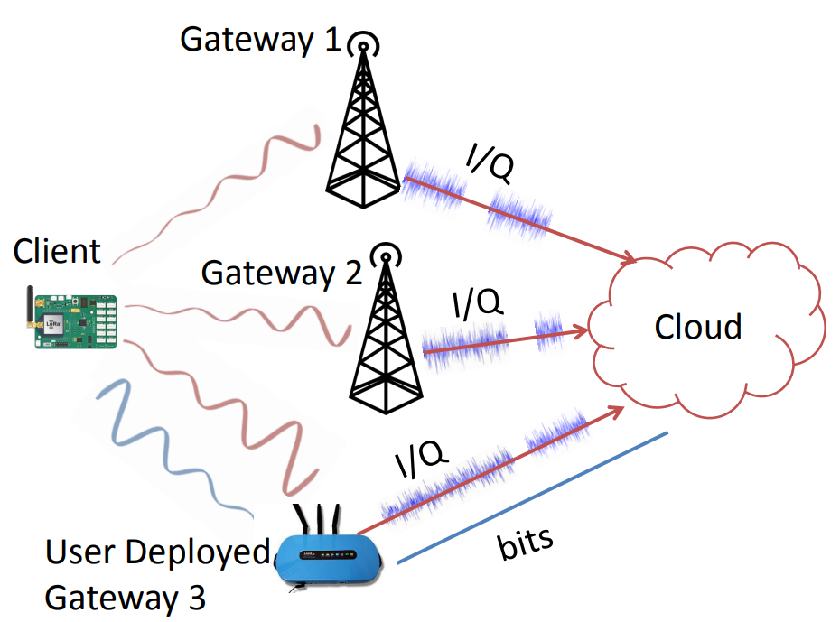
Charm
Take advantage of multiple gateways in range of a device
Combine signals received at each gateway to recover packets that weren’t received cleanly

Slide 62
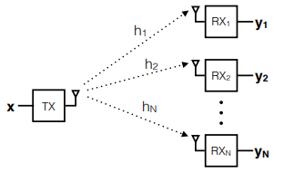
Coherent combining
Signal received at each receiver is a combination of
Signal
Wireless channel
Random noise
Signal and wireless channel are similar at all receivers
Noise is different though! Independent
When combined, signals are coherent (build in strength) whereas noise is incoherent (spreads out)

Slide 63
Charm uses coherent combining across gateways
Gateways send signal data to the cloud
The cloud can perform combining on the data and recover signals
Challenges
Only send the data when it’s needed
Tight time synchronization on the data
Gateway hardware changes

Slide 64
Can we recover packets that have bad CRCs?

Slide 65
Opportunistic Packet Recovery (OPR)
What if we have some information about where the interference might have occurred during the signal transmission?
OPR demonstrates that we can recover packets!
Process
Receive bits even for bad packets
Measure RSSI for each bit along the way
Look for changes in RSSI that signals interference
Try different values for the effected bits until the CRC succeeds!

Slide 66
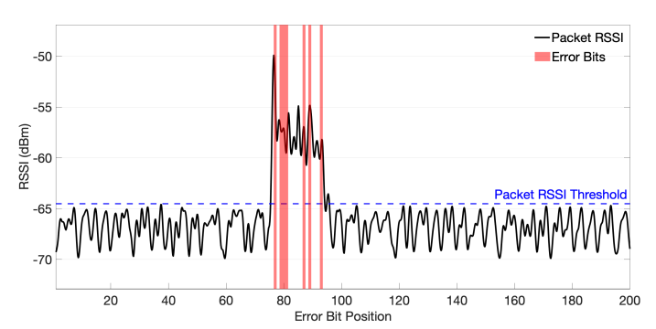
Detecting error bits in transmitted packets
Correctly identifies 83% of the corrupted bits with 17% false positives

Slide 67
Multiple gateways do even better
If multiple gateways receive the packet, they can compare their received data
Common bits are likely correct, while differences are likely interference

Slide 68
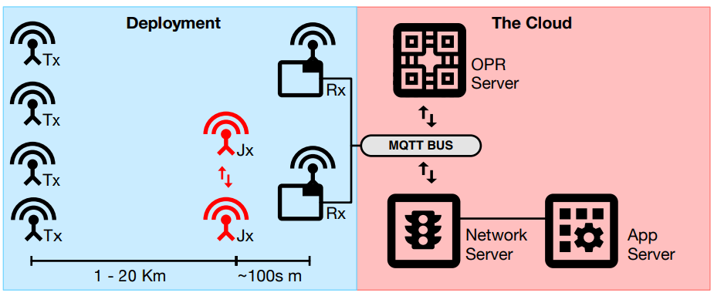
OPR total design
Bad packets are sent to the OPR Server for handling along with RSSI data
OPR server attempts to reconstruct the packet
In practice, system can correct up to 72% of CRC errors!
Also completes correction in time for the ACK response (within 1 second)

Slide 69
Resources
LoRaWAN
LoRaWAN Specification version 1.1
LoRaWAN Regional Parameters version 1.0.2

