Slide 1
Wireless for the Internet of Things WiFi (IEEE 802.11)
While we get started, take the quiz on canvas!
CS/ECE 4501
Spring 2024
UVA
[Pannuto, Ghena, Campbell]

Slide 2
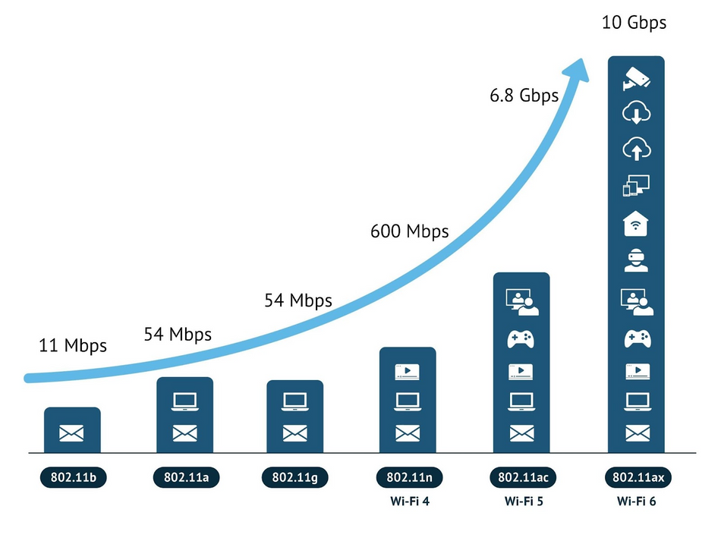
Today’s Goals
Introduce the ins and outs of WiFi
Think about how WiFi (IEEE 802.11) has managed to keep up over 25 years
https://www.wevolver.com/article/the-evolution-of-wi-fi-networks-from-ieee-80211-to-wi-fi-6e

Slide 3
Characterizing WiFi
Throughput
Throughput
Channel Size
Range
Power
Wireless Spectrum Frequency
Plot BLE, 802.15.4, LoRa, and WiFi on each set of axes

Slide 4
Outline
WiFi Overview
WiFi PHY
WiFi MAC and Packets
IoT + WiFi

Slide 5
What is WiFi?
Most successful wireless protocol (family)
Small Area (~35m), high performance (up to 9,600 Mbit/s)
~25 years young
We’ll do some history
Note the parallels in technology development
First: Maximize the performance of a single channel
Now: Improve performance through parallelism (more channels working together)

Slide 6
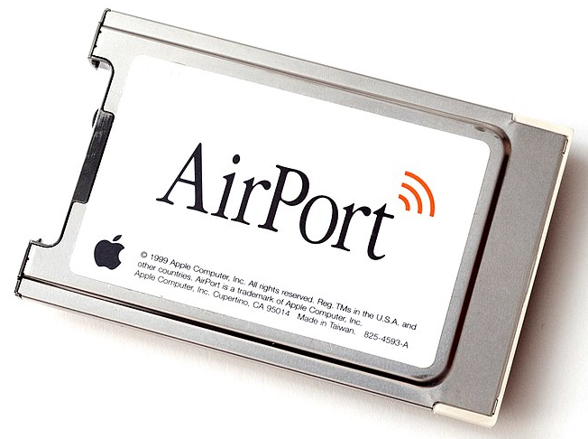
IEEE 802.11 timeline
1985 – US FCC rules ISM band for unlicensed use
1990s – WaveLAN (NCR Corporation, Netherlands)
Wireless ethernet for cashier systems
1997 – 802.11 specification
1999 – 802.11b and 802.11a amendments
1999 – WiFi Alliance formed for certification of devices
1999 – Apple iBook is the first consumer WiFi product

Slide 7
Major amendments
 | Protocol | Year | Frequency | PHY | Max Rate | Range
- | 802.11 | 1997 | 2.4 GHz | DSSS/FHSS | 2 Mbps | 20 m
1 | 802.11b | 1999 | 2.4 GHz | DSSS | 11 Mbps | 35 m
2 | 802.11a | 1999 | 5 GHz | OFDM | 54 Mbps | 35 m
3 | 802.11g | 2003 | 2.4 GHz | OFDM | 54 Mbps | 38 m
4 | 802.11n | 2009 | 2.4/5 GHz | OFDM + MIMO | 600 Mbps | 70 m
5 | 802.11ac | 2013 | 5 GHz | OFDM + MU-MIMO (downlink only) | 3.4 Gbps | 35 m
6 | 802.11ax | 2021 | 2.4/5/[6] GHz | OFDMA + MU-MIMO | 9.6 Gbps | 35 m
7 | 802.11be | 2024 | 2.4/5/6 GHz | OFDMA + MU-MIMO | 46 Gbps | 35 m
8 | 802.11bn | ~2028 | 2.4/5/6/7/42.5/71 |  | 100 Gbps
802.11b was very popular but is now usually unsupported
802.11a never saw major deployment
WiFi Alliance rebranded 802.11ac as “WiFi 5” and backported scheme

Slide 8
Resources
Peter Steenkiste – Carnegie Mellon University
https://www.cs.cmu.edu/~prs/wirelessS18/handouts/L11-AdHoc.pdf
https://www.cs.cmu.edu/~prs/wirelessS18/handouts/L12-LAN.pdf
Raj Jain – Washington University in Saint Louis
https://www.cse.wustl.edu/~jain/cse574-14/ftp/j_05lan.pdf
https://www.cse.wustl.edu/~jain/cse574-14/ftp/j_06lan.pdf
Honestly
https://en.wikipedia.org/wiki/IEEE_802.11

Slide 9
Outline
WiFi Overview
WiFi PHY
802.11/802.11b
802.11a/802.11g
802.11n/802.11ac
802.11ax
WiFi MAC and Packets
IoT + WiFi

Slide 10
Goal: improve throughput
In twenty years, WiFi has gone from 2 Mbps to 9.6 Gbps
How does a network PHY improve its throughput?
More capable modulation and/or bit transmission
Better radios
New modulation schemes: 64-QAM, 256-QAM, etc.
Better spatial use
MIMO techniques
More bandwidth
OFDM techniques
Increased channel width at 2.4 GHz and bigger 5 GHz channels

Slide 11
Walking through PHY changes by amendment
 | Protocol | Year | Frequency | PHY | Max Rate | Range
- | 802.11 | 1997 | 2.4 GHz | DSSS/FHSS | 2 Mbps | 20 m
1 | 802.11b | 1999 | 2.4 GHz | DSSS | 11 Mbps | 35 m
2 | 802.11a | 1999 | 5 GHz | OFDM | 54 Mbps | 35 m
3 | 802.11g | 2003 | 2.4 GHz | OFDM | 54 Mbps | 38 m
4 | 802.11n | 2009 | 2.4/5 GHz | OFDM + MIMO | 600 Mbps | 70 m
5 | 802.11ac | 2013 | 5 GHz | OFDM + MU-MIMO | 3.4 Gbps | 35 m
6 | 802.11ax | 2021 | 2.5/5/[6] GHz | OFDMA + MU-MIMO | 9.6 Gbps | 35 m
7 | 802.11be | TBA | 2.5/5/6 GHz | OFDMA + MU-MIMO | 40 Gbps | 35 m

Slide 12
Original WiFi specification (1997)
Legacy WiFi
Frequency Hopping Spread Spectrum (FHSS)
GFSK (Gaussian Frequency-Shift Keying)
Relatively simple radio design
Frequency hopping over 80 channels (1 MHz each)
Actually supports an Infrared PHY as well!!

Slide 13
802.11b (1999)
802.11b
Direct Sequence Spread Spectrum (DSSS)
DBPSK and DQPSK (Differential Binary/Quadrature Phase-Shift Keying)
Translate data into “codes”
Each data bit corresponds to several code bits (Chips)
Chips are what is actually modulated over the air
Data can be recovered by knowing the code patterns
Modulation
Phase-shift Keying (of the Chips)

Slide 14
802.11b channels
14 channels total
1-11 for US
1-13 for most of the rest of the world
1-14 for Japan (but 14 only for 802.11b)
22 MHz channels
5 MHz spacing -> significant channel overlap
Channels 1, 6, and 11 can be used without overlap

Slide 15
Question
If the majority of channels overlap, why even have them?
Different options for different regions
Inside US use three channels: 1, 6, 11
Outside of North America can use four channels: 1, 5, 9, 13
Historical: avoid other 2.4 GHz users
If they’re at the low end of the band, you could switch to channel 2 or 3

Slide 16
Walking through PHY changes by amendment
 | Protocol | Year | Frequency | PHY | Max Rate | Range
- | 802.11 | 1997 | 2.4 GHz | DSSS/FHSS | 2 Mbps | 20 m
1 | 802.11b | 1999 | 2.4 GHz | DSSS | 11 Mbps | 35 m
2 | 802.11a | 1999 | 5 GHz | OFDM | 54 Mbps | 35 m
3 | 802.11g | 2003 | 2.4 GHz | OFDM | 54 Mbps | 38 m
4 | 802.11n | 2009 | 2.4/5 GHz | OFDM + MIMO | 600 Mbps | 70 m
5 | 802.11ac | 2013 | 5 GHz | OFDM + MU-MIMO | 3.4 Gbps | 35 m
6 | 802.11ax | 2021 | 2.5/5/[6] GHz | OFDMA + MU-MIMO | 9.6 Gbps | 35 m
7 | 802.11be | TBA | 2.5/5/6 GHz | OFDMA + MU-MIMO | 40 Gbps | 35 m

Slide 17
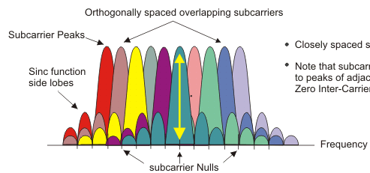
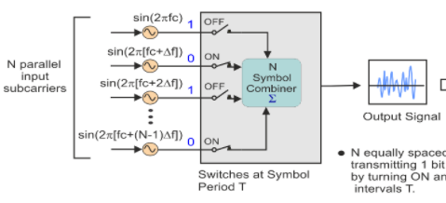
Increase performance with more bandwidth: OFDM
Replace DSSS with Orthogonal Frequency Division Multiplexing (OFDM)
OFDM idea
Split band into a number of narrow subcarriers
Subcarriers are spaced so that they don’t interfere
Transmit on multiple subcarriers at once to increase throughput
Intuition: easier to send/receive N simpler transmissions than one complex (wide bandwidth) transmission. Analogy:
Chinese: 电脑
English: Computer
OFDM enables higher throughput
Recall DSSS

Slide 18
802.11a channels
802.11a did promote the use of 5 GHz band
Several 20 MHz channels with no overlap (9ish in the US)
Big increase from “three” channels of 2.4 GHz
Various regional rules on a number of different channels
Needs to avoid frequencies in use by existing radar deployments
Orange channels aren’t usually used in the US at least

Slide 19
802.11g (2003)
Applies OFDM to 2.4 GHz band
Increases throughput from 11 Mbps to 54 Mbps
Same 2.4 GHz channels as 802.11b, but 20 MHz bandwidth
Still 1, 6, 11 in US
1, 5, 9, 13 in other regions
Backwards compatible with 802.11b
Capable of DSSS communication when required

Slide 20
Improved WiFi hardware is in high demand
Typically, standards lead hardware by several years
BLE 5.2 is out, but 5.0 is just being adopted in phones
Development of 802.11g hardware started before finalization of standard
Demand for increased performance was already high in 2003
Phenomena continues in modern WiFi and Cellular protocols
Hardware supports some features as soon as it’s clear they’ll exist

Slide 21
Walking through PHY changes by amendment
 | Protocol | Year | Frequency | PHY | Max Rate | Range
- | 802.11 | 1997 | 2.4 GHz | DSSS/FHSS | 2 Mbps | 20 m
1 | 802.11b | 1999 | 2.4 GHz | DSSS | 11 Mbps | 35 m
2 | 802.11a | 1999 | 5 GHz | OFDM | 54 Mbps | 35 m
3 | 802.11g | 2003 | 2.4 GHz | OFDM | 54 Mbps | 38 m
4 | 802.11n | 2009 | 2.4/5 GHz | OFDM + MIMO | 600 Mbps | 70 m
5 | 802.11ac | 2013 | 5 GHz | OFDM + MU-MIMO | 3.4 Gbps | 35 m
6 | 802.11ax | 2021 | 2.5/5/[6] GHz | OFDMA + MU-MIMO | 9.6 Gbps | 35 m
7 | 802.11be | TBA | 2.5/5/6 GHz | OFDMA + MU-MIMO | 40 Gbps | 35 m

Slide 22
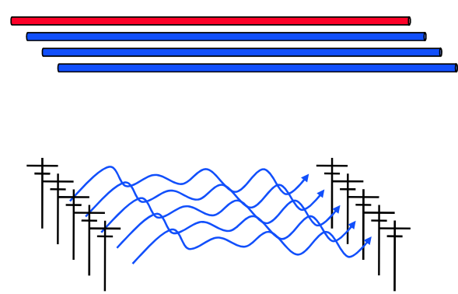
How do we increase throughput?
Wired world
Add more wires in parallel
Wireless world
Add more antennas?

Slide 23
How do we increase throughput?
Water world
Fatter pipes
Wireless world
Fatter channels (with more bandwidth)
802.11.n — WHY NOT BOTH?

Slide 24
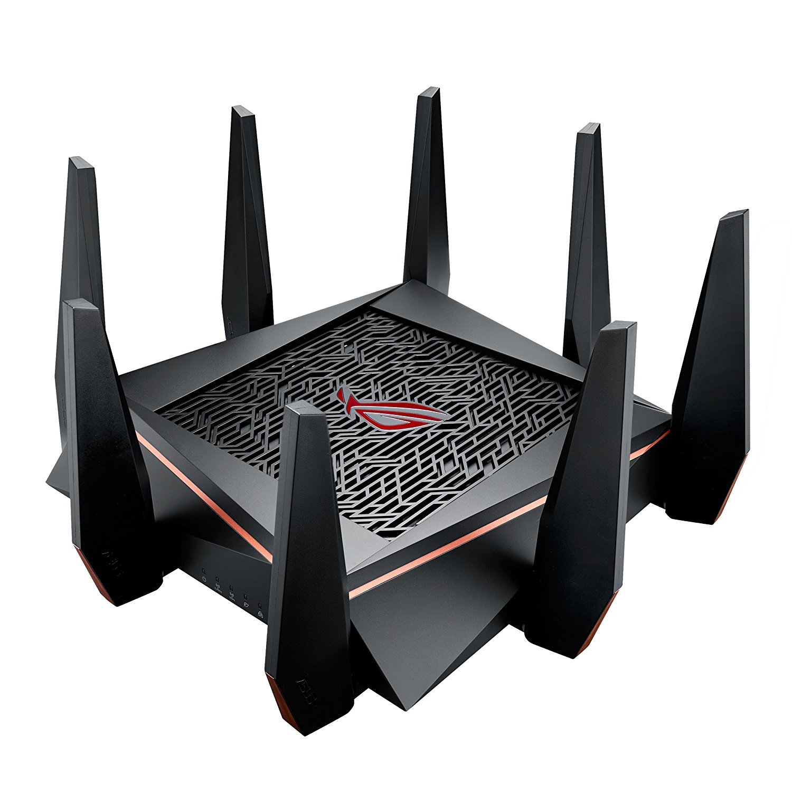
MIMO – Multiple In Multiple Out
N x M subchannels can be used to send data simultaneously
Huge boost in data throughput
Antenna diversity adds to reliability as well
The signals may interfere with each other
But receiving all of them allows the data to be recovered
Beamforming
Use interactions between array of antennas to focus energy on the receiver
Way outside of the scope of this class

Slide 25
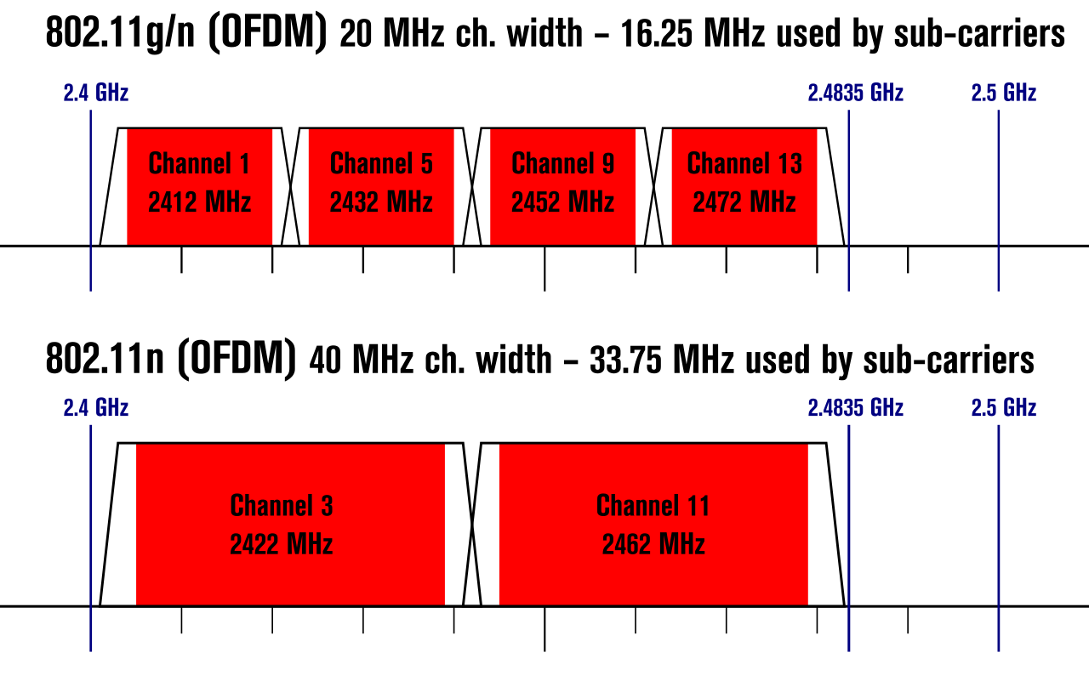
Expandable bandwidth
OFDM allows many subcarriers within a channel to be used at once
Throughput scales with the amount of bandwidth available
Allow larger 40 MHz channels to be used

Slide 26
802.11n (2009)
Supports OFDM and MIMO on 2.4 GHz and 5 GHz
Supports 20 MHz and 40 MHz channels
Easier to create large channels in 5 GHz band
Backwards compatible with 802.11g (tries not to be with 802.11b)
Wildly successful
Still the 2.4 GHz band protocol (802.11ac is 5 GHz only)
A little less than half of the networks visible to me are still 802.11n

Slide 27
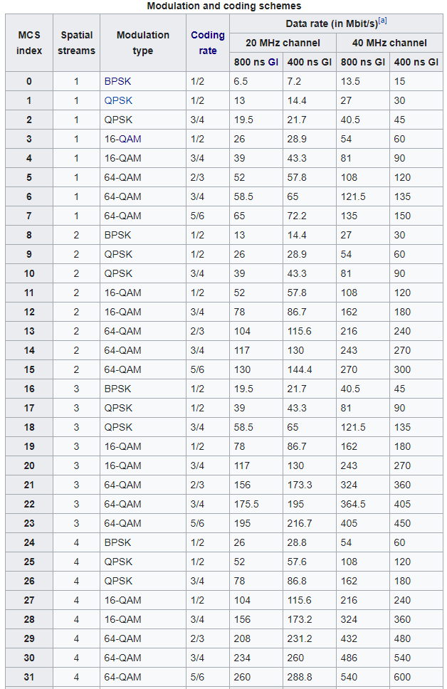
802.11n modulation and coding schemes
MCS – Modulation and Coding Scheme
GI – Guard Interval: delay between transmitted symbols

Slide 28
Break + Open Question
How much bandwidth is acceptable to use?
Is it okay for a WiFi network to use the entire 2.4 GHz spectrum?
Maybe. At least the range is pretty short!
Only next-door neighbor’s network interfere with your network
Someone further away isn’t affected at all
Need to share with neighbors nearby though
Theoretically better to have separate allocations than to overlap and deal with the collisions

Slide 29
Walking through PHY changes by amendment
 | Protocol | Year | Frequency | PHY | Max Rate | Range
- | 802.11 | 1997 | 2.4 GHz | DSSS/FHSS | 2 Mbps | 20 m
1 | 802.11b | 1999 | 2.4 GHz | DSSS | 11 Mbps | 35 m
2 | 802.11a | 1999 | 5 GHz | OFDM | 54 Mbps | 35 m
3 | 802.11g | 2003 | 2.4 GHz | OFDM | 54 Mbps | 38 m
4 | 802.11n | 2009 | 2.4/5 GHz | OFDM + MIMO | 600 Mbps | 70 m
5 | 802.11ac | 2013 | 5 GHz | OFDM + MU-MIMO | 3.4 Gbps | 35 m
6 | 802.11ax | 2021 | 2.5/5/[6] GHz | OFDMA + MU-MIMO | 9.6 Gbps | 35 m
7 | 802.11be | TBA | 2.5/5/6 GHz | OFDMA + MU-MIMO | 40 Gbps | 35 m

Slide 30
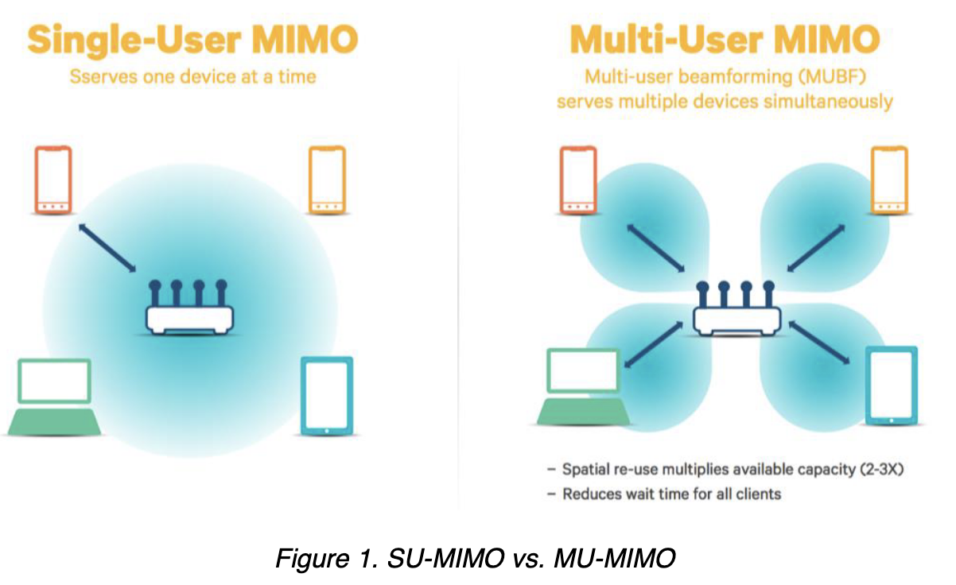
“The MIMO Gap”
Access points have 3-4 [or more now] antennas
Client devices have 1-2 [or more now] antennas
While absolute numbers keep going up, trend holds
Asymmetric design pattern again: More complexity in the AP than clients
Original MIMO was one device at a time
No expand to be multiple device simultaneously

Slide 31
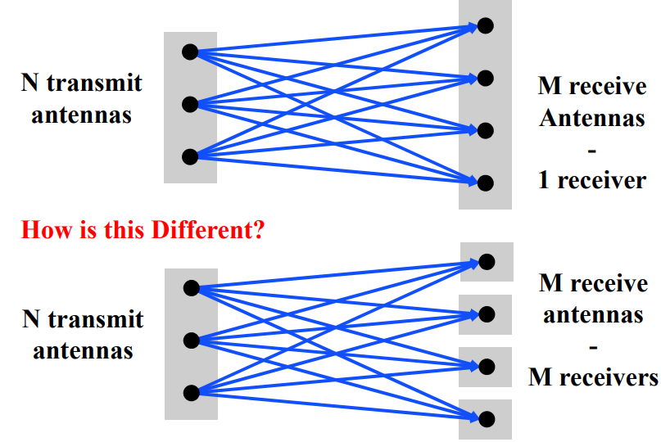
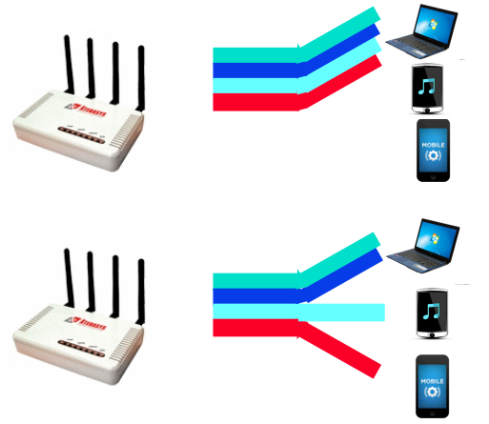
Multi-user Multiple In Multiple Out (MU-MIMO)
Multi-user MIMO uses the same techniques to send in parallel to multiple devices

Slide 32
802.11ac (2013)
Update for 5 GHz band only
Supports Downlink MU-MIMO (from AP to device)
Supports channels widths up to 160 MHz
Engineering updates: up to 256-QAM
Routers apply 802.11ac to 5 GHz and 802.11n to 2.4 GHz
Still in wide use (as of 2023)
Eduroam is 802.11ac

Slide 33
802.11ac channels

Slide 34
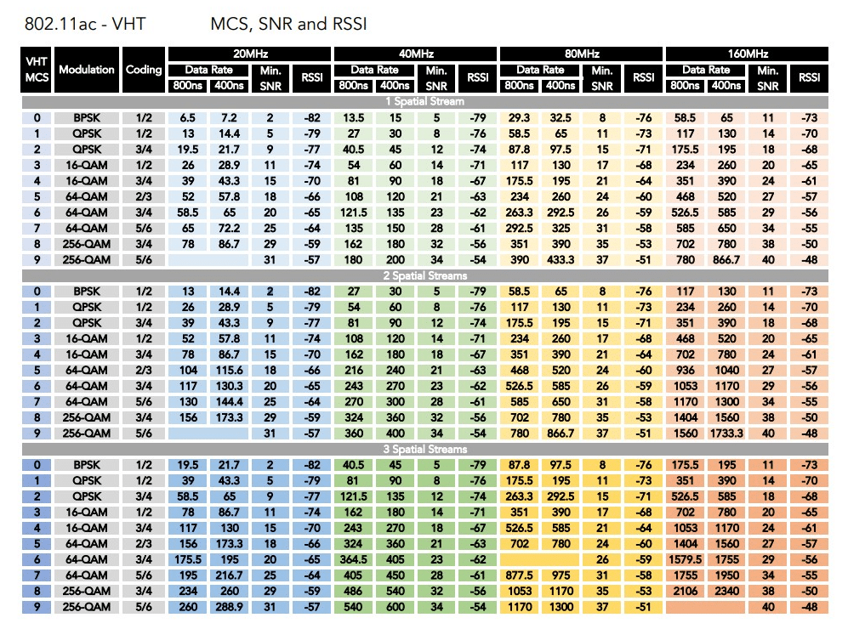
802.11ac modulation and coding schemes
4 spatial streams is also allowed, getting up to 3466 Mbps

Slide 35
Walking through PHY changes by amendment
 | Protocol | Year | Frequency | PHY | Max Rate | Range
- | 802.11 | 1997 | 2.4 GHz | DSSS/FHSS | 2 Mbps | 20 m
1 | 802.11b | 1999 | 2.4 GHz | DSSS | 11 Mbps | 35 m
2 | 802.11a | 1999 | 5 GHz | OFDM | 54 Mbps | 35 m
3 | 802.11g | 2003 | 2.4 GHz | OFDM | 54 Mbps | 38 m
4 | 802.11n | 2009 | 2.4/5 GHz | OFDM + MIMO | 600 Mbps | 70 m
5 | 802.11ac | 2013 | 5 GHz | OFDM + MU-MIMO | 3.4 Gbps | 35 m
6 | 802.11ax | 2021 | 2.5/5/[6] GHz | OFDMA + MU-MIMO | 9.6 Gbps | 35 m
7 | 802.11be | TBA | 2.5/5/6 GHz | OFDMA + MU-MIMO | 40 Gbps | 35 m

Slide 36
New directions in WiFi focus: Aggregate throughput across all devices
For point-to-point, WiFi is “(more than) fast enough”
Now the problem is the quantity of devices in a single space
Desktop, laptop, tablet, smartphone, smartwatch, IoT devices, etc.
Insight: Bring established cellular techniques to WiFi

Slide 37
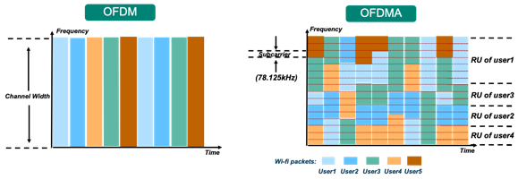
Orthogonal Frequency Division Multiple Access
OFDM: split channel into subcarriers and transmit on those
OFDMA: allocate subcarriers to a device for an amount of time
Turns OFDM into an access control mechanism
Complicated question: which device gets which subcarriers at which time?

Slide 38
OFDM vs OFDMA Orthogonal Frequency Division Multiplexing vs. Orthogonal Frequency Division Multiple Access
Net spectrum usage ~the same
In same time slot, assign sub-carriers to different users
Effect: Lower bandwidth per user, but more simultaneous users
This is the same strategy cellular “resource blocks” use
Called “Resource Units” in WiFi

Slide 39
802.11ax (2021)
Standard approved on February 9th 2021
First devices started supporting it in 2019 (WiFi 6)
6 GHz band (WiFi 6E)
1.2 GHz of bandwidth (5.925-7.125 GHz)
2020: US FCC made band available for unlicensed use!!!
EU followed by June 2021
OFDMA
MAC scheduling variant of OFDM
AP schedules devices based on time and subcarrier allocations

Slide 40
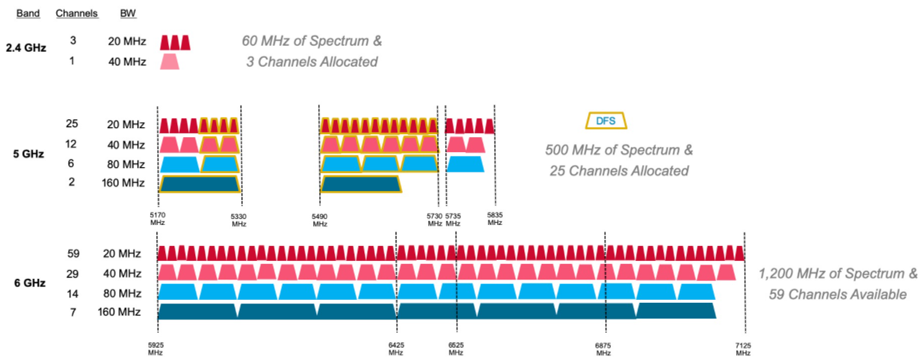
6 GHz band is an enormous amount of bandwidth

Slide 41
Less bandwidth in the 6 GHz band in Europe

Slide 42
WiFi 6 Hardware
Two varieties:
WiFi 6
Most of the features, but NOT the new frequencies
WiFi 6E
Includes the extra 6 GHz channels
Basically entirely unused as of 2023
WiFi 6E is the stuff you want for future proofing

Slide 43
What’s coming next: 802.11.be
Still in flux, “WiFi 7” aka “Extremely High Throughput” (EHT)
Adds…
More channel bonding / wider bandwidth: up to 320 MHz
Up to 4096-QAM
Up to 16-stream MIMO
AP coordination for non-enterprise networks
Lots of fancy timing estimation stuff (802.1Q)
Primary focus seems to be AV-streaming Quality-of-Service (QoS)

Slide 44
Outline
WiFi Overview
WiFi PHY
WiFi MAC and Packets
802.11 Access Control
802.11 Frame format
802.11e Improvements to MAC
IoT + WiFi

Slide 45
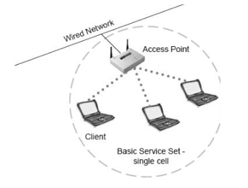
Basic WiFi network
Star topology network
Basic Service Set (BSS)
Access point(s)
Multiple connected clients
Service Set ID (SSID)
Identifies network
Broadcast by access point in beacons

Slide 46
WiFi superframe structure
Beacon followed by contention-free period followed by contention
Repeats periodically (default ~100 ms)
802.15.4 adopted a similar superframe
This is more hypothetical than real

Slide 47
WiFi superframe in practice
Continuous contention access period
Any device may send at any time
PCF is unused in practice
Periodic beacons
Which also use CSMA and therefore may be delayed
Contention
Based Access
Delayed Beacon
Beacon
Time

Slide 48
802.11 beacons
Transmitted periodically (~100 ms by default)
Enable discovery of network
Contain capabilities and SSID for the network (802.11b/g/n/ac/ax…)
Assign contention-free slots if used
Notify devices of waiting packets
Traffic Indication Map (TIM) has a bitmap specifying which devices data is for
Enables devices to sleep, skipping a number of beacons
Handles broadcast/multicast messages
Every N beacons includes a notation of available broadcast messages
Messages are transmitted during next contention access period using normal CSMA
Defines maximum sleep period for devices (must listen to these beacons)

Slide 49
Contention-free access
Known as Point Coordination Function (PCF)
Allocates a contention-free period for specific devices
Access Point decides when to grant based on requests
Drawbacks
Latency depends on beacon intervals
Mechanism for explicit Quality of Service is unclear
PCF is not used in practice

Slide 50
Contention-based access
Known as Distributed Coordination Function (DCF)
Base communication method for WiFi (essentially always)
All packets are immediately ACK’d by receiving device
Uses CSMA/CA to determine when it can send
With random backoff
Problem: packets can be very long (up to 20 milliseconds)
Solution: Network Allocation Vector (NAV)
Packets include a notation of their duration
Sensing the beginning of a packet allows backoff to skip the whole packet duration before continuing

Slide 51
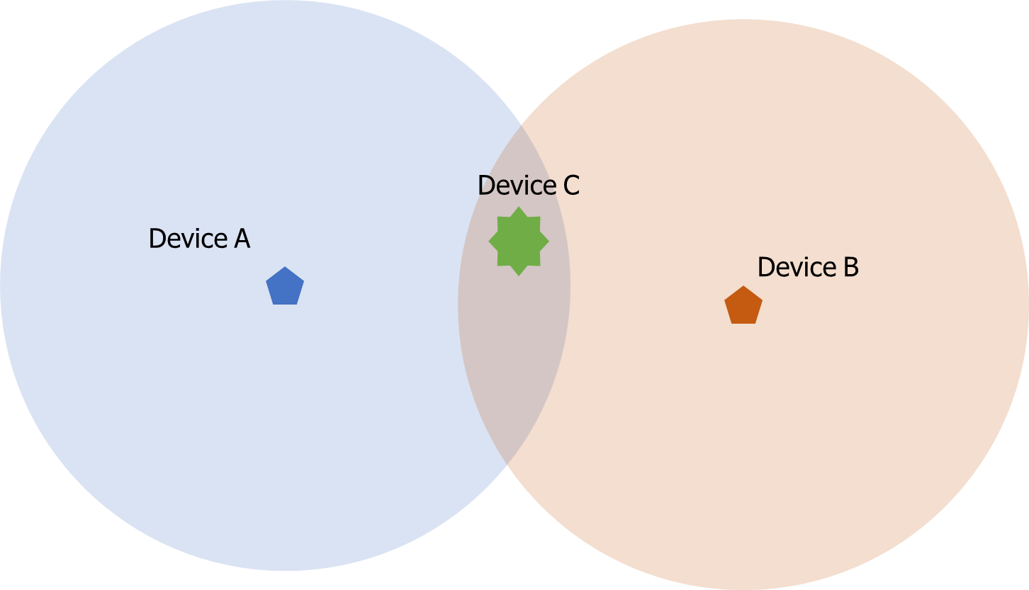
Reminder: hidden terminal problem
Two devices communicating with Access Point may not be able to hear each other
CSMA fails and Access Point losses both messages
A solution: RTS/CTS (Request/Clear To Send)

Slide 52
Drawbacks of RTS/CTS
Four packets per data (RTS, CTS, Data, Ack)
Could have just sent data instead of RTS
Significant portion of traffic are application-layer Acks
Probably better to just have it fail and try again later
RTS/CTS only used for very large packets in practice
*It’s mentioned still in 802.11n and 802.11ac, so not entirely unused

Slide 53
Backoff in WiFi
Listen for activity
If free
Wait for Inter Frame Spacing (IFS)
If still free, transmit
If busy
Randomly select a number of backoff Slots
Count down slots whenever medium is not busy
If busy when backoff completes:
Increase maximum backoff Slots
Repeat
Slot time: basic time unit for protocol
Total time of: switch from Rx to Tx, plus processing time, plus propagation delay

Slide 54
Prioritizing packets with varying IFS
Tiered Contention Multiple Access (TCMA)
Idea: assign different inter-frame spacing based on traffic class
Inherently prioritizes communication
Acknowledgements sent with Short IFS (SIFS)
Will always transmit before new data clears CSMA check
New data sent with DCF IFS (DIFS)

Slide 55
Putting backoff together
Two variables
Contention Window (CW) – maximum backoff amount
Backoff Count (BO) – current remaining backoff
When attempting to send, if busy Backoff selected in [0, CW]
Countdown Backoff slots whenever medium is not busy
At 0, attempt to transmit if not busy
If busy, double Window and select Backoff again
802.11g values:
Slot time= 20 us, CWmin= 15 slots (300 us), CWmax= 1023 slots (20 ms)
SIFS= 10 us, DIFS= 50 us

Slide 56
802.11 backoff example
A and B want to send and see the medium is busy
Followed by an Acknowledgement after SIFS
Other Traffic
ACK
SIFS
DIFS
A
Arrival A
B
Arrival B
C

Slide 57
802.11 backoff example
Each chooses a random backoff [0, CW] (we’ll say CW is 32)
Start counting down backoff slots
Other Traffic
ACK
SIFS
DIFS
A
Arrival A
Backoff = 10
B
Arrival B
Backoff = 8
C

Slide 58
802.11 backoff example
C wants to send, waits DIFS, and can send immediately
No other traffic is going on
A and B pause backoff for packet duration
Other Traffic
ACK
C Traffic
SIFS
DIFS
DIFS
A
Arrival A
Backoff = 10
B
Arrival B
Backoff = 8
C
Arrival C

Slide 59
802.11 backoff example
A and B used NAV to pause backoff for entire traffic plus ACK
After DIFS, resume backoff count from its previous value
Other Traffic
ACK
C Traffic
ACK
SIFS
DIFS
DIFS
SIFS
DIFS
A
Arrival A
Backoff = 10
Backoff = 6
B
Arrival B
Backoff = 8
Backoff = 4
C
Arrival C

Slide 60
802.11 backoff example
B reaches zero backoff, finds channel empty, transmits
A pauses its backoff again for duration plus ACK
Other Traffic
ACK
C Traffic
ACK
B Traffic
SIFS
DIFS
DIFS
SIFS
DIFS
A
Arrival A
Backoff = 10
Backoff = 6
B
Arrival B
Backoff = 8
Backoff = 4
C
Arrival C

Slide 61
Outline
WiFi Overview
WiFi PHY
WiFi MAC and Packets
IoT + WiFi

Slide 62
Why, why not, talk WiFi in a wireless for IoT class
Pros
Ubiquitous
High-performance
Cons
Complex configuration
And security requirements
Device-Northwestern anyone?
Expensive in energy and money

Slide 63
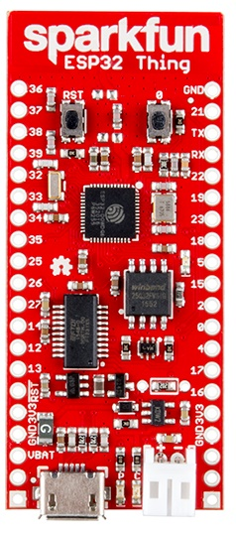
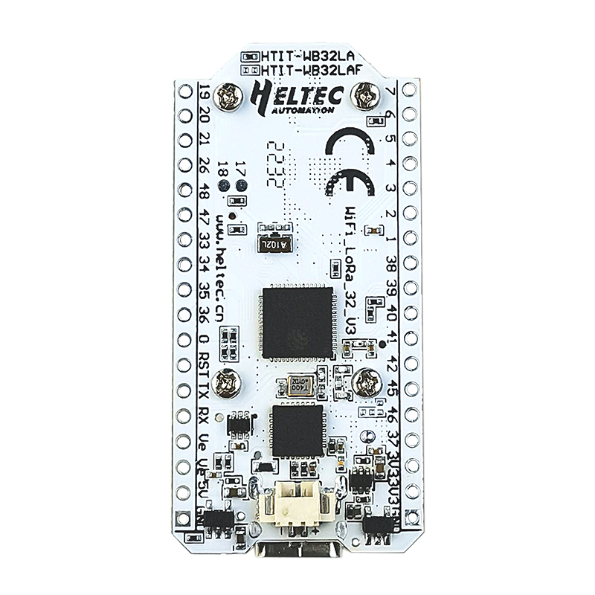
WiFi capability in microcontrollers
ESP32
Microcontroller plus WiFi radio in single chip
(Same idea as nRF52840)
Capabilities
802.11b/g/n 2.4 GHz only
20 MHz or 40 MHz channels
Single antenna only (no MIMO)
MCS0-7
7 Mbps – 150 Mbps
Tx power up to 20.5 dBm

Slide 64
Low power WiFi
Question: should a microcontroller stay connected or reconnect?
Light sleep: stay connected always, only listening to beacons
Deep sleep: reconnect to network each time data is ready
Answer for ESP32 depends on security and data interval
Resecuring during connection takes lots of energy
Crossover point is about 60 seconds
Insecure transmissions have a crossover of 5-15 seconds
https://blog.voneicken.com/2018/lp-wifi-esp-comparison/#conclusions

Slide 65
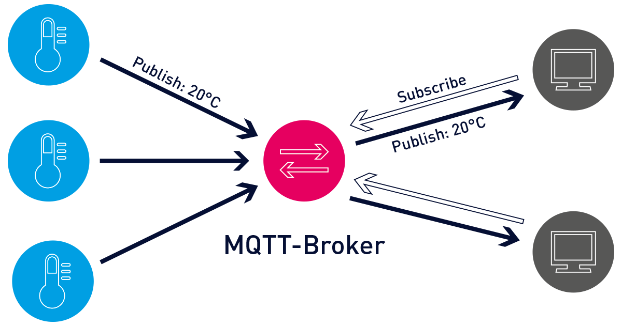
Bonus: MQTT – answer to the “where do you send data” question

Slide 66
Outline
WiFi Overview
WiFi PHY
WiFi MAC and Packets
IoT + WiFi

Slide 67
Outline
WiFi Overview
WiFi PHY
WiFi MAC and Packets
802.11 Access Control
802.11 Frame format
802.11e Improvements to MAC
IoT + WiFi

Slide 68
802.11 frame
Frame control (various bits)
Type of packet (Control, Management, Data)
Subtype (Association, RTS, CTS, Ack, etc.)
Indication of to/from “distribution system” (Internet rather than intranet)
Duration
Specifies on-air time of full packet in microseconds
Note: no actual length field 😱
Surprising, but smart!
Recall modulation schemes vary — but everyone needs to be able to parse header (for duration, for NAV)
Length can be very large (e.g. in ac: 5.5 ms max duration is 4.5 MB length!); sent at full data rate

Slide 69
802.11 frame
Sequence control
4-bit fragment number
12-bit sequence number
Quality of Service control
Identifies traffic category
High Throughput Control
Configurations for selecting best data rate
Frame body
Max size depends on PHY
~2000 for lower rates
~8000 for 802.11n
~11000 for 802.11ac
Frame check sequence
32-bit CRC

Slide 70
Address field use cases
Source
AP
2
Repeater
2
Destination
Devices filter on Address 1
 | To DS | From DS | Address 1 | Address 2 | Address3 | Address4 | Use Case
1 | 0 | 0 | Destination Addr | Source Addr | BSS ID | - | Direct communication
2 | 0 | 1 | Destination Addr | BSS ID | Source Addr | - | Traffic from Internet
3 | 1 | 0 | BSS ID | Source Addr | Destination Addr | - | Traffic to Internet
4 | 1 | 1 | Receiver Addr | Transmitter Addr | Destination Addr | Source Addr | Repeater

Slide 71
Address field use cases
3
Source
3
AP
Repeater
Destination
Devices filter on Address 1
 | To DS | From DS | Address 1 | Address 2 | Address3 | Address4 | Use Case
1 | 0 | 0 | Destination Addr | Source Addr | BSS ID | - | Direct communication
2 | 0 | 1 | Destination Addr | BSS ID | Source Addr | - | Traffic from Internet
3 | 1 | 0 | BSS ID | Source Addr | Destination Addr | - | Traffic to Internet
4 | 1 | 1 | Receiver Addr | Transmitter Addr | Destination Addr | Source Addr | Repeater

Slide 72
Address field use cases
Source
AP
1
Repeater
Destination
Devices filter on Address 1
 | To DS | From DS | Address 1 | Address 2 | Address3 | Address4 | Use Case
1 | 0 | 0 | Destination Addr | Source Addr | BSS ID | - | Direct communication
2 | 0 | 1 | Destination Addr | BSS ID | Source Addr | - | Traffic from Internet
3 | 1 | 0 | BSS ID | Source Addr | Destination Addr | - | Traffic to Internet
4 | 1 | 1 | Receiver Addr | Transmitter Addr | Destination Addr | Source Addr | Repeater

Slide 73
Address field use cases
Source
4
AP
Repeater
4
Destination
Devices filter on Address 1
 | To DS | From DS | Address 1 | Address 2 | Address3 | Address4 | Use Case
1 | 0 | 0 | Destination Addr | Source Addr | BSS ID | - | Direct communication
2 | 0 | 1 | Destination Addr | BSS ID | Source Addr | - | Traffic from Internet
3 | 1 | 0 | BSS ID | Source Addr | Destination Addr | - | Traffic to Internet
4 | 1 | 1 | Receiver Addr | Transmitter Addr | Destination Addr | Source Addr | Repeater

Slide 74
Sending frames in WiFi
Frame bursting
Transmit multiple frames in a row
Frame fragmentation
Split service data over multiple frames
Frame aggregation
Multiple service data in a single frame
Allows multiple packets to reach Access Point in a single transmission

Slide 75
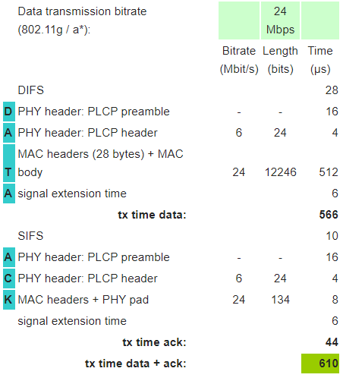
Calculating packet durations
Example duration for a 1500 byte 802.11g packet
6 Mbps for header
24 Mbps for payload
566 μs for total packet
Plus 10 μs for SIFS
Plus 34 μs for ACK
https://sarwiki.informatik.hu-berlin.de/Packet_transmission_time_in_802.11

Slide 76
Implementation Drives Specification Sometimes
SIFS nominally defined by processing time
Aside: Big challenge for SDRs
Convolutional decoders need(ed) 16 µs to finish processing
For highest-rate MCS (ERP-OFDM)
SIFS is 10 μs, so extension needed
Processing must finish before next packet starts
To be able to decode NAV in header
Notes:
https://www.electronics-notes.com/articles/connectivity/wifi-ieee-802-11/802-11g.php

Slide 77
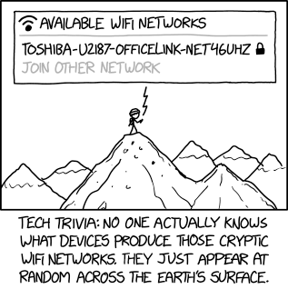
Break + xkcd
https://xkcd.com/2199/

Slide 78
Outline
WiFi Overview
WiFi PHY
WiFi MAC and Packets
802.11 Access Control
802.11 Frame format
802.11e Improvements to MAC
IoT + WiFi

Slide 79
802.11e improves MAC layer
Hybrid Coordination Function (HCF)
Modifies contention-free access (still no one uses it)
Modifies contention-based access: Enhanced Distributed Channel Access (EDCA)
Modifies Quality of Service based on application
Example of breaking layering for an optimization
Categories (lowest to highest priority):
Background
Best Effort
Video
Voice

Slide 80
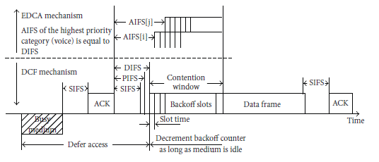
Different priority for different application category
Expand to more IFS lengths for different traffic categories
Smallest AIFS (equal to DIFS) goes to Voice, Largest to Background
Contention Window min and max also change for each category
Selects a probability that most important category goes first

Slide 81
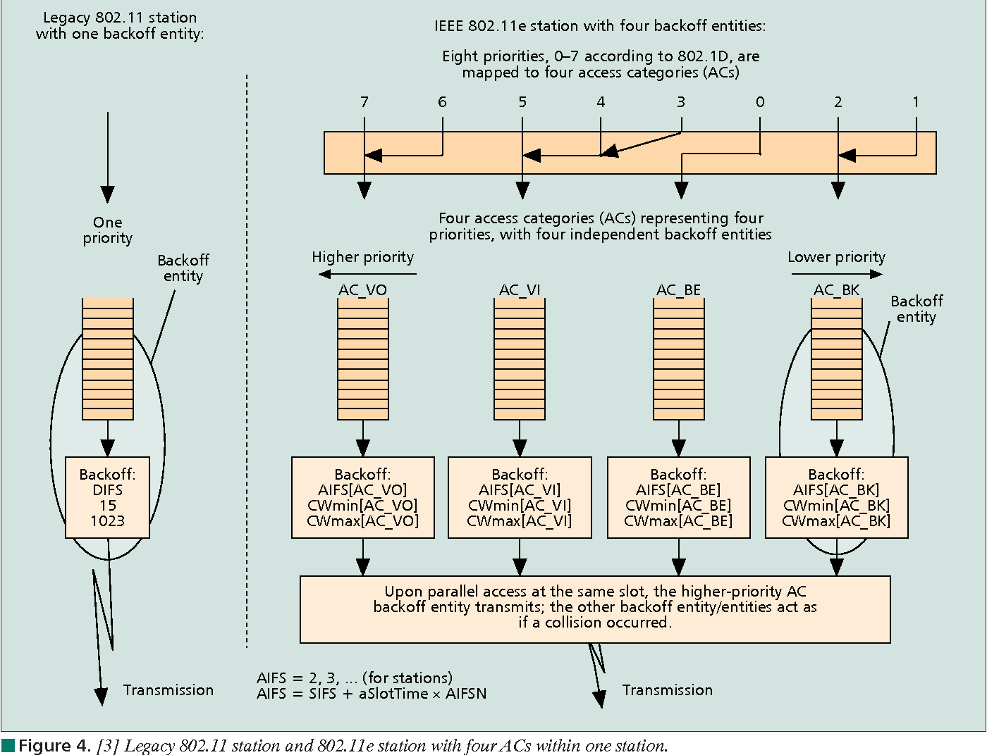
Multiple queues within a single device

Slide 82
802.11e also adds maximum durations
802.11e also defines duration a device can transmit for
Based on PHY in use and Application category
Background/Best Effort: one frame per contention win
Example, up to 11 ms for Voice on 802.11ac
Could be one really big frame at a low data rate
Could be multiple frames in a row separated by SIFS

