Slide 1



From Energy Audits to Monitoring Megawatt Loads:
A Flexible and Deployable Power Metering System
Brad Campbell, Ye-sheng Kuo, Prabal Dutta
IoTDI’18

Slide 2
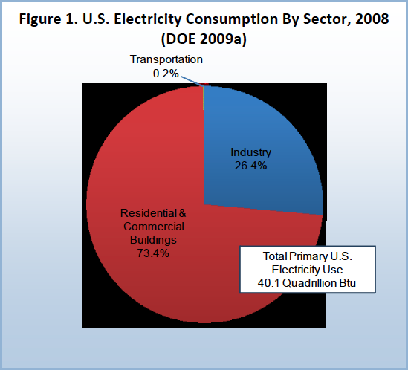

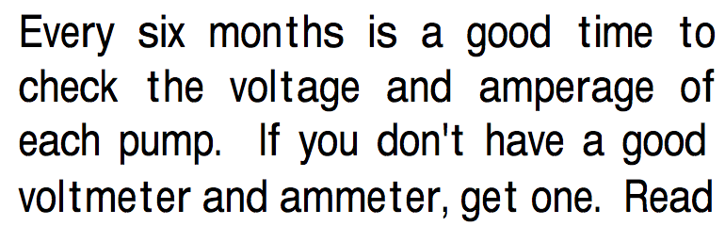
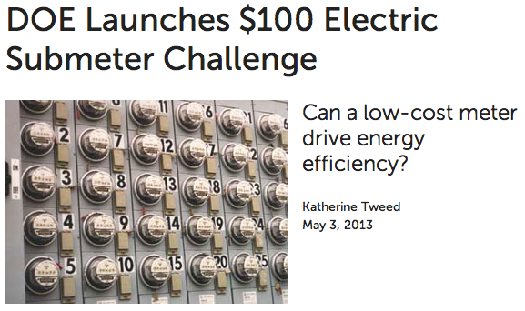
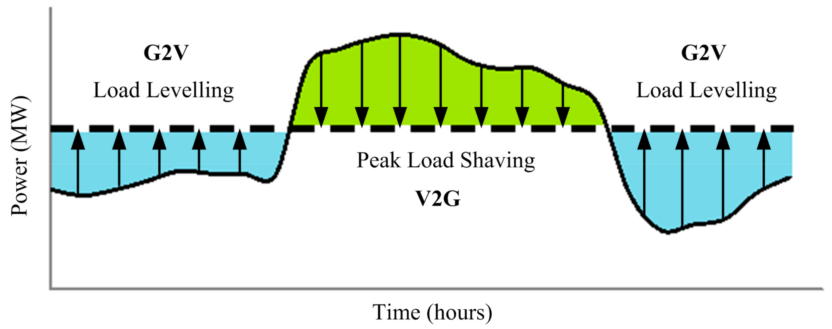
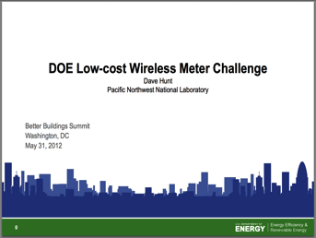

We need submetering!
Buildings
Maintenance
Money Saving
“However, sub-metered energy use data are not available for many buildings, often due to the high cost of metering and gathering data.”
US Department of Energy Building Technologies Office

Slide 3

Does anyone actually want new submeters?
?
System Integrators
Potential Users
“Submetering?
That’s a solved problem.”
“I can’t guarantee a ROI.”
“Continuous monitoring is too expensive.”
“Johnson Controls and Siemens sell solutions.”
“I can’t schedule the downtime.”
“I would love to see how my equipment is performing.”

Slide 4
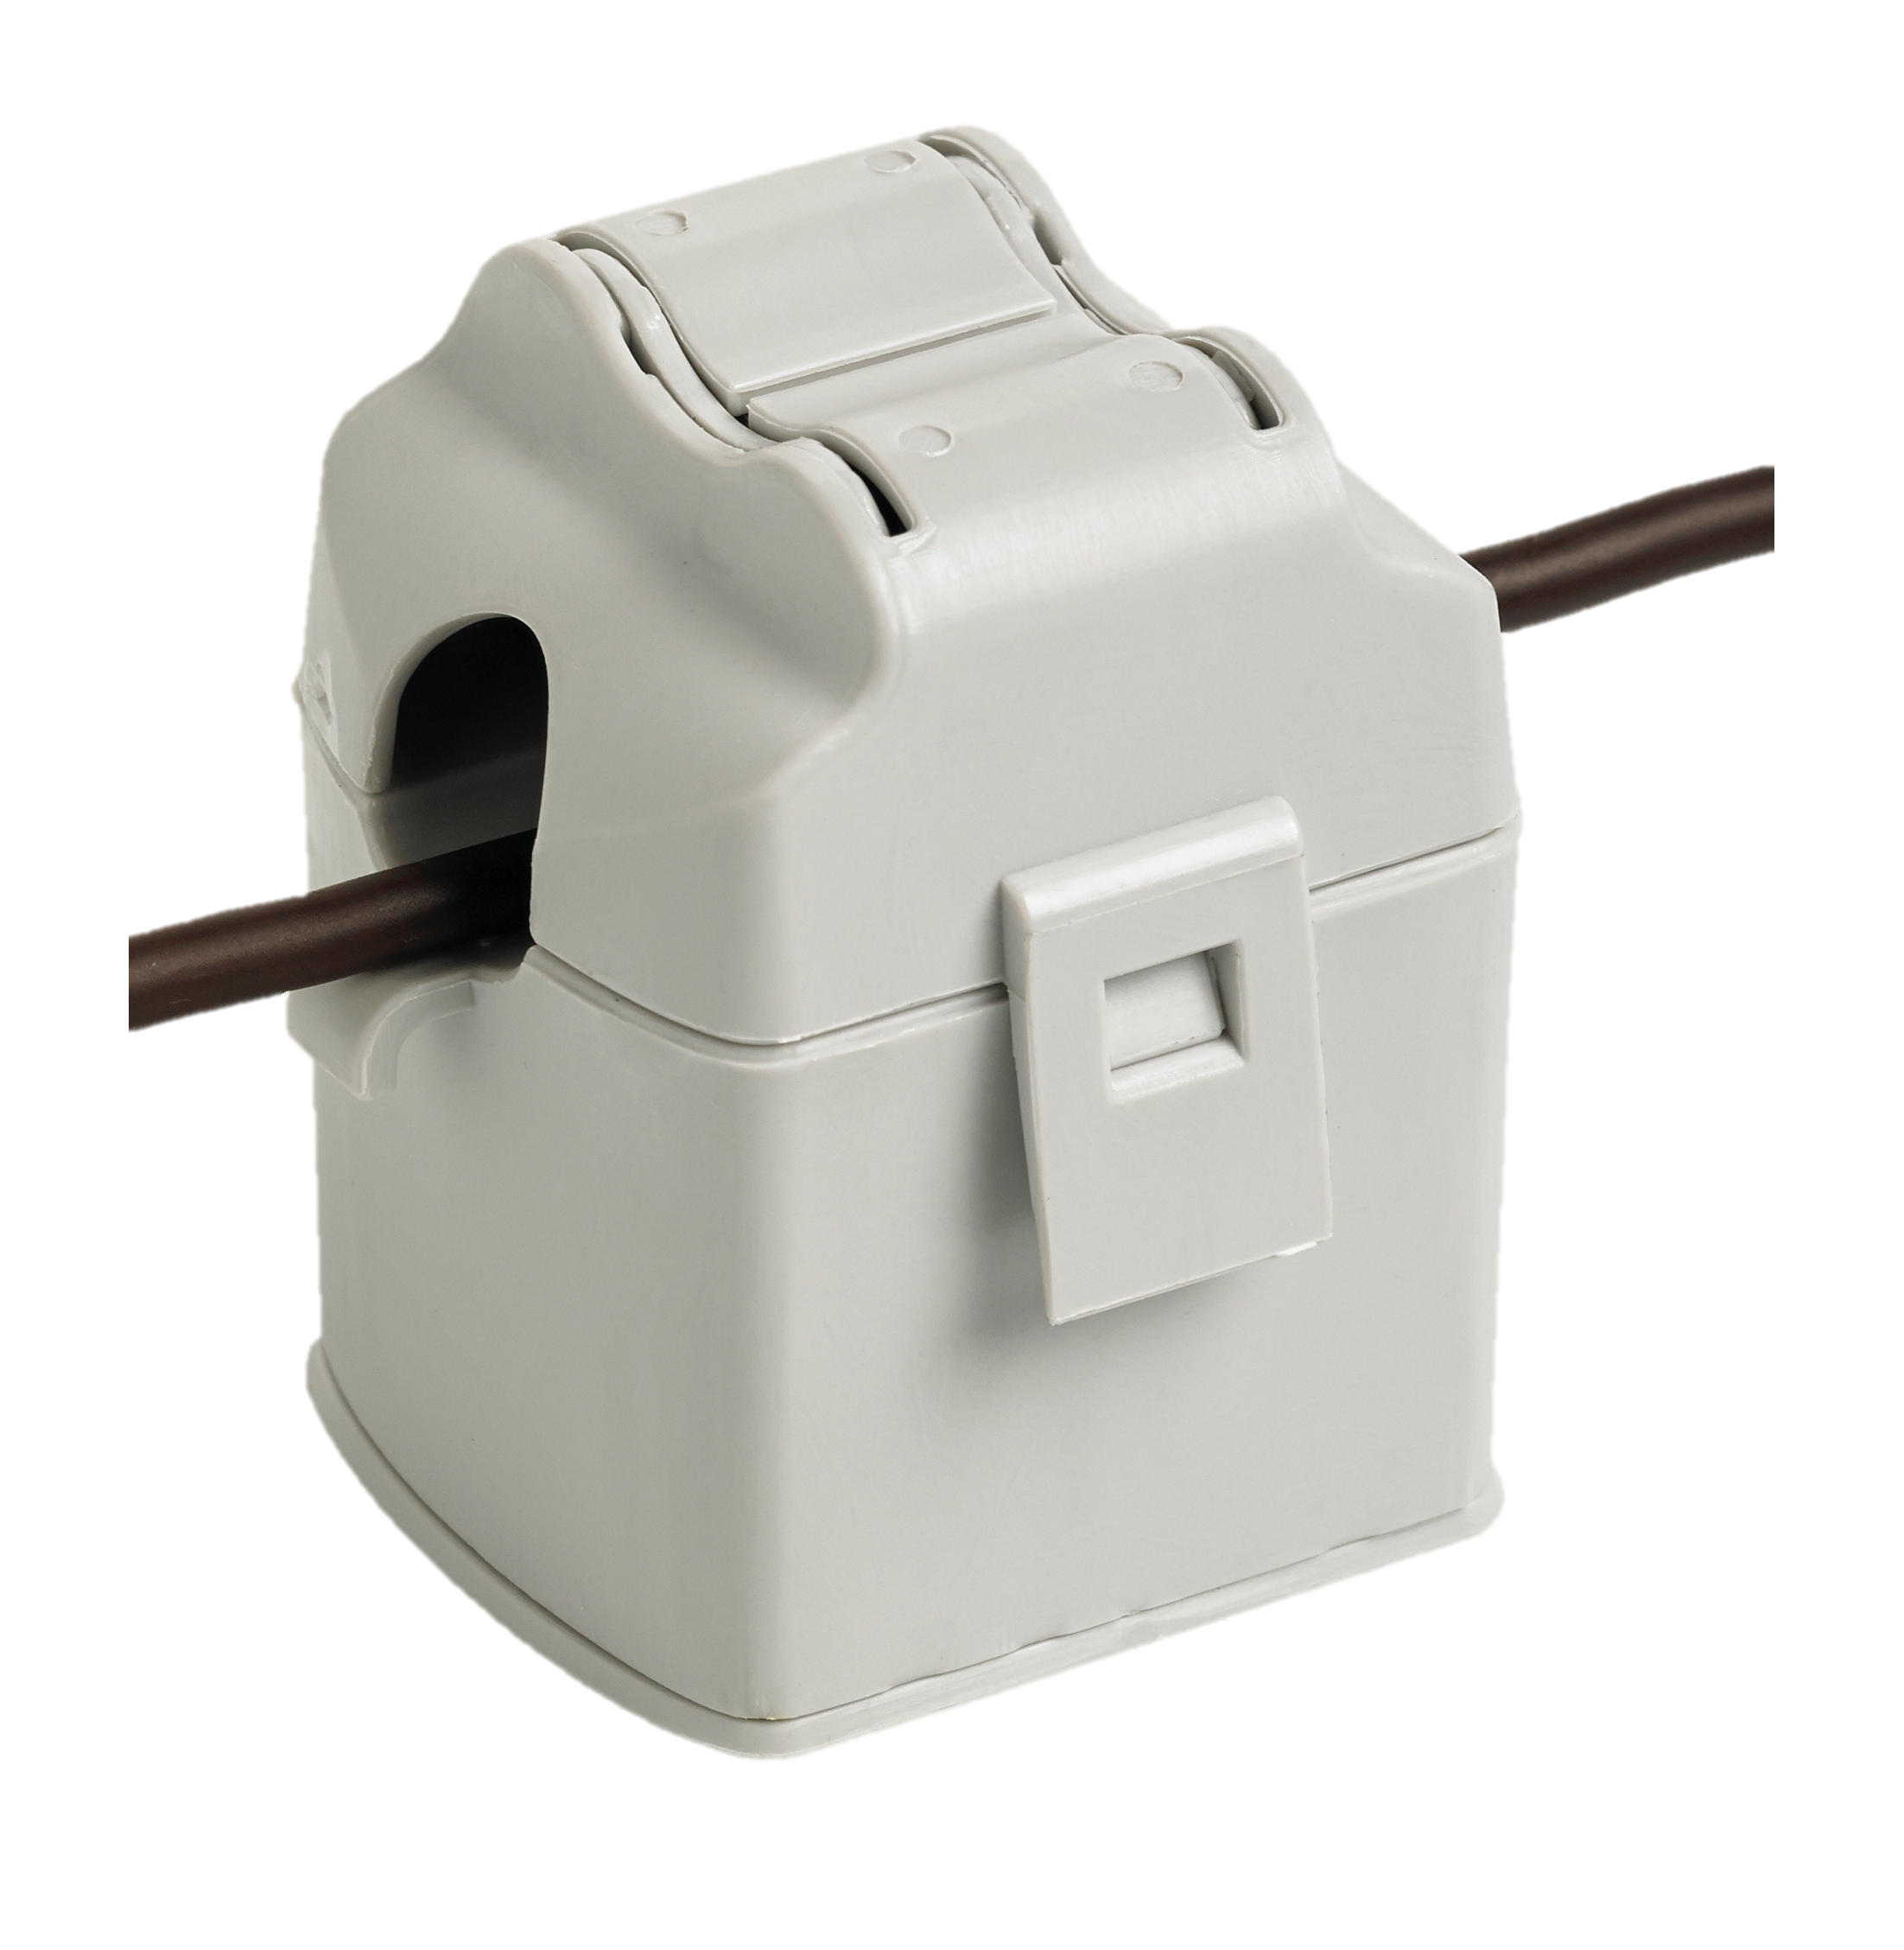
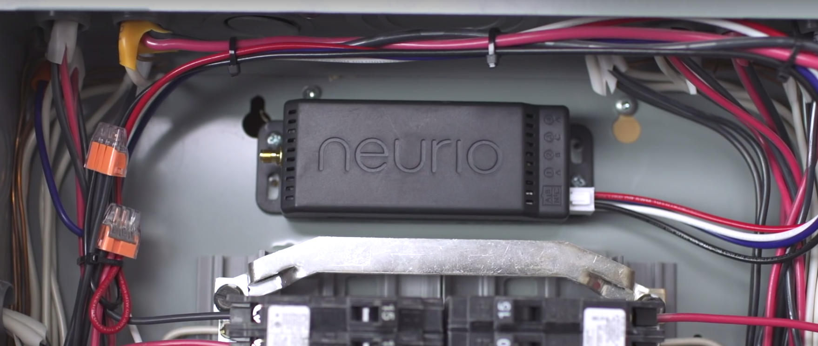
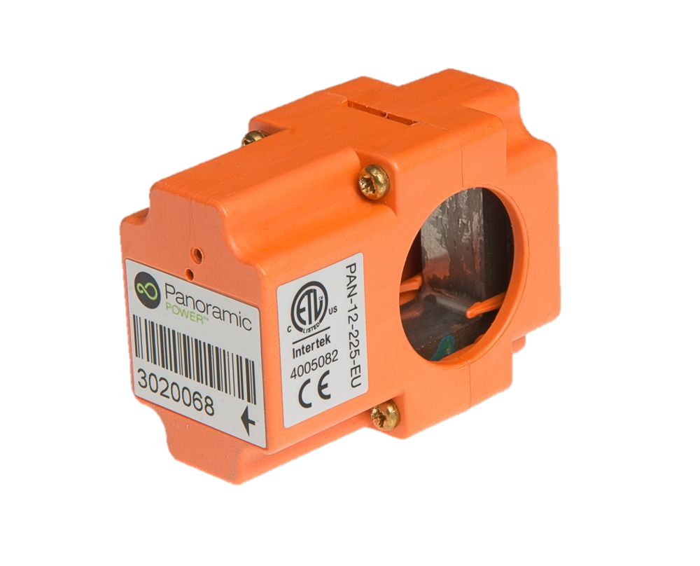
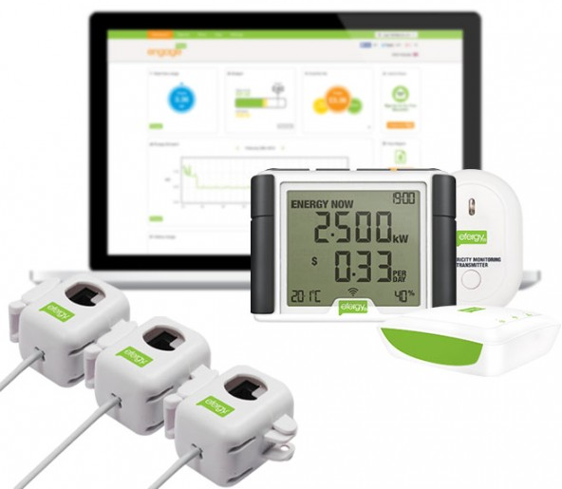
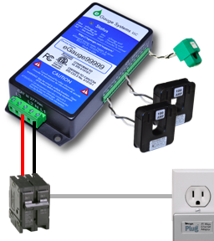
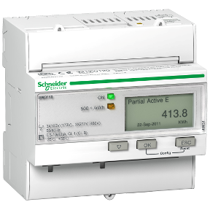
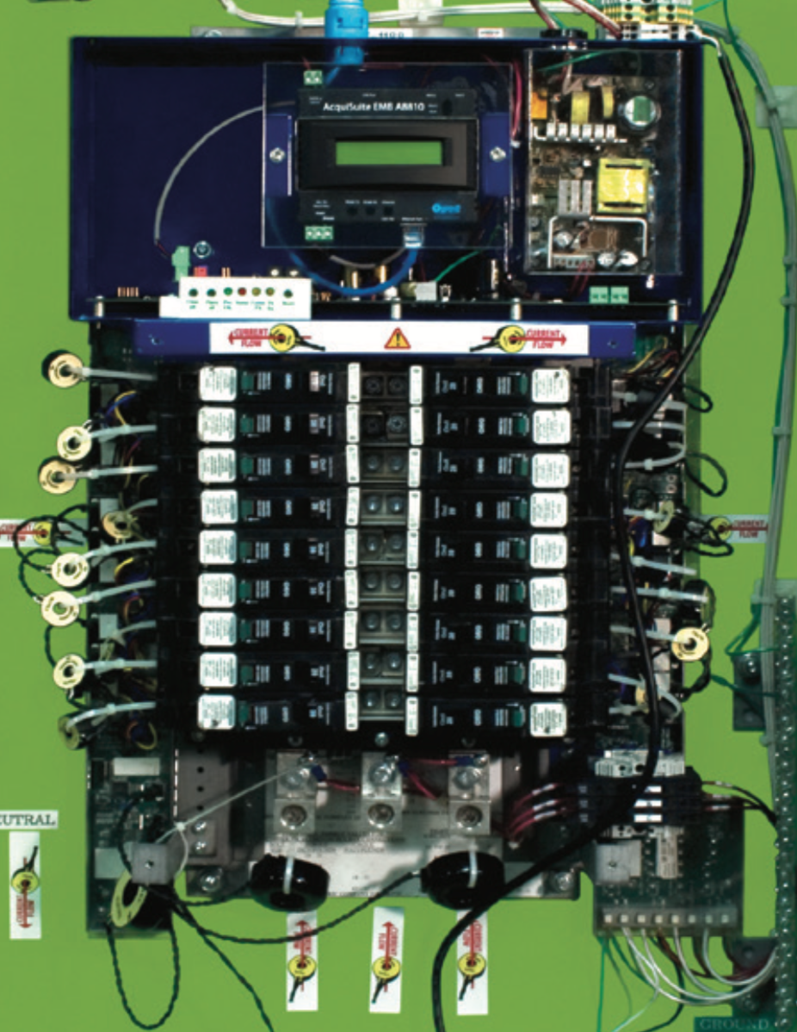
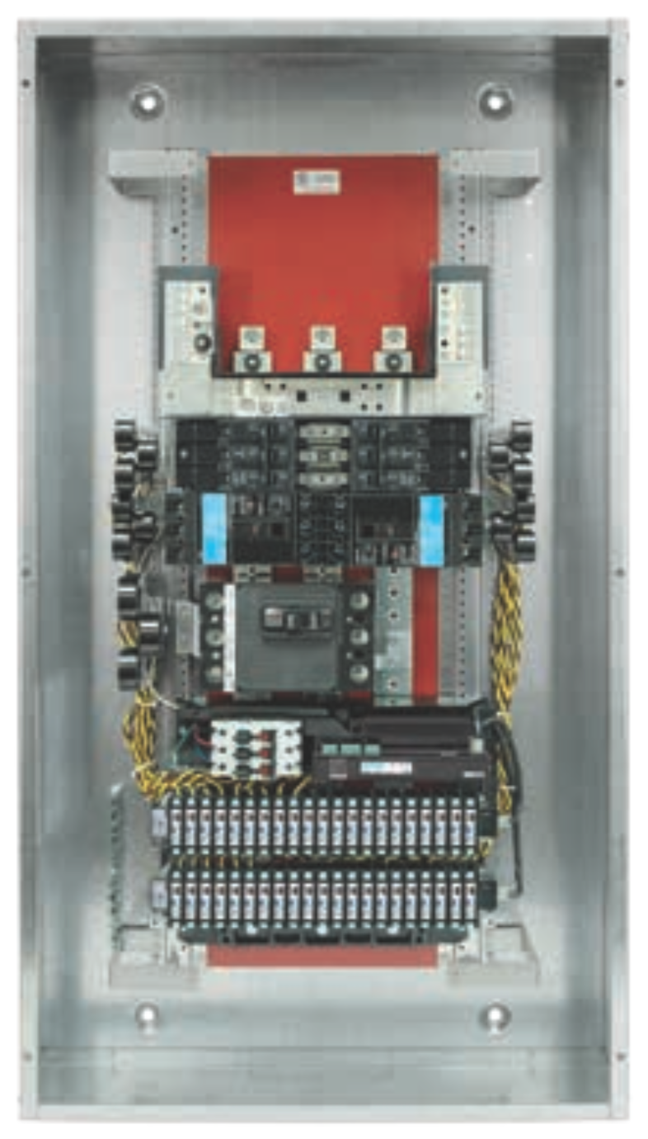
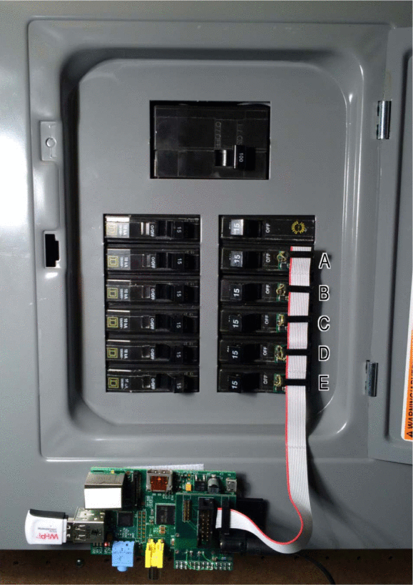
Current submetering options have numerous drawbacks
Meter Cost
Installation Complexity
Accuracy
Connectivity
Limited Use Cases
Calibration

Slide 5
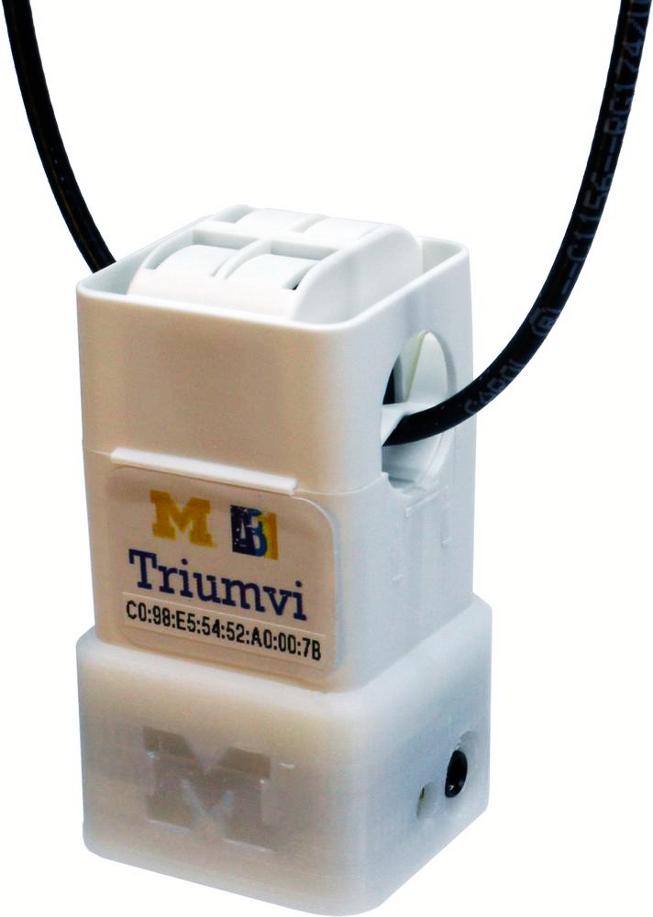
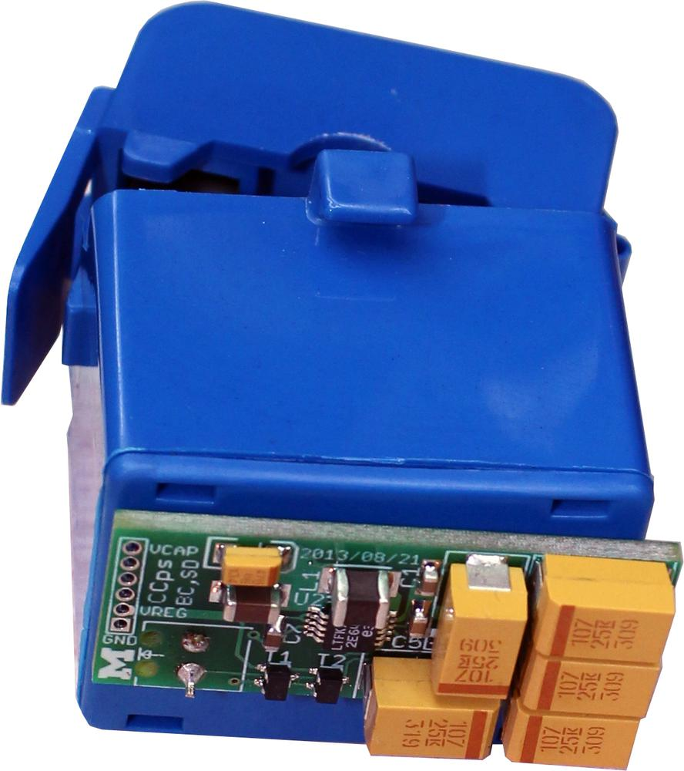
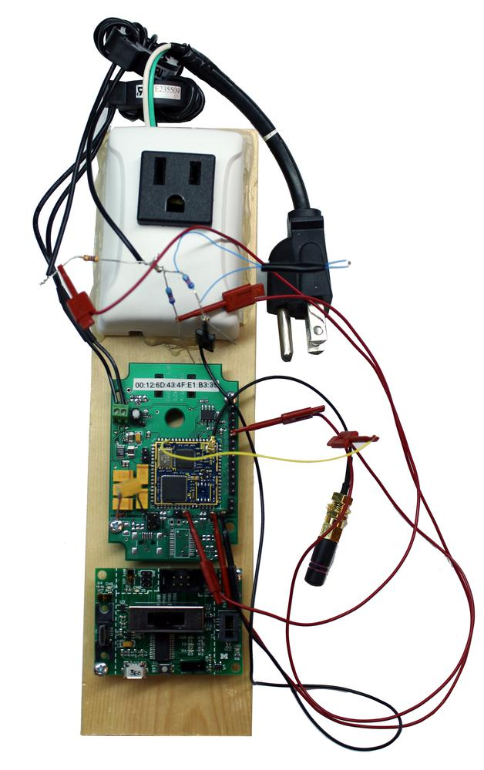
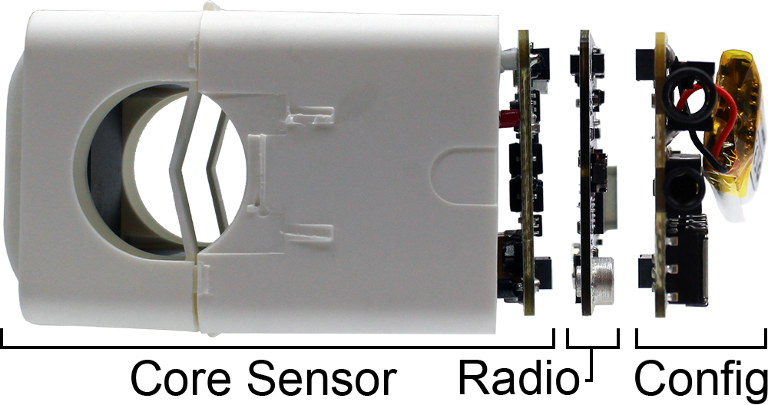
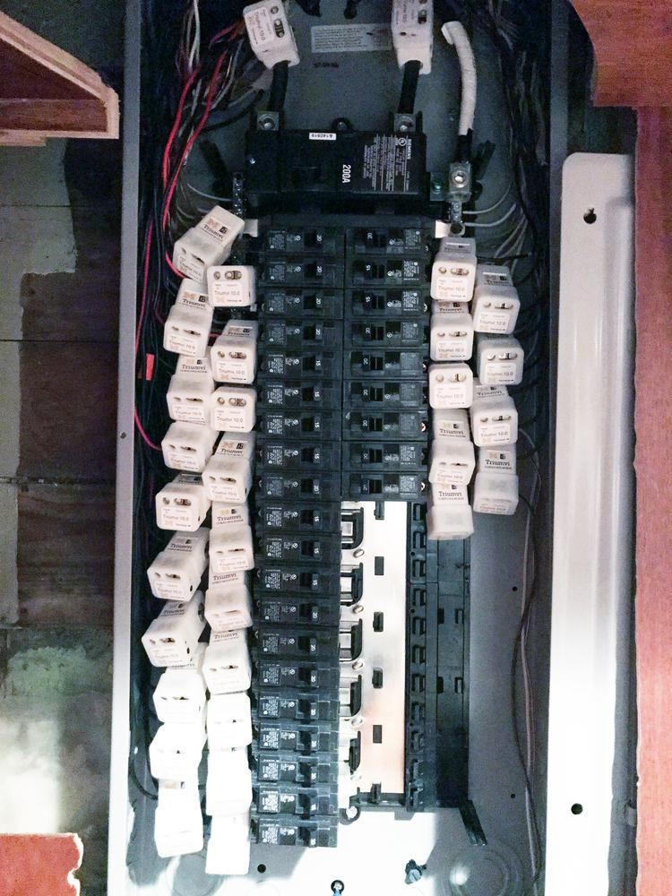
Triumvi integrates several techniques to address these issues
Standalone
Accurate
Monjolo [SenSys’13]
Upgradeable
Scalable
Configurable
Flexible
Gemini [RTSS’14]

Slide 6
Standalone operation requires a power source, the current channel, and the voltage channel
Power Source
Current Channel
Tap into breakers
External outlet
Battery
Energy-harvesting
Hall effect sensor
Additional current transformer
Reuse current transformer
LTC3588
VCC

Slide 7
Sharing the current transformer requires carefully switching between modes

Slide 8
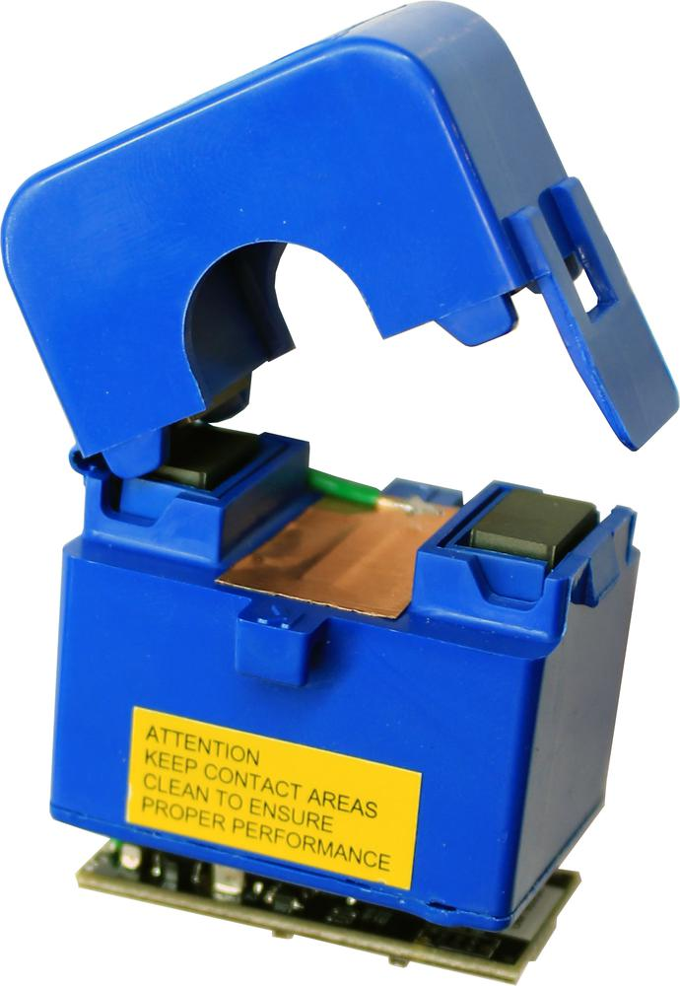
Standalone operation requires a power source, the current channel, and the voltage channel
Power Source
Current Channel
Voltage Channel
Tap into breakers
External outlet
Battery
Energy-harvesting
Hall effect sensor
Additional current transformer
Reuse current transformer
Direct contact
Wireless sync
Capacitive coupling
LTC3588
VCC

Slide 9
Without calibration, detecting voltage phase is accurate
Graph from paper on wire position versus error
Voltage amplitude, however, is not

Slide 10
Access to the voltage channel enables higher accuracy than current-only approaches (PF=0.85)
Graphs from paper on error with loads of differencing power factor
Triumvi without voltage
Voltage uncertainty
Triumvi
Pressac CT
Triumvi

Slide 11
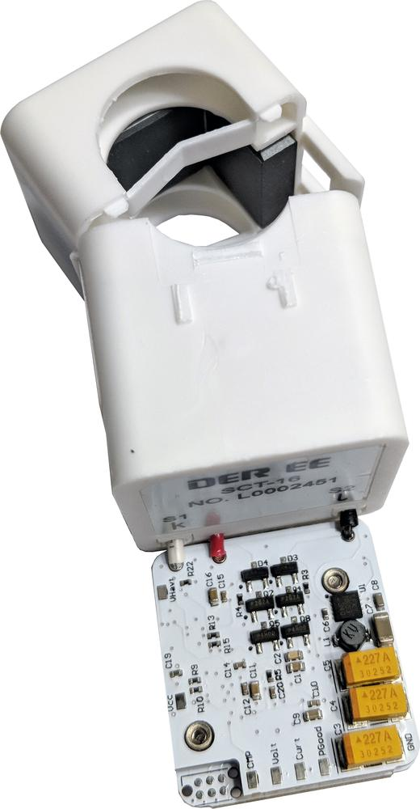
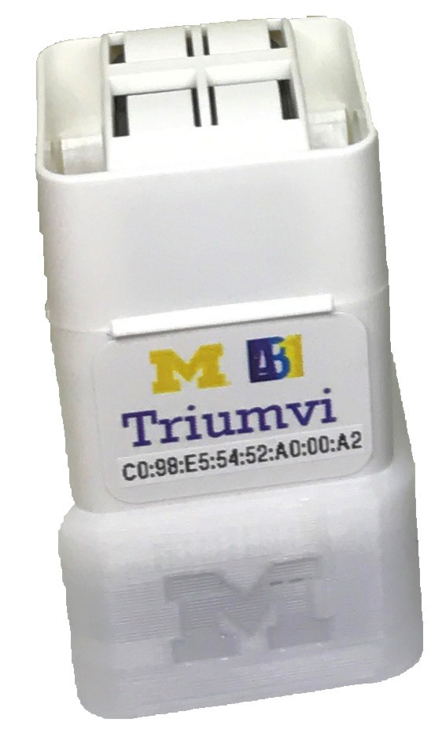
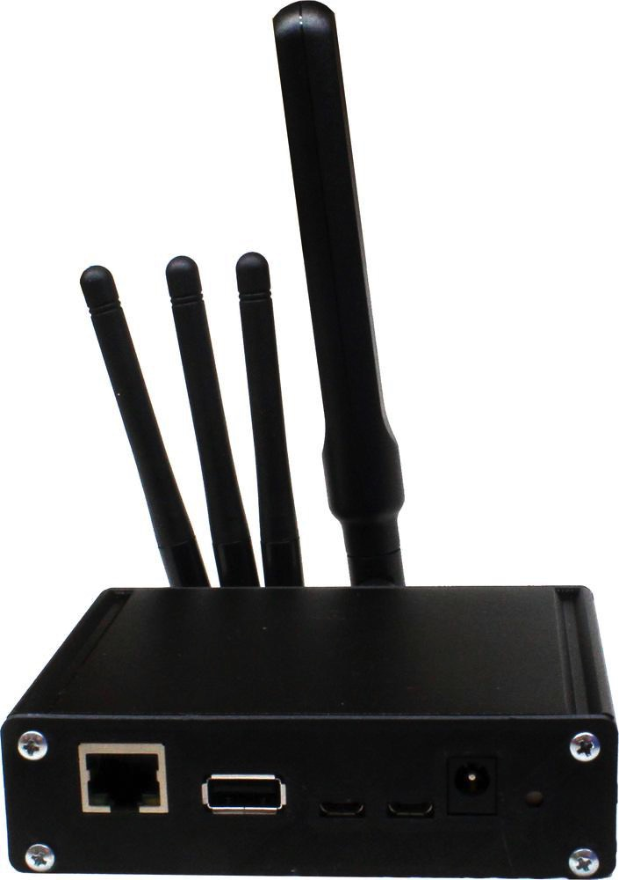
Energy-harvesting + current transformer + capacitive voltage coupling = accurate, standalone energy meter
Some sort of recap slide
802.15.4
Energy-Harvesting
Measurement
Transmission

Slide 12
Triumvi can sense a range of loads accurately (6.2% RMS error)
3 graphs from paper
“Home”
“Office”
Servers

Slide 13
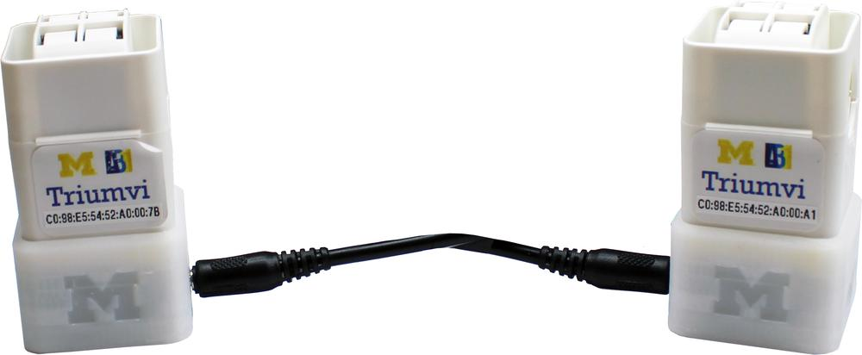
Triumvi nodes can share charge to help “struggling” circuits
600 W
Circuit
60 W
Circuit
And they can synchronize their sampling for three phase loads
Shared bus
1
All nodes sample simultaneously
2
3
Wired NOR

Slide 14
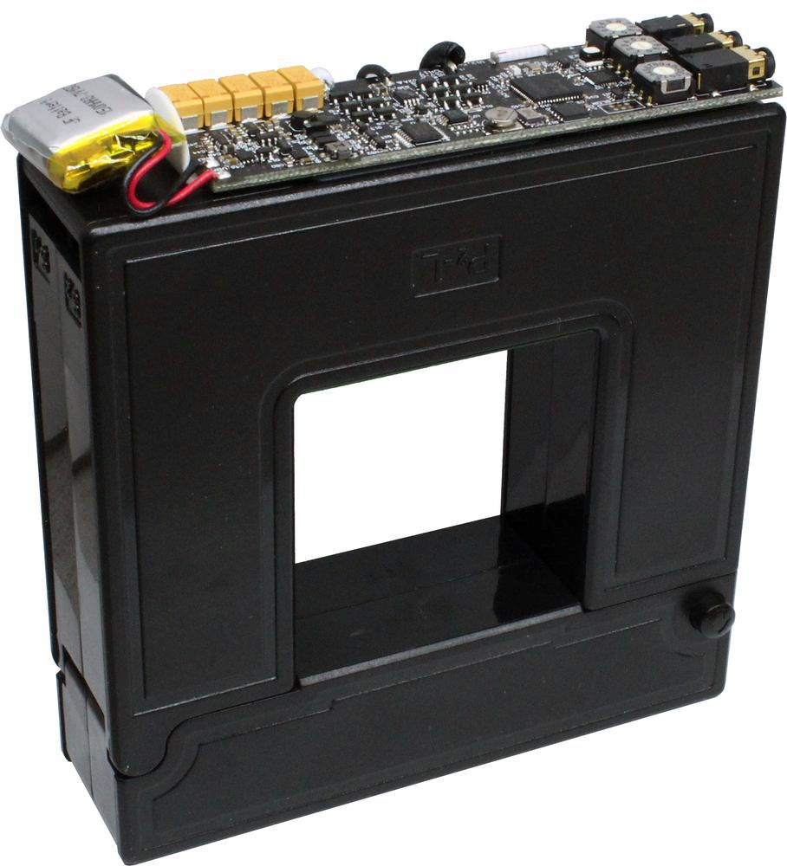
Triumvi can adapt to different deployment scenarios
Current Waveform Analysis
Large Loads
Reported
by Triumvi
Rated for
1000 A
Reliable Sampling
Local Interval Data
DC Power Supply
Time Req
Current Time
Daisy-chained power
RTC
FRAM
Timestamped measurements

Slide 15
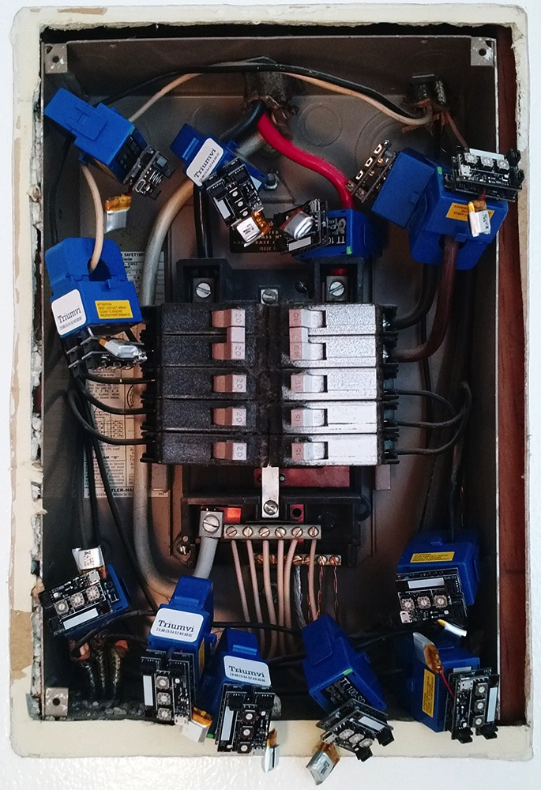
So deploy we did!
Quick “energy audits” in an apartment.
“Deploy on Monday, inspect on Wednesday”

Slide 16
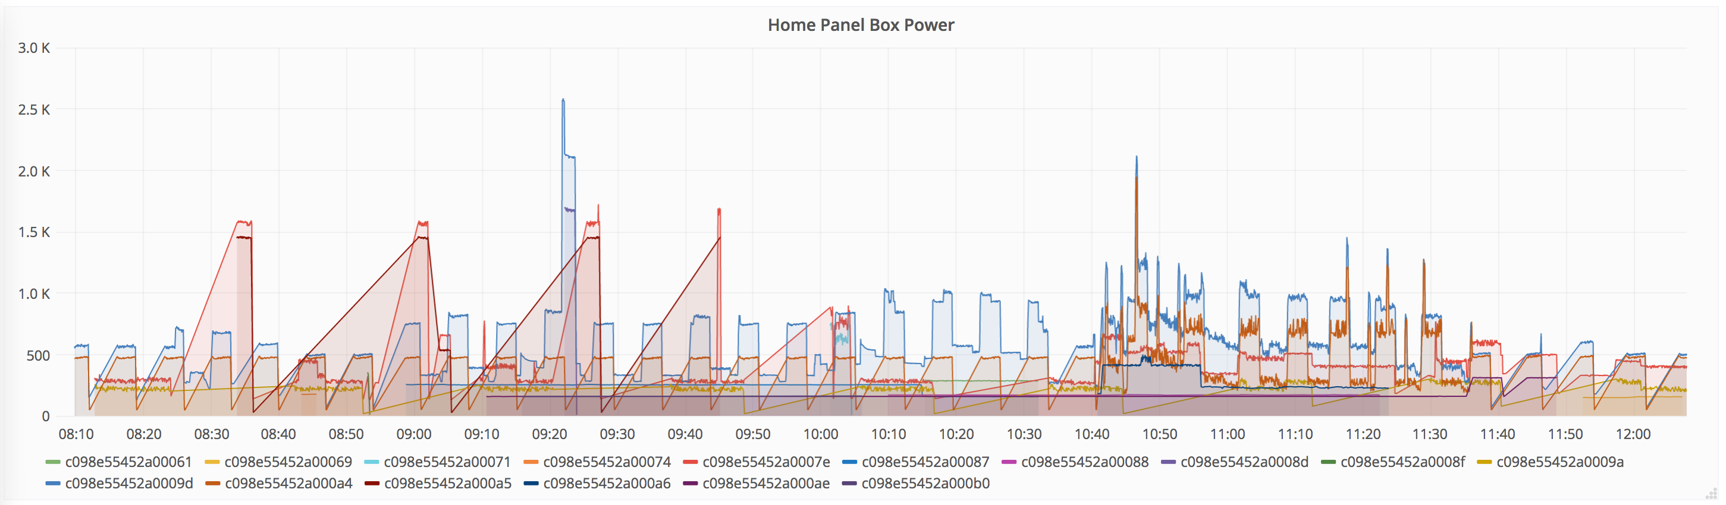
Longer term measurements in a house
1,693,966 measurements in 1 month
One day breakdown

Slide 17
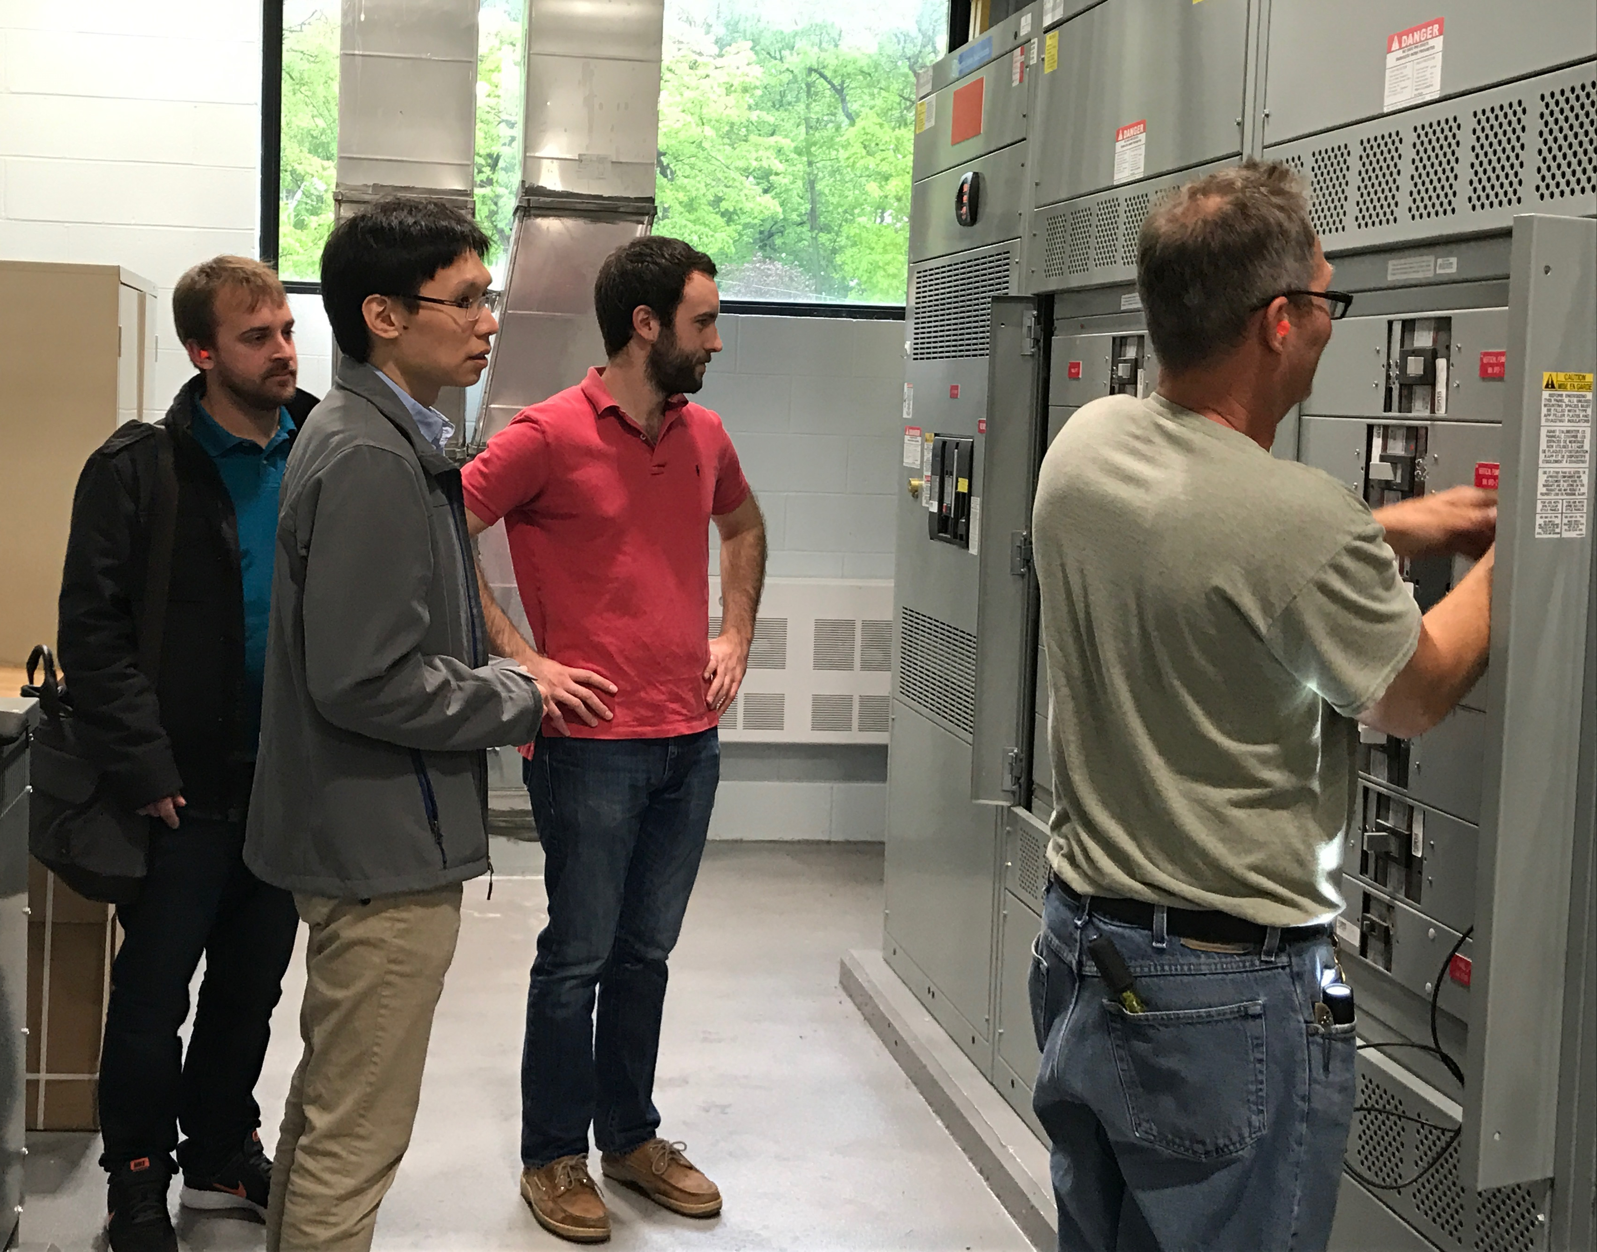
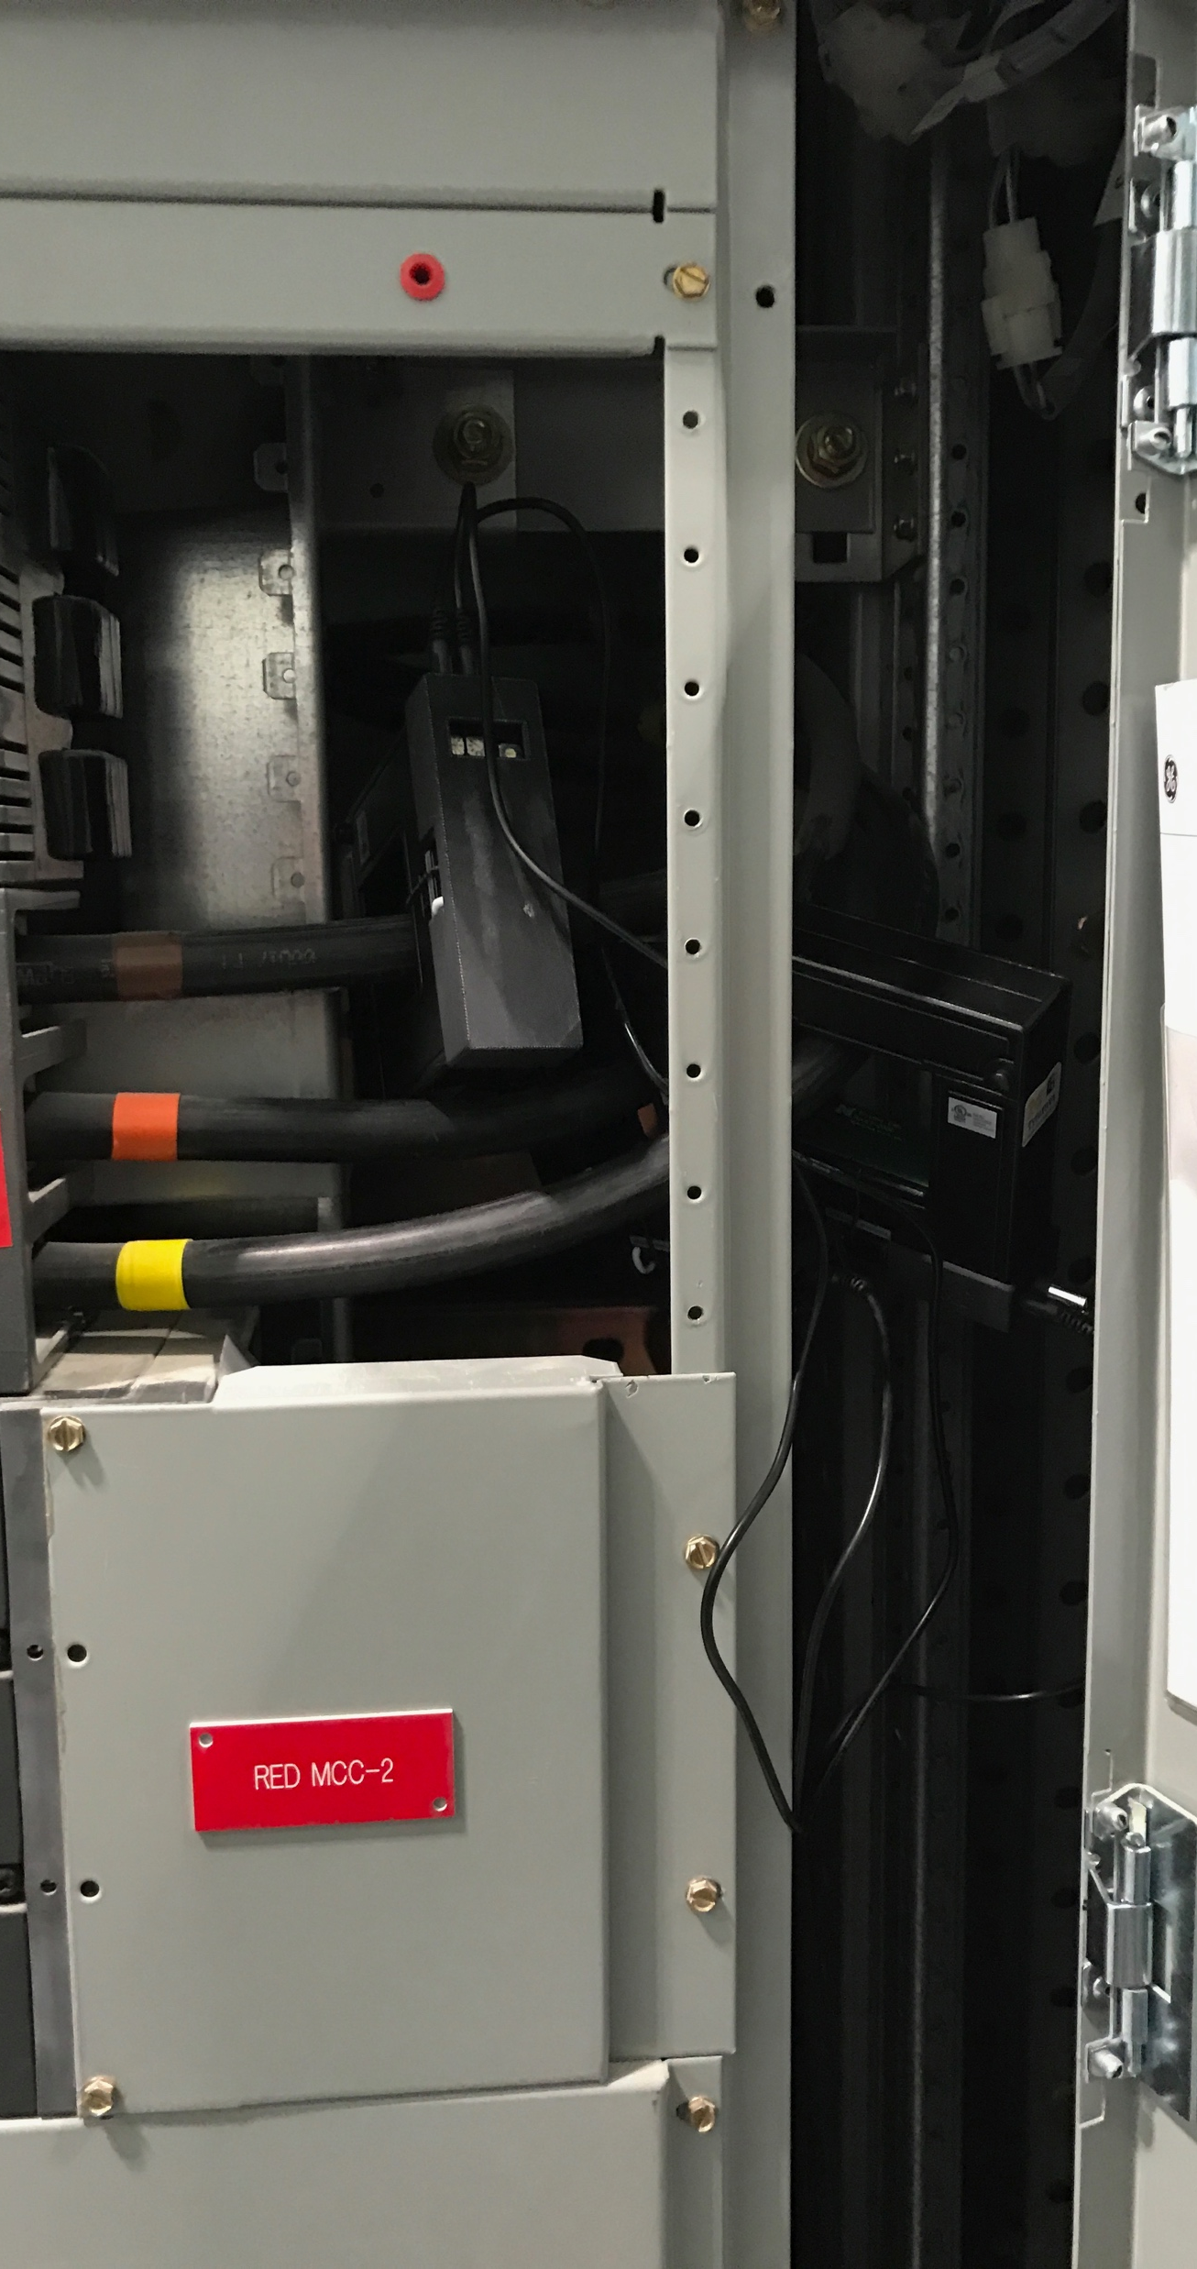
Monitoring large (~50 kW) water pumps
4,046,215 measurements
88.4% of the samples successfully received
Packet interval: 90th percentile is 2.46 seconds
Consecutively dropped packets: 99.9th percentile is five dropped packets

Slide 18
Triumvi: a flexible energy metering platform
Standalone: energy-harvesting +
current sensing + voltage phase sensing
Flexible: multiple operating modes,
large loads, synchronized sampling,
charge sharing
Deployable: supports multiple deployment scenarios
Brad Campbell
bradjc@virginia.edu
@bradjc5

