Slide 1
Lecture 11: Generalizing List Procedures
cs1120 Fall 2009
David Evans
http://www.cs.virginia.edu/cs1120

Slide 2
Menu
Using list-map
PS3
Generalizing List Procedures
I’ll be away next week (no office hours, but I will have email).
Prof. Wes Weimer will lead the classes.

Slide 3
list-map
From last class:
(define (list-map f p)
(if (null? p)
null
(cons (f (car p))
(list-map f (cdr p)))))
Equivalent to the built-in procedure map (except map can work on more than one list).

Slide 4
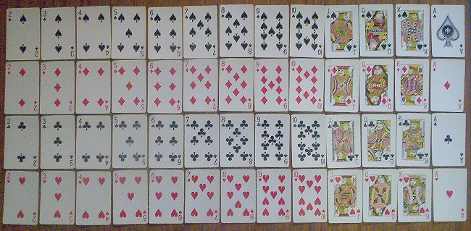
Maps are Useful
(define full-deck
(list-flatten
(list-map
(lambda (rank) (list-map
(lambda (suit) (make-card rank suit))
(list Hearts Diamonds Clubs Spades)))
(list 2 3 4 5 6 7 8 9 10 Jack Queen King Ace))))
From PS2:
Image: http://www.codinghorror.com/blog/archives/001008.html

Slide 5
Maps are Useful
From PS2:
(define (choose-n n lst)
;; operands: a number n and a list (of at least n elements)
;; result: evaluates to a list of all possible was of choosing n elements from lst
(if (= n 0)
(list null)
(if (= (list-length lst) n)
(list lst) ; must use all elements
(list-append
(choose-n n (cdr lst)) ;; all possibilities not using first element
(list-map (lambda (clst) (cons (car lst) clst))
(choose-n (- n 1) (cdr lst)))))))

Slide 6
Maps are Useful!
From PS1:
(define (select-mosaic-tiles samples tiles)
(map2d find-best-match samples))
How can we define map2d that maps a list of lists with the input procedure?
(define (map2d f p)
(list-map
(lambda (inner-list) (list-map f inner-list))
p))

Slide 7
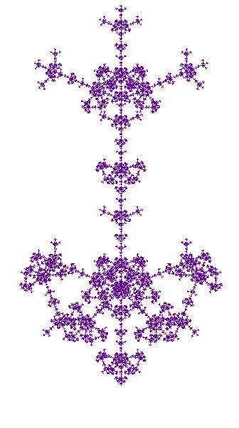
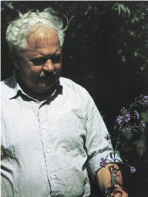
PS3: Lindenmayer System Fractals
Broccoli Fallout
by Paul DiOrio, Rachel Phillips
Purple Arrow
by Rachel Lathbury and Andrea Yoon
Aristid Lindenmayer (1925-1989)

Slide 8
L-Systems
CommandSequence ::= ( CommandList )
CommandList ::= Command CommandList
CommandList ::= ε
Command ::= F
Command ::= RAngle
Command ::= OCommandSequence
Cherry Blossom
by Ji Hyun Lee, Wei Wang

Slide 9
L-System Rewriting
CommandSequence ::= ( CommandList )
CommandList ::= Command CommandList
CommandList ::=
Command ::= F
Command ::= RAngle
Command ::= OCommandSequence
Start: (F)
Rewrite Rule:
F → (F O(R30 F) F O(R-60 F) F)
Work like BNF replacement rules, except replace all instances at once!
Why is this a better model for biological systems?

Slide 10
Maps are Useful!!
PS3 Question 5:
(define (rewrite-lcommands lcommands replacement)
(flatten-commands
(map
; Procedure to apply to each command
lcommands)))

Slide 11
Drawing Functions
y
y = (lambda (x) x)
x

Slide 12
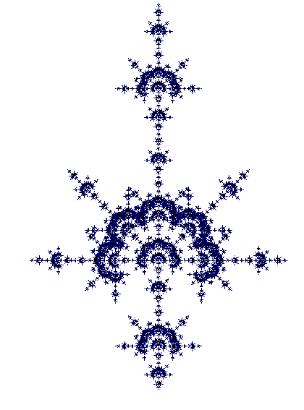
Drawing Arbitrary Curves
(x, y) = (lambda (t)
(make-point …))
Rose Bush by Jacintha Henry and Rachel Kay
Tie Dye by Bill Ingram

Slide 13
Curves
A curve c is the set of points that results from applying c to every real number t value between 0.0 and 1.0.
How many points?
Infinitely many!
We can draw an approximate representation of the curve by sampling some of the points.

Slide 14
Defining Curves
1.0
(lambda (t) (make-point t t))
y
y = (lambda (x) x)
(define diag-line
(lambda (t) (make-point t t))
0.0
x
1.0

Slide 15
Drawing Curves
(define (draw-curve-points curve n)
(define (draw-curve-worker curve t step)
(if (<= t 1.0)
(begin
(window-draw-point (curve t))
(draw-curve-worker curve (+ t step) step))))
(draw-curve-worker curve 0.0 (/ 1 n)))
Does this recursive definition have a base case?

Slide 16
PS3 Questions?
The Great Lambda Tree
of Ultimate Knowledge
and Infinite Power
(Level 5 with color + randomness)

Slide 17
Generalizing List Procedures
(define (list-map f p)
(if (null? p)
null
(cons (f (car p))
(list-map f (cdr p)))))
(define (list-sum p)
(if (null? p)
0
(+ (car p) (list-sum (cdr p)))))
(define (list-length p)
(if (null? p)
0
(+ 1 (list-length (cdr p)))))
(define (is-list? p)
(if (null? p)
true
(if (pair? p) (is-list? (cdr p)) false)))

Slide 18
Similarities and Differences
(define (list-map f p)
(if (null? p)
null
(cons (f (car p))
(map f (cdr p)))))
(define (list-sum p)
(if (null? p)
0
(+ (car p)
(sumlist (cdr p)))))
(define (list-cruncher ? ... ? p)
(if (null? p)
base result
(combiner (car p)
(recursive-call ... (cdr p))))

Slide 19
list-cruncher
(define (list-cruncher baseres carproc combiner p)
(if (null? p) baseres
(combiner
(carproc (car p))
(list-cruncher baseres carproc combiner (cdr p)))))
(define (list-sum p)
(list-cruncher 0 (lambda (x) x) + p))
(define (list-map f p)
(list-cruncher null f cons p))

Slide 20
Can list-cruncher crunch length?
(define (list-cruncher baseres carproc combiner p)
(if (null? p) baseres
(combiner
(carproc (car p))
(list-cruncher baseres carproc combiner (cdr p)))))
(define (list-length p)
(if (null? p) 0
(+ 1 (list-length (cdr p)))))

Slide 21
Can list-cruncher crunch length?
(define (list-cruncher baseres carproc combiner p)
(if (null? p) baseres
(combiner
(carproc (car p))
(list-cruncher baseres carproc combiner (cdr p)))))
(define (list-length p)
(if (null? p) 0
(+ 1 (list-length (cdr p)))))
(define (list-length p)
(list-cruncher 0 (lambda (x) 1) + p))

Slide 22
Can list-cruncher crunch is-list??
(define (list-cruncher baseres carproc combiner p)
(if (null? p) baseres
(combiner
(carproc (car p))
(list-cruncher baseres carproc combiner (cdr p)))))
(define (is-list? p)
(if (null? p)
true
(if (pair? p) (is-list? (cdr p)) false)))
No! If p is non-null, (car p) is always evaluated by list-cruncher so it produces an error if p is not a list.

Slide 23
Crunchers vs. Accumulators
(define (list-cruncher baseres carproc combiner p)
(if (null? p) baseres
(combiner
(carproc (car p))
(list-cruncher baseres carproc combiner (cdr p)))))
(define (list-accumulate f base p)
(if (null? p) base
(f (car p) (list-accumulate f base (cdr p)))))
(define (list-sum p)
(list-cruncher 0 (lambda (x) x) + p))
(define (list-sum p)
(list-accumulate + 0 p))

Slide 24
Crunchers vs. Accumulators
(define (list-cruncher baseres carproc combiner p)
(if (null? p) baseres
(combiner
(carproc (car p))
(list-cruncher baseres carproc combiner (cdr p)))))
(define (list-accumulate f base p)
(if (null? p) base
(f (car p) (list-accumulate f base (cdr p)))))
Is there any procedure that can be defined using list‑accumulate that can’t be defined using list-cruncher?

Slide 25
Crunchers vs. Accumulators
(define (list-cruncher baseres carproc combiner p)
(if (null? p) baseres
(combiner
(carproc (car p))
(list-cruncher baseres carproc combiner (cdr p)))))
(define (list-accumulate f base p)
(if (null? p) base
(f (car p) (list-accumulate f base (cdr p)))))
No! Proof-by-construction:
(define (list-accumulate f base p)
(list-cruncher base (lambda (x) x) f p))

Slide 26
Crunchers vs. Accumulators
(define (list-cruncher baseres carproc combiner p)
(if (null? p) baseres
(combiner
(carproc (car p))
(list-cruncher baseres carproc combiner (cdr p)))))
(define (list-accumulate f base p)
(if (null? p) base
(f (car p) (list-accumulate f base (cdr p)))))
Gold star bonus: Is there any procedure that can be defined using list‑cruncher that can’t be defined using list‑accumulate?

Slide 27
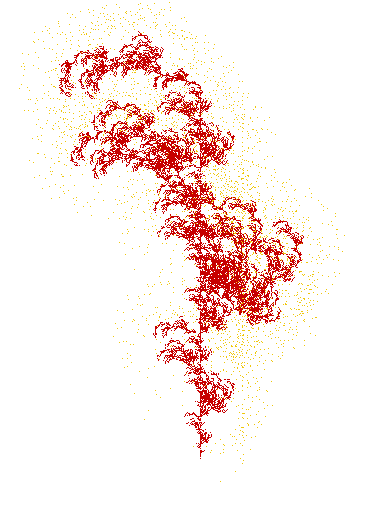
Charge
You should be able to:
Define, understand, and use recursive procedures on lists
Including: list-map, list-length, list-sum, list-append, list-filter
Understand and define procedures using list-cruncher, list-accumulate, or a similar procedure
PS3 due Wednesday
Upcoming help hours:
Sunday 6-8:30pm (Olsson 001)
Monday noon-1:30pm (Thorton Stacks)
Monday 4-6:30pm (Small Hall)
where the red fern grows
by Jessica Geist, Ellen Clarke

