Slide 1
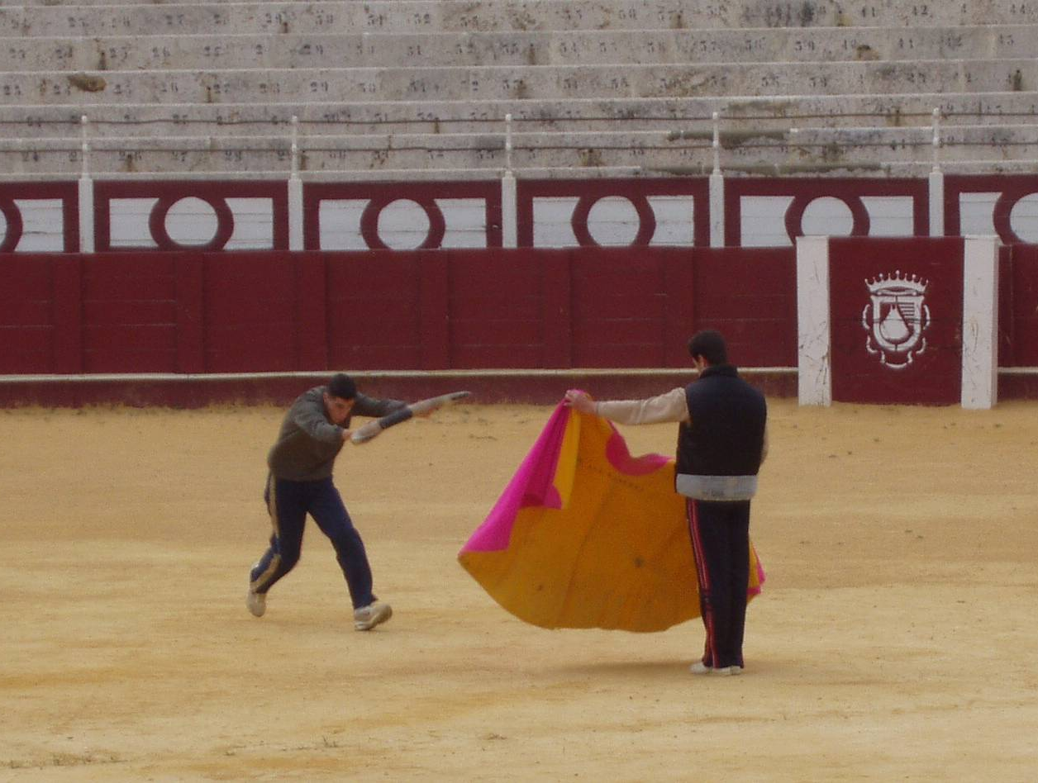
Lecture 15: Running Practice
cs1120 Fall 2009
David Evans
http://www.cs.virginia.edu/evans

Slide 2
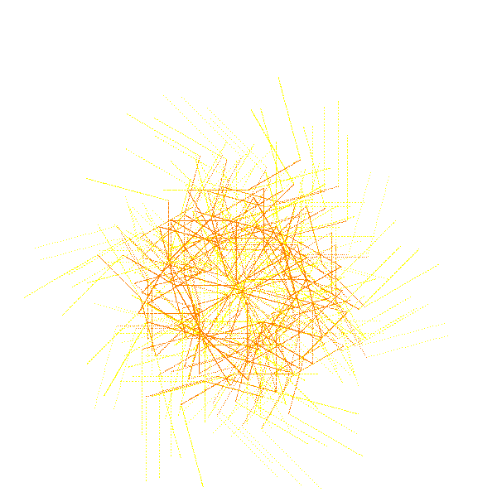
Menu
Any Questions from Last Week?
Exam 1
Practice Analyzing Procedures
Finest Fractalists
Sunburst
by Erika Crawford

Slide 3
Exam 1
Handed out at end of Friday’s class, due at the beginning of Wednesday’s class
Open non-human resources except for Scheme interpreters but no help from other people
Covers everything through this Wednesday including:
Lectures 1-16, Course Book Chapters 1-8, PS 1-4
Sample exams from previous years: if you can do well on Spring 2009 Exam 1, you should do well on our Exam 1 (of course, questions will be different!)
Review Session, Wednesday 6:30 in Olsson 001

Slide 4
Running Time Practice
From ps3:
(define (flatten-commands ll)
(if (null? ll) ll
(if (is-lsystem-command? (car ll))
(cons (car ll) (flatten-commands (cdr ll)))
(flat-append (car ll) (flatten-commands (cdr ll))))))
What is the asymptotic running time of flatten-commands?
First: determine running times of all the procedures applied in flatten-commands.

Slide 5
Flatten Running Time
From ps3:
(define (flatten-commands ll)
(if (null? ll) ll
(if (is-lsystem-command? (car ll))
(cons (car ll) (flatten-commands (cdr ll)))
(flat-append (car ll) (flatten-commands (cdr ll))))))
First: determine running times of all the procedures applied in flatten-commands.
null?, car, cons, cdr – we already know there are constant time
What about is-lsystem-command?

Slide 6
is-lsystem-command?
(define (is-lsystem-command? lcommand)
(or (is-forward? lcommand)
(is-rotate? lcommand)
(is-offshoot? lcommand)))
or is a special form:
OrExpression ::= (or MoreExpressions)
To evaluate (or Expr₁ MoreExpressions):
1. Evaluate Expr₁.
2. If it evaluates to a non-false value, that is the value of the or
expression. None of the other sub-expressions are evaluated.
Otherwise, the value of the or-expression is the value of
(or MoreExpressions)
The value of (or) is false.

Slide 7
is-lsystem-command?
(define (is-lsystem-command? lcommand)
(or (is-forward? lcommand)
(is-rotate? lcommand)
(is-offshoot? lcommand)))
is-lsystem-command? has constant running time: it involves applications of at most three constant time procedures.
(define (is-forward? lcommand)
(eq? (car lcommand) 'f))
(define (is-rotate? lcommand)
(eq? (car lcommand) 'r))
(define (is-offshoot? lcommand)
(eq? (car lcommand) 'o))
Each of these procedures has
constant running time: they involve only applications of constant time procedures eq? and car.

Slide 8
Flatten Running Time
From ps3:
(define (flatten-commands ll)
(if (null? ll) ll
(if (is-lsystem-command? (car ll))
(cons (car ll) (flatten-commands (cdr ll)))
(flat-append (car ll) (flatten-commands (cdr ll))))))
First: determine running times of all the procedures applied in flatten-commands.
null?, car, cons, cdr, and is-lsystem-command? are constant time

Slide 9
Running Time Practice
Remember: we care about the size of the input.
Introduce variables:
N₁ = number of elements in first input list (lst)
N₂ = number of elements in second input list (ll)
(define (flat-append lst ll)
(if (null? lst) ll
(cons (car lst) (flat-append (cdr lst) ll))))
What is the asymptotic running time of flat-append?
Other than the recursive call, each execution is constant time:
null?, car, cons, cdr, are constant time
How many recursive calls are there?
N₁ (the number of elements in the first input list)
What is the running time?
The asymptotic running time of flat-append is in θ(N₁) where N₁ is the number of elements in the first input.
Note: flat-append is the same as list-append! (Stupid to define this as a separate procedure and name it flat-append.)

Slide 10
Flatten Running Time
(define (flatten-commands ll)
(if (null? ll) ll
(if (is-lsystem-command? (car ll))
(cons (car ll) (flatten-commands (cdr ll)))
(flat-append (car ll) (flatten-commands (cdr ll))))))
First: determine running times of all the procedures applied in flatten-commands.
null?, car, cons, cdr, and is-lsystem-command? are constant time
flat-append has running time in θ(N₁) where N₁ is the number of elements in the first input.
Second: determine running time for each application except for recursive call.
Need to consider both paths:
(if (is-lsystem-command? (car ll))
(cons (car ll) (flatten-commands (cdr ll)))
(flat-append (car ll) (flatten-commands (cdr ll))))))

Slide 11
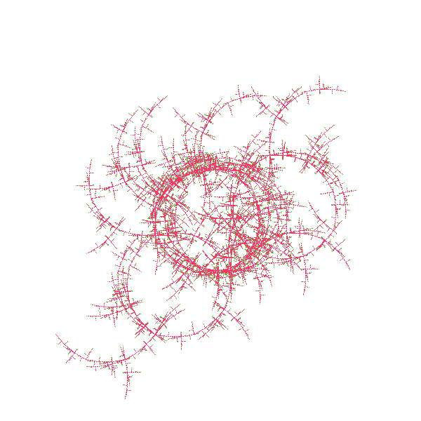
Paths to Flattening
(if (is-lsystem-command? (car ll))
(cons (car ll) (flatten-commands (cdr ll)))
(flat-append (car ll) (flatten-commands (cdr ll))))))
Each recursive call involves θ(P) work where
P is the number of elements in (car ll).
Each recursive call reduces the number of elements in ll by one.
Teamwork by
Rose Cunnion and Lucy Raper
For input list that is all lists of length P:
flatten-commands has running time in θ(QP) where Q is the
number of sub-lists (of length P) in the input list.
to be continued Wednesday...

Slide 12
Fractal Finalists

Slide 13
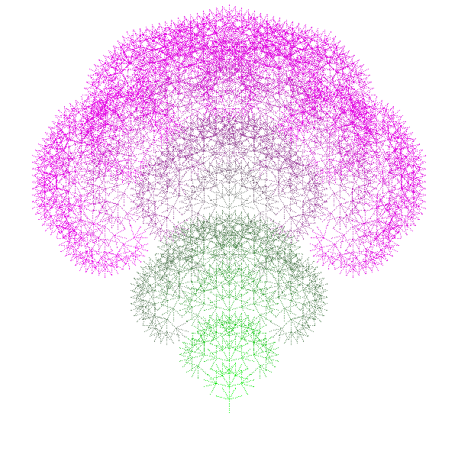
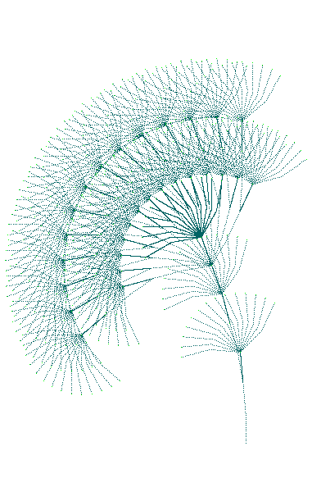
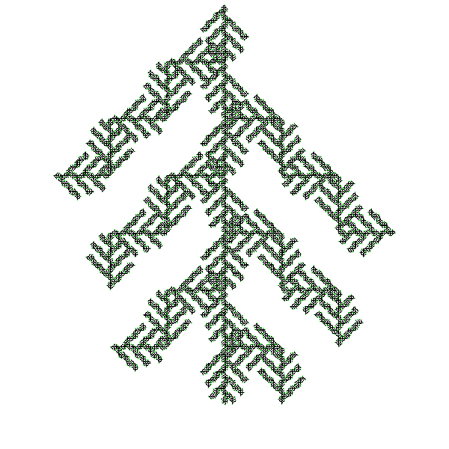
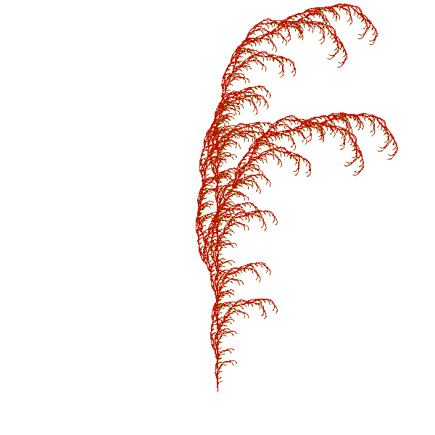
Blowin’ in the Wind
TwistOnTiffany’s
1
2
Bouquet
3
5 Ascension
August Wheat
4 CrissCross
6

Slide 14
Blowin’ in the Wind

Slide 15
TwistOnTiffany’s

Slide 16
Bouquet

Slide 17
CrissCross

Slide 18
Ascension

Slide 19
August Wheat

Slide 20
Winner! by popular vote
Blowin' in the Wind
by Ian Nathan
TwistOnTiffany’s by Brittney Blanks
Bouquet by Richard McPherson
CrissCross by Trygve Loken and Andrew Crute
Ascension by Siddharth Rajagopalan
August Wheat
by Melissa Bailey

Slide 21
Charge
PS4 is due Wednesday
Exam 1 is out Friday, due next Wednesday
Exam Review, Wednesday 6:30 in Olsson 001

Slide 22
Returning PS3
Front
abc8a … dwa2x
eab8d … jsw8a
jta9nk … mz2h
os9e … wch9a

