Slide 1
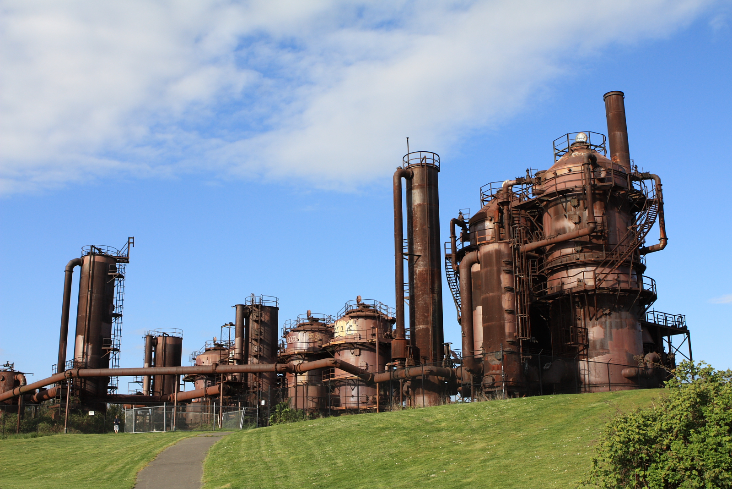
Lecture 16: Power Analysis
cs1120 Fall 2009
David Evans
http://www.cs.virginia.edu/evans

Slide 2
Menu
Finishing Analyzing Flattening
Power
Reminders:
Review Session, Wednesday 6:30 in Olsson 001
Extra Office Hours, Thursday 1:30-3 in Olsson 236A

Slide 3
Recap: Flatten Running Time
(define (flatten-commands ll)
(if (null? ll) ll
(if (is-lsystem-command? (car ll))
(cons (car ll) (flatten-commands (cdr ll)))
(flat-append (car ll) (flatten-commands (cdr ll))))))
First: determine running times of all the procedures applied in flatten-commands.
null?, car, cons, cdr, and is-lsystem-command? are constant time
flat-append has running time in θ(N₁) where N₁ is the number of elements in the first input.
Second: determine running time for each application except for recursive call.
Need to consider both paths:
(if (is-lsystem-command? (car ll))
(cons (car ll) (flatten-commands (cdr ll)))
(flat-append (car ll) (flatten-commands (cdr ll))))))

Slide 4
Paths to Flattening
(if (is-lsystem-command? (car ll))
(cons (car ll) (flatten-commands (cdr ll)))
(flat-append (car ll) (flatten-commands (cdr ll))))))
Each recursive call involves constant work .
Each recursive call reduces the number of elements in ll by one.
For input list that is all lsystem commands of length N:
flatten-commands has running time in θ(N) where N is the number of lcommands in the input list.

Slide 5
Paths to Flattening
(if (is-lsystem-command? (car ll))
(cons (car ll) (flatten-commands (cdr ll)))
(flat-append (car ll) (flatten-commands (cdr ll))))))
Each recursive call involves θ(P) work where
P is the number of elements in (car ll).
Each recursive call reduces the number of elements in ll by one.
For input list that is all lists of length P:
flatten-commands has running time in θ(QP) where Q is the
number of sub-lists (of length P) in the input list.

Slide 6
Combining the Paths
(define (flatten-commands ll)
(if (null? ll) ll
(if (is-lsystem-command? (car ll))
(cons (car ll) (flatten-commands (cdr ll)))
(flat-append (car ll) (flatten-commands (cdr ll))))))
For input list that is all lsystem-commands:
flatten-commands has running time in θ(N) where N is the number of elements in the input list.
For input list that is all lists of length P:
flatten-commands has running time in θ(QP) where Q is the
number of sub-lists (of length P) in the input list.
For any input:
flatten-commands has running time in θ(M) where M is the size of the input list (the total number of lcommands in ll and all its sub-lists,
not counting elements in offshoot command lists).

Slide 7
Power
Define and analyze the asymptotic running time of a procedure power that takes two numbers, a and n, and input, and outputs a^{n}.
Hint:
a⁰ = 1
a^{n} = a * a^{n-1} for n > 0

Slide 8
Simple Power
(define (power a n)
(if (= n 0) 1
(* a (power a (- n 1)))))
What is the asymptotic running time of power?

Slide 9
Running Time Analysis
(define (power a n)
(if (= n 0) 1
(* a (power a (- n 1)))))
What are the running times of procedures applied by power?
What is the running time of evaluating the body except for the recursive call?
How many recursive calls are there?
n, the value of the second input n

Slide 10
Running Time Analysis
(define (power a n)
(if (= n 0) 1
(* a (power a (- n 1)))))
What are the running times of procedures applied by power?
What is the running time of evaluating the body except for the recursive call?
How many recursive calls are there?
= and – with one input constant: constant running time
n, the value of the second input n

Slide 11
What about *?
(* a (power a (- n 1)))
Cannot be constant time
Multiplication must at least look at all the digits in both numbers
Grade-school multiplication algorithm has running time in Θ(W²)
* is in Ω(W) where W is the total length (number of bits) of the inputs.
* is in O(W²) where W is the total length (number of bits) of the inputs.
Note: O instead of Θ since there may be faster * algorithms, and we don’t know what Scheme interpreter actually does.

Slide 12
What about *?
(* a (power a (- n 1)))
* is in Ω(W) where W is the total length (number of bits) of the inputs.
* is in O(W²) where W is the total length (number of bits) of the inputs.
What can we say about * as it is used here? (what is W?)
Worst case: W = bits in a + bits in a^{n-1}
* has running time in O((a_{b}n_{v} )²) where a_{b} is number of bits in a and n_{v} is value of n.

Slide 13
Running Time Analysis
(define (power a n)
(if (= n 0) 1
(* a (power a (- n 1)))))
Each body evaluation:
Number of recursive calls:
= and – with one input constant: constant running time
* has running time in O((a_{b}n_{v})²) and Ω(a_{b}n_{v})
n_{v}, the value of the second input n
Running time for power is in O(n_{v}(a_{b}n_{v})²) = O(a_{b}²n_{v}³) and Ω(a_{b}n_{v}²)

Slide 14
Bits and Values
Running time for power is in O(a_{b}²n_{v}³) and Ω(a_{b}n_{v}²)
where a_{b} is number of bits in a and n_{v} is value of n.
What is the running time in terms of the size of the input?
n_{v} = 2^{nb}
Running time for power is in O(a_{b}²(2^{nb} )³) and Ω(a_{b}²(2^{nb} )²).

Slide 15
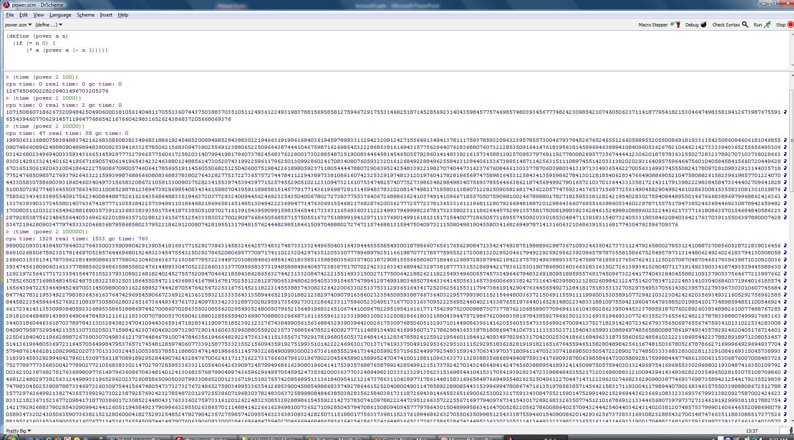
Testing Power Analysis
Running time for power is in O(a_{b}²(2^{nb} )³) and Ω(a_{b}²(2^{nb} )²).
n_{b} = 14
> (time (power 2 10000))
cpu time: 47 real time: 38 gc time: 0
n_{b} = 16
> (time (power 2 100000))
cpu time: 1529 real time: 1533 gc time: 763
> (/ (power (power 2 16) 3) (power (power 2 14) 3))
64
> (/ (power (power 2 16) 2) (power (power 2 14) 2))
16
> (/ 1529 47)
32 25/47

Slide 16
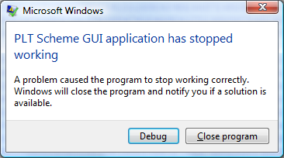
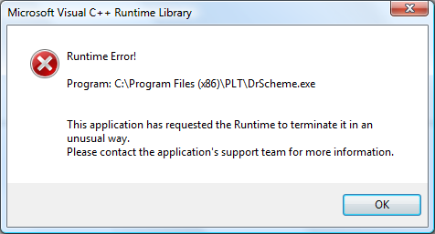
Running time for power is in O(a_{b}²(2^{nb} )³) and Ω(a_{b}²(2^{nb} )²).
n_{d} = 7
> (time (power 2 1000000))

Slide 17
Faster Powering?
a^{2n} = a^{n} * a^{n}
Gold Star Challenge Problem: define and analyze (correctly!) an asymptotically faster power procedure.

Slide 18
Charge
ACs’ Exam Review Session: Tonight at 6:30, Olsson 001
Extra Office Hours, Thursday 1:30-3pm
Exam 1 out Friday

