Slide 1
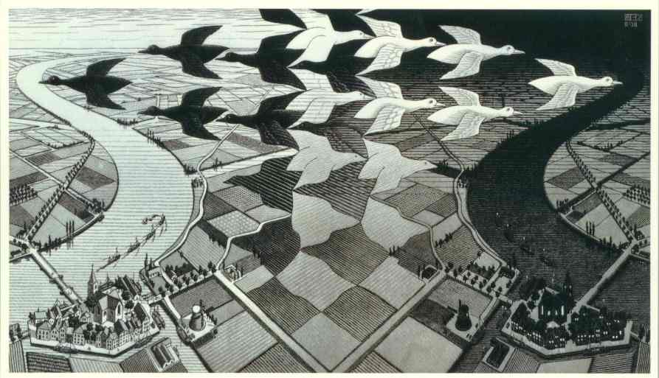
Lecture 18: Changing State
cs1120 Fall 2009
David Evans
http://www.cs.virginia.edu/evans
Sounds of Colossus: http://pixelh8.co.uk/discography/

Slide 2
Menu
Computing with Electrons
The Story So Far
Introduction Mutation

Slide 3
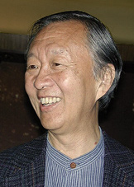
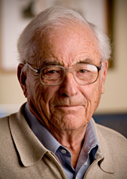
Yesterday’s Nobel Prize in Physics
Charles K. Kao
Willard S. Boyle | George E. Smith
Standard Telecommunication Laboratories, United Kingdom
fiberoptics: using light to transmit data
Bell Labs, New Jersey
Charge-Coupled Device (1969)

Slide 4
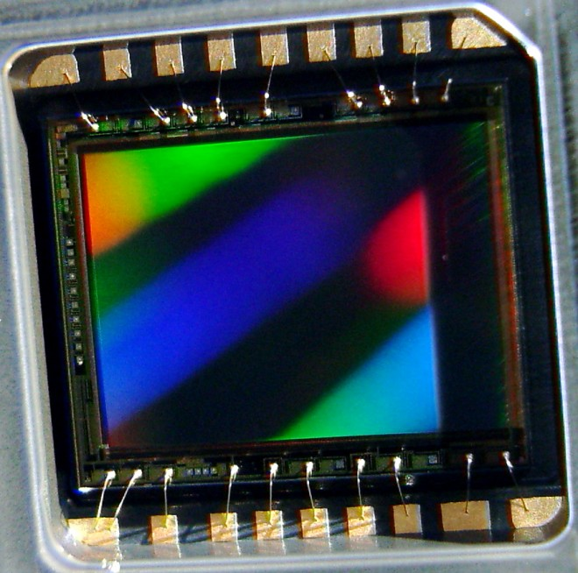
Charge-Coupled Device (CCD)

Slide 5
Moving Collected Charge
Light
Photocell:
photoelectric effect (Einstein’s 1921 nobel prize): photons hit silicon plate and knock out electrons (more light, more electrons)
Photocell
Silicon substrate:
not powered, conducts well
powered, does not conduct
Voltage

Slide 6
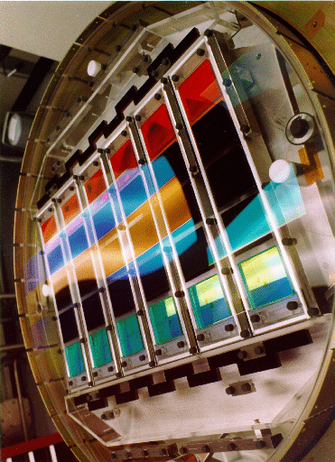
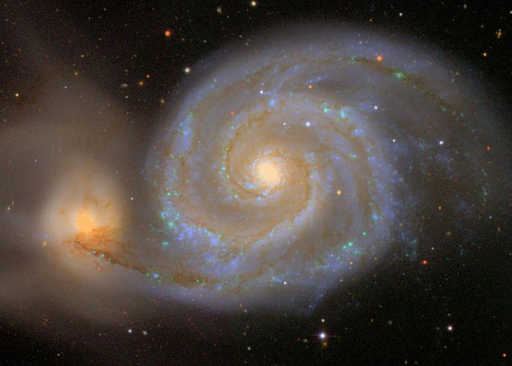
CCDs Today
Sloan Digital Sky Survey (1998): array of 30, ~4Mpixel CCDs

Slide 7
cs1120 Story so Far

Slide 8
Course Roadmap
Synthesis
PS8, 9: Building Web
Applications
Ch 3: Programming
PS6, Ch 10: Objects
Ch 2: Language
Ch 4: Procedures
PS5, Ch 9: State
Ch 5: Data
Ch 1: Computing
Ch 8: Sorting and Searching
PS7, Ch 11: Interpreters
Ch 7: Cost
You are here
Ch 6: Machines
Ch 13: Intractability
Ch 12: Computability
Analysis

Slide 9
Computer Science: cs1120 so far
How to describe information processes by defining procedures (Chapters 3, 4, 5)
Programming with procedures, lists, recursion
How to predict properties about information processes (Chapter 6, 7)
Predicting how running time grows with input size
How to efficiently implement information processes (not much on this)
Chapter 3 (rules of evaluation)
Chapter 6 (machines)

Slide 10
cs1120 Upcoming
How to describe information processes by defining procedures
Programming with state (Ch 9), objects (Ch 10), languages (Ch 11)
How to predict properties about information processes
Are there problems which can’t be solved by algorithms? (Ch 12)
What is the fastest process that can solve a given problem? (Ch 13)
How to efficiently implement information processes
How to implement a Scheme interpreter (Ch 11)

Slide 11
The Liberal Arts
From Chapter 1/Lecture 1:
language
numbers
Trivium (3 roads)
Quadrivium (4 roads)
Grammar
Rhetoric
Logic
Arithmetic
Music
Geometry
Astronomy

Slide 12
Liberal Arts Checkup
Grammar: study of meaning in written expression
Rhetoric: comprehension of verbal and written discourse
Logic: argumentative discourse for discovering truth
Arithmetic: understanding numbers
Geometry: quantification of space
Music: number in time
Astronomy
BNF, RTN, rules of
evaluation for meaning
Not much yet…interfaces
between components (PS6-9),
program and user (PS8-9)
Trivium
Rules of evaluation, if,
recursive definitions
adding, multiplying with simple logic
representing numbers, more in Nov
Quadrivium
Curves as procedures,
fractals (PS3)
Yes, listen to “Hey Jude!”
Soon: read Neil deGrasse Tyson’s essay

Slide 13
Introducing Mutation

Slide 14
Evaluation Rule 2: Names
From Lecture 3:
A name expression evaluates to the value associated with that name.
> (define two 2)
> two
2
This has been more-or-less okay so far, since the value associated with a name never changes...

Slide 15
Names and Places
A name is not just a value, it is a place for storing a value.
define creates a new place, associates a name with that place, and stores a value in that place
(define x 3)
x: 3

Slide 16
Bang!
set! (“set bang”) changes the value associated with a place
> (define x 3)
> x
3
> (set! x 7)
> x
7
x:
3
7

Slide 17
set! should make you nervous
> (define x 2)
> (nextx)
3
> (nextx)
4
> x
4
Before set! all procedures were functions (except for some with side-effects). The value of (f) was the same every time you evaluate it. Now it might be different!

Slide 18
Defining nextx
(define (nextx)
(set! x (+ x 1))
x)
(define nextx
(lambda ()
(begin
(set! x (+ x 1))
x))))
syntactic sugar for

Slide 19
Evaluation Rules
> (define x 3)
> (+ (nextx) x)
7
or 8
> (+ x (nextx))
9
or 10
DrScheme evaluates application subexpressions left to right, but Scheme evaluation rules allow any order.

Slide 20
Mutable Cons Cell
mcons – creates a mutable cons cell
(mcar m) – first part of a mutable cons cell
(mcdr m) – second part of a mutable cons cell
1
2
(mcons 1 2)

Slide 21
set-mcar! and set-mcdr!
(set-mcar! p v)
Replaces the car of mutable cons p with v.
(set-mcdr! p v)
Replaces the cdr of mutable cons p with v.
These should scare you even more then set!!

Slide 22
> (define pair (mcons 1 2))
> pair
(1 . 2)
pair:
1
2

Slide 23
> (define pair (mcons 1 2))
> pair
{1 . 2}
> (set-mcar! pair 0)
> (mcar pair)
0
> (mcdr pair)
2
> (set-mcdr! pair 1)
> pair
{0 . 1}
pair:
1
0
2
1

Slide 24
Impact of Mutation
We will need to revise our evaluation rules for names and application expressions: substitution model of evaluation no longer works since values associated with names change
We need to be much more careful in our programs to think about when things happen: order matters since values change

Slide 25
Charge
PS5: posted now, due next Wednesday
Read Chapter 9
Friday: return Exam 1, Revising our Evaluation Rules to handle mutation
Monday, 19 October
WAHOO! Auctions

