Slide 1
Class 2: Language
David Evans
cs1120 Fall 2009

Slide 2
Menu
First Main Theme: Recursive Definitions
Survey Results
Language

Slide 3
What’s the longest word in the English language?

Slide 4
Longest Words?
honorificabilitudinitatibus (27 letters, longest by Shakespeare)
With honor.
antidisestablishmentarianism (28 letters)
Movement against division of church and state.
hippopotomonstrosesquipedaliophobia (35 letters)
Fear of long words.
pneumonoultramicroscopicsilicovolcanoconiosis (45 letters) (longest word in most dictionaries)
Lung disease contracted from volcanic particles.
Like all words, these words are “made up”.
Notes:
I marvel thy master hath not eaten thee for a word; for thou art not so long by the head as honorificabilitudinitatibus: thou art easier swallowed than a flap-dragon.

Slide 5
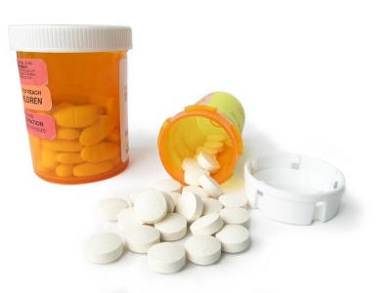
Making Longer Words
antihippopotomonstrosesquipedaliophobia
Against the fear of long words.
antiantihippopotomonstrosesquipedaliophobia
Against a thing against the fear of long words.

Slide 6
Language is Recursive
No matter what word you think is the longest word, I can always make up a longer one!
word ::= anti-word
By itself, this definition of word is circular.

Slide 7
Zero, One, Infinity
word ::= anti-word
This rule can make 0 words.
word ::= hippopotomonstrosesquipedaliophobia
This rule can make 1 word.
word ::= anti-word
word ::= hippopotomonstrosesquipedaliophobia
These two rules can make infinitely many words, enough to express all ideas in the universe!

Slide 8
Recursive Definitions
We can define things in terms of themselves
Recursive definitions are not circular:
they eventually end with something real
word ::= anti-word
word ::= hippopotomonstrosesquipedaliophobia

Slide 9
Recursive Definitions
Allow us to express infinitely many things starting with a few.
This is powerful!
We will see lots of examples in this course.

Slide 10
Menu
First Main Theme: Recursive Definitions
Survey Results
Language

Slide 11
Who is in the class?
Produced by http://www.wordle.net/

Slide 12
Ever written a computer program?

Slide 13
Language
More survey results (and my answers to questions) will be posted on the website before Monday.

Slide 14
What is a language?
Webster:
A systematic means of communicating ideas or feelings by the use of conventionalized signs, sounds, gestures, or marks having understood meanings.

Slide 15
Linguist’s Definition
(Charles Yang)
A description of pairs (S, M), where S stands for sound, or any kind of surface forms, and M stands for meaning.
A theory of language must specify the properties of S and M, and how they are related.

Slide 16
Languages
A language is:
a set of surface forms (usually strings of characters), and
a way to map any surface form
in the language to a meaning
Caveat: computer scientists often use language to mean just a set of surface forms.

Slide 17
What are languages made of?
Primitives (all languages have these)
The simplest surface forms with meaning
Means of Combination (all languages have these)
Ways to make new surface forms from ones you already have
Means of Abstraction (all powerful languages have these)
Ways to use simple surface forms to represent complicated ones

Slide 18
Does English have these?
Primitives
Words (?)
“hippopotomonstrosesquipedaliophobia” is not a primitive
Morphemes – smallest units of meaning
e.g., anti- (“opposite”)
Means of combination
e.g., Sentence ::= Subject Verb Object
Precise rules, but not the ones you learned in grammar school
Ending a sentence with a preposition is something up with which we will not put.
Winston Churchill

Slide 19
Does English have these?
Means of abstraction
Pronouns: she, he, it, they, which, etc.
Confusing since they don’t always mean the same thing, it depends on where they are used.
The “these” in the slide title is an abstraction for the three elements of language introduced 2 slides ago.
The “they” in the confusing sentence is an abstraction for pronouns.

Slide 20
How should we describe precise languages?

Slide 21
Requirements
Describe infinitely many surface forms with a short description
Listing them all doesn’t work: need ways to generate the surface forms
Way to map each surface form to exactly one precise meaning
Today: formally
Monday: informally (using English)
Later: more formally (defining an interpreter)

Slide 22
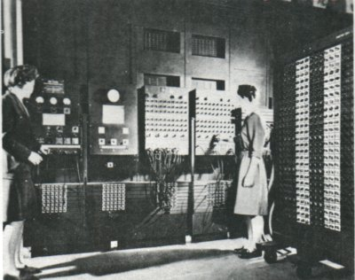
ENIAC: Electronic Numerical Integrator and Computer
Early WWII computer
but not the first (PS4)
Built to calculate bombing tables
Memory size:
twenty 10 decimal digit accumulators =
Apollo Guidance Computer (1969): 1 inch
You: 4.4 miles
664 bits
ENIAC (1946): ½ mm

Slide 23
Directions for Getting 6
Choose any regular accumulator (ie. Accumulator #9).
Direct the Initiating Pulse to terminal 5i.
The initiating pulse is produced by the initiating unit's Io terminal each time the Eniac is started. This terminal is usually, by default, plugged into Program Line 1-1 (described later). Simply connect a program cable from Program Line 1-1 to terminal 5i on this Accumulator.
Set the Repeat Switch for Program Control 5 to 6.
Set the Operation Switch for Program Control 5 to ADD .
Set the Clear-Correct switch to C.
Turn on and clear the Eniac.
Normally, when the Eniac is first started, a clearing process is begun. If the Eniac had been previously started, or if there are random neons illuminated in the accumulators, the “Initial Clear” button of the Initiating device can be pressed.
Press the “Initiating Pulse Switch” that is located on the Initiating device.
Stand back.

Slide 24
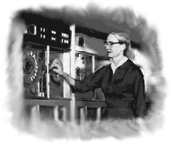
Admiral Grace Hopper (1906-1992)
Mathematics PhD Yale, 1934
Entered Navy, 1943
First to program Mark I (first “large” computer, 51 feet long)
Wrote first compiler (1952) – program for programming computers
Co-designer of COBOL (most widely used programming language until a few years ago)
“Nobody believed that I had a running compiler and nobody would touch it. They told me computers could only do arithmetic.”

Slide 25
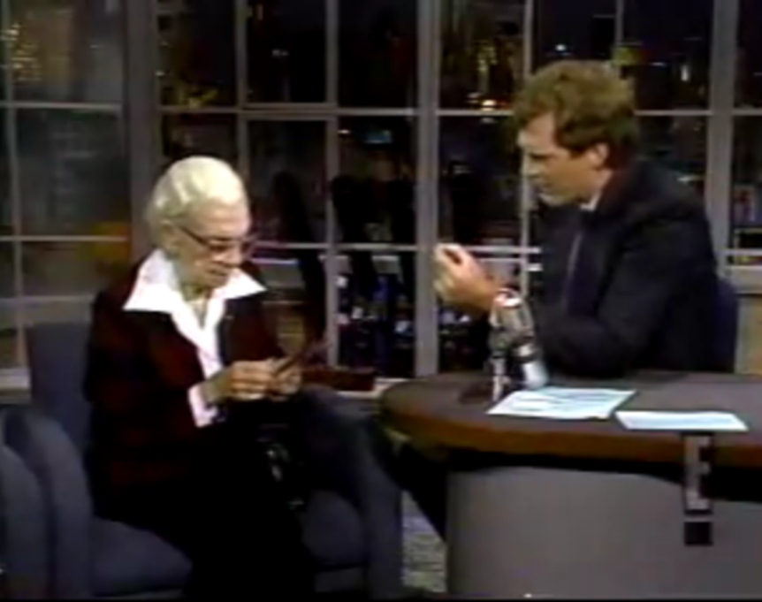
USS Hopper
“Dare and Do”
Guest on David Letterman

Slide 26
Nanostick
How far does light travel in 1 nanosecond?
> (define nanosecond (/ 1 (* 1000 1000 1000))) ;; 1 billionth of a s
> (define lightspeed 299792458) ; m / s
> (* lightspeed nanosecond)
149896229/500000000
> (exact->inexact (* lightspeed nanosecond))
0.299792458
= just under 1 foot
Lab machines have at least “2 GHz Pentium 4 CPU”
GHz = GigaHertz = 1 Billion times per second
They must finish a step before light travels 11.5 cm!

Slide 27
Code written by humans
Compiler translates
from code in a high-level language to machine code
Compiler
Code machine can run
DrScheme uses an interpreter. An interpreter is like a compiler, except it runs quickly and quietly on small bits of code at a time.

Slide 28
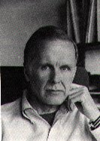
John Backus
Chemistry major at UVA (entered 1943)
Flunked out after second semester
Joined IBM as programmer in 1950
Developed Fortran, first commercially successful programming language and compiler

Slide 29
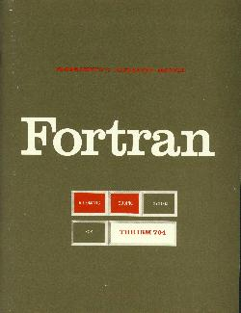
IBM 704 Fortran manual, 1956

Slide 30
Describing Languages
Fortran language was described using English
Imprecise
Verbose, lots to read
Ad hoc
DO 10 I=1.10
Assigns 1.10 to the variable DO10I
DO 10 I=1,10
Loops for I = 1 to 10
(Often incorrectly blamed for loss of Mariner-I)
Wanted a more precise way of describing a language

Slide 31
Backus Naur Form
symbol ::= replacement
We can replace symbol with replacement
nonterminal – symbol that appears on left side of rule
terminals – symbol that never appears on the left side of a rule
A ::= B means anywhere you have an A, you can replace it with a B.

Slide 32
BNF Example
Sentence ::= NP Verb
NP ::= Noun
Noun ::= Dave
Noun ::= Scheme
Verb ::= rocks
Verb ::= sucks
What are the terminals?
Dave, Scheme, rocks, sucks
How many different things can we express with this language?
4, but only 2 are true.

Slide 33
BNF Example
Sentence ::= NP Verb
NP ::= Noun
NP ::= Noun and NP
Noun ::= Dave
Noun ::= Scheme
Verb ::= rocks
Verb ::= sucks
How many different things can we express with this language?
Infinitely many!
Recursion is powerful.

Slide 34
Most Essential Scheme
Expr ::= PrimitiveExpr
PrimitiveExpr ::= Number
PrimitiveExpr ::= + | * | <= | ...
Expr ::= Name
Expr ::= ApplicationExpr
ApplicationExpr ::= (Expr MoreExprs)
MoreExprs ::=
MoreExprs ::= Expr MoreExprs
This is enough for everything you need for PS1

Slide 35
Charge
Problem Set 1: due Wednesday
Read through Chapter 3 by Monday
Help Hours: posted on website
Sunday in Olsson 001 (6-8:30pm)
Monday in Thorton Stacks (noon-1:30pm); Small Hall (4-6:30pm)
Tuesday in Small Hall (2-3pm; 3:30-5pm; 7-8:30pm)

