Slide 1
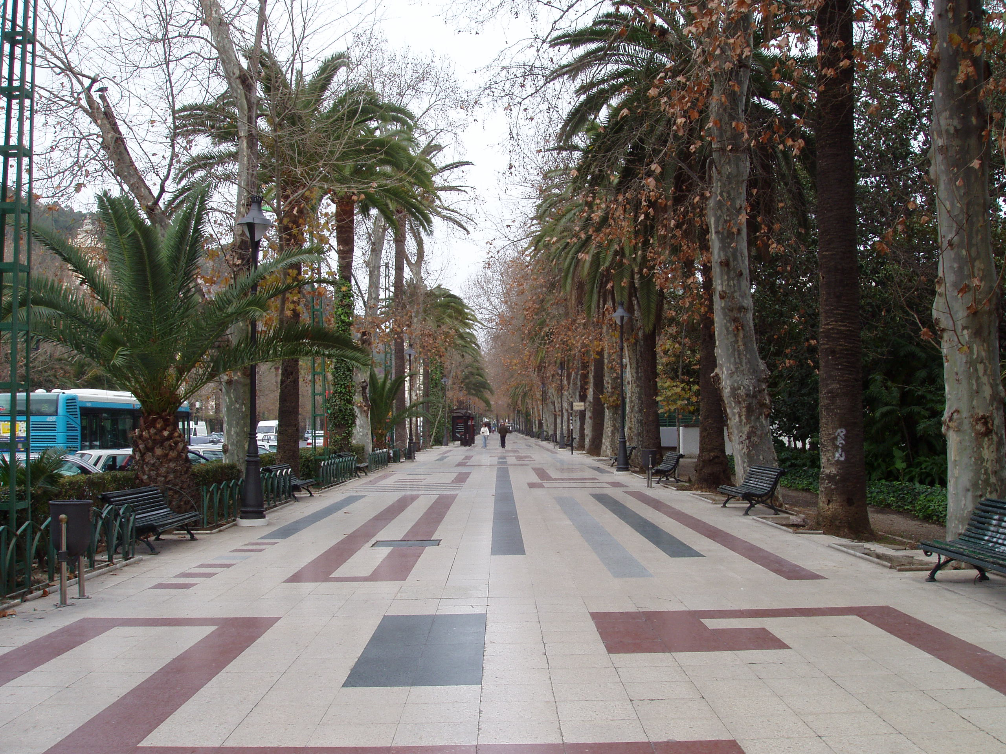
Class 23: Objectifying Objects
University of Virginia cs1120
David Evans

Slide 2
Menu
PS6, PS7, Project
Objects
PS5 vs. “Real” Databases
Sorry, no Office Hours today! Email me to arrange another time.
I will have my usual office hours tomorrow morning (10:30-11:30).

Slide 3
Remaining Problem Sets
PS6: Programming with Objects
Posted later today,
Due 30 October
PS7: Implementing Interpreters
Due 9 November
Tutorial: Web Applications (was PS8)
Python
Project:
Build a Dynamic Web Application
Django, HTML, SQL
Due last day of class (7 December)

Slide 4
Project Assignment
Problem: Make an interesting dynamic web site.
Teams of 1-61 students
Mostly teams of 3 (need a good reason for a smaller or larger team)
You can form your own teams, or be assigned team
You will be asked to rate your teammates at the end of the project
Can be anything you want that:
Involves interesting computation
Follows University’s use policies (or on external server)
Complies with ADA Section 508 (accessible)

Slide 5
PS6: Programming with Objects
PS6
PS7: Implementing Interpreters
Extra Ambitious PS9 Project
Project
Build a dynamic web application
Exam 2
Default
Negotiate with me in advance

Slide 6
from Class 22: nextx
(define x 0)
(define (nextx)
(set! x (+ x 1))
x)
> (nextx)
1
> (set! x 23)
> (next x)
24
global
environment
+ : #<primitive:+>
x : 24
nextx:
environment:
parameters: () body: (begin (set! x (+ x 1)) x)

Slide 7
A Better Counter
The place that keeps track of the count should be part of the counter, not part of the global environment
Can have more than one counter
Counter state is encapsulated: can only be modified by counter procedure
Can we do this?

Slide 8
Stateful Application Rule:
To apply a constructed procedure:
Construct a new environment, whose parent is the environment of the applied procedure.
For each procedure parameter, create a place in the frame of the new environment with the name of the parameter. Evaluate each operand expression in the environment or the application and initialize the value in each place to the value of the corresponding operand expression.
Evaluate the body of the procedure in the newly created environment. The resulting value is the value of the application.

Slide 9
A Better Counter
(define (make-counter)
((lambda (count)
(lambda ()
(set! count (+ 1 count))
count))
0))

Slide 10
Sweeter Version
(define (make-counter)
(let ((count 0))
(lambda ()
(set! count (+ 1 count))
count)))
This is easier to read (syntactic sugar), but means the same thing. The place for count is created because of the application that is part of the let expression.

Slide 11
(let ((Name₁ Expression₁) (Name₂ Expression₂)
... (Name_{k} Expression_{k}))
Expression_{body})
is equivalent to
((lambda (Name₁ Name₂ . . . Name_{k})
Expression_{body})
Expression₁ Expression₂ . . . Expression_{k})
Draw the environment after evaluating:
> (define mycount
(make-counter))
> (mycount)
1
> (mycount)
2
(define (make-counter)
(let ((count 0))
(lambda ()
(set! count (+ 1 count))
count)))

Slide 12
global
environment
(define (make-counter)
((lambda (count)
(lambda ()
(set! count (+ 1 count))
count))
0))
+ : #<primitive:+>
make-counter:
mycount:
> (define mycount
(make-counter))
> (mycount)
1
> (mycount)
2
> (mycount)
3
environment:
parameters: () body: ((lambda …
0
3
1
2
count :
environment:
parameters: () body: (lambda () (set! count …)

Slide 13
Versatile Counter
(define (make-counter)
((lambda (count)
(lambda ()
(set! count (+ 1 count))
count))
0))
How can we make a counter that can do things other than just add 1?

Slide 14
An Even Sweeter Counter
(define (make-counter)
(let ((count 0))
(lambda (message)
(cond ((eq? message ’reset!) (set! count 0))
((eq? message ’next!)
(set! count (+ 1 count)))
((eq? message ’current) count)
(else
(error "Unrecognized message"))))))

Slide 15
Using Counter
> (define bcounter (make-counter))
> (bcounter 'next)
> (bcounter 'next)
> (bcounter 'next)
> (bcounter 'how-many)
3
> (bcounter 'reset)
> (bcounter 'how-many)
0

Slide 16
Objects
An object packages:
state (“instance variables”)
procedures for manipulating and observing that state (“methods”)
Why is this useful?

Slide 17
Problem-Solving Strategies
PS1-PS4: Functional Programming
Focused on procedures
Break a problem into procedures that can be composed
PS5: Imperative Programming
Focused on data
Design data for representing a problem and procedures for updating that data
PS6: “Object-Oriented Programming”
Focused on objects that package state and procedures
Solve problem by designing objects that model the problem
Lots of problems in real (and imaginary) worlds can be thought of this way

Slide 18
PS5
How are commercial databases different from what you implemented for PS5?
UVa’s Integrated Systems Project to convert all University information systems to use an Oracle database was originally budgeted for $58.2 Million (starting in 1999). Actual cost ended up over $100 Million.
http://www.virginia.edu/isp/
www.virginia.edu/isp/timeline.html

Slide 19
Real Databases
Atomic Transactions
a transaction may involve many modifications to database tables, but the changes should only happen if the whole transaction happens (e.g., don’t charge the credit card unless the order is sent to the shipping dept)
Security
limit read/write access to tables, entries and fields
Storage
efficiently store data on disk, backup mechanisms
Scale
support really big data tables efficiently

Slide 20
How big are big databases?
Microsoft TerraServer
Claimed biggest in 1998
Aerial photos of entire US (1 meter resolution)

Slide 21
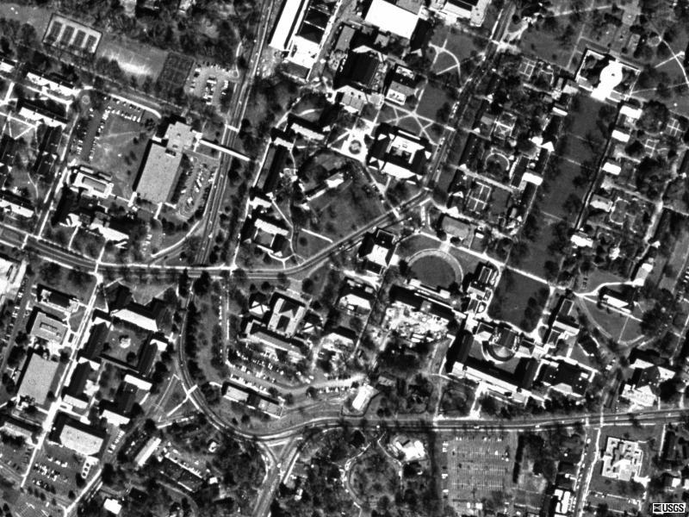
Recursa
Amphitheater
You are here

Slide 22
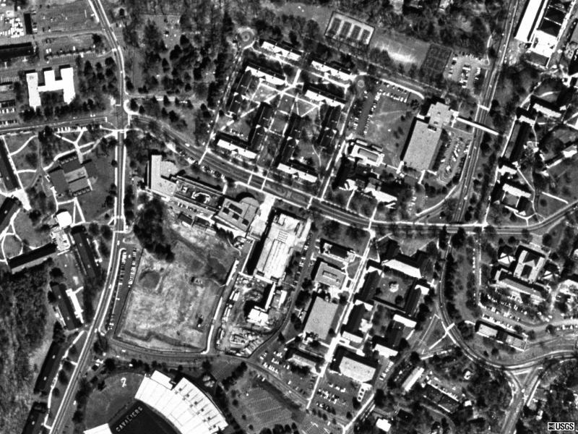
You are here
AFC?
UVA 26 FSU 21
Picture from 2 Apr 1994

Slide 23
Big Databases Today
Microsoft TerraServer
3.3 Terabytes (claimed biggest in 1998)
Internal Revenue Service
150 Terabytes
Wal-Mart
> 500 Terabytes (2003)
Yahoo! (2008)
2 Petabytes
Analyze behavior of 500 M web visitors per month
National Energy Research Scientific Computing
2.6 Petabytes
Atomic energy research, high-energy physics
Each particle collision generate > 30 KB
1 Petabyte = 1000 Terabytes
= 10¹⁵ bytes
Lots more information to be collected: telephone calls in one year ~ 20 Exabytes
1 Exabyte = 1000 Petabytes = 10¹⁸ bytes
Notes:
http://www.computerworld.com/s/article/9087918/Size_matters_Yahoo_claims_2_petabyte_database_is_world_s_biggest_busiest

Slide 24
How much work?
table-select is in Θ(n) where n is the number of entries in the table
Would your table-select work for Wal-Mart?
If 1M entry table takes 1s, how long would it take Wal-Mart to select from >500TB ~ 2 Trillion Entries?
2 000 000s ~ 23 days
How do expensive databases perform table-select so much faster?
Indexing is the key! See Section 8.2.3

Slide 25
Making Objects in Scheme
(define (make-counter)
(let ((count 0))
(lambda (message)
(cond ((eq? message ’reset!) (set! count 0))
((eq? message ’next!)
(set! count (+ 1 count)))
((eq? message ’current) count)
(else
(error "Unrecognized message"))))))

Slide 26
Python Version
class defines a new class
class Counter:
def __init__(self):
self.count = 0
def reset(self):
self.count = 0
def current(self):
return self.count
def advance(self):
self.count = self.count + 1
The __init__ method is special: it constructs
a new object of the class.
self is the object we are creating (for __init__)
or manipulating (for the other methods).
self.count = 0 (like (let ((count 0)) …)
In __init__: creates a new place named
count as part of this object’s frame, and initializes its value to 0.
Python’s built-in support for objects should (soon) make this easier to read and understand than the Scheme object system.

Slide 27
Charge
PS6 will be posted tonight
Wednesday: Python, Object-Oriented Programming
Friday: “Golden Age of Science”
Start thinking about Project ideas
If you want to do an “extra ambitious” project (instead of PS7) convince me your idea is worthy before November 1

