Slide 1
Class 24: Programming with Objects
University of Virginia cs1120
David Evans

Slide 2
Menu
Python
Programming with Objects
Inheritance

Slide 3
Why learn Python?

Slide 4
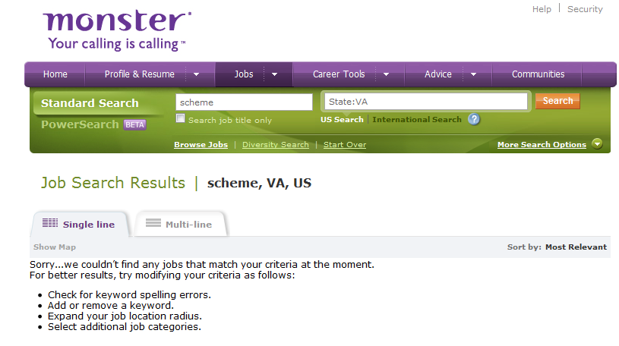
Reason 1: Vocational Skill
Job listings at monster.com (20 October 2009)
Keyword | All US | Virginia Only | Typical Salary
Python | 527 | 38 | $60-180K
Java | 5000+ | 535 | $70-140K
SQL | 5000+ | 783 | $60-150K
Scheme | 83 | 0 | $100-999K

Slide 5
“Scheme” Jobs

Slide 6
Reason 1: Vocational Skill
Job listings at monster.com (20 October 2009)
Keyword | All US | Virginia Only | Typical Salary
Python | 527 | 38 | $60-180K
Java | 5000+ | 535 | $70-140K
SQL | 5000+ | 783 | $60-150K
Scheme | 83 | 0 | $100-999K

Slide 7
Reason 2: Expanding Minds
Languages change the way we think.
The more languages you know, the more different ways you have of expressing ideas and for thinking about (and solving) problems.

Slide 8
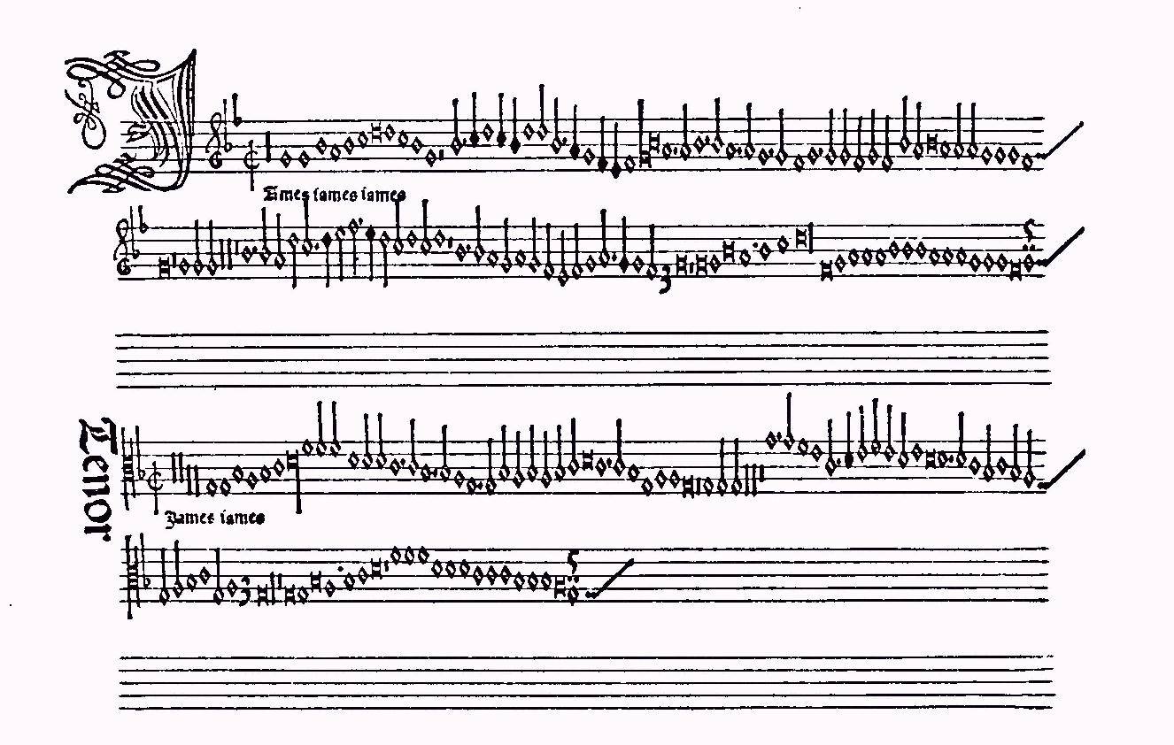
“Jamais Jamais Jamais” from Harmonice Musices Odhecaton A. Printed by Ottaviano Dei Petrucci in 1501 (first music with movable type)

Slide 9
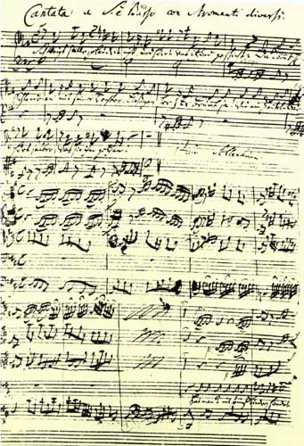
“Jamais Jamais Jamais” from Harmonice Musices Odhecaton A. (1501)
J S Bach, “Coffee Cantata”, BWV 211 (1732)
www.npj.com/homepage/teritowe/jsbhand.html

Slide 10
Reason 3: Deepening Understanding
By seeing how the same concepts we encountered in Scheme are implemented by a different language, you will understand those concepts better (especially procedures, assignment, data abstraction).

Slide 11
Reason 4: Building Confidence
By learning Python (mostly) on your own, the next time you encounter a problem that is best solved using a language you don’t know, you will be confident you can learn it (rather than trying to use the wrong tool to solve the problem).
This is also important for taking cs2110 this Spring: assumes you can learn Java on your own.

Slide 12
Reason 5: Fun
Programming in Python is fun (possibly even more fun than programming in Scheme!)
Especially because:
It is an elegant and simple language
Most programs mean what you think they mean
It is dynamic and interactive
It can be used to easily build web applications
It is named after Monty Python’s Flying Circus
It was designed by someone named Guido.

Slide 13
Python
A universal programming language
Everything you can compute in Scheme you can compute in Python, and vice versa
Chapter 11/PS7: implement a Scheme interpreter in Python
Chapter 12: more formal definition of a universal PL
Imperative Language
Designed to support a programming where most of the work is done using assignment statements: x = e
Object-Oriented Language
All data are objects
Built in support for classes, methods, inheritance

Slide 14
Learning New Languages
Syntax: Where the {,%;!,$, etc. all go
If you can understand a BNF grammar, this is easy
(Okay, it still takes some getting used to a new syntax…)
Semantics: What does it mean
Learning the evaluation rules
Harder, but most programming languages have very similar evaluation rules (but the subtle differences can cause lots of problems)
Style: What are the idioms and customs of experienced programmers in that language?
Takes many years to learn - need it to be a “professional” Python programmer, but not to make a useful program

Slide 15
Python If
Instruction ::= if (Expression) : Block_{Consequent}
else: Block_{Alternate}
Evaluate Expression. If it evaluates to a true value, evaluate the Block_{Consequent} ; otherwise, evaluate the Block_{Alternate}.
Similar to (if Expression (begin Block_{Consequent}) (begin Block_{Alternate}))
Differences:
Indenting and new lines matter!
Changing the indentation changes meaning of code
What is a “true value”:
Scheme: anything that is not false.
Python: anything that is not False, None, 0, an empty string or container

Slide 16
If Example
if []:
print "Empty is true!"
else:
print "Empty is false!"
Empty is false!

Slide 17
Learning Python
We will introduce (usually informally) Python constructs in class as we use them, example code in PS6
The “Schemer’s Guide to Python” is an introduction to Python: covers the most important constructs you need for PS6, etc.
Course book: Chapter 11 introduces Python
Read ahead Section 11.1
On-line Python documentation

Slide 18
Making Objects
ClassDefinition ::= class Name: FunctionDefinitions
class Dog:
def bark(self):
print “wuff wuff wuff wuff”
In Washington, it’s dog eat dog. In academia, it's exactly the opposite. Robert Reich

Slide 19
Making a Dog
class Dog:
def bark(self):
print "wuff wuff wuff wuff"
spot = Dog()
AssignmentStatement ::= Variable = Expression
Python assignments are like both define and set!.
If the Variable name is not yet defined, it creates a new place.
The value in the named place is initialized to the value of the Expression.

Slide 20
Python Procedures
class Dog:
def bark(self):
print "wuff wuff wuff wuff"
FunctionDefinition ::= def Name ( Parameters ): Block Parameters ::= ε | SomeParameters SomeParameters ::= Name | Name, SomeParameters
Block ::= Statement
Block ::= <newline> indented(Statements)
Statements ::= Statement <newline> MoreStatments
MoreStatements ::= ε | Statement <newline> MoreStatments

Slide 21
Some Python Procedures
FunctionDefinition ::= def Name ( Parameters ): Block Parameters ::= ε | SomeParameters SomeParameters ::= Name | Name, SomeParameters
Block ::= Statement
Block ::= <newline> indented(Statements)
Statements ::= Statement <newline> MoreStatments
MoreStatements ::= ε | Statement <newline> MoreStatments
def square(x):
return x * x
def bigger(a,b):
if a > b:
return a
else:
return b

Slide 22
Whitespace Matters!
def bigger(a,b):
if a > b:
return a
else:
return b
def bigger(a,b):
if a > b:
return a
else:
return b
File "<pyshell#1>", line 4
else:
^
IndentationError: unindent does not match any outer indentation level
Python requires you to format your code structurally!

Slide 23
Barking: Invoking Methods
class Dog:
def bark(self):
print "wuff wuff wuff wuff"
ApplicationStatement ::= Name ( Arguments ) Arguments ::= ε | MoreArguments MoreArguments ::= Argument , MoreArguments MoreArguments ::= Argument Argument ::= Expression
spot = Dog()
spot.bark(“Hello”)
wuff wuff wuff wuff
<obj>.<method>(<arguments>)
Invoke method on obj. The obj will be the first (self) parameter to the method.

Slide 24
Object Lingo
“Apply a procedure” :: “Invoke a method”
We apply a procedure to parameters.
We invoke a method on an object, and pass in parameters.

Slide 25
Dogs with Names
class Dog:
def __init__(self, n):
self.name = n
spot = Dog(“Spot”)
spot.name
Spot
bo = Dog(“Bo”)
bo.name
Bo
__init__ is a constructor
It creates a new object of the type.
It is called when Dog(n) is evaluated.

Slide 26
Summary
An object packages state and procedures.
A class provides procedures for making and manipulating a type of object.
The procedures for manipulating objects are called methods. We invoke a method on an object.
Friday: Inheritance
Monday: Excursion on Exponential Growth
Please ready Tyson essay before Monday!

