Slide 1
Class 25: Python, Objects, Bombs, and Inheritance
University of Virginia cs1120
David Evans

Slide 2
Menu
PS5: end-auction! running time
Lists in Python
Inheritance

Slide 3
end-auction!
(define (end-auction!)
(mmap
(lambda (item-entry)
(let ((item-name (list-get-element item-entry (table-field-number items 'item-name))))
(let ((high-bid (get-highest-bid item-name)))
(if (null? high-bid)
(printf "No bids on ~a.~n“ (list-get-element item-entry (table-field-number items 'item-name)))
(printf "Congratulations ~a! You have won the ~a for $~a.~n"
(list-get-element high-bid (table-field-number bids 'bidder-name))
item-name
(list-get-element high-bid (table-field-number bids 'amount)))
(list-get-element high-bid (table-field-number bids 'amount))))))
(table-entries items))))
mmap: N applications of mapping procedure
list-get-element running time is in Θ(N)
get-highest-bid running time is in Θ(N)
Overall running time:
N * (Θ(N) + Θ(N)) = Θ(N²)
WRONG: need to be careful what N means!

Slide 4
end-auction!
(define (end-auction!)
(mmap
(lambda (item-entry)
(let ((item-name (list-get-element item-entry (table-field-number items 'item-name))))
(let ((high-bid (get-highest-bid item-name)))
(if (null? high-bid)
(printf "No bids on ~a.~n“ (list-get-element item-entry (table-field-number items 'item-name)))
(printf "Congratulations ~a! You have won the ~a for $~a.~n"
(list-get-element high-bid (table-field-number bids 'bidder-name))
item-name
(list-get-element high-bid (table-field-number bids 'amount)))
(list-get-element high-bid (table-field-number bids 'amount))))))
(table-entries items))))
mmap: t applications of mapping procedure
t is the number of entries in the items table
list-get-element running time is in Θ(N) => constant time
N is the number of elements in input list:
here, number of fields in items: constant
get-highest-bid running time is in Θ(N) => Θ(b)
N is number of entries in bids table, b
Overall running time:
t * (O(1) + Θ(b)) = Θ(tb) where
t is number of items, b is number of bids

Slide 5
Python Lists
Built-in datatypes for both mutable lists [] and immutable tuples ()
>>> m = range(1, 1000)
>>> m[0]
1
>>> m[-1]
999
>>> len(m)
999
>>> m[1:]
[2, ..., 999]
range(1,1000) ∼ (intsto 999)
m[0] ∼ (mcar m)
Python lists can access any element in approx. constant time!
len is also constant time
m[1:] ∼ (mcdr m) ?

Slide 6
Is m[1:] like mcdr?
>>> m1 = m[1:]
>>> m1[0]
2
>>> m[1]
2
>>> m1[0] = 3
>>> m[1]
2
m[1:] is a new copy of the list,
except for the first element.
Uses Θ(N) time and space!

Slide 7
Implementing list-map in Python
def schemish_list_map(f, p):
if not p:
return []
else:
return [f(p[0])] + schemish_list_map(f, p[1:])
Running time is in Θ(N²) where N is number of elements in p.
“Literal” translation...not a good way to do this.
Note: there is a built-in map in Python.

Slide 8
Pythonic Mapping
def mlist_map(f, p):
for i in range(0, len(p)):
p[i] = f(p[i])
return p
Unlike the previous one, this mutates p.

Slide 9
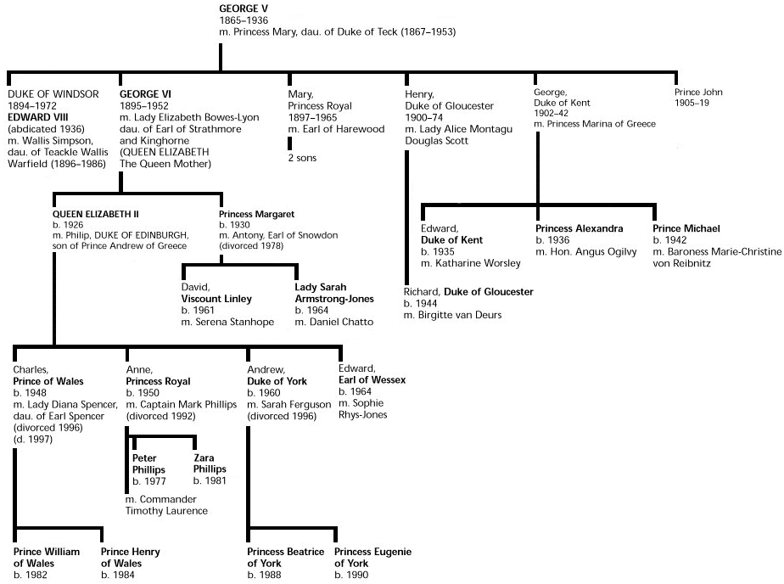
Inheritance

Slide 10
There are many kinds of Dogs…
class Dog:
def __init__(self, n):
self.name = n
def bark(self):
print “wuff wuff wuff wuff”
class TalkingDog (Dog):
def speak(self, stuff):
print stuff

Slide 11
Subclasses
ClassDefinition ::= class SubClassName ( SuperClassName ) : FunctionDefinitions
class TalkingDog (Dog):
def speak(self, stuff):
print stuff
TalkingDog is a subclass of Dog.
Dog is the superclass of TalkingDog.

Slide 12
Every Dog has its Day
class Dog:
def __init__(self, n):
self.name = n
def bark(self):
print “wuff wuff wuff wuff”
>>> bo = Dog('Bo')
>>> scooby = TalkingDog('Scooby Doo')
>>> scooby.speak('Ta-da!')
Ta-da!
>>> bo.speak('Ta-da!')
Traceback (most recent call last):
File "<pyshell#11>", line 1, in <module>
bo.speak('Ta-da!')
AttributeError: Dog instance has no attribute 'speak‘
>>> scooby.bark()
wuff wuff wuff wuff
class TalkingDog (Dog):
def speak(self, stuff):
print stuff

Slide 13
Speaking about Inheritance
Inheritance is using the definition of one class to define another class.
TalkingDog inherits from Dog.
TalkingDog is a subclass of Dog.
The superclass of TalkingDog is Dog.
Dog
TalkingDog
These all mean the same thing.

Slide 14
PS6 Make an adventure game programming with objects Many objects in our game have similar properties and behaviors, so we use inheritance.

Slide 15
PS6 Classes
SimObject
PhysicalObject
Place
MobileObject
OwnableObject
Person
Student
PoliceOfficer

Slide 16
class SimObject:
def __init__(self, name):
self.name = name
def note(self, msg):
print "%s: %s" % (self, msg)
SimObject
PhysicalObject
Place
class PhysicalObject (SimObject):
def __init__(self, name):
SimObject.__init__(self, name)
self.location = None
def install(self, loc):
self.note ("Installing at " + str(loc))
self.location = loc
loc.add_thing(self)
MobileObject
OwnableObject
Person
class MobileObject (PhysicalObject):
def change_location(self, loc):
self.location.remove_thing(self)
loc.add_thing(self)
self.location = loc
Student
PoliceOfficer

Slide 17
SimObject
class MobileObject (PhysicalObject):
def change_location(self, loc):
self.location.remove_thing(self)
loc.add_thing(self)
self.location = loc
PhysicalObject
Place
MobileObject
OwnableObject
Person
class OwnableObject (MobileObject):
def __init__(self, name):
MobileObject.__init__(self, name)
self.owner = None
def is_ownable(self): return True
Student
PoliceOfficer

Slide 18
PS6 Objects
SimObject
PhysicalObject
Place
MobileObject
Place(‘Cabal Hall’)
An object that is an instance of the Place class.
OwnableObject
Person
Student
PoliceOfficer
aph = Student(‘Alyssa P. Hacker’)

Slide 19
Object-Oriented Summary
An object packages state and procedures.
A class provides procedures for making and manipulating a type of object.
The procedures for manipulating objects are called methods. We invoke a method on an object.
Inheritance allows one class to refine and reuse the behavior of another. This is a good thing.
Friday: Excursion on Exponential Growth
Please ready Tyson essay before Friday!

